Slide 1

WEEK 2
Secure SDLC, Tooling & Fuzzing
Software Security · Nutthakorn Chalaemwongwan
Notes:
Hook: open by running a scanner live on a flawed repo and let a finding pop up in seconds — "this is how the industry finds bugs at scale." Today = the tools + the mindset of catching bugs early. ~2 min.

Slide 2

Today
Security across the SDLC ("shift left")
SAST · DAST · SCA · secret scanning · fuzzing
Triaging findings by CWE
🏁 Game: Bug Triage Race + a Fuzzing Race
Software Security · Week 2
Notes:
Roadmap, 1 min. Flag the lab: scan a deliberately flawed repo, triage by CWE, then fix. Bonus: first team to crash a target with a fuzzer.

Slide 3
Recap — Week 1
Threat modeling finds design flaws (before code)
This week: find implementation flaws — automatically, at scale
Same goal: catch it early, cheap to fix
Software Security · Week 2
Notes:
Bridge from W1. W1 = think (design). W2 = automate (code). Remind the cost curve: a bug caught in CI costs ~1×, in production ~100×. ~2 min.

Slide 4
Security across the SDLC
Requirements → Design → Code → Build → Test → Deploy → Operate
Each phase has security activities
Shift left: find issues early — cheaper to fix
DevSecOps = security automated into the pipeline
Software Security · Week 2
Notes:
Walk the phases on the board; ask "where can security live?" (answer: every phase). Threat modeling = design; SAST/secret scan = code/commit; DAST = test; monitoring = operate. "Shift left" = move detection earlier. ~5 min.

Slide 5
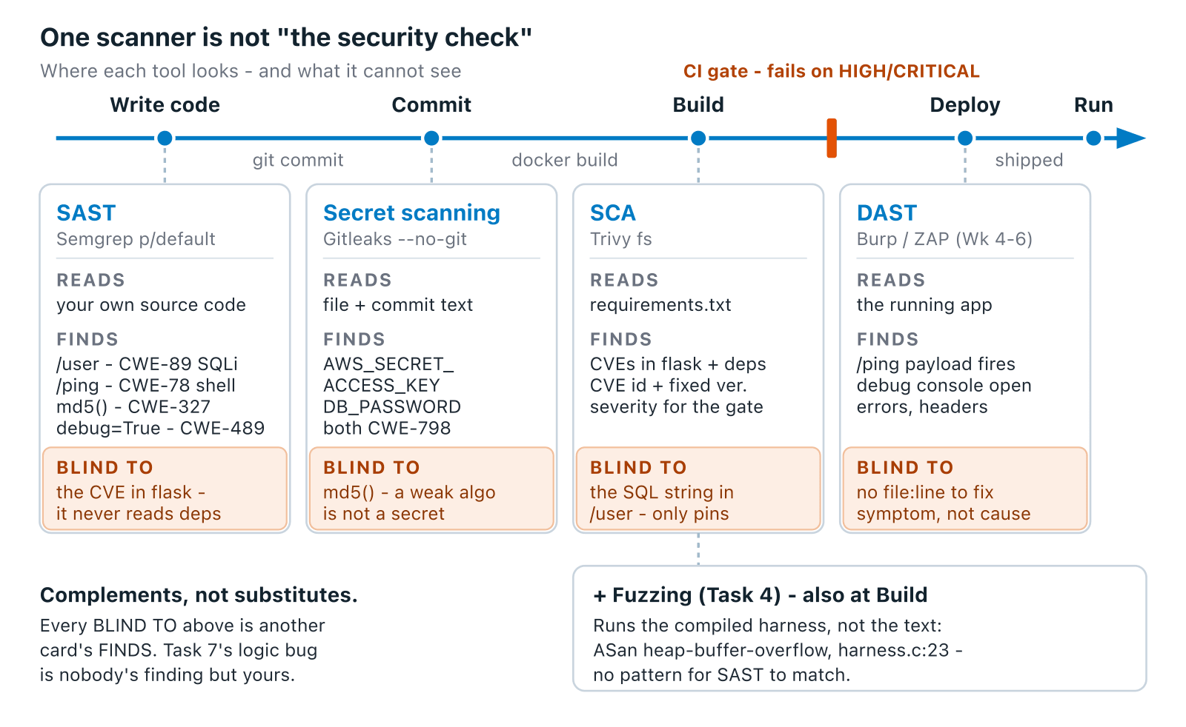
The tooling families
Software Security · Week 2
Notes:
The mental map for the whole unit. Stress: no single tool finds everything — they see different things. Every READS/FINDS/BLIND-TO on this diagram is real output from this week's own vulnerable-repo, not a hypothetical — walk it left to right and land on "complements, not substitutes." Tie each to a later week (SCA → W12, DAST → Burp in W4-6). ~5 min.
Diagram: A left-to-right software development pipeline with five stages: write code, commit, build, deploy, run. Four scanners are placed at the stage each one actually operates on, and under each is written what it cannot see, grounded in the actual CWEs found in this week's vulnerable-repo/app.py and harness.c.

Slide 6
SAST vs DAST in one line
SAST — reads the code, finds bug patterns (no running). Many false positives.
DAST — attacks the live app from outside. Fewer FPs, misses source-level issues.
Use both — they find different things.
Software Security · Week 2
Notes:
The classic comparison students confuse. Analogy: SAST = proofreading the recipe; DAST = tasting the cooked dish. SAST sees a hardcoded secret DAST never will; DAST sees an auth bypass SAST can't. ~4 min.

Slide 7
Worked example: what each tool catches
@app.route("/user")
def user():
name = request.args.get("name")
q = "SELECT * FROM users WHERE name='%s'" % name # SAST → CWE-89
return db.execute(q).fetchall()
AWS_SECRET_ACCESS_KEY = "hK8pQ2mN5vX9wZ3rT6yU1sA4bC7dE0fG2hJ5kL8" # Gitleaks → CWE-798
Semgrep (SAST): flags the string-built SQL query (CWE-89)
Gitleaks (secret scan): flags the hardcoded key — must be a real-looking secret; the AWS-docs example key (wJalr...EXAMPLEKEY) is a known public string and won't fire any rule
Software Security · Week 2
Notes:
The make-it-concrete slide — point at the exact lines each tool fires on. This is the `vulnerable-repo/app.py` they'll scan in the lab. Ask: "which tool finds the secret? which finds the SQLi? could one tool find both?" ~6 min.

Slide 8
Worked example: what each tool catches (cont.)
DAST/fuzzer: would catch a crash/SQLi by hitting /user, not reading it
Same file also plants command injection, a weak md5 hash, and debug=True — Task 1 grades all five
Software Security · Week 2
Notes:
The make-it-concrete slide — point at the exact lines each tool fires on. This is the `vulnerable-repo/app.py` they'll scan in the lab. Ask: "which tool finds the secret? which finds the SQLi? could one tool find both?" ~6 min.

Slide 9
Fuzzing — how real CVEs are found
Feed random/mutated inputs, watch for crashes
Coverage-guided (libFuzzer/AFL++) explores new code paths
Pair with sanitizers (ASan) to pinpoint the bug
# run inside labs/toolbox — Apple clang has no libFuzzer runtime
clang -g -fsanitize=address,fuzzer harness.c -o fuzz
mkdir -p corpus && printf 'FUZ' > corpus/seed && ./fuzz corpus
Software Security · Week 2
Notes:
Fuzzing is the highest-yield bug finder in industry (most memory CVEs come from it). Explain coverage-guided = the fuzzer "learns" inputs that reach new code — each correct byte unlocks a new path, which is why it beats blind random guessing. The seed corpus matters (seeded finds it in ~1 second; unseeded has to rediscover 3 magic bytes on its own) — the exact "how much faster" isn't a number I have a verified source for, so don't state one; the mechanism is the teachable part. Deep dive + exploit comes in W11. ~5 min.

Slide 10
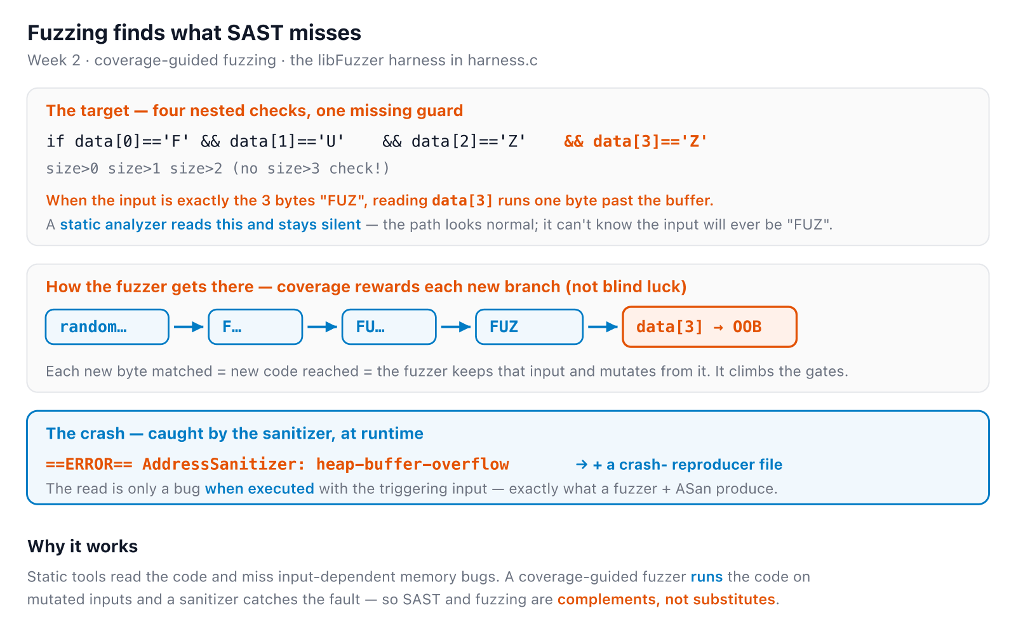
How fuzzing finds it
Software Security · Week 2
Notes:
The static companion to the fuzz-verdict sim, and the answer to 'why fuzz if we already ran SAST?' Walk it: SAST can't know the input will ever be exactly FUZ, so it stays silent (blue); the fuzzer doesn't brute-force randomly — coverage feedback rewards each new gate passed, so it climbs to FUZ and the unguarded data[3] read faults under ASan (orange). Land on: static reads, fuzzing runs — complements. ~4 min.
Diagram: A coverage-guided fuzzer reaches a bug a static analyzer misses: the harness has four nested byte checks (F, U, Z, Z) and the fourth reads data[3] with no size>3 guard, so the input 'FUZ' reads one byte out of bounds. SAST reads the code and stays silent; the fuzzer mutates inputs and is rewarded for each new branch reached, climbing random -> F -> FU -> FUZ until the unguarded read crashes under AddressSanitizer, which writes a reproducer file. SAST and fuzzing are complements, not substitutes.

Slide 11
Try it — what actually crashes this harness
Type bytes, or pick a preset. Each cell is one if in the real source.
Try it live: /sim/fuzz-verdict (interactive simulation, web only)
Software Security · Week 2
Notes:
This is harness.c's exact logic, computed in the browser — not an animation of "how fuzzing feels." Make sure "FUZ" (3 bytes, overflow) and "FUZZ" (4 bytes, deliberate trap via __builtin_trap — a different crash class, no memory-safety bug at all) both get tried, since that distinction is easy to blur. Ties to worksheet Task 4. ~4 min.

Slide 12
Triage: not every finding is a bug
True positive vs false positive
Map each to a CWE + severity
Prioritize by exploitability × impact
Noise kills trust in tools — triage well
Software Security · Week 2
Notes:
Crucial professional skill: a scanner that cries wolf gets ignored. IMPORTANT — a real `bash scan.sh` run against this week's own vulnerable-repo returns 12 findings and all 12 are genuine true positives; there is no clean false-positive example in this specimen, so don't invent one live. The real triage skill THIS repo exercises is deduplication: 5 Semgrep rules fire on the identical SQLi line, 3 fire on the identical command-injection line — teach "same root cause, one row in your table" rather than promising a false positive you won't be able to produce on demand. Every finding still gets a CWE + a TP call + a one-line justification. ~4 min.

Slide 13
Try it — which bug is this, really?
Seven raw findings from a real scan. Map each back to the one bug underneath.
Try it live: /sim/triage-drill (interactive simulation, web only)
Software Security · Week 2
Notes:
Every rule ID and line number here is copied from an actual scan.sh run, not invented. The point: "5 rules fired" is not "5 bugs" — recognizing the SAME root cause under two different rule names is the real-world triage skill, more useful than a TP/FP guess. Directly rehearses worksheet Task 3's triage table. ~4 min.

Slide 14
Tools you'll meet
Trivy — the SCA scanner you'll actually run this lab (dependency scan today; image + IaC scanning return in W12/13)
SonarQube, GitHub Advanced Security (GHAS) — quality-gate/SAST-in-the-repo tools you'll see in industry/internships, not used in this lab
Address technical debt early — cheaper than re-work later
Software Security · Week 2
Notes:
Trivy is the one they'll type today (Task 5, scanning the NoteVault target) — say so explicitly so "tools you'll meet" doesn't read as "tools this lab uses." SonarQube/GHAS are real-world awareness. Connect "technical debt" to the cost curve from the recap. ~3 min.

Slide 15
🏁 Game — Bug Triage Race
Run Semgrep + Gitleaks on the flawed repo
Score = true positives − misclassified · live scoreboard
docker run --rm -v "$PWD/vulnerable-repo:/src" semgrep/semgrep \
semgrep --config p/default --config p/owasp-top-ten /src
docker run --rm -v "$PWD/vulnerable-repo:/repo" zricethezav/gitleaks:latest \
detect -s /repo -v --no-git
Software Security · Week 2
Notes:
Explain the game before lab: speed + accuracy. Penalize wild guessing (misclassified subtracts) so they must justify each finding. Mirrors a real bug-bounty triage queue. Warn about the two gotchas up front: Gitleaks needs `--no-git` or it silently reports zero leaks; the repo root's own `.gitleaks.toml` deliberately allowlists this lab's secrets, so scan `vulnerable-repo/` specifically, not the repo root. ~3 min.

Slide 16
🐝 Mini-game — Fuzzing Race
First team to make the provided target crash wins
One crash → one root-cause note
Full fuzz→exploit lab returns in Week 11
Software Security · Week 2
Notes:
Quick, fun, instant feedback (it crashes or it doesn't). Sets up W11. If short on time, make this a demo. ~2 min.

Slide 17
Lab 2 — deliverable
📋 Worksheet 2 — labs/week02-sdlc-tooling/worksheet.md (Part 3) · kickoff: bash scan.sh (Semgrep ×2 rulesets + Gitleaks --no-git on ./vulnerable-repo)
A findings triage table: tool, CWE, severity, TP/FP, fix idea (3 TP + 1 FP, justified)
1 fuzzing crash with a one-line root cause
Trivy SCA scan of the NoteVault project target
A security CI gate built from Week 15's security-ci.yml
One SAST blind spot you found by hand
Software Security · Week 2
Notes:
The graded output — six tasks, not three. The defend/fix task (25 pts, "Defense") is the single biggest score component and is easy to undersell if you only recap the triage table. Point to scan.sh.

Slide 18
Lab 2 — deliverable (cont.)
Defend/fix: remediate all 5 planted flaws, before/after diff — this alone is 25 of 100 rubric points
+ Audit the AI and EiPE / Prompt Problem (see worksheet)
Software Security · Week 2
Notes:
The graded output — six tasks, not three. The defend/fix task (25 pts, "Defense") is the single biggest score component and is easy to undersell if you only recap the triage table. Point to scan.sh.

Slide 19
Key takeaways
No single tool finds everything — layer SAST/DAST/SCA/fuzzing
Triage by CWE + severity; kill the noise
Fuzzing is the highest-yield bug finder — automate it
Software Security · Week 2
Notes:
Recap, 3 lines. Cold-call: "name a bug SAST would miss but DAST would catch." ~2 min.

Slide 20
Questions?
Next week: Cryptography used correctly
Notes:
Cliffhanger: "Next week we break crypto — crack passwords and decrypt a secret in minutes." Remind: scanners ready in their VM.

