Slide 1

WEEK 12
Software Supply-Chain Security
Software Security · Nutthakorn Chalaemwongwan
Notes:
Hook: ask how many lines of code they wrote in their last project vs how many they shipped. The gap is dependencies — and that's the attack surface this week. One poisoned package = thousands of victims. ~2 min.

Slide 2

Today
Why the supply chain is now top-tier
Dependency confusion & typosquatting
SBOMs, SLSA provenance
Signing with Sigstore/Cosign
🎮 Game: Dependency Confusion Heist
Software Security · Week 12
Notes:
Roadmap, 1 min. Three verbs to remember all week: KNOW your ingredients (SBOM), PROVE your build (SLSA), SIGN your artifacts (Cosign).

Slide 3
The new #1 design risk
Your code is ~10% yours, ~90% dependencies
One bad package → thousands of victims (xz, event-stream, SolarWinds)
OWASP A03:2025 Software Supply Chain Failures
Software Security · Week 12
Notes:
New in OWASP 2025 — promoted to A03, reflecting reality. The 10/90 ratio shocks students. You can write perfect code and still be owned through a dependency you never read. ~4 min.

Slide 4
Real supply-chain attacks
Case | What happened
SolarWinds (2020) | trojanized vendor update → 18k orgs
Log4Shell (2021) | RCE in a ubiquitous logging dep
event-stream (npm) | malicious dep stole crypto-wallet keys
XZ Utils (2024) | backdoor planted in liblzma upstream
CircleCI (2023) | stolen CI tokens → customer secrets
Software Security · Week 12
Notes:
Spend time on xz (2024): a patient attacker became a trusted maintainer over years, then planted a backdoor caught only by luck (a 0.5s SSH delay). The lesson: trust in maintainers is itself attackable. ~5 min.

Slide 5
Real supply-chain attacks (cont.)
Attacks are shifting upstream: registry → maintainer → CI/CD.
Software Security · Week 12
Notes:
Spend time on xz (2024): a patient attacker became a trusted maintainer over years, then planted a backdoor caught only by luck (a 0.5s SSH delay). The lesson: trust in maintainers is itself attackable. ~5 min.

Slide 6
Attack vectors
Typosquatting — reqeusts vs requests; the malicious package's setup.py runs at install time, before any of your code runs — you don't have to import it to be owned
Dependency confusion (CWE-1357) — public pkg shadows internal name
Malicious updates — compromised maintainer
Transitive risk — deps of deps you never chose
Software Security · Week 12
Notes:
Define dependency confusion clearly (it's the game): if your internal pkg "acme-utils" isn't scoped, a public "acme-utils" with a higher version number can get pulled instead. Transitive = you vet your 10 deps, but they pull 800 you never saw. Stress the install-time-execution point — it's why "I never imported it" isn't a defense, and it's exactly what the lab's PWNED.txt marker proves. ~5 min.

Slide 7
Try it — which package actually installs?
Set both versions and the index mode. The resolver's real rule decides.
Try it live: /sim/resolver-confusion (interactive simulation, web only)
Software Security · Week 12
Notes:
Let them find the uncomfortable case themselves: merged mode with the private version numerically HIGHER also happens to be "safe" — but say explicitly that this is not a defense, just luck, since the attacker picks their own version number and will publish something higher. The only real fix in this sim is switching to single-index mode. Ties directly to Task 2 and Task 4's defense #2. ~4 min.

Slide 8
SCA — find vulnerable deps
docker run --rm -v "$PWD:/src" aquasec/trivy fs /src # this lab's Python deps
pip-audit # vs PyPI advisories
Produces CVEs + fix versions
CWE-1104 (unmaintained), CWE-829 (untrusted inclusion), CWE-1395 (known-vulnerable 3rd-party dependency)
Software Security · Week 12
Notes:
Hands-on tooling (ties to W2 SCA). This lab is pure Python — no npm project — so it's trivy fs + pip-audit, not npm audit/dependency-check. Run trivy live on the project — it lists CVEs + the fixed version. Q6 of the quiz asks for one real vulnerable dependency they found + remediation. ~4 min.

Slide 9
Integrity: prove what you shipped
SBOM (CycloneDX/SPDX) — ingredient list of the build
SLSA — levels of build provenance & tamper-resistance
A08:2025 Software/Data Integrity Failures
Software Security · Week 12
Notes:
SBOM = the food-label analogy: you can't manage what you can't list. When the next Log4Shell drops, an SBOM answers "are we affected?" in seconds. SLSA Build Track = levels L0–L3 of build provenance / tamper-resistance (L3 is the top; the old "1–4" numbering was v0.1 and is deprecated). ~5 min.

Slide 10
Signing with Cosign (keyless)
IMG=week12-supplychain:lab
docker run --rm -v "$PWD:/src" -v /var/run/docker.sock:/var/run/docker.sock \
aquasec/trivy:latest image --format cyclonedx \
--output /src/sbom.cdx.json "$IMG" # SBOM
docker run --rm -e COSIGN_EXPERIMENTAL=1 \
-v /var/run/docker.sock:/var/run/docker.sock \
gcr.io/projectsigstore/cosign:latest sign --yes "$IMG" # sign (OIDC)
docker run --rm -e COSIGN_EXPERIMENTAL=1 \
-v /var/run/docker.sock:/var/run/docker.sock \
gcr.io/projectsigstore/cosign:latest verify \
--certificate-identity-regexp ".*" \
--certificate-oidc-issuer-regexp ".*" "$IMG" # verify
Software Security · Week 12
Notes:
Demo the sign→verify loop. sign.sh runs both tools dockerized — match that here, not a bare local binary. Keyless (Sigstore) = identity-based signing via OIDC through Fulcio, logged in Rekor, no key to leak — name both by name, worksheet Q4 grades on the vocabulary. The deploy gate: refuse any image that doesn't verify → a tampered artifact can't ship. This is the lab's defend step. ~4 min.

Slide 11
Signing with Cosign (keyless) (cont.)
Unsigned/tampered image → verification fails
Every step needs the docker-socket mount (trivy has to reach the local image, not just a local dir) — the SBOM step is a common copy-paste failure if it's dropped
cosign verify needs the two --certificate-*-regexp flags in keyless mode — without them it errors, it doesn't just "fail closed"
Keyless signing is backed by Fulcio (short-lived cert authority) + Rekor (public transparency log) — no long-lived private key sitting on disk to leak (CWE-321)
Software Security · Week 12
Notes:
Demo the sign→verify loop. sign.sh runs both tools dockerized — match that here, not a bare local binary. Keyless (Sigstore) = identity-based signing via OIDC through Fulcio, logged in Rekor, no key to leak — name both by name, worksheet Q4 grades on the vocabulary. The deploy gate: refuse any image that doesn't verify → a tampered artifact can't ship. This is the lab's defend step. ~4 min.

Slide 12
Tooling — GitHub Advanced Security (GHAS)
Secret scanning + push protection — block secrets at push time (before they reach the remote)
CodeQL code scanning — semantic SAST queries
Dependabot — alerts + auto-PRs for vulnerable deps
Native in the repo → results in the Security tab
Software Security · Week 12
Notes:
The managed option students will meet in industry. Dependabot is the practical supply-chain workhorse: it opens PRs bumping vulnerable deps automatically. Push protection stops secrets at push time — local commits with a secret are allowed, the block fires on push to the remote (recall W2). ~3 min.

Slide 13
Defenses
pip install --require-hashes — a substituted package's hash won't match; install refuses
Single --index-url, not --extra-index-url — one trusted index; the resolver won't "shop around" and pick a higher-versioned public package over your internal one
Verify signatures before deploy (admission policy)
Generate + store SBOMs per release
2FA/MFA on dev/CI/cloud accounts; least privilege
Automate SCA in CI (next week)
Software Security · Week 12
Notes:
The payoff checklist, now with the exact flags Task 4 grades. --require-hashes and single-index-url are what actually stops dependency confusion — "pin + scope" alone is too vague to reconstruct on the exam. Verify-before-deploy kills tampered artifacts; MFA on maintainer/CI accounts kills the xz/CircleCI vector. "Automate in CI" sets up W15. ~4 min.

Slide 14
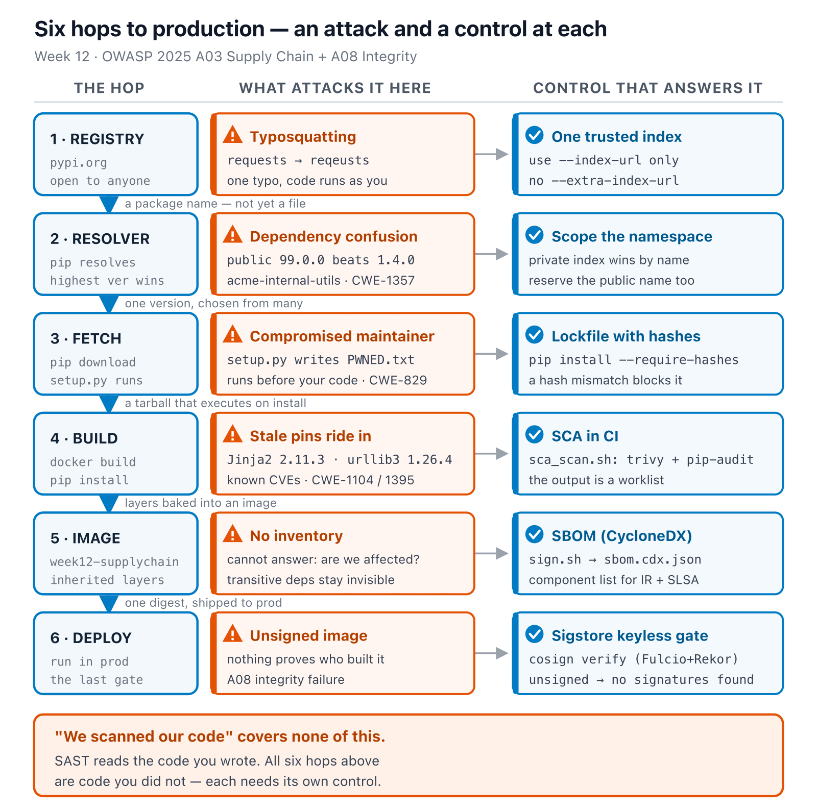
The whole journey, one dependency
Software Security · Week 12
Notes:
The synthesis slide — everything from the last five slides (SAST/SCA, SBOM, Cosign, the defenses checklist) is one column each in this diagram, chained in the order a real dependency actually travels. Walk it left to right ONE time, don't re-teach each hop — the point is showing they were never separate tools, they're six links in the same chain. Land on the closing line before moving to the game. ~5 min.
Diagram: Six hops a dependency crosses from a public registry into production, each with its own attack and the control that answers it: registry (typosquatting → one trusted index), resolver (dependency confusion → scope the namespace), fetch (compromised maintainer → lockfile with hashes), build (stale pins → SCA in CI), image (no inventory → SBOM), deploy (unsigned image → Sigstore keyless gate). "We scanned our code" covers none of this — SAST reads the code you wrote, all six hops are code you didn't.

Slide 15
📦 Game — Dependency Confusion Heist
1
Attack: no live registry in this lab — use the resolver simulation to watch a higher-version public pkg beat the private one
2
Defend: pin + scope; generate SBOM; sign & verify with Cosign; add a provenance gate
Software Security · Week 12
Notes:
Explain before lab — the resolver simulation stands in for a live registry (ethics: never publish a real typosquat). Defend side is graded. The SLSA self-assessment makes them reason about their own pipeline. ~3 min.

Slide 16
Deliverable
📋 Worksheet 12 — labs/week12-supply-chain/worksheet.md (Parts 1–4) · kickoff: bash sca_scan.sh (trivy fs + pip-audit)
SCA report + remediation plan (Part 3)
SBOM file + sign/verify transcript (Part 3)
One-paragraph SLSA self-assessment + XZ Utils case analysis (Part 4)
+ Audit the AI / EiPE / Prompt Problem (required, after Part 4 — see worksheet)
Software Security · Week 12
Notes:
The SLSA self-assessment is the thinking part — they place their own build on the ladder and justify it. AI-resilient tasks count.

Slide 17
Key takeaways
Most of your attack surface is other people's code
Know your ingredients (SBOM), prove your build (SLSA), sign your artifacts
Verify before you trust
Software Security · Week 12
Notes:
Recap with the three verbs. Cold-call: "the next Log4Shell drops at 2am — what artifact tells you if you're affected?" (the SBOM). ~2 min.

Slide 18
Questions?
Next week: Cloud & container security
Notes:
Cliffhanger: "Next week — where your code runs. We'll hunt cloud/container misconfigs, the #1 real-world breach cause."

