Slide 1

WEEK 4
Injection & Input Handling
Software Security · Nutthakorn Chalaemwongwan
Notes:
Hook: type one quote mark into a login box and become admin — promise that demo. Injection is the oldest trick that still works. Today they exploit it, then fix it for real. ~2 min.

Slide 2

Today
Why injection is still #1-class of bug
The general injection pattern
SQL injection — hands-on
Command injection
Defenses: parameterized queries + validation
🎮 Game: SQLi Warm-up
Software Security · Week 4
Notes:
Roadmap, 1 min. Tell them the one big idea (data becomes code) unifies SQLi, command injection, and even XSS next week. Lab = exploit DVWA/Juice Shop then patch it.

Slide 3
Recap — Week 3
Crypto failures: ECB, weak hashes, hardcoded keys
Hashing ≠ encryption ≠ encoding
Use vetted KDFs (bcrypt/argon2) + authenticated encryption
Software Security · Week 4
Notes:
1-min bridge. Last week we protected data at rest; today the attacker sends malicious data IN. Cold-call: "how should we store passwords?" to check W3 stuck.

Slide 4
The injection pattern (one idea)
Untrusted data gets interpreted as code/commands.
Attacker input crosses a trust boundary into an interpreter
SQL, OS shell, LDAP, XPath, template engines, NoSQL…
Maps to OWASP A05:2025 Injection
Software Security · Week 4
Notes:
This is THE mental model for the whole week — say it twice. Every injection is the same shape: an interpreter can't tell your data from its own instructions. Ask the class to name interpreters in a typical app (DB, shell, template). ~5 min.

Slide 5
SQL injection — how it works
-- vulnerable (this week's app.py, SQLite)
"SELECT * FROM users WHERE username = '" + input + "'"
Input ' OR '1'='1 → always true
UNION-based → read other tables in one shot (today's lab)
Stacked queries ('; DROP TABLE users; --) are the textbook example, but don't assume they work everywhere — Python's sqlite3 refuses multiple statements in one execute() call; this week's target raises an error instead
Software Security · Week 4
Notes:
Walk the string-concatenation on the board: show how the quote in the input lands inside the SQL string and breaks out. This app is SQLite via Python's sqlite3 module — no stacked queries, no blind SQLi task this week (that's UNION-based, direct-output only). Don't promise a DROP TABLE demo works here; it doesn't. ~7 min.

Slide 6
Try it — watch the parse tree change
Type an input. See exactly where the quote breaks out of the string.
Try it live: /sim/sqli-parse (interactive simulation, web only)
Software Security · Week 4
Notes:
Live payoff for "the quote lands inside the string and breaks out" — the sim renders the actual token boundaries shifting as they type, so the break-out is something they watch happen, not a claim on a slide. ~4 min.

Slide 7
Auth bypass — anatomy of one payload
Inject into the username field:
alice'--
SELECT * FROM users WHERE username = 'alice'--' AND password = '...';
' closes the string literal you're injected into
-- comments out everything after it, including the password check
Software Security · Week 4
Notes:
The worked example — slow down here. Decompose the payload token by token; this is exactly the SQLi Warm-up's auth-bypass hit. A common wrong instinct is to add `OR 1=1` and a `LIMIT` clause copied from a MySQL tutorial — walk through why neither is needed against this SQLite app, and why the bare `'--` is what the worksheet actually uses. ~8 min.

Slide 8
Auth bypass — anatomy of one payload (cont.)
No trailing space, no LIMIT trick needed — this app is SQLite via fetchone(), not a MySQL row-count gate; don't carry over MySQL-specific folklore ("needs a space after --") — that's a different engine's quirk
Software Security · Week 4
Notes:
The worked example — slow down here. Decompose the payload token by token; this is exactly the SQLi Warm-up's auth-bypass hit. A common wrong instinct is to add `OR 1=1` and a `LIMIT` clause copied from a MySQL tutorial — walk through why neither is needed against this SQLite app, and why the bare `'--` is what the worksheet actually uses. ~8 min.

Slide 9
The fix: parameterize — data stays data
# concatenation: DB gets ONE finished string, decides grammar AFTER
"...WHERE username = '" + user + "'" # user = alice'-- -> ' breaks out, code
# parameterized: structure parsed and LOCKED first, value bound AFTER
db.execute("...WHERE username = ? AND password = ?", (user, pw))
? locks the query structure before the input ever arrives
alice'-- is then bound as a value — it can no longer become SQL grammar
Escaping quotes patches symptoms; this is the actual fix for SQLi
Software Security · Week 4
Notes:
THE slide that makes SQLi click — spend time here, it's the one students miss. Draw both on the board. Concatenation: the DB receives one already-joined string and only THEN parses which characters are grammar vs. value, so the user's ' can retroactively become a string-terminator (the break-out they saw in the sim). Parameterized: the driver sends the template WITH the ?-placeholders to the DB and the DB parses+plans the structure FIRST — 'there are exactly two values here' is decided before any user byte is seen — then the values are shipped separately and slotted in as pure data. Because parsing already finished, alice'-- is just a 9-char username that matches no row; the ' and -- are inert. Punch line: parameterization doesn't *clean* the input, it *removes the input's power to change the grammar*. That's why it beats escaping/block-lists, which only try to spot bad characters. ~7 min.

Slide 10
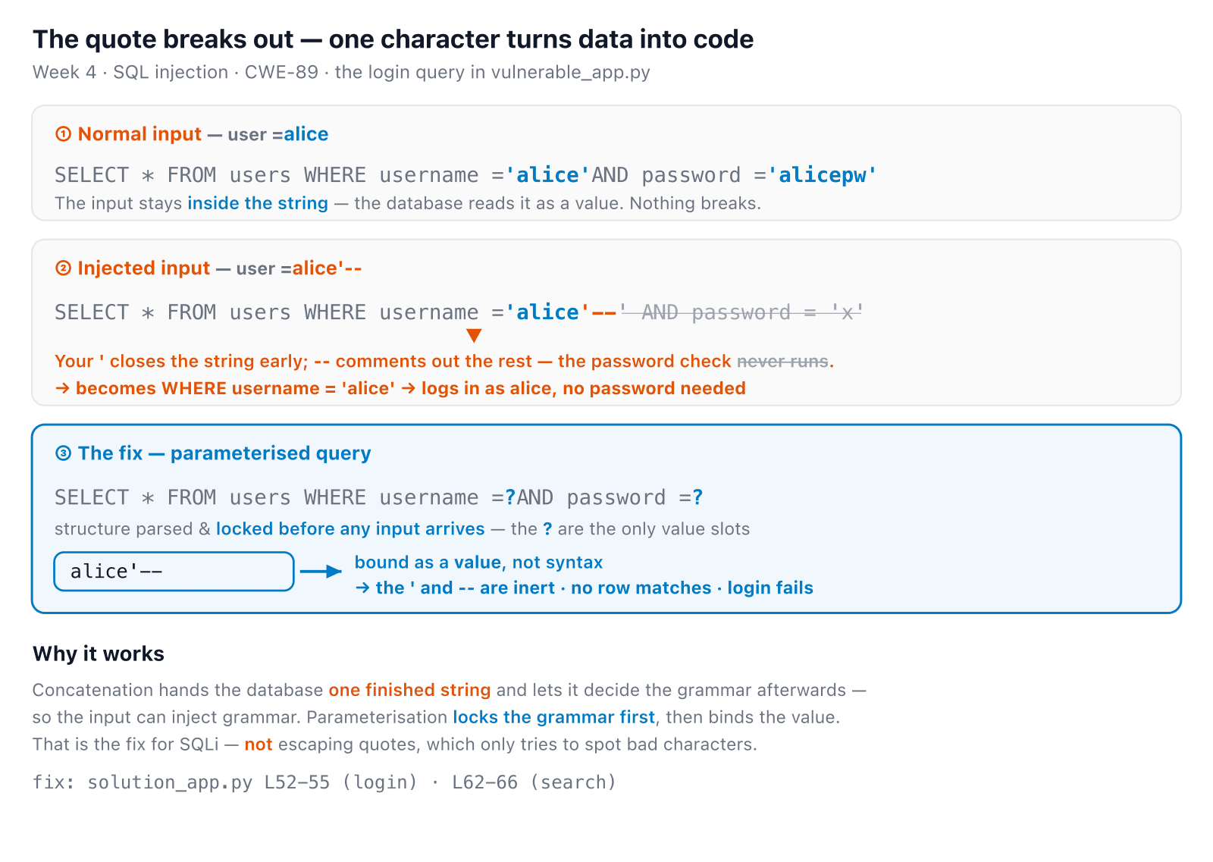
SQLi in one picture — break-out vs. bound value
Software Security · Week 4
Notes:
The consolidation slide — leave it up while students work Task 1. It shows all three states at once (normal / injected / parameterised) with the token colours: blue = value/data, orange = attacker chars that became code, struck-through grey = the check that no longer runs. Point at the orange ' in row 2 — 'that one character is the whole bug' — then the ? in row 3 — 'the value can't reach the grammar'. Same picture the sqli-parse sim animates live. ~3 min.
Diagram: Three SQL login queries stacked: normal input sits inside the string as data; the injected username alice'-- makes the user's quote close the string and -- comment out the password check so it logs in with no password; and the parameterised version binds alice'-- into a ? placeholder as pure data so the quote and dashes are inert and login fails.

Slide 11
Real-world impact
Equifax (2017): unvalidated HTTP header → Struts RCE (CVE-2017-5638); 147M people, ~$700M settlement
Heartland (2008): SQLi into payment systems → 130M+ cards
Bulgaria: data on almost all adults leaked via SQLi
Impact: data leak/modification, full DB control, DoS, reputation
Software Security · Week 4
Notes:
Make it real — these are careers ended and companies fined. Equifax = a single unpatched input parser. Tie back: every breach here started as "untrusted data interpreted as code". ~4 min.

Slide 12
Validate: allow-list, not block-list
Allow-list (preferred): accept only known-good (e.g. 0–9 for a phone)
Block-list: ban known-bad → bypassed by new payloads
Validate type · length · range · format
Client-side for UX, server-side for security
Software Security · Week 4
Notes:
Key principle that recurs all term. Block-lists always lose (attackers invent new payloads); allow-lists define what's acceptable. Emphasize: validation is defense-in-depth, NOT the primary SQLi fix (that's parameterization — next). ~4 min.

Slide 13
Demo / attack surface
Login forms, search boxes, URL params, JSON fields, headers
Error messages leak schema → enumeration
Today's lab: raw payloads via browser/curl against app.py — no scanner needed to see the mechanism
Burp Suite / sqlmap are real-world tools worth knowing (sandbox-only, ethically) — not required for this week's tasks
Software Security · Week 4
Notes:
Point out injection isn't just login boxes — any input reaching an interpreter. Note verbose DB errors are a gift to attackers (schema leakage). Be clear Burp/sqlmap are industry-awareness, not something this week's worksheet has them install — every task here is a plain URL/curl payload. ~3 min.

Slide 14
Command injection
system("ping -c 1 " . $_GET['host']); // vulnerable
// host = 8.8.8.8; cat /etc/passwd
Shell metacharacters: ; | & $() \ >`
Leads to RCE — full server compromise
Software Security · Week 4
Notes:
Same pattern, deadlier outcome (RCE = own the server, not just the DB). Walk the metacharacters: `;` chains a second command. Ask: "what does `8.8.8.8; cat /etc/passwd` run?" ~5 min.

Slide 15
The fix: no shell — pass an argument vector
# vulnerable: shell=True -> the OS shell parses the whole string
subprocess.run("ping -c 1 " + host, shell=True) # host = 8.8.8.8;cat /flag.txt
# fixed: shell=False + argument array -> no shell, no metacharacters
subprocess.run(["ping", "-c", "1", host], shell=False) # + allow-list host
shell=True hands your string to /bin/sh, which reads ; | $() as syntax
An arg vector runs ping directly — host is one literal argument, never parsed
8.8.8.8;cat /flag.txt becomes one impossible "hostname"; the ; is inert
Software Security · Week 4
Notes:
Same shape as the SQLi fix — separate command from data. shell=True actually spawns `/bin/sh -c "ping -c 1 <yourstring>"`, so sh does the parsing and every metacharacter (; | & $() backtick > <) is live -> command injection. With an argv list there is NO shell in the picture: execve runs the ping binary with argv = ["ping","-c","1",host], the kernel hands ping exactly four arguments, and host is a single opaque string -> ping tries to resolve "8.8.8.8;cat /flag.txt" as a hostname, fails, done. Nothing ever parses the ;. Exact parallel to parameterized queries: the structure (command + fixed flags) is fixed in code, the data (host) rides in a separate slot no interpreter re-parses. Add an allow-list on host as defense in depth. Punch line: you don't sanitize the metacharacters — you remove the shell that would interpret them. ~6 min.

Slide 16
Upload → RCE (a classic chain)
The classic chain, attacker uploads shell.php:
<?php system($_GET['cmd']); ?>
If the upload dir is web-served and PHP-executable: .../uploads/shell.php?cmd=ls%20-l → RCE
This week's lab stops one step earlier: CWE-434 unrestricted upload — the app accepts any file type/extension, but the upload directory is not served or executed. Your task: explain which missing control would complete the chain (type check, extension allow-list, storage outside web root, no-exec) — not demonstrate a live shell
Software Security · Week 4
Notes:
Connects to W1's /upload threat model. Be precise: this app does NOT give you a working webshell today — Task 4 is a documentation exercise ("what's missing, and why does that stop RCE?"), not a live exploit. Don't imply students will pop a shell; they'll reason about the one control standing between this bug and that outcome. ~5 min.

Slide 17
Upload → RCE (a classic chain) (cont.)
Fix: validate file type via mime_content_type(), allow-list extensions, store uploads outside web root, no execute
Software Security · Week 4
Notes:
Connects to W1's /upload threat model. Be precise: this app does NOT give you a working webshell today — Task 4 is a documentation exercise ("what's missing, and why does that stop RCE?"), not a live exploit. Don't imply students will pop a shell; they'll reason about the one control standing between this bug and that outcome. ~5 min.

Slide 18
CWE mapping
CWE-89 — SQL injection
CWE-78 — OS command injection (CWE-77 is its general parent — cite CWE-78, the specific one)
CWE-434 — unrestricted upload of a dangerous file type
Software Security · Week 4
Notes:
They map every lab finding to a CWE id — these three are what this week's worksheet actually grades. CWE-434 is a quarter of the exploitation score; don't drop it from this list. ~1 min.

Slide 19
Defenses that actually work
Parameterized queries / prepared statements (the fix for SQLi)
ORM with bound parameters
Allow-list input validation (type, length, format)
Avoid shells: use exec APIs with arg arrays, not string concat
Least-privilege DB accounts
Software Security · Week 4
Notes:
The payoff. #1 message: parameterization makes data STAY data — the DB never parses it as SQL. For shells, pass an argv array, not a string. Least-privilege limits blast radius if they still get in. ~5 min.

Slide 20
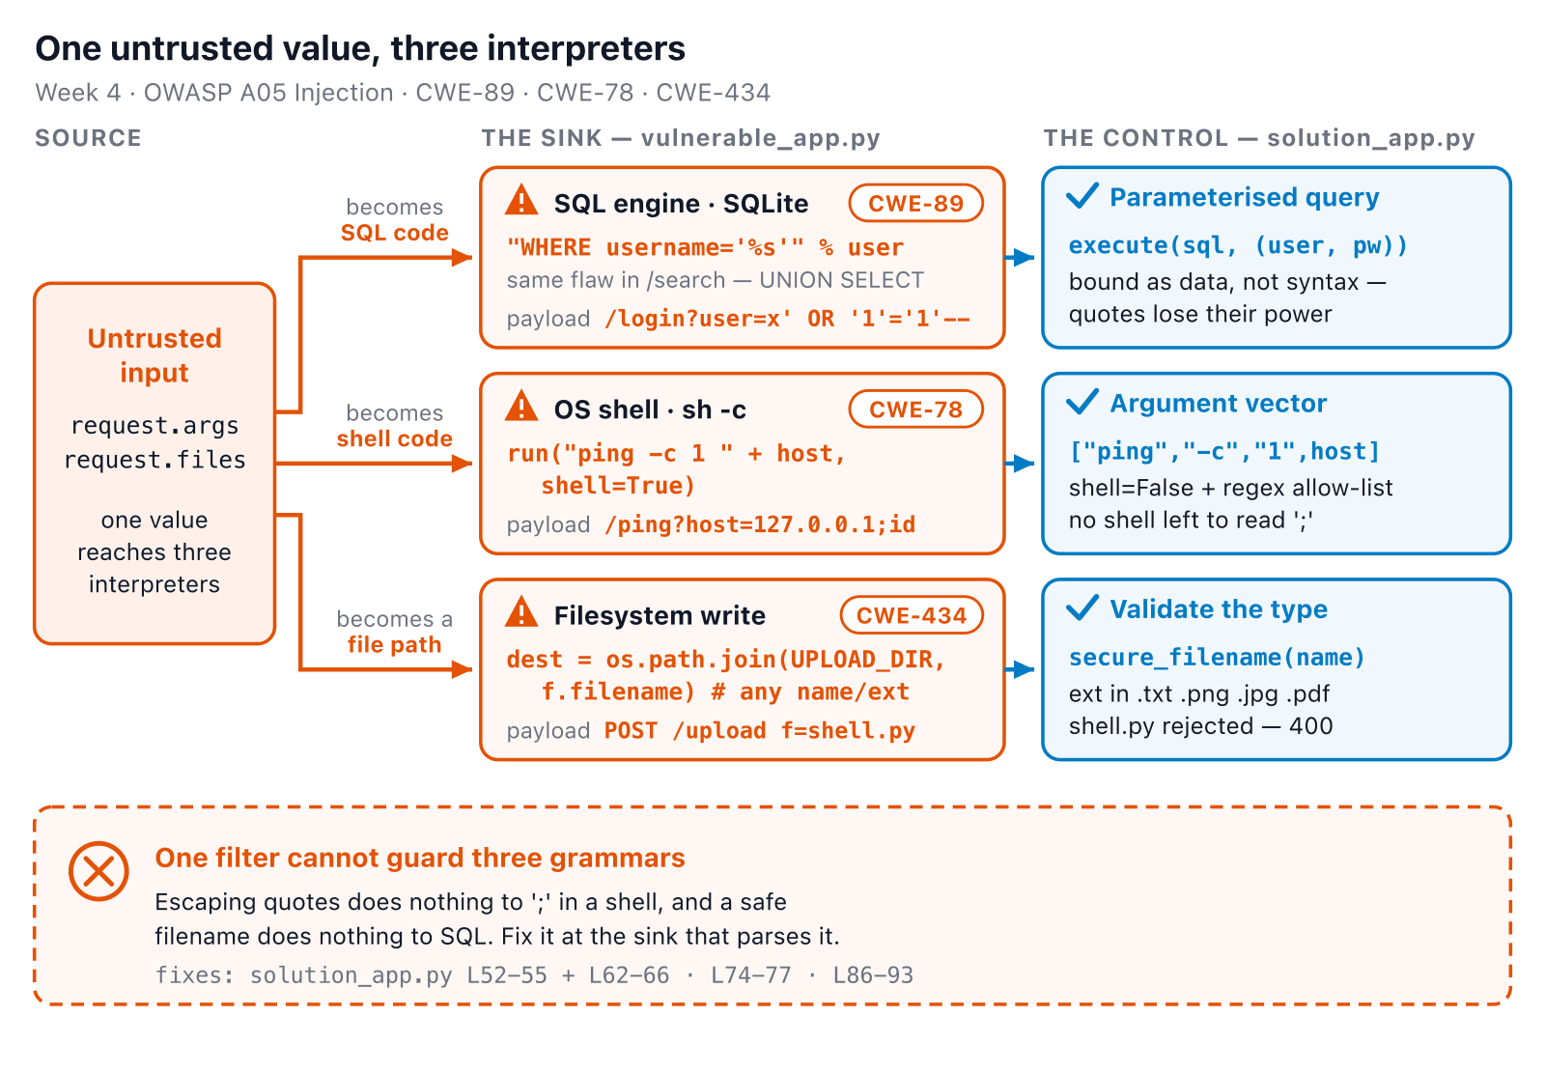
One value, three interpreters
Software Security · Week 4
Notes:
Synthesis slide — the SAME untrusted value from request.args/request.files is what feeds all three attacks just covered. Land on the closing line: escaping quotes does nothing to a semicolon in a shell, and a safe filename does nothing to SQL. Sets up "Defenses" as three separate fixes, not one. ~4 min.
Diagram: One untrusted request value reaches three different interpreters — SQL (CWE-89, fixed by a parameterized query), the OS shell (CWE-78, fixed by an argument vector with shell=False), and a filesystem write (CWE-434, fixed by an extension allow-list). One input filter cannot guard three grammars — the fix belongs at the sink that parses the value, not at the source.

Slide 21
One value, three interpreters (cont.)
SQL (WHERE username = <in>) → parameterized query — bind the value
Shell (ping … <in>) → argument vector + shell=False — no shell to parse it
Filesystem (save(<in>)) → extension allow-list + store outside web root
One filter can't guard three grammars — fix at each sink, not at the source
Software Security · Week 4
Notes:
Synthesis slide — the SAME untrusted value from request.args/request.files is what feeds all three attacks just covered. Land on the closing line: escaping quotes does nothing to a semicolon in a shell, and a safe filename does nothing to SQL. Sets up "Defenses" as three separate fixes, not one. ~4 min.
Diagram: One untrusted request value reaches three different interpreters — SQL (CWE-89, fixed by a parameterized query), the OS shell (CWE-78, fixed by an argument vector with shell=False), and a filesystem write (CWE-434, fixed by an extension allow-list). One input filter cannot guard three grammars — the fix belongs at the sink that parses the value, not at the source.

Slide 22
⚔️ Game — SQLi Warm-up
Four hits against this week's own app — no filters to bypass, the app has none:
1
Auth bypass (alice'--)
2
UNION dump (steal all credentials)
3
Command injection
4
Unrestricted upload
Software Security · Week 4
Notes:
Explain before lab: this is NOT a tiered WAF-bypass ladder — it's 4 fixed attacks against app.py, then proving solution_app.py blocks all 4 ("warm-up cleared" = Task 5). No filter exists in the vulnerable app to bypass; don't set that expectation. DVWA/Juice Shop remain available as optional secondary targets, not the graded game. This is deliberately separate from the arena's own "SQLi Boss Fight" container challenge later in the session — same technique, different target, don't conflate the two names. ~3 min.

Slide 23
⚔️ Game — SQLi Warm-up (cont.)
5
Warm-up cleared: run solution_app.py, prove all four attacks now fail, cite the exact fix line for each
Software Security · Week 4
Notes:
Explain before lab: this is NOT a tiered WAF-bypass ladder — it's 4 fixed attacks against app.py, then proving solution_app.py blocks all 4 ("warm-up cleared" = Task 5). No filter exists in the vulnerable app to bypass; don't set that expectation. DVWA/Juice Shop remain available as optional secondary targets, not the graded game. This is deliberately separate from the arena's own "SQLi Boss Fight" container challenge later in the session — same technique, different target, don't conflate the two names. ~3 min.

Slide 24
Lab steps
📋 Worksheet 4 — labs/week04-injection/worksheet.md (Part 3) · kickoff: docker compose up → http://localhost:8080
docker run --rm -p 80:80 vulnerables/web-dvwa # optional extra target (or Juice Shop)
1
Find an injectable parameter, bypass auth
2
Extract data (UNION dump)
3
Achieve command injection
Software Security · Week 4
Notes:
Logistics. Circulate with TAs. Remind: step 4 (rewrite + prove the payload now fails) is graded, not just the exploit. Also kick off the NoteVault project injection task (worksheet).

Slide 25
Lab steps (cont.)
4
Probe the upload endpoint — document the missing control
5
Rewrite the endpoints safely & re-test
Software Security · Week 4
Notes:
Logistics. Circulate with TAs. Remind: step 4 (rewrite + prove the payload now fails) is graded, not just the exploit. Also kick off the NoteVault project injection task (worksheet).

Slide 26
Deliverable
Findings: each injection point + payload + impact (CWE-mapped)
The fixed code (prepared statements / validation)
Proof the payload no longer works
+ Audit the AI / EiPE / Prompt Problem (see worksheet)
Software Security · Week 4
Notes:
Set expectations: before AND after code + proof. The AI-resilient tasks are part of the grade. The weekly quiz no longer asks for their payload/flag (that question was dropped — quiz runs before the lab, so it couldn't be answered) — the payload + flag are required in the worksheet's Task 1 and Evidence & Integrity section instead.

Slide 27
Key takeaways
Never build interpreter strings from untrusted input
Parameterize first; validate as defense-in-depth
Injection = data treated as code
Software Security · Week 4
Notes:
Recap in 3 lines. Cold-call: "what's the ONE fix for SQLi?" (parameterized queries). ~2 min.

Slide 28
Questions?
Next week: XSS & client-side risks
Notes:
Cliffhanger: "Next week the same trick runs in the victim's browser — and skims credit cards." Remind DVWA/Juice Shop ready in their VM.

