Slide 1

WEEK 7
Reflection & Review
Pre-Midterm · Weeks 1–6
Notes:
Energy up — review week is a GAME, not a lecture. Set the frame: today's job is "zero surprises on exam day." ~5h block = cumulative quiz + Jeopardy + mock CTF + cheat sheet. ~2 min.

Slide 2

Goal today
Consolidate Weeks 1–6
🎯 Security Jeopardy team quiz-show
🧪 Mock CTF in the midterm format
Build your one-page cheat sheet
Software Security · Week 7 · Review
Notes:
Roadmap, 1 min. Start the session with the cumulative review quiz (quiz1.md, 25 pts, 30 min) per the AGENDA, THEN the games. Tell them everything today mirrors the real exam.

Slide 3
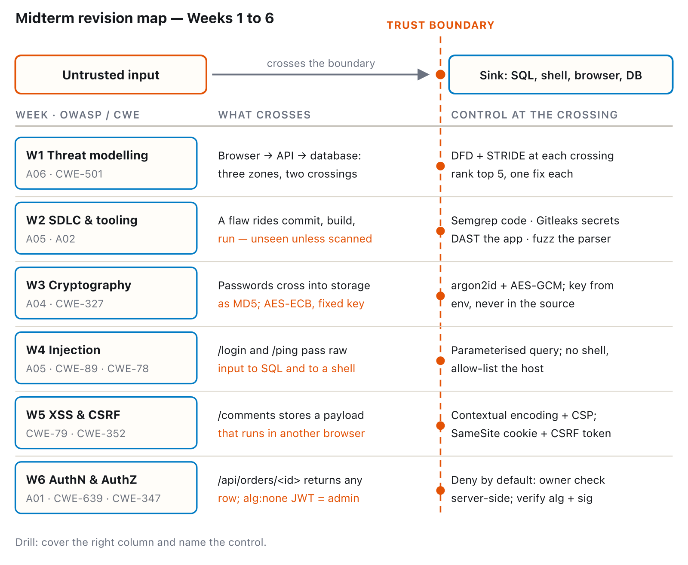
Map of the half
Software Security · Week 7 · Review
Notes:
Fast recap — cold-call one student per row to give the one-liner from memory. Don't lecture; it's retrieval practice. Same unifying shape as Week 1's own trust-boundary concept: input crosses, a control sits at the crossing — the map makes that pattern visible across all 6 weeks at once, not just stated per week. ~10 min.
Diagram: A revision map of weeks 1 to 6: untrusted input crosses a trust boundary toward a sink, and every week places its control exactly at that crossing. Week 1 threat modeling: draw the DFD, run STRIDE at each crossing. Week 2 SDLC/tooling: Semgrep, Gitleaks, DAST and fuzzing catch what rides through commit/build/run unseen. Week 3 crypto: argon2id + AES-GCM with the key from the environment, not MD5/ECB with a fixed key. Week 4 injection: a parameterized query, no shell, an allow-list on the host. Week 5 XSS/CSRF: contextual encoding, a strict CSP, SameSite plus a real CSRF token. Week 6 auth: deny by default, a server-side owner check, and verifying the JWT's algorithm and signature.

Slide 4
🎯 Security Jeopardy
Categories × point values:
Threat Modeling | Tooling | Crypto | Injection | XSS | Auth
Software Security · Week 7 · Review
Notes:
Run by Houses/teams. Prep the board beforehand (6 categories × 5 values, questions seeded from the exam item bank). Rules: team picks, answers; wrong answer loses the points; end with a Final-Jeopardy wager. Keep it fast and loud. Award points into the CTFd/Houses board. ~60–75 min.

Slide 5
🧪 Mock CTF
Same format as Week 9, 6 challenges, ~150 min:
Injection (SQLi / command)
XSS (stored only — reflected/DOM aren't in this mock)
Auth / IDOR / JWT
Crypto (crack a hash — the ECB oracle is a Week 3 lab task, not part of this mock)
No surprises on exam day.
Software Security · Week 7 · Review
Notes:
Run the EXACT Week 9 format (see mock-ctf.md) so the real CTF feels familiar — but the TIMING is 150 min per AGENDA.md and mock-ctf.md itself, not 90; get this wrong on stage and the room's schedule breaks by an hour. Circulate; offer hints that cost points. The point is calibration: they should leave knowing what they can/can't do. ~150 min.

Slide 6
Common mistakes to avoid
Confusing encoding vs encryption vs hashing
"Validated input" ≠ safe → still parameterize
Authentication without authorization
Trusting client-side checks
Software Security · Week 7 · Review
Notes:
Spend real time here — these are the top exam point-losers every cohort. Ask the room which they're shaky on and drill those. ~8 min.

Slide 7
Deliverable
A one-page cheat sheet (your own) — may be allowed in the exam at instructor's discretion.
Software Security · Week 7 · Review
Notes:
Making the cheat sheet IS the studying (generative learning). Decide + announce now whether it's allowed in the written exam.

Slide 8
Midterm next week
Wk 8 = written · Wk 9 = hands-on CTF · covers Weeks 1–6
Notes:
Logistics: state exam dates, what to bring, room/VM readiness for W9. Reassure: today's mock = the real thing.

