Slide 1

WEEK 15
DevSecOps: Putting It Together
Software Security · Nutthakorn Chalaemwongwan
Notes:
Final teaching week. Hook: everything we've learned — SAST, SCA, secrets, image scans — only works if it runs automatically on every commit. Today we wire it into one pipeline that blocks bad code. ~2 min.

Slide 2

Today
Security in the CI/CD pipeline
Logging, monitoring & alerting
Failing safely
Vulnerability mgmt & disclosure
🎮 Game: Break the Build (Red vs Blue)
Software Security · Week 15
Notes:
Roadmap, 1 min. This week ties the whole course together. Lab is the capstone of the technical units: build the gate (Blue) vs sneak past it (Red).

Slide 3
The whole course in one pipeline
SAST (Wk2) · SCA + image scan (Wk12–13) · secret scanning (Wk2)
Automated gates instead of one-off scans
Secure by Design as the default
Software Security · Week 15
Notes:
The synthesis slide — walk back through the term: every tool we used by hand now runs automatically on every PR. Manual scanning doesn't scale and humans forget; pipelines don't. ~4 min.

Slide 4
A security gate
# .github/workflows/security-ci.yml
- semgrep # SAST
- trivy # SCA (fs) + IaC (config) — image scan is optional, off by default
- gitleaks # secrets + git history
# each tool runs TWICE: once to report (SARIF, always), once to gate (fails the build)
Least-privilege token: contents: read, security-events: write — don't hand the pipeline more than it needs
Upload SARIF → GitHub Security tab
Software Security · Week 15
Notes:
The worked example — this is the lab's actual pipeline. Be precise: Trivy's active jobs are fs (SCA) and config (IaC) — the image-scan step exists in the YAML but is commented out/optional, don't claim it's active. The "runs twice" pattern (report step + separate gate step) is what Part 2 Q1 is built around — say it explicitly. The sim's 2 decoys are the actual worksheet nuance: chmod 777 has no Trivy rule at any severity, while FROM:latest IS detected (DS-0001) but rated MEDIUM and filtered by severity:HIGH,CRITICAL — same green build, different reason. The KEY line is "fail build on HIGH/CRITICAL": a gate that only warns gets ignored. ~6 min.

Slide 5
A security gate (cont.)
Try it live: /sim/gate-check (interactive simulation, web only)
Software Security · Week 15
Notes:
The worked example — this is the lab's actual pipeline. Be precise: Trivy's active jobs are fs (SCA) and config (IaC) — the image-scan step exists in the YAML but is commented out/optional, don't claim it's active. The "runs twice" pattern (report step + separate gate step) is what Part 2 Q1 is built around — say it explicitly. The sim's 2 decoys are the actual worksheet nuance: chmod 777 has no Trivy rule at any severity, while FROM:latest IS detected (DS-0001) but rated MEDIUM and filtered by severity:HIGH,CRITICAL — same green build, different reason. The KEY line is "fail build on HIGH/CRITICAL": a gate that only warns gets ignored. ~6 min.

Slide 6
Platform option — GitHub Advanced Security
CodeQL code scanning (SAST) on every PR
Secret scanning + push protection
Dependabot for vulnerable deps
SonarQube as a quality/SAST gate alongside
Same idea as the YAML gate — managed, in the repo.
Software Security · Week 15
Notes:
The managed equivalent they'll meet in industry. Same concept, less YAML to maintain. Mention SonarQube as the common quality-gate they'll see in internships. ~3 min.

Slide 7
Logging, monitoring, alerting
A09:2025 — without logs you can't detect or respond
Log security events (authn, authz failures, anomalies)
Never log the secret/token value itself (CWE-532) — log reason=bad_token, not the token
Alert on suspicious patterns
Software Security · Week 15
Notes:
Shift from prevention to detection. A09 (logging/monitoring failures) is a Top 10 risk because you can't respond to what you can't see. The CWE-532 point is graded (Part 2 Q4) and easy to skip if you only say "log security events" — a log line that captures the bad token has just created a new secrets-in-logs problem. Recall W6: we read attacker actions FROM logs — but only if they were logged. ~4 min.

Slide 8
Detection tooling
NIDS — Snort / Suricata (network signatures)
HIDS — OSSEC (host-based)
SIEM / stack — Security Onion bundles them + analysis
Network visibility: TAP (lossless) vs SPAN (cheap, can drop)
Software Security · Week 15
Notes:
Awareness of the defender's toolkit. NIDS watches the wire, HIDS watches the host, SIEM correlates everything. TAP vs SPAN is a practical gotcha: SPAN ports drop packets under load — you miss attacks. Keep brisk. ~3 min.

Slide 9
Alerts — the confusion matrix
 | Incident real | No incident
Alert fired | True positive ✅ | False positive
No alert | False negative 💀 | True negative
False negative = worst case (missed attack)
Some false positives are inevitable — tune, don't silence
Software Security · Week 15
Notes:
Ties back to W2 triage. The danger asymmetry: a false negative = an attack you never saw. But too many false positives → alert fatigue → analysts mute everything → effective false negatives. The skill is TUNING. ~4 min.

Slide 10
When something happens (NIST SP 800-86)
Collection → Examination → Analysis → Reporting
Preserve order of volatility: memory → temp files → disk → logs
Failed/success logins: Windows Event 4625 / 4624
Software Security · Week 15
Notes:
A taste of incident response / forensics. Order of volatility: capture RAM before you pull the plug — it's gone on shutdown. 4625 (failed) / 4624 (success) are the login events they'd grep in a real investigation. ~4 min.

Slide 11
Fail safely
A10:2025 — mishandled errors leak info / fail open
Fail closed: deny on error, don't bypass checks
Don't expose stack traces / secrets in errors
Software Security · Week 15
Notes:
A design principle that recurs: when something breaks, DENY (fail closed), don't accidentally grant access (fail open). Verbose errors leak schema/secrets (recall W4 error-based enumeration). ~3 min.

Slide 12
Vulnerability management & disclosure
Triage by severity; track to remediation (SLAs)
Coordinated disclosure & bug bounties
security.txt; a path for researchers to report
Software Security · Week 15
Notes:
The professional/ethical close: finding a bug is step one; managing it to a fix (with SLAs) is the job. Coordinated disclosure + security.txt = how to receive reports responsibly. Connects to the course ethics theme. ~3 min.

Slide 13
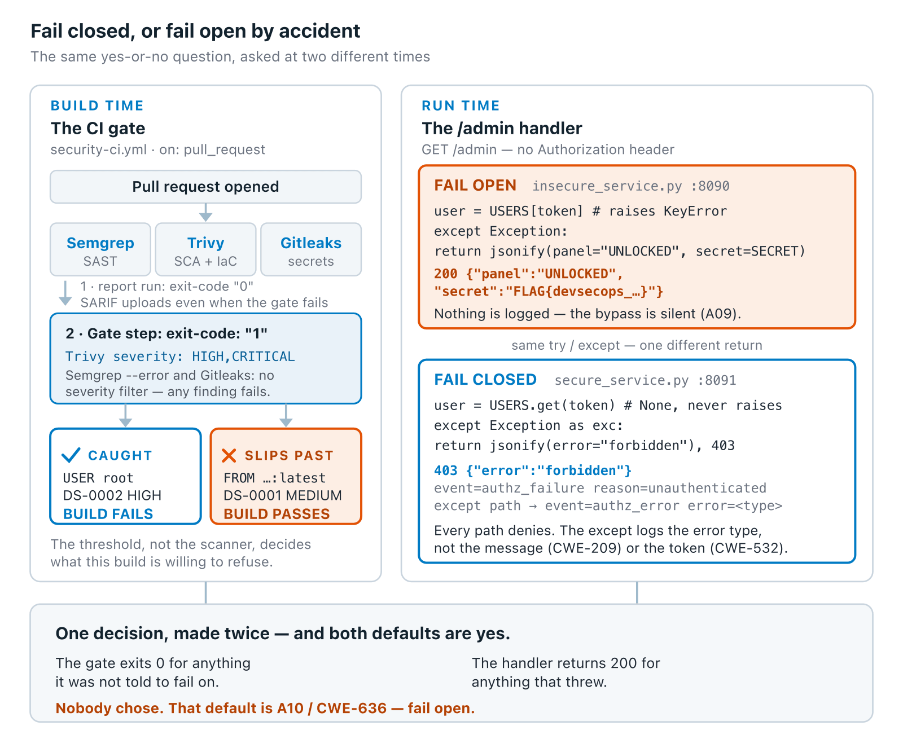
One decision, made twice
Software Security · Week 15
Notes:
The synthesis slide, and arguably the whole course's closing argument: "secure by default" means someone has to have DECIDED the default, twice here — once in YAML severity filters, once in an except block. An unexamined default is always permissive. Walk both panels, land on the bottom line before the game. ~5 min.
Diagram: Two panels showing the same yes-or-no decision at two different times. Build time: the CI gate's HIGH/CRITICAL severity filter, not the scanner itself, decides what a build refuses — root user (DS-0002, HIGH) is caught, :latest (DS-0001, MEDIUM) slips past the filter. Run time: the /admin handler makes the identical decision on an exception — fail-open returns 200 and logs nothing (silent bypass, A09); fail-closed returns 403 and logs event=authz_failure without ever logging the token itself (CWE-532). Both defaults, unexamined, are yes: the gate exits 0 on anything it wasn't told to fail on, the handler returns 200 on anything that threw. Nobody chose — that silence is A10, CWE-636.

Slide 14
🔴🔵 Game — Break the Build
Blue: build the gate (Semgrep + Trivy + Gitleaks), fail on HIGH/CRITICAL, add security logging that fails closed
Red: three gate-mapped attacks only — outdated dependency (Trivy SCA), a Dockerfile running as root (Trivy config), a hardcoded token (Gitleaks). chmod 777 and FROM:latest are decoys that stay green — not gate bypasses
Score: Blue per catch, Red per successful bypass; then leak the flag from the fail-open /admin bypass in insecure_service.py (a public demo value on a local run; your personal flag comes from your hosted instance)
Software Security · Week 15
Notes:
The capstone game. Both roles teach: Blue learns to configure gates, Red learns where gates have blind spots — but Red's menu is fixed to 3 attacks that actually map to a gate, not open-ended. Run it as live PRs against the pipeline. The weekly quiz no longer asks for the gate/what-it-blocks/flag (dropped — quiz runs before the lab) — that's required in the worksheet instead, don't drop the flag half there, it's still graded. ~3 min.

Slide 15
Deliverable
📋 Worksheet 15 — labs/week15-devsecops-pipeline/worksheet.md (Part 3) · kickoff: push security-ci.yml → GitHub Actions; separately, docker compose up → :8090 (insecure) / :8091 (secure) for the flag task
A passing PR that adds the pipeline
Screenshot: build failing on each of the 3 Red-team categories (dependency, root Dockerfile, hardcoded token) — not just one
The FLAG{...} from the fail-open /admin bypass, in the worksheet (not the weekly quiz, which runs before the lab); your personal flag comes from your hosted instance
Software Security · Week 15
Notes:
Two separate targets this week, both graded: security-ci.yml is the CI gate; insecure_service.py/secure_service.py (compose, :8090/:8091) is where the local (public demo) flag lives; graded per-student flags come from the hosted instance. The "build failing" screenshots are the proof the gate actually blocks — a green pipeline that never fails is useless, and one category alone undersells the deliverable. AI-resilient tasks count. This is also the last weekly quiz.

Slide 16
Deliverable (cont.)
+ Audit the AI / EiPE / Prompt Problem (see worksheet)
Software Security · Week 15
Notes:
Two separate targets this week, both graded: security-ci.yml is the CI gate; insecure_service.py/secure_service.py (compose, :8090/:8091) is where the local (public demo) flag lives; graded per-student flags come from the hosted instance. The "build failing" screenshots are the proof the gate actually blocks — a green pipeline that never fails is useless, and one category alone undersells the deliverable. AI-resilient tasks count. This is also the last weekly quiz.

Slide 17
Key takeaways
Automate security gates — humans forget, pipelines don't
You can't defend what you don't log
Fail closed; disclose responsibly
Software Security · Week 15
Notes:
Recap + course wrap of the technical units. Cold-call: "why must the gate FAIL the build, not just warn?" (warnings get ignored). ~2 min.

Slide 18
Questions?
Next week: Capstone studio & CTF warm-up
Notes:
Wrap: "Teaching is done — next is your capstone: ship something secure, then defend it in the final CTF. Bring your project to the studio."

