Slide 1
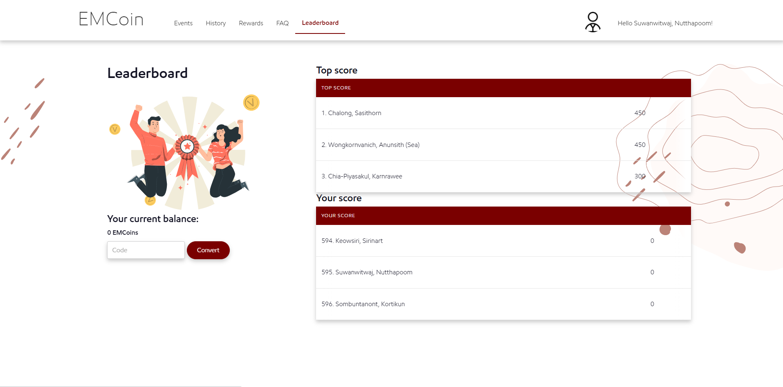
TOP Five | Team | EMCOINS
1. Employee A | EM Function/Team A | 450
2. Employee B | EM Function/Team B | 400
3. Employee C | EM Function/Team A | 350
4. Employee D | EM Function/Team C | 300
5. Employee E | EM Function/Team D | 250

Slide 2
Team A TOP Five | Team | EMCOINS
1. Employee A | EM Function/Team A | 450
2. Employee B | EM Function/Team A | 400
4. Employee C | EM Function/Team A | 350
12. Employee D | EM Function/Team A | 300
15. Employee E | EM Function/Team A | 250

Slide 3
Relative rank | Team | EMCOINS
21. Employee A | EM Function/Team A | 450
22. Employee B | EM Function/Team B | 400
23. You | EM Function/Team A | 350
24. Employee D | EM Function/Team C | 200
25. Employee E | EM Function/Team D | 50

Slide 4
Add friends name
Your Friend Rank | Team | EMCOINS
3. Friend A | EM Function/Team A | 450
12. Friend B | EM Function/Team B | 400
13. Friend C | EM Function/Team A | 350
21. You | EM Function/Team C | 300
55. Friend D | EM Function/Team D | 250

Slide 5
TOP THREE
1. Chalong, Sasithorn | GSC EMIT | 450
2. Wongkornvanich, Anunsith (Sea) | GSC EMIT | 400
3. Chia-Piyasakul, Karnrawee | GSC EMIT | 350
Your score
1. Chalong, Sasithorn | GSC EMIT | 450
2. Wongkornvanich, Anunsith (Sea) | GSC EMIT | 400
3. Chia-Piyasakul, Karnrawee | GSC EMIT | 350

Slide 6
TOP SCORE
1. Chalong, Sasithorn | 450
2. Wongkornvanich, Anunsith (Sea) | 400
3. Chia-Piyasakul, Karnrawee | 350
4. Apiwattanapron, Siraphatr (Off) | 300
5. Sukseree, Manasicha | 250
Your score
1. Chalong, Sasithorn | 450
2. Wongkornvanich, Anunsith (Sea) | 400
3. Chia-Piyasakul, Karnrawee | 350
4. Apiwattanapron, Siraphatr (Off) | 300
5. Sukseree, Manasicha | 250

Slide 7
TOP SCORE
1. Chalong, Sasithorn | 450
2. Wongkornvanich, Anunsith (Sea) | 400
3. Chia-Piyasakul, Karnrawee | 350
Your score
1. Chalong, Sasithorn | 450
2. Wongkornvanich, Anunsith (Sea) | 400
3. Chia-Piyasakul, Karnrawee | 350

