Slide 1

JavaEE Beginner
By Nuttipol

Slide 2
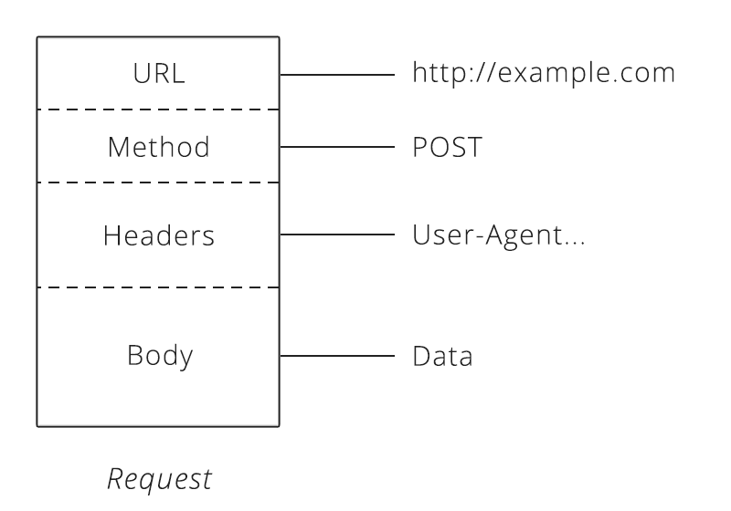
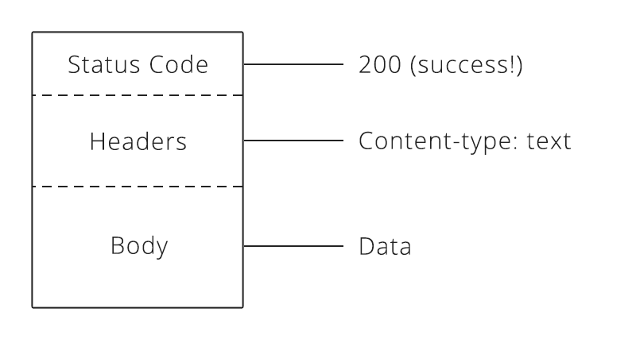
HTTP Protocol
Client
Server
Browser
Chrome
Firefox
Edge
IE
Safari
Opera
Mobile
Java API
POSTMAN
SOAP-UI
.NET
etc.
Apache HTTP
Apache Tomcat
Weblogic
Websphere
IIS
etc.
HTML
SOAP
REST API
HTTP Request
HTTP Response
https://restful.io/an-introduction-to-api-s-cee90581ca1b
Notes:
https://restful.io/an-introduction-to-api-s-cee90581ca1b

Slide 3
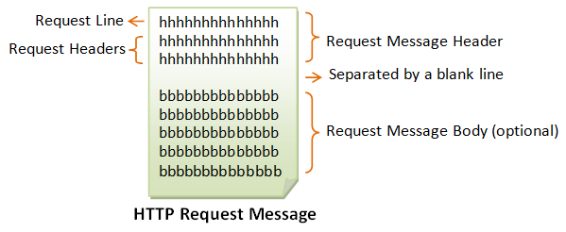
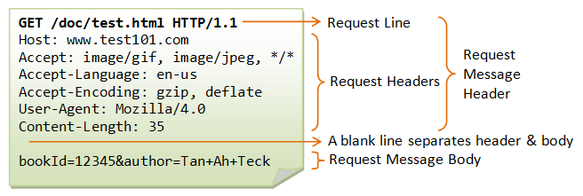
HTTP Request
https://www.ntu.edu.sg/home/ehchua/programming/webprogramming/HTTP_Basics.html
Notes:
https://www.ntu.edu.sg/home/ehchua/programming/webprogramming/HTTP_Basics.html

Slide 4
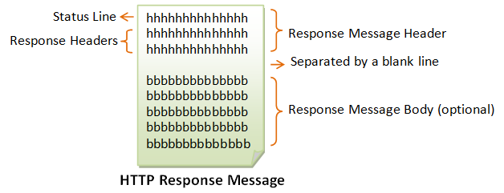
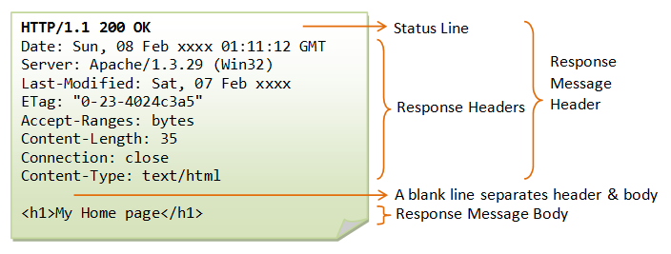
HTTP Response
https://www.ntu.edu.sg/home/ehchua/programming/webprogramming/HTTP_Basics.html
Notes:
https://www.ntu.edu.sg/home/ehchua/programming/webprogramming/HTTP_Basics.html

Slide 5
HTTP Message
Request Headers
Method
Body
Response Headers
Status Code

Slide 6
Request Headers
Host
Accept
Content-length
Content-type
User-agent
https://th.wikipedia.org/wiki/เอชทีทีพี
https://developer.mozilla.org/en-US/docs/Web/HTTP/Messages
Notes:
https://developer.mozilla.org/en-US/docs/Web/HTTP/Messages
https://th.wikipedia.org/wiki/เอชทีทีพี

Slide 7
Method
GET — Asks the server to retrieve a resource.
POST — Asks the server to create a new resource.
PUT — Asks the server to edit/update an existing resource.
DELETE — Asks the server to delete a resource.

Slide 8

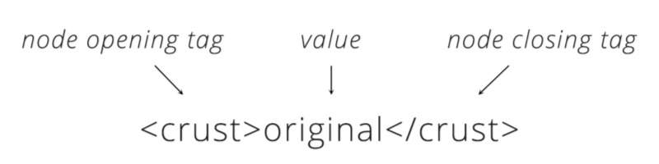
Body
JSON (application/json)
XML (application/xml)
Text (text/plain) (text/html)
Binary (application/pdf) (application/msword) (image/png) (image/jpeg)
https://en.wikipedia.org/wiki/Media_type
Notes:
https://en.wikipedia.org/wiki/Media_type

Slide 9
Response Headers
Content-Type
Content-Length
Last-modified
Etag
Expires
Max-Age
https://betterexplained.com/articles/how-to-optimize-your-site-with-http-caching/
Notes:
https://betterexplained.com/articles/how-to-optimize-your-site-with-http-caching/

Slide 10
Status Code
1xx (Informational): Request received, server is continuing the process.
2xx (Success): The request was successfully received, understood, accepted and serviced.
3xx (Redirection): Further action must be taken in order to complete the request.
4xx (Client Error): The request contains bad syntax or cannot be understood.
5xx (Server Error): The server failed to fulfill an apparently valid request.
https://th.wikipedia.org/wiki/รายชื่อรหัสสถานภาพของเอชทีทีพี
Notes:
https://th.wikipedia.org/wiki/รายชื่อรหัสสถานภาพของเอชทีทีพี

Slide 11
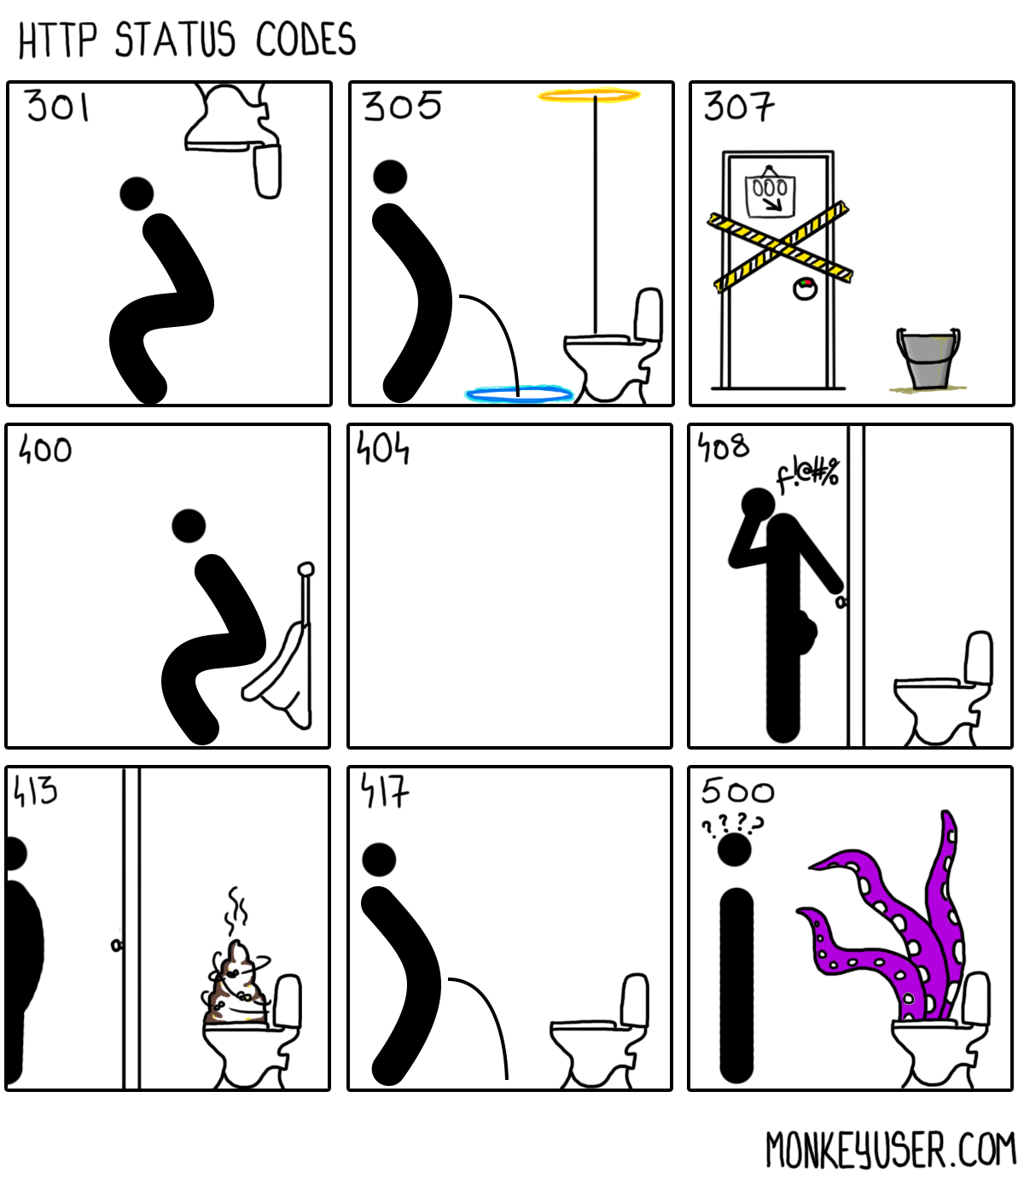
Status Code
200 OK
201 Created
204 No Content
301 Move Permanently
304 Not Modified
305 Use Proxy
307 Temporary Redirect
400 Bad Request
401 Authentication Required
403 Forbidden
404 Not Found
405 Method Not Allowed
406 Not Acceptable
408 Request Timeout
413 Request Entity Too Large
414 Request URI too Large
417 Expectation Failed
500 Internal Server Error
503 Service Unavailable
504 Gateway Timeout
https://www.ideagital.com/savepong/http-status-code
Notes:
https://www.ideagital.com/savepong/http-status-code

Slide 12
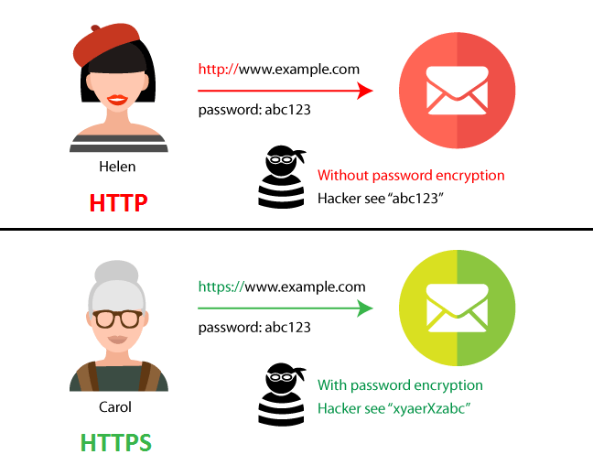
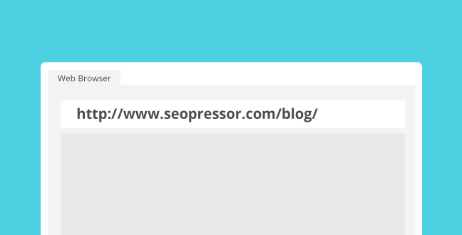
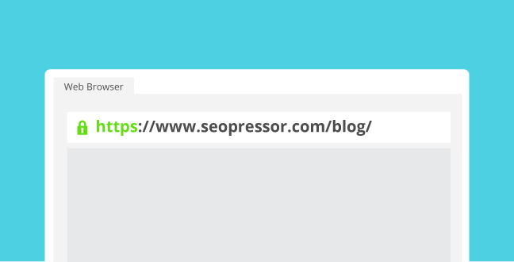
HTTP vs HTTPS
https://seopressor.com/blog/http-vs-https/
Notes:
https://seopressor.com/blog/http-vs-https/

Slide 13
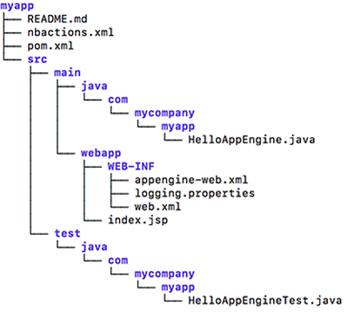
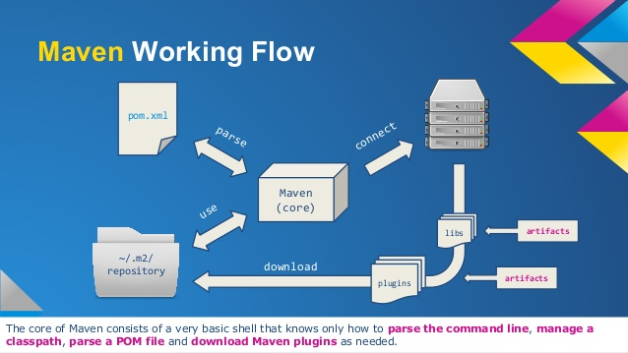
Apache Maven
Apache Maven is a software project management and comprehension tool. Based on the concept of a project object model (POM), Maven can manage a project's build, reporting and documentation from a central piece of information.

Slide 14
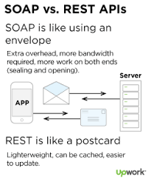


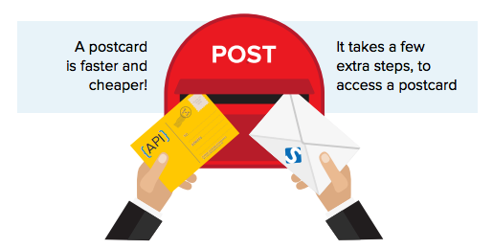
SOAP vs REST
https://www.google.com/search?q=soap%20rest%20api&tbm=isch
Notes:
https://www.google.com/search?q=soap%20rest%20api&tbm=isch

Slide 15
HTTP Message (SOAP)
POST http://localhost:8080/ws-server-jax-ws/Calculator HTTP/1.1
Accept-Encoding: gzip,deflate
Content-Type: text/xml;charset=UTF-8
SOAPAction: ""
Content-Length: 328
Host: localhost:8080
Connection: Keep-Alive
User-Agent: Apache-HttpClient/4.1.1 (java 1.5)
<soapenv:Envelope xmlns:soapenv="http://schemas.xmlsoap.org/soap/envelope/" xmlns:ws="http://ws.example.my/">
<soapenv:Header/>
<soapenv:Body>
<ws:add>
<arg0>1</arg0>
<arg1>1</arg1>
</ws:add>
</soapenv:Body>
</soapenv:Envelope>
HTTP/1.1 200
Content-Type: text/xml;charset=utf-8
Transfer-Encoding: chunked
Date: Tue, 30 Apr 2019 10:31:45 GMT
<S:Envelope xmlns:S="http://schemas.xmlsoap.org/soap/envelope/">
<S:Body>
<ns2:addResponse xmlns:ns2="http://ws.example.my/">
<return>2</return>
</ns2:addResponse>
</S:Body>
</S:Envelope>

Slide 16
HTTP Message (REST)
GET http://localhost:8080/ws-server-rest/users HTTP/1.1
accept: */*
accept-encoding: gzip, deflate
cache-control: no-cache
connection: keep-alive
host: localhost:8080
postman-token: 179fea94-b184-4dae-9547-92f83d0781cb
user-agent: PostmanRuntime/7.11.0
HTTP/1.1 200
Content-Type: application/json
Content-Length: 99
Date: Thu, 02 May 2019 10:03:10 GMT
{ "name":"John", "age":30, "car":null }

Slide 17
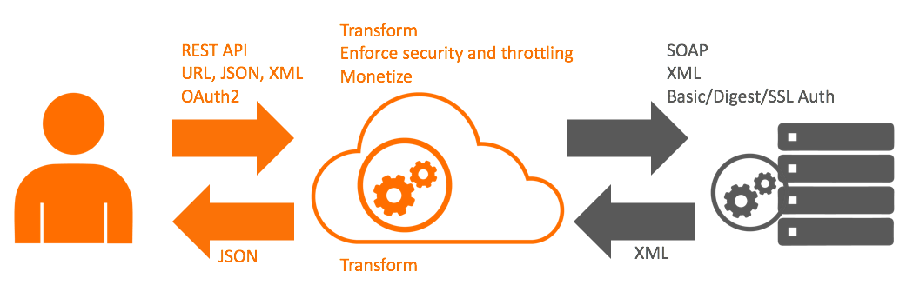
SOAP vs REST
SOAP (Simple Object Access Protocol) is a messaging protocol specification for exchanging structured information in the implementation of web services in computer networks. Its purpose is to provide extensibility, neutrality and independence. It uses XML Information Set for its message format, and relies on application layer protocols, most often Hypertext Transfer Protocol (HTTP) or Simple Mail Transfer Protocol (SMTP), for message negotiation and transmission.
REST (Representational State Transfer) is a software architectural style that defines a set of constraints to be used for creating Web services.

Slide 18

Idempotent & non-Idempotent
Notes:
http://www.notaboutcode.com/post/16-idempotent/

Slide 19
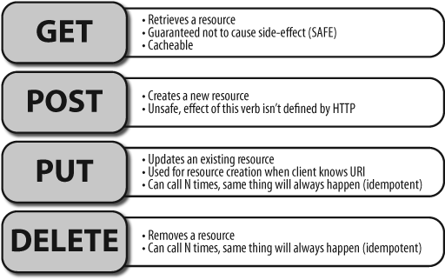
Idempotent & non-Idempotent

Slide 20
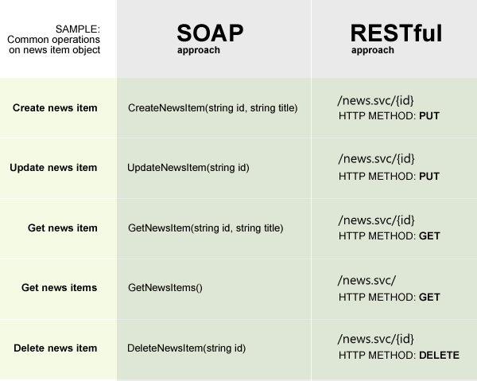
SOAP vs REST
https://www.progress.com/documentation/sitefinity-cms/for-developers-restful-wcf-services-in-sitefinity
Notes:
https://www.progress.com/documentation/sitefinity-cms/for-developers-restful-wcf-services-in-sitefinity

Slide 21
HTTP methods (verbs)
HTTP Verb | CRUD | API endpoint | Operation
GET | Read (All) | /users | listUsers
GET | Read (x) | /users?name=xxx | listUsers(name)
GET | Read | /users/1 | getUser
POST | Create | /users | addNewUser
PUT | Update | /users/1 | updateUser
DELETE | Delete | /users/1 | deleteUser
https://slashs10.wordpress.com/2017/03/09/rest-api-and-http-method/
Notes:
https://slashs10.wordpress.com/2017/03/09/rest-api-and-http-method/

Slide 22
HTTP methods (verbs)
HTTP Verb | CRUD | API endpoint | Operation
PUT | Update | /users/1/roles/1 | addNewUserRole
DELETE | Delete | /users/1/roles/1 | deleteUserRole
GET | Read (All) | /users/1/roles | listUserRoles
GET | Read | /users/1/department | getUserDepartment
GET | Read (All) | /departments | listDepartments
GET | Read | /departments/1 | getDepartment
Notes:
https://slashs10.wordpress.com/2017/03/09/rest-api-and-http-method/

Slide 23

Good Practices for API Design
1. Use nouns but no verbs
2. GET method and query parameters should not alter the state
3. Use plural nouns
4. Use sub-resources for relations
5. Use HTTP headers for serialization formats
6. Use HATEOAS
7. Provide filtering, sorting, field selection and paging for collections
8. Version your API
9. Handle Errors with HTTP status codes
https://medium.com/hashmapinc/rest-good-practices-for-api-design-881439796dc9
https://blog.mwaysolutions.com/2014/06/05/10-best-practices-for-better-restful-api/
Notes:
https://blog.mwaysolutions.com/2014/06/05/10-best-practices-for-better-restful-api/
https://medium.com/hashmapinc/rest-good-practices-for-api-design-881439796dc9

