Slide 1
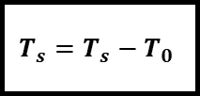
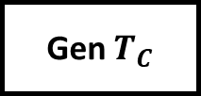
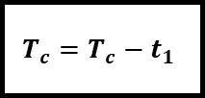
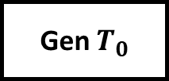
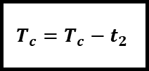
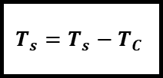
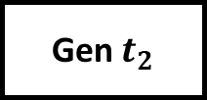
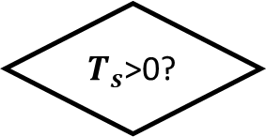
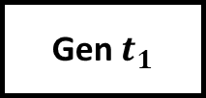
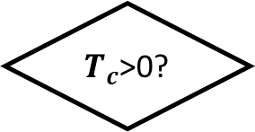
Start
Simulation End?
Yes
END
No
Gen Ts
Random WiFi state 0/1/2
WiFi status = 0?
No
Yes
Gen $T_{0}$
Gen $T_{C}$
$$T_{s}=T_{s}−T_{0}$$
$$T_{s}=T_{s}−T_{C}$$
No
Gen $t_{1}$
Yes
WiFi status = 1?
No
Gen $t_{2}$
$T_{s}$>0?
Yes
$$T_{c}=T_{c}−t_{1}$$
$$T_{c}=T_{c}−t_{2}$$
Toggle WiFi state 0/1/2
No
$T_{c}$>0?
Yes
Toggle WiFi state 1/2

Slide 2












$$N_{1}=3$$
$$N_{2}=3$$
$$N=2$$
$$T_{S}=300$$
$$T_{0}=50$$
$$T_{C}=100$$
$$T_{0}=100$$
$$T_{C}=60$$
$$t_{1}$$
$$t_{2}$$
$$t_{1}$$
$$t_{2}$$
$$t_{2}$$
$$t_{1}$$

