Slide 2









$$t_{1}$$
$$t_{0}$$
$$t_{1}$$
$$t_{0}$$
$$t_{s}$$
WiFi Connection
WiFi Connection
Time
Cellular Connection
Cellular Connection
$$t_{s}$$
$$d$$
$$d$$
WiFi Connection
WiFi Connection
Time
Cellular Connection
Cellular Connection
$$t_{s}$$
WiFi Connection
WiFi Connection
Time
Cellular Connection

Slide 3
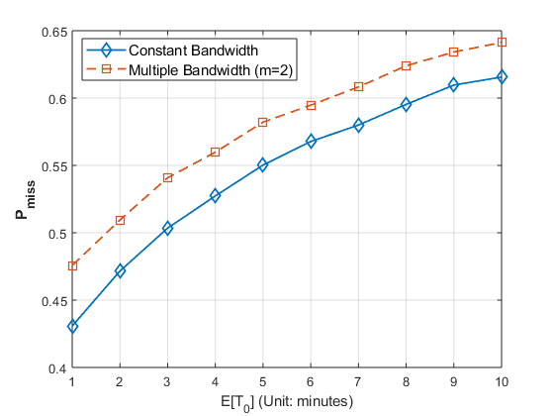
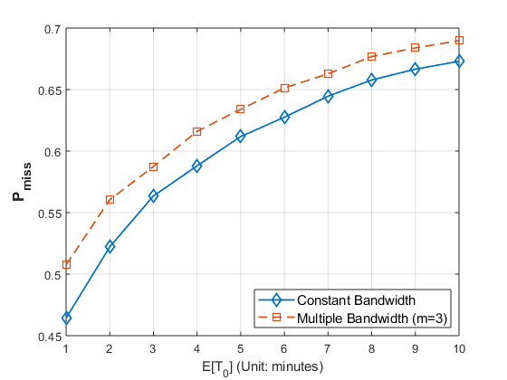
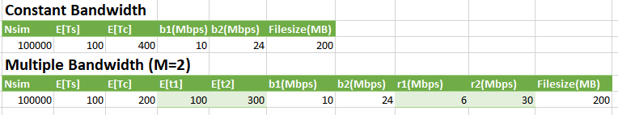
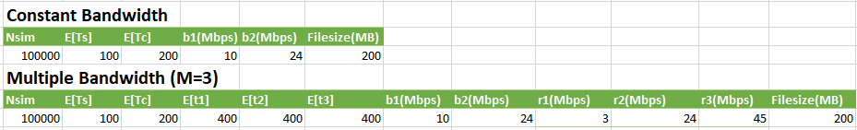

Slide 4
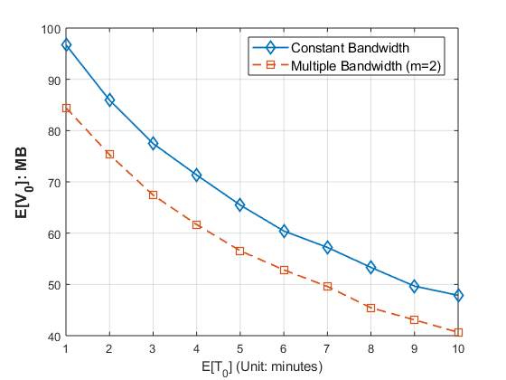
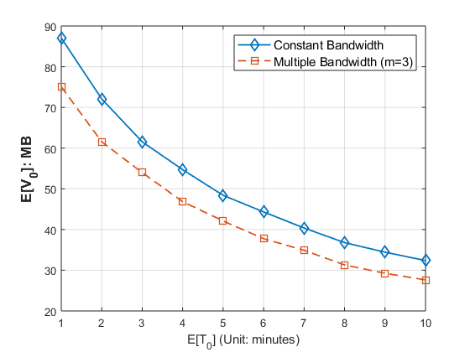

Slide 5
