Slide 1
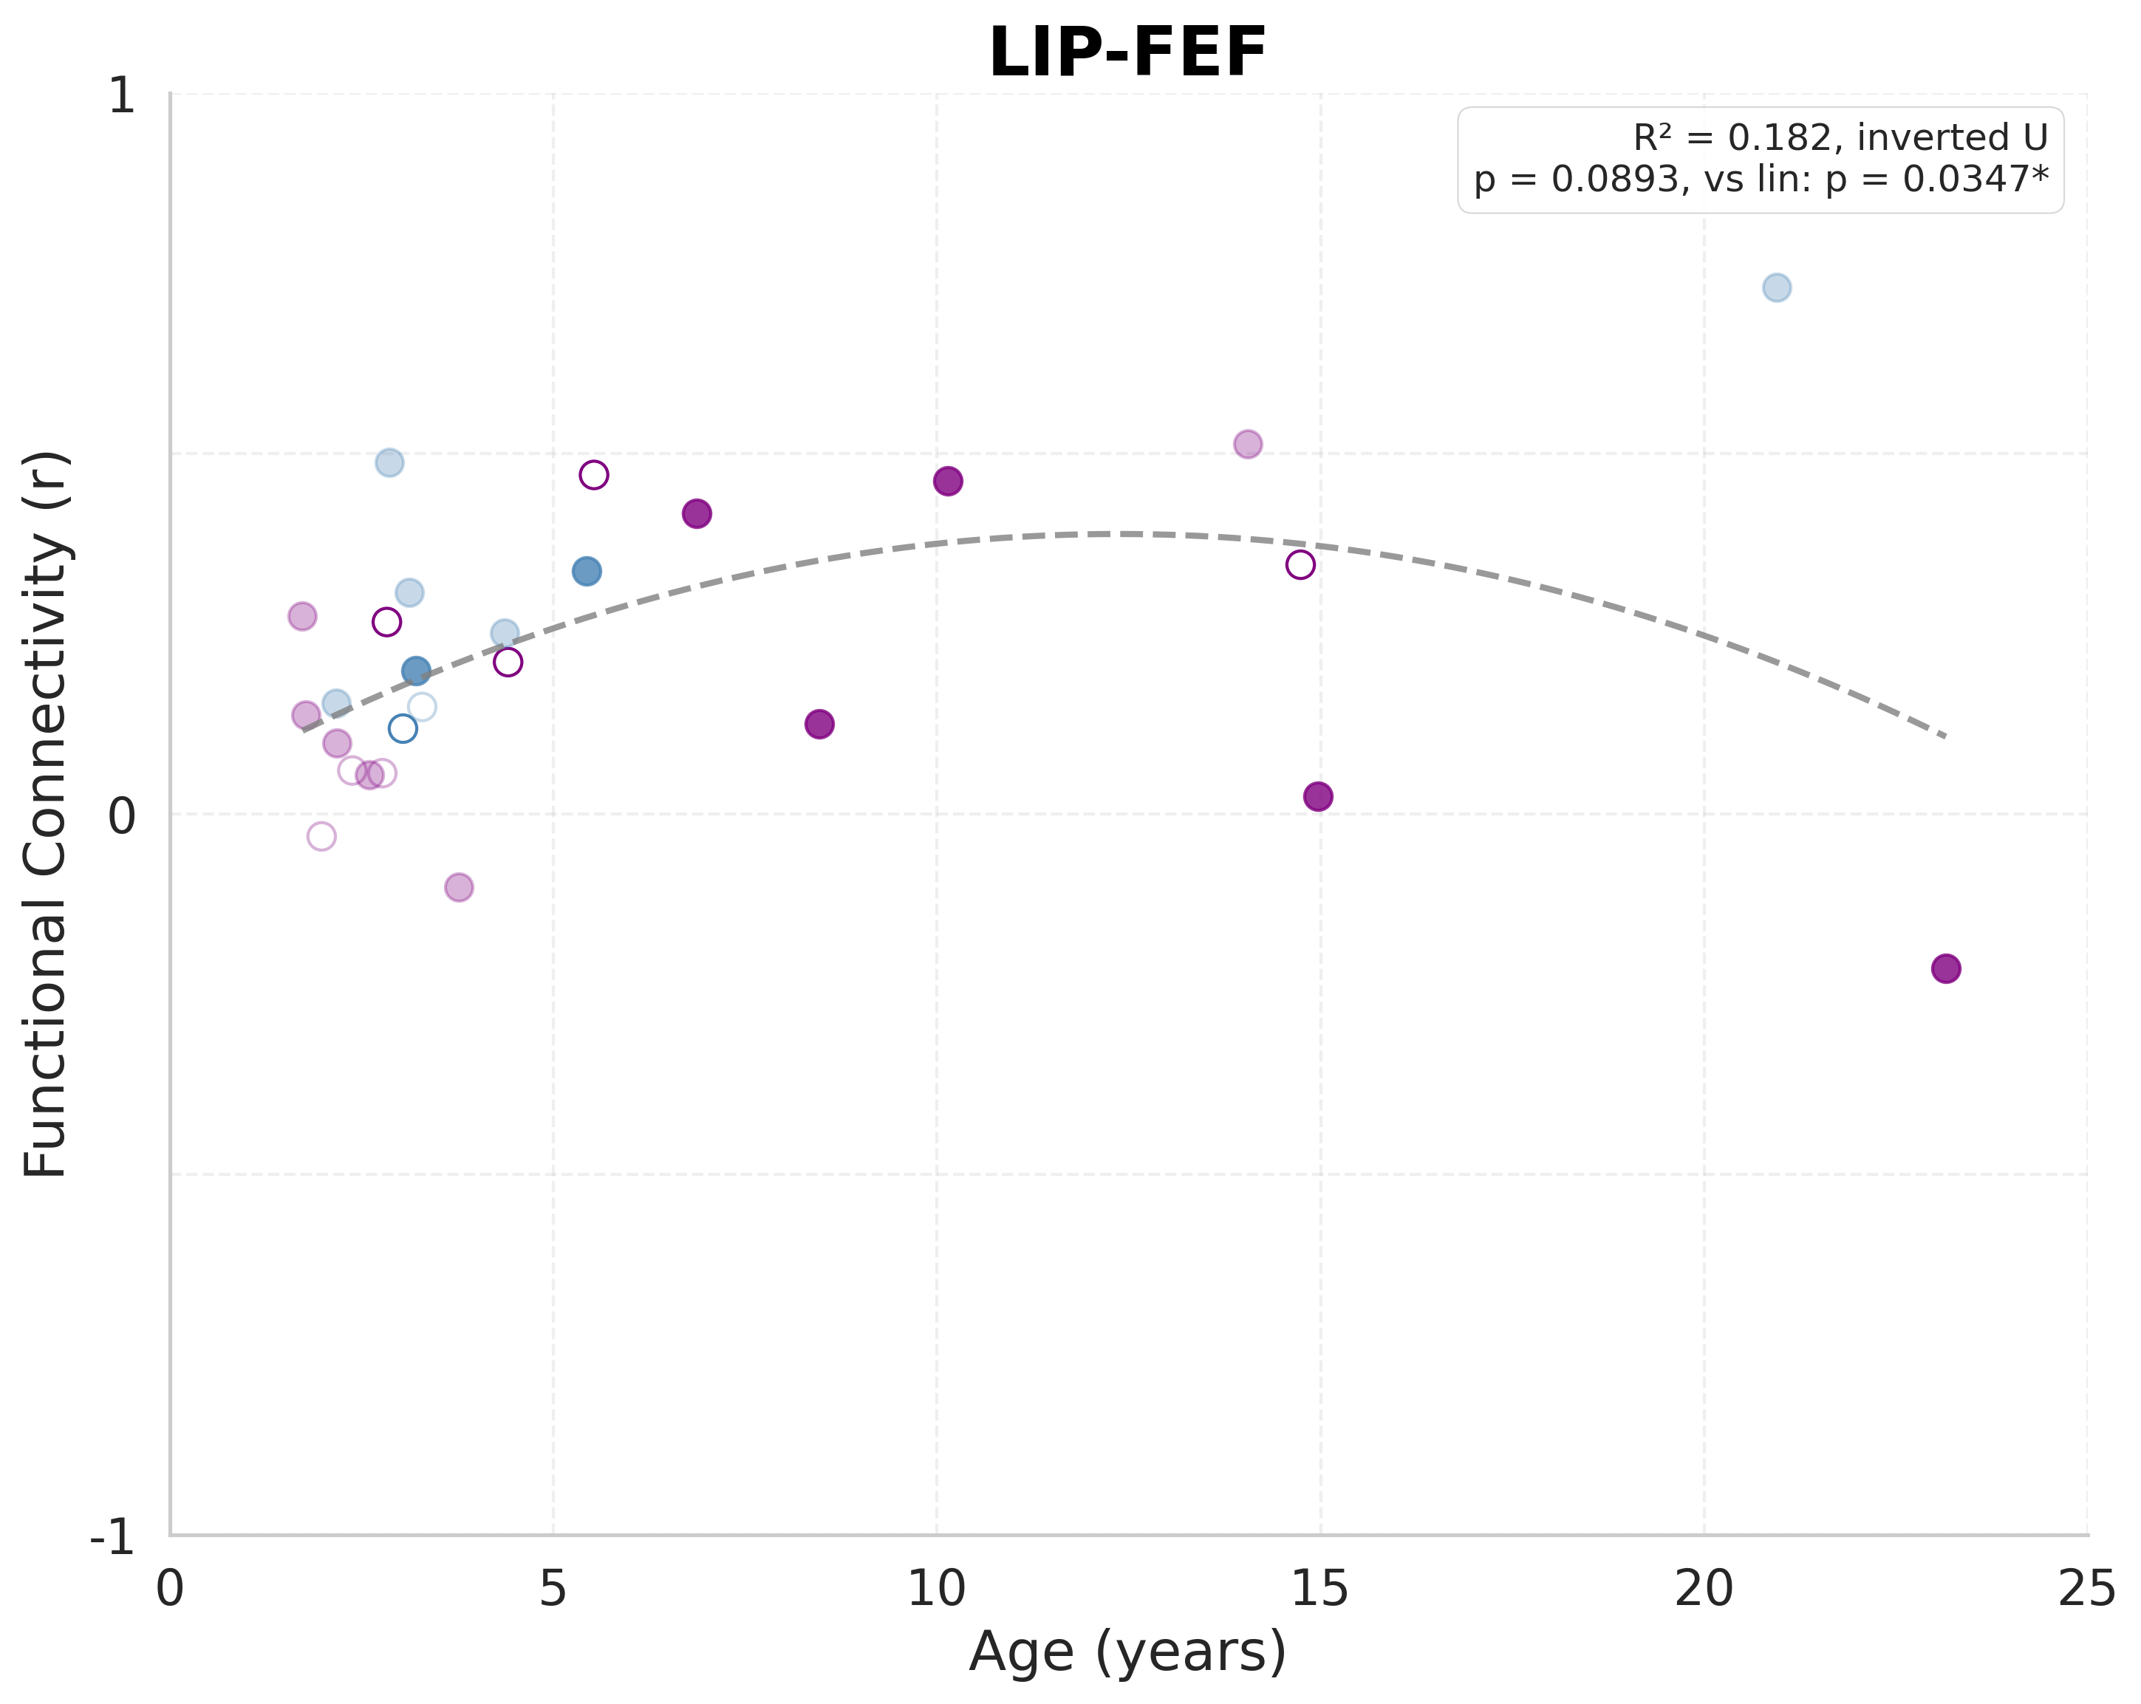
Resting-State Connectivity: LIP-FEF
Notes:
LIP-FEF
Sample size: n=27
(includes both behavioral and imaging-only subjects)
LINEAR MODEL:
R² = 0.0355
F(1, 25) = 0.9196
p-value = 0.346755
y = 0.0066x + 0.1763
AIC = -82.29
BIC = -79.69
QUADRATIC MODEL:
R² = 0.1824
F(2, 24) = 2.6763
p-value = 0.089285
y = -0.002416x² + 0.0597x + 0.0191
AIC = -84.75
BIC = -80.86
Likelihood ratio test vs. linear: p = 0.034688 * (significantly better)
Pattern: Inverted U-shaped (developmental peak)
MODEL SELECTION:
Best model (by AIC): QUADRATIC
Best model (by R²): QUADRATIC

Slide 2
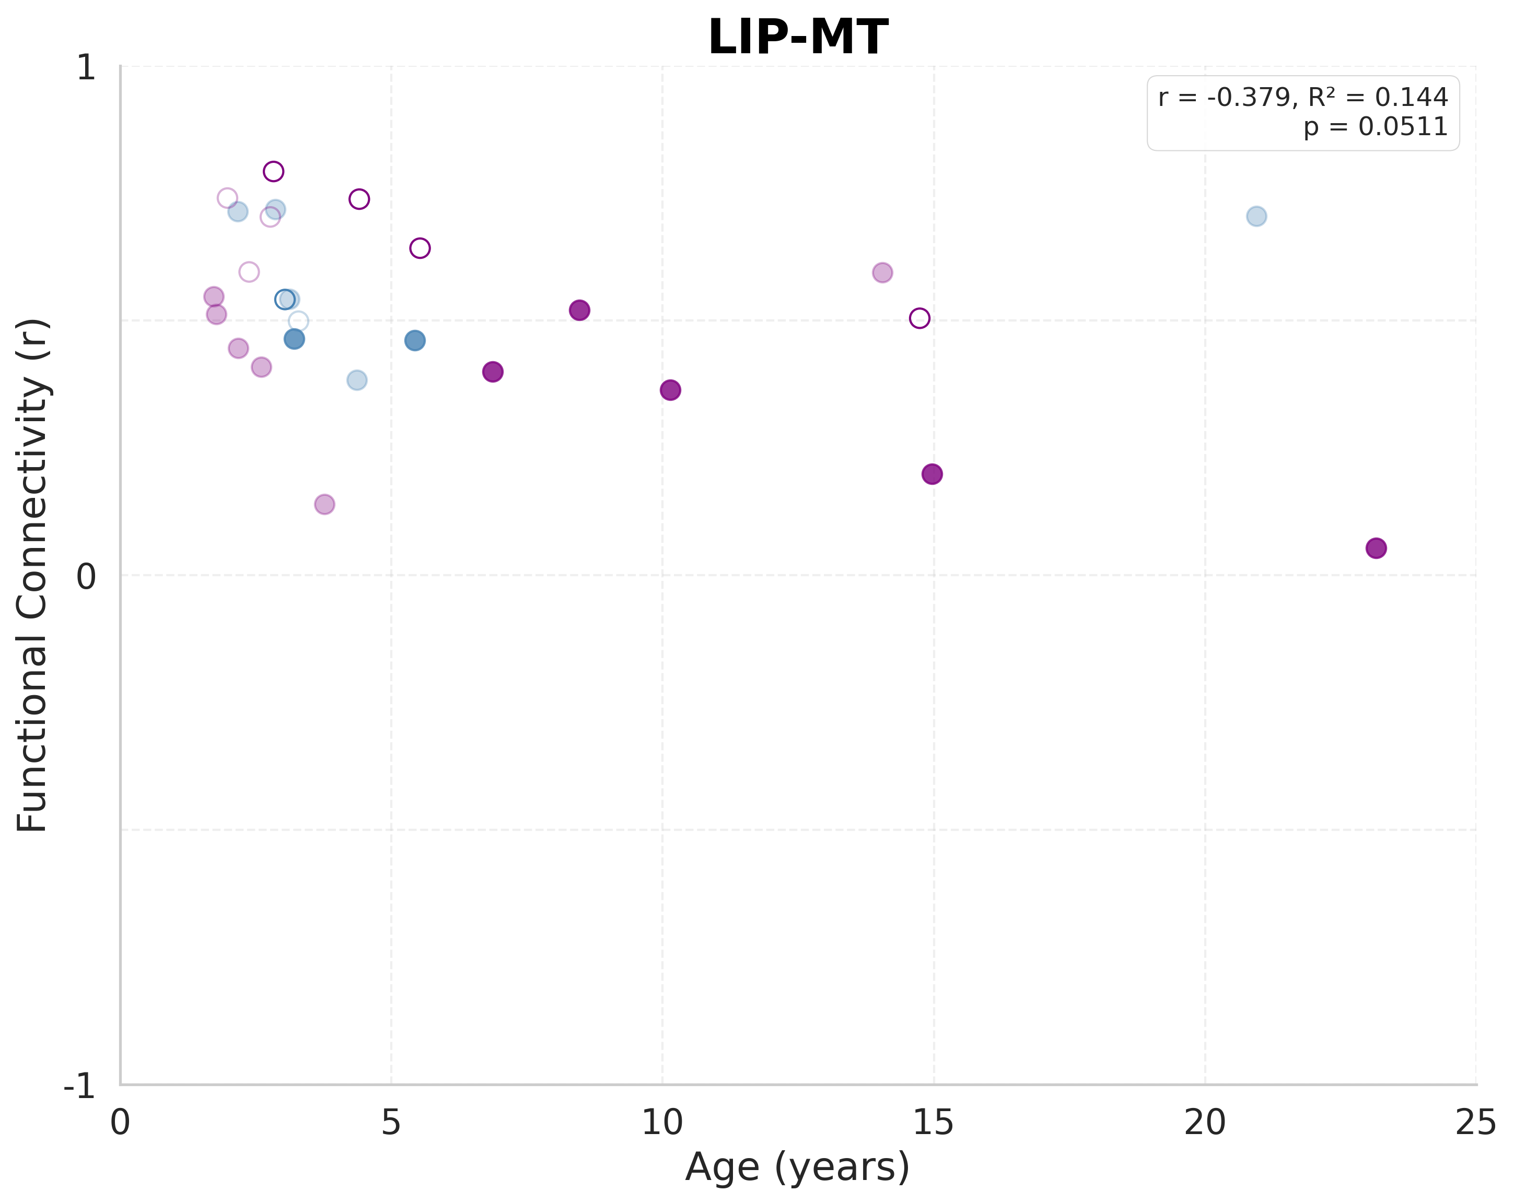
Resting-State Connectivity: LIP-MT
Notes:
LIP-MT
Sample size: n=27
(includes both behavioral and imaging-only subjects)
LINEAR MODEL:
R² = 0.1438
F(1, 25) = 4.1990
p-value = 0.051080
y = -0.0117x + 0.5904
AIC = -92.28
BIC = -89.69
QUADRATIC MODEL:
R² = 0.1441
F(2, 24) = 2.0207
p-value = 0.154507
y = 0.000099x² + -0.0139x + 0.5968
AIC = -90.29
BIC = -86.40
Likelihood ratio test vs. linear: p = 0.920665
Pattern: U-shaped (developmental valley)
MODEL SELECTION:
Best model (by AIC): LINEAR
Best model (by R²): QUADRATIC

Slide 3
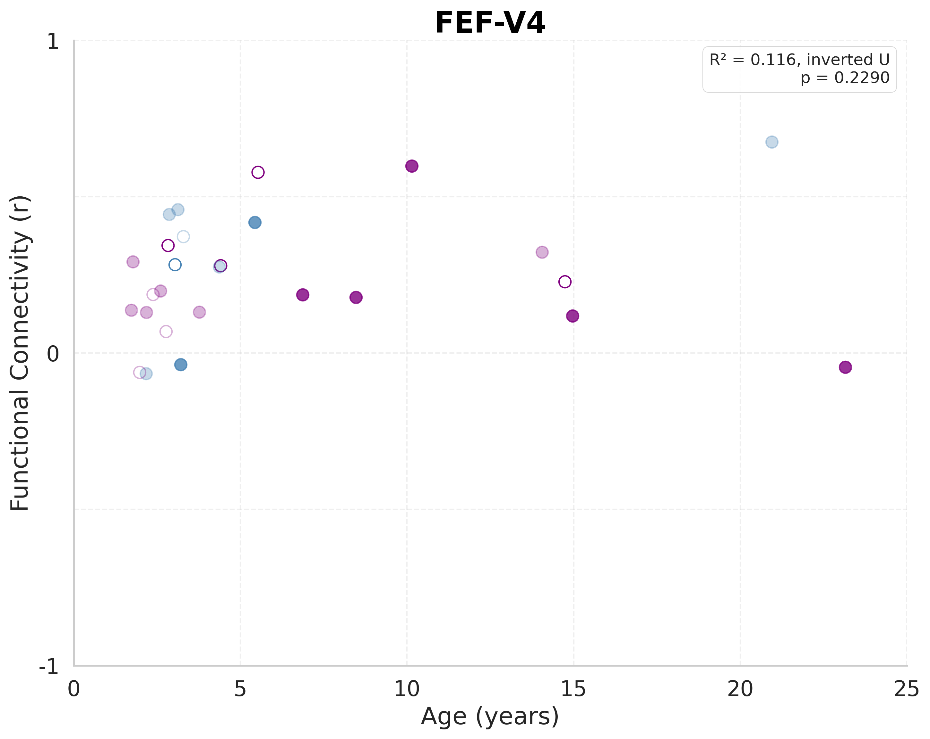
Resting-State Connectivity: FEF-V4
Notes:
FEF-V4
Sample size: n=27
(includes both behavioral and imaging-only subjects)
LINEAR MODEL:
R² = 0.0234
F(1, 25) = 0.5979
p-value = 0.446648
y = 0.0051x + 0.2155
AIC = -84.91
BIC = -82.31
QUADRATIC MODEL:
R² = 0.1156
F(2, 24) = 1.5686
p-value = 0.228963
y = -0.001813x² + 0.0449x + 0.0976
AIC = -85.58
BIC = -81.70
Likelihood ratio test vs. linear: p = 0.101689
Pattern: Inverted U-shaped (developmental peak)
MODEL SELECTION:
Best model (by AIC): QUADRATIC
Best model (by R²): QUADRATIC

Slide 4
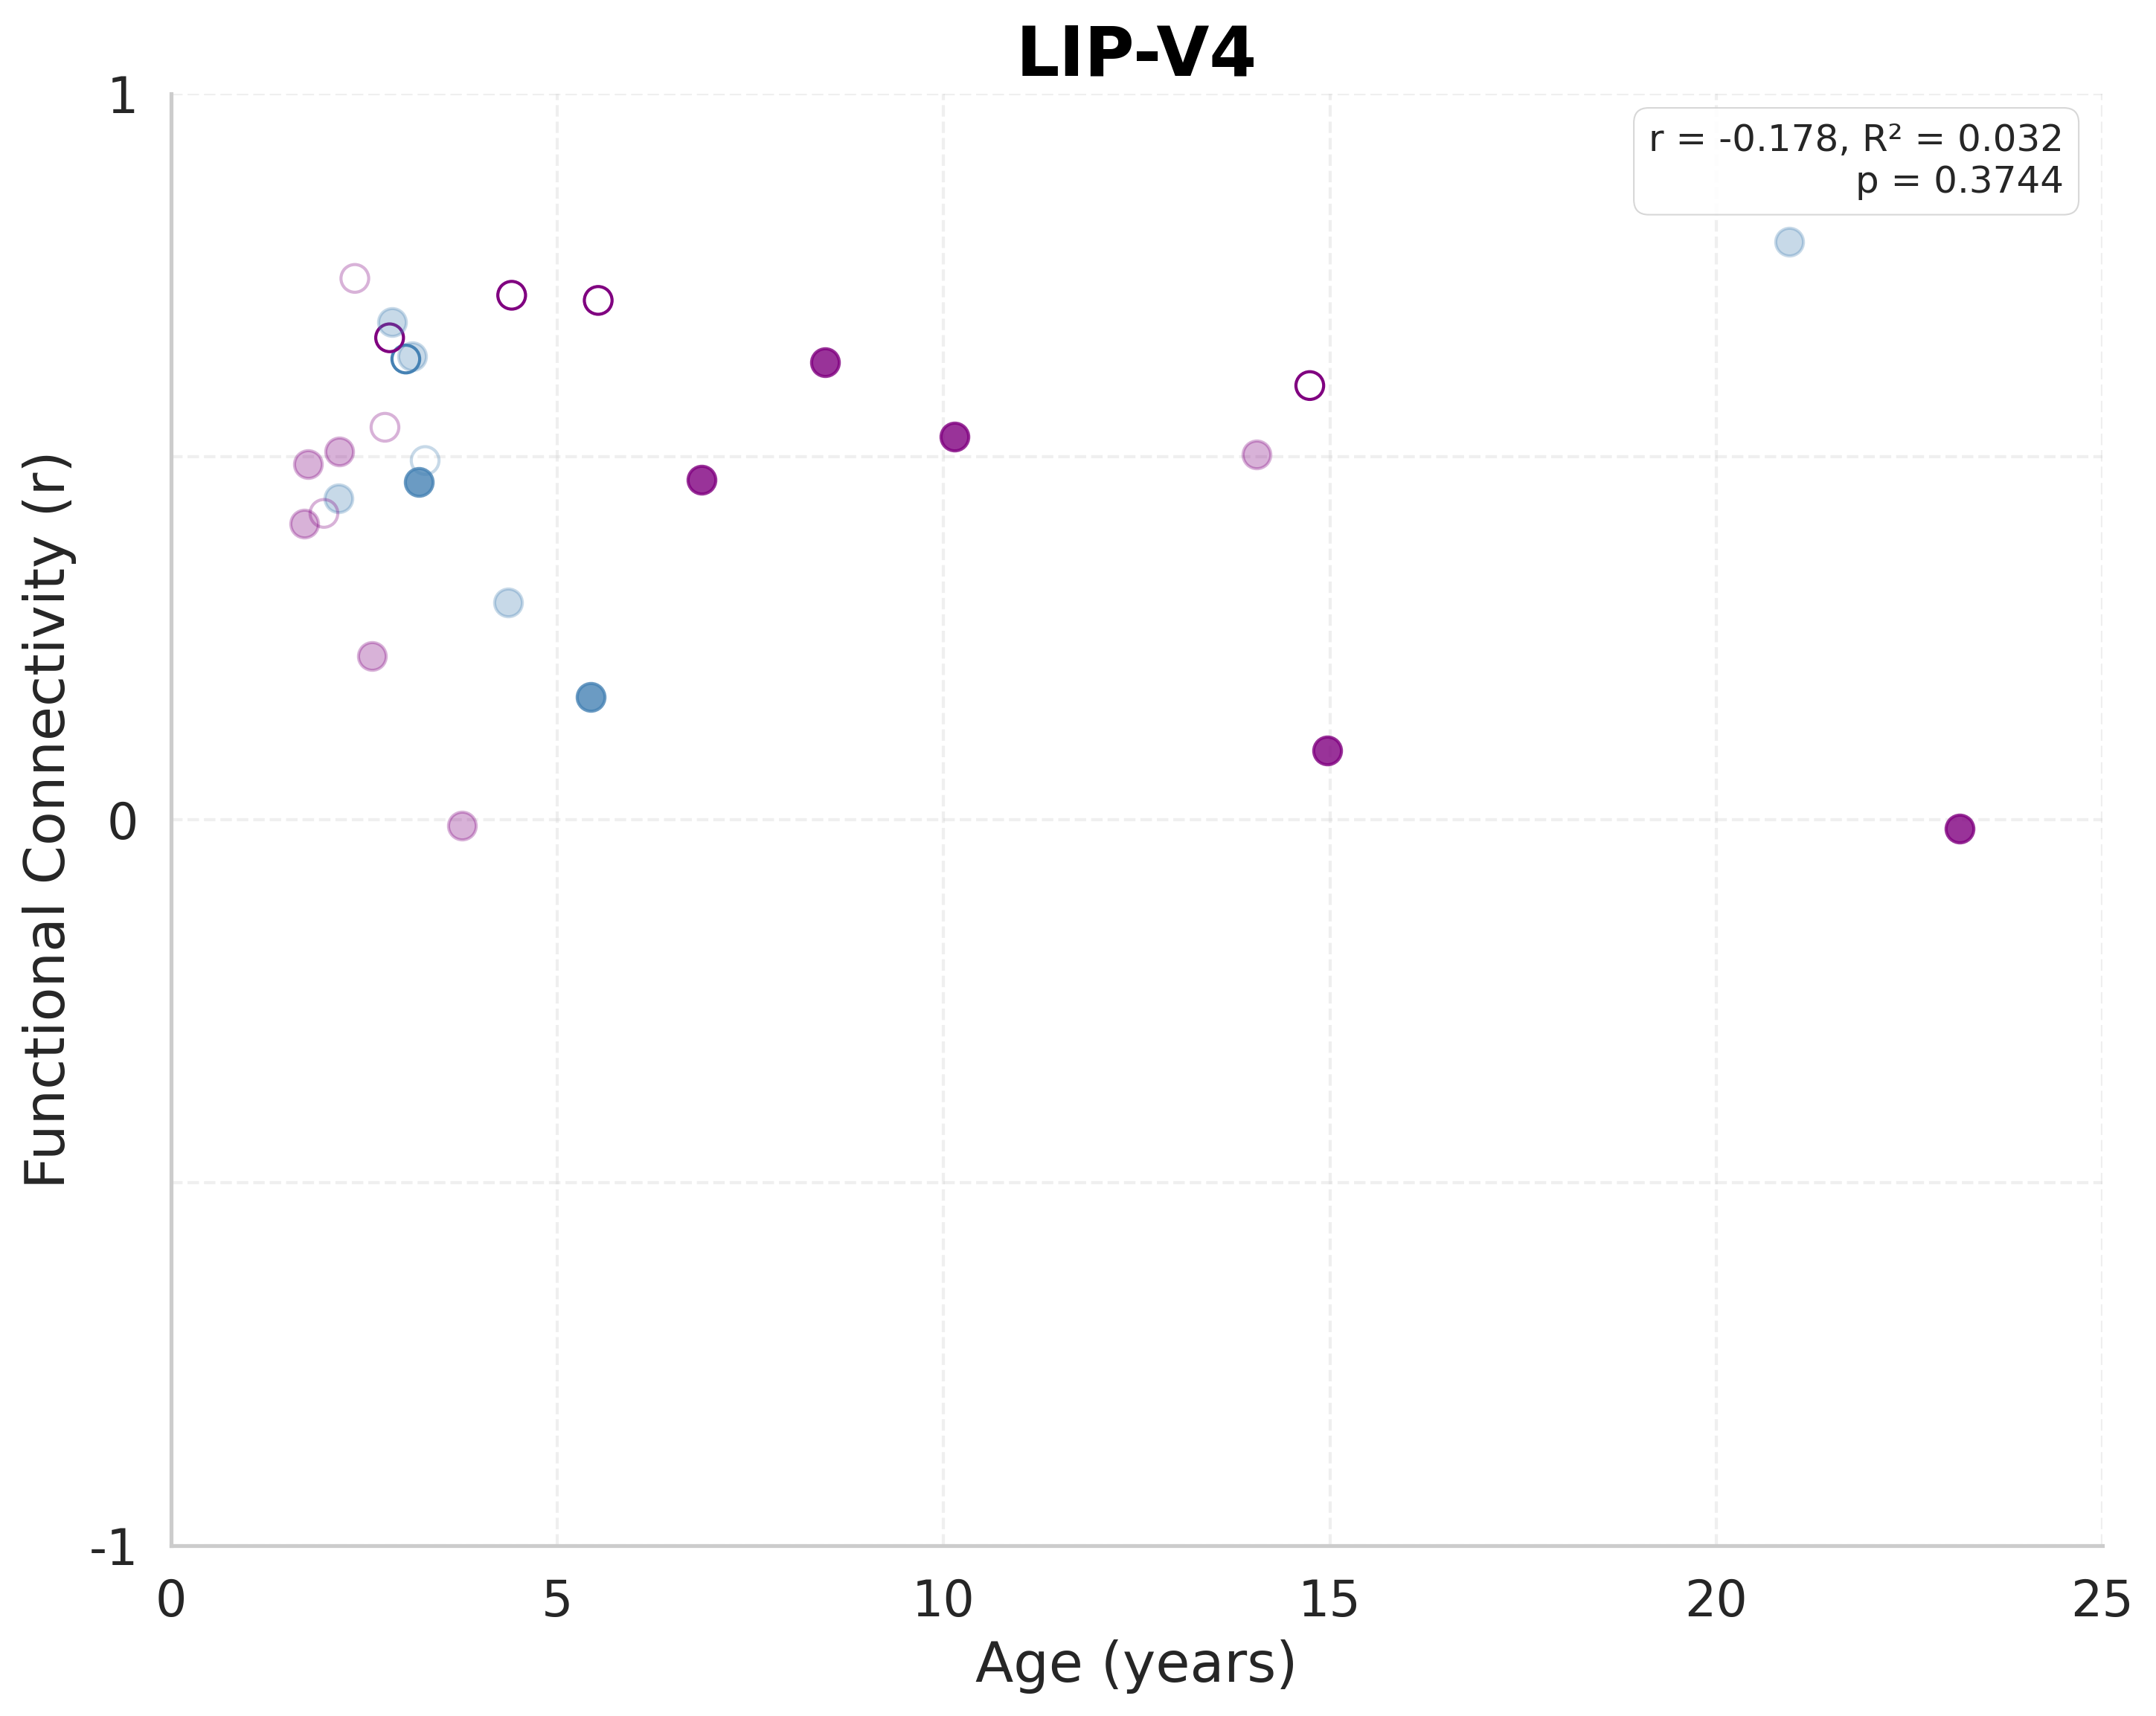
Resting-State Connectivity: LIP-V4
Notes:
LIP-V4
Sample size: n=27
(includes both behavioral and imaging-only subjects)
LINEAR MODEL:
R² = 0.0317
F(1, 25) = 0.8179
p-value = 0.374437
y = -0.0066x + 0.5186
AIC = -79.05
BIC = -76.46
QUADRATIC MODEL:
R² = 0.0482
F(2, 24) = 0.6077
p-value = 0.552766
y = -0.000859x² + 0.0123x + 0.4627
AIC = -77.52
BIC = -73.63
Likelihood ratio test vs. linear: p = 0.495440
Pattern: Inverted U-shaped (developmental peak)
MODEL SELECTION:
Best model (by AIC): LINEAR
Best model (by R²): QUADRATIC

Slide 5
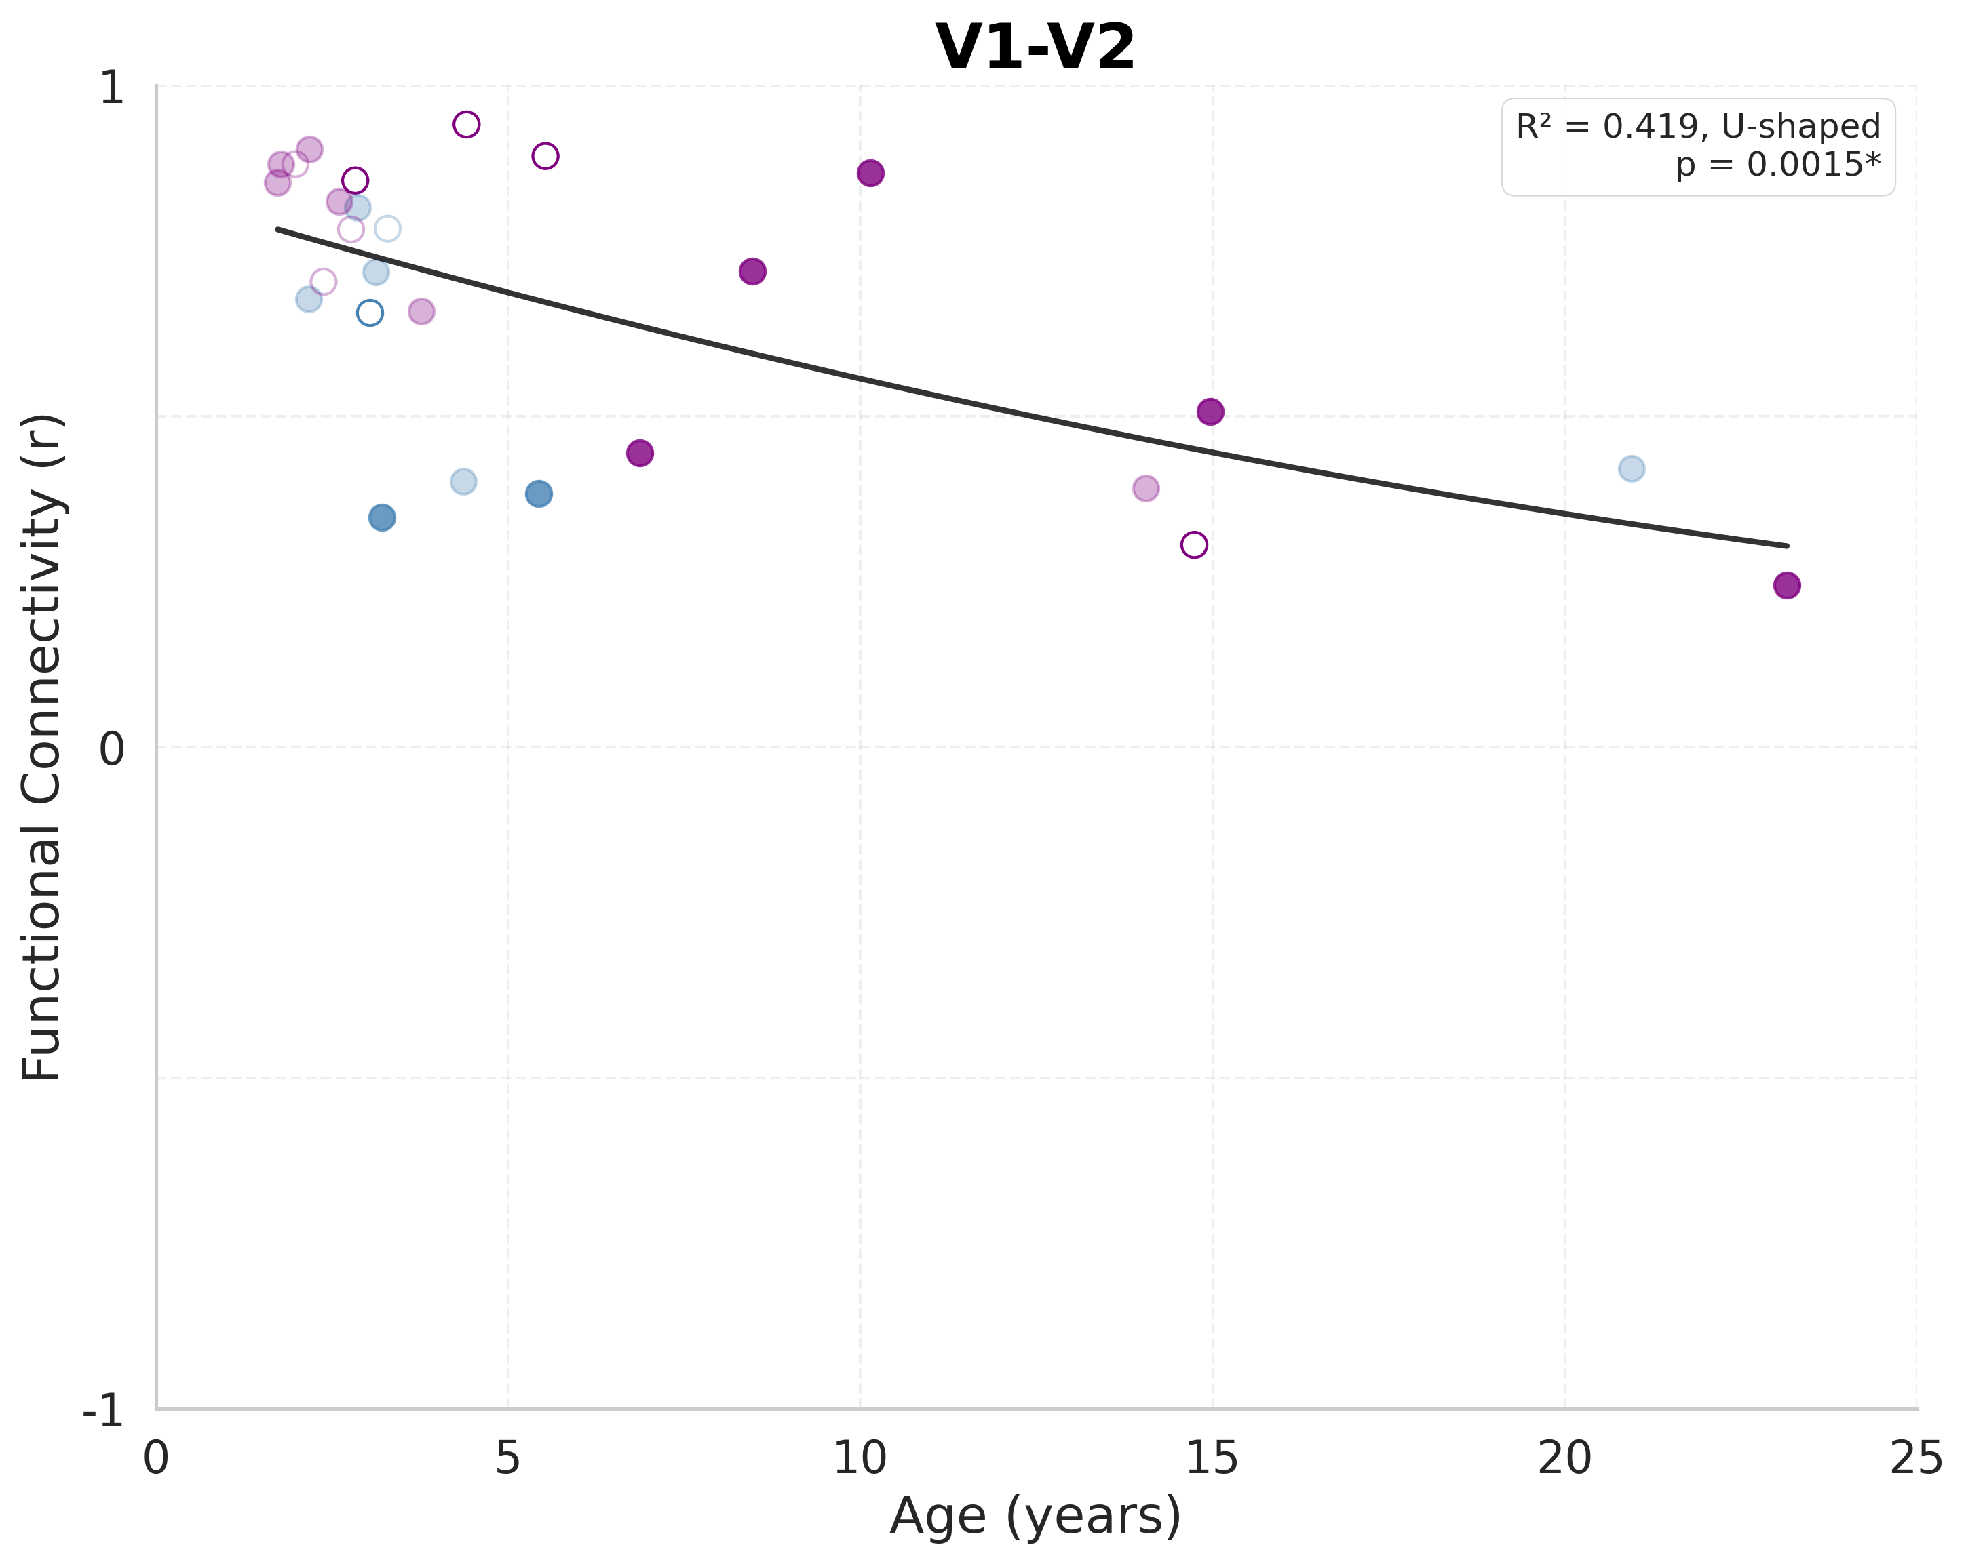
Resting-State Connectivity: V1-V2
Notes:
V1-V2
Sample size: n=27
(includes both behavioral and imaging-only subjects)
LINEAR MODEL:
R² = 0.4159
F(1, 25) = 17.8014
p-value = 0.000282 ***
y = -0.0234x + 0.8115
AIC = -93.74
BIC = -91.15
QUADRATIC MODEL:
R² = 0.4192
F(2, 24) = 8.6607
p-value = 0.001474 **
y = 0.000375x² + -0.0317x + 0.8359
AIC = -91.89
BIC = -88.00
Likelihood ratio test vs. linear: p = 0.696604
Pattern: U-shaped (developmental valley)
MODEL SELECTION:
Best significant model (by R²): QUADRATIC
Best model (by AIC): LINEAR
Best model (by R²): QUADRATIC

Slide 6
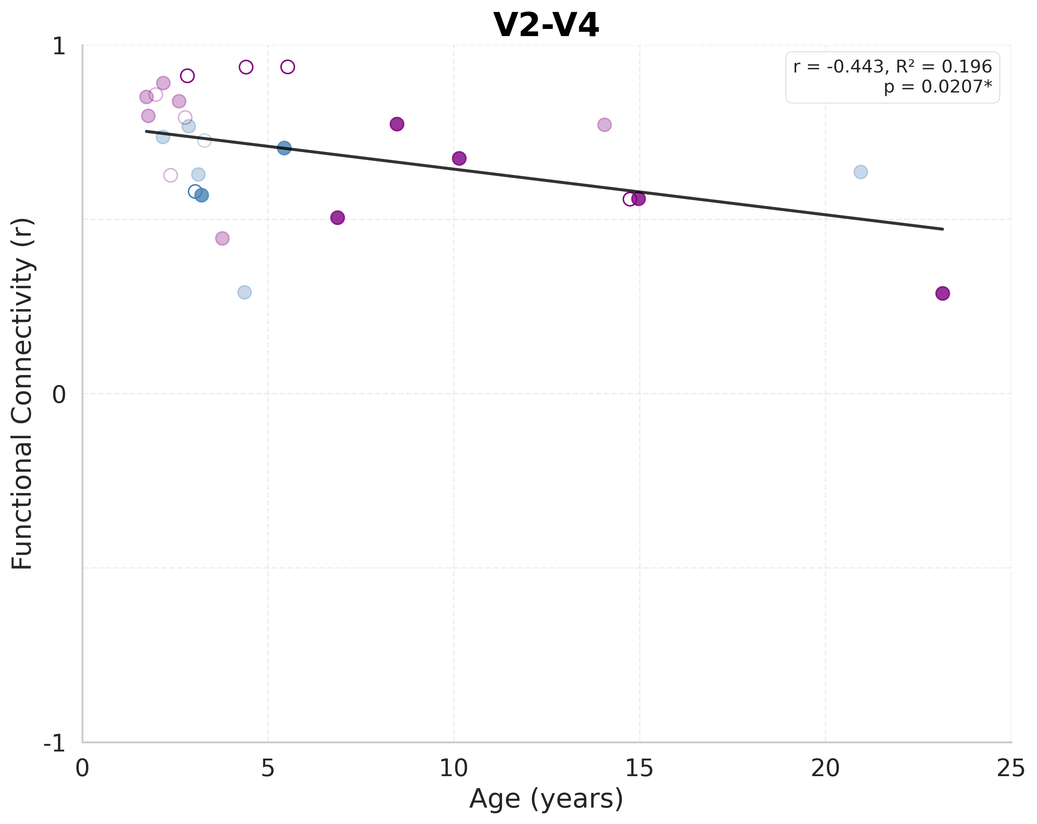
Resting-State Connectivity: V2-V4
Notes:
V2-V4
Sample size: n=27
(includes both behavioral and imaging-only subjects)
LINEAR MODEL:
R² = 0.1962
F(1, 25) = 6.1010
p-value = 0.020686 *
y = -0.0131x + 0.7747
AIC = -96.24
BIC = -93.65
QUADRATIC MODEL:
R² = 0.2015
F(2, 24) = 3.0274
p-value = 0.067229
y = -0.000388x² + -0.0046x + 0.7495
AIC = -94.42
BIC = -90.53
Likelihood ratio test vs. linear: p = 0.672796
Pattern: Inverted U-shaped (developmental peak)
MODEL SELECTION:
Best significant model (by R²): LINEAR
Best model (by AIC): LINEAR
Best model (by R²): QUADRATIC

Slide 7
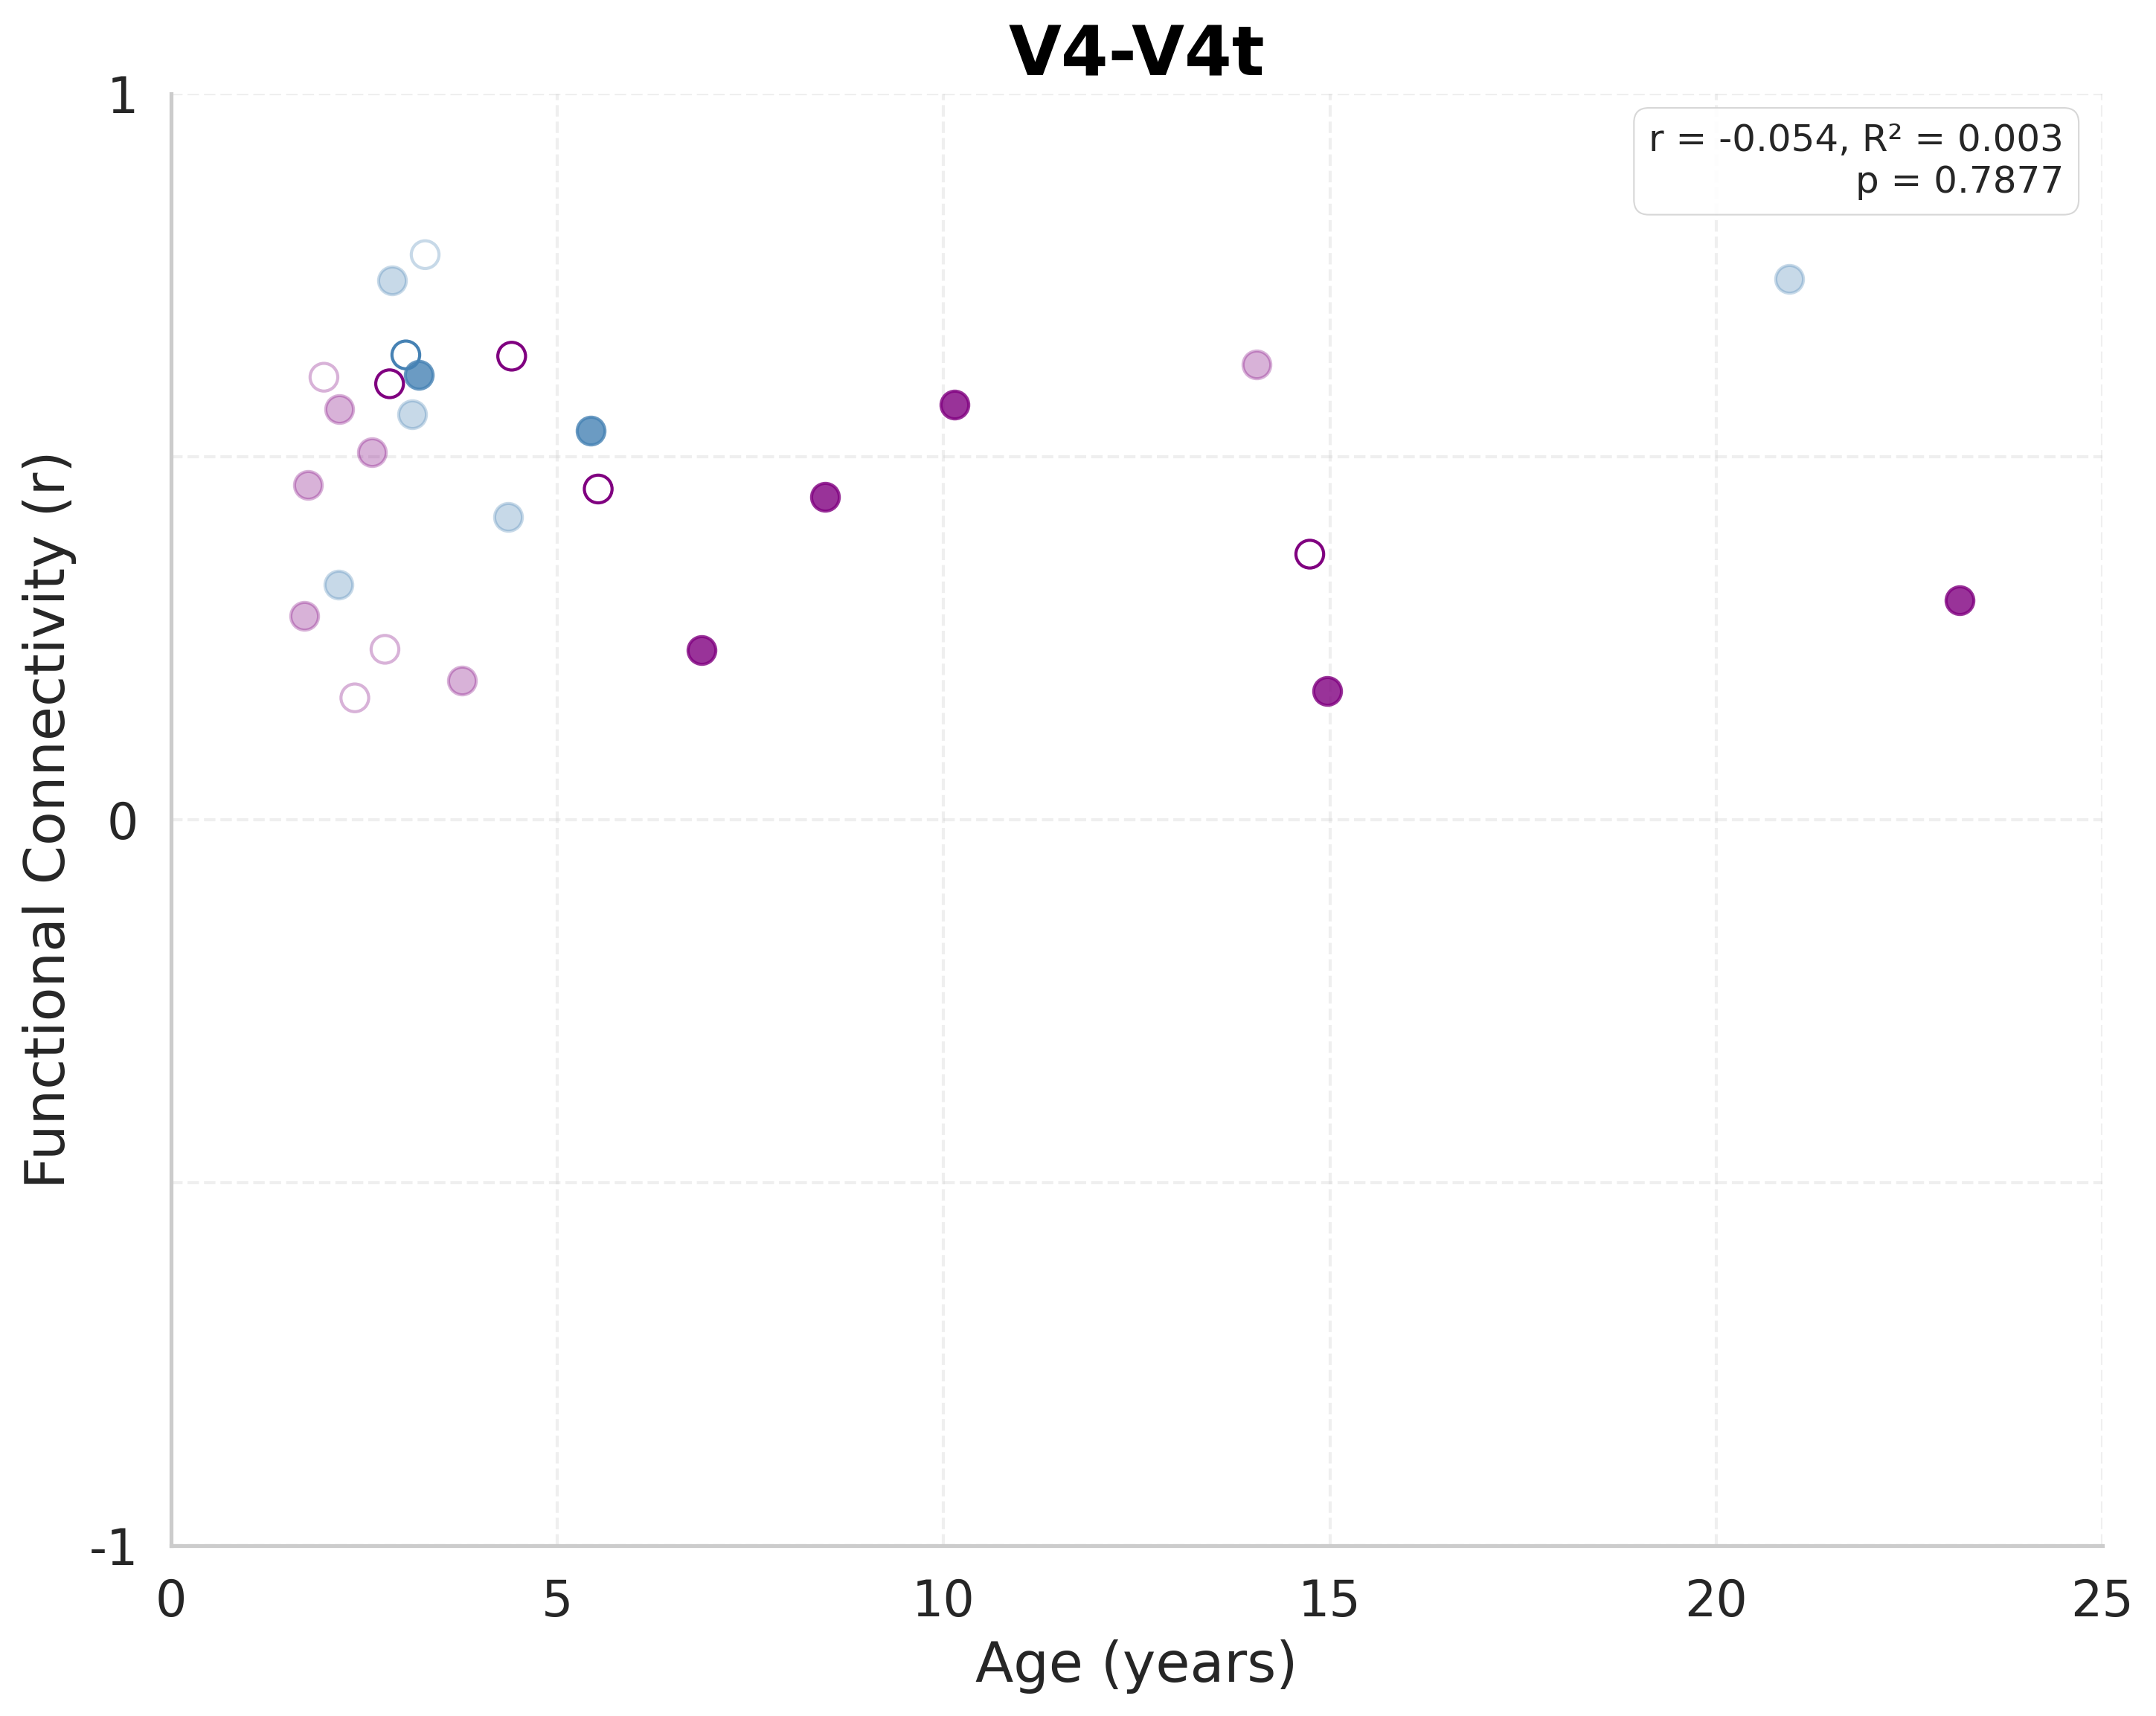
Resting-State Connectivity: V4-V4t
Notes:
V4-V4t
Sample size: n=27
(includes both behavioral and imaging-only subjects)
LINEAR MODEL:
R² = 0.0030
F(1, 25) = 0.0741
p-value = 0.787672
y = -0.0017x + 0.4842
AIC = -88.45
BIC = -85.86
QUADRATIC MODEL:
R² = 0.0039
F(2, 24) = 0.0471
p-value = 0.954126
y = 0.000170x² + -0.0054x + 0.4952
AIC = -86.48
BIC = -82.59
Likelihood ratio test vs. linear: p = 0.872552
Pattern: U-shaped (developmental valley)
MODEL SELECTION:
Best model (by AIC): LINEAR
Best model (by R²): QUADRATIC

Slide 8
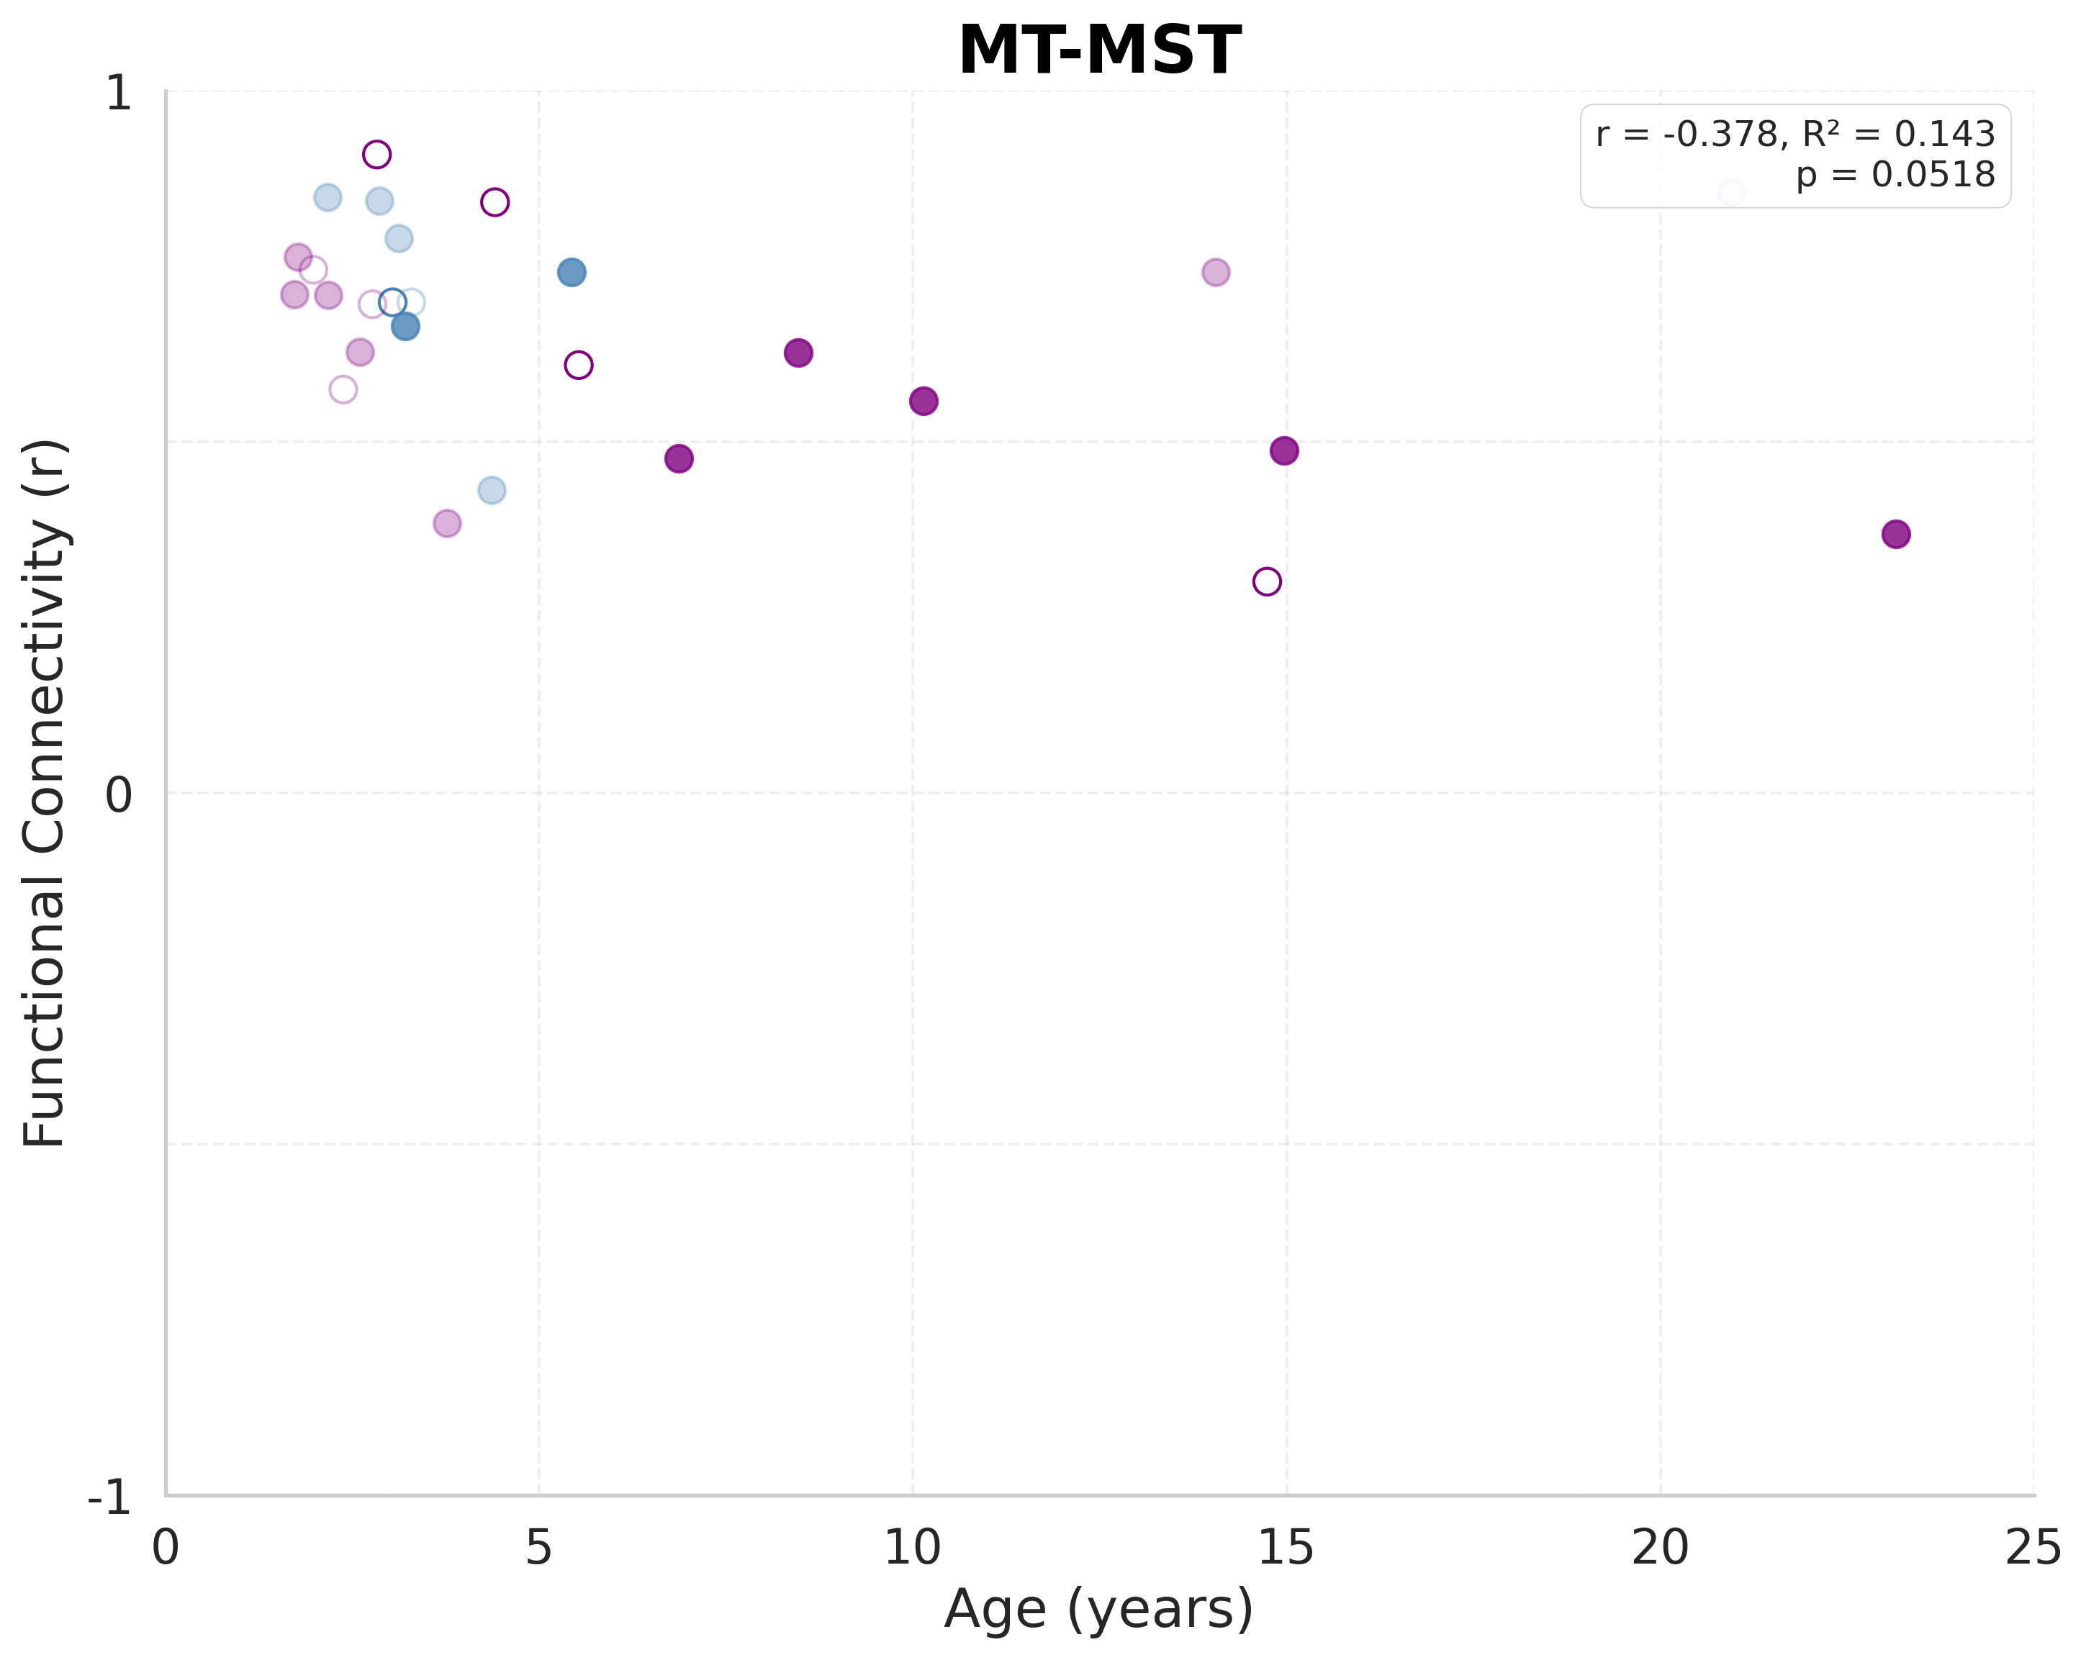
Resting-State Connectivity: MT-MST
Notes:
MT-MST
Sample size: n=27
(includes both behavioral and imaging-only subjects)
LINEAR MODEL:
R² = 0.1430
F(1, 25) = 4.1703
p-value = 0.051823
y = -0.0102x + 0.7211
AIC = -99.32
BIC = -96.73
QUADRATIC MODEL:
R² = 0.1919
F(2, 24) = 2.8490
p-value = 0.077590
y = 0.001079x² + -0.0340x + 0.7912
AIC = -98.91
BIC = -95.02
Likelihood ratio test vs. linear: p = 0.207850
Pattern: U-shaped (developmental valley)
MODEL SELECTION:
Best model (by AIC): LINEAR
Best model (by R²): QUADRATIC

Slide 9
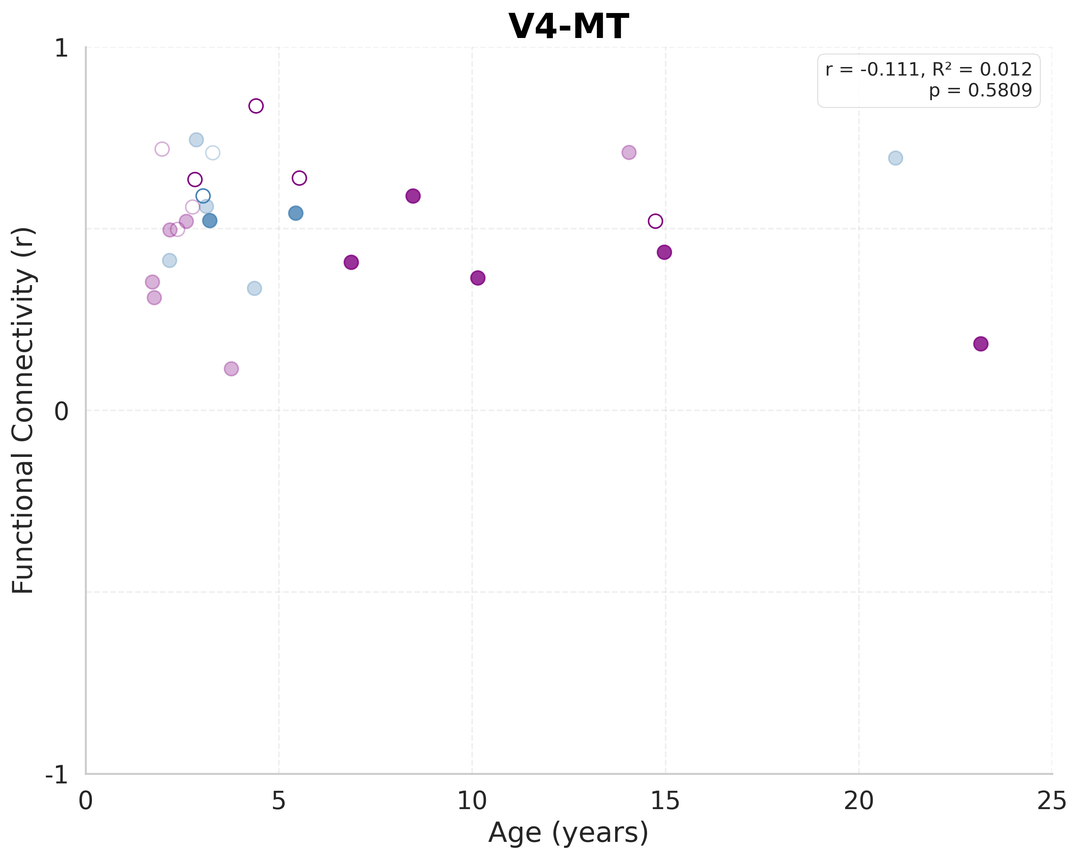
Resting-State Connectivity: V4-MT
Notes:
V4-MT
Sample size: n=27
(includes both behavioral and imaging-only subjects)
LINEAR MODEL:
R² = 0.0124
F(1, 25) = 0.3128
p-value = 0.580938
y = -0.0032x + 0.5392
AIC = -92.25
BIC = -89.66
QUADRATIC MODEL:
R² = 0.0456
F(2, 24) = 0.5729
p-value = 0.571437
y = -0.000944x² + 0.0176x + 0.4778
AIC = -91.17
BIC = -87.29
Likelihood ratio test vs. linear: p = 0.336593
Pattern: Inverted U-shaped (developmental peak)
MODEL SELECTION:
Best model (by AIC): LINEAR
Best model (by R²): QUADRATIC

Slide 10

Resting-State Connectivity: FEF-V1
Notes:
FEF-V1
Sample size: n=27
(includes both behavioral and imaging-only subjects)
LINEAR MODEL:
R² = 0.0308
F(1, 25) = 0.7953
p-value = 0.381013
y = -0.0056x + 0.1574
AIC = -86.63
BIC = -84.04
QUADRATIC MODEL:
R² = 0.0582
F(2, 24) = 0.7418
p-value = 0.486854
y = -0.000960x² + 0.0155x + 0.0949
AIC = -85.41
BIC = -81.52
Likelihood ratio test vs. linear: p = 0.378980
Pattern: Inverted U-shaped (developmental peak)
MODEL SELECTION:
Best model (by AIC): LINEAR
Best model (by R²): QUADRATIC

Slide 11
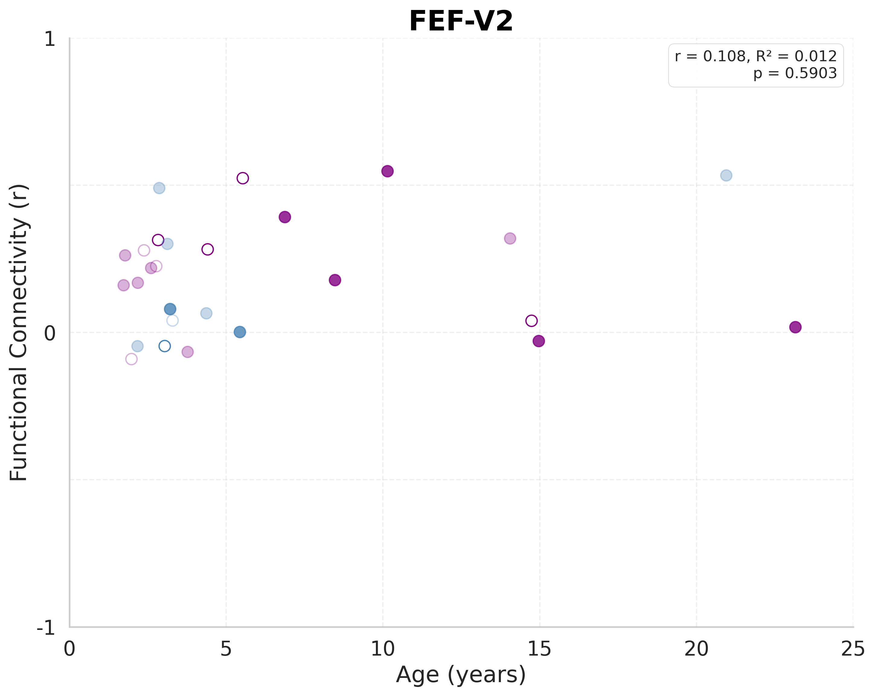
Resting-State Connectivity: FEF-V2
Notes:
FEF-V2
Sample size: n=27
(includes both behavioral and imaging-only subjects)
LINEAR MODEL:
R² = 0.0118
F(1, 25) = 0.2974
p-value = 0.590336
y = 0.0035x + 0.1686
AIC = -85.29
BIC = -82.70
QUADRATIC MODEL:
R² = 0.0398
F(2, 24) = 0.4972
p-value = 0.614336
y = -0.000986x² + 0.0252x + 0.1044
AIC = -84.07
BIC = -80.18
Likelihood ratio test vs. linear: p = 0.378088
Pattern: Inverted U-shaped (developmental peak)
MODEL SELECTION:
Best model (by AIC): LINEAR
Best model (by R²): QUADRATIC

Slide 12
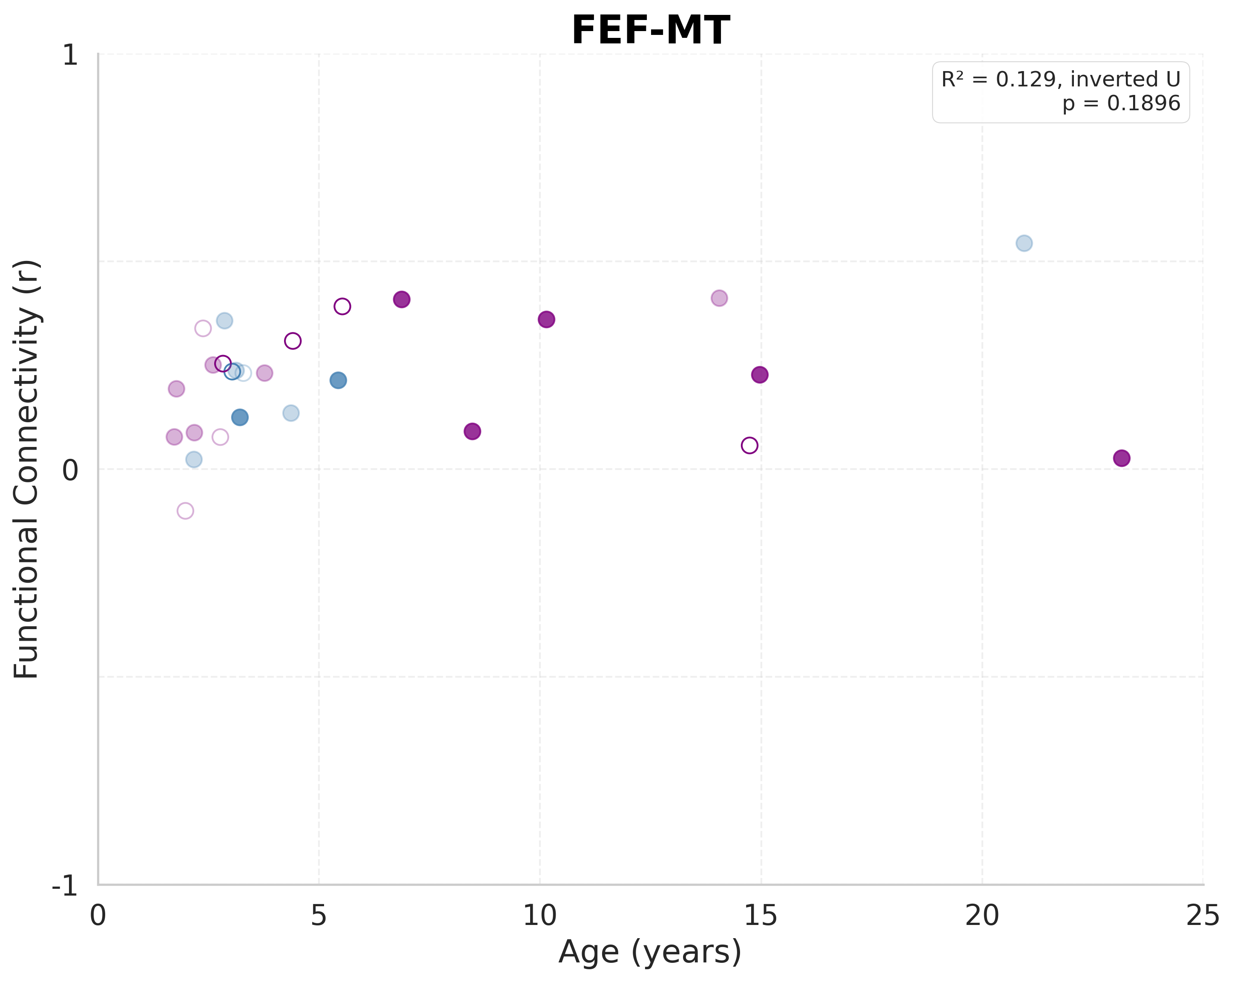
Resting-State Connectivity: FEF-MT
Notes:
FEF-MT
Sample size: n=27
(includes both behavioral and imaging-only subjects)
LINEAR MODEL:
R² = 0.0446
F(1, 25) = 1.1664
p-value = 0.290447
y = 0.0052x + 0.1814
AIC = -101.55
BIC = -98.96
QUADRATIC MODEL:
R² = 0.1294
F(2, 24) = 1.7838
p-value = 0.189564
y = -0.001291x² + 0.0336x + 0.0974
AIC = -102.06
BIC = -98.18
Likelihood ratio test vs. linear: p = 0.113084
Pattern: Inverted U-shaped (developmental peak)
MODEL SELECTION:
Best model (by AIC): QUADRATIC
Best model (by R²): QUADRATIC

Slide 13
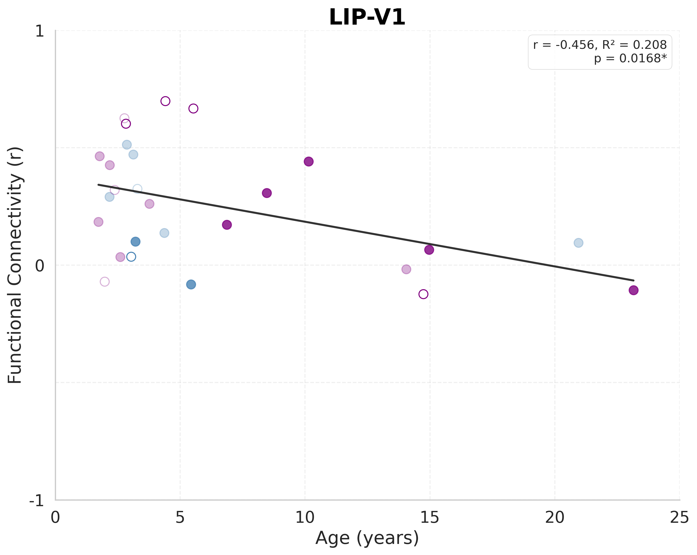
Resting-State Connectivity: LIP-V1
Notes:
LIP-V1
Sample size: n=27
(includes both behavioral and imaging-only subjects)
LINEAR MODEL:
R² = 0.2080
F(1, 25) = 6.5656
p-value = 0.016805 *
y = -0.0190x + 0.3749
AIC = -78.01
BIC = -75.42
QUADRATIC MODEL:
R² = 0.2110
F(2, 24) = 3.2084
p-value = 0.058233
y = -0.000410x² + -0.0100x + 0.3483
AIC = -76.11
BIC = -72.23
Likelihood ratio test vs. linear: p = 0.750341
Pattern: Inverted U-shaped (developmental peak)
MODEL SELECTION:
Best significant model (by R²): LINEAR
Best model (by AIC): LINEAR
Best model (by R²): QUADRATIC

Slide 14
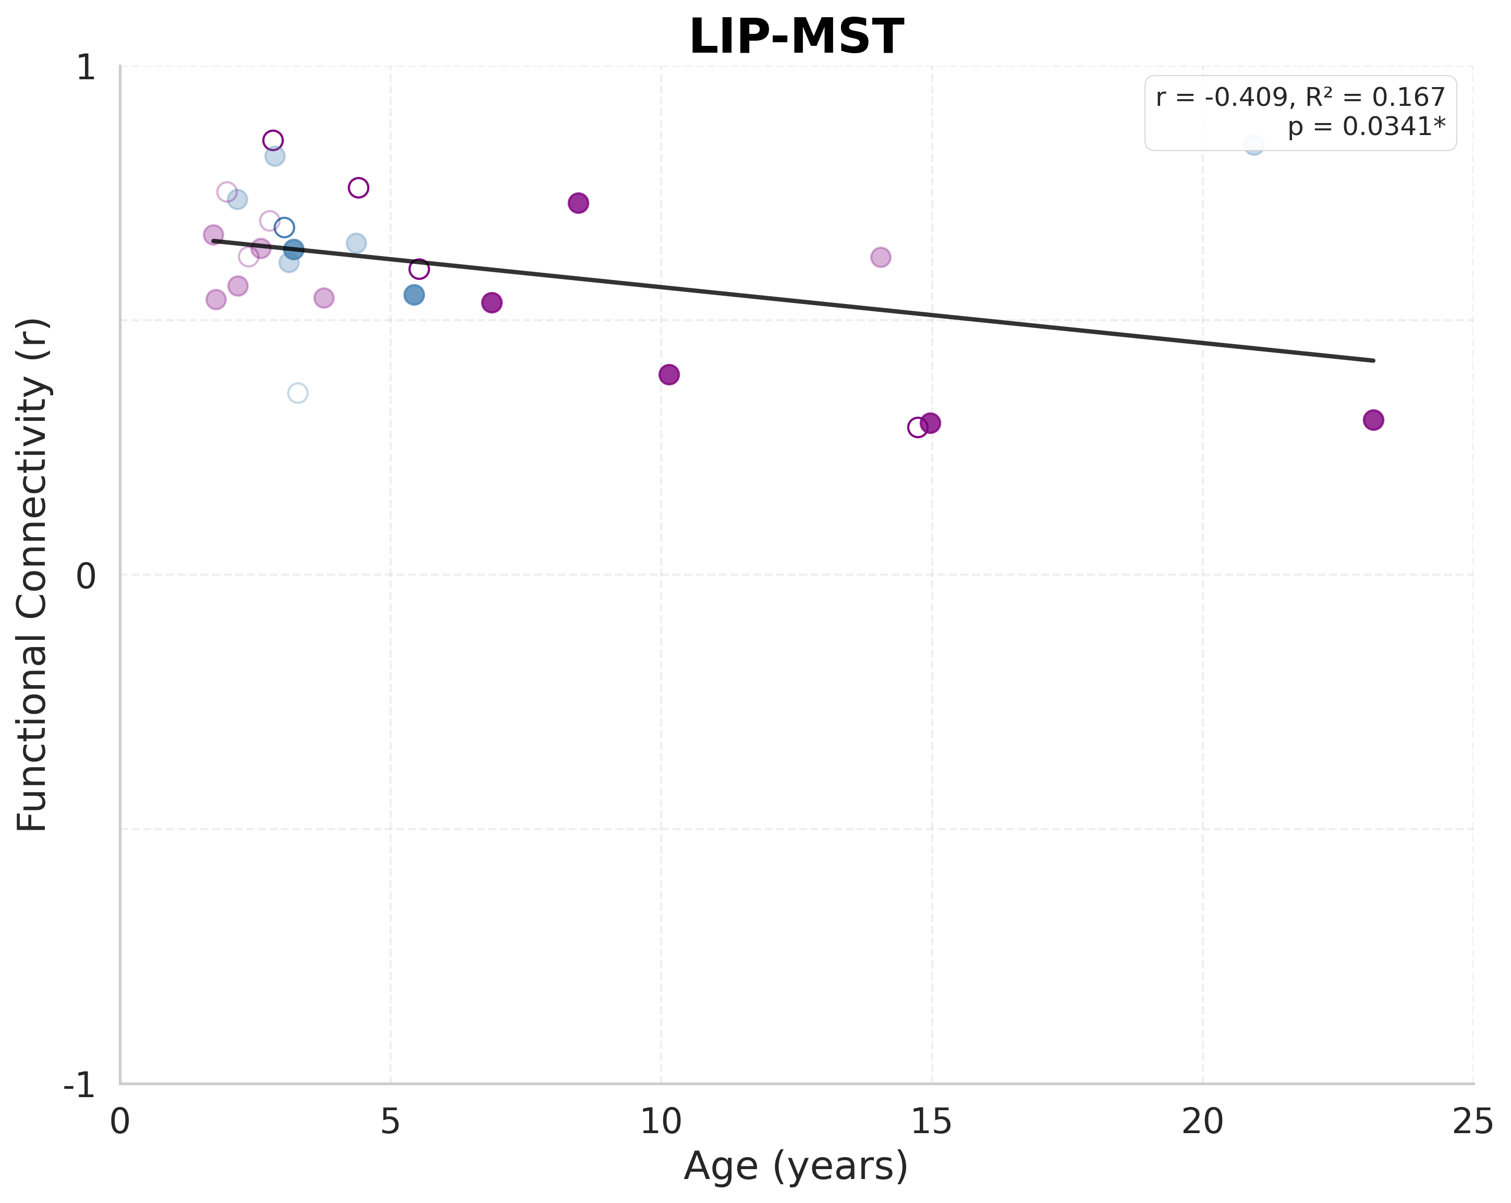
Resting-State Connectivity: LIP-MST
Notes:
LIP-MST
Sample size: n=27
(includes both behavioral and imaging-only subjects)
LINEAR MODEL:
R² = 0.1673
F(1, 25) = 5.0222
p-value = 0.034147 *
y = -0.0110x + 0.6746
AIC = -100.49
BIC = -97.90
QUADRATIC MODEL:
R² = 0.2060
F(2, 24) = 3.1131
p-value = 0.062794
y = 0.000953x² + -0.0319x + 0.7366
AIC = -99.78
BIC = -95.89
Likelihood ratio test vs. linear: p = 0.256951
Pattern: U-shaped (developmental valley)
MODEL SELECTION:
Best significant model (by R²): LINEAR
Best model (by AIC): LINEAR
Best model (by R²): QUADRATIC

Slide 15
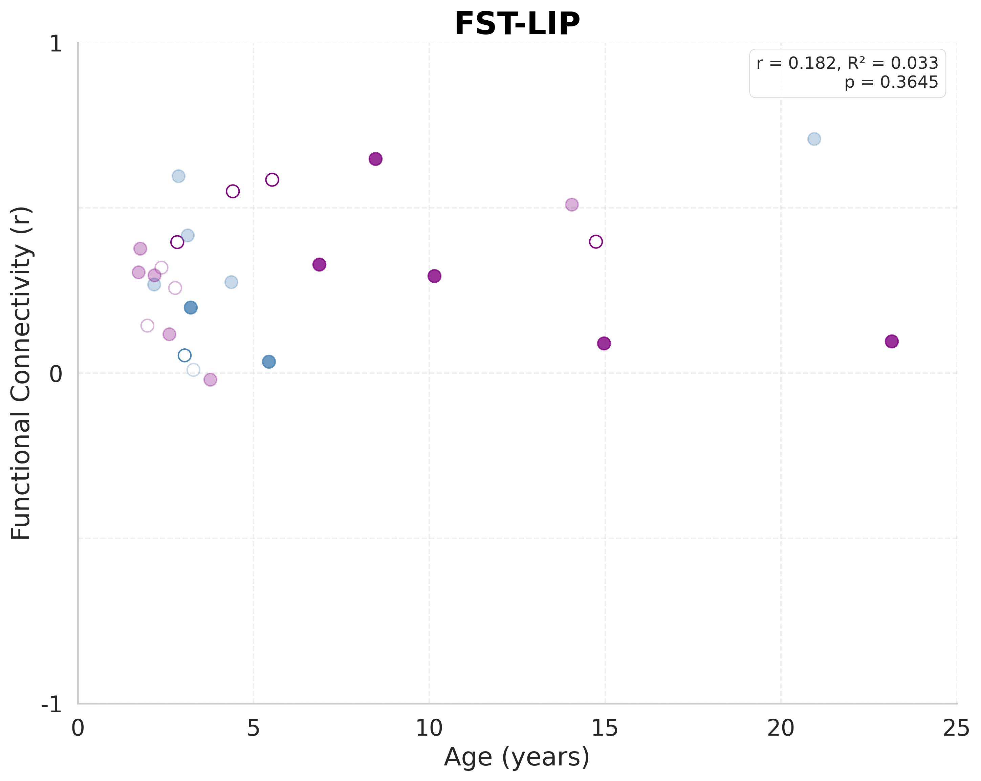
Resting-State Connectivity: FST-LIP
Notes:
FST-LIP
Sample size: n=27
(includes both behavioral and imaging-only subjects)
LINEAR MODEL:
R² = 0.0330
F(1, 25) = 0.8531
p-value = 0.364503
y = 0.0062x + 0.2664
AIC = -83.88
BIC = -81.29
QUADRATIC MODEL:
R² = 0.0633
F(2, 24) = 0.8113
p-value = 0.456094
y = -0.001064x² + 0.0296x + 0.1971
AIC = -82.74
BIC = -78.86
Likelihood ratio test vs. linear: p = 0.353631
Pattern: Inverted U-shaped (developmental peak)
MODEL SELECTION:
Best model (by AIC): LINEAR
Best model (by R²): QUADRATIC

Slide 16
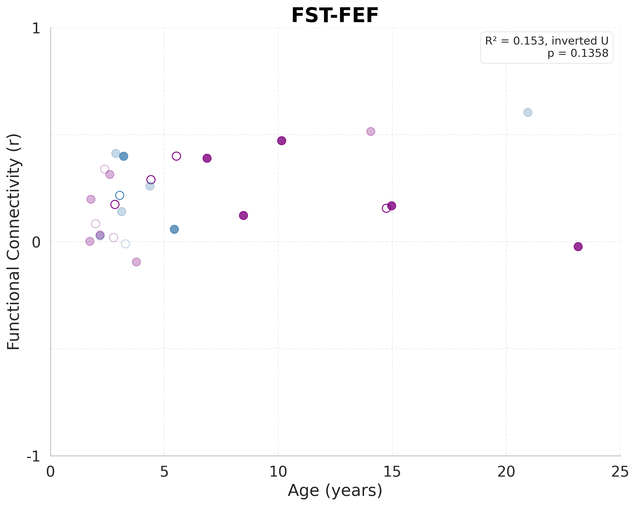
Resting-State Connectivity: FST-FEF
Notes:
FST-FEF
Sample size: n=27
(includes both behavioral and imaging-only subjects)
LINEAR MODEL:
R² = 0.0642
F(1, 25) = 1.7161
p-value = 0.202102
y = 0.0078x + 0.1597
AIC = -89.70
BIC = -87.11
QUADRATIC MODEL:
R² = 0.1533
F(2, 24) = 2.1725
p-value = 0.135779
y = -0.001665x² + 0.0445x + 0.0514
AIC = -90.40
BIC = -86.51
Likelihood ratio test vs. linear: p = 0.100345
Pattern: Inverted U-shaped (developmental peak)
MODEL SELECTION:
Best model (by AIC): QUADRATIC
Best model (by R²): QUADRATIC

Slide 17
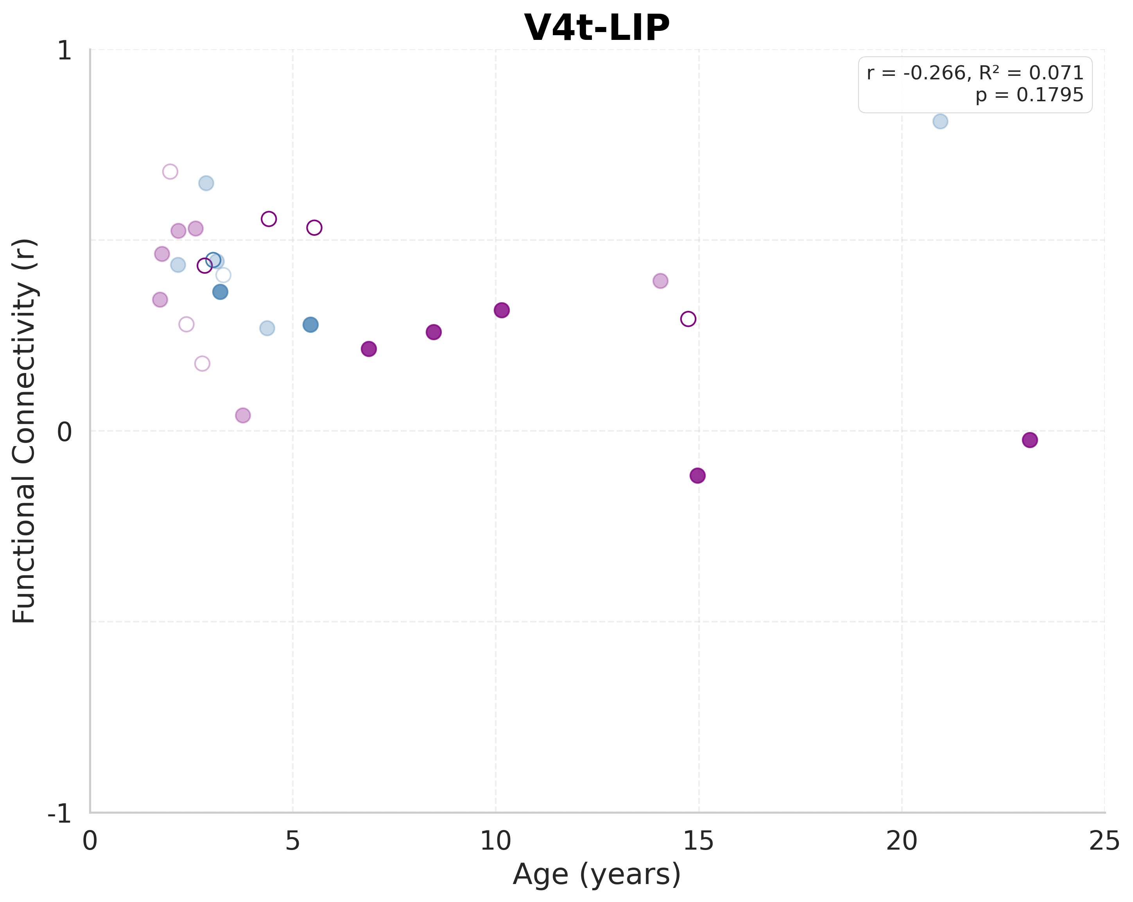
Resting-State Connectivity: V4t-LIP
Notes:
V4t-LIP
Sample size: n=27
(includes both behavioral and imaging-only subjects)
LINEAR MODEL:
R² = 0.0709
F(1, 25) = 1.9072
p-value = 0.179492
y = -0.0092x + 0.4295
AIC = -83.87
BIC = -81.28
QUADRATIC MODEL:
R² = 0.1086
F(2, 24) = 1.4613
p-value = 0.251854
y = 0.001210x² + -0.0358x + 0.5082
AIC = -82.99
BIC = -79.10
Likelihood ratio test vs. linear: p = 0.290454
Pattern: U-shaped (developmental valley)
MODEL SELECTION:
Best model (by AIC): LINEAR
Best model (by R²): QUADRATIC

Slide 18
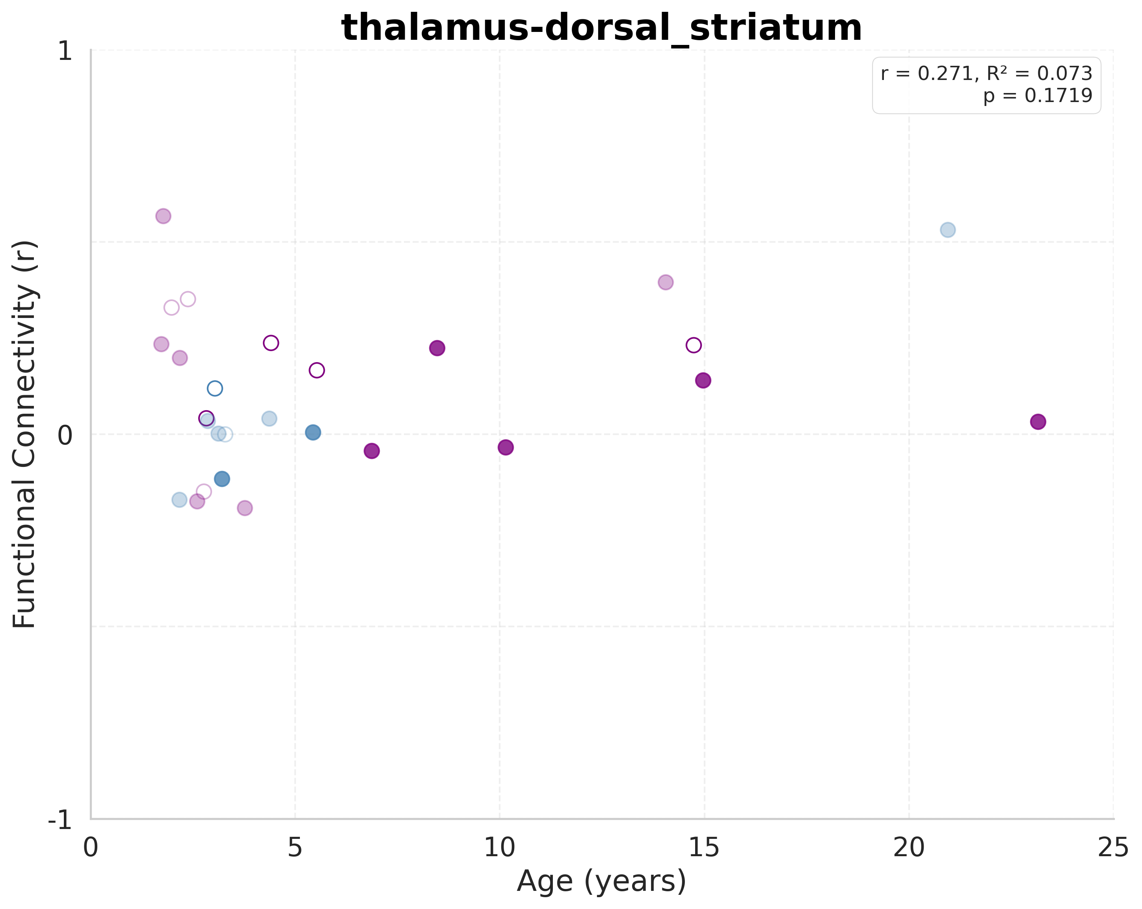
Resting-State Connectivity: thalamus-dorsal_striatum
Notes:
thalamus-dorsal_striatum
Sample size: n=27
(includes both behavioral and imaging-only subjects)
LINEAR MODEL:
R² = 0.0733
F(1, 25) = 1.9783
p-value = 0.171880
y = 0.0093x + 0.0514
AIC = -84.08
BIC = -81.48
QUADRATIC MODEL:
R² = 0.0788
F(2, 24) = 1.0272
p-value = 0.373226
y = 0.000462x² + -0.0008x + 0.0815
AIC = -82.24
BIC = -78.35
Likelihood ratio test vs. linear: p = 0.687956
Pattern: U-shaped (developmental valley)
MODEL SELECTION:
Best model (by AIC): LINEAR
Best model (by R²): QUADRATIC

Slide 19
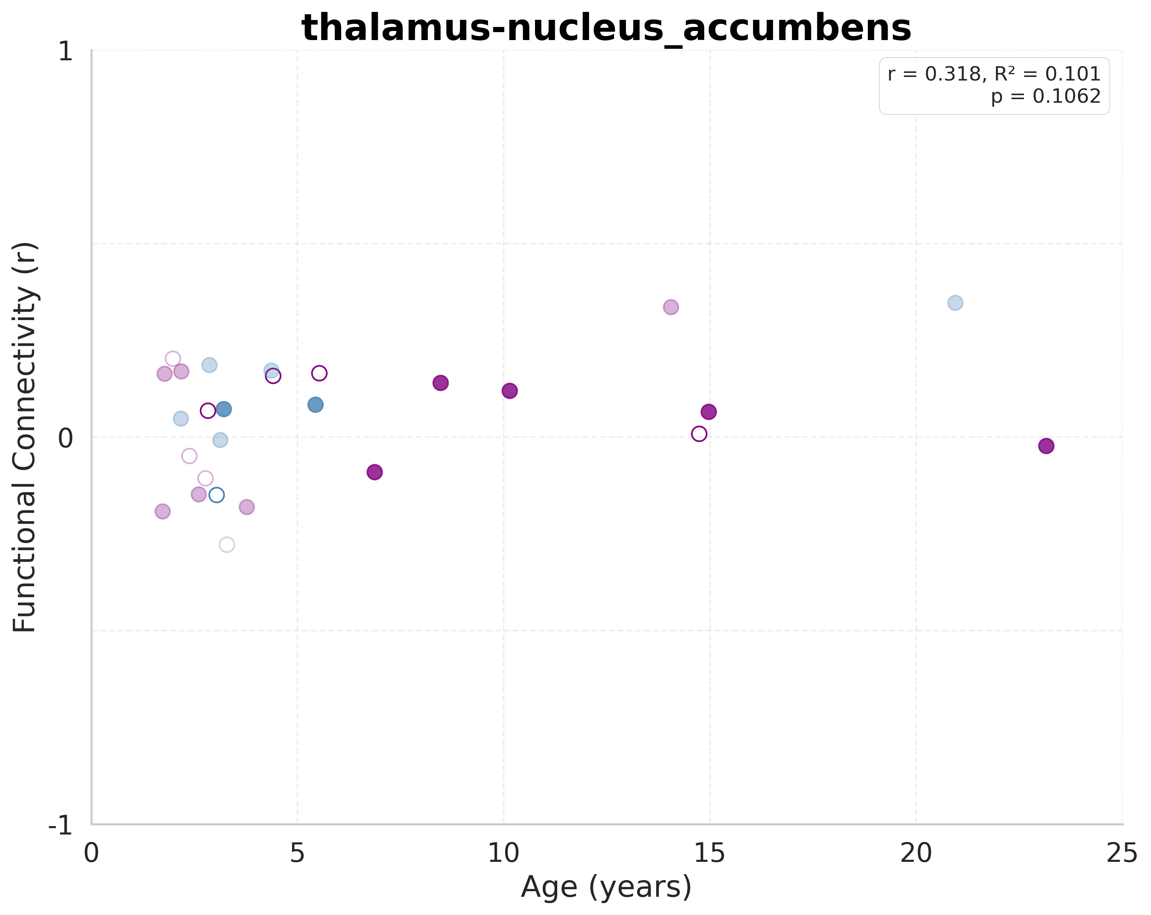
Resting-State Connectivity: thalamus-nucleus_accumbens
Notes:
thalamus-nucleus_accumbens
Sample size: n=27
(includes both behavioral and imaging-only subjects)
LINEAR MODEL:
R² = 0.1010
F(1, 25) = 2.8095
p-value = 0.106171
y = 0.0084x + -0.0063
AIC = -99.22
BIC = -96.62
QUADRATIC MODEL:
R² = 0.1221
F(2, 24) = 1.6695
p-value = 0.209481
y = -0.000693x² + 0.0237x + -0.0514
AIC = -97.86
BIC = -93.97
Likelihood ratio test vs. linear: p = 0.423175
Pattern: Inverted U-shaped (developmental peak)
MODEL SELECTION:
Best model (by AIC): LINEAR
Best model (by R²): QUADRATIC

Slide 20
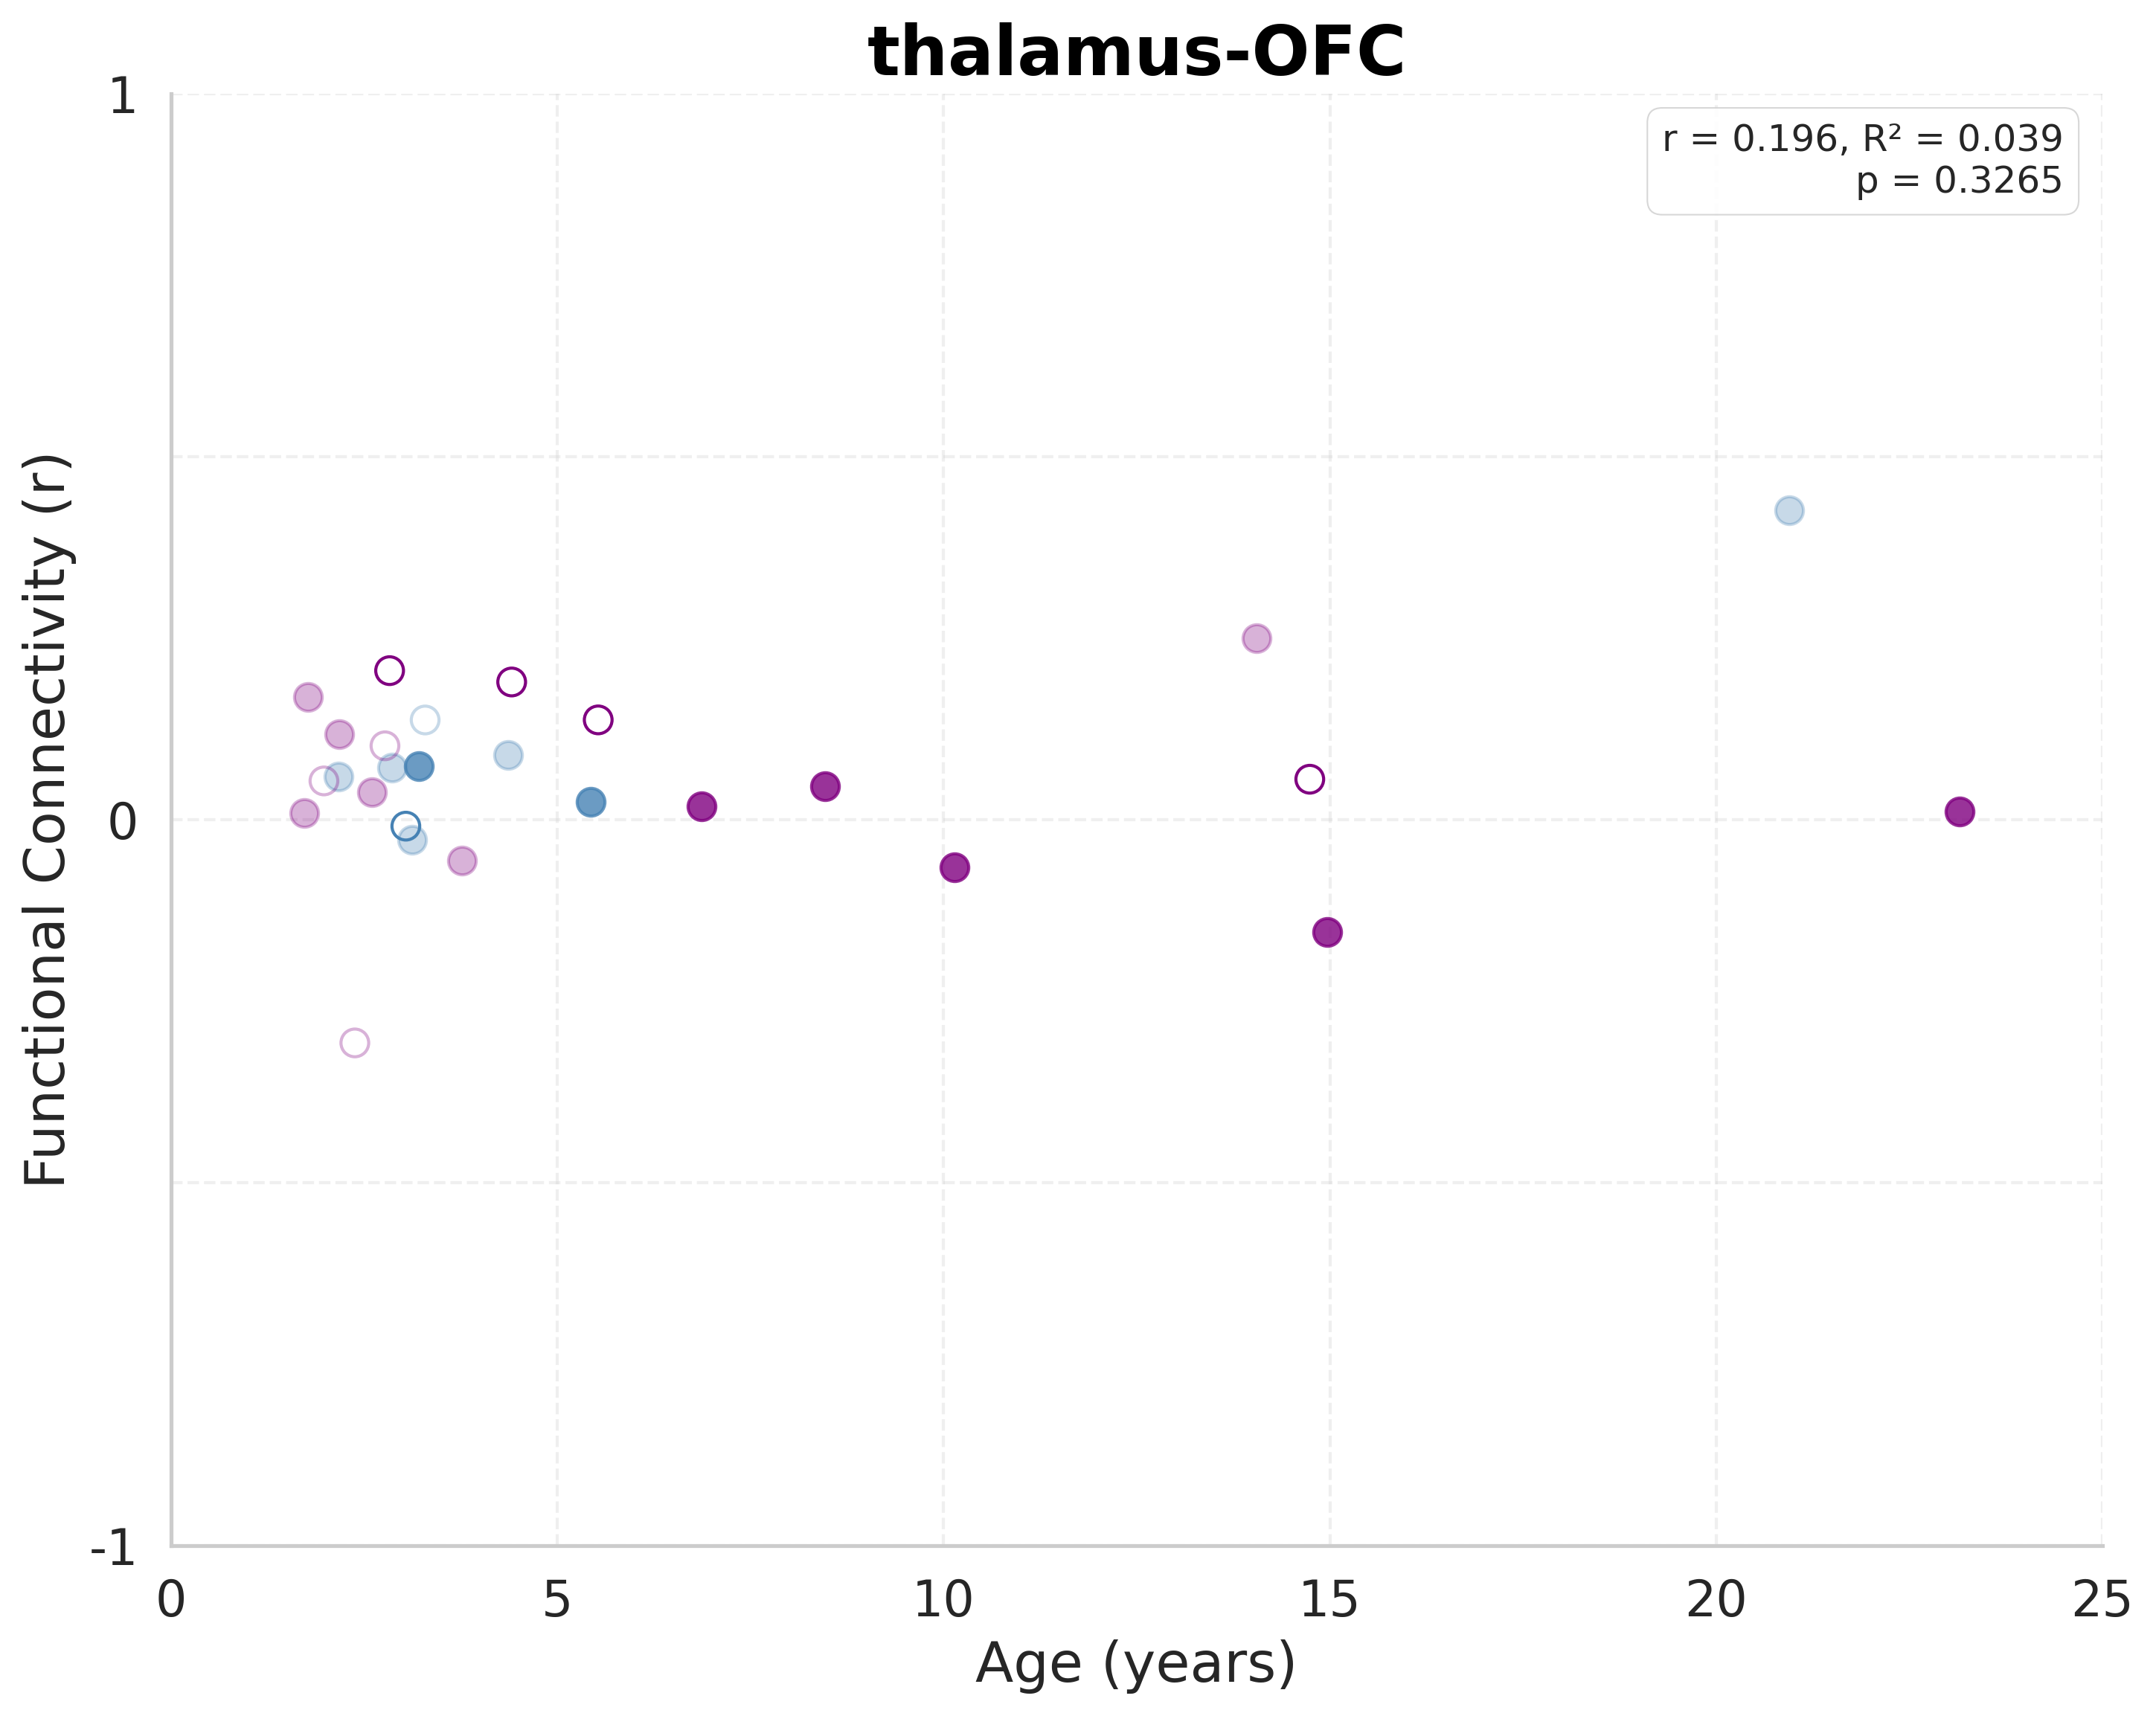
Resting-State Connectivity: thalamus-OFC
Notes:
thalamus-OFC
Sample size: n=27
(includes both behavioral and imaging-only subjects)
LINEAR MODEL:
R² = 0.0385
F(1, 25) = 1.0017
p-value = 0.326497
y = 0.0044x + 0.0333
AIC = -106.42
BIC = -103.83
QUADRATIC MODEL:
R² = 0.0551
F(2, 24) = 0.7003
p-value = 0.506322
y = 0.000521x² + -0.0071x + 0.0672
AIC = -104.89
BIC = -101.00
Likelihood ratio test vs. linear: p = 0.492701
Pattern: U-shaped (developmental valley)
MODEL SELECTION:
Best model (by AIC): LINEAR
Best model (by R²): QUADRATIC

Slide 21
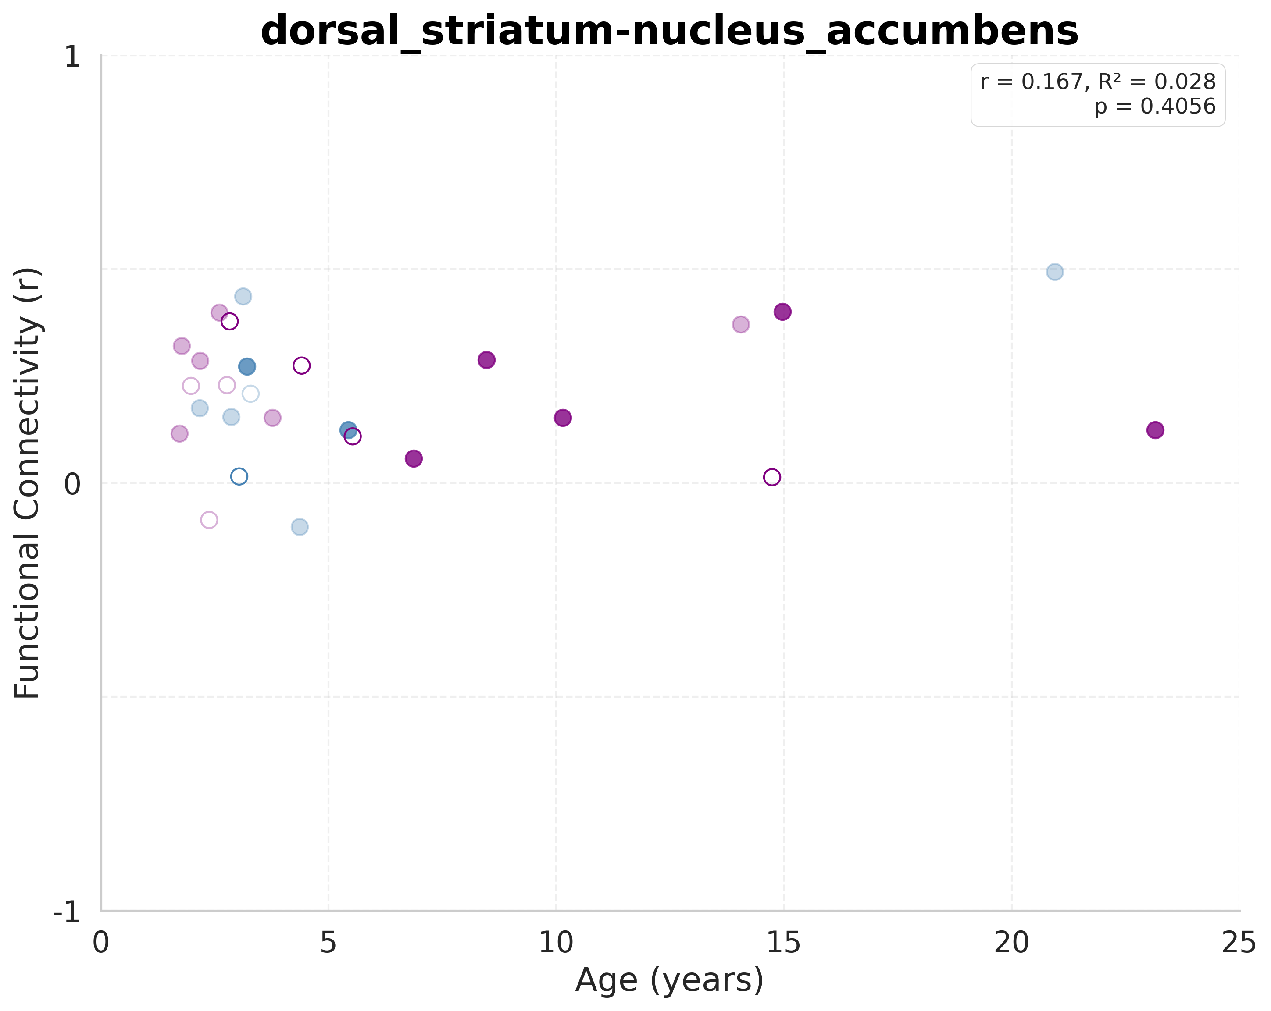
Resting-State Connectivity: dorsal_striatum-nucleus_accumbens
Notes:
dorsal_striatum-nucleus_accumbens
Sample size: n=27
(includes both behavioral and imaging-only subjects)
LINEAR MODEL:
R² = 0.0278
F(1, 25) = 0.7158
p-value = 0.405558
y = 0.0043x + 0.1794
AIC = -98.62
BIC = -96.03
QUADRATIC MODEL:
R² = 0.0349
F(2, 24) = 0.4343
p-value = 0.652735
y = 0.000391x² + -0.0043x + 0.2048
AIC = -96.82
BIC = -92.93
Likelihood ratio test vs. linear: p = 0.656639
Pattern: U-shaped (developmental valley)
MODEL SELECTION:
Best model (by AIC): LINEAR
Best model (by R²): QUADRATIC

Slide 22
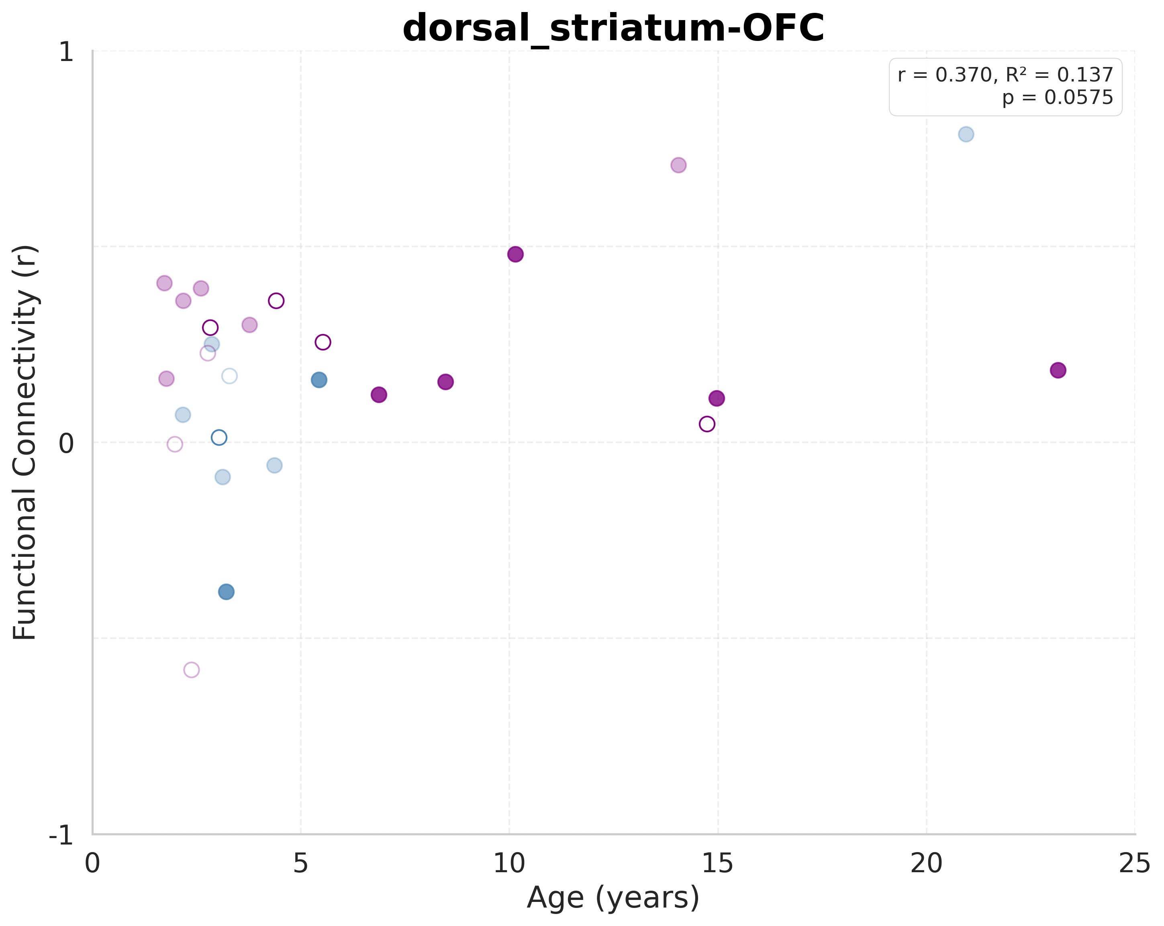
Resting-State Connectivity: dorsal_striatum-OFC
Notes:
dorsal_striatum-OFC
Sample size: n=27
(includes both behavioral and imaging-only subjects)
LINEAR MODEL:
R² = 0.1369
F(1, 25) = 3.9653
p-value = 0.057482
y = 0.0174x + 0.0705
AIC = -69.38
BIC = -66.79
QUADRATIC MODEL:
R² = 0.1407
F(2, 24) = 1.9642
p-value = 0.162169
y = -0.000519x² + 0.0288x + 0.0367
AIC = -67.50
BIC = -63.61
Likelihood ratio test vs. linear: p = 0.731201
Pattern: Inverted U-shaped (developmental peak)
MODEL SELECTION:
Best model (by AIC): LINEAR
Best model (by R²): QUADRATIC

Slide 23
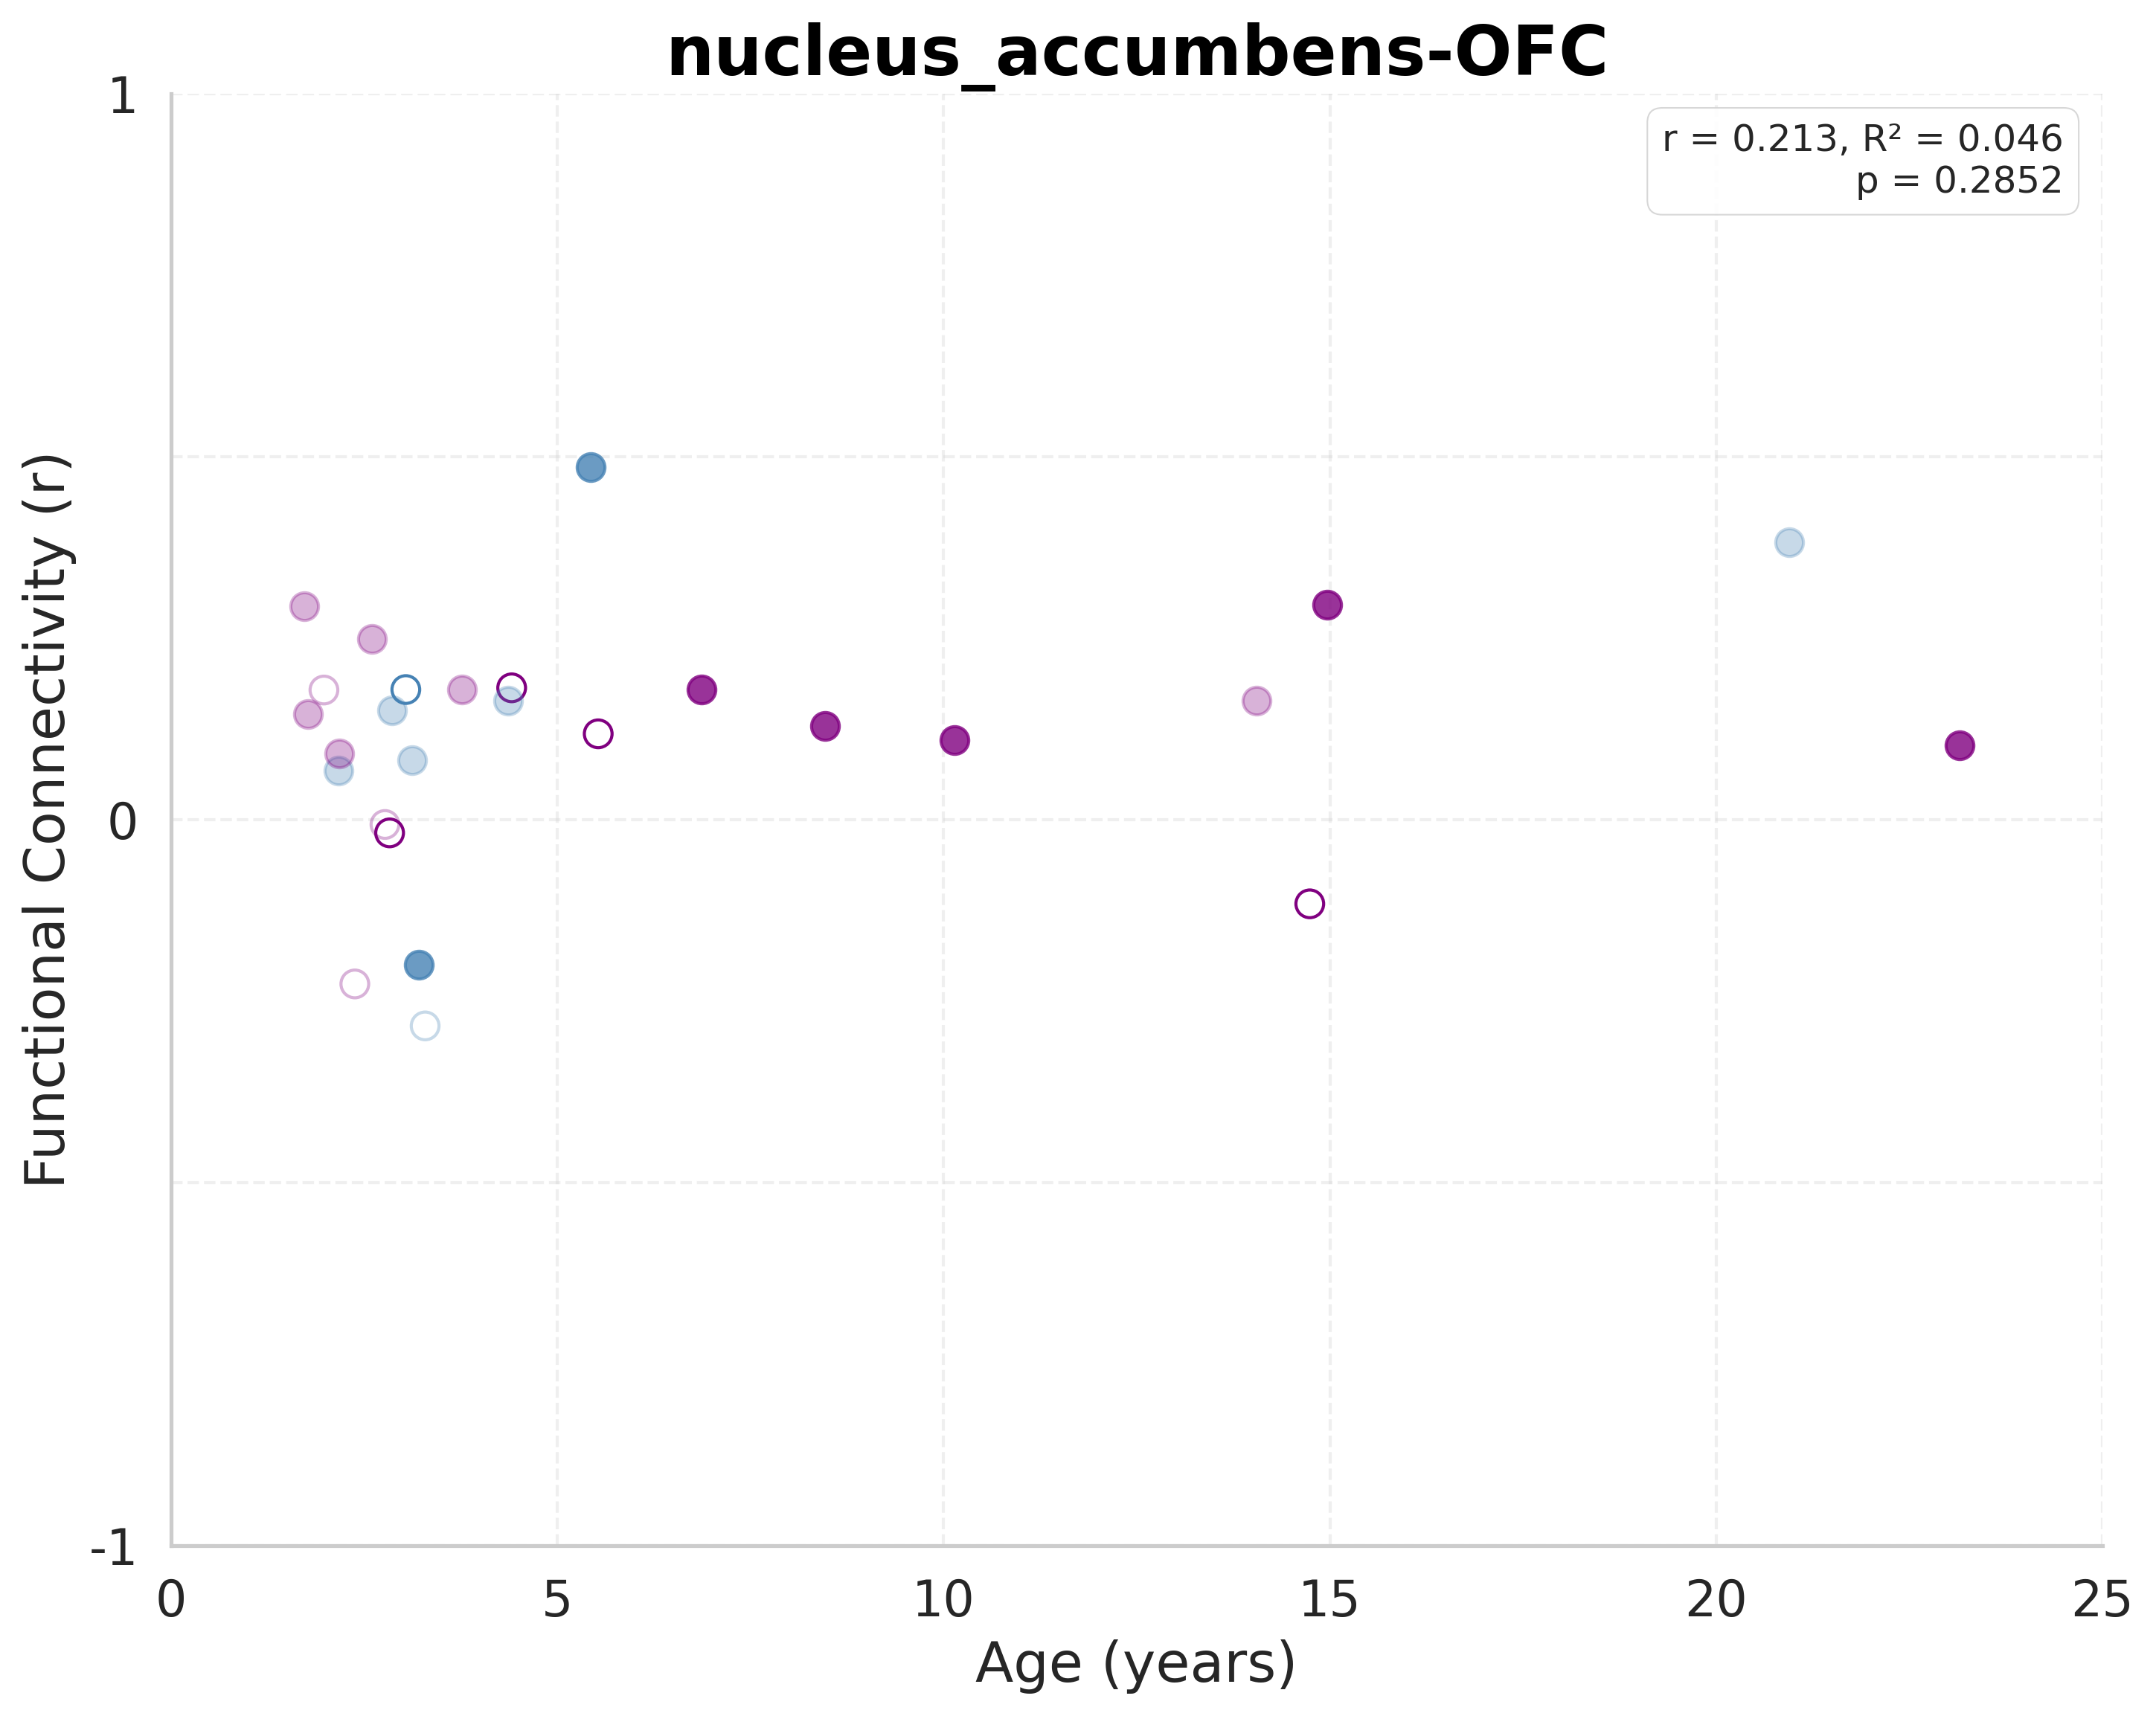
Resting-State Connectivity: nucleus_accumbens-OFC
Notes:
nucleus_accumbens-OFC
Sample size: n=27
(includes both behavioral and imaging-only subjects)
LINEAR MODEL:
R² = 0.0455
F(1, 25) = 1.1927
p-value = 0.285204
y = 0.0062x + 0.0743
AIC = -92.79
BIC = -90.19
QUADRATIC MODEL:
R² = 0.0474
F(2, 24) = 0.5974
p-value = 0.558212
y = -0.000227x² + 0.0112x + 0.0595
AIC = -90.84
BIC = -86.95
Likelihood ratio test vs. linear: p = 0.817115
Pattern: Inverted U-shaped (developmental peak)
MODEL SELECTION:
Best model (by AIC): LINEAR
Best model (by R²): QUADRATIC

