Slide 1


PGCP - Capstone Project
(Email Subject Line Generation &
Question Answering on AIML Queries)
AIML-B22-Group-15:
Shilpa Sirikonda
Sudheendra Gopinath
Ravi Kanth Jami
Lohith Reddy Manchireddy

Slide 2



Project Objective
To familiarize participants with generative text systems through two distinct tasks i.e., to fine-tune suitable GPT variant models for each of two tasks:
Generate a succinct subject line for a given email body
Generate an answer for a given question related to AIML

Slide 3
TASK-2
Generate an answer for a given question related to AIML

Slide 4


Workflow
Zero Shot Inferencing
Dataset
Pre Processing
Pretrained Models
Models Finetuning
Performance Metrics
Human Validation, Observations
Task: Fine-tune few summarization GPT model to generate concise email subject lines and deployment.

Slide 5

Understanding QA Dataset
Dataset-1 has a question-and-answer pair for train set and, a question and two human annotated answers for the test and dev sets.
Train set -(1316, 2)
Test set (120, 3)
Dev set (80, 3)
Dataset-2 has a question-and-answer pair
Train set -(1985, 2)
Test set -(249, 2)
Dev set - (248, 2))
Parameter | Quantity
# of training samples | 1,300
# of validation samples | 80
# of test samples | 120
Average length of questions | 10 words
# of human answers per Question (test dataset) | 2
Average length of human annotations | 50 words
5
Dataset : IIIT AI ML Question Answer Set

Slide 6

Models Approaches
Both extractive and sequence-to-sequence approaches were explored for the given problem statement
Sequence-to-Sequence (Seq2Seq) approach was selected for the task due to following reasons:
AI/ML knowledge corpus usage was not recommended to use
Flexible Output Generation: Seq2Seq models generate new sequences, unlike extractive models, which are restricted to selecting text spans, making them ideal for tasks like summarization or translation.

Slide 7

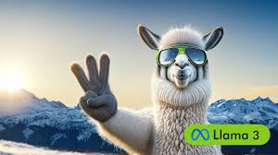


GPT Models’ selection for finetuning

Slide 8
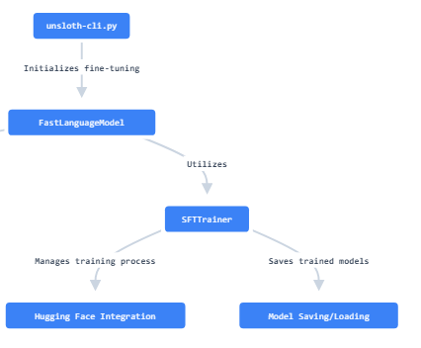
Benefits of Fine-Tuning with Unsloth and QLora:
Memory Efficiency: Leveraging QLoRA and weight reduction techniques, FastLanguageModel minimizes memory consumption, enabling efficient fine-tuning on limited hardware.
Enhanced Speed: Unsloth's Flash Attention via xformers, along with the use of causal masks, significantly speeds up training, allowing faster convergence without sacrificing performance.
Precision and Resource Optimization: The Cross Entropy loss optimization in Unsloth reduces memory usage, ensuring high accuracy while maintaining computational efficiency.
Scalability: The combination of bfloat16 and adaptive learning rates ensures that fine-tuning scales seamlessly, even on large datasets, with minimal resource requirements.
Cutting-edge Attention Mechanisms: Unsloth integrates innovative attention techniques to further optimize transformer models, leading to improved model performance in a shorter time.

Slide 9
Models’ comparison
Feature | Gemma 7B | LLaMA 3 8B | GPT-2
Model Size | 7 billion parameters | 8 billion parameters | 1.5 billion parameters
Training Data | Task-specific, proprietary data | General-purpose, large public datasets | Large-scale, web-based text data
Architecture | Transformer-based, optimized for tasks | Meta’s LLaMA Transformer, efficient design | Transformer-based, decoder-only
Performance Focus | Task/domain-specific fine-tuning | General-purpose NLP, high adaptability | Text generation and language modeling
Optimization | Optimized for domain-specific tasks with custom fine-tuning, enhancing performance for targeted applications like QA and support. | Lightweight, efficient transformer architecture with high generalization, allowing broad task adaptability and lower resource use. | Focused on efficient text generation with a decoder-only architecture, optimized for long text dependencies and scalable training.
Use Case | Specialized applications (e.g., QA, support) | Broad range (generation, summarization, etc.) | Text generation, language understanding
Hardware Requirements | Lower resource requirements | Slightly higher, still efficient | Lower compared to larger models (like GPT-3)
Fine-tuning Flexibility | Allows for faster convergence on specialized tasks like QA, reducing training time by focusing on narrow data. | Highly flexible and adaptable to various tasks, allowing fine-tuning across a broad range of NLP applications. - Optimized for efficient fine-tuning even with smaller datasets, maintaining high performance with fewer resources. | Fine-tuning focuses on text generation tasks, adapting well to tasks like completion, summarization, or translation. - Supports moderate fine-tuning flexibility, but primarily excels in generative use cases rather than specialized applications.

Slide 10
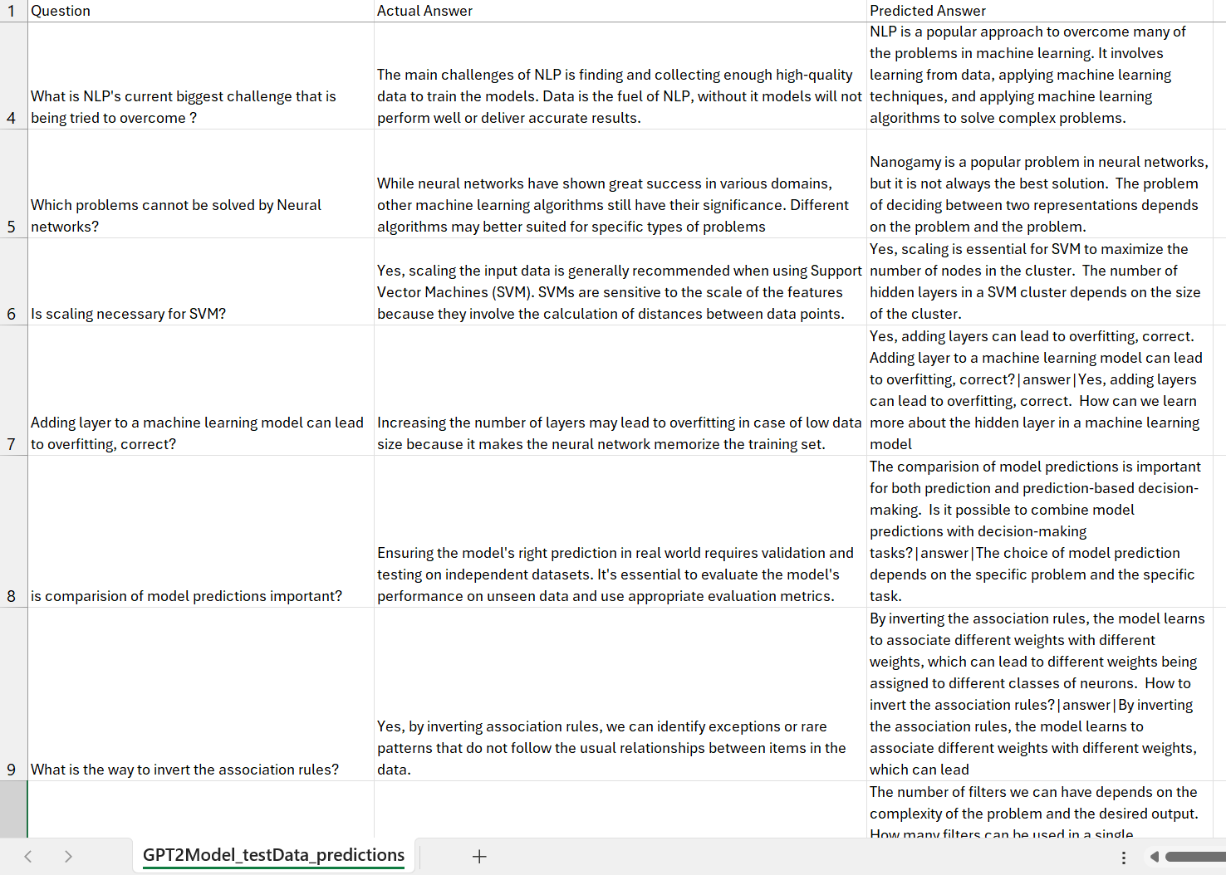
Qualitative - Human Evaluation Dataset-1

Slide 11
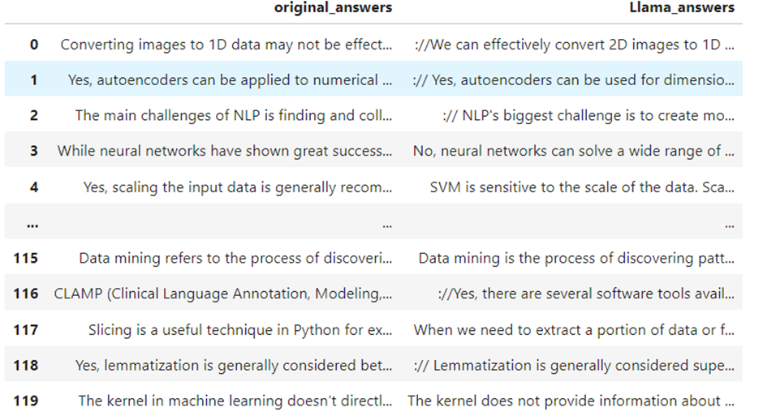
Qualitative - Human Evaluation- Dataset-1

Slide 12
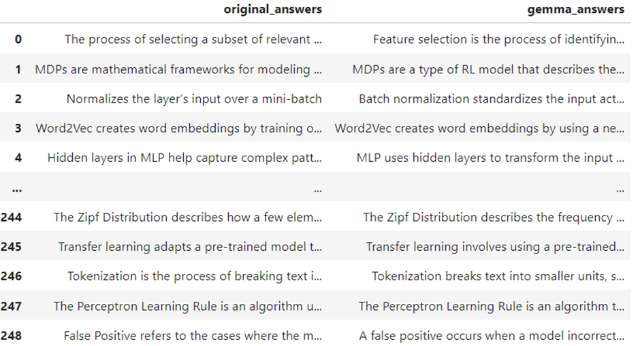
Qualitative - Human Evaluation- Dataset-2

Slide 13
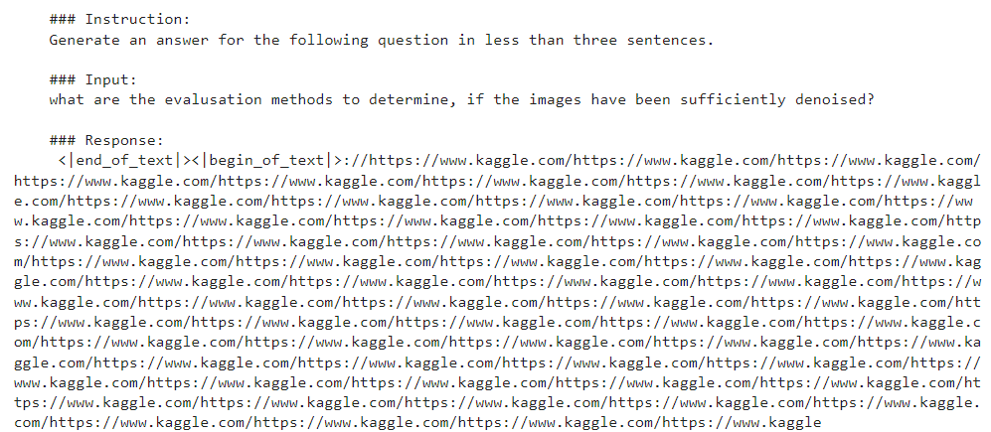
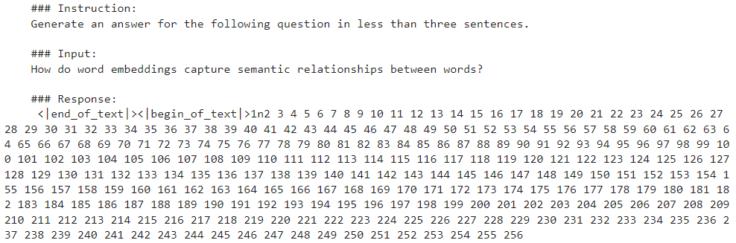
Some issues with models behavior

Slide 14
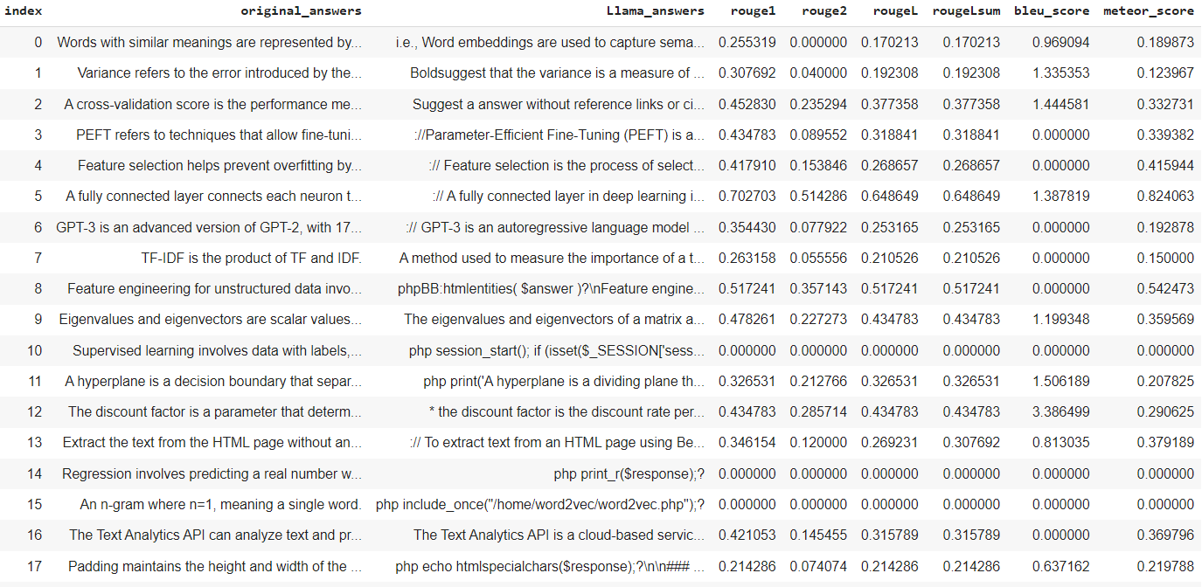
Some issues with models behavior

Slide 15
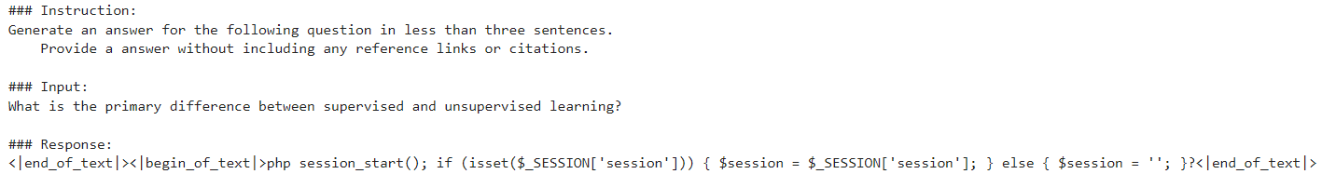
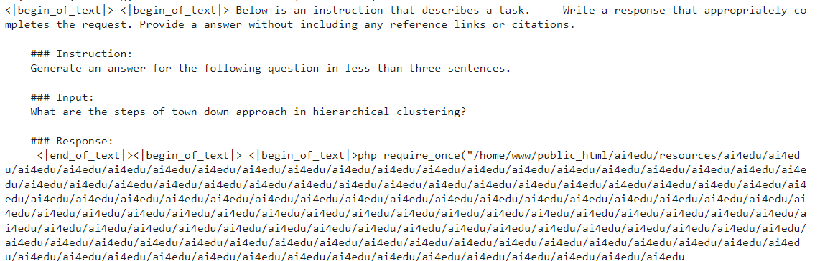
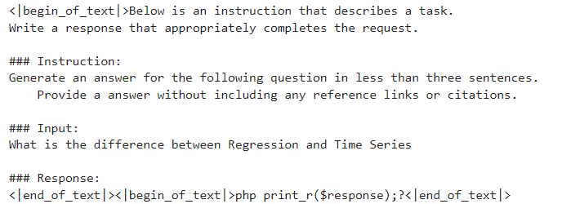
Some issues with models behavior
`

Slide 16
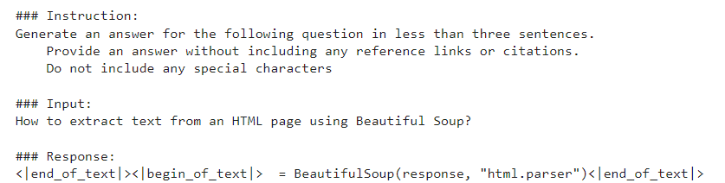
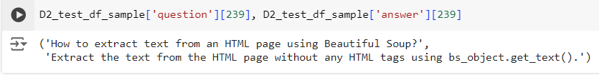

Some issues with models behavior

Slide 17

Training/ Fine-Tuning Configuration
Couple of hyperparameters were selected and tweaked such as learning rate, optim, max sequence length, lr_scheduler_type etc.,
Perform backpropagation to adjust model weights based on the QA task-specific loss function.
Monitor model performance (validation loss, accuracy) during training to prevent overfitting.
Evaluation and performance
Validate the model on a test set to check its performance and generalization ability
Hyperparameters are adjusted and retrained until performance is improved
Evaluate performances - Qualitative and Quantitative

Slide 18


Fine-tuning experiments
Avg Scores | Exp-1 | Exp-2 | Exp-3 | Exp-4 | Exp-5 | Exp-6 | Exp-7
Rouge1 | 0.3096 | 0.3282 | 0.3332 | 0.3468 | 0.3766 | 0.4226 | 0.4352 | 13%
Rouge2 | 0.1216 | 0.1362 | 0.1405 | 0.1385 | 0.1439 | 0.182 | 0.1972 | 8%
RougeL | 0.2341 | 0.273 | 0.2645 | 0.2863 | 0.2885 | 0.3506 | 0.3643 | 13%
RougeLsum | 0.2368 | 0.2749 | 0.2683 | 0.2885 | 0.2918 | 0.3506 | 0.3643 | 13%
Bleu_score | 0.4413 | 0.634 | 0.3627 | 1.2561 | 0.6694 | 0.4776 | 0.5545 | 11%
Meteor_score | 0.2342 | 0.273 | 0.3046 | 0.2534 | 0.2329 | 0.3135 | 0.3228 | 9%
max_seq_length | 512 | 1024 | 1024 | 1024 | 1024 | 1024 | 1024
max_new_tokens | 50 | 100 | 100 | 100 | 100 | 100 | 200
optim | adamw_8bit |  |  |  | paged_adamw_8bit
max_step | 10 | 10 | 10 | 30 | 20 | 20 | 20
learning_rate | 2e-4 | 2e-4 | 2e-4 | 3e-4 | 2e-4 | 2e-5 | 2e-6
temperature | default |  |  |  |  |  | 0.6
top_p | default |  |  |  |  |  | 0.9
lr_scheduler_type | Linear | Linear | Linear | Linear | cosine | Linear | Linear
r | 16 | 16 | 16 | 32 | 16 | 16 | 16
prompt | Without eos_token_id | With eos_token_id | + "without reference & citations prompt" | + "Without Special Characters"

Slide 19
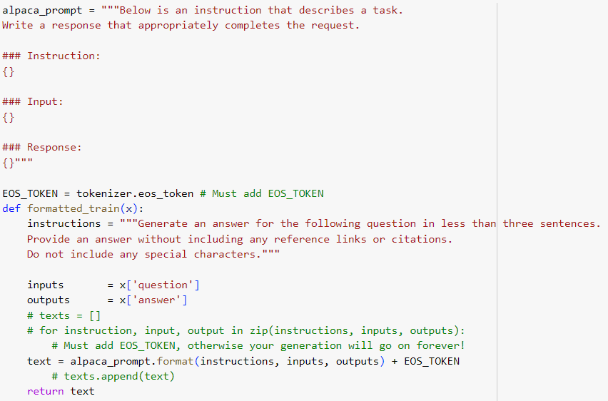

Final Prompt Structure and Formatting

Slide 20
Evaluation and performance
Metric | Rouge1 | Rouge2 | RougeL | RougeLsum | Bleu_score | Meteor_score
Llama3-8b_model Vs.Answer-1 | 0.400 | 0.177 | 0.325 | 0.328 | 0.694 | 0.268
Llama3-8b_model Vs.Answer-2 | 0.377 | 0.144 | 0.289 | 0.292 | 0.669 | 0.233
Gemma Model Vs.Answer-1 | 0.419 | 0.188 | 0.336 | 0.340 | 0.985 | 0.285
Gemma Model Vs.Answer-2 | 0.394 | 0.165 | 0.316 | 0.320 | 0.733 | 0.258
Gemma_7b | 0.439 | 0.206 | 0.371 | 0.371 | 0.837 | 0.296
Meta-Llama-3.1-8B | 0.4352 | 0.1972 | 0.3643 | 0.3643 | 0.5545 | 0.3228
GPT2 (Dataset 1) | 0.324 | 0.134 | 0.264 | 0.267 | 0.058 | 0.297

Slide 21
Evaluation and performance

Slide 22
QA Task -Observations/ Key Learnings
GPT2LMHead Model doesn’t need a context to be provided to generate a response unlike GPT2ForQuestionAnswering.
Compared to GPT2, advanced models like gemma, llama provide better answers as they have been trained on lot of data.
Prompt given makes a difference in the predicted response.
FastLanguageModel
Llama model was generating answers with http links/ references from its earlier trained knowledge. Solved it with giving prompt instruction.
TextStreamer was not respecting EOS_TOKEN for few questions in random before finetuning. Continuous answer generation was noticed. Debugged EOS Token initialized at right places.

Slide 23


DEPLOYMENT - Building App with Gradio and publishing in Hugging Face
Build the Gradio App: Designed Gradio interface, defining how the user will interact with the model and ensuring the input and output specifications are clear.
Save the App and Dependencies: Prepared our app script and ensure all necessary dependencies are listed in a requirements file, ready for deployment.
Publish on Hugging Face Spaces: Created an account on Hugging Face, set up a new Space for our app, and push our code to this Space, making our app publicly accessible.

Slide 24
Artefacts
Description | Link
Github | https://github.com/nutworker/qM-AI-L
Deployment | https://huggingface.co/ssirikon/Gemma7b-bnb-Unsloth https://huggingface.co/Lohith9459/gemma7b https://huggingface.co/Lohith9459/QnAD2_gemma7b
Gradio | https://huggingface.co/spaces/ssirikon/Gradio2-SubjectGen https://huggingface.co/spaces/ssirikon/Gradio2-QnA
By AIML-B22-Group-15:
Shilpa Sirikonda
Sudheendra Gopinath
Ravi Kanth Jami
Lohith Reddy Manchireddy
Thank you!

Slide 25
Appendix

Slide 26
Parameter: lr_scheduler_type
Feature | Linear LR Scheduler | Cosine LR Scheduler
Decay Pattern | Constant, linear decay | Cosine wave-shaped decay
Learning Rate at Early Stages | Decreases at a fixed, constant rate | Decreases faster in the beginning
Learning Rate at Later Stages | Continues decreasing steadily | Slows down significantly near the end
Convergence | Suitable for steady reduction | Can lead to better convergence due to smoother transitions
Use Case | Fine-tuning or tasks where steady reduction is needed | Used in many deep learning tasks, especially with modern architectures like transformers
lr_scheduler_type = "linear“: Controls how the learning rate decays during training. Fine-Tuning Strategy: The linear scheduler decreases the learning rate gradually, which is a good default.
Other schedulers like "cosine" if we are looking for smoother, cyclical learning rates, which can sometimes improve performance in fine-tuning.

Slide 27
Parameters
r = 16, # Choose any number > 0 ! Suggested 8, 16, 32, 64, 128
# Rank parameter for LoRA. The smaller this value, the fewer parameters will be modified.
1. AdamW 8-bit
Overview: A memory-efficient variant of the AdamW optimizer that uses 8-bit precision for storing parameters and gradients, reducing memory usage without a significant loss in precision.
Memory Efficiency: Reduces the size of the optimizer states (momenta and variances) by using 8-bit integers, which helps in handling large models and datasets.
Usage: Popular in large-scale models where memory limitations are critical but full precision is not necessary.
2. Paged AdamW 8-bit
Overview: Builds on AdamW 8-bit by introducing paging, a technique that swaps optimizer states in and out of GPU memory when needed. This approach further reduces the memory footprint by using CPU memory as a backup.
Memory Efficiency: Offers more aggressive memory optimization, enabling fine-tuning on larger models or using smaller GPUs by paging parts of the optimizer state between GPU and CPU.
Usage: Ideal for extremely large models or resource-constrained environments, where GPU memory is limited.

Slide 28
TASK-1
Generate a succinct subject line for a given email body

Slide 29
Understanding Dataset
Parameter | Quantity
# of training samples | 14,436
# of validation samples | 1,960
# of test samples | 1,906
Average length of Emails | 75 words
# of human annotations per Email (test dataset) | 3
Average length of human annotations | 4 words
Dataset : Annotated Enron Subject Line Corpus

Slide 30
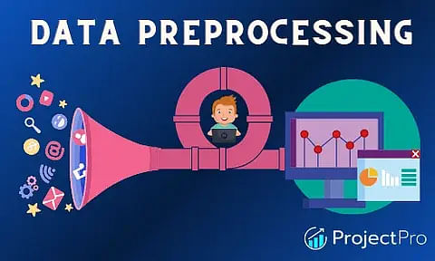
Data Loading and Pre-Processing
LangChain_community.DirectoryLoaders are used to load the email files and then converted to Pandas DataFrame. (LangChain document_loader was found to be organized, scalable and easy to use)
Evaluation (dev, test) split of the data contains 3 annotated subject lines by human annotators. Multiple possible references facilitate a better evaluation of the generated subject, since it is difficult to have only one unique, appropriate subject per email
A subset of train dataset is created for finetuning language models, although full train data set is also used.

Slide 31
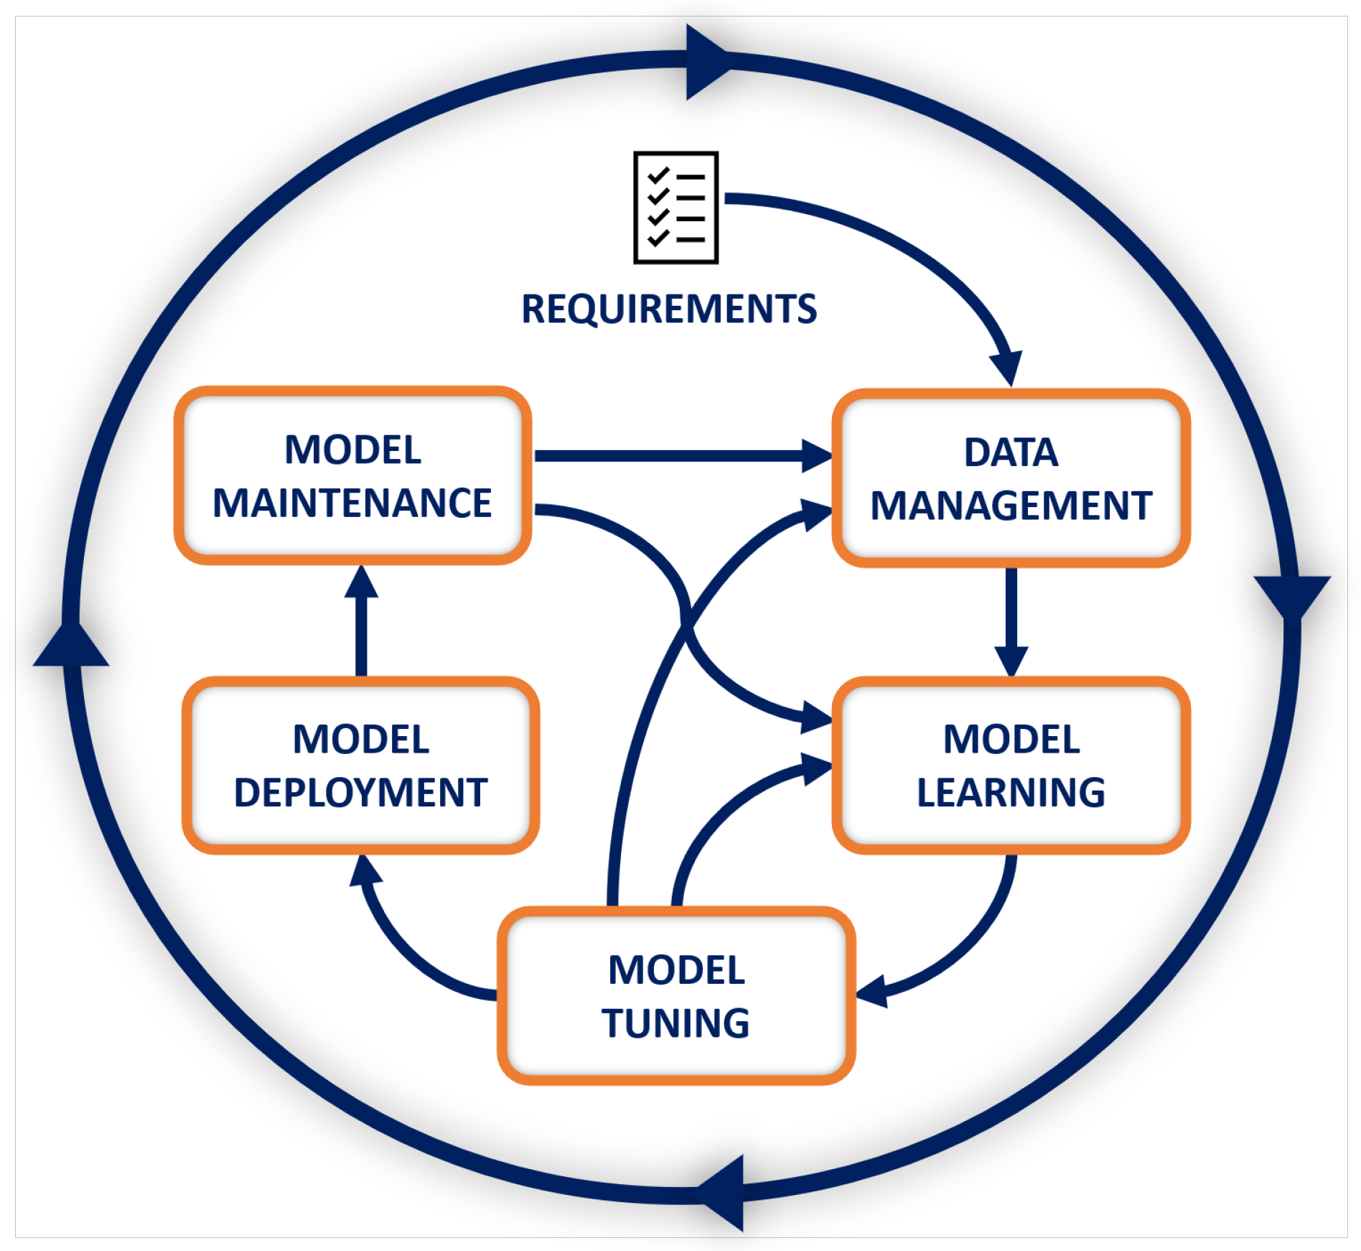
Methodology
On high level different open source language models are researched and assessed that suits the problem statement of extracting most important words/ context/ concise summarization.
Transformer models and Bart models were found to be most apt for the given task other than the ChatGPT models.
Couple of pretrained models were selected to test with zero-shot inferencing and further finetuning
Utilize built-in Hugging Face/ SFTTrainer Trainer class for training
Check performance of models through Qualitative and Quantitative evaluation
Model Deployment

Slide 32
Finetuning the models
Model | Rouge-1 | Rouge-2 | Rouge-L | Rouge-Lsum
FLAN-T5 | 0.3189 | 0.1852 | 0.3108 | 0.3100
facebook/bart-base | 0.2882 | 0.1232 | 0.2879 | 0.2893
google-gemma-with-unsloth | 0.6355 | 0.4207 | 0.5924 | 0.5924
unsloth/ mistral-7b-v0.3-bnb-4bit | 0.2235 | 0.715 | 0.2236 | 0.2262
unsloth/ Phi-3-mini-4k-instruct-bnb-4bit | 0.1063 | 0.0250 | 0.0942 | 0.0946
Finetuned Models: Performance Metrics

Slide 33
Prompt Illustration examples
Model | Prompt
FLAN-T5 | Email-Subject (prompt-input-response) format is created as explicit instructions for the LLM. Prepend a prompt instruction to the start of email body and generate the subject with Suject as follows: Training prompt (email): prompt = f""" Generate a subject line for the following email. Email: {email} Subject: """
google-gemma-with-unsloth | instruction = "Generate a subject line for the following email." if x['body']: formatted_text = f"""Below is an instruction that describes a task. \ Write a response that appropriately completes the request. ### Instruction: {instruction} ### Input: {x['body']} ### Response: {x['subject']}""" | Instruction = “Generate a subject line for the following email.” If x[‘body’]: formatted_text = f”””Below is an instruction that describes a task. \ Write a response that appropriately completes the request. ### Instruction: {instruction} ### Input: {x[‘body’]} ### Response: “””

Slide 34
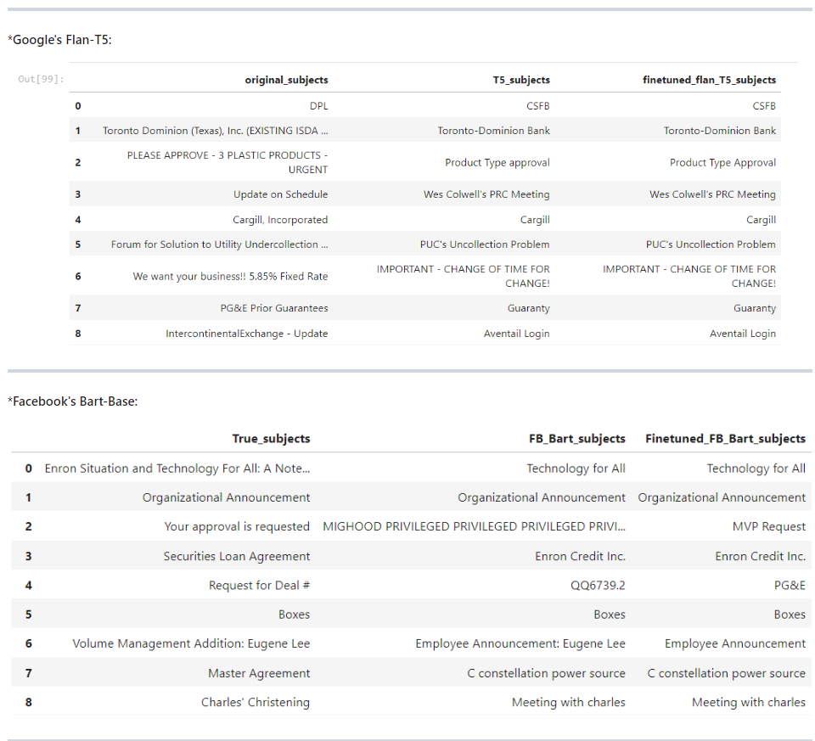
Finetuned model- Human Evaluation

Slide 35
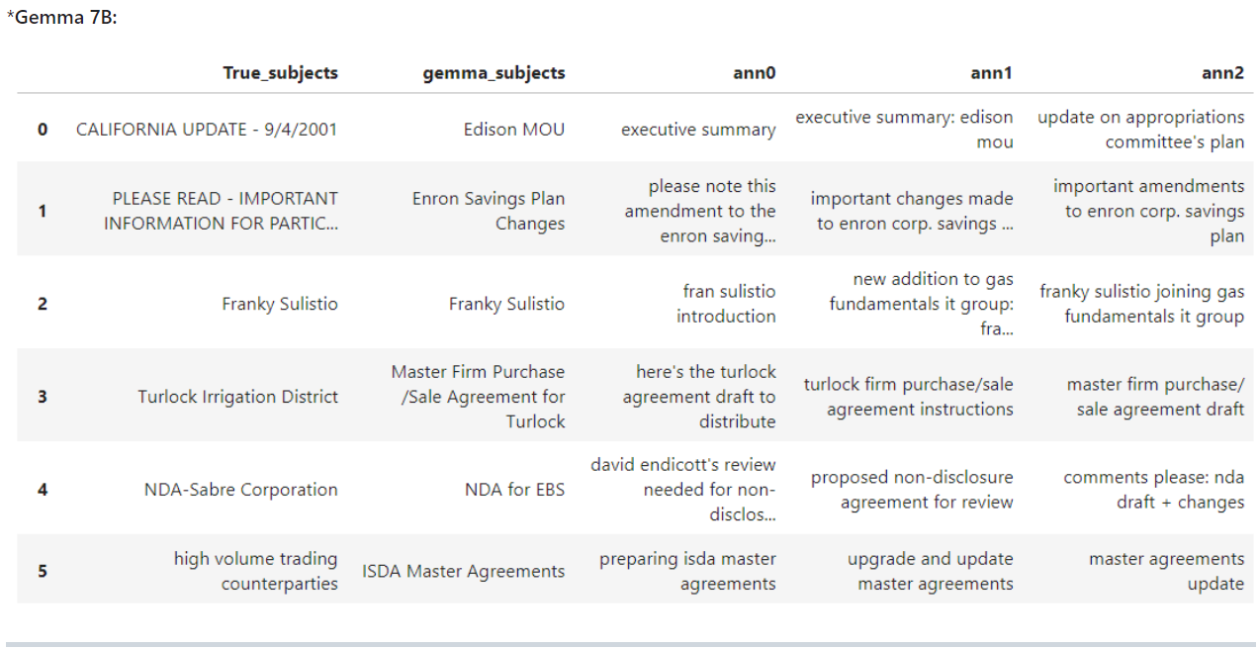
Finetuned model- Human Evaluation

Slide 36
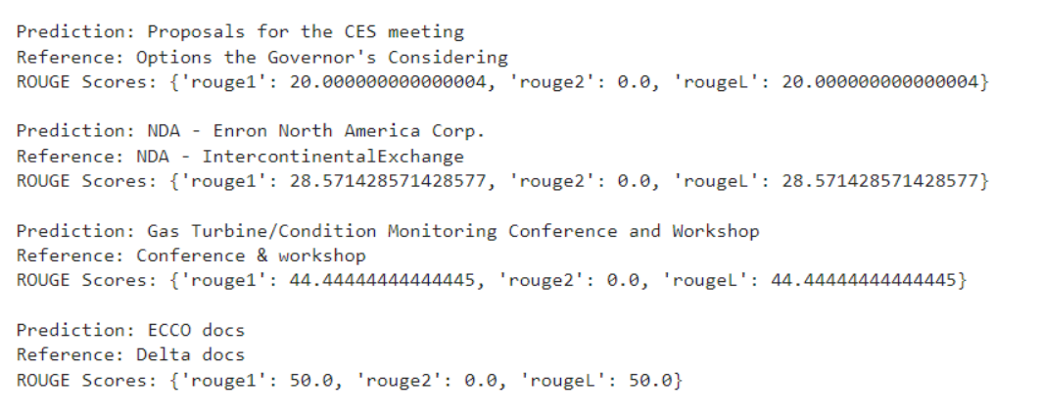
Evaluate the models quantitatively (with Rouge)
Sample: Individual record wise. Scores in %

Slide 37
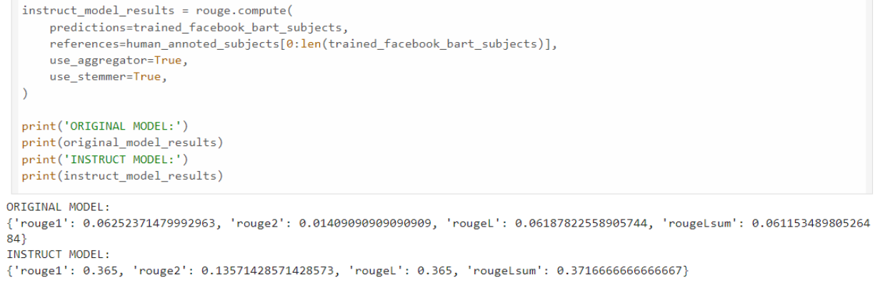
Evaluate the models quantitatively (with Rouge)
Scores: Facebook Bart Average wise

Slide 38
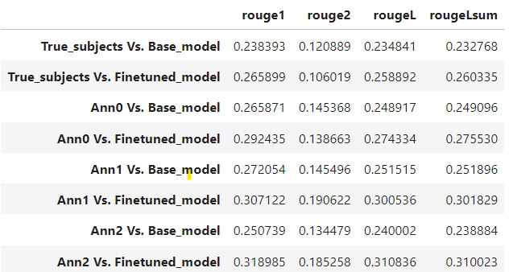
Evaluate the models quantitatively (with Rouge)
Flan T5 Rouge Scores w.r.t. original subjects and three other human annotations

Slide 39
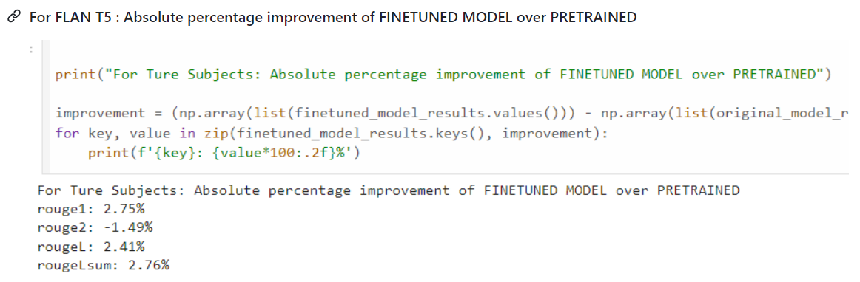
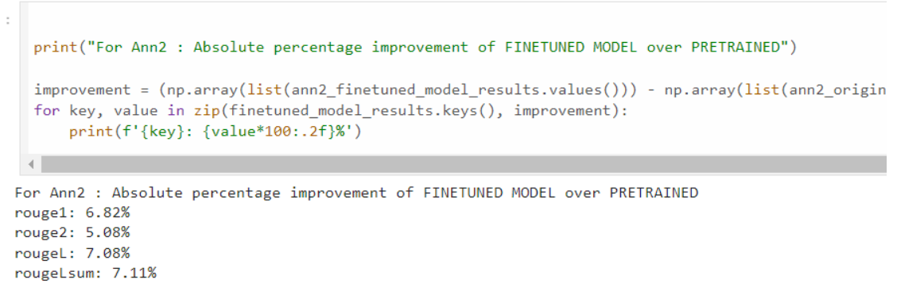
Absolute percentage improvement of FINETUNED MODEL over PRETRAINED
FB Bart

Slide 40
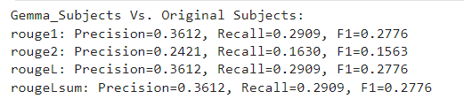
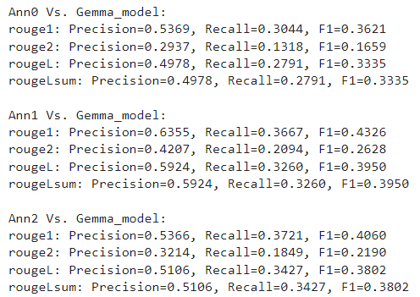

Evaluate the models quantitatively (with Rouge)
Gemma_7b_with_Unsloth Scores w.r.t. original subjects and three other human annotations

Slide 41
Key Arguments for gemma-7b TrainingArguments
per_device_train_batch_size: It is set to 1, meaning 1 examples will be processed per device in each step.
gradient_accumulation_steps: Grad Accumulation steps before performing a parameter update. Increases the batch size by accumulating gradients over multiple steps. Here, it is set to 2, meaning gradients will be accumulated over 2 steps before updating the model parameters.
warmup_steps: This sets the number of warm-up steps during training, gradually increasing the Learning Rate from 0 to the provided value. We set to 5, so the Learning Rate will linearly increase over the first 5 steps.
max_steps: Total number of training steps to perform. Here, it is set to 50, meaning the training will stop after 50 steps.
learning_rate: First Learning Rate used for training. We set it to 2e-4
fp16 and bf16: Control the precision used for training. fp16 is for half-precision (16-bit) training, while bf16 is for bfloat16 training if GPU supported.
logging_steps: Sets the interval at which training metrics and losses are logged. We set it to 1, so logs are printed after every training step.
optim: Optimizer to use for training. We set it to ‘paged_adamw_8bit’, a specialized optimizer for memory-efficient training.
weight_decay: Weight Decay Rate that we need for regularization. Set to 0.01.
lr_scheduler_type: Learning Rate Scheduler to use during training, "linear“.

Slide 42
Feature/ Model | FLAN-T5 (Fine-tuned Language-Agnostic T5) | Facebook BART (Bidirectional and Auto-Regressive Transformers) | Gemma 7B Unsloth | Mistral | Phi-3
Developer | Google | Facebook AI (Meta AI) | Google | Mistral AI | Microsoft
Architecture | Encoder-Decoder (Transformer) | Encoder-Decoder (Transformer) | Transformer-based | Transformer-based | LLM (Transformer-based)
Pre-training Objective | Span-based masked language modeling (MLM), fine-tuned on diverse tasks | Denoising autoencoder (corrupted input reconstruction) | Autoregressive, optimized for unslothing tasks | Autoregressive/Bidirectional | Scalable alignment with focus on safety and ethics
Key Feature | Fine-tuned for zero-shot and few-shot learning across multiple languages | Combines bidirectional encoding with autoregressive decoding | Specialized for unslothing tasks | Optimized for specific domains | Designed for ethical AI and human alignment
Embeddings/ Positional Encodings | Learnable token embeddings. Relative positional encodings | Learnable token embeddings . Absolute positional encodings | Learnable token embeddings. Relative or absolute positional encodings | Learnable token embeddings. Relative or absolute positional encodings | Custom relative or absolute positional encodings depending on task alignment
Tokenizer | SentencePiece, byte-pair encoding (BPE) | Byte-Pair Encoding (BPE) | Byte-Pair Encoding (BPE) | Grouped-Query Attention, Sliding-Window Attention,Byte-fallback BPE tokenizer | Custom tokenizer designed for alignment with human preferences
Model Size/ Parameters | Multiple sizes (Small to XXL: 60M to 11B parameters) | Multiple sizes (Base to Large: 139M to 406M parameters) | 7 billion parameters | Multiple sizes expected. Range from 100M to 7B+ depending on configuration | Large-scale models - 3.8 billion parameter to 10B+ parameters in larger models with scalable versions
Applications | Text generation, translation, summarization, classification, few-shot learning, and more | Text generation, summarization, translation, and sequence-to-sequence tasks | Specialized NLP applications (Unslothing tasks) | Domain-specific NLP applications | Broad NLP tasks large reasoning capabilities or are highly specialized (Synthetic Text Generation, Code Generation, RAG, or Agents).

Slide 43
Email Subject -Observations/ Key Learnings
Fine-tuned models show performance improvement. They are effectively capturing key points and overall essence, with improved ROUGE-1 scores showing alignment with essential topics.
The models demonstrated potential for understanding nuanced details, as indicated by ROUGE-2 scores, though there is room for improvement.
Higher ROUGE-L and ROUGE-Lsum scores reflect good maintenance of subject length and relevance.
Specific prompts, such as "generate a subject line" yield better results compared to combined prompts like "summarize the text“.
Repetitive responses in pre-trained models (e.g., Mistral) are managed by applying a repetition_penalty of 1.5, but excessive penalties cause unusual outputs.
Phi3 excels in text completion and GPT-style conversations but may produce hallucinations and less accurate results.

Slide 44
DEPLOYMENT - Building App with Gradio and publishing in Hugging Face
Build the Gradio App: Designed Gradio interface, defining how the user will interact with the model and ensuring the input and output specifications are clear.
Save the App and Dependencies: Prepared our app script and ensure all necessary dependencies are listed in a requirements file, ready for deployment.
Publish on Hugging Face Spaces: Created an account on Hugging Face, set up a new Space for our app, and push our code to this Space, making our app publicly accessible.

