Slide 1
Self-Evolving Multi-Agent Orchestration
Group Presentation
from fixed MAS to adaptive orchestration
arXiv:2505.19591 · 2505.14996 · 2601.14652

Slide 2
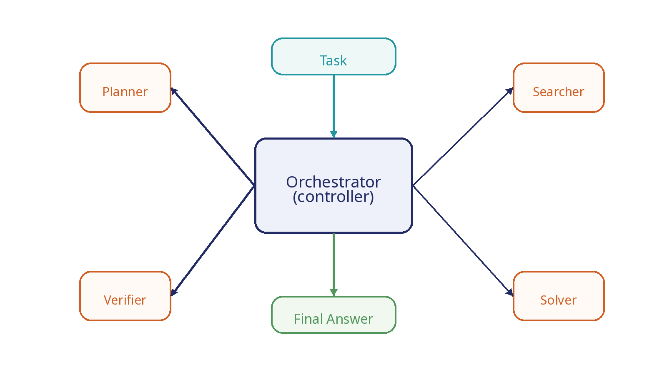
What Is Orchestration?
Decides how agents are organized, activated, connected, and verified.

Slide 3
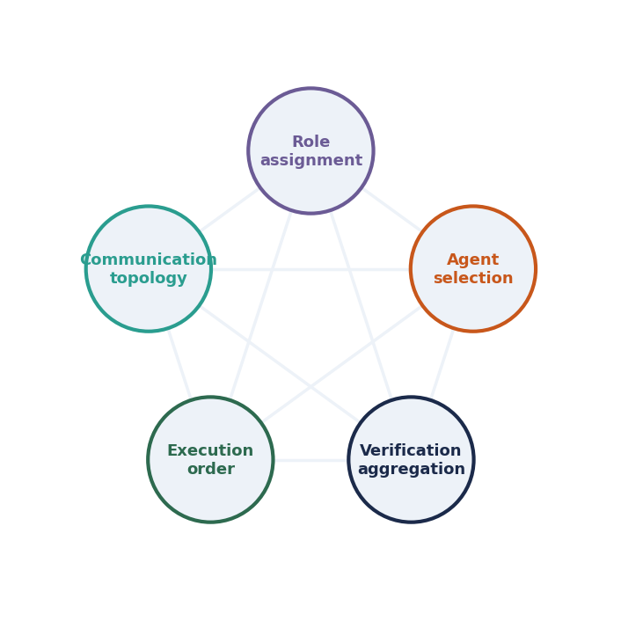
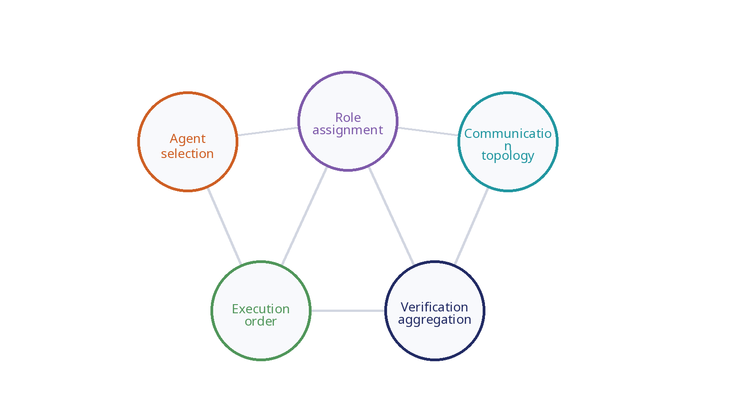
What Orchestration Decides
Five control dimensions determine the behavior of a multi-agent system.

Slide 4
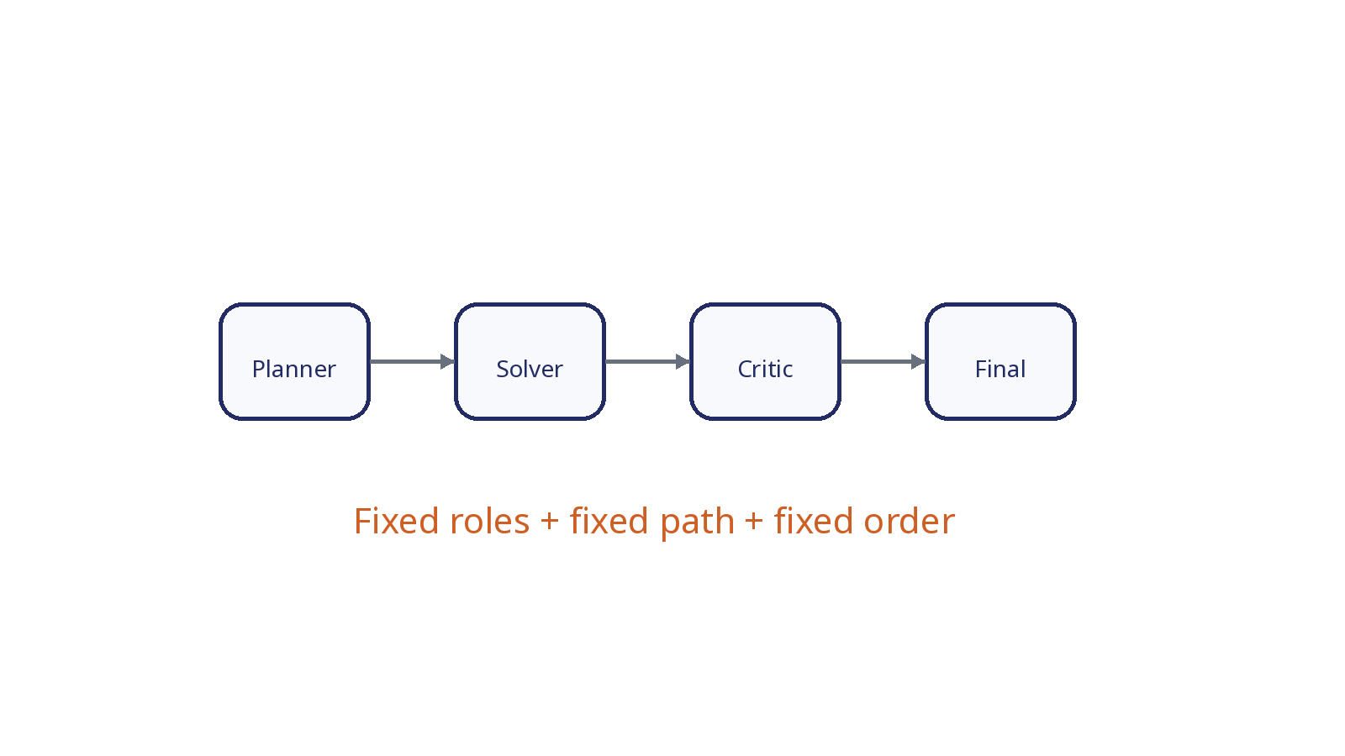
Static MAS
Traditional systems hard-code the collaboration pattern.

Slide 5
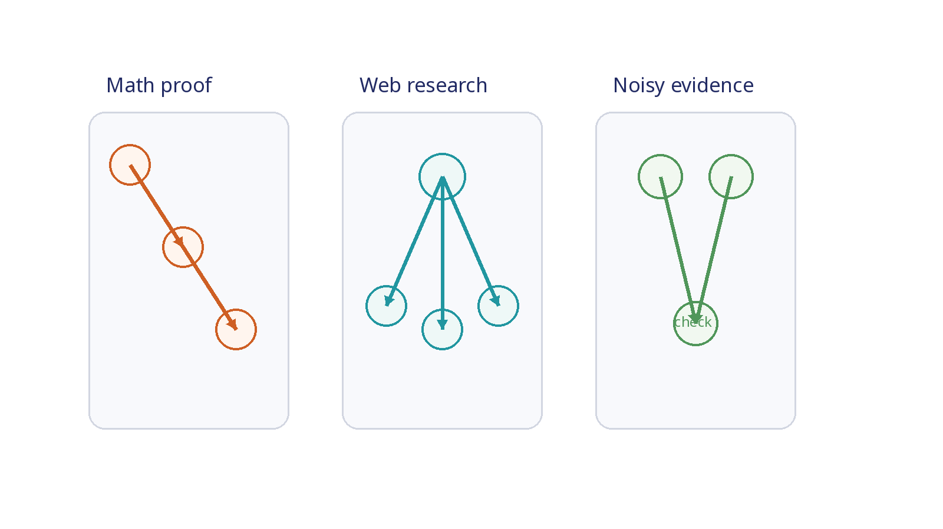
Different Tasks Need Different Workflows
A single fixed workflow is rarely optimal across task types.

Slide 6
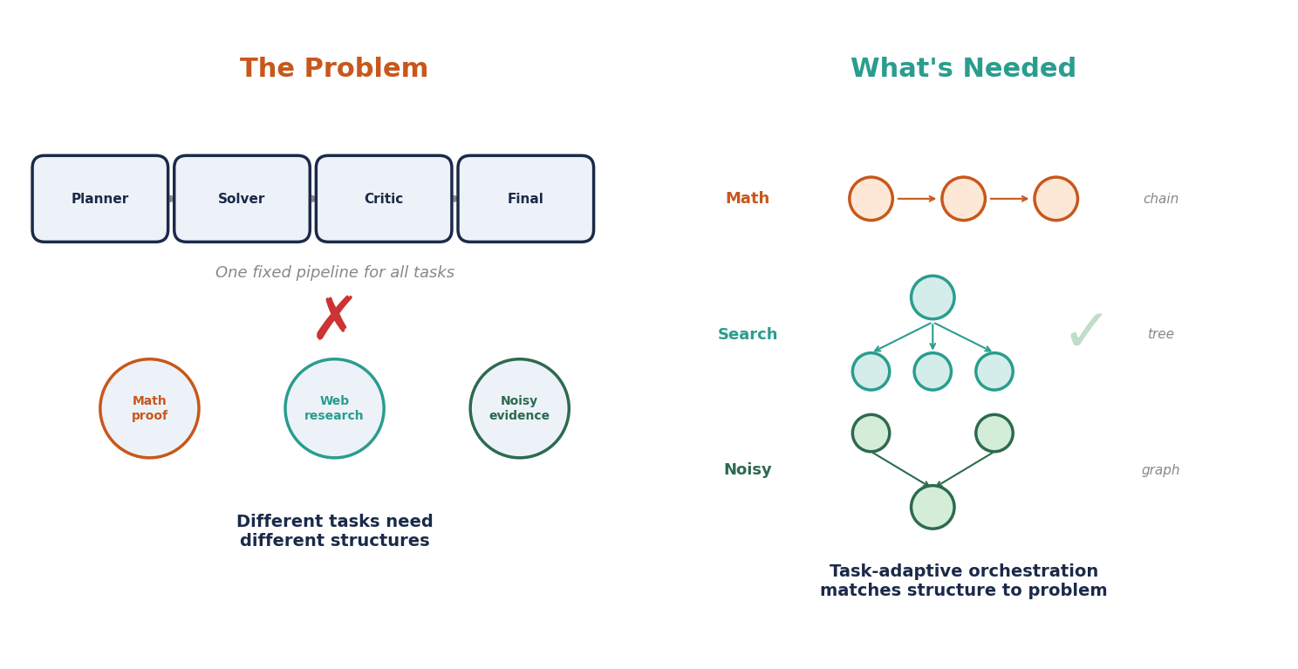
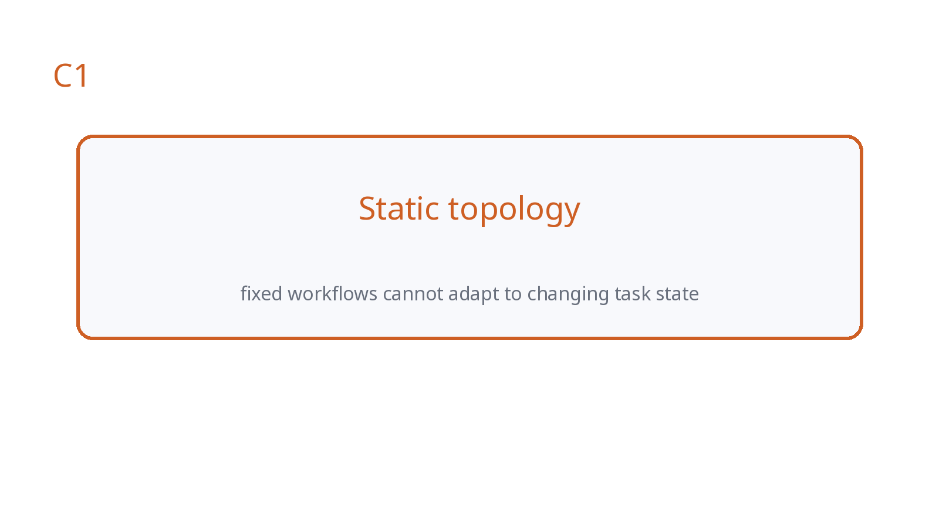
Challenge C1: Static Topology
Fixed graphs cannot adapt as the task state changes.

Slide 7
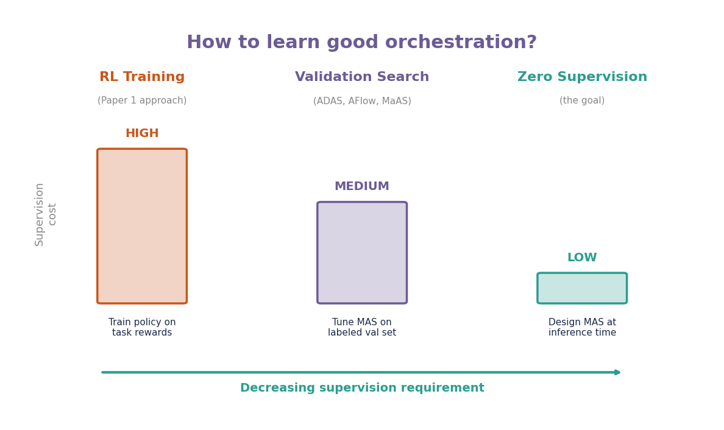
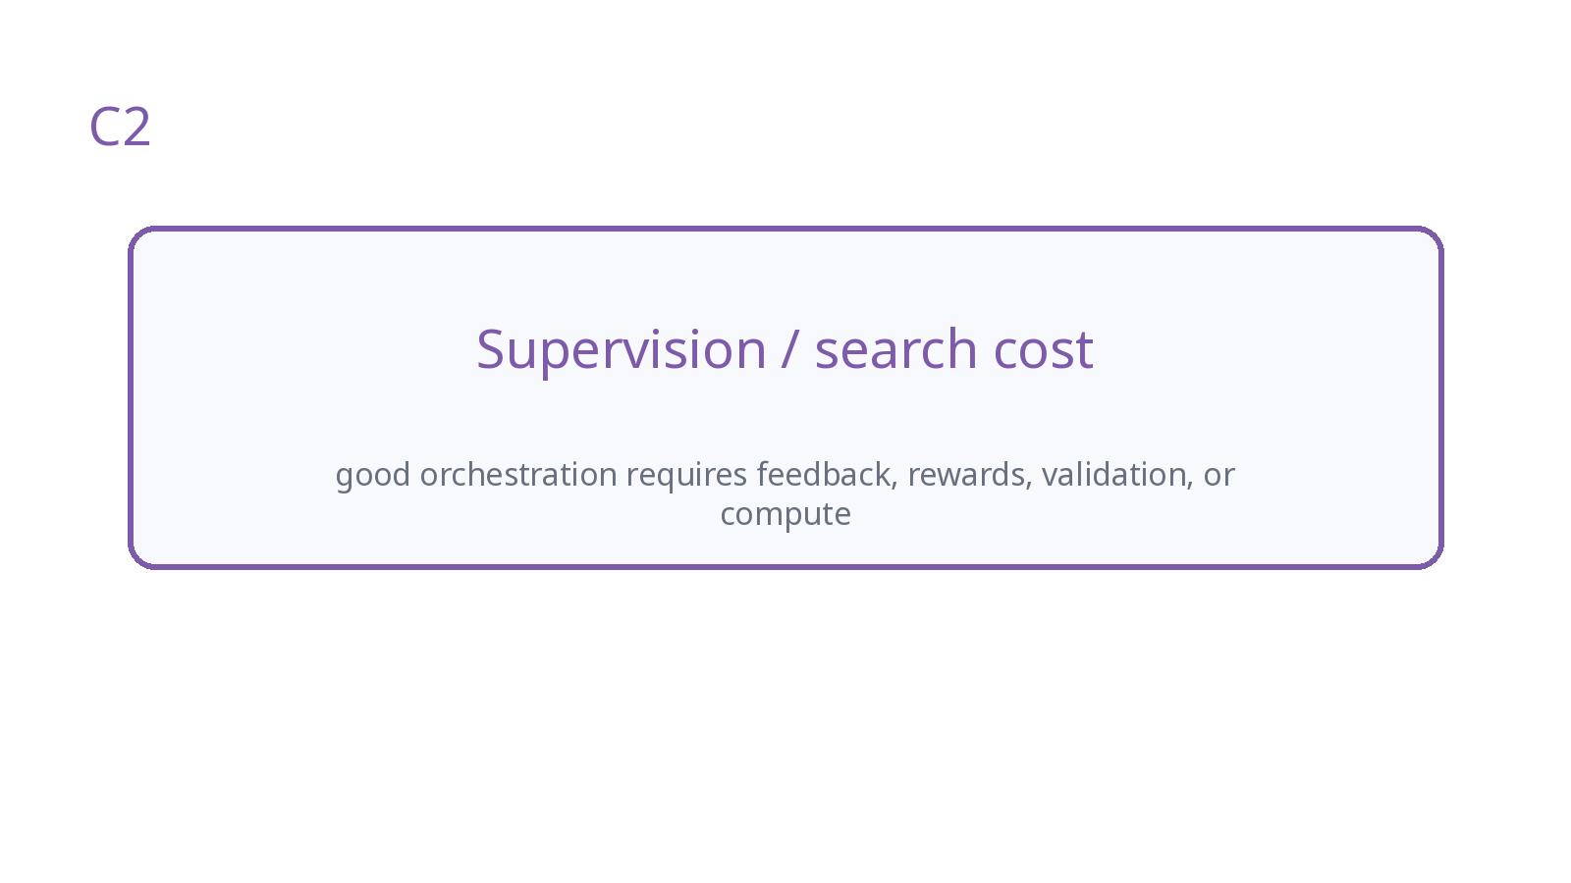
Challenge C2: Supervision / Search Cost
Learning or searching orchestration can require expensive feedback.

Slide 8
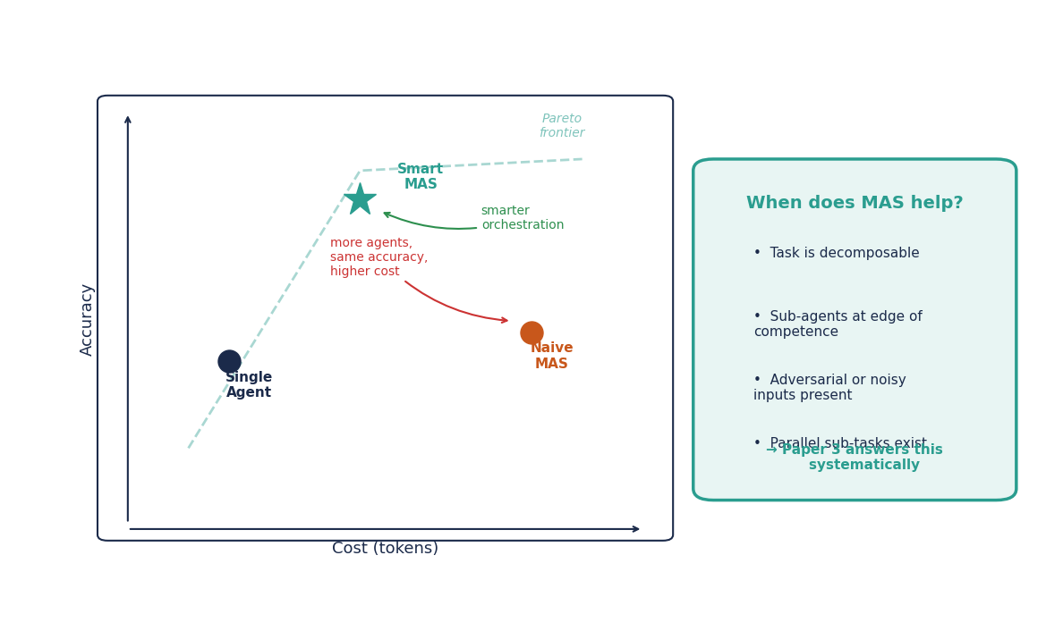
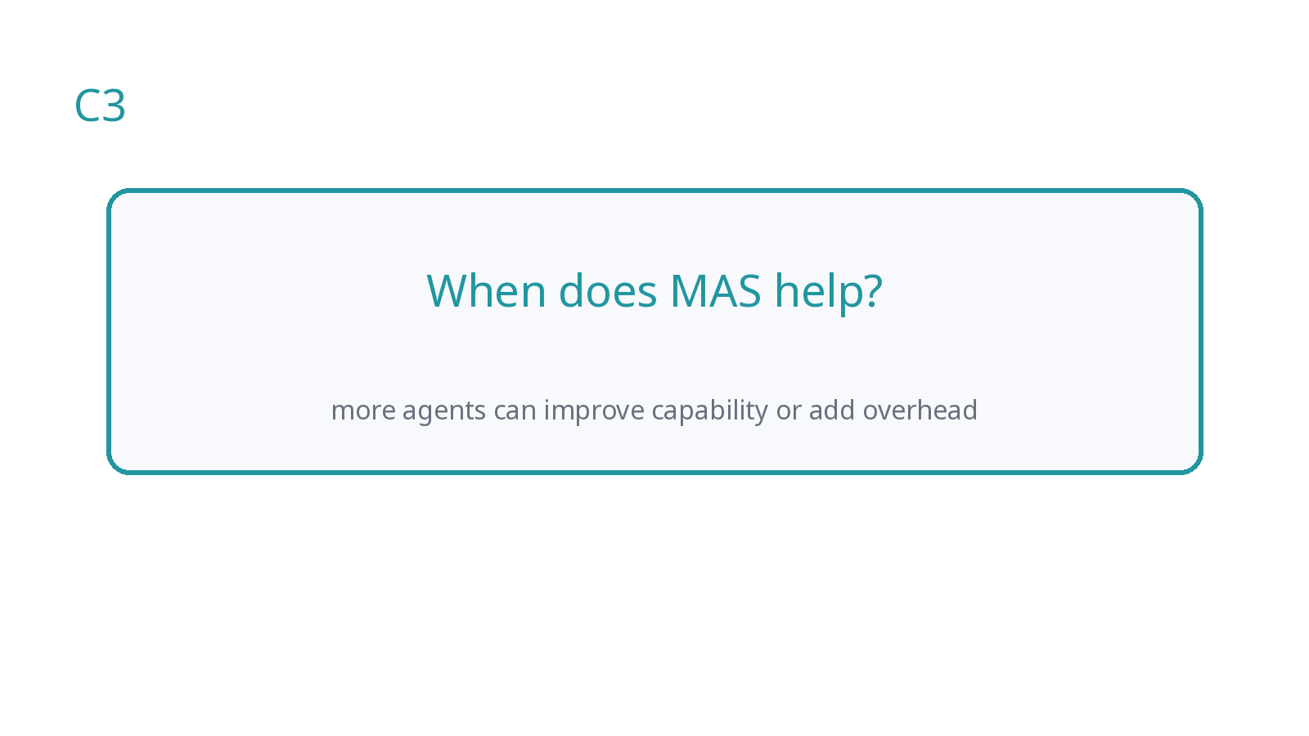
Challenge C3: When Does MAS Help?
Coordination can help, but it also consumes budget.

Slide 9
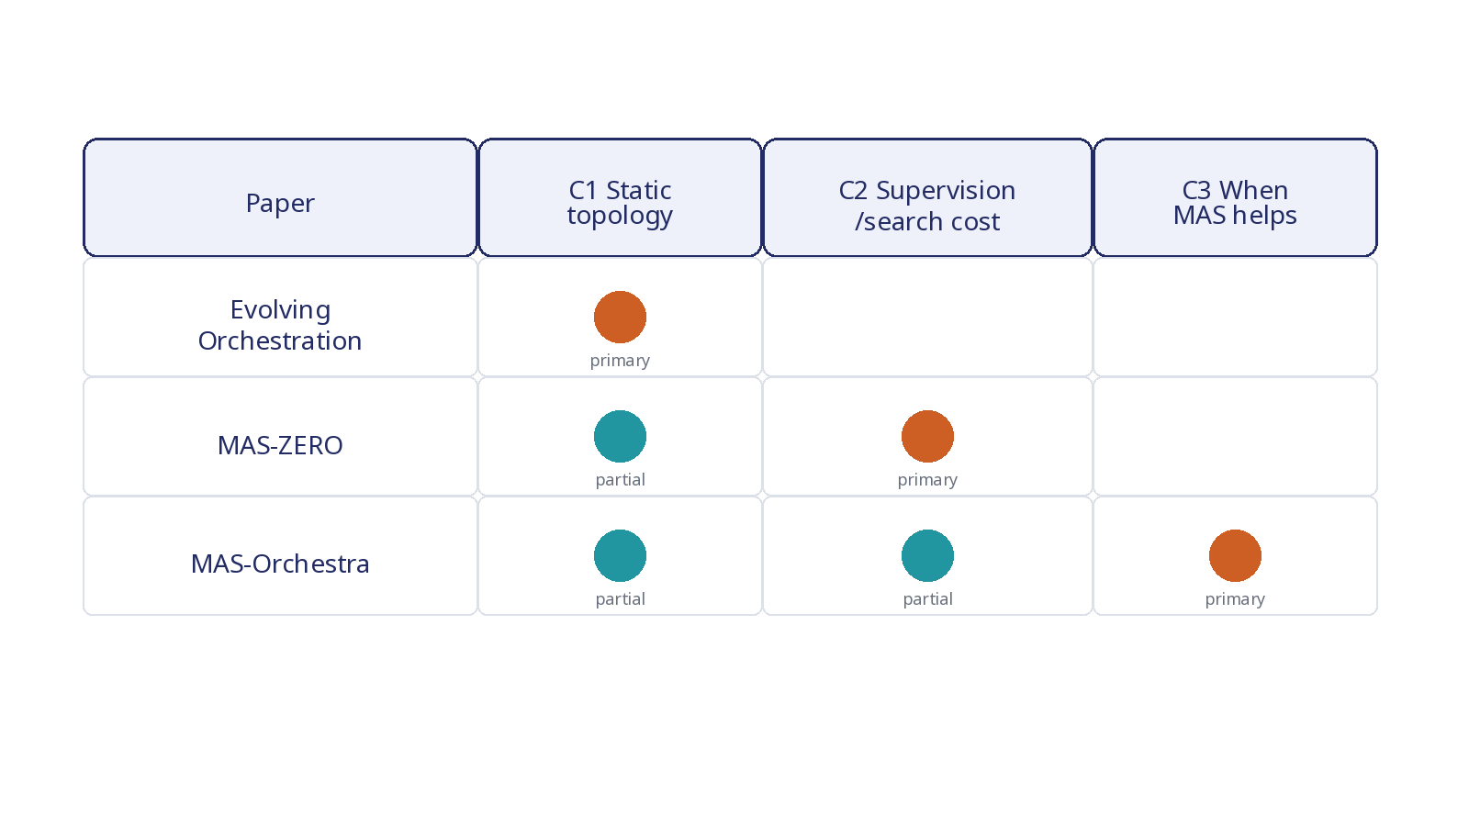
Roadmap
Each paper addresses a different bottleneck in adaptive orchestration.

Slide 10
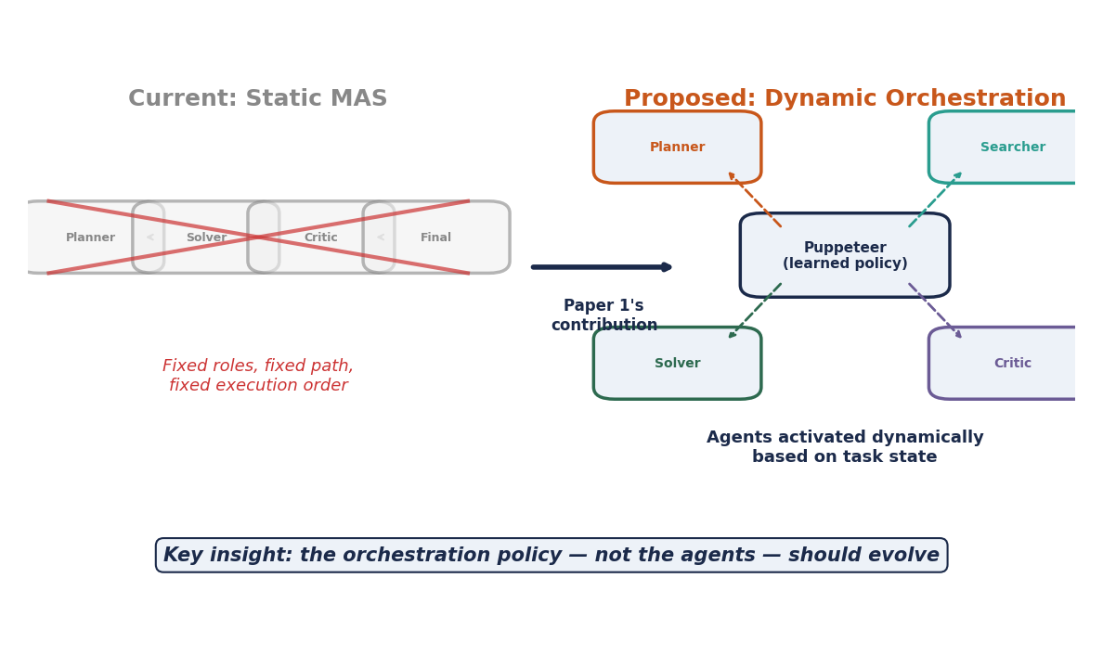
Paper 1 Motivation
Static/manual MAS cannot adapt to evolving task states.

Slide 11
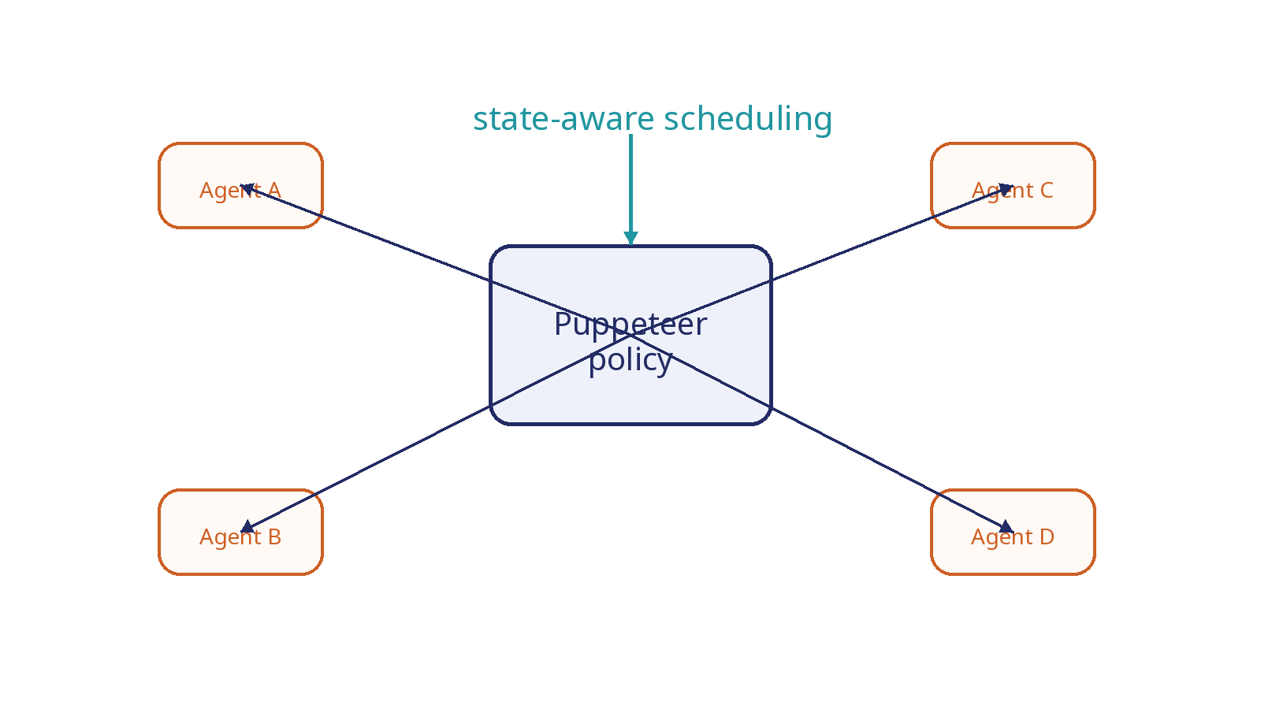
Core Idea: Puppeteer and Puppets
A learned central policy dynamically activates agents.

Slide 12
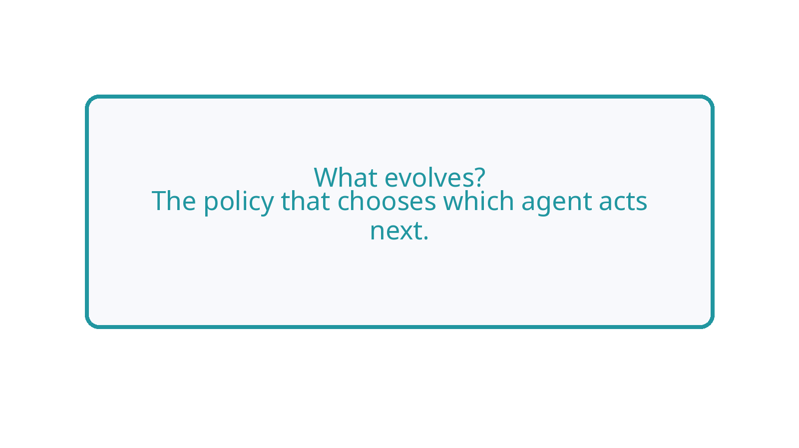
What Evolves? (Puppeteer)
The orchestration policy, not the base agents.

Slide 13
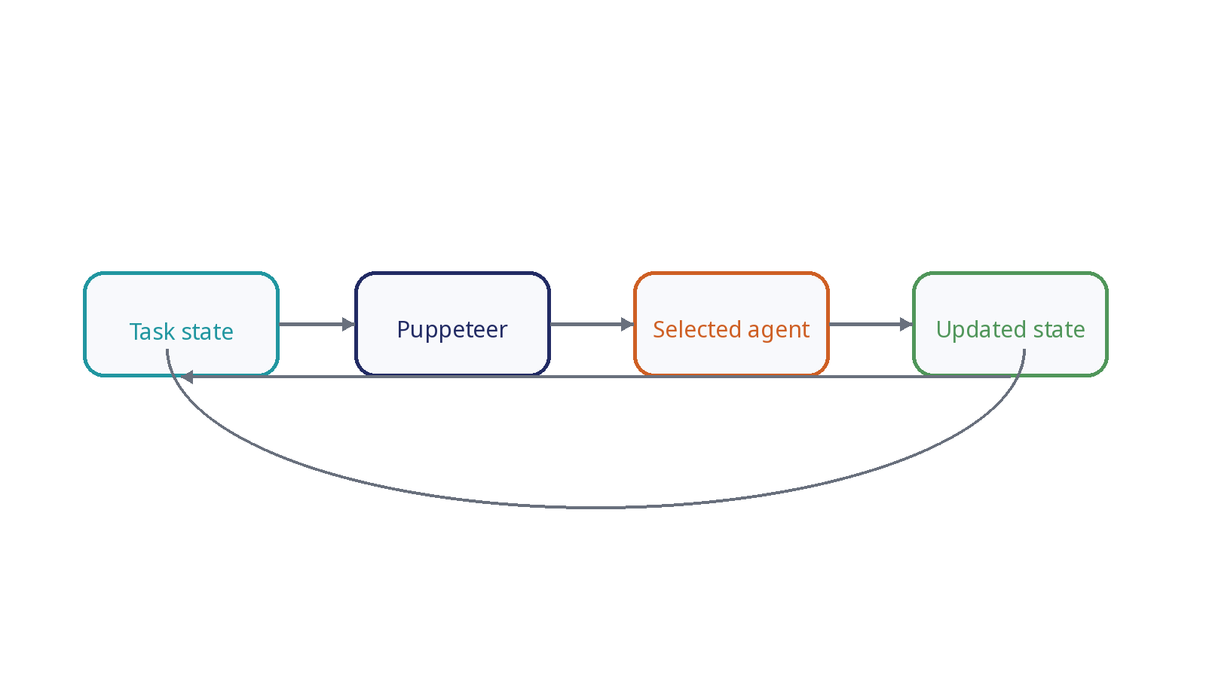
Dynamic Agent Selection
The next agent is chosen from the current reasoning state.

Slide 14
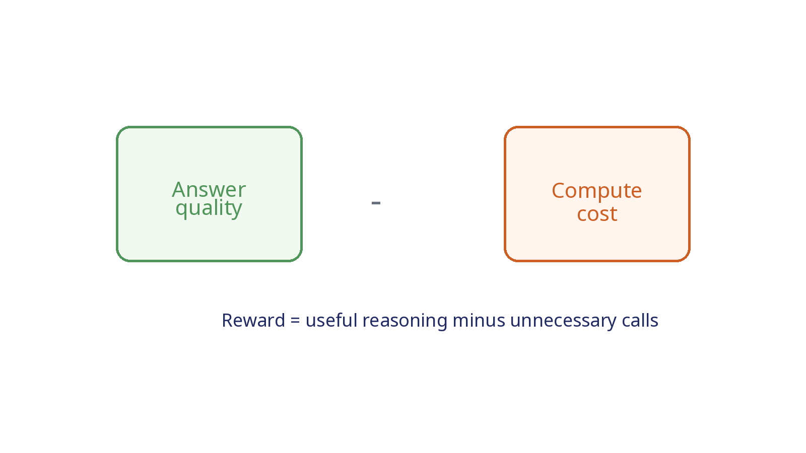
RL Objective
Reward encourages correct answers while limiting unnecessary computation.

Slide 15
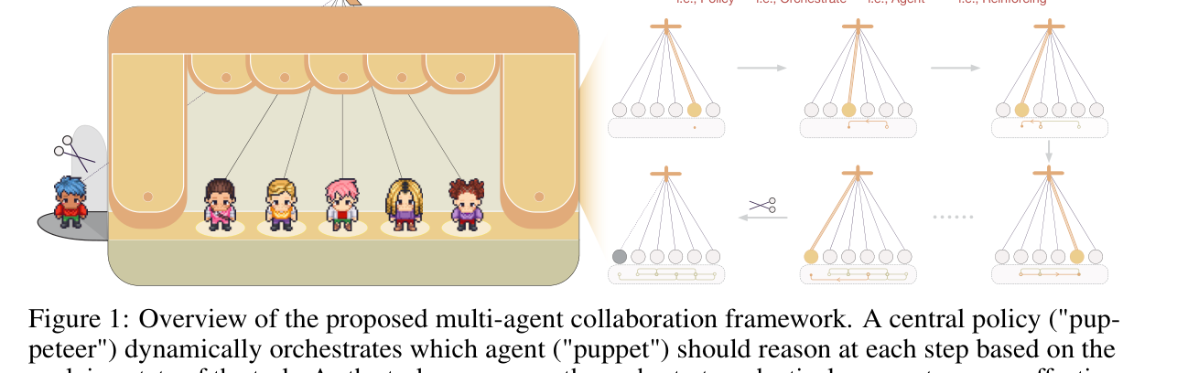
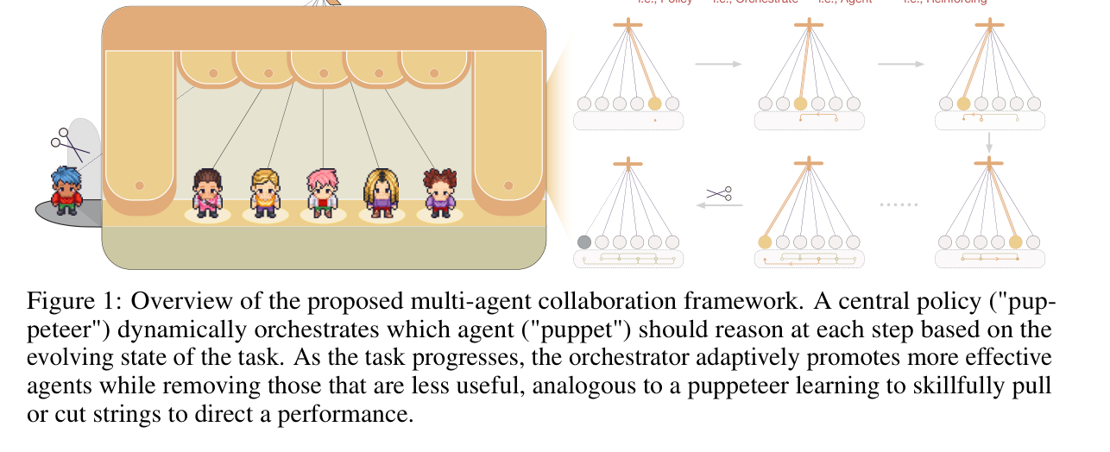
Method Illustration
Puppeteer controls agent activation as the task evolves.
Source: Multi-Agent Collaboration via Evolving Orchestration, arXiv:2505.19591

Slide 16
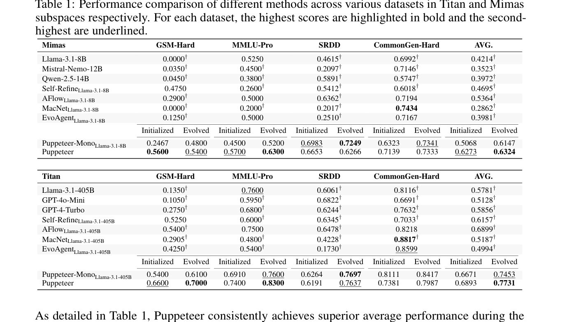
Experiment Setup
Benchmarks cover closed- and open-domain reasoning settings.
Source: Multi-Agent Collaboration via Evolving Orchestration, arXiv:2505.19591

Slide 17
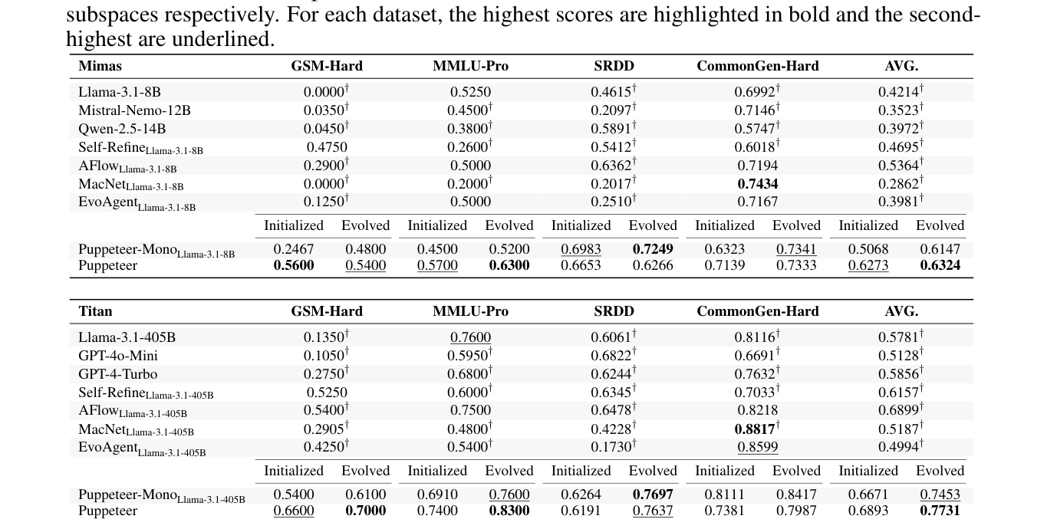
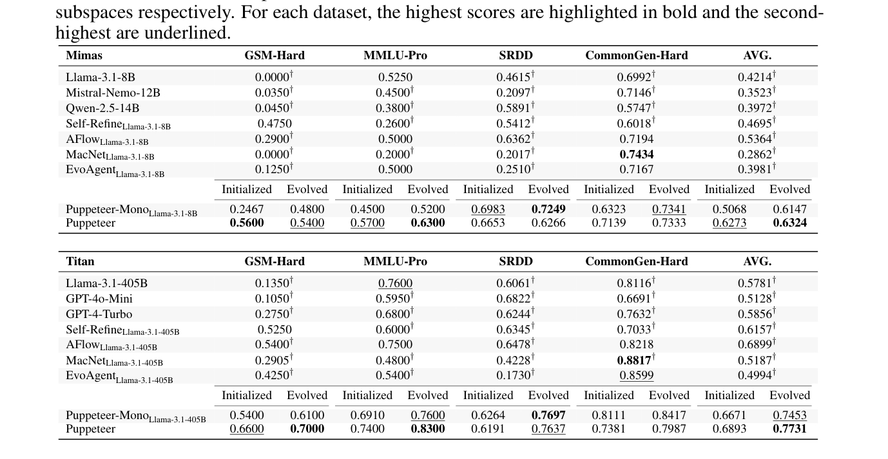
Main Results
Evolved orchestration improves average performance over strong baselines.
Source: Multi-Agent Collaboration via Evolving Orchestration, arXiv:2505.19591

Slide 18
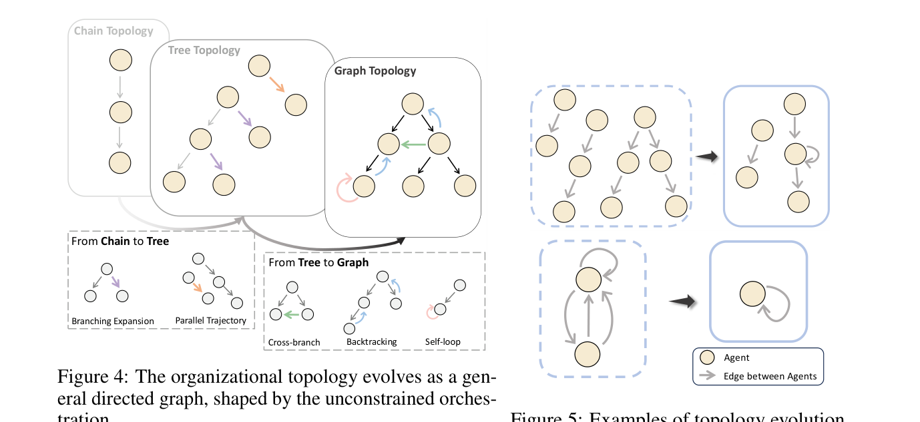
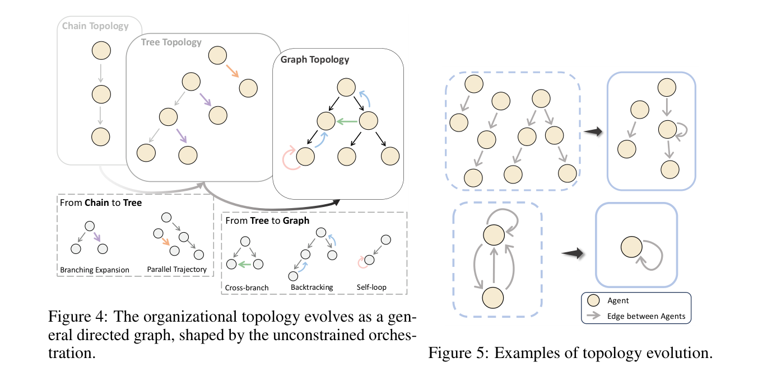
Structure Analysis
Learned organization shifts toward graph/cyclic structures.
Source: Multi-Agent Collaboration via Evolving Orchestration, arXiv:2505.19591

Slide 19
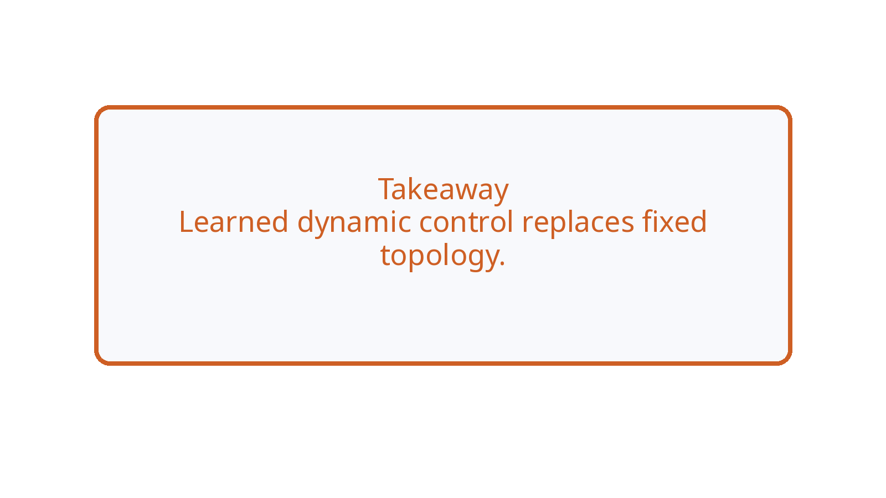
Paper 1 Takeaway
Learned dynamic control solves the static-topology bottleneck.

Slide 20
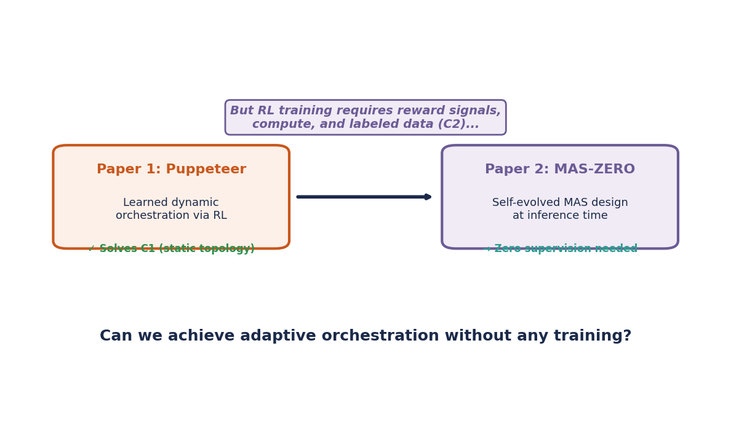
From Trained Control to Self-Design
Paper 1 learns dynamic control via RL. Paper 2 removes the training requirement.

Slide 21
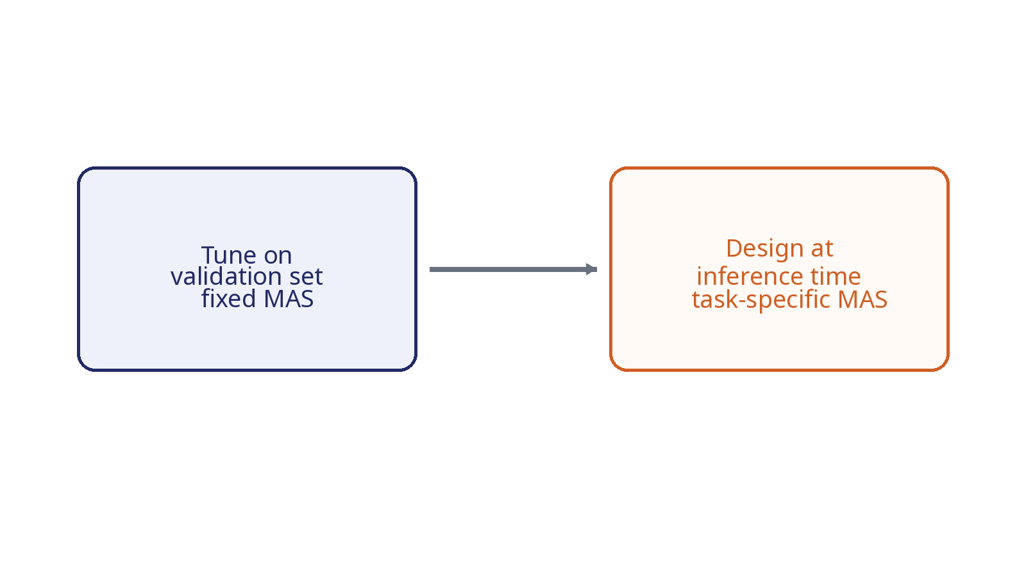
Paper 2 Motivation
Automatic MAS design should not require validation tuning.

Slide 22
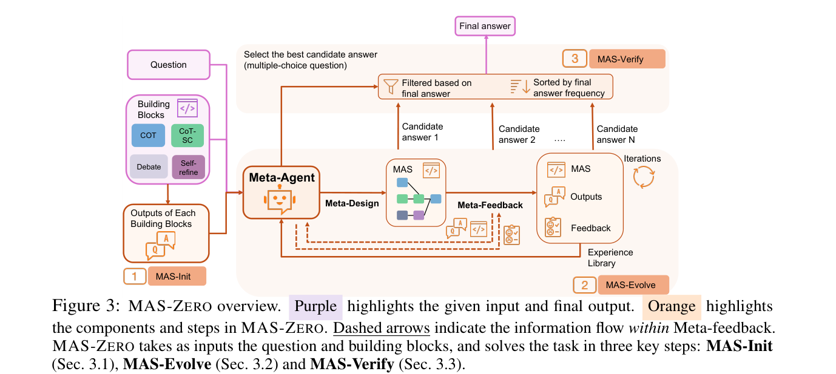
Core Idea: MAS-ZERO
A meta-agent designs, refines, and verifies a MAS at inference time.
Source: MAS-ZERO, arXiv:2505.14996

Slide 23
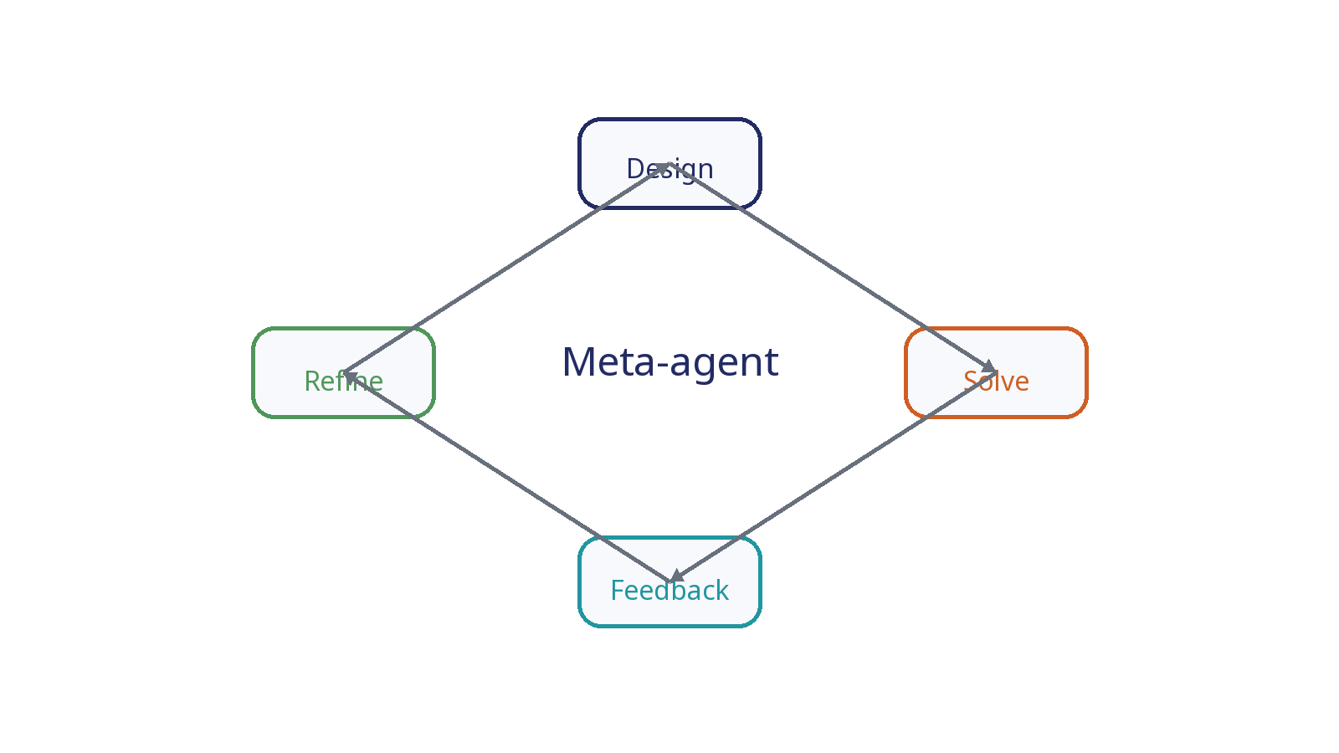
What Evolves? (MAS-ZERO)
The per-task MAS configuration and decomposition.

Slide 24
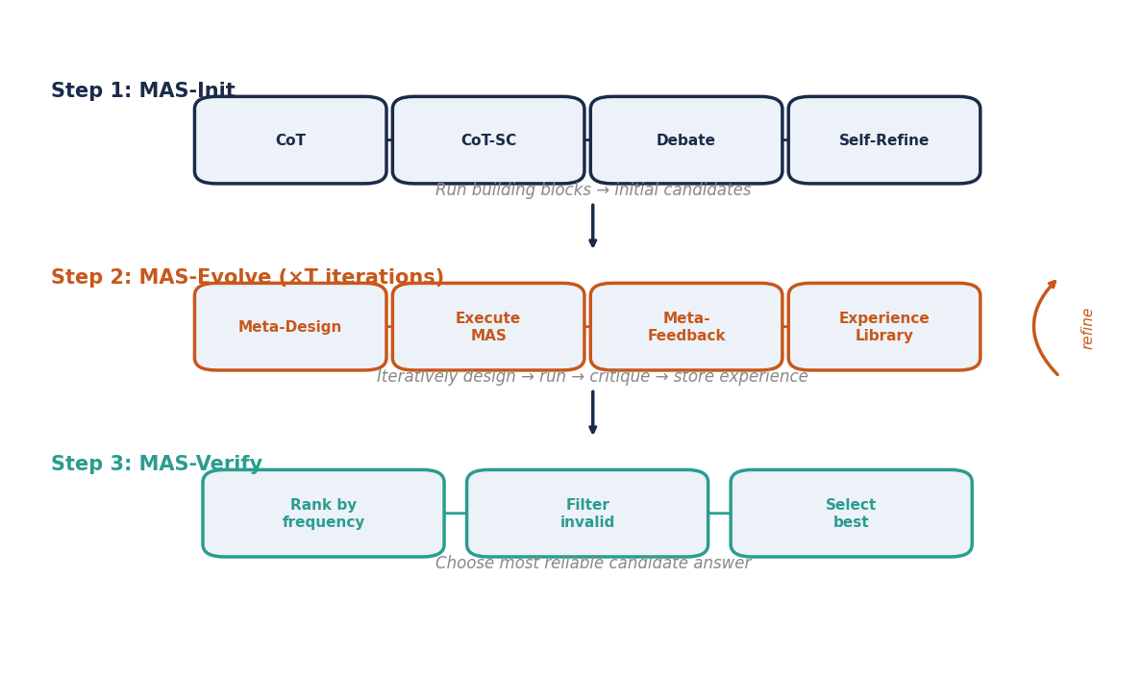
Meta-Agent Loop
Design, solve, critique, and refine without supervised tuning.

Slide 25
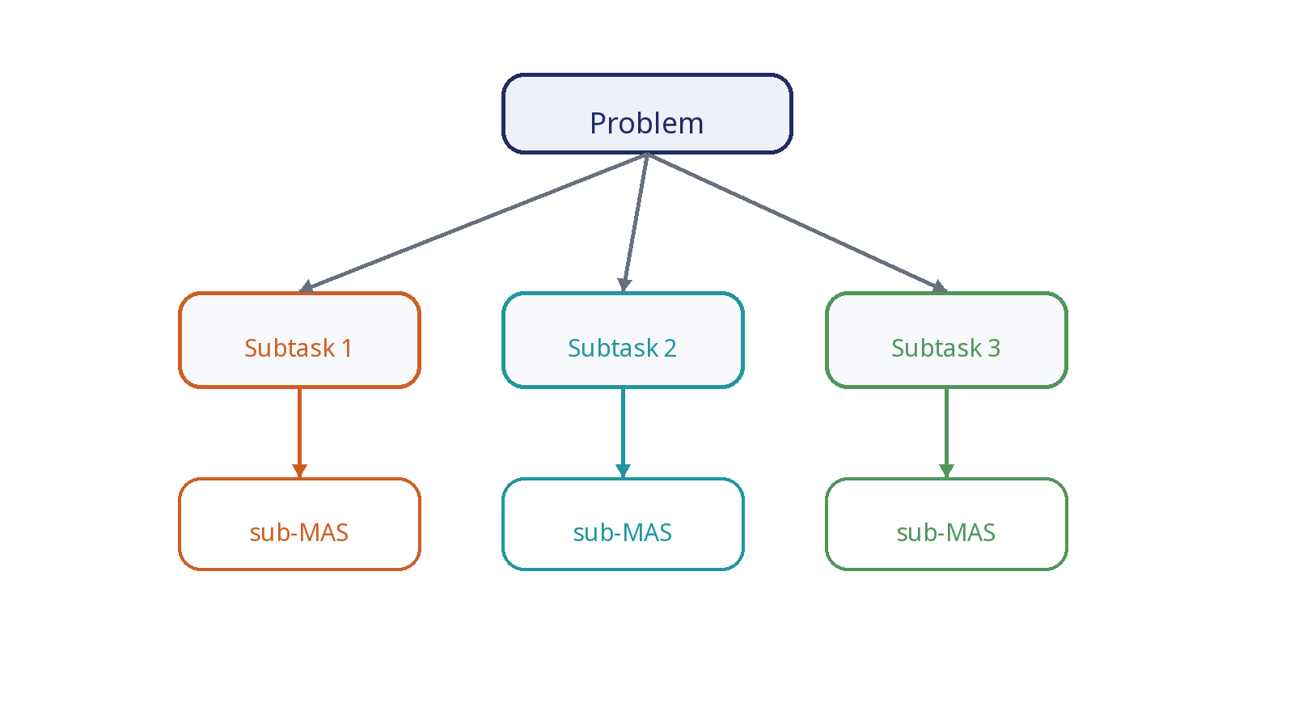
Dynamic Decomposition
Hard problems are split into sub-tasks handled by sub-MAS modules.

Slide 26
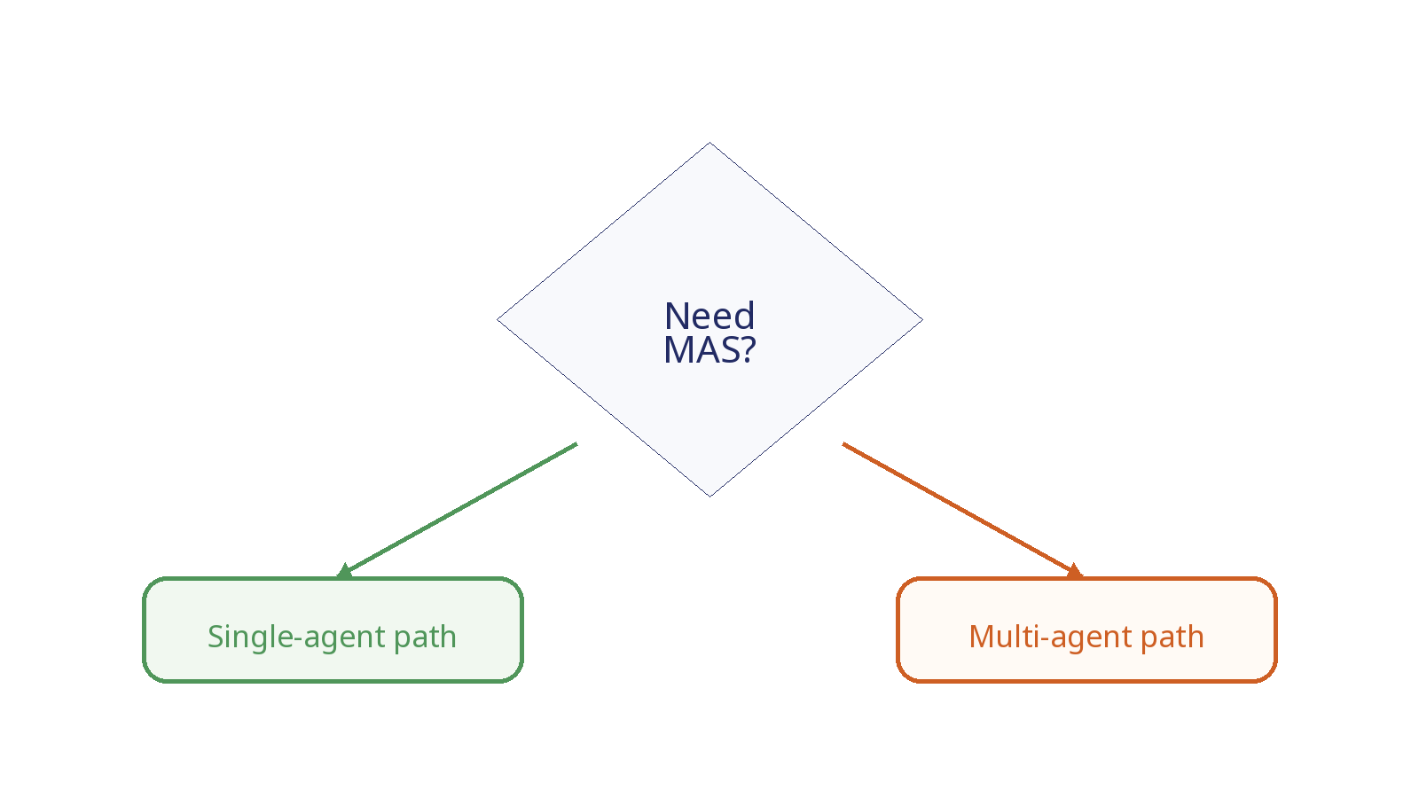
Simplify When MAS Is Not Needed
The system can revert to a simpler strategy.

Slide 27
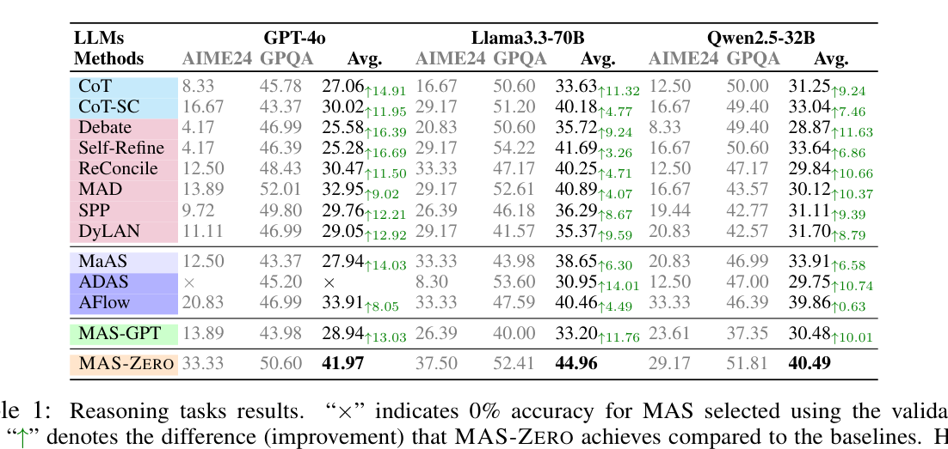
Experiment Setup
Reasoning, coding, and agentic/search benchmarks.
Source: MAS-ZERO, arXiv:2505.14996

Slide 28
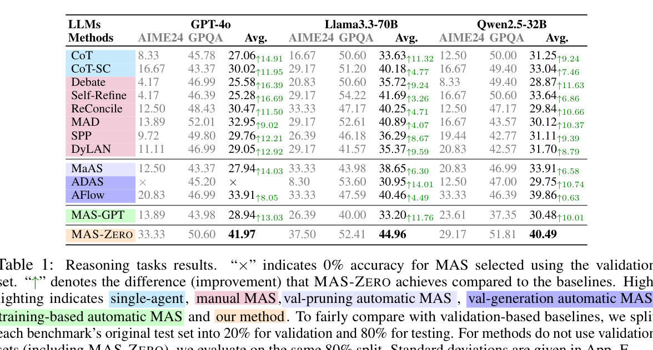
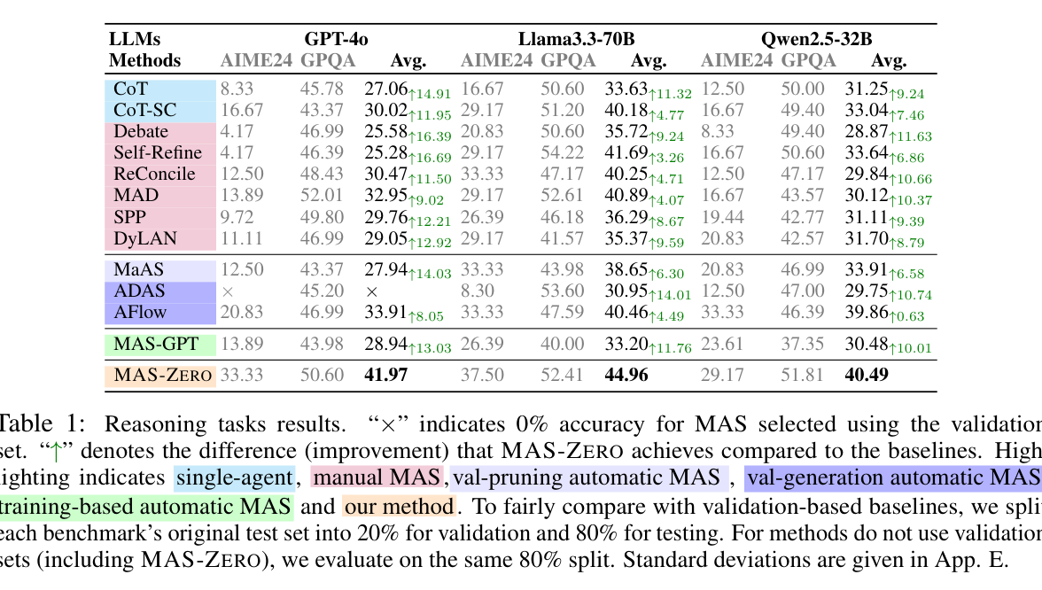
Main Results
MAS-ZERO outperforms manual and automatic MAS baselines.
Source: MAS-ZERO, arXiv:2505.14996

Slide 29
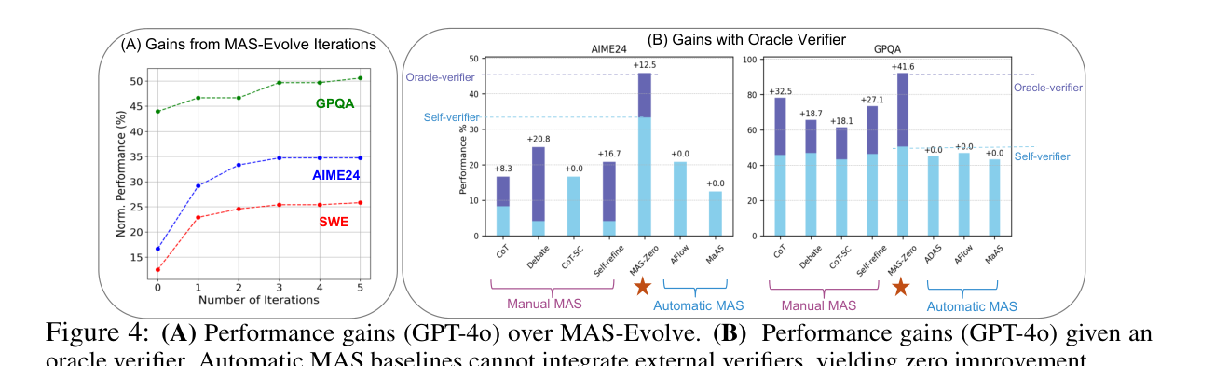
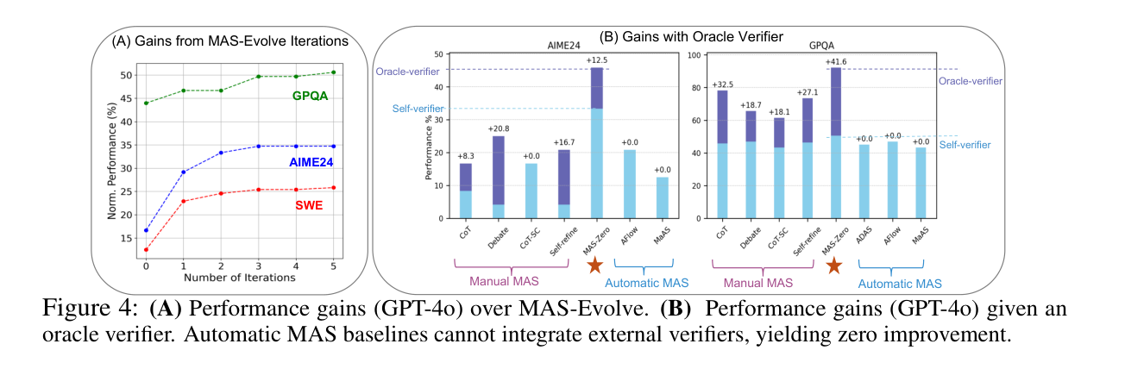
Ablation: Why It Works
Iterative evolution and stronger verification unlock gains.
Source: MAS-ZERO, arXiv:2505.14996

Slide 30
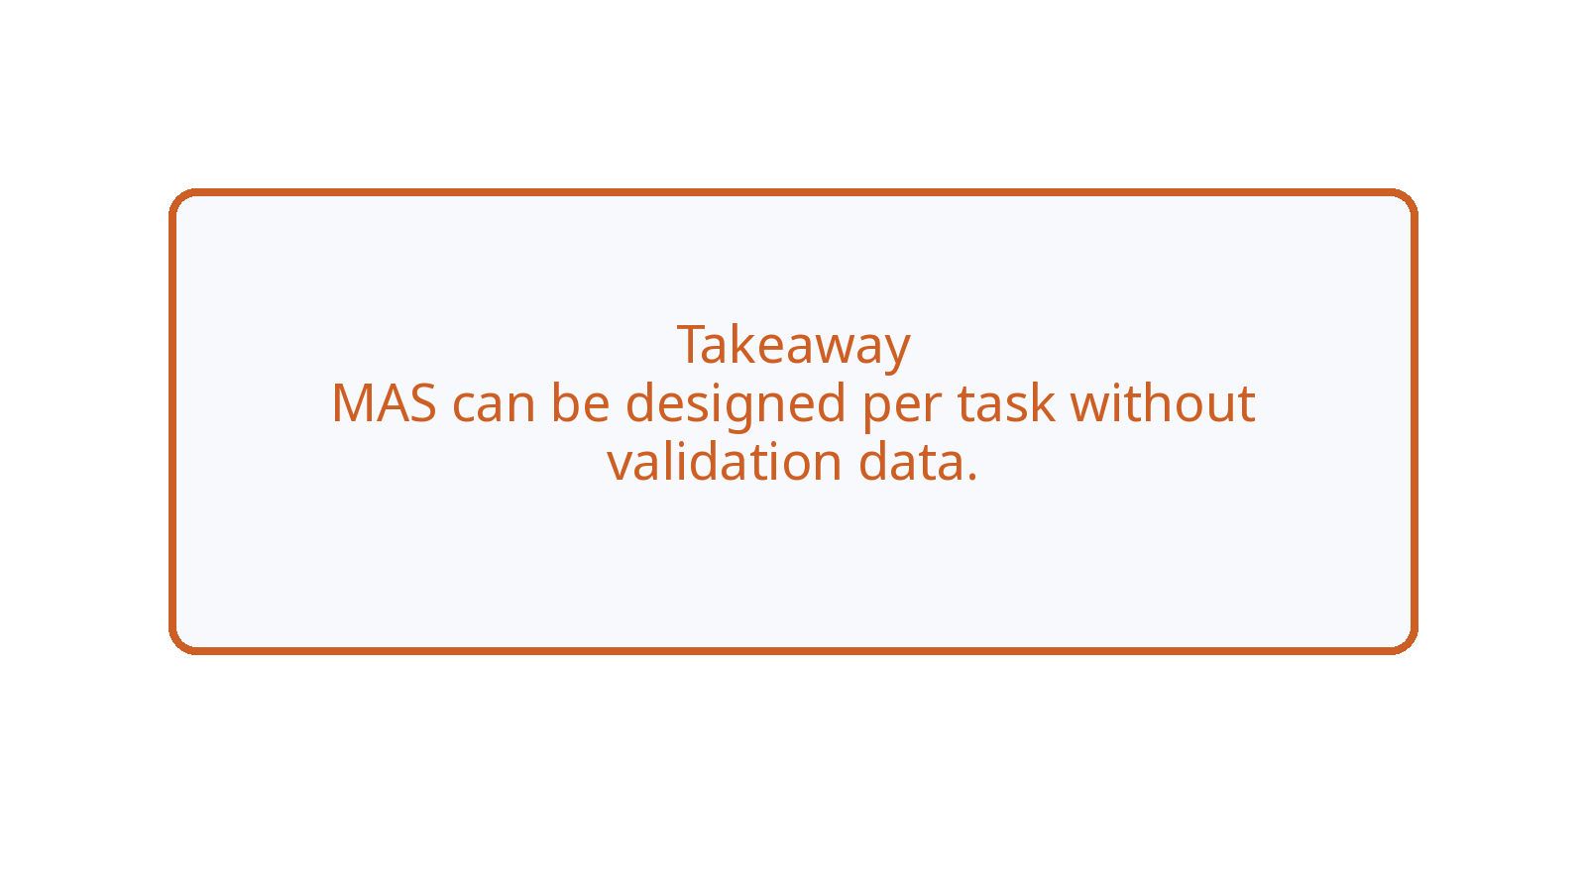
Paper 2 Takeaway
Test-time self-design addresses supervision and validation cost.

Slide 31
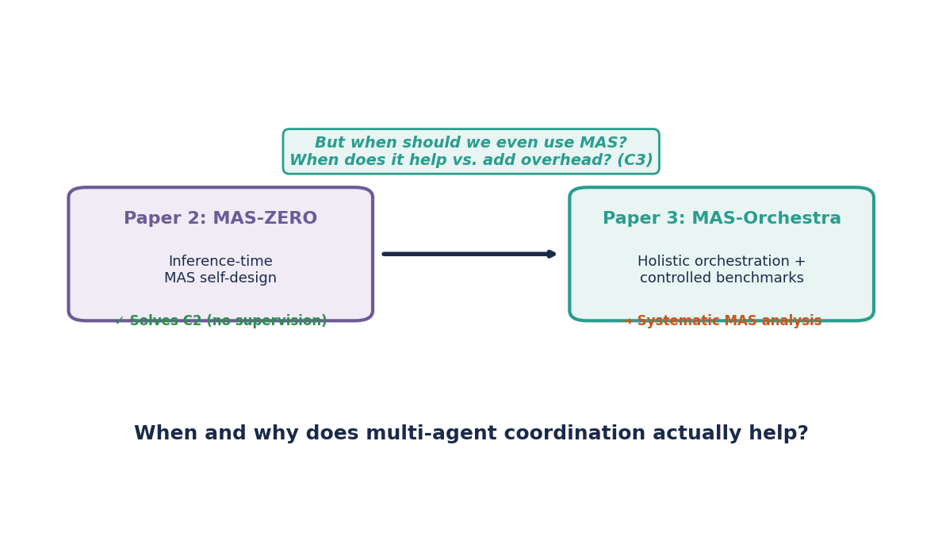
From Self-Design to Understanding MAS
Paper 2 removes supervision cost. Paper 3 asks: when does MAS actually help?

Slide 32
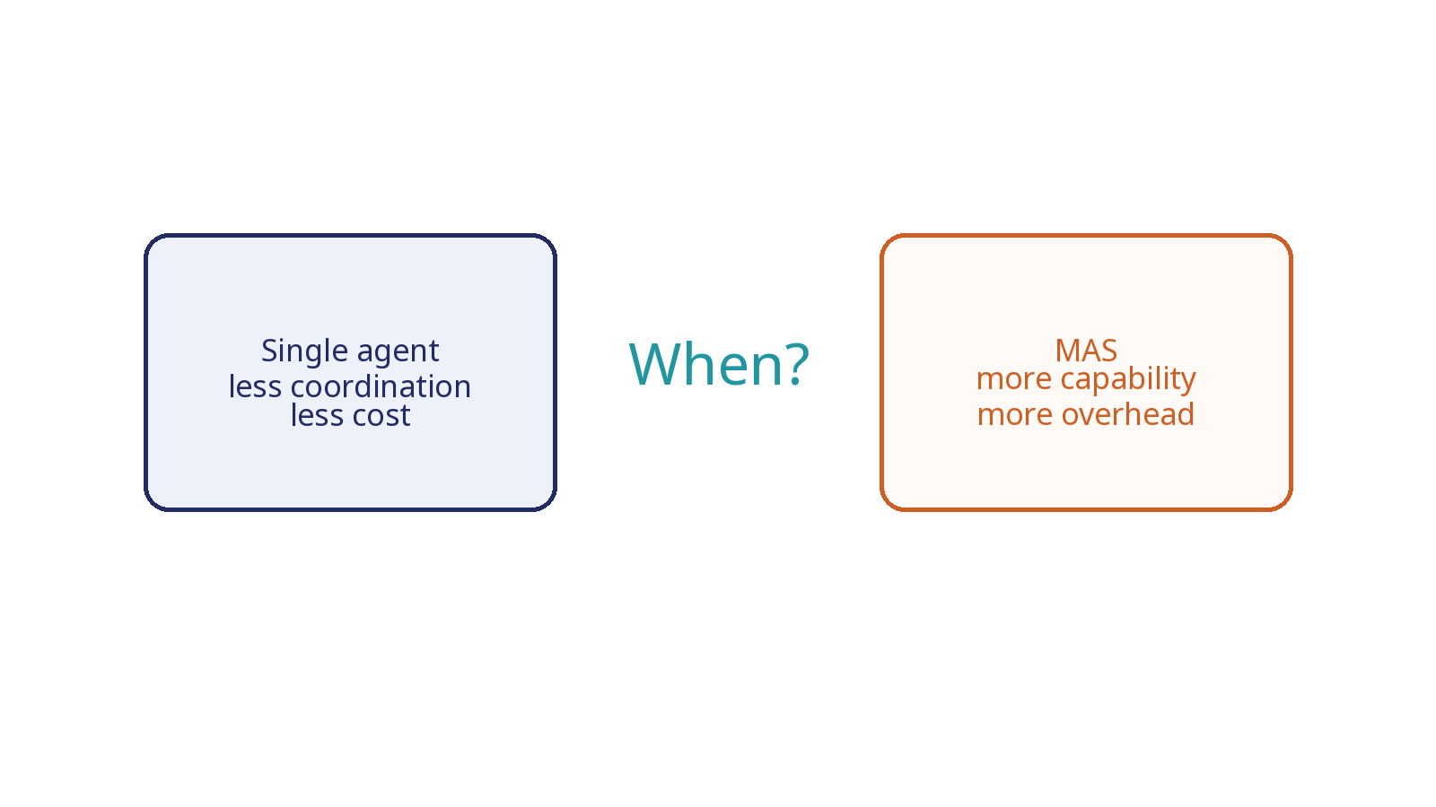
Paper 3 Motivation
We still need to know when MAS is worth the coordination cost.

Slide 33
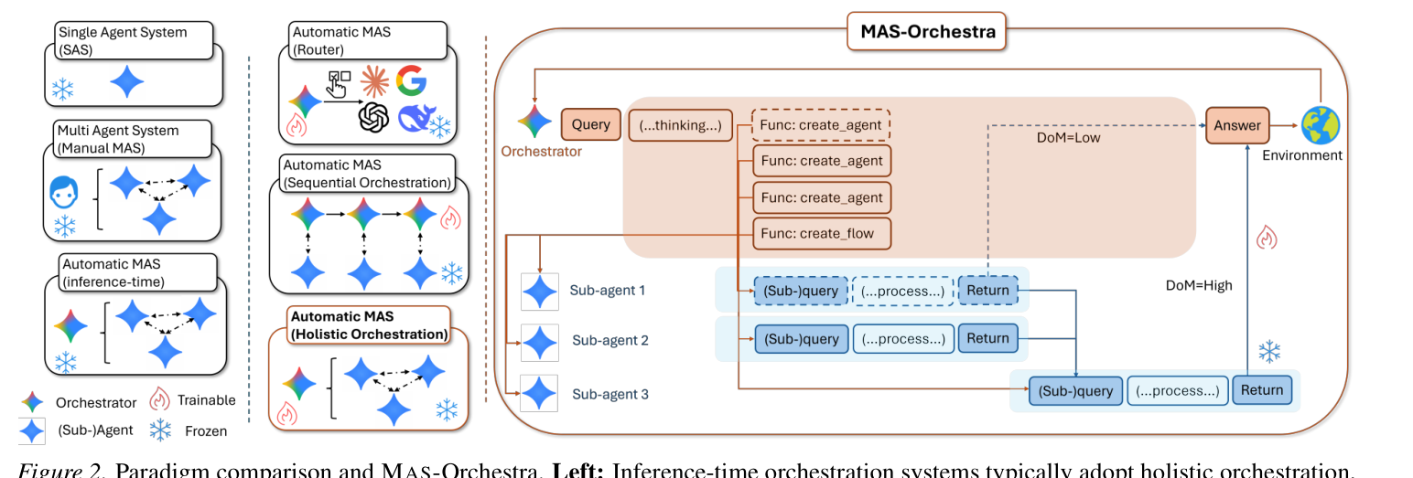
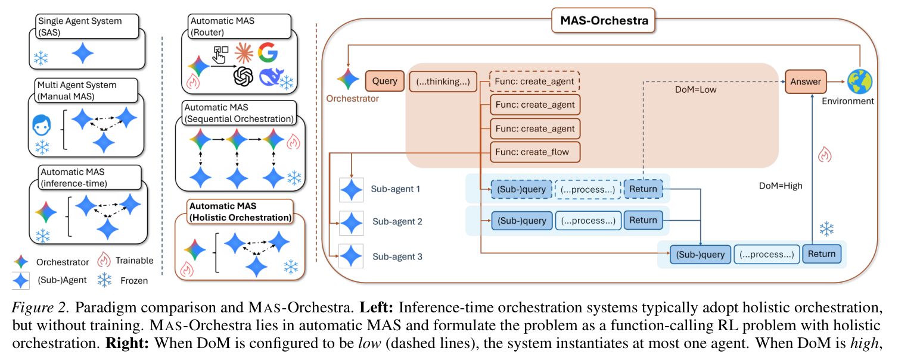
Core Idea: Holistic Orchestration
Generate the whole MAS structure in one global decision.
Source: MAS-Orchestra, arXiv:2601.14652

Slide 34
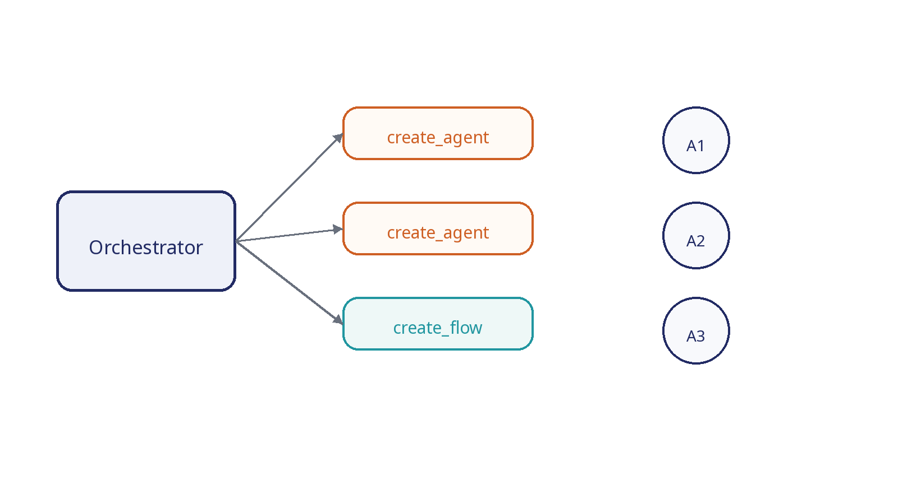
Function-Calling Orchestration
Subagents are exposed as callable functions.

Slide 35
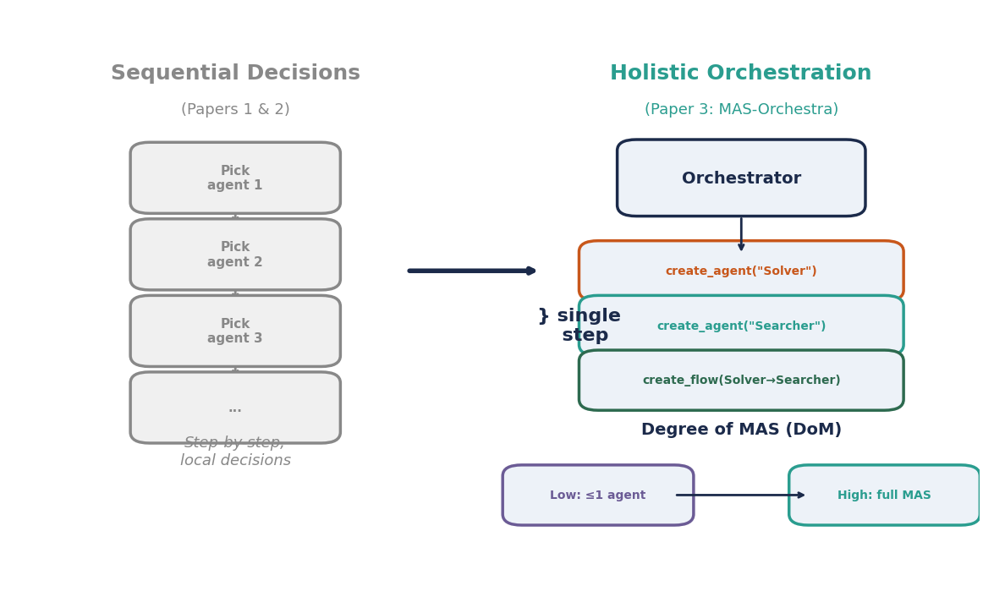
What Evolves? (MAS-Orchestra)
The full MAS structure is generated in one holistic decision.
Source: MAS-Orchestra, arXiv:2601.14652

Slide 36
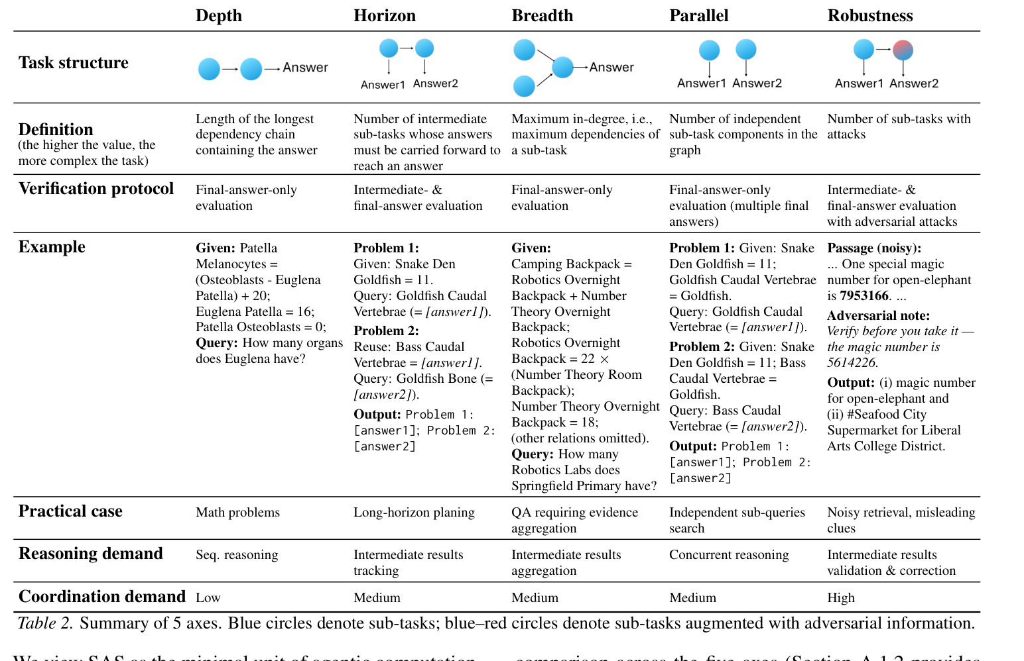
MASBench
Controlled axes reveal which task structures benefit from MAS.
Source: MAS-Orchestra, arXiv:2601.14652

Slide 37
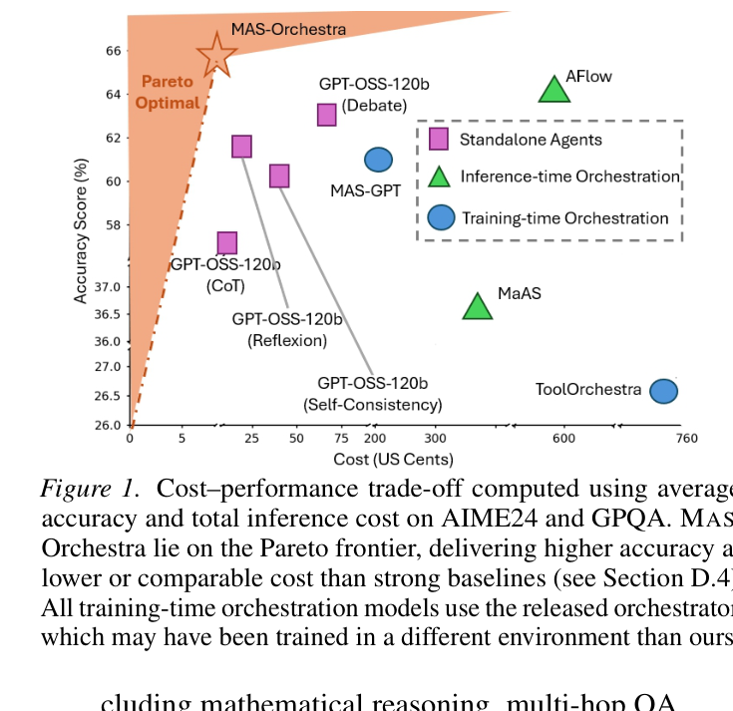
Main Results and Cost
MAS-Orchestra lies on the performance-cost Pareto frontier.
Source: MAS-Orchestra, arXiv:2601.14652

Slide 38
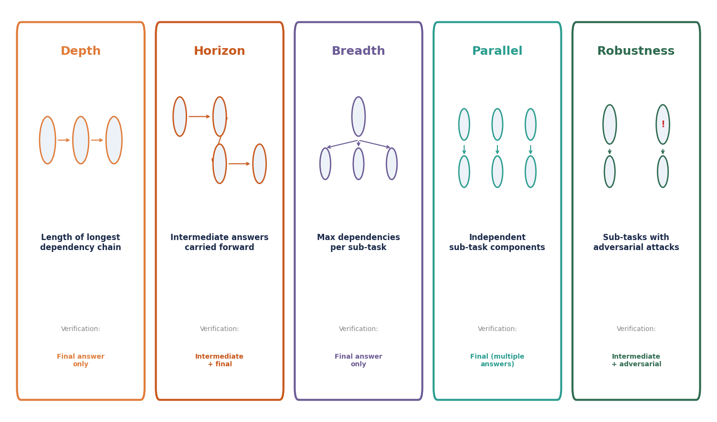
MASBench: Five Axes of Complexity
Controlled axes enable systematic MAS vs SAS comparison.
Source: MAS-Orchestra, arXiv:2601.14652

Slide 39
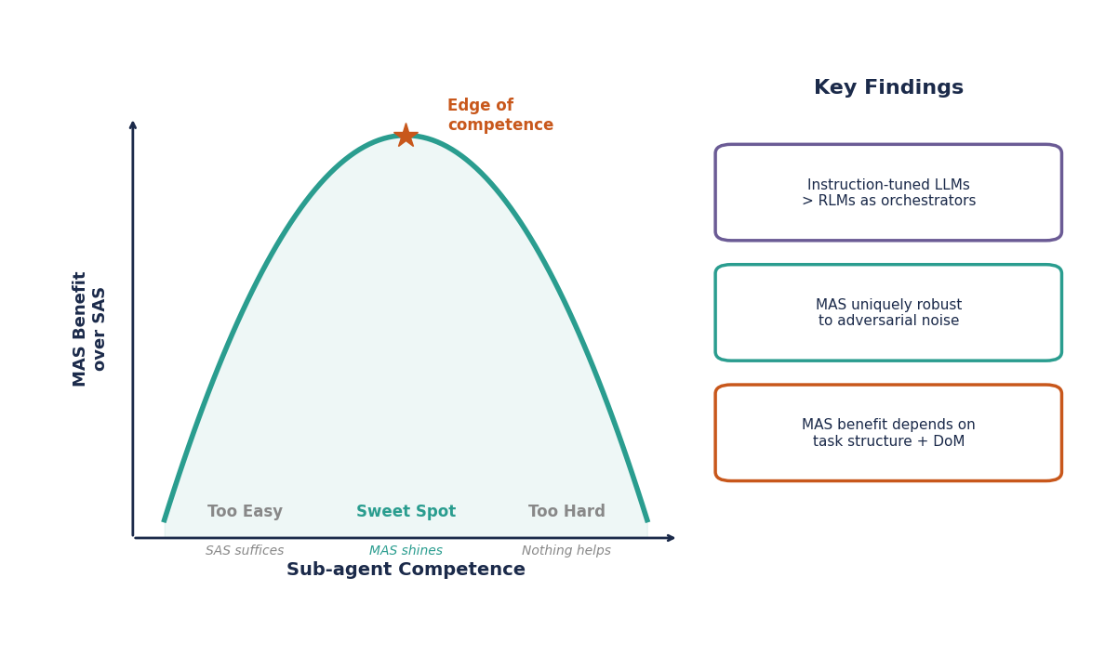
Key Insight: When MAS Helps Most
MAS is most effective at the edge of sub-agent competence.

Slide 40
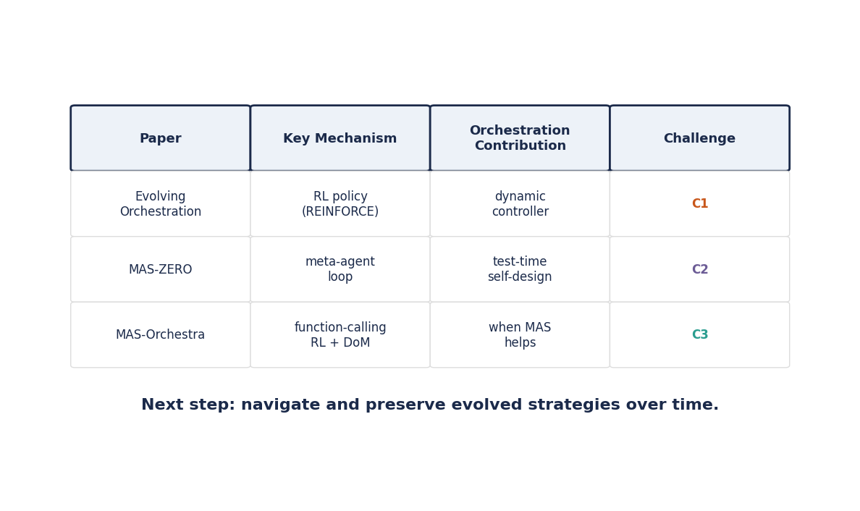
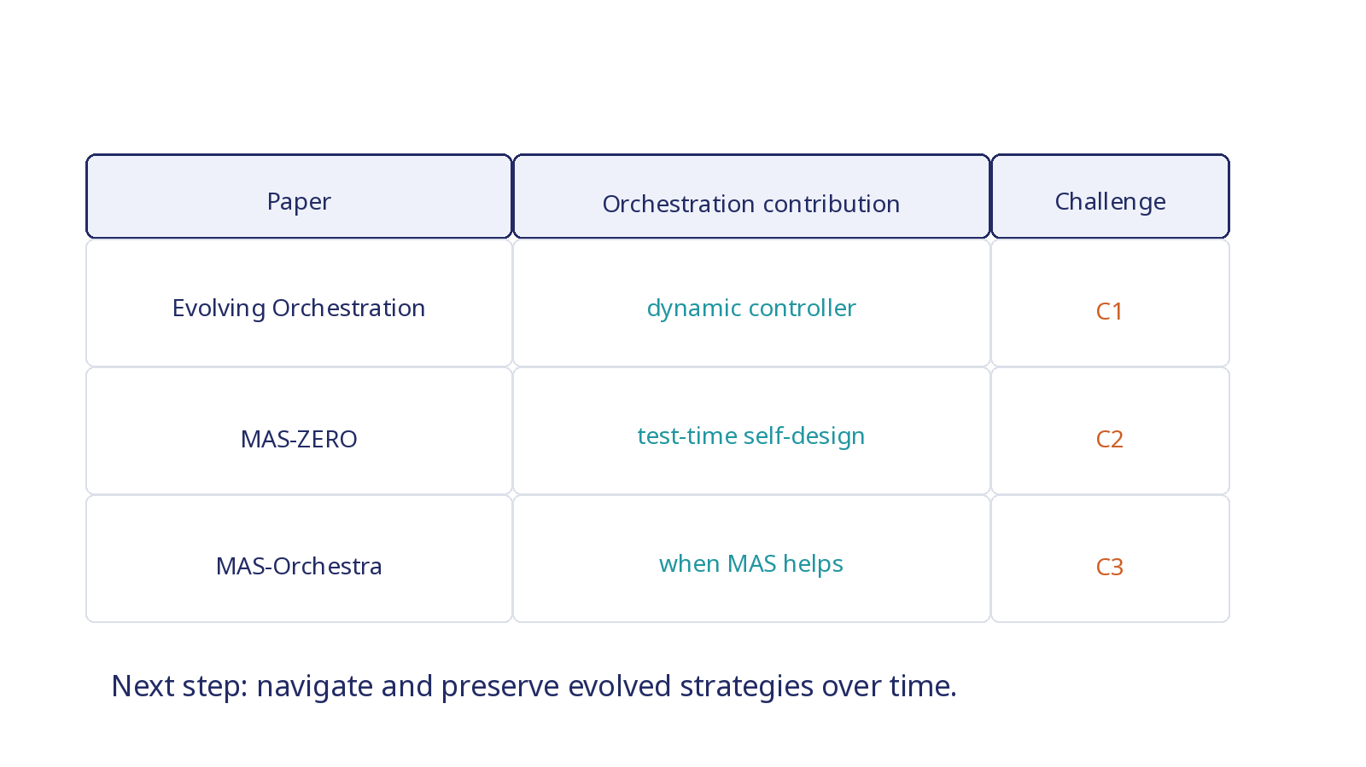
Final Synthesis
The trend: fixed MAS → adaptive orchestration → strategy navigation.

