Slide 1
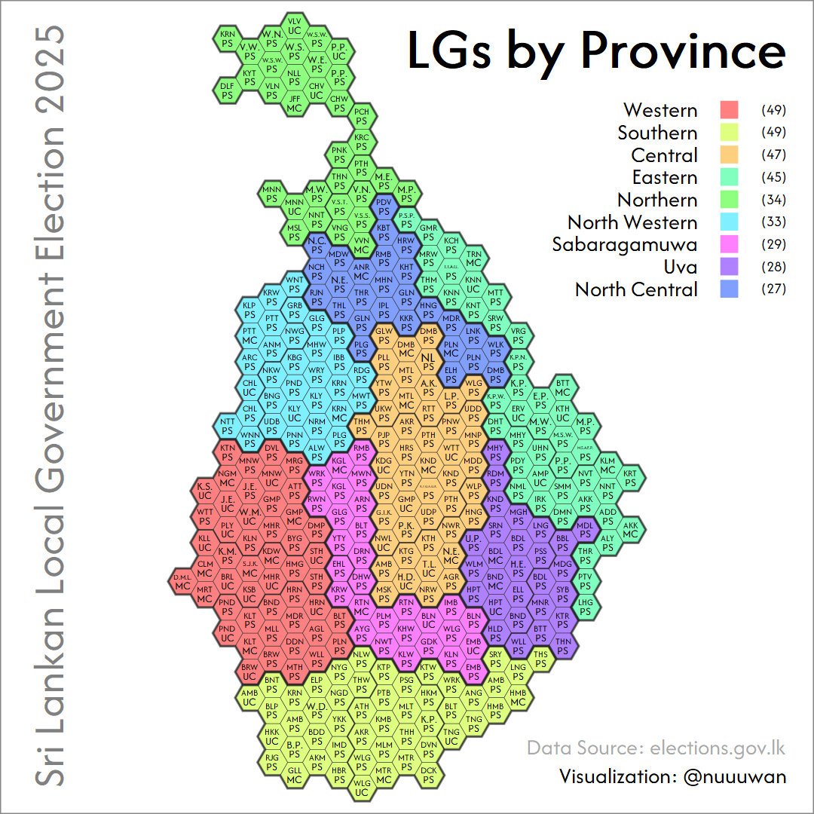
Notes:
Sri Lankan Local Government Election 2025
Results Explained in HexMaps
HexMaps & LGs

