Slide 1
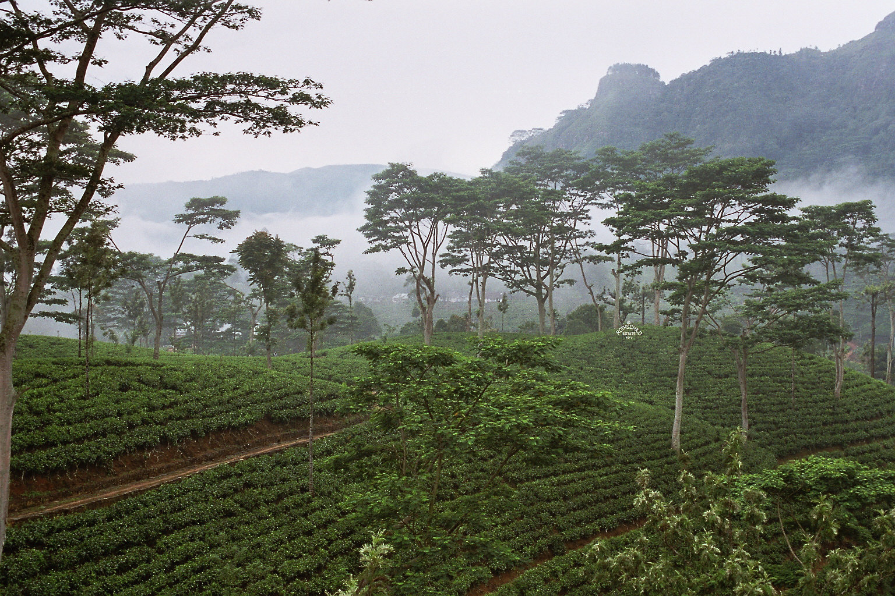
Notes:
This is an image from a tea-estate in Sri Lanka.

