Slide 1

Thimble
6/9/15
Notes:
We’re Thimble, and our mission is to help budding independent fashion designers launch their professional careers. But before we tell you about the product, we want to tell you about ourselves.

Slide 2
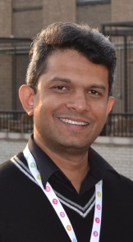
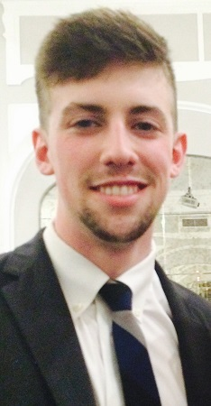
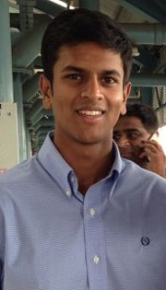

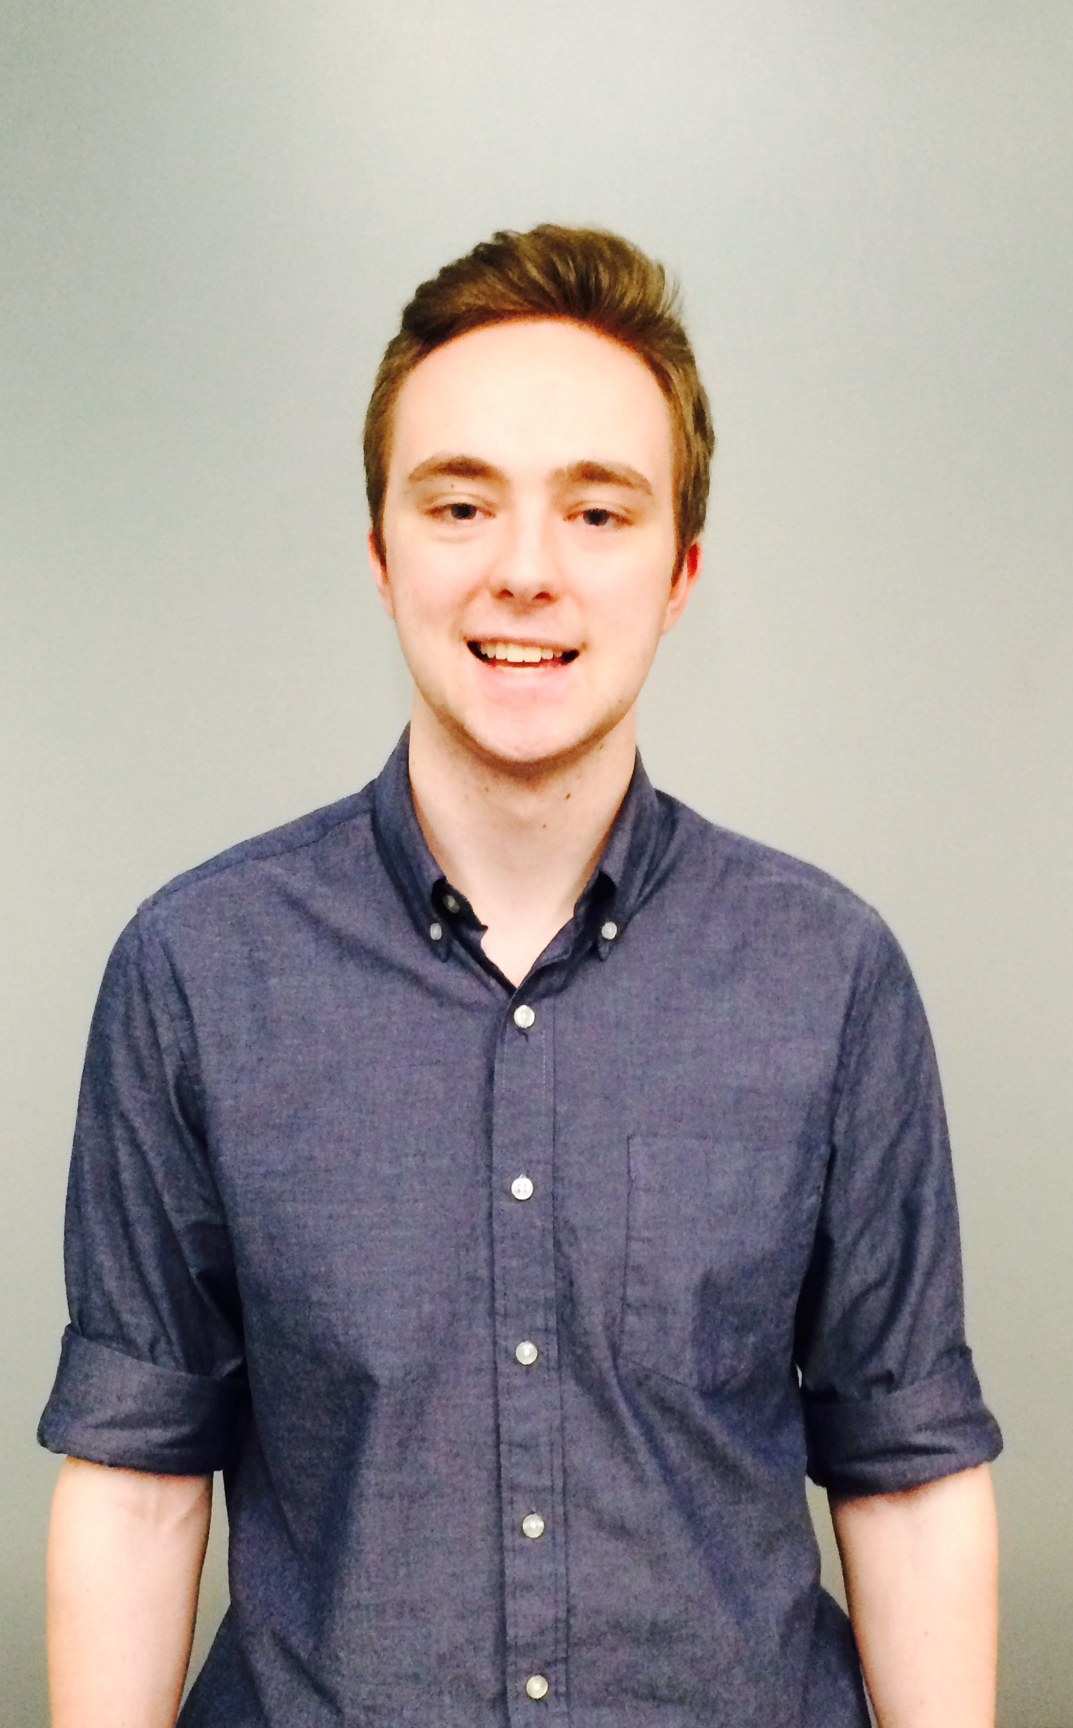
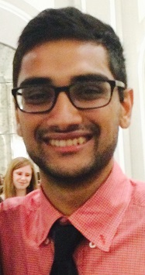
Chacko Poothicote
McCormick Masters
Engineering Management
Clayton Gentry
Medill Sophomore
Journalism, English literature
Nihar Bobba
Weinberg Junior
Economics, Mathematics
Henry Spindell
Weinberg Senior
Computer Science
Ryan Madden
McCormick Sophomore
Computer Science
Salil Gupta
McCormick Senior
Computer Science
Notes:
It’s no secret we’re six guys, several of them whose primary occupation is in a CS or IT realm. And here we are, operating in the independent fashion space. That said, we’re going to take it on ourselves to prove today that over the course of the past six months, we’ve come to understand this market really well.

Slide 3
12 Boutiques
20 Designers
1 Fashion Show
5 Fashion Schools
1 Fashion Incubator
3 Retail Chains
1 Fashion Expo
3 Textile Manufacturers
Notes:
Through cold-calls, walk-ins and coffee, we’ve engaged about 20 independent designers in Chicago, as well as 12 boutiques, 5 fashion schools and a host of other fashion aficionados in Chicago and elsewhere. Also, as a presentation note, you can see we’ve put our buyers – that is, boutiques and retailers – in brown, and our designers in yellow. We’ll hold to that color scheme to make sure we don’t create confusion over this two-sided market.

Slide 4
Tradeshows
Boutiques
Notes:
So what’s the problem?
Budding designers lack market visibility. To get into boutiques, first they need to get into tradeshows, which are expensive, elite and often geographically distant. But to be accepted to a tradeshow, you need a strong resume of boutique appearances. You see how this goes.

Slide 5
Bridge the gap between budding fashion designers and small boutiques.
Notes:
Thimble breaks down that barrier-to entry, bridging the gap between budding fashion designers and small boutiques.
How do we do that?

Slide 6
Virtual Tradeshow
Notes:
We host an ongoing virtual tradeshow where designers and boutiques can discover one another, just like they do at real-world tradeshows around the world.

Slide 7
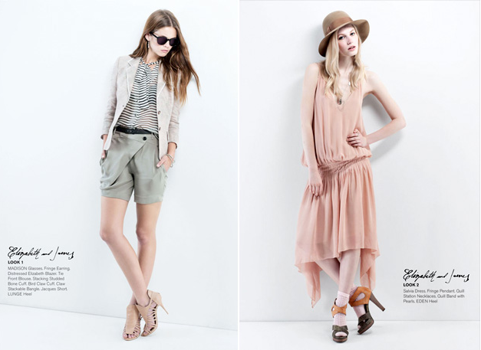
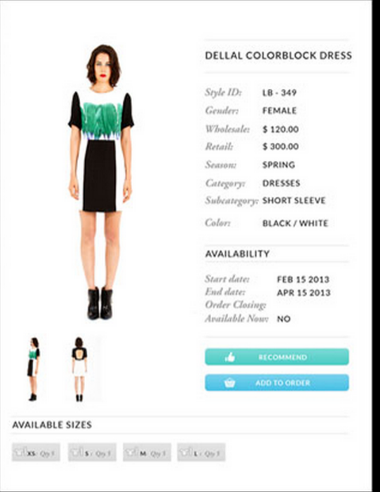
Lookbook
Linesheet
Notes:
Our tradeshows integrates both lookbooks to enable designer discovery, as well as linesheets, which host the data points that buyers need to know to handle a real transaction.

Slide 8
Designer Focus
Size
Designer Business Maturity
Notes:
We’re going to target on-the-rise designers who don’t YET have the funds or resume points to access in-person tradeshows in Paris, New York and Los Angeles. One such designer…(go to next slide)

Slide 9
“Having a platform like Thimble would definitely encourage me to be more enthusiastic about selling wholesale because the buyers are more attainable.”
Shruti Kirti, Designer-in-Residence
Chicago Fashion Incubator
Notes:
…Shruti Kirti, who designs out of the Chicago Fashion Incubator, thought about us during her meeting with one of the mentors at CFI about her selling strategy. Quote.
Through our research, we’ve gathered other insights as well.

Slide 10
Industry Insights
Notes:
Add Sarah notes
Zoe notes about Chicago as designer exporter

Slide 11
Targeted Styling
Notes:
The first piece of insight has to do with style matching. Buyers have told us a lot about how much spam they receive from designers who haven’t done the research and don’t match what their store sells. We want buyers to find the right designers, and designers to find the right buyers for them. We do that through a tagging system that allows buyers and designers to define themselves on their own terms. Then all we have to do is match them.

Slide 12
Safeguard
Buyers
Notes:
On that note, we have to safeguard buyers against designer mistakes. Most importantly, we have to ensure quality control and currency. Photos should be naturally lit, color schemes should be simple and truthful, and designers need to keep their fabrics up to date.

Slide 13
Market Size
Notes:
Add Sarah notes
Zoe notes about Chicago as designer exporter

Slide 14
35k
US boutiques
$27.1 bn
In total 2014 US boutique revenue
Source: IBIS World industry report Oct. 2014

Slide 15
59k
Fashion designers in US
$2.7 bn
In total 2014 US designer revenue
Source: IBIS World industry report Oct. 2014
Notes:
So the United States is a substantial market, but for us…(go to next slide)
Source: IBIS World industry report Oct. 2014

Slide 16
Virality begins at local programs like School of the Art Institute, Columbia College and other fashion schools.
Notes:
Virality begins at local programs like School of the Art Institute, Columbia College and other fashion schools – we have contacts at the fashion school at Kent State University in Ohio, for example.

Slide 17
Potential partnerships include CFI, CFDA and Mayor’s Fashion Council.
Notes:
We see potential partnerships with the Chicago Fashion Incubator, the Council of Fashion Designers of America, and the Mayor’s Fashion Council. We’ve already built close relationships with two designers in CFI and have the opportunity to talk to four more through its Designer-In-Residence program. We’re also working with the co-chair of the Mayor’s Fashion Council, Trideep Das, who can provide us with access to local tradeshows and boutiques.

Slide 18
Advanced Analytics
Trend Forecasting
Access to Rich Content
Live Inventory Tracking
Live Price Tracking
All Premium Features
Create Line Sheets
Access Line Sheets
Unlimited Connections
Manage Orders
Basic Analytics
All Free Features
Create Lookbooks
Browse Lookbooks
Limited Connections
Free
Premium
$29/month - Designer
$69/month - Boutique
Enterprise
$299
Notes:
Our pricing scheme is triple-tiered.
At the free level, we’re allowing people to create a portfolio, and we’re limiting the number of engagements they can make with the other party, be it buyer or designer.
At the premium level, we’re not going to limit those engagements, and we’re also going to allow people to add the linesheet data that make those business relationships practical.
At the enterprise level, we’re going to offer trend forecasting, price tracking and advanced analytics, as well as rich content. Some of that content would be images, for example, that publications or media outlets could access on a subscription basis.

Slide 19
Notes:
Our customer acquisition targets aren’t small. We want to acquire 700 designers and 200 buyers by the end of year 1, and we’d like to just about double that by the end of year 2 – that is, 1200 designers and 600 buyers.

Slide 20
Q1
Q2
Q3
Q4
Q5
Q6
Q7
Q8
+ $100,000
+ $250,000
Profitable
Cashflow +
Notes:
Over the course of year 1, we’re expecting a cash burn of about 100,000 dollars, and we’re expecting to burn about 250,000 year 2. We’d like to be profitable by the end of quarter 5, and cashflow positive by the end of year 2. You’ll notice that our revenue generation relies heavily on designers as we onboard them, and we plan to attract more buyers with our high volume of designers year 2.

Slide 21
ERP Expansion
Analytics & Trend Forecasting
Q4
Q3
Order Management
Quality
Control
Connection
Interface
Q2
Q1
Deeper Discovery Interface
Notes:
In quarter 1, we’re going to focus on our connection and discovery interface because we feel like enabling the professional relationships between buyers and designers is one of the most important features Thimble offers. Facilitating transactions smoothly and professionally takes precedence quarter 2, then we’ll expand to advance functionality like analytics, forecasting and quality control thereafter.

Slide 22
Building a Bridge
Notes:
But at the end of the day, Thimble’s ultimate mission is to bridge the gap between the budding independent designer and the small boutique. We want to break down the barriers-to-entry – namely cost, time, and access – implicit in a seasonal, cross-country tradeshow circuit and open up the independent fashion market to up-and-coming talented fashion designers.

Slide 23
Thank you

Slide 24
one
COLOR
scheme
Notes:
Buyers want simplicity. For smoothest communication with buyers, designers must be able to summarize their collections into a single color scheme, as well as keep their fabric and sizing options simple and concise.

Slide 25

















B2B wholesale platforms
Fashion Reps
Portfolio Websites
Thimble
Tradeshows
Websites builders
Fashion Agencies
Notes:
This was created using simple powerpoint objects.
Editing the number of petals:
Ungroup the objects
Rotate petals every x degrees (360/#_of_petals)
Manually align
I suppose someone could build a tool to do this, but this one is at least worth the price paid.

