Slide 1
It’s not on, if it’s not Hands-On
DevOps CICD using Jenkins, Ansible & Docker

Slide 2
Agenda
Know your Lab
Docker - Image & Container
About Demo Projects
Manual Build & Deploy
Configure Jenkins
Manual Build & Deploy using Jenkins
Continuous Integration
Continuous Deployment
Build Pipeline

Slide 3
Know your lab: Get familiar with your Lab

Slide 4
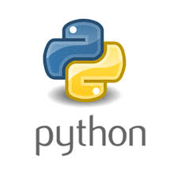

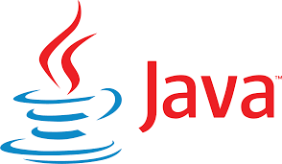
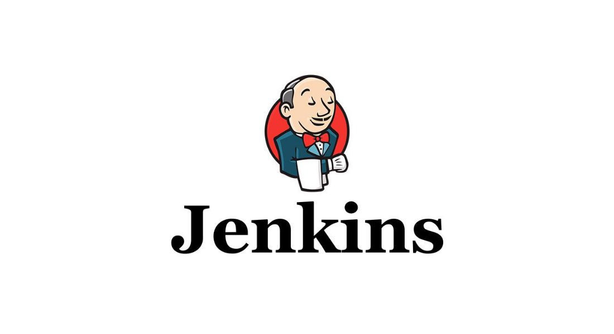

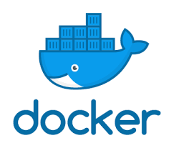



Know your lab: Lab Software

Slide 5
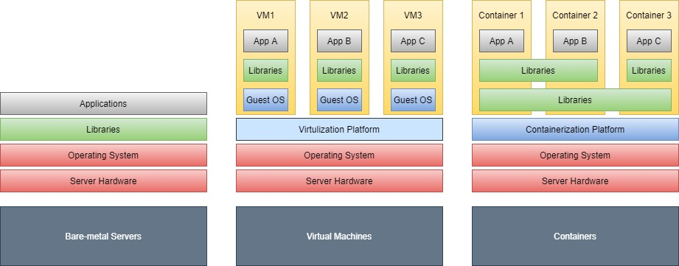
Docker Containerization

Slide 6
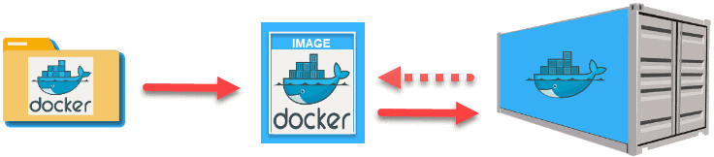
Docker Image & Container

Slide 7
About Demo Projects
Applications
https://github.com/nuvepro-hands-on-labs/DevOpsCICD-Demo-Commons.git
https://github.com/nuvepro-hands-on-labs/DevOps-CICD-Demo-WebAppJAR.git
https://github.com/nuvepro-hands-on-labs/DevOps-CICD-Demo-WebAppWAR.git
Automation
https://github.com/nuvepro-hands-on-labs/Test-Automation-CICD-Demo.git

Slide 8
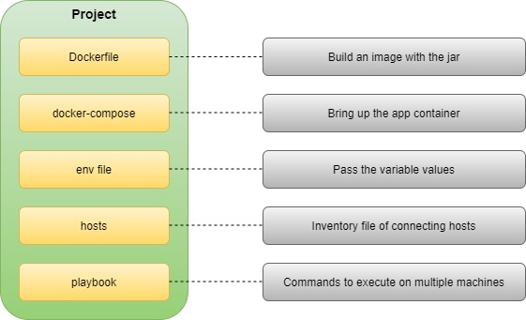
Deployment Configuration

Slide 9
Ready to go Hands-On…

Slide 10
Manual Build & Deploy

Slide 11
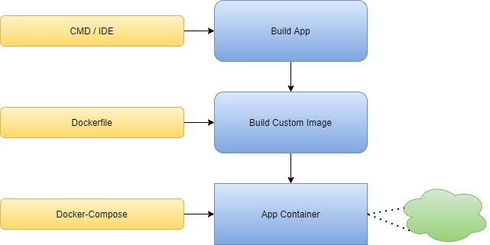
Summary: Manual Build & Deploy

Slide 12
Docker: Test your knowledge
What is true about docker Run and Start commands? (Choose more than one option if found matching)
a) Start can download the image and make the container up.
b) Start and Run commands can be used to make the stopped container up.
c) Using the start command, only those containers can be restarted that were already created and then stopped.
d) Run can download the image and make the container up.

Slide 13
Docker: Test your knowledge
What command is used for stopping a running container?
a) docker stop <container_id>
b) docker rm <container_id>
c) docker kill <container_id>
d) docker terminate <container_id>

Slide 14
Docker: Test your knowledge
What command is used for viewing all running containers?
a) docker container ls
b) docker container ls -a
c) docker container list
d) docker container show

Slide 15
Docker: Test your knowledge
What command is used to go inside a running container?
a) docker container sh <container_id>
b) docker container exec -it <container_id> sh
c) docker container access <container_id>
d) docker container ps -a

Slide 16
Configure Jenkins

Slide 17
Summary: Configure Jenkins
Secret Password, Initial Plugins & Admin User
Java
Maven
Git
Publish over SSH
GitHub Plugin for Integration
Build Pipeline Plugin
TestNG Plugin

Slide 18
Jenkins: Test your knowledge
Which of the following plugin facilitates Git SCM connectivity?
a) Github
b) Git
c) Maven
d) None of these

Slide 19
Jenkins: Test your knowledge
Can we install a custom plugin into my Jenkins instance?
a) Yes
b) No

Slide 20
Jenkins: Test your knowledge
Which of the following is a type of Jenkins Job?
a) Freestyle
b) Pipeline
c) Multibranch Pipeline
d) All the above

Slide 21
Manual Build & Deploy using Jenkins

Slide 22
Summary: Deploy using Jenkins
Added New Item
Configure SCM
Configure Build Triggers
Build Step
Post-build Action
Build & Deploy Project

Slide 23
Continuous Integration Continuous Deployment

Slide 24
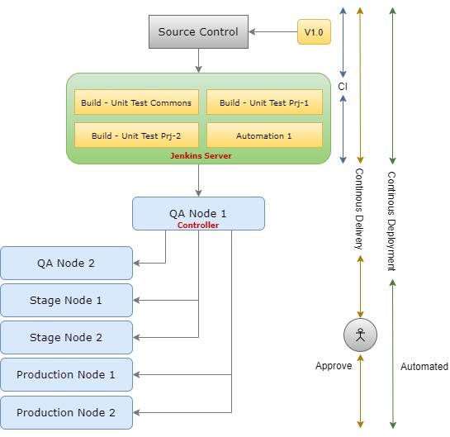
Continuous Integration / Continuous Deployment

Slide 25
Ansible: Test your knowledge
What language is an Ansible playbook written in by default?
a) JSON
b) XML
c) HTML
d) YAML

Slide 26
Ansible: Test your knowledge
Ansible is written in Python.
a) True
b) False

Slide 27
Ansible: Test your knowledge
What are the things Ansible can do?
a) Task automation
b) Configuration management
c) Deployment of application
d) All of the above

Slide 28
Ansible: Test your knowledge
What's the Ansible Playbook execution order?
a) Playbook->Play->Tasks->Task
b) Playbook->Play->Task->Tasks
c) Play->Playbook->Tasks->Task
d) Playbook->Tasks->Play-Task

Slide 29
Build Pipeline

Slide 30
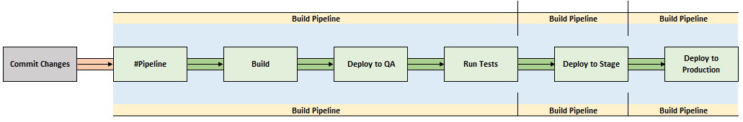
Build Pipeline

Slide 31
All set to be hands-on?

