Slide 1
Javascript Everywhere: Backend to Web and to Mobile Apps
Nuwan Bandara
and Srinath Perera
WSO2 In.

Slide 2
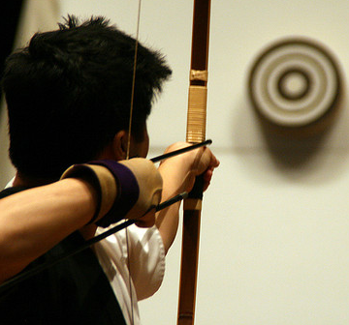
Outline
We will mainly discuss about Jaggery
Start with a high level discussion
Then Hands On

Slide 3
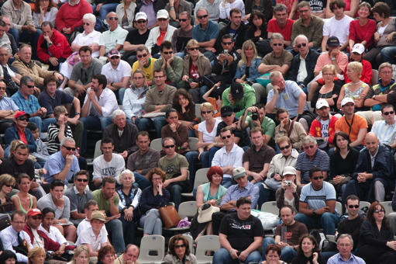
Reaching Out the Last Mile
Users Interfaces (UIs) covers the last mile
Often decides the success and how much it will integrate with the user’s lives.
Users no longer accept average user experience

Slide 4
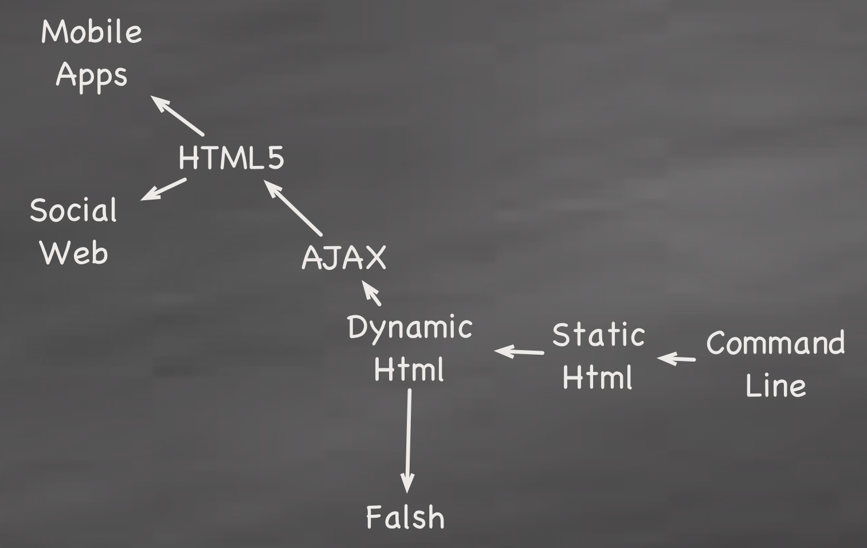
History of Web Applications

Slide 5
Different types of Apps
Client side (Static HTML)
Client driven, blocking (old Forms based submit )
Client driven, non blocking (AJAX)
Client and server driven, non-blocking (web sockets)

Slide 6
UI Technologies (Web Apps)
Javascripts has become the defacto technology (except for Mobile apps)
Supported by all browsers
Thanks to Web 2.0 and HTML5, no longer simplistic applications
Widely used

Slide 7
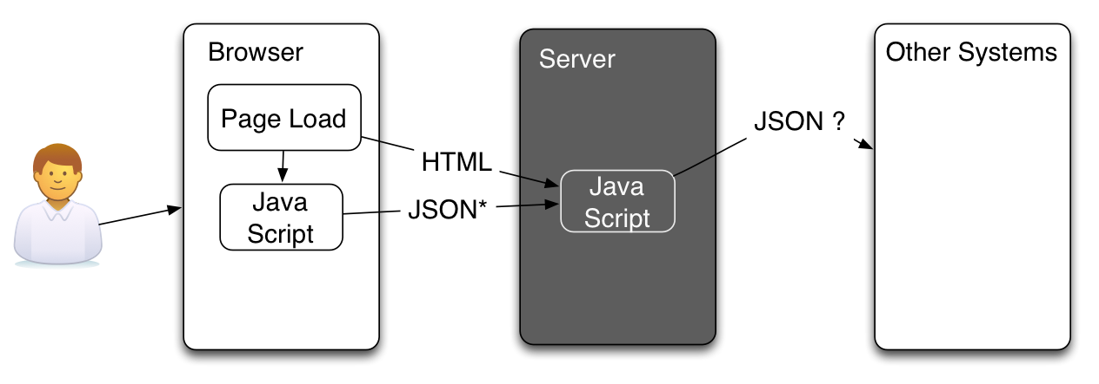
Javascript end to end?
One technology across the board
Lesser development complexity

Slide 8
Javascript end to end?
No complexities in data binding (UI to Business logic thanks to JSON)
No serialization / de-serialization
Rich space with many common javascript libraries
Rapid application development
No compiling, making & building

Slide 9
What are the JS end to end Options?
NodeJS -
Built as the runtime for Chrome Browser
event driven, non-blocking processing
Jaggery
WSO2 Dynamic User Application development technology
Provides scripting support for UIs unlike JSP.

Slide 10
Introduction to Jaggery
Like JSP/ PHP, but user writes code in java script
Runs as a Web app (e.g. tomcat)
Runs on top of Java
Provides very close integration with WSO2 Products (e.g. Users, Web service calls, access registry, access OSGI calls etc. )

Slide 11
Install Jaggery

Slide 12
Print Hello WSO2 Coffee Shop

Slide 13
Login Page with DB access

Slide 14
Database call

Slide 15
Show user’s name on the side
using sessions

Slide 16
Write Coffe Order Service
how to write a rest service

Slide 17
Call Coffe Order Service
calling a rest service

Slide 18
Pay calling a SOAP Service

Slide 19
Collect Coffee Stats
using init

Slide 20
Push Coffee is ready notification

Slide 21
Redo a page with Handle bars

Slide 22
Visualization 1: Graphs and Plots

Slide 23
Visualization 2: HTML5 Canvas

Slide 24
Improving the sample
Responsive UI
WebSockets

