Slide 1
Javascript Everywhere: Backend to Web and to Mobile Apps
Nuwan Bandara &
Srinath Perera
WSO2 Inc.

Slide 2

Outline
We will mainly discuss about JaggeryJS
Start with a high level discussion
Then Hands On

Slide 3

Reaching Out the Last Mile
Users Interfaces (UIs) covers the last mile
Often decides the success and how much it will integrate with the user’s lives.
Users no longer accept average user experience

Slide 4
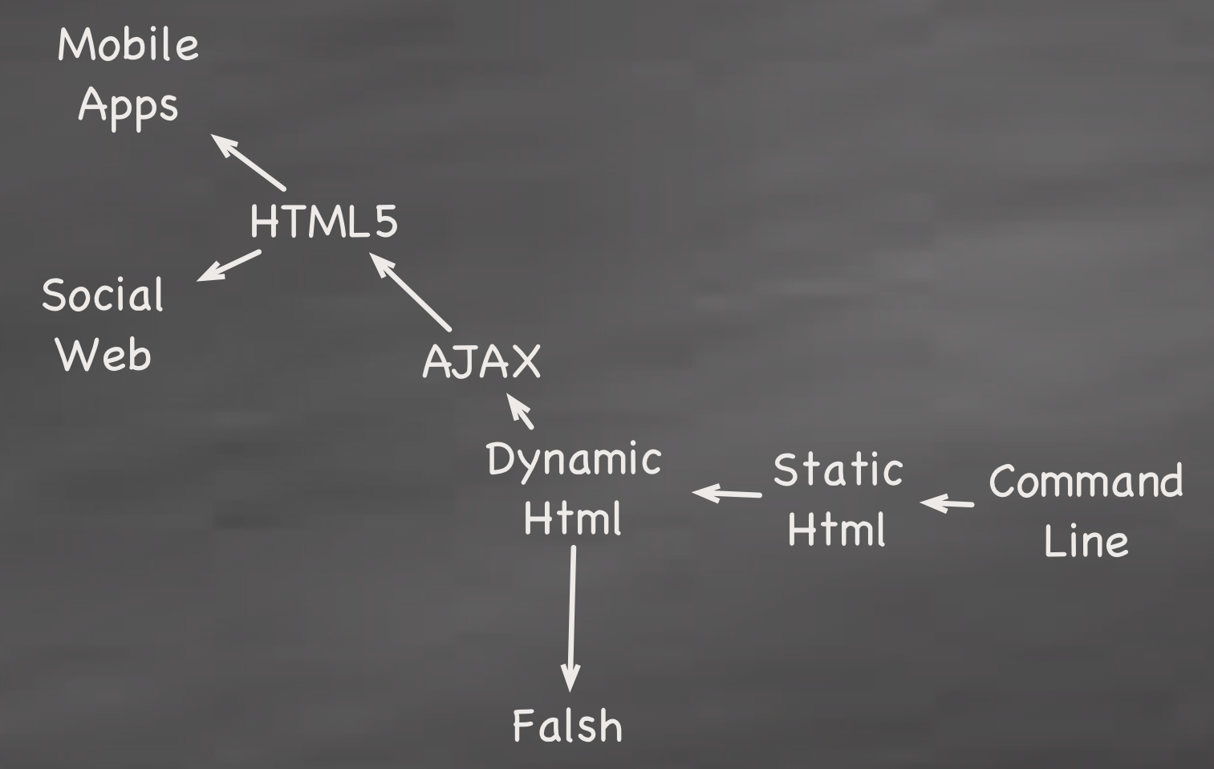
History of Web Applications

Slide 5
Different types of Apps
Client side (Static HTML)
Client driven, blocking (old Forms based submit )
Client driven, non blocking (AJAX)
Client and server driven, non-blocking (web sockets)

Slide 6
UI Technologies (Web Apps)
Javascript has become the defacto technology (except for Mobile apps)
Supported by all browsers
Thanks to Web 2.0 and HTML5, no longer simplistic applications
Widely used

Slide 7
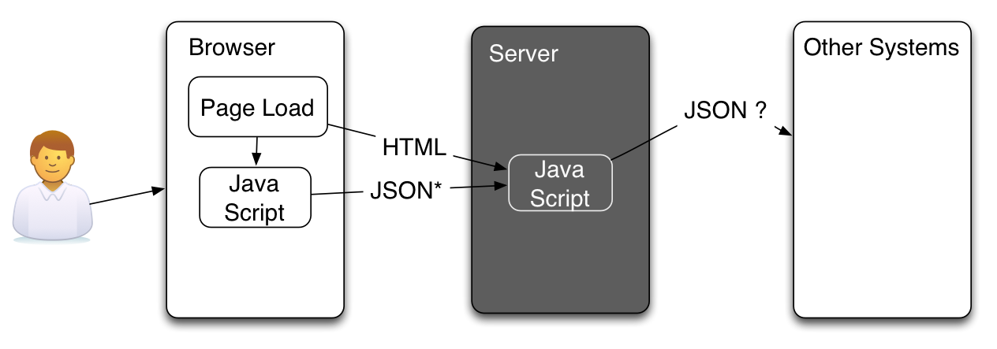
Javascript end to end?
One technology across the board
Lesser development complexity

Slide 8
Javascript end to end? (Contd.)
No complexities in data binding (UI to Business logic thanks to JSON)
No serialization / de-serialization
Rich space with many common javascript libraries
Rapid application development
No compiling, making & building

Slide 9
What are the JS end to end Options?
NodeJS -
Based on Google V8 JS engine
event driven, non-blocking processing
Jaggery
Provided traditional development experience like in PHP/JSP
De-facto framework for all WSO2 user facing applications

Slide 10
Introduction to Jaggery
Like JSP/ PHP, but user writes code completely in javascript (Data access / Business Logic / UI)
Runs as a Web app (e.g. tomcat)
Runs on top of Java
Provides very close integration with WSO2 Products (e.g. Users, Web service calls, access to the registry, access OSGI services etc. )

Slide 11
Install Jaggery
Nothing complex
If you are familiar with WSO2 server runtimes, it’s the same thing
Else extract the zip, run sh /bin/server.sh
Pre-loaded with bunch of samples
/docs explains the API

Slide 12

Print Hello WSO2 Coffee Shop
Most straight forward API method
Open up a text editor
Create {JAGGERY_HOME}/apps/coffee/hello.jag
Call it, http://localhost:9763/coffee/hello.jag

Slide 13
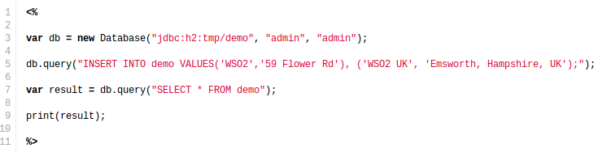
Database access
Create a DB connection
Perform CRUD operations
Results sent as json

Slide 14
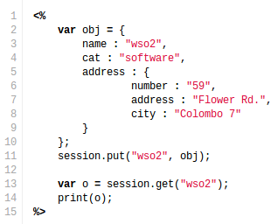
Server APIs
Bunch of methods exposed
request / response / session / application

Slide 15
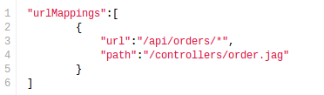
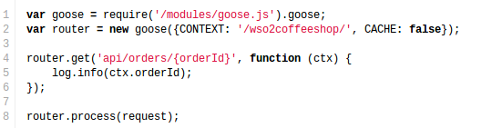
RESTful Service Composition
URL Mapping
Using inbuilt jaggery.conf
Usring goose.js

Slide 16
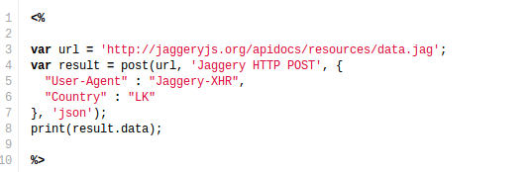
Calling out http services
Easy http client calls (just like you do in the browser)

Slide 17
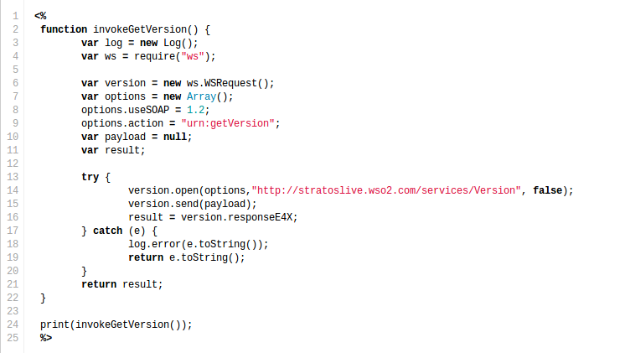
Calling out a SOAP Service

Slide 18
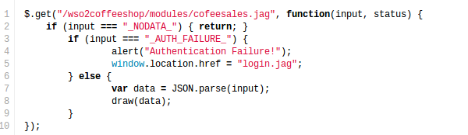
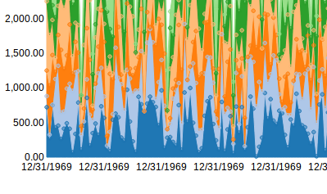
Collect Coffee Stats
Seemless integration with json apis

Slide 19
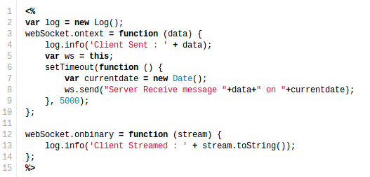
Pushing messages
aka WebSockets

Slide 20
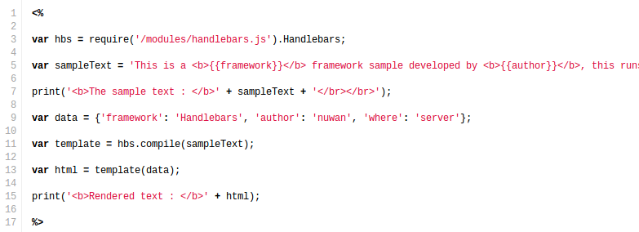
Including 3rd party js libraries
Some logic-less templating ?

Slide 21
Visualization 1: Graphs and Plots
http://localhost:9763/wso2coffeeshop/views/salesByCategory.html
<div>
<svg id="chart1"></svg>
</div>
Data = [{
"key" : "latte", "values" : [[0.0, 658.0],..}
..
}
var chart;
nv.addGraph(function() {
chart = nv.models.stackedAreaChart()
.x(function(d) { return d[0] })
.y(function(d) { return d[1] })
.color(keyColor)
.transitionDuration(300);
d3.select('#chart1')
.datum(data)
.transition().duration(0)
.call(chart);

Slide 22
Visualization 2: HTML5 Canvas
http://localhost:9763/wso2coffeeshop/views/salesRealTime.html
<canvas id="tree" width="500" height="500">
Please stop using IE8 and upgrade, already.
</canvas>
Then later
var paper = document.getElementById("tree");
var context = paper.getContext("2d");
context.fillStyle = "#0066CC";
context.fillRect(10,10, 530, 700);
setInterval(redraw, 1000);

Slide 23

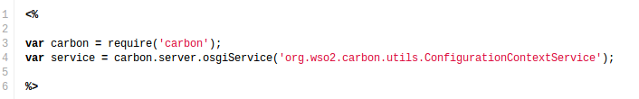
Some utilities
Process module
Carbon module
File Api / Email Api / Feed Api etc

