Slide 1


Introduction to Learning from Streaming Data
KEEPER Workshop Tutorial 2024
Nuwan Gunasekara^{*1}, Sepideh Pashami ^{1,}
https://nuwangunasekara.github.io/KEEPER2025/
* Corresponding author: heitor.gomes@vuw.ac.nz
[1] Center for Applied Intelligent Systems Research, Halmstad University, Sweden

Slide 2
Our goals
Introduce attendees to several machine-learning tasks for streaming data, such as:
Classification, regression, concept drifts, anomaly detection
Enable attendees to apply and extend the concepts demonstrated using Python and capymoa

Slide 3
Outline
Machine Learning for Streaming Data (intro)
Learning cycle
Evaluation
CapyMOA
01_KEEPER2025_introduction.ipynb
Supervised Learning
Classification
Regression
02_KEEPER2025_supervised.ipynb
Unsupervised Learning
Anomaly detection
03_KEEPER2025_anomaly_detection.ipynb
Notebooks: https://nuwangunasekara.github.io/KEEPER2025/

Slide 4
Machine Learning for Streaming Data

Slide 5
Stream Learning
What are data streams?
Sequences of items, possibly infinite, each item having a timestamp, and so a temporal order
Machine learning for streaming data (or Stream learning)
Data items arrive one by one, and we would like to build and maintain models, such as patterns or predictors, of these items in real time (or near real time)

Slide 6
Stream Learning
What are data streams?
Sequences of items, possibly infinite, each item having a timestamp, and so a temporal order
Machine learning for streaming data (or Stream learning)
Data items arrive one by one, and we would like to build and maintain models, such as patterns or predictors, of these items in real time (or near real time)

Slide 7
Stream Learning: Examples
Sensor data (IoT): energy demand prediction, environmental monitoring, traffic flow
Marketing and e-commerce: product recommendation, click stream analysis, sentiment analysis (social networks)
Cybersecurity: malware detection, spam detection, intrusion detection
And many more!*
* Not every problem should be treated as a stream learning problem!

Slide 8
Stream Learning
When should we abstract the data as a continuous stream?

Slide 9
Stream Learning
When should we abstract the data as a continuous stream?
can’t store all the data; or
shouldn’t store all the data

Slide 10
Stream Learning: can’t store
Storing all the data may exceed the available storage capacity or cause practical limitations
The volume or velocity of incoming data may be too high to store and process in its entirety

Slide 11
Stream Learning: shouldn’t store
Storing all the data may not be desirable due to privacy concerns, compliance requirements, or the nature of the problem
For example, if we are only interested in real-time analysis or immediate decision-making

Slide 12
Stream Learning
Using a stream abstraction, we can process the data incrementally, focusing on the most recent or relevant data points, and discard or aggregate the older data as needed

Slide 13
Stream Learning
ML for Batch (“static”) data
vs.
ML for Streaming (“online”) data

Slide 14
ML for Batch data
Fixed size dataset
Random access to any instance
Well-defined phases (Train, Validation, Test)
Challenges
noise, missing data, imbalance, high dimensionality, …
X₀
y₀
X₁
y₁
X₂
y₂
X₃
y₃
X₄
y₄
X₅
y₅
…
…
…
X_{k}
y_{k}
…
X_{n}
y_{n}

Slide 15
ML for Streaming data
…
Continuous flow of data
Limited time to inspect data points
Interleaved phases (Train, Validation, Test)
Challenges
Concept drifts, concept evolution, strict memory/processing requirements, may more and…
X₀
y₀
X₁
y₁
X₂
y₂
Time
…
X_{k}
y_{k}
…
X_{n}
y_{n}
…
inherit all those from batch

Slide 16
Batch vs. Streaming
Batch data
The output is a trained model
Streaming data
The output is a trainable model

Slide 17
The Learning Cycle

Slide 18
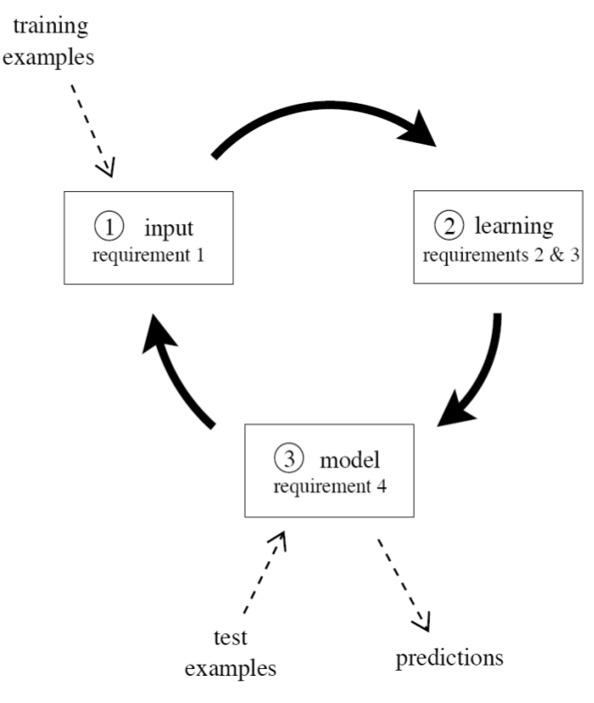
The Learning Cycle
Process an example at a time, and inspect it only once (at most)
Use a limited amount of memory
Work in a limited amount of time
Be ready to predict at any point
Requirements
Bifet, A., Gavalda, R., Holmes, G., & Pfahringer, B. (2017). Machine learning for data streams: with practical examples in MOA. MIT press.

Slide 19
The Learning Cycle
Process an example at a time, and inspect it only once (at most)
Use a limited amount of memory
Work in a limited amount of time
Be ready to predict at any point
Requirements
Bifet, A., Gavalda, R., Holmes, G., & Pfahringer, B. (2017). Machine learning for data streams: with practical examples in MOA. MIT press.

Slide 20
The Learning Cycle
Process an example at a time, and inspect it only once (at most)
Use a limited amount of memory
Work in a limited amount of time
Be ready to predict at any point
Requirements
Bifet, A., Gavalda, R., Holmes, G., & Pfahringer, B. (2017). Machine learning for data streams: with practical examples in MOA. MIT press.

Slide 21
The Learning Cycle
Process an example at a time, and inspect it only once (at most)
Use a limited amount of memory
Work in a limited amount of time
Be ready to predict at any point
Requirements
Bifet, A., Gavalda, R., Holmes, G., & Pfahringer, B. (2017). Machine learning for data streams: with practical examples in MOA. MIT press.

Slide 22
Evaluation

Slide 23
Evaluation overview
Aspects concerning predictive performance evaluation:
- Evaluation metrics: How errors are considered?
- Evaluation framework: How past predictions influence the current metric?
Other measurements (e.g. wall-clock time, CPU time, …)

Slide 24
Evaluation Framework
Cumulative (test-then-train): At any point during execution, we observe the average over all instances seen so far
Windowed (prequential): Similar to cumulative, but we observe the metrics over a window of the latest instances

Slide 25
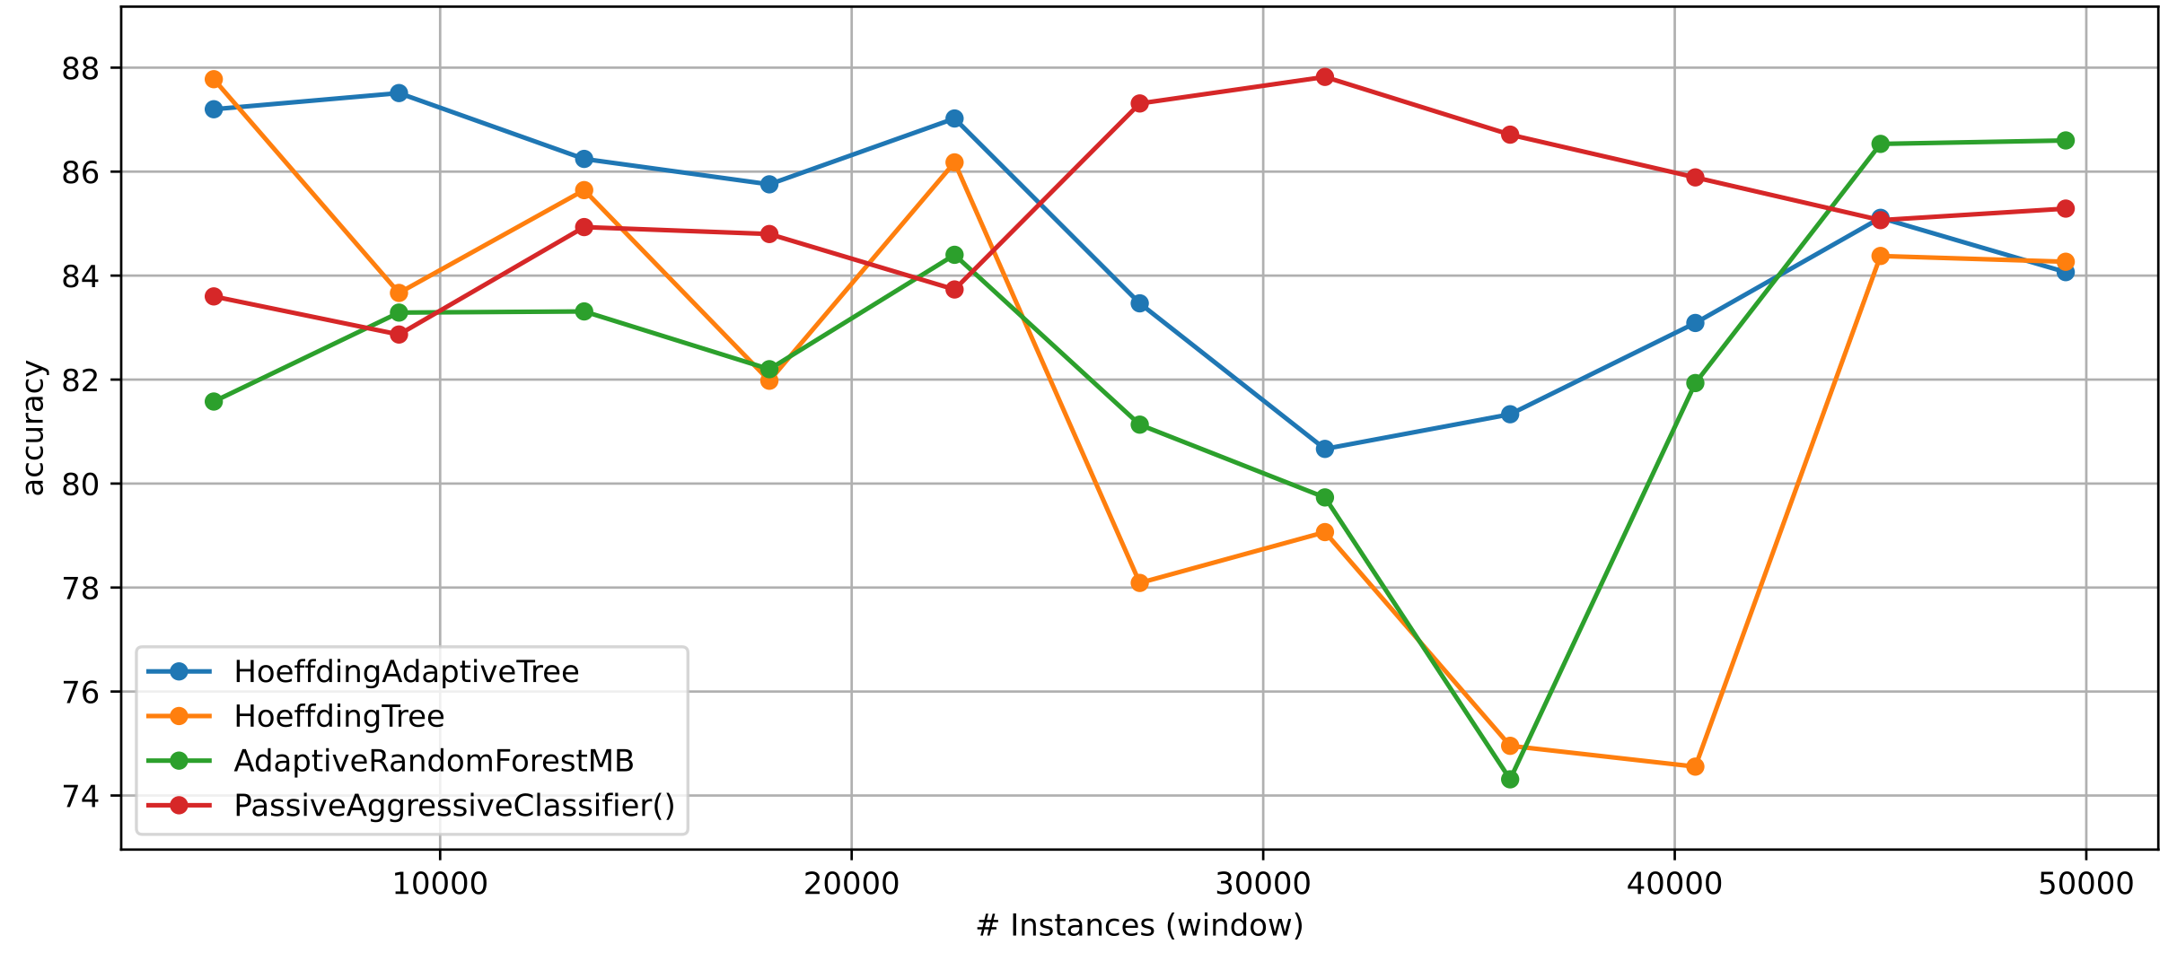
Evaluation Framework (example)
In capymoa prequential_evaluation(…) will return both results
Cumulative
Windowed
Algorithm | Accuracy (cumulative)
HoeffdingAdapt. | 84.6861
HoeffdingTree | 81.6604
AdaptiveRand. | 81.9076
PassiveAggr. | 85.2445

Slide 26


CapyMOA
Machine learning for data streams
https://capymoa.org/
https://github.com/adaptive-machine-learning/CapyMOA

Slide 27
CapyMOA
A machine learning library for streaming data based on three pillars:
Efficiency
Interoperability
Accessibility
capymoa is open-source and it was first publicly available on May 03, 2024
Other frameworks: MOA (java)¹, river (python)² and scikit-multiflow (python)³
[1] Bifet, A., Holmes, G., Pfahringer, B., Kranen, P., Kremer, H., Jansen, T., & Seidl, T. (2010). Moa: Massive online analysis, a framework for stream classification and clustering. In Workshop on applications of pattern analysis (pp. 44-50). PMLR.
[2] Montiel, J., Halford, M., Mastelini, S.M., Bolmier, G., Sourty, R., Vaysse, R., Zouitine, A., Gomes, H.M., Read, J., Abdessalem, T. and Bifet, A., 2021. River: machine learning for streaming data in python. Journal of Machine Learning Research, 22(110), pp.1-8.
[3] Montiel, J., Read, J., Bifet, A., & Abdessalem, T. (2018). Scikit-multiflow: A multi-output streaming framework. Journal of Machine Learning Research, 19(72), 1-5.

Slide 28
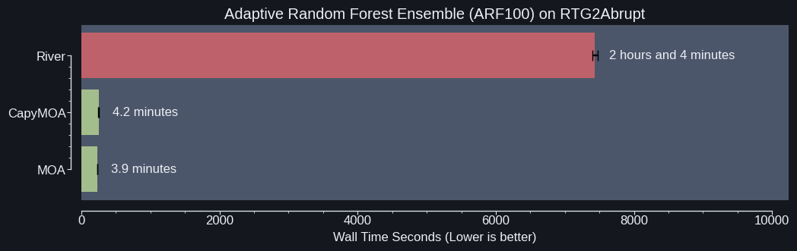
Why? Efficiency
Reproducibility: https://github.com/adaptive-machine-learning/CapyMOA/blob/main/notebooks/benchmarking.py

Slide 29
Why? Accessibility
Easy to configure and execute complex experiments
Code in Python, but take advantage of MOA (Java) objects
Allows access to existing and future MOA implementations
Integrate stream simulation with evaluation and visualisation

Slide 30
Why? Accessibility
from capymoa.stream.generator import SEA
from capymoa.stream.drift import DriftStream, AbruptDrift, GradualDrift
from capymoa.classifier import AdaptiveRandomForestClassifier
from capymoa.evaluation import prequential_evaluation
from capymoa.evaluation.visualization import plot_windowed_results
SEA3drifts = DriftStream(stream=[SEA(1),
AbruptDrift(10000),
SEA(2),
GradualDrift(start=20000,
end=25000),
SEA(3),
AbruptDrift(45000),
SEA(1)])
arf = AdaptiveRandomForestClassifier(schema=SEA3drifts.get_schema(),
ensemble_size=100,
number_of_jobs=4)
results = prequential_evaluation(stream=SEA3drifts,
learner=arf,
window_size=1000,
max_instances=50000)
print(f"Cumulative accuracy = {results['cumulative'].accuracy()}")
print(f"wallclock = {results['wallclock']} seconds")
display(results['windowed'].metrics_per_window())
plot_windowed_results(results, ylabel=‘Accuracy')
Simulate a data stream with 3 concepts drifts

Slide 31
Why? Accessibility
from capymoa.stream.generator import SEA
from capymoa.stream.drift import DriftStream, AbruptDrift, GradualDrift
from capymoa.classifier import AdaptiveRandomForestClassifier
from capymoa.evaluation import prequential_evaluation
from capymoa.evaluation.visualization import plot_windowed_results
SEA3drifts = DriftStream(stream=[SEA(1),
AbruptDrift(10000),
SEA(2),
GradualDrift(start=20000,
end=25000),
SEA(3),
AbruptDrift(45000),
SEA(1)])
arf = AdaptiveRandomForestClassifier(schema=SEA3drifts.get_schema(),
ensemble_size=100,
number_of_jobs=4)
results = prequential_evaluation(stream=SEA3drifts,
learner=arf,
window_size=1000,
max_instances=50000)
print(f"Cumulative accuracy = {results['cumulative'].accuracy()}")
print(f"wallclock = {results['wallclock']} seconds")
display(results['windowed'].metrics_per_window())
plot_windowed_results(results, ylabel=‘Accuracy')
Configure an ensemble with 100 learners and 4 jobs (multithreaded)

Slide 32
Why? Accessibility
from capymoa.stream.generator import SEA
from capymoa.stream.drift import DriftStream, AbruptDrift, GradualDrift
from capymoa.classifier import AdaptiveRandomForestClassifier
from capymoa.evaluation import prequential_evaluation
from capymoa.evaluation.visualization import plot_windowed_results
SEA3drifts = DriftStream(stream=[SEA(1),
AbruptDrift(10000),
SEA(2),
GradualDrift(start=20000,
end=25000),
SEA(3),
AbruptDrift(45000),
SEA(1)])
arf = AdaptiveRandomForestClassifier(schema=SEA3drifts.get_schema(),
ensemble_size=100,
number_of_jobs=4)
results = prequential_evaluation(stream=SEA3drifts,
learner=arf,
window_size=1000,
max_instances=50000)
print(f"Cumulative accuracy = {results['cumulative'].accuracy()}")
print(f"wallclock = {results['wallclock']} seconds")
display(results['windowed'].metrics_per_window())
plot_windowed_results(results, ylabel=‘Accuracy')
Calculate cumulative and windowed metrics

Slide 33
Why? Accessibility
from capymoa.stream.generator import SEA
from capymoa.stream.drift import DriftStream, AbruptDrift, GradualDrift
from capymoa.classifier import AdaptiveRandomForestClassifier
from capymoa.evaluation import prequential_evaluation
from capymoa.evaluation.visualization import plot_windowed_results
SEA3drifts = DriftStream(stream=[SEA(1),
AbruptDrift(10000),
SEA(2),
GradualDrift(start=20000,
end=25000),
SEA(3),
AbruptDrift(45000),
SEA(1)])
arf = AdaptiveRandomForestClassifier(schema=SEA3drifts.get_schema(),
ensemble_size=100,
number_of_jobs=4)
results = prequential_evaluation(stream=SEA3drifts,
learner=arf,
window_size=1000,
max_instances=50000)
print(f"Cumulative accuracy = {results['cumulative'].accuracy()}")
print(f"wallclock = {results['wallclock']} seconds")
display(results['windowed'].metrics_per_window())
plot_windowed_results(results, metric=‘accuracy’)
Plot the windowed results

Slide 34







CapyMOA team
Heitor Murilo Gomes (project leader)¹
Anton Lee¹
Nuwan Gunasekara²
Yibin Sun²
Guilherme Cassales²
Marco Heyden³
Justin Liu²
Jesse Read⁴
Maroua Bahri⁵
Marcus Botacin⁶
Vitor Cerqueira⁷
Albert Bifet^{2,9}
Bernhard Pfahringer²
Yun Sing Koh⁸
And many other individual contributors
[1] Victoria University of Wellington, New Zealand
[4] École polytechnique, IP Paris, France
[7] Porto University, Portugal
[2] University of Waikato, New Zealand
[5] INRIA Paris, France
[8] University of Auckland, New Zealand
[3] KIT, Germany
[6] Texas A&M Engineering, USA
[9] Télécom Paris, IP Paris, France

Slide 35

CapyMOA summary
Code in Python or Java, or both
Integration with PyTorch and scikit-learn
Streams, learners and evaluation are designed to interoperate with visualization
Latest release (0.9.0): March, 2025
20 classifiers, 8 regressors, 11 drift detectors, 3 anomaly detectors, evaluation, data representation, … as of 0.8.0
www.capymoa.org

Slide 36
Practical examples
01_KEEPER2025_introduction.ipynb
Notebooks: https://nuwangunasekara.github.io/KEEPER2025/

