Slide 1
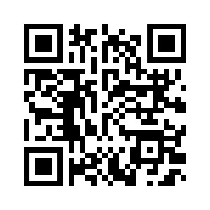

Introduction to Learning from Streaming Data
KEEPER Workshop Tutorial 2024
Nuwan Gunasekara^{*1}, Sepideh Pashami ^{1,}
https://nuwangunasekara.github.io/KEEPER2025/
* Corresponding author: heitor.gomes@vuw.ac.nz
[1] Center for Applied Intelligent Systems Research, Halmstad University, Sweden

Slide 2
Classification algorithms

Slide 3
Random Forest (RF)
Main components:
Bagging
Random subset of features
Breiman, L. (2001). Random forests. Machine learning.

Slide 4
Bagging
Bootstrap Aggregating
Bagging trains each model of the ensemble with a bootstrap sample from the original dataset.
Every bootstrap contains each original sample K times, where Pr(K=k) follows a binomial distribution.
Breiman, L. (1996). Bagging predictors. Machine learning, 24(2), 123-140.

Slide 5
Bagging
Original Data

Slide 6
Bagging
Subsample 1
Original Data
Sampling with replacement
Subsample 2
Subsample 3

Slide 7
Bagging
Subsample 1
Build the models
Original Data
Model 1
Sampling with replacement
Subsample 2
Model 2
Subsample 3
Model 3

Slide 8
Bagging
On average subsample contains:
~64% of the original dataset instances
~37% repeated instances
~37% not present* instances
of the original dataset.
* Out-Of-Bag (OOB)
Breiman, L. (1996). Bagging predictors. Machine learning, 24(2), 123-140.

Slide 9
Bagging
The predictions of each learner are aggregated using majority vote to obtain the final prediction.
Prediction for a given instance X…
Model 1
Model 2
Model 3
Prediction=0
Prediction=1
Prediction=0
Ensemble Prediction=0

Slide 10
Randomizing the feature set
Local randomization
Global randomization
Random Forest
Random Subspaces
Random Patches
{f₁, f₂, f₃ , f₄, f₅ , f₆, f₇ , f₈}
{f₄, f₁, f₂}
{f₄, f₁, f₂}
{f₁, f₃, f₆}
{f₃, f₅, f₈}
Notes:
Several ensembles for both batch and data stream classification.
One of the ways to characterise an ensemble is through its diversity induction strategy.
I am going to give you a brief introduction to 4 of them. First,
Random subspaces induce diversity by training the base models on subsets of features
Bagging train the base models using different instances
Random forest and Random Patches combine both approaches, but they do this differently.
Both perform bagging to train individual models using different instances, however, random forest include a random subspace approach that can be identified as “local” randomization, because every new node, you sample from the original input set a subspace of features to use. Random Patches randomly selects a subset of features prior to training the model, this can be identified as a “global” randomization approach. This does not change. A random patch is a subset of features and instances.

Slide 11
Adaptive Random Forest (ARF)
Streaming version of the original Random Forest by Breiman
Main differences:
Online base learner, Online bagging & drift adaptation
Overview:
Online bagging
Random subset of features
Drift detector for each tree
Breiman, L. (2001). Random forests. Machine learning.
Gomes, H. M., Bifet, A., Read, J., …, T. (2017). Adaptive random forests for evolving data stream classification. Machine Learning.

Slide 12
Online base learner
Uses a variation of the Hoeffding Tree (HT)
HT builds a tree that converges to the tree built by a batch learner given sufficiently large data
Hulten, G., Spencer, L., & Domingos, P. (2001). Mining time-changing data streams. In ACM SIGKDD.

Slide 13
Online Bagging
We cannot apply Bagging directly to data streams…
Unfeasible to store all data before creating each bootstrap subsample
We need to build the subsamples online
N. Oza and S. Russel “Online bagging and boosting” Artificial Intelligence and Statistics, 2001

Slide 14
Online Bagging
Given a dataset with N samples
In Bagging, every bootstrap contains each original sample K times, where Pr(K=k) follows a binomial distribution
Oza and Russel found out that for large N, the binomial distribution tends to a Poisson(1) distribution
Online Bagging instead of sampling with replacement, gives each example a weight according to Poisson(1) distribution
N. Oza and S. Russel “Online bagging and boosting” Artificial Intelligence and Statistics, 2001

Slide 15
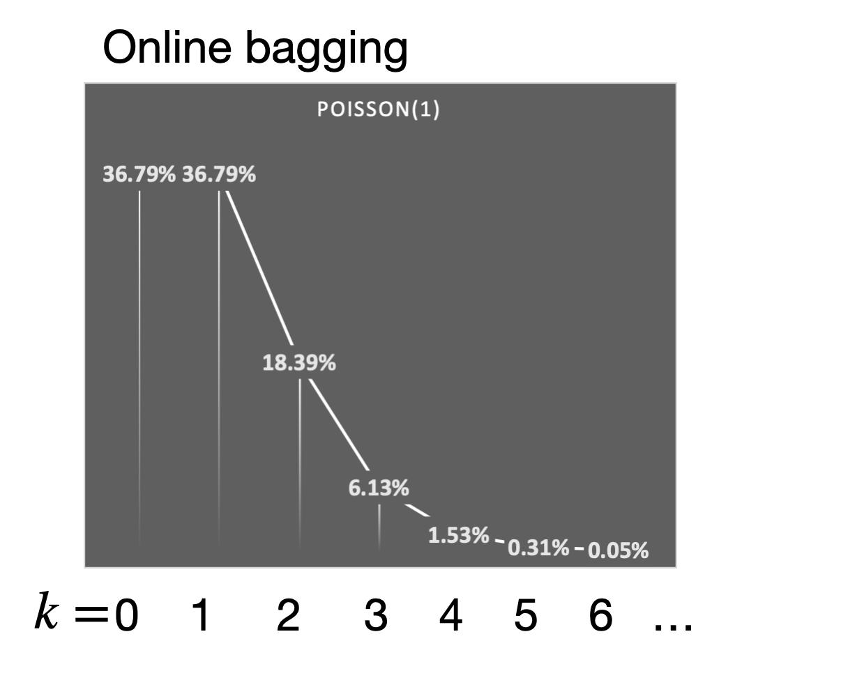
Subsamples
Batch bagging
~64% from the original dataset
~37% are repeated
~37% are not present
Probability mass function
k is the number of occurrences
N. Oza and S. Russel “Online bagging and boosting” Artificial Intelligence and Statistics, 2001

Slide 16
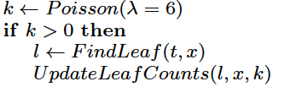
Online Bagging
stream
…
(x^{t},y^{t})
…
(λ=1)
k “weight” train
Practical effect: train learners multiple times or update counters multiple times
N. Oza and S. Russel “Online bagging and boosting” Artificial Intelligence and Statistics, 2001

Slide 17
Randomizing the feature set
Local randomization
Global randomization
Random Forest
Random Subspaces
Random Patches
{f₁, f₂, f₃ , f₄, f₅ , f₆, f₇ , f₈}
{f₄, f₁, f₂}
{f₄, f₁, f₂}
{f₁, f₃, f₆}
{f₃, f₅, f₈}
Notes:
Several ensembles for both batch and data stream classification.
One of the ways to characterise an ensemble is through its diversity induction strategy.
I am going to give you a brief introduction to 4 of them. First,
Random subspaces induce diversity by training the base models on subsets of features
Bagging train the base models using different instances
Random forest and Random Patches combine both approaches, but they do this differently.
Both perform bagging to train individual models using different instances, however, random forest include a random subspace approach that can be identified as “local” randomization, because every new node, you sample from the original input set a subspace of features to use. Random Patches randomly selects a subset of features prior to training the model, this can be identified as a “global” randomization approach. This does not change. A random patch is a subset of features and instances.

Slide 18
ARF: Detect and Adapt
One Warning and one Drift detector per base model
Relies on the Adaptive WINdow (ADWIN) algorithm for detection (other algorithms could be used)
Background learners are started once a warning is detected, their subspace of features may not correspond to the subspace of features used by the “foreground” learner.
Once a drift is detected, the background learner replaces the “foreground” learner.
Notes:
When a warning is detected, a background learner is started.

Slide 19
Ensembles re-cap
Use Poisson distribution to derive weights for multiple training iterations
More advance methods use drift detectors to adapt to changes
Latest developments
Streaming Gradient Boosting [3]
Use task parallelism for bagging ensembles using mini-batches [1, 2]
[1] G. Cassales, H. M. Gomes, A. Bifet, B. Pfahringer and H. Senger, Improving the performance of bagging ensembles for data streams through mini-batching, Information Sciences,Volume 580, 2021, Pages 260-282, ISSN 0020-0255, https://doi.org/10.1016/j.ins.2021.08.085.
[2] G. Cassales, H. M. Gomes, A. Bifet, B. Pfahringer and H. Senger, "Balancing Performance and Energy Consumption of Bagging Ensembles for the Classification of Data Streams in Edge Computing," in IEEE Transactions on Network and Service Management, vol. 20, no. 3, pp. 3038-3054, Sept. 2023, doi: 10.1109/TNSM.2022.3226505
[3] Gunasekara, N., Pfahringer, B., Gomes, H., & Bifet, A. (2024). Gradient boosted trees for evolving data streams. Machine Learning, 113(5), 3325-3352.

Slide 20
Regression algorithms

Slide 21
Adaptive Random Forest Regression
Similar to ARF for classification
builds regression trees
for prediction, uses mean of predictions (by each tree)
Gomes HM, Barddal JP, Ferreira LEB, Bifet A (2018) Adaptive random forests for data stream regression. ESANN

Slide 22
Practical examples
02_KEEPER2025_supervised.ipynb

Slide 23
Hoeffding Tree*
* Also known as Very Fast Decision Tree (VFDT)
Goal: Grow a decision tree incrementally
This means that after every new training instance, the tree may grow
Key question: When should a split happen?
Hypothesis: A small sample is often enough to choose a near optimal split decision
Hulten, G., Spencer, L., & Domingos, P. (2001). Mining time-changing data streams. In ACM SIGKDD.

Slide 24
Hoeffding Bound
It is a statistical inequality that provides a theoretical guarantee on the convergence of sample average to the true mean with a given probability
In other words, the Hoeffding Bound helps in determining whether the observed differences in the attributes’ purity are statistically significant or merely due to random variation
Wassily Hoeffding (1963) Probability Inequalities for Sums of Bounded Random Variables, Journal of the American Statistical Association, 58:301, 13-30, DOI: 10.1080/01621459.1963.10500830

Slide 25
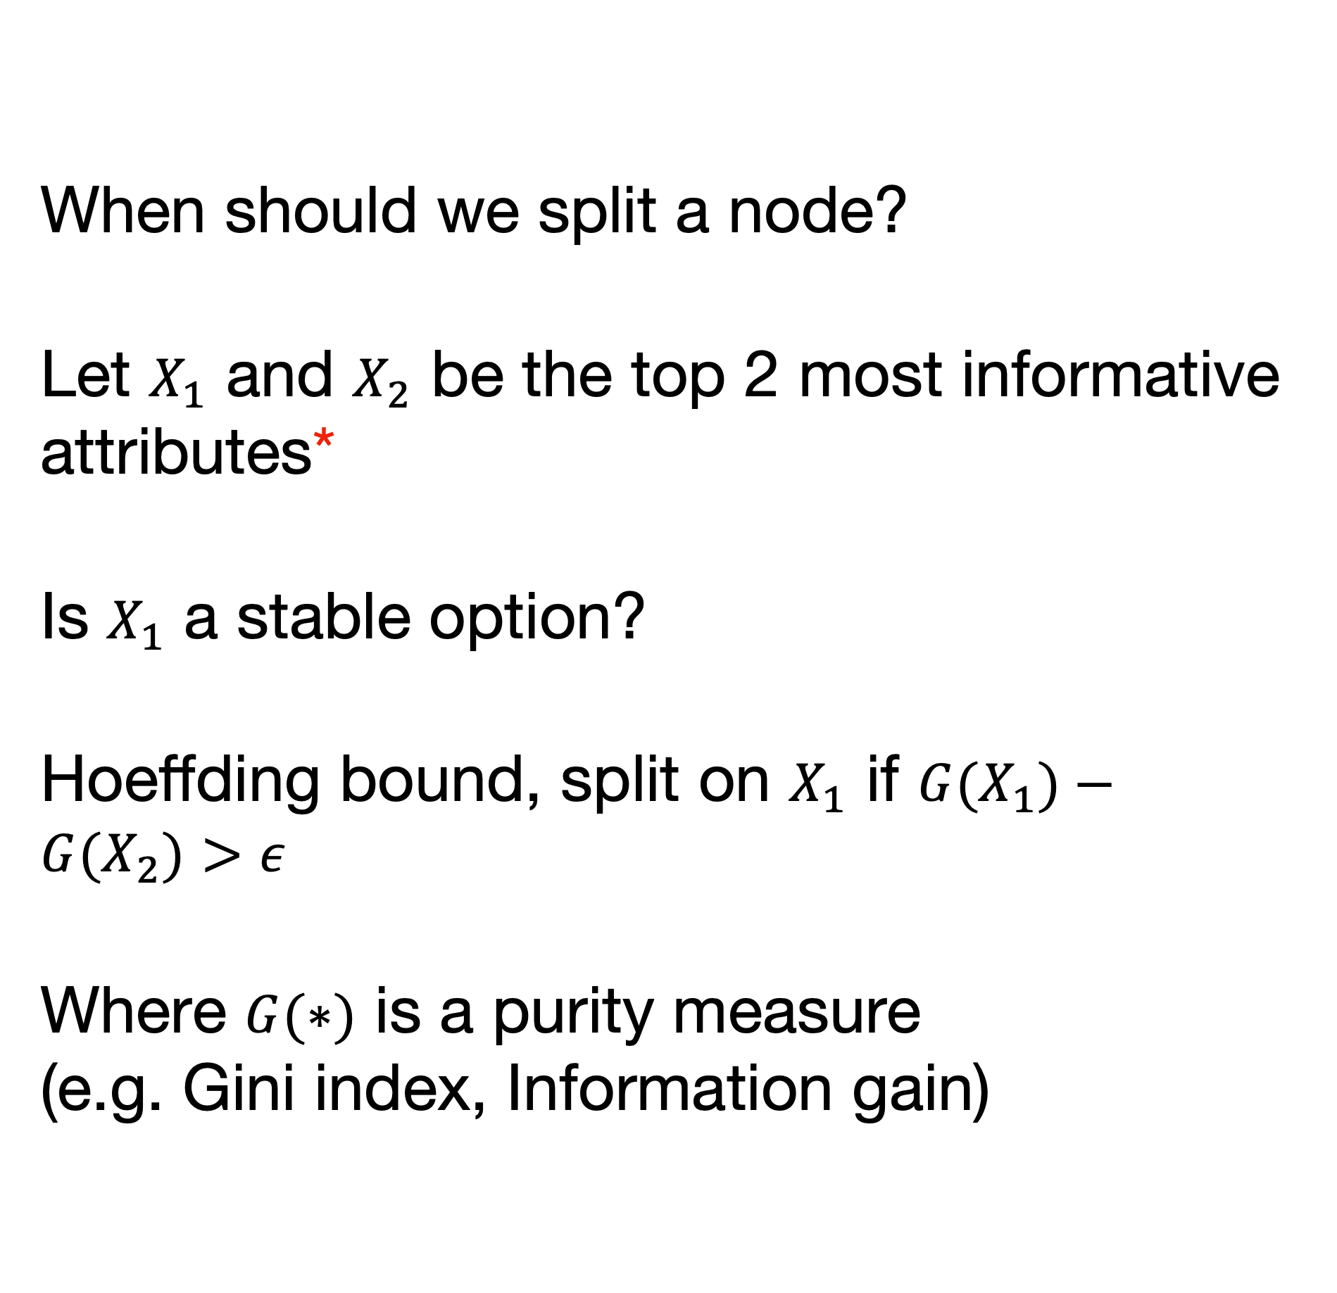
Hoeffding Bound
When should we split a node?
Let $X_{1}$ and $X_{2}$ be the top 2 most informative attributes*
Is $X_{1}$ a stable option?
Hoeffding bound, split on $X_{1}$ if $G(X_{1})−G(X_{2})>ε$
Where $G(∗)$ is a purity measure (e.g. Gini index, Information gain)
* The top attributes to split, the ones that will cause the splits to be “purer”

Slide 26
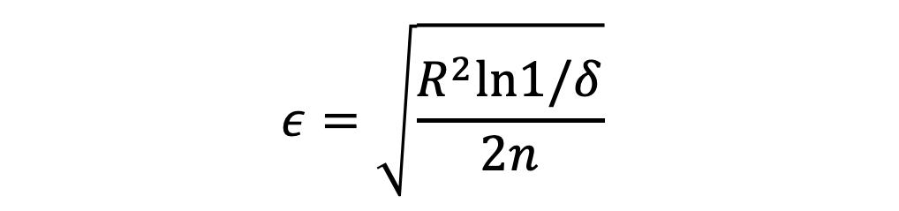
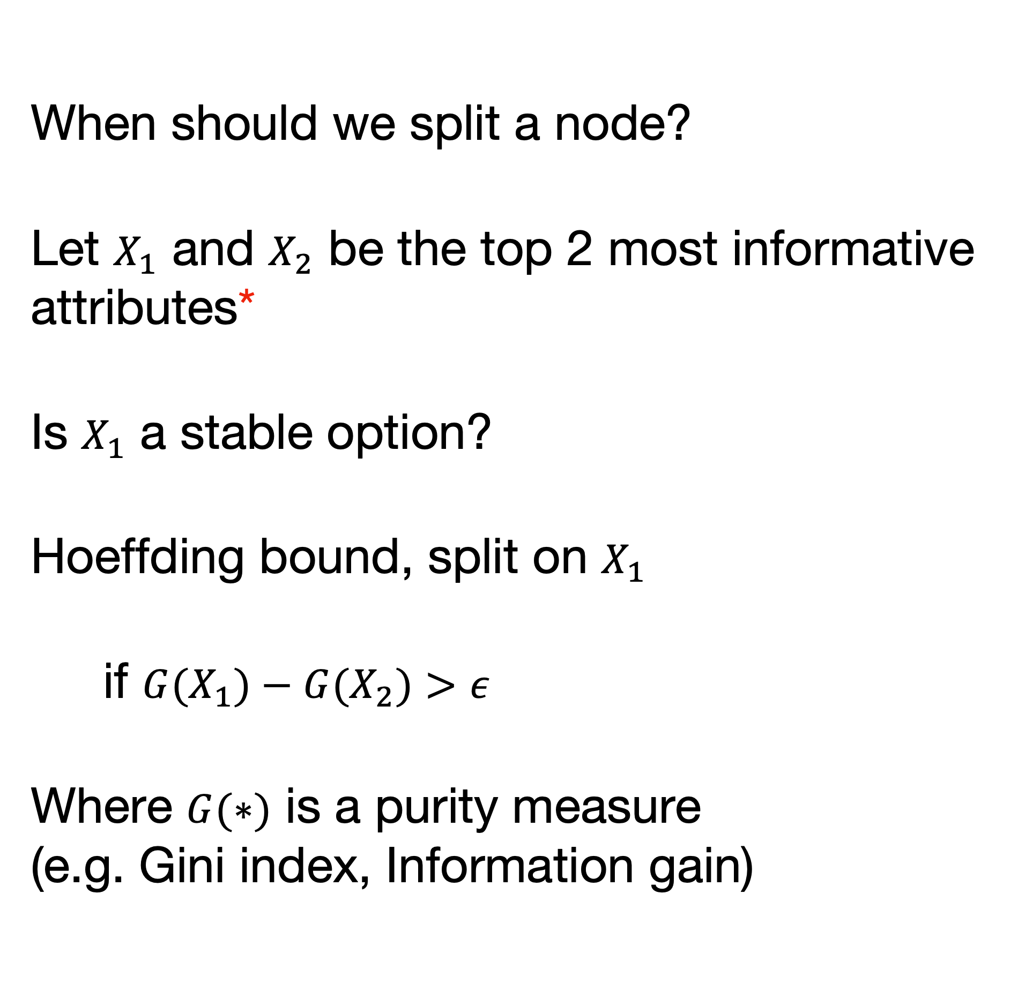

Hoeffding Bound
When should we split a node?
Let $X_{1}$ and $X_{2}$ be the top 2 most informative attributes*
Is $X_{1}$ a stable option?
Hoeffding bound, split on $X_{1}$
if $G(X_{1})−G(X_{2})>ε$
Where $G(∗)$ is a purity measure (e.g. Gini index, Information gain)
$$ε=\sqrt{\frac{R^{2}ln1/δ}{2n}}$$
$R$ = Range of observed random variable
$δ$ = The desired probability of the estimate not being within $ε$ of its expected value
$1−δ$ = The desired probability of the estimate within $ε$ its expected value
$n$ = Number of observed instances
* The top attributes to split, the ones that will cause the splits to be “purer”

Slide 27
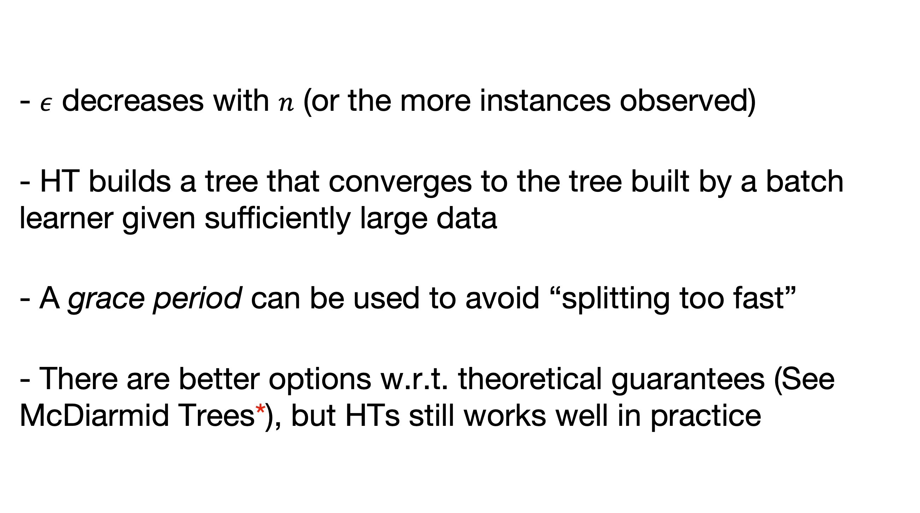
Hoeffding Tree wrap-up
- $ε$ decreases with $n$ (or the more instances observed)
- HT builds a tree that converges to the tree built by a batch learner given sufficiently large data
- A grace period can be used to avoid “splitting too fast”
- There are better options w.r.t. theoretical guarantees (See McDiarmid Trees*), but HTs still works well in practice
* Rutkowski, L., Pietruczuk, L., Duda, P., & Jaworski, M. (2012). Decision trees for mining data streams based on the McDiarmid's bound. IEEE Transactions on Knowledge and Data Engineering.

Slide 28
Other Streaming Decision Tree algorithms
The Extremely Fast Decision Tree (EFDT) [1] algorithm improves upon the Hoeffding Tree by using a more relaxed criterion for splitting nodes, allowing it to grow the tree more quickly.
EFDT can revisit and revise earlier splits if better splits are found later, which can lead to subtree pruning and potentially sudden drops in accuracy.
[1] Manapragada, Chaitanya, Geoffrey I. Webb, and Mahsa Salehi. Extremely fast decision tree. ACM SIGKDD International, 2018

Slide 29
Bagging
Bootstrap Aggregating
Bagging trains each model of the ensemble with a bootstrap sample from the original dataset.
Every bootstrap contains each original sample K times, where Pr(K=k) follows a binomial distribution.
Breiman, L. (1996). Bagging predictors. Machine learning, 24(2), 123-140.

Slide 30
Bagging
Original Data

Slide 31
Bagging
Subsample 1
Original Data
Sampling with replacement
Subsample 2
Subsample 3

Slide 32
Bagging
Subsample 1
Build the models
Original Data
Model 1
Sampling with replacement
Subsample 2
Model 2
Subsample 3
Model 3

Slide 33
Bagging
On average for each subsample:
~64% of the instances are from the original dataset
~37% are repeated instances
~37% of the original instances are not present*
* Out-Of-Bag (OOB)
Breiman, L. (1996). Bagging predictors. Machine learning, 24(2), 123-140.

Slide 34
Bagging
The predictions of each learner are aggregated using majority vote to obtain the final prediction.
Prediction for a given instance X…
Model 1
Model 2
Model 3
Prediction=0
Prediction=1
Prediction=0
Ensemble Prediction=0

Slide 35
Self-Optimizing k-Nearest Leaves (SOKNL)
Extends Adaptive Random Forest Regression
Generates a representative data point (centroid) in each leaf by compressing information from all instances in that leaf
During prediction, calculates distances between input instance and centroids for relevant leaves
Uses only k leaves with smallest distances for prediction
Dynamically tuning k values based on historical information
Yibin Sun, B Pfahringer, H M Gomes, and A Bifet. "SOKNL: A novel way of integrating K-nearest neighbours with adaptive random forest regression for data streams" Data Mining and Knowledge Discovery (2022)

Slide 36
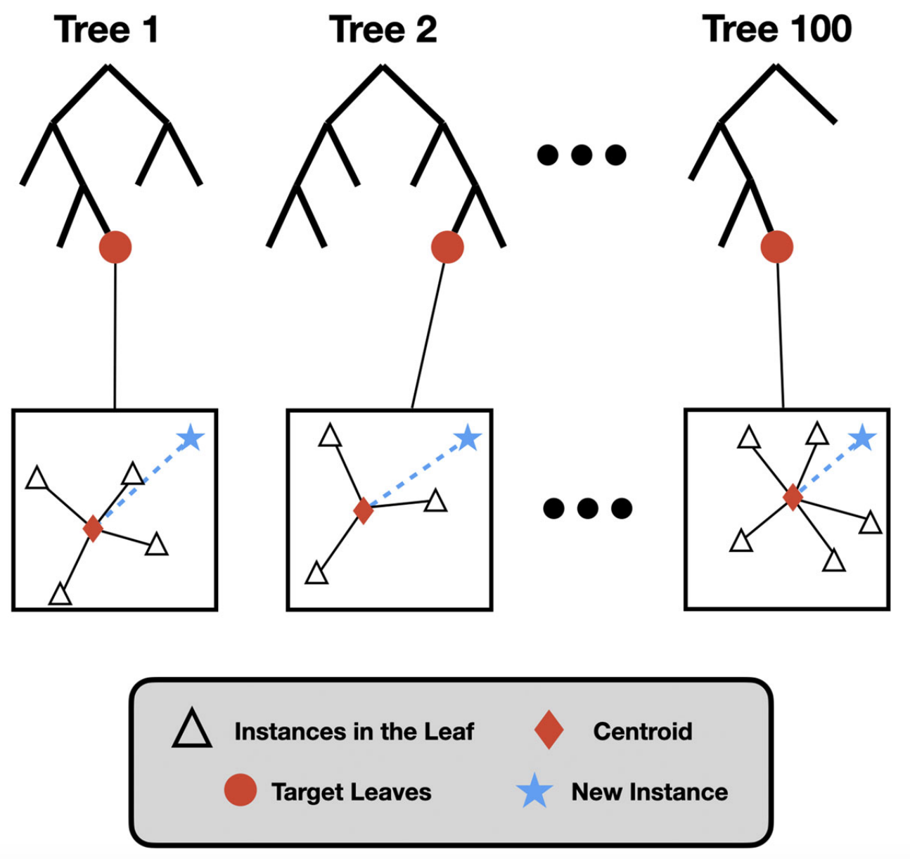
Self-Optimizing k-Nearest Leaves (SOKNL)
Yibin Sun, B Pfahringer, H M Gomes, and A Bifet. "SOKNL: A novel way of integrating K-nearest neighbours with adaptive random forest regression for data streams" Data Mining and Knowledge Discovery (2022)

Slide 37
Self-Optimizing k-Nearest Leaves (SOKNL)
at time t
K :
1
2
3
4
5
Error:
9.85
7.26
6.97
6.97
8.66
8.20
Yibin Sun, B Pfahringer, H M Gomes, and A Bifet. "SOKNL: A novel way of integrating K-nearest neighbours with adaptive random forest regression for data streams" Data Mining and Knowledge Discovery (2022)

Slide 38
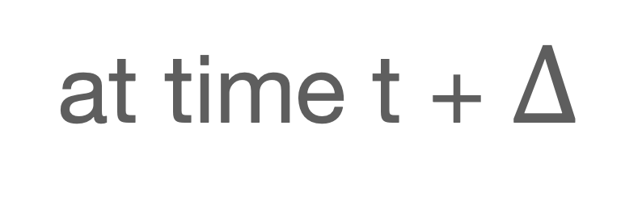
Self-Optimizing k-Nearest Leaves (SOKNL)
at time t + $Δ$
K :
1
2
3
4
5
Error:
9.94
8.65
8.24
7.95
7.61
Yibin Sun, B Pfahringer, H M Gomes, and A Bifet. "SOKNL: A novel way of integrating K-nearest neighbours with adaptive random forest regression for data streams" Data Mining and Knowledge Discovery (2022)

