Slide 1
Customer Segmentation &Retention Strategy E-Shop Pro

Slide 2
Business Case
E-Shop Pro has strong acquisition but struggles with customer retention.
Many customers churn shortly after their first purchase.
Need to understand when retention drops and who the customers are (segments).

Slide 3
Why Segmentation?
• Understand customer groups based on Recency, Frequency, and Monetary (RFM) behavior
• Identify high-value customers and at-risk segments
• Tailor marketing and retention strategies for each group

Slide 4
• Features used: Recency (days since last purchase), Frequency (how often customers patronise), Monetary (total spend)
• Applied K-Means clustering → 4 customer groups identified
• Cluster metrics show distinct behavioral patterns

Slide 5
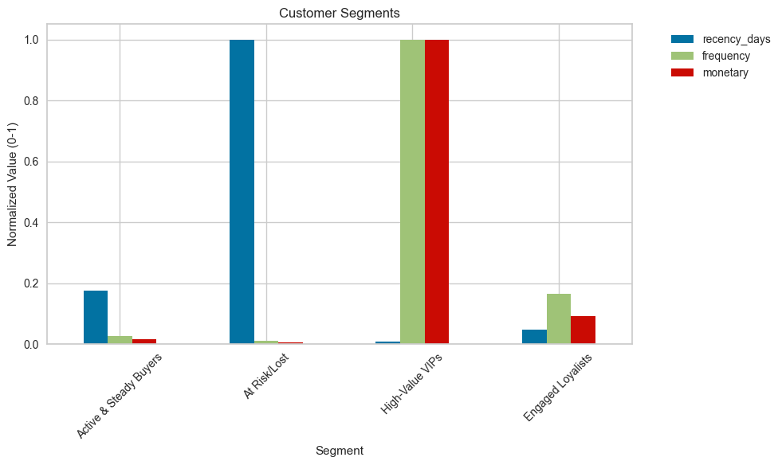

Slide 6
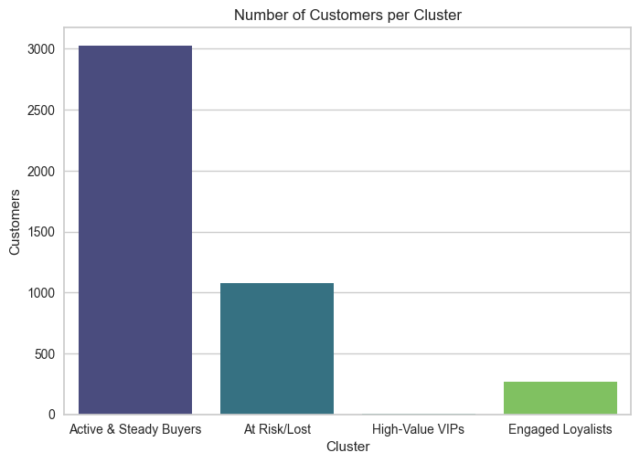

Slide 7
Insights & Personas
• Active & Steady Buyers: Reliable customers, stable revenue
• At Risk Customers: Long time since last purchase, may churn
• High-Value VIPs: Tiny group, huge spend — top priority
• Engaged Loyalists: Growing VIPs, high frequency, strong potential

Slide 8
Recommendations
• VIPs : Exclusive offers, loyalty perks, personalised engagement.
• Steady Buyers : Upsell with bundles, encourage larger checkout carts.
• At Risk : Reactivation campaigns with discounts & surveys.
• New Customers : Onboarding emails, first-purchase discounts, personalized product recommendations.

Slide 9
Conclusion
Cohorts reveal timing of churn → biggest drop-off after Month 1.
Clusters show customer value profiles → clear opportunities for targeted engagement.
Integrated approach (Cohorts + Clusters) enables smarter retention strategies:
Retain regulars
Win back at-risk
Nurture VIPs

