Slide 1

What Made Us.
Forrester Wave
for DAM
Launches Nuxeo Platform
GS & Kennet
2d Investment
MongoDB
GS & Kennet
Investment
Gartner
MQ
for CSPs
Series A funding
Enters the US market
Nuxeo
Insight
Nuxeo Studio
Elasticsearch
R&D and market validation
2008
2011
2012
2013
2014
2015
2016
2017
2018
Today
FastTrack
release process
1B-objects benchmark
New 1B-objects benchmark
Nuxeo
Content Cloud
Build Smarter Solutions for Today’s Content Challenges
Nuxeo makes it easy to build smart content applications that enhance customer experiences, improve decision making, and accelerate products to market.

Slide 2




What Made Us.
Forrester Wave
for DAM
2000
Launches Nuxeo Platform
GS & Kennet
2d Investment
MongoDB
GS & Kennet
Investment
Gartner
MQ
for CSPs
Series A funding
Enters the US market
Nuxeo
Insight
Nuxeo Studio
Elasticsearch
R&D and market validation
2008
2011
2012
2013
2014
2015
2016
2017
2018
Today
Today
The industry’s
most innovative
Content Services Platform
FastTrack
release process
1B-objects benchmark
New 1B-objects benchmark
Nuxeo
Content Cloud
Build Smarter Solutions for Today’s Content Challenges
Nuxeo makes it easy to build smart content applications that enhance customer experiences, improve decision making, and accelerate products to market.

Slide 3
Where We Are.
What Made Us.
Who We Are.
“We don’t do crap”
Eric Barroca - CEO

Slide 4
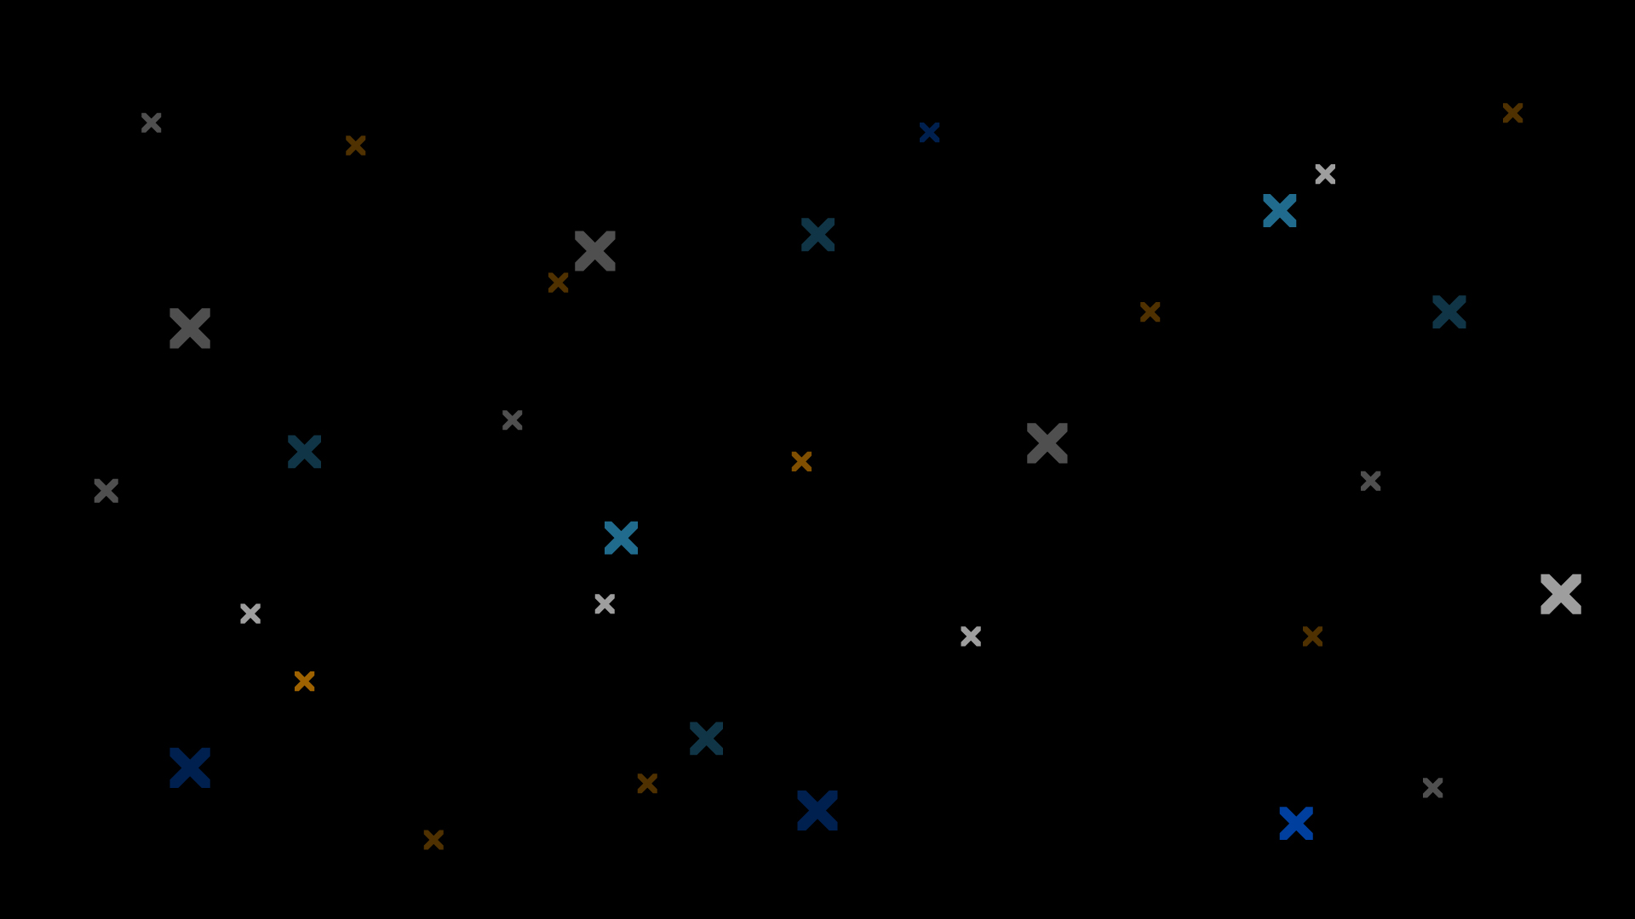
Build Smarter Solutions for
Today’s Content Challenges
Notes:
This is our tagline

Slide 5
We’re a Low-Code Platform for Content.
BUSINESS APPLICATIONS
Digital Asset Management
Document Management
Case Management
Knowledge Management
• • •
NUXEO PLATFORM
Analytics
Transformation & Delivery
Data Enrichment
Case & Process Management
Data Model
Security & Audit
Query & Search
Ingestion
Nuxeo Federation Services
STORAGE
Database
File Storage
Cloud
Hybrid
On-Premises
Nuxeo Cloud
Self-Managed
Notes:
(explain each part, etc. etc.)
Remember things oveloap: a DAM WF can be as complex as a Case Management (somehow). Line between these classical type of app is now super blurry
And we will see more in the architecture 32,000 feet overview a little more arund storage.

