Slide 1

GNU/Linux 101
Introduction to *nix systems
Xavier Petit
Except where otherwise noted, content on this site is licensed under a Creative commons Attribution 4.0 International license (BY) (SA)

Slide 2
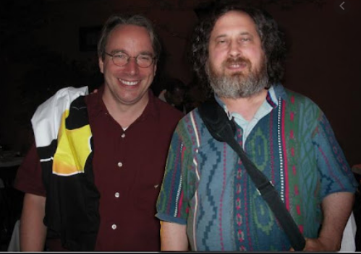
TOC
A brief of history about Unix
Building blocks (POSIX theory)
101
Directories
Permissions
Process / Signals
Unix Philosophy / Some common practices
References and copyrights

Slide 3
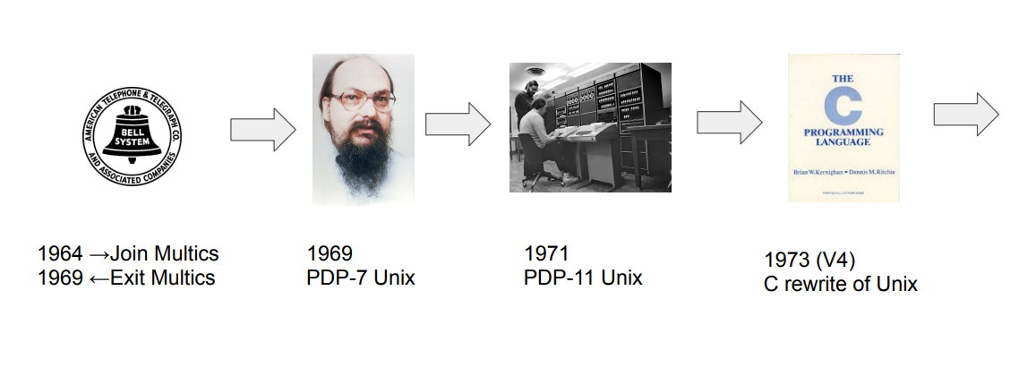
A brief history (1)
*https://papers.freebsd.org/2020/fosdem/losh-hidden_early_history_of_unix/
Notes:
https://papers.freebsd.org/2020/FOSDEM/losh-Hidden_early_history_of_Unix.files/slides.pdf

Slide 4
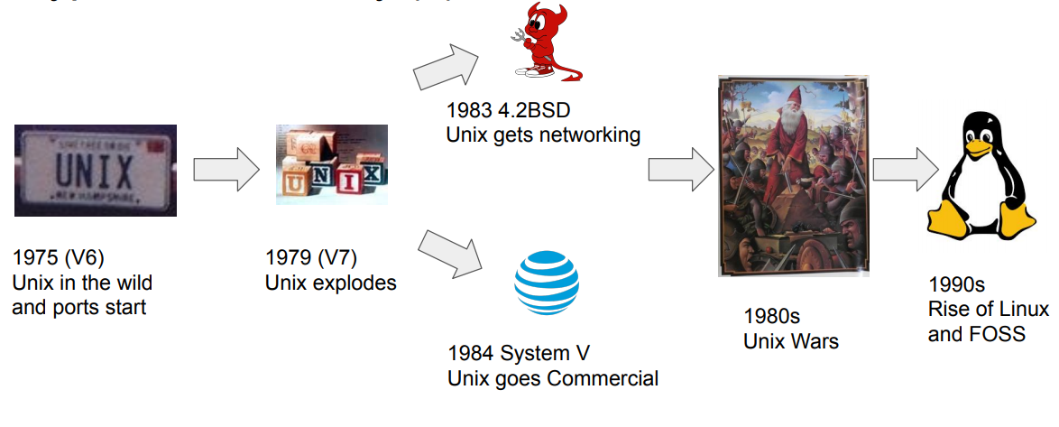
A brief history 2
Notes:
https://papers.freebsd.org/2020/FOSDEM/losh-Hidden_early_history_of_Unix.files/slides.pdf

Slide 5

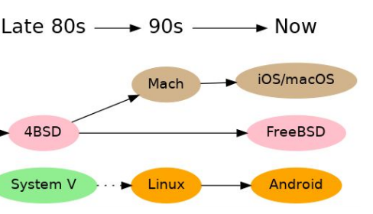
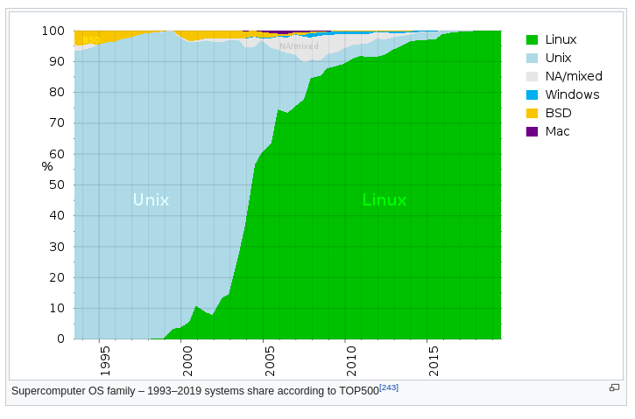
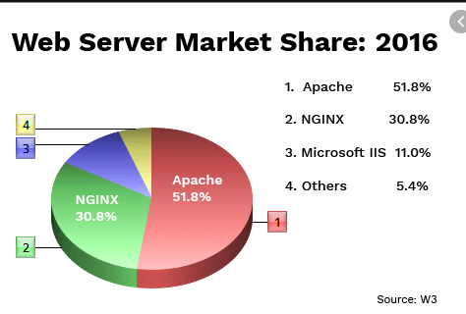


Where is Unix?
Notes:
https://papers.freebsd.org/2020/FOSDEM/losh-Hidden_early_history_of_Unix.files/slides.pdf

Slide 6
Building blocks (1)
POSIX: The POSIX 1003.1 standard is an ISO standard that specifies operating system functionality in a C language interface
Process:
A process is an abstraction that represents an executing program.
Multiple processes execute independently and have separate address spaces.
Processes can create, interrupt, and terminate other processes, subject to security restrictions.
Permissions: Each user of a POSIX system has a defined user ID and group ID. User IDs and group IDs are integers; usernames and group names are strings. Permissions are defined in terms of the user ID and group ID.

Slide 7
Building blocks (2)
Signals: A signal is an interruption of a process. Signals can be generated by the operating system; they may also be generated by one process and sent to another (CAUGHT by the proc destiny). Some signals cannot be caught. The signal SIGKILL can be used to terminate another process without allowing the target process to intercept termination. * AKA kill -9 vs kill -15
Files: (1) A POSIX file is a stream of bytes. (2) A regular file is stored on disk and supports random access. (3) A special file has special properties: ex: a user's terminal. Another example is a pipe, which is a software connection between two processes; characters written to the pipe by one process can be read by the other process.
Directories: POSIX files are organized into directories. A directory is a file that contains a list of other files and their attributes.
Links: it permits more than one pathname to refer to the same file.

Slide 8
Building blocks (3)
Terminal and sessions: A POSIX terminal is a special file. POSIX provides interfaces that are valid only for terminal files. A controlling terminal is a POSIX terminal that controls a set of processes called a session. In a normal UNIX system, a session is started when a user logs in; the controlling terminal is the terminal associated with the login.
Shell: The shell is a specialized application that is used to invoke other programs; it implements a scripting language that can be used in a similar fashion to Python. There are differents types of shells, being bash and shell the more used.

Slide 9
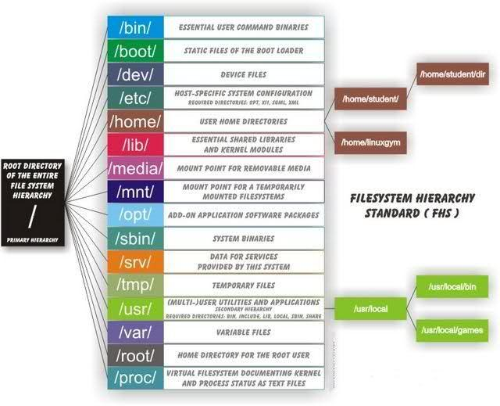
Directories
Key directories and files:
/etc
passwd -> users
group -> groups
resolv.conf -> dns
hosts -> map ip/hosts
issue -> distro
/var/log
message / dmesg -> system
wtmp * binary -> last
mail
/home/{user}
/bin /usr/bin /usr/local/bin
/proc
meminfo
cpuinfo
/dev/sd.. -> physical representation of our disk
Notes:
https://unix.stackexchange.com/questions/11544/what-is-the-difference-between-opt-and-usr-local

Slide 10
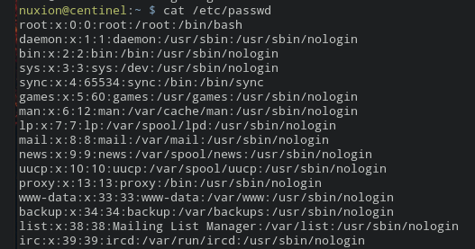
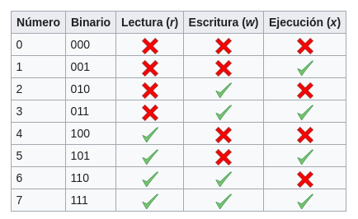
Permissions / Users
Notes:
https://unix.stackexchange.com/questions/11544/what-is-the-difference-between-opt-and-usr-local

Slide 11
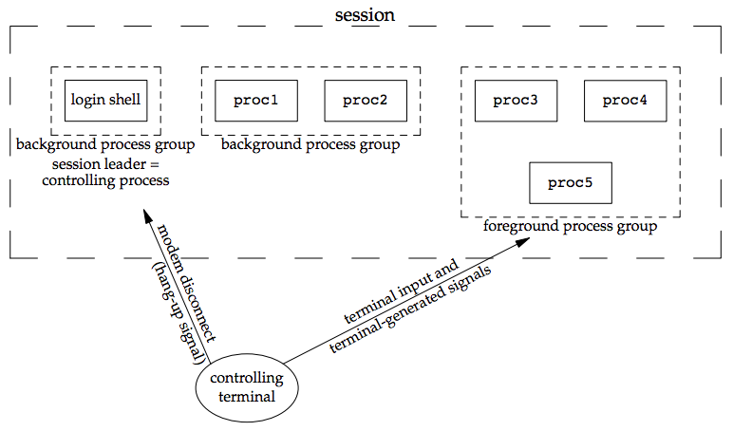
Processes and signals (1)
Notes:
https://unix.stackexchange.com/questions/11544/what-is-the-difference-between-opt-and-usr-local

Slide 12
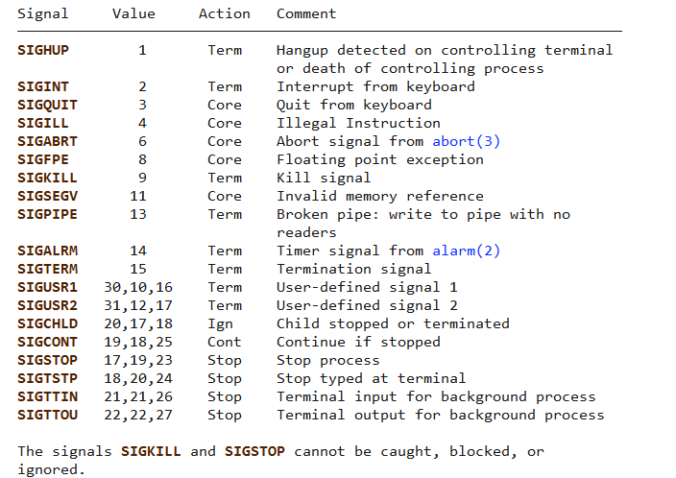
Processes and signals (2)
Notes:
https://unix.stackexchange.com/questions/11544/what-is-the-difference-between-opt-and-usr-local

Slide 13
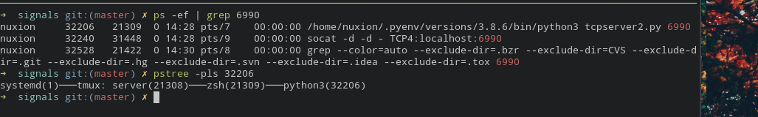
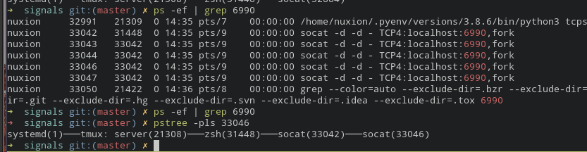
Processes and signals (3)
Notes:
https://unix.stackexchange.com/questions/11544/what-is-the-difference-between-opt-and-usr-local

Slide 14
Processes and signals (4)
Commands:
ps
top
jobs, bg, fg
pstree
netstat -nap
htop
kill
|
grep
awk

Slide 15
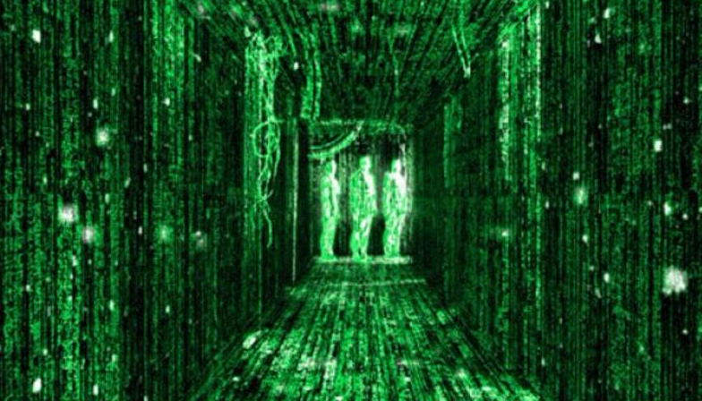
DEMO

Slide 16
Unix philosophy
Doug McIlroy, the inventor of Unix pipes and one of the founders of the Unix tradition, had this to say at the time [McIlroy78]:
(i) Make each program do one thing well. To do a new job, build afresh rather than complicate old programs by adding new features.
(ii) Expect the output of every program to become the input to another, as yet unknown, program. Don't clutter output with extraneous information. Avoid stringently columnar or binary input formats. Don't insist on interactive input.
(iii) Design and build software, even operating systems, to be tried early, ideally within weeks. Don't hesitate to throw away the clumsy parts and rebuild them.
(iv) Use tools in preference to unskilled help to lighten a programming task, even if you have to detour to build the tools and expect to throw some of them out after you've finished using them.
ref: http://www.catb.org/~esr/writings/taoup/html/ch01s06.html

Slide 17
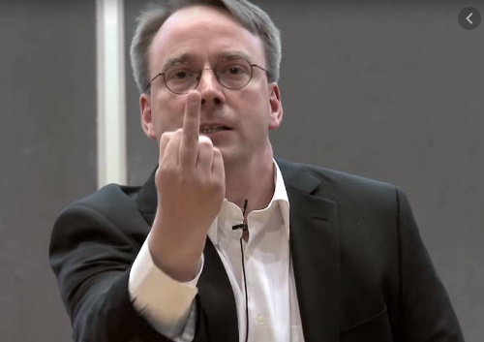
kill -9
Thanks all

Slide 18
References / Copyrights
Images was got from google images, except terminal screenshots.
[Source code] https://gituhub.com/nuxion/linux101
Introduction
https://medium.com/ingeniouslysimple/philosophy-of-unix-development-aa0104322491
https://papers.freebsd.org/2020/fosdem/losh-hidden_early_history_of_unix/
http://www.catb.org/~esr/writings/taoup/html/index.html
https://lwn.net/Articles/357658/
https://www.bbc.com/news/technology-18419231
https://support.sas.com/documentation/onlinedoc/sasc/doc750/html/lr2/zid-6574.htm
Directories
https://www.pathname.com/fhs/pub/fhs-2.3.html
https://unix.stackexchange.com/questions/11544/what-is-the-difference-between-opt-and-usr-local
https://www.howtogeek.com/117435/htg-explains-the-linux-directory-structure-explained/
Process and signals
https://notes.shichao.io/apue/ch10/

