Slide 1
Learn From Everyone
An informative
session on latest ​
trends and ​
technologies ​
Date – 26th August 2022​
Topic – A Step into JAVA
Presenter – THANIGA

Slide 2
“Before software can be reusable it first has to be usable.” – Ralph Johnson

Slide 3
Programming Language
Language is a mode of communication, used to share ideas, opinions with each other…
Programming language is a computer language, using by the programmers to communicate with computers.
It is a set of rules for instructing a computer to perform specific tasks(which tells the computer what to do).

Slide 4
Machine Language
Machine Code or Language is a low-level language made up of binary numbers or bits that computers can understand.
Machine code is a set of instructions in machine language. The CPU can directly execute it
The Programming language must be translated to machine code by a compiler or interpreter.because binary code is the only language that computer hardware can understand

Slide 5
Compiler, interpreters translate programs written in high-level languages into machine code that computer understands
1

Slide 6
Compiler vs Interpreter
Compiler
A compiler converts the entire source code into an equivalent machine code at once.
Interpreter
An interpreter converts the source code line by line into the equivalent machine code
Therefore, a compiler-based language is faster than an interpreter based language.

Slide 7
Machine Code vs Byte Code
Machine Code
machine code is a set of instructions in machine language or binary that can be directly executed by the CPU
Byte Code
Bytecode is an intermediate code generated from compiling a source code which can be executed by a virtual machine.

Slide 8
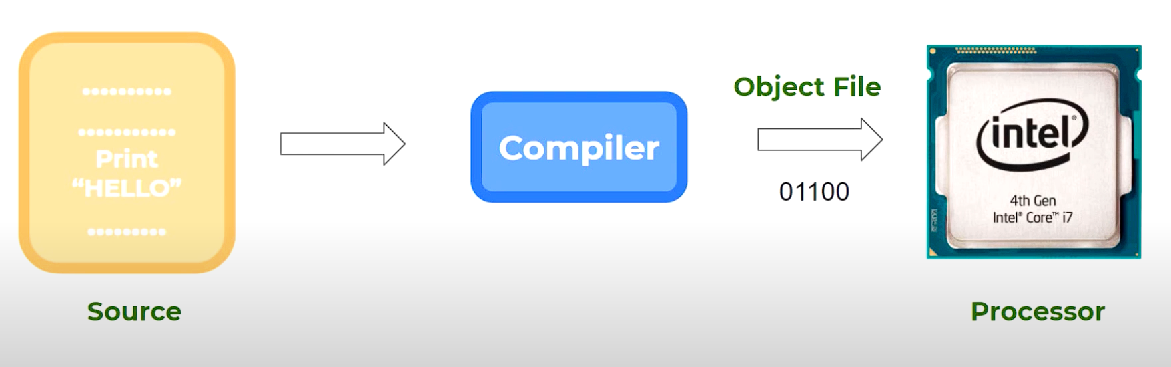
How source codes are executed
The compiler takes the Source code(program) and convert it into the machine language(object file)
The object file which created in windows can’t be used in Mac (not a cross platform).

Slide 9
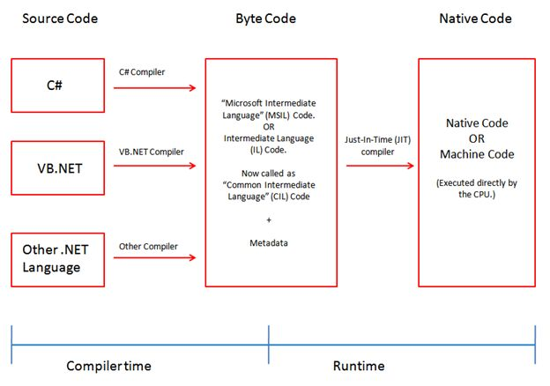
How source codes are executed
Compile time:
Compile-time is the time at which the source code is converted into an executable code
Runtime:
run time is the time at which the executable code is started running.

Slide 10
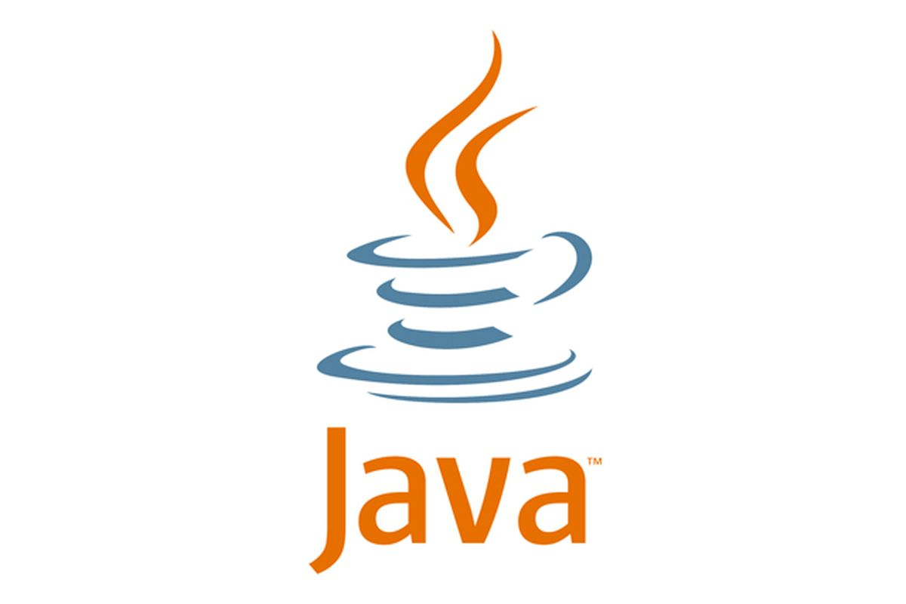
JAVA is a class based, high level object-oriented programming language.

Slide 11
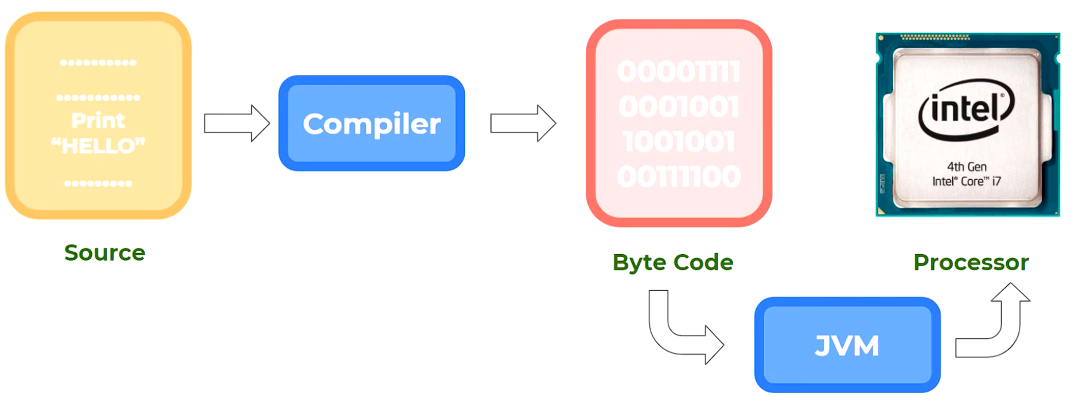
How source codes are executed in java
In java, Programs are compiled into bytecode, which JVM then executes at runtime.

Slide 12
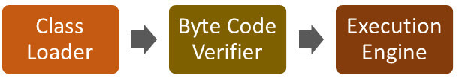
JAVA Virtual Machine
JVM act as a run-time engine to run java application.
JVM is the one that actually calls the main method present in Java Code. It is a part of JRE
It is specifically responsible for converting bytecode to machine-specific code

Slide 13
JAVA Virtual Machine
JVM performs the following operations:
Loads Code
Verifies Code
Executes Code
Provides Runtime Environment

Slide 14
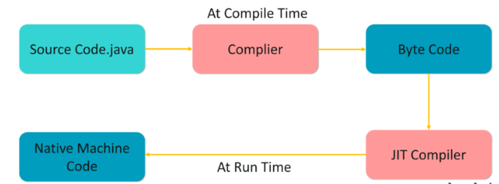
JIT in java (Just In Time)
JIT is a integral part of JVM
Java Runtime Environment, that is responsible for performance optimization of java based applications at run time

Slide 15
Bytecode is one of the most important features of java that aids in cross-platform execution.
These Bytecode have to be interpreted or compiled to proper machine instructions.
Interpreting the bytecode affects the speed of execution.
In order to improve performance, JIT compilers interact with the Java Virtual Machine (JVM) at run time to compile byte code sequences into native machine code.
The frequently used methods are compiled once and kept into memory

Slide 16
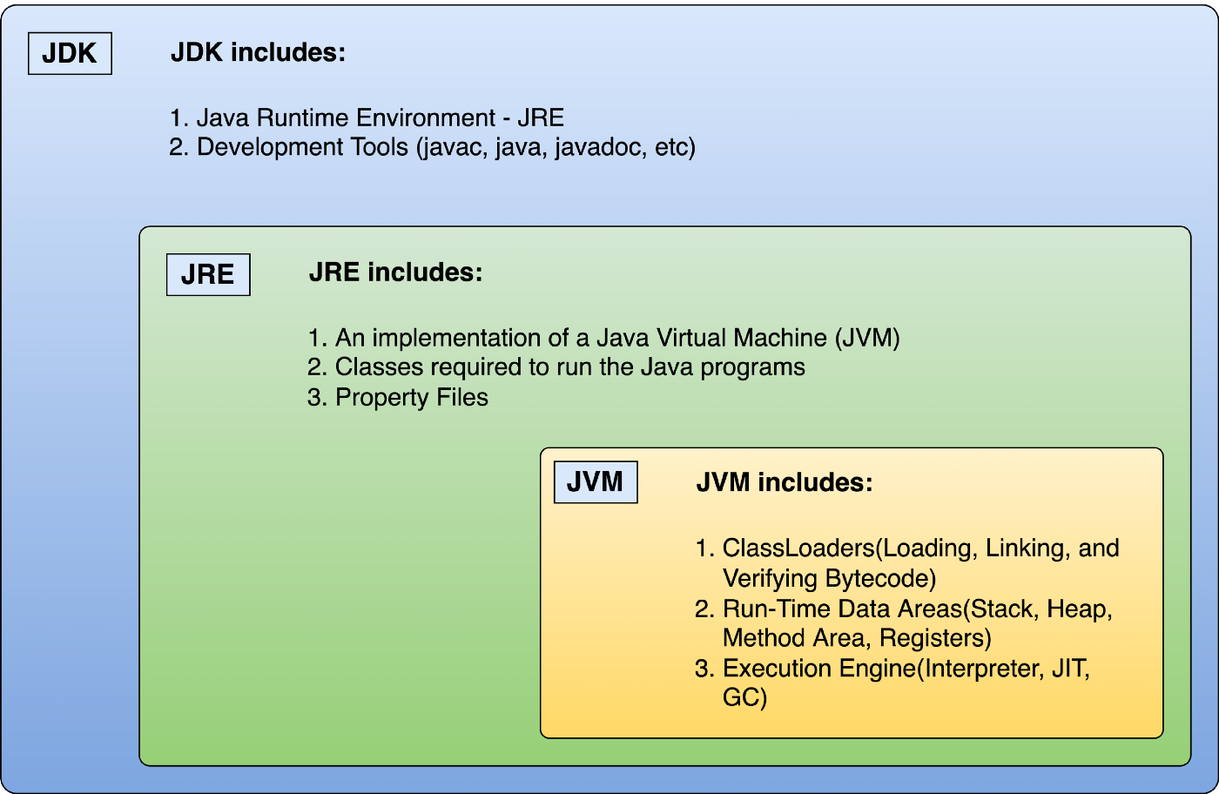
The JRE runs on to of the OS and abstracts it and create a consistent platform to run and deploy Java applications.
The Class Loader connects class libraries with the JVM
JDK is a package of tools + JRE for developing Java-based software, whereas the JRE is a Platform for running Java code.

Slide 17
Thank you!

