Slide 1
Structuring your Data and Testing
Dallin Dyer
Dallin.Dyer@domo.com
https://www.linkedin.com/in/dallindyer
https://github.com/nuxusr/AndroidArchitecture
Notes:
Going to talk about how to structure your data.
Current Employment
Previous projects – team of 4 that delivered a product to about 50 million monthly users
No right one solution for everyone’s issues. However this model described here closely follows some of the internal google projects, facebook, tunein, and others
@ Domo we used these patterns and we’ve managed to build a very robust app in 4 months that matches iOS funtionality – which they had a huge headstart on

Slide 2
What do we mean by structure
Simple Android patterns to keep your code SOLID, robust, easily testable, and in line with the performance patterns Google suggests
Notes:
Not really going to talk about how to organize your files – although we’ll touch it some
Some people organize by feature, some by type
Things change, patterns evolve, etc. All you can do is use common sense, the best implementations/patterns for the situation and then adapt as time progresses.
These same conversations will always arise in our industry because the only constant IS change. :)

Slide 3
SOLID
https://en.wikipedia.org/wiki/SOLID_(object-oriented_design)
S – Single responsibility principle
A class should have only a single responsibility
O – Open/closed principle
Software entities… should be open for extension, but closed for modification
L – Liskov substitution principle
Objects in a program should be replaceable with instances of their subtypes without altering the correctness of that program
I – Interface segregation principle
Many client-specific interfaces are better than one general-purpose interface
D – Dependency inversion principle
One should “Depend upon Abstractions. Do not depend upon concretions”
Notes:
Acronym by Michael Feathers for the “first five principles” named by Robert C. Martin.
Robert Martin – co-author of the Agile Manifesto
Today we’ll mostly cover the S, I, & D

Slide 4
Robust
No longer fear the screen rotation
Handle activities on the bottom of your activity stack killed when resources are low
Statics deleted when memory is low and app is backgrounded
View binding/cache when an activity is on the bottom of a stack

Slide 5
Testable
How do you build your app to be tested off of the network?
How to isolate activities so they can be tested individually

Slide 6
High level overview
Dependency Injection - Dagger 2
Cursor Loaders (AsyncLoaders)
Content Providers
Code gen
Automated Testing with Espresso

Slide 7
Quick “Go to” library list
Examples are built on top of the great open-source world we live in
OkHttp, Retrofit, Picasso, Glide, Dagger[1|2], ButterKnife, JavaPoet, Lombok, Mockito, Espresso, Stetho, Apache Commons, Leak Canary, Provigen, Timber, IcePick, IntentBuilder, FragmentWithArgs, Vinyl
Take advantage of generated code
Notes:
On reddit..
Reddit.com/androiddev
Pros and Cons of Generated code.
App runs quicker

Slide 8
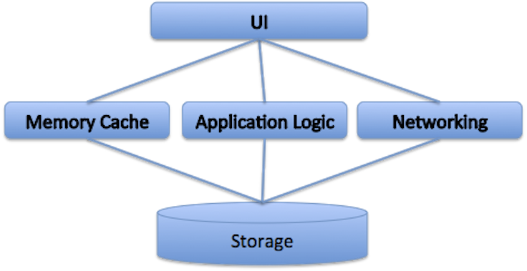
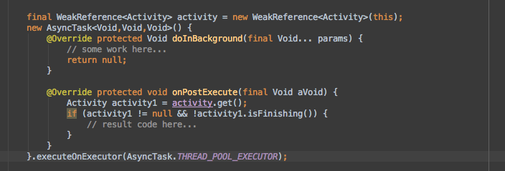
High level overview
Traditional – but problematic on Android:
Diagrams shamelessly stolen from FB
Notes:
A memory cache normally means that we would keep much more in memory than what is needed for displaying the UI.
Many Android devices on the market still have a per-app memory limit of 48 MB or less. When you add in the overhead of the Java garbage collector, this can have implications for performance.
Application logic needs to deal with the memory cache, UI, and storage, but typically code related to the UI and to storage takes place on different threads. Keeping the threading model simple in a large application can be difficult.
The UI typically receives data from multiple sources, such as cached data in storage, new data from the network, local data mutations from application logic, and more. This requires the UI to have to deal with different kinds of data change scenarios and can result in UI overdraw.
Bad scenario:
Start a netowrk request, hit something that takes them to another activity, android kills off your activity due to low resrources, user hits back and comes back into your activity…

Slide 9
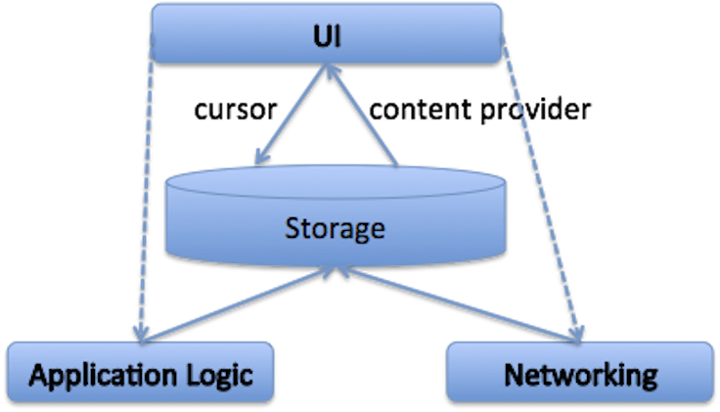
High level overview
The approach we’ll be talking about
Diagrams shamelessly stolen from FB
Notes:
Benefits of this approach:
The UI is built directly on top of storage using standard Android cursors, and since storage-to-UI is the hottest execution path in most Android apps, this can help keep the UI responsive.
The application logic and networking components have been moved beneath the storage layer, allowing all logic there to take place on a background thread and ensure that results are reflected in storage first.
Then UI can then be notified to redraw through the use of standard Android content provider notifications.
This architecture allows a clean separation between the UI and application logic layers — and we could simplify the logic for each.
The UI components only need to reflect the state of the storage, and the application logic only needs to write the final (correct) information to the storage layer.
The UI and application logic layers live on different threads, and they never have to communicate with each other directly.
Searching to your app
Activities
Loaders
Content Providers
Sqlite tables

Slide 10
What does this look like in Code?
Notes:
Open Android studio to test project
Folder structure discussion
By feature, by Class type
Lots of code generation and I can setup proguard rules for packages and directories
Can’t remember an activity name I can just open the activity folder
-- pros to both ways though
Hybrid approach

Slide 11
Dagger 2
https://www.youtube.com/watch?v=oK_XtfXPkqw
Dependency injection
Spring, Guice, Dagger 1
Notes:
Guice takes waaaayy to long to load.
Dagger 1 – great & still used by square (they don’t’ consider 2 to be the update of dagger 1) – doesn’t support proguard, more work creating graphs
Dagger 2 – Google’s project, supports proguard

Slide 12
How does injection help us
class Coffee { /* */ } interface Heater { /* */ } interface Pump { /* */ } class ElectricHeater implements Heater { /* */ } class Thermosiphon implements Pump { /* */ } class CoffeeMaker { private final Heater mHeater; private final Pump mPump; CoffeeMaker() { mHeater = new ElectricHeater(); mPump = new Pump(); } Coffee makeCoffee() { return new Coffee(); } }
Problems?
Can’t send in a Mock Heater or Mock pump
Can’t re-use with another heater or pump type
Class has to know how to instantiate these dependencies
Class has to care about what the dependencies are
If you want a singleton or unique instance of this class you have to build that into the class itself or create a factory for it
Notes:
Why?
Violates SOLID design principles
Instead of building dependencies you’re handed interfaces to them.
Testing this
Isolate coffeemaker without

Slide 13
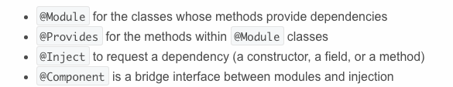
Lets see it in action
http://code.tutsplus.com/tutorials/dependency-injection-with-dagger-2-on-android--cms-23345

Slide 14
Cursor Loaders
https://github.com/codepath/android_guides/wiki
http://www.androiddesignpatterns.com/2012/07/loaders-and-loadermanager-background.html
Notes:
Glue layer between your data and your storage.
They automatically handle your cursors (closing)
They automatically handle screen rotations, activities killed off and then resumed, data changed while in another activity, etc.
They don’t’ hold static references to your activity

Slide 15
Loading without loaders…

Slide 16
Lets see how they work in code

Slide 17
Content Providers
Can safely access your data across processes
Can be generated if you want
Notes:
* Good news is you don’t have to build these out if you don’t want to
ProviGen
ContentProvider vs SharedPreferences or CookieStore
Native Code used the Poco C++ libraries
Data handled by db safely across processes (exported services), jni, etc.

Slide 18
Generated code FTW

Slide 19
ContentProvider examples
Notes:
I’ve extended

Slide 20
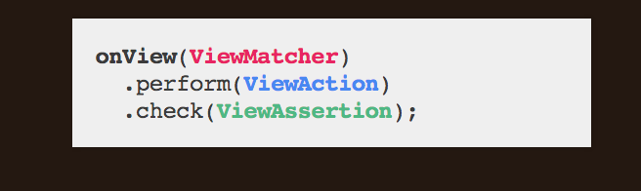
Automated testing - Espresso
https://www.youtube.com/watch?v=hfoAC9gdC74
^ great talk given by Chiu-Ki Chan at the Big Android BBQ
Notes:
Why?
Other options:
How?

Slide 21
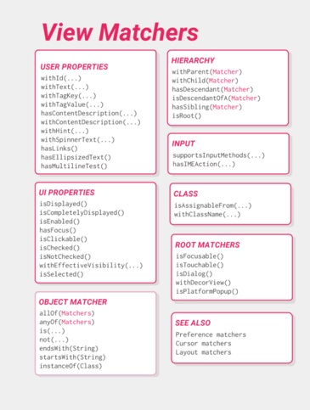
Espresso Docs & Cheat sheet
https://google.github.io/android-testing-support-library/docs/index.html
https://google.github.io/android-testing-support-library/docs/espresso/cheatsheet/index.html

Slide 22
Thank you

