Slide 1
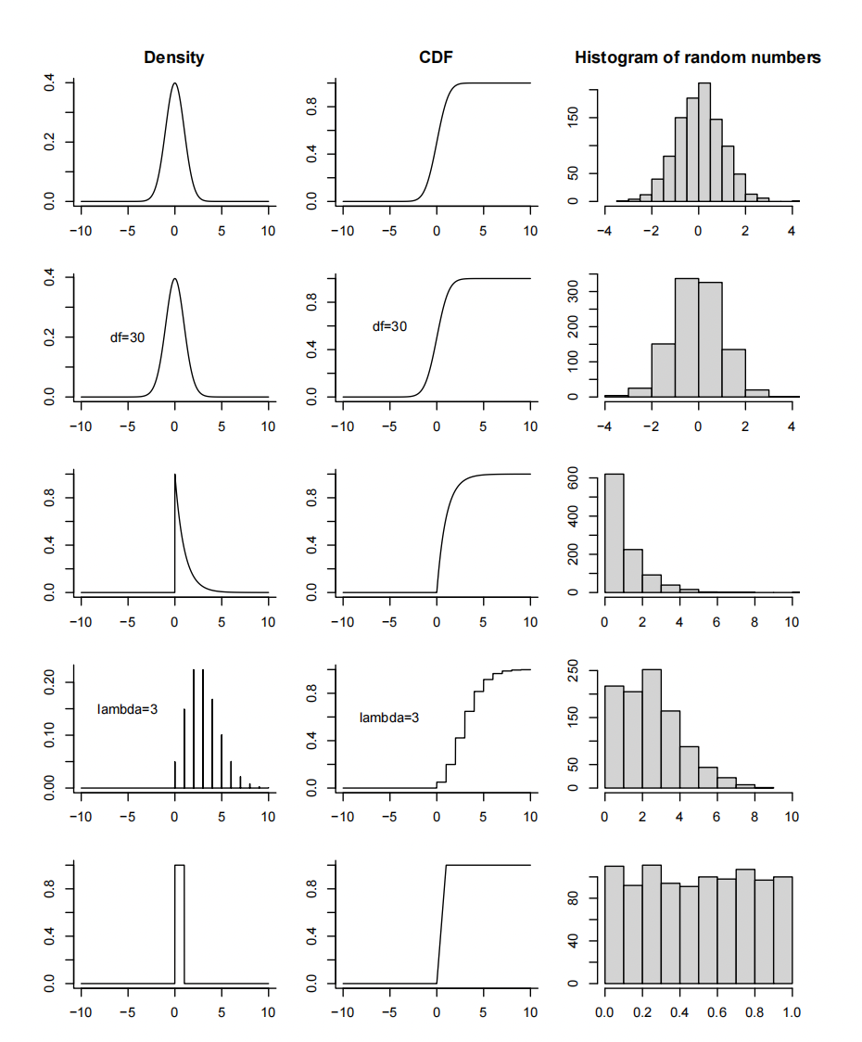
Normal
Student t
Exponential
Poisson
Uniform

