Slide 1
Cosmos3-Edge on
Jetson Orin Nano
Iteration history and measured findings
Current deployment: MLP-only RTN INT4, compact buffers
Earlier FP16 phases: slides 2–28. New MLP results: slides 33–37.
Updated 2026-09-20
Notes:
Current deployment is the selected MLP-only RTN INT4 candidate with compact buffers. The cover date uses the user’s local day, 2026-09-20.
Historical FP16 phases remain on slides 2–28. Slides 29–32 show the user-provided recording at the earlier restored FP16 stage. Slides 33–37 document the new MLP goal and current selection.
The frozen comparator records a 1.19% observed latency reduction, below the 10% continuation threshold. The agent corrected its initial interpretation after measurement: stop searching while retaining the useful lower-memory deployment. This does not establish a 10% latency success.
Sources:
results/mlp-goal/selection.json
results/mlp-goal/policy-clarification.json
results/mlp-goal/comparison-01.json
results/mlp-goal/verification.json

Slide 2
Installed hardware and software
Component | Observed configuration
Device | Jetson Orin Nano P3767-0005 8 GB shared RAM
Storage and mode | WD_BLACK SN7100 1 TB Stock 25 W, ID1
Operating system | JetPack 7.2.1, L4T 39.2.1 Kernel 6.8.12-1021-tegra
Compute libraries | CUDA nvcc13.2.86, TensorRT 10.16.2.10
Installation evidence | Verified USB-C QSPI + NVMe flash Verified NVMe boot and CUDA calculation
Official NVIDIA flash tools ran through an original SSH/NFS transport bridge.
Measured findings, 2026-09-20
2
Notes:
Installed platform facts come from the actual device receipts. Advertised RAM and Linux MemTotal are distinct.
Measured values supplied by output/final-findings-data.json.
Sources:
results/normal-boot.json
results/jetpack-flash-status.json
results/installed-compute-packages.json
https://developer.nvidia.com/embedded/jetpack/downloads

Slide 3
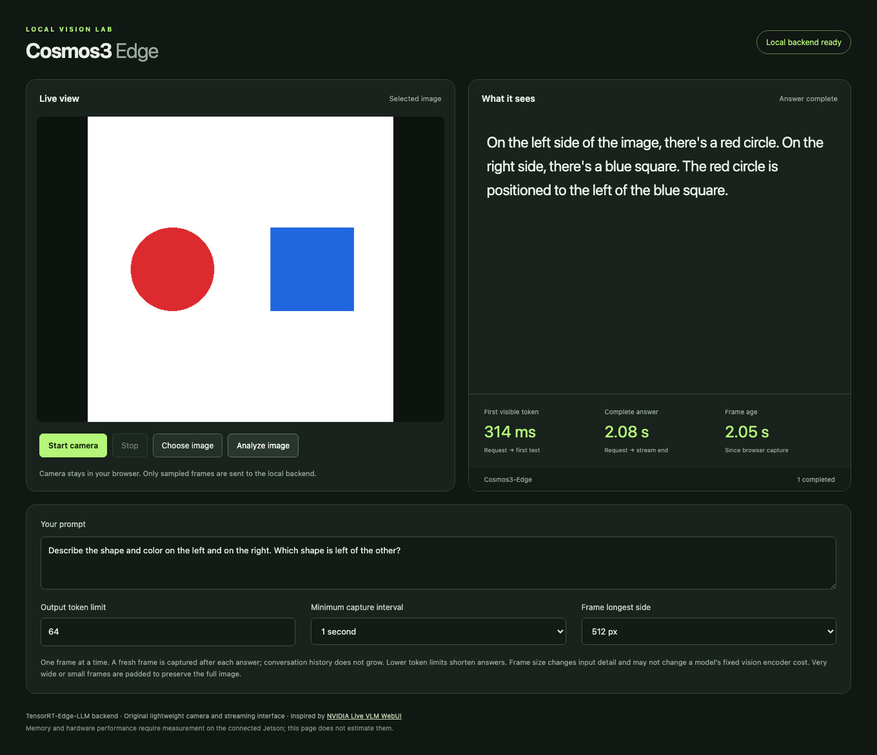
Streaming browser interface
Browser checks
Streaming: Pass
Stop and restart: Pass
Synthetic camera: Pass
Web access
http://localhost:8090
Actual Orin service through the Mac SSH tunnel
Measured findings, 2026-09-20
3
Notes:
Original UI and actual inference screenshot. Crop removes lower settings only. Screenshot timing is one request, not the benchmark distribution. The screenshot does not establish general image accuracy.
Measured values supplied by output/final-findings-data.json.
Sources:
results/browser-live-ui-final.json
results/browser-live-ui-final.json
results/browser-camera-ui-final.json
https://github.com/NVIDIA-AI-IOT/live-vlm-webui

Slide 4
Request and inference path
Stage | Responsibility | Source
Browser | Capture JPEG, prompt and sampling settings | Original UI
Orin HTTP proxy | Forward one request and stream SSE events | Original proxy
Resident backend | Decode image, run vision and language engines | TensorRT Edge-LLM
Checkpoint | Learned image and language behavior | NVIDIA Cosmos3-Edge
Browser response | Incremental text, timing and cancellation | Original UI
The webpage runs on the Orin. Access through a tunnel remains a transport detail.
Measured findings, 2026-09-20
4
Notes:
Original browser/proxy components wrap the public TensorRT Edge-LLM reasoner. One active request prevents accumulating frames. The application displays only real upstream token deltas.
Measured values supplied by output/final-findings-data.json.
Sources:
scripts/serve_ui.py
web/app.js
https://github.com/NVIDIA/TensorRT-Edge-LLM/blob/e8b29522938901f6df19ebeedd4b69bc8edbcd97/experimental/server/cli.py
https://github.com/NVIDIA/TensorRT-Edge-LLM/blob/e8b29522938901f6df19ebeedd4b69bc8edbcd97/experimental/server/runtime/engine.py

Slide 5
Compatibility and correctness repairs
Observed defect | Task contribution using public conventions
Generated runtime sidecars | Restore existing RoPE aliases and image/video delimiters
HWC weights with CHW pixels | Apply the public exporter’s patch-weight column permutation
Position interpolation | Select the Cosmos half-pixel convention in the existing kernel
Independent image cache | Expose its existing byte budget and set it to zero for measurement
NVIDIA supplies the model, runtime and underlying conventions. This task repairs their integration.
Measured findings, 2026-09-20
5
Notes:
These original diagnoses and small integrations reuse the public model/exporter conventions. No model training or new interpolation algorithm is claimed. Patch projection requires a fresh visual engine. Position and cache API changes require rebuilding the native binding.
Measured values supplied by output/final-findings-data.json.
Sources:
patches/cosmos3-patch-embedding-chw.md
patches/cosmos3-half-pixel-position.md
patches/encoder-cache-budget.json
scripts/repair_cosmos_runtime_config.py
scripts/repair_cosmos_chat_template.py
https://github.com/NVIDIA/TensorRT-Edge-LLM/blob/e8b29522938901f6df19ebeedd4b69bc8edbcd97/tensorrt_edgellm/models/cosmos3_reasoner/modeling_cosmos3_reasoner_visual.py
https://github.com/huggingface/transformers/blob/c587bc884db2c2e31fc2b8102314656b17aa07b1/src/transformers/models/cosmos3_edge/modeling_cosmos3_edge.py

Slide 6

Quality checks and their limits
18 / 19 synthetic facts
Strict screen: Fail
Reference equivalence: Accepted
Both paths describe the flat circles as spheres.
Natural photos
Official answer identical: Yes
All previously correct facts must remain correct. No additional false claim is permitted.
5/9 with partial credit.
0/3 fully correct photos.
Official reference also 5/9.
2/3 answers match exactly.
Cause remains unassigned.
Measured findings, 2026-09-20
6
Notes:
Strict six-image fixture grading and optimization equivalence are separate. The official unmodified model reproduced the entire case05 sphere answer on the exact image and prompt. A pre-INT4 policy preserves every previously correct fact and permits only that precise known error. It does not turn the strict 18/19 result into a 19/19 pass.
The distinct natural-photo smoke check is outside candidate selection. Fully correct photos means every required observation is correct, not merely a completed HTTP response. The natural-image official reference runs the unchanged public model through Transformers on Mac MPS FP16. It scores 5/9 with the same grading interpretation, with 2/3 answers exactly matching the Orin. In the recorded comparison, market gives only "Carrots." and dog incorrectly says "wooden deck" in both paths. The cap/mitt wording differs but both miss the required cap-on-mitt relation. The displayed 5/9 gives generous partial credit for carrot identity even though "Carrots." omits the required lower-right relation. Strict full-fact grading is 4/9. No photo satisfies every required fact under either interpretation. These observations do not establish a model-only cause for every failure. Mac execution time is diagnostic and is not an Orin performance measurement.
Captured official reference answer: Both objects are purple. The left object, which is a sphere, is larger than the right object, which is a smaller sphere.
Measured values supplied by output/final-findings-data.json.
Sources:
results/quality-final-service-01-review.json
results/optimization-quality-policy.json
results/reference-official-05-comparison.json
results/natural-smoke-final-01-review.json
results/reference-natural-smoke.json
benchmarks/natural-smoke/manifest.json
benchmarks/natural-smoke/README.md
results/reference-official-05.json
https://huggingface.co/nvidia/Cosmos3-Edge/blob/344d602b128d1bbdacb43b08d0a3626f46343e29/README.md

Slide 7
Measurement workload and stopping rule
Fixed workload
Baseline runtime profile
512 × 512 JPEG
Output ceiling: 64 tokens
Temperature 0, top_p 1
5 warmups, 30 measured requests
Input 1024, KV 2048, batch 1
Encoder cache: 0 bytes
Text context reuse: Off
At most 5 candidates. Stop after 3 consecutive non-improvements.
Require at least 5% lower p50 latency or peak memory, with no greater than 5% regression in the counterpart or p95 latency. Reject errors, OOM and swapping.
Measured findings, 2026-09-20
7
Notes:
Warmups remain separate from measured requests. TTFT starts at request dispatch and ends on the first nonempty text delta. Completion token counts must come from real backend usage. Equivalent-quality qualification is an overlay referencing unchanged raw measurements.
Measured values supplied by output/final-findings-data.json.
Sources:
research/benchmark-method.md
GOAL.md
results/benchmark-fp16-qualified.jsonl
results/raw/benchmark-fp16-reference-01.jsonl
results/optimization-quality-policy.json
results/optimization-search-plan.json

Slide 8
Measured FP16 baseline
Latency | p50 | p95
First visible text | 266.3 ms | 271.7 ms
Complete answer | 1830.4 ms | 1834.9 ms
20.21 tokens/s
End-to-end throughput
37 completion tokens
Shared RAM unavailable peak: 6.38 GiB
Process RSS peak: 5.90 GiB
Errors: 0 OOM: No Swap activity: No
Measured findings, 2026-09-20
8
Notes:
The qualification overlay references the original 35-request run, rather than recording a second measurement. Original raw SHA256: 3ecce48f18c461161a99368c221dc87abc43a8cb1e1a7c1b199f46f8d7d65417. Shared unavailable memory equals MemTotal minus MemAvailable. RSS is the process resident set. These overlapping counters must never be added.
Measured values supplied by output/final-findings-data.json.
Sources:
results/benchmark-fp16-qualified.jsonl
results/raw/benchmark-fp16-reference-01.jsonl
results/optimization-quality-policy.json

Slide 9
Original CPU INT4 conversion
2.22 GiB
First trial: all language linears
Uncalibrated RTN quantizes language linear weights and the LM head. Vision, projector and embedding tensors stay FP16.
Checkpoint file on disk
169 language linear modules
Group size 128
Native INT4 V1 kernels
GPTQ-compatible storage
The storage layout lets the pinned builder load RTN values. It makes no claim of GPTQ or AWQ optimization.
Checkpoint size is distinct from measured resident RAM, allocation and latency.
Measured findings, 2026-09-20
9
Notes:
Group-128 symmetric round-to-nearest with stored FP16 scales and signed values -7 through 7. RTN_GPTQ dispatch describes RTN values in GPTQ-compatible packing. No GPTQ optimization, AWQ optimization, calibration dataset, GPU conversion or community checkpoint was used. Source shards stayed read-only. The exact public parser and V1/V2 repackers passed CPU tests.
Measured values supplied by output/final-findings-data.json.
Sources:
results/rtn-cpu-validation.json
scripts/quantize_cosmos3_rtn.py
scripts/rtn_backend.py
tests/test_rtn_quantization.py
https://github.com/NVIDIA/TensorRT-Edge-LLM/blob/e8b29522938901f6df19ebeedd4b69bc8edbcd97/experimental/builder/weight_packing/int4.py
https://github.com/NVIDIA/TensorRT-Edge-LLM/blob/e8b29522938901f6df19ebeedd4b69bc8edbcd97/experimental/builder/core/quantization.py

Slide 10
Baseline, first INT4 trial and selection
Metric | FP16 baseline | First RTN: rejected | Final selected
TTFT p50 / p95 | 266.3 ms / 271.7 ms | 266.7 ms / 269.6 ms | 265.5 ms / 267.4 ms
Answer p50 / p95 | 1830.4 ms / 1834.9 ms | 1228.8 ms / 1234.2 ms | 1825.9 ms / 1830.0 ms
Shared RAM peak¹ | 6.38 GiB | 4.20 GiB | 6.43 GiB
Strict quality facts | 18/19 | 13/19 | 18/19
Reference equivalence | Pass | Fail | Pass
Selected: fp16-corrected-i1024-kv2048
¹ System RAM unavailable. Quality rejection takes precedence over latency or memory gains.
Measured findings, 2026-09-20
10
Notes:
First INT4 execution status: rejected. 13/19 facts; new errors and token-limit truncation.. Selection: fp16-corrected-i1024-kv2048. Identical workload fingerprints and memory counters are required for comparisons. The selected column is a separate final verification after swap was disabled; search-trial measurements remain unchanged. Rejected RTN measurements describe a tradeoff and cannot qualify it for selection. Strict quality and reference-equivalent quality remain separate.
Measured values supplied by output/final-findings-data.json.
Sources:
results/benchmark-fp16-qualified.jsonl
results/raw/benchmark-rtn-v1-rejected-01.jsonl
results/raw/benchmark-final-service-01.jsonl
results/optimization-quality-policy.json

Slide 11
Bounded search and memory constraints
Candidate | Result | Facts | p50 answer | RAM peak¹
FP16 reference | Selected | 18/19 | 1830.4 ms | 6.38 GiB
RTN INT4 all linears | Rejected | 13/19 | 1228.8 ms | 4.20 GiB
RTN INT4 MLP only | Rejected | 18/19 | 1026.6 ms | 5.01 GiB
FP16 fixed clocks | Rejected | 18/19 | 1758.3 ms | 6.35 GiB
Linux exposes 7.37 GiB shared physical RAM. Selected process RSS peak: 5.91 GiB.
¹ MemTotal − MemAvailable overlaps process RSS. Never add them.
CUDA allocator telemetry: not collected. Disk sizes measure storage.
Measured findings, 2026-09-20
11
Notes:
Orin Nano uses unified physical RAM for CPU and GPU. MemTotal minus MemAvailable includes CPU, GPU and system pressure. Process RSS and CUDA allocator telemetry answer different questions and overlap. Disk checkpoint/engine size is separate from memory. Missing allocator telemetry is explicitly unavailable.
Measured values supplied by output/final-findings-data.json.
Sources:
GOAL.md
research/fp16-build-memory.md
results/benchmark-fp16-qualified.jsonl
results/raw/benchmark-rtn-v1-rejected-01.jsonl
results/raw/benchmark-final-service-01.jsonl
results/optimization-search-plan.json
results/benchmark-fp16-qualified.jsonl
results/raw/benchmark-rtn-v1-rejected-01.jsonl
results/raw/benchmark-rtn-mlp-rejected-01.jsonl
results/raw/benchmark-fp16-clocks-01.jsonl

Slide 12
Selected configuration and sustained run
fp16-corrected-i1024-kv2048
FP16 preserves reference quality. Both INT4 variants add errors; fixed clocks miss the 5% gain and swap gate.
FP16 · dynamic stock 25 W · swap disabled
FP16 retained. Final service verification is separate from the four search trials.
Sustained-run check | Observed result
Duration and successful requests | 601 seconds / 366 requests
Minimum MemAvailable | 0.94 GiB
Errors / OOM / swap | 0 / No / No
Candidates considered: 4. Stop reason: Stopped after three consecutive non-improvements.
Measured findings, 2026-09-20
12
Notes:
This is a bounded observed selection, not a claim of a global optimum. Final export requires a 10-minute soak, no errors/OOM/swapping, at least 512 MiB minimum MemAvailable, and explicit candidate selection. Compare latency/memory improvement only under the same declared memory counter and workload.
Measured values supplied by output/final-findings-data.json.
Sources:
results/optimization-selection.json
results/raw/benchmark-final-service-01.jsonl
results/raw/soak-final-service-01.summary.json
GOAL.md
results/optimization-search-plan.json

Slide 13
Upstream contributions and licenses
Project / team | Contribution | Terms
NVIDIA Cosmos3-Edge | Pretrained model and tokenizer | OpenMDW-1.1
TensorRT Edge-LLM | Runtime, builders and kernels | Apache-2.0
live-vlm-webui contributors | Public interaction reference | Apache-2.0
PyTorch / Transformers | Official-model reference execution | Component licenses
Original task integration | UI, transport, repairs, measurements, RTN | Apache-2.0
Public repository contributors
UI: tokk-nv, chitoku
Runtime: nvluxiaoz, ever-wong, jhalabi-nv, nvxingkaiz, JCalafato, poweiw
Measured findings, 2026-09-20
13
Notes:
Repository contributors are public contribution credits, not assigned individual ownership of each feature. NVIDIA owns the model/runtime contributions. Original task code is Apache-2.0. Model OpenMDW-1.1, JetPack/CUDA/TensorRT terms and bundled dependency licenses remain separate. Paramiko LGPL-2.1 supports the optional SSH bridge. NumPy uses BSD-3-Clause and Pillow MIT-CMU. Official PyTorch and Transformers supply reference execution. PyTorch wheels retain all bundled license notices, beyond its main BSD-style license. See the contribution ledger for exact public evidence.
Measured values supplied by output/final-findings-data.json.
Sources:
research/contribution-ledger.md
THIRD_PARTY_NOTICES.md
https://huggingface.co/nvidia/Cosmos3-Edge/blob/344d602b128d1bbdacb43b08d0a3626f46343e29/README.md
https://github.com/NVIDIA/TensorRT-Edge-LLM/blob/e8b29522938901f6df19ebeedd4b69bc8edbcd97/LICENSE
https://github.com/NVIDIA-AI-IOT/live-vlm-webui
https://github.com/huggingface/transformers/blob/c587bc884db2c2e31fc2b8102314656b17aa07b1/LICENSE
https://github.com/pytorch/pytorch/blob/cf30153c4c131c8164ee7798e5022d810682e2cb/LICENSE
https://github.com/NVIDIA/TensorRT-Edge-LLM/commit/e8b29522938901f6df19ebeedd4b69bc8edbcd97

Slide 14
Limits and reproduction
Quality: 18/19 synthetic facts; natural photos 5/9 with partial credit, 0/3 fully correct.
Streaming checks passed. Natural-video and temporal understanding remain untested.
Small inputs are padded around a documented position-interpolation limit.
RAM and RSS overlap. CUDA allocator peak was not collected.
NVMe timeouts recur at cold load. Service recovers; storage issue remains unresolved.
Build selected engines
Native runtime + engine build:
docs/backend-build.md
Section 4, selected FP16
Serve on the Orin
sudo systemctl start cosmos-edge-backend cosmos-edge-ui
Repeat the measured workload
scripts/benchmark.py
Invocation and fixed settings:
research/benchmark-method.md
Measured findings, 2026-09-20
14
Notes:
Commands are supplied from the selected validated deployment. Exact source/model revisions, conversion receipts, patch hashes, engine receipts and raw benchmark files preserve provenance. The source corpus contains public code and original task assets only. No personal-namespace project or internal repository was used.
Measured values supplied by output/final-findings-data.json.
Sources:
docs/backend-build.md
sources.lock.json
docs/quality-workload.md
patches/cosmos3-half-pixel-position.md

Slide 15
Original goal and agent stopping policy
User-defined goal
Agent-chosen policy | Recorded limit
Search ceiling | 12 initially, then 5
Each measured trial | 5 warmups + 30 requests
Required gain | At least 5%, with quality checks
Early stop | 3 consecutive non-improvements
Actual outcome | 4 trials, corrected FP16 retained
Install JetPack through USB-C.
Run Cosmos3-Edge with TRT-Edge-LLM.
Serve streaming vision on the Orin.
Measure memory and latency.
Present findings and public-source credits.
“so you don’t keep iterating on marginal gains”
User request for a finite search
Measured findings, 2026-09-20
15
Notes:
The user requested installing JetPack over USB-C, Cosmos3-Edge through TensorRT-Edge-LLM, a streaming UI served on the Orin, low memory and latency after signs of life, and a findings presentation. The user explicitly required public code and prohibited personal-namespace/internal repositories and communications. Exact user quote: “Give yourself a proper goal setting so you don’t keep iterating on marginal gains for either.” Numeric thresholds were agent choices. The initial ceiling was 12 candidates, later tightened to 5. Each measured trial used 5 warmups and 30 measured requests. Three consecutive non-improvements stop the search. A candidate needs at least 5% improvement in p50 answer latency or sampled peak memory, no greater than 5% regression in the counterpart or p95 latency, preserved reference-equivalent quality, and no errors, OOM or workload swap. Four trials were evaluated. The compact fifth trial was not run.
Safe transcript excerpts and attribution audit: research/first-version-journey.md.
Sources:
GOAL.md
results/deployment-status.json
results/optimization-search-plan.json
results/optimization-selection.json

Slide 16
User steering and progress oversight
Progress oversight
“Did you install jetpack via the usb-c?”
“what have you done thus far?”
Connectivity reports from the user
“can you work on wifi or do you want ethernet”
“giving the GPU ethernet back and you on wifi”
Optional GPU access
“Isolate your work from anything else on that computer.”
Agent authentication failed. No remote workspace or auxiliary GPU use.
Measured findings, 2026-09-20
16
Notes:
Exact user oversight prompts: “Did you install jetpack via the usb-c?” and “what have you done thus far?” These are status requests, not physical interventions. Exact connectivity reports: “Do you need the GPU? I took the ethernet offline so you can go faster, can you work on wifi or do you want ethernet”; “nvm we’ll take all night if you need to, giving the GPU ethernet back and you on wifi”. These statements are user reports, not independently verified interface changes or measured network speed improvements. Optional GPU authorization required all remote work to remain in one newly created task directory. The safe exact excerpt “Isolate your work from anything else on that computer.” omits host and credentials. The user also said “ok was able to ssh in from the terminal inside this codex side chat”. A user login did not establish agent authentication: the recorded agent clients were rejected, no task directory or files were created, and the auxiliary GPU was never used. Local Mac MPS reference execution and actual Orin GPU inference are distinct from that unused auxiliary machine.
Safe transcript excerpts and attribution audit: research/first-version-journey.md.
Sources:
GOAL.md
results/aux-gpu-status.json
results/normal-boot.json

Slide 17
Human readiness and verified agent actions
Stage | Human report or request | Verified agent action
Recovery entry | FC REC–GND reported “done”: readiness confirmation | Detect APX, read EEPROM, upload RAM recovery
USB access | Accessory approval requested if a prompt appeared Approval unconfirmed | Use native USB SSH and an NFS bridge Complete official QSPI/NVMe flash
Normal boot | “the jumper isn’t in” Reported state, no action timestamp | Verify NVMe boot and task-key SSH Run CUDA and expand storage
Agent preparation continued while hardware readiness was unresolved.
Measured findings, 2026-09-20
17
Notes:
The user reported “Poll the USB and see if you see it now, it’s jumpered FC REC and GND”. The later “done” followed a requested fresh recovery power cycle and is recorded here as a readiness confirmation, not independent proof of a detailed unplug/replug sequence or its timing. The status receipt records a user-confirmed physical reset, and the subsequent EEPROM/bulk-upload receipt passed. The user later said “the jumper isn’t in”. This establishes user-reported state, not who removed it or when. At RAM boot the agent asked for accessory approval if a prompt appeared. Approval itself was not confirmed; the agent instead verified native Mac USB SSH and used an SSH/NFS bridge around the VM networking issue. The official flash finished without reboot. The agent continued source/model and package preparation while normal-boot readiness remained unresolved. Package installation in a native ARM chroot was not GPU execution. After the user’s jumper-state confirmation, normal NVMe boot, task-key SSH, CUDA execution and storage expansion passed. Receipt timestamps are recording times. This history does not establish a physical reboot after the later systemd service installation.
Safe transcript excerpts and attribution audit: research/first-version-journey.md.
Sources:
results/host-inventory.json
results/deployment-status.json
results/jetson-board.json
results/ram-recovery-boot.json
results/usb-transfer-path.json
results/jetpack-flash-status.json
results/chroot-compute-provisioning.json
results/blocked-audit.json
results/normal-boot.json
results/cuda-preflight.json
results/final-service-audit.json

Slide 18
First-version boundary and later follow-ups
First version: Orin inference, four trials and the soak. Benchmark ceiling stays 64 tokens.
After the first version | Verified follow-up status
CPU / GPU / memory UI | Added and verified. RAM is shared system memory.
Upstream prompt + token limit | Matched the sample prompt and 512-token UI default.
Direct Orin webpage | https://192.168.6.252:8443 HTTP now redirects to HTTPS for camera access.
Capture comparison toggle | Live VLM now defaults to full source / every 30 frames. Lightweight retains the earlier capture settings.
Camera access requires accepting the local certificate and granting permission.
Comparison follow-up, 2026-09-20
18
Notes:
Slides 1–17 retain the earlier findings and intervention record. This slide updates the later UI state. User steering first matched prompt and the 512-token default, then explicitly requested a capture comparison toggle with Live VLM WebUI as the default. The default requests ideal 1280×720 with no FPS constraint, counts 30 browser-presented frames, preserves source dimensions, skips samples while busy, and uses temperature 0.7. Lightweight preserves previous capture settings. Prompt/token edits survive switching. This matches documented settings with remaining browser/WebRTC, JPEG and streaming differences. HTTP now redirects the LAN page to HTTPS. The original deterministic 64-token benchmark is unchanged. No new candidate search ran after the preset correction.
Sources:
research/first-version-journey.md
research/capture-preset-comparison.md
results/ui-presets-validation.json
results/browser-ui-presets.json
results/ui-camera-redirect-validation.json
results/browser-ui-camera-redirect.json

Slide 19
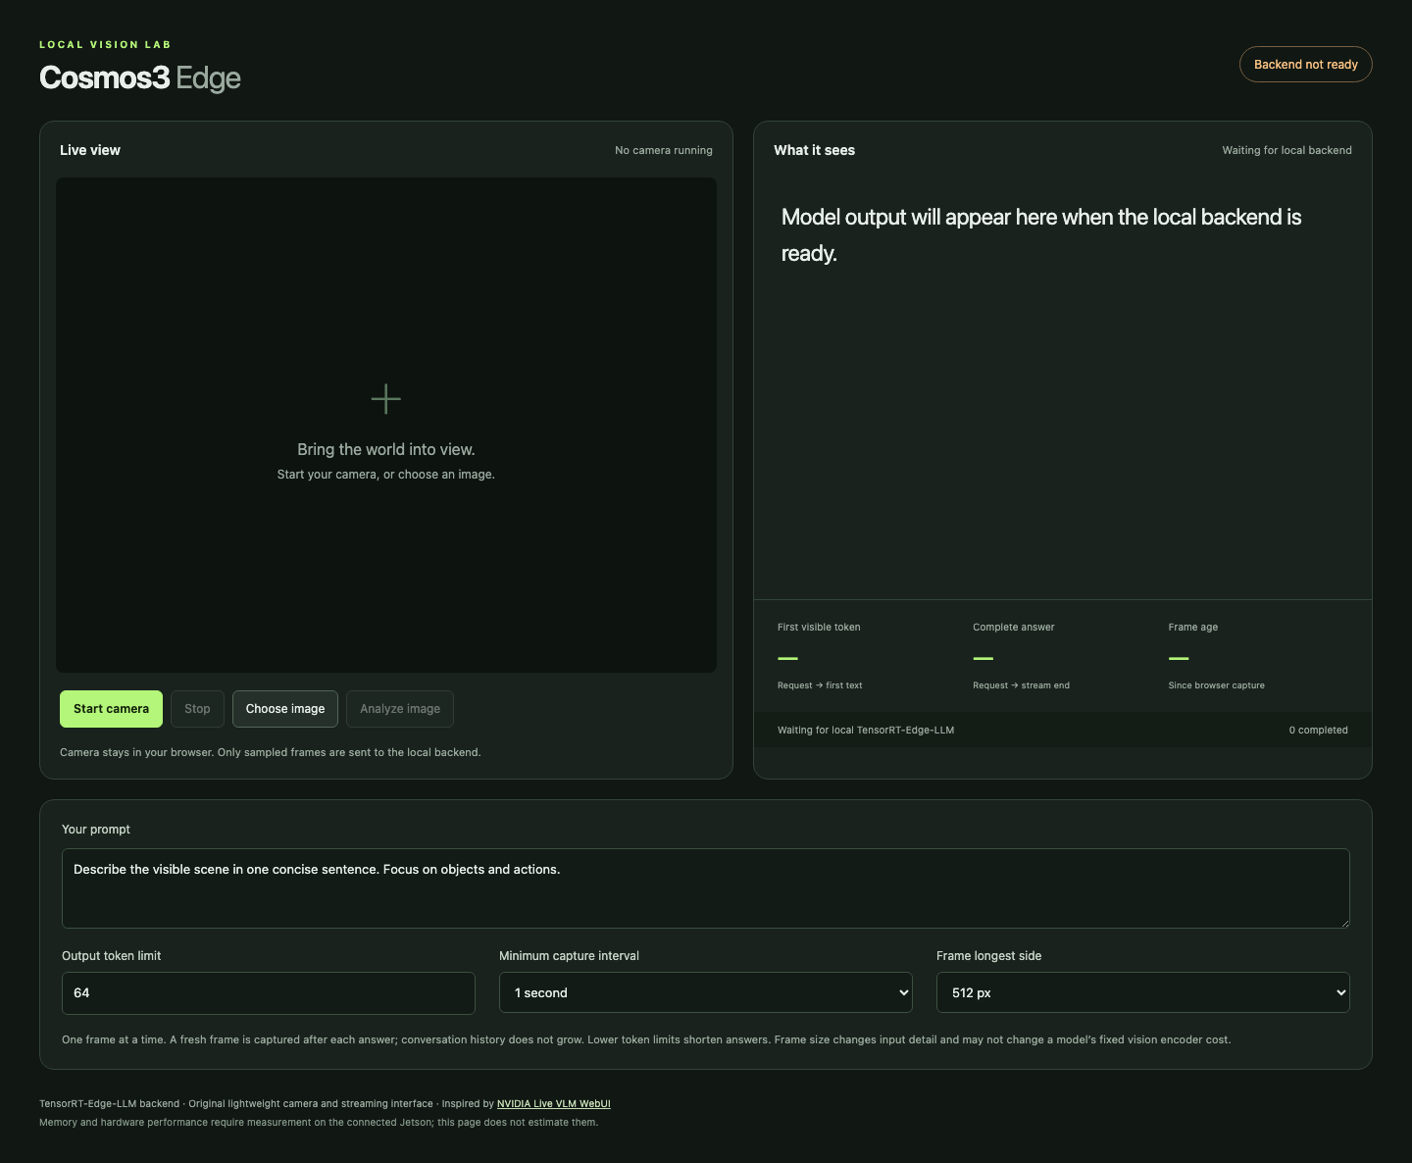
My initial assumptions and their limits
My starting choices
640×480 camera, ideal 15 FPS
512 px longest side, 1 s interval
64 output tokens, temperature 0
Working hypothesis
Capped frames and resident inference would reduce backlog and setup overhead.
Comparison gap
I had not matched Live VLM’s default workload before running the search.
Initial preview before backend readiness. The claimed overhead benefit was a hypothesis.
Comparison follow-up, 2026-09-20
19
Notes:
I treated Live VLM WebUI as a workflow reference and selected a compact deterministic initial workload. The preserved initial UI screenshot shows a 64-token ceiling, 1-second minimum interval, 512-pixel longest side, and prompt: “Describe the visible scene in one concise sentence. Focus on objects and actions.” Camera request 640×480, ideal 15 FPS/max 30 FPS, JPEG 0.8 and temperature 0/top_p 1 are preserved in the later Lightweight profile and comparison contract. The original interim presentation explicitly labels reduced backlog/setup overhead from capped frames and resident inference as a hypothesis. The screenshot was captured before backend readiness and establishes settings only. The candidate benchmark later used its separate frozen geometric prompt with 512×512 images and 64 output tokens. Smaller frames, fewer output tokens, and greedy decoding did not establish an equivalent workload to Live VLM defaults.
Sources:
.qa/ui-desktop.png
.presentation-build/create.mjs
research/benchmark-method.md
research/capture-preset-comparison.md
web/app.js

Slide 20
Your steering changed the comparison settings
“Make the Live VLM WebUI default”
Setting | My initial defaults | Defaults after your steering
Camera request | 640×480, ideal 15 FPS | 1280×720, no FPS constraint
Sent image | 512 px longest side | Preserve full source dimensions
Capture cadence | 1 s minimum, after answer | Every 30 frames, skip while busy
JPEG quality | Browser 0.8 | Browser 0.75, nominal match
Output ceiling | 64 tokens | 512 tokens
Generation | Temperature 0, greedy | Temperature 0.7
Prompt now: “Describe what you see in this image in one sentence.”
The toggle retains Lightweight. Encoding, transport and timing boundaries still differ.
Comparison follow-up, 2026-09-20
20
Notes:
Exact user sequence: “Set the max tokens and the sample prompt to the same default parameters as Web VLM UI.” Then: “Are the capture interval and the frame longest side the same defaults as Web VLM UI?” Then: “can we have a toggle so we have an apples to apples comparison to web vlm ui? Make the Live VLM WebUI default”. Prompt/token matching happened first. The explicit toggle request later aligned capture and generation defaults. Initial UI prompt was “Describe the visible scene in one concise sentence. Focus on objects and actions.” New prompt is shown on this slide. Full source frames remain subject to documented input bounds. Source dimensions are the actual negotiated camera dimensions, not guaranteed to equal the ideal request. The browser JPEG 0.75 value is nominal: upstream uses Pillow defaults, so bytes differ. Initial top_p=1 used greedy temperature 0; Live VLM omits top_p/top_k so the backend resolves 0.9/50. Upstream uses received WebRTC frames while this app uses browser-presented frames. The UI streams tokens while upstream requests non-streaming answers. These limits prevent an identical end-to-end transport equivalence claim.
Sources:
research/first-version-journey.md
research/capture-preset-comparison.md
results/ui-telemetry-validation.json
results/ui-presets-validation.json
https://github.com/NVIDIA-AI-IOT/live-vlm-webui/blob/2fd5ba0b334c334d24bf0f9439d8742b243d22be/src/live_vlm_webui/static/index.html
https://github.com/NVIDIA-AI-IOT/live-vlm-webui/blob/2fd5ba0b334c334d24bf0f9439d8742b243d22be/src/live_vlm_webui/video_processor.py
https://github.com/NVIDIA-AI-IOT/live-vlm-webui/blob/2fd5ba0b334c334d24bf0f9439d8742b243d22be/src/live_vlm_webui/vlm_service.py

Slide 21
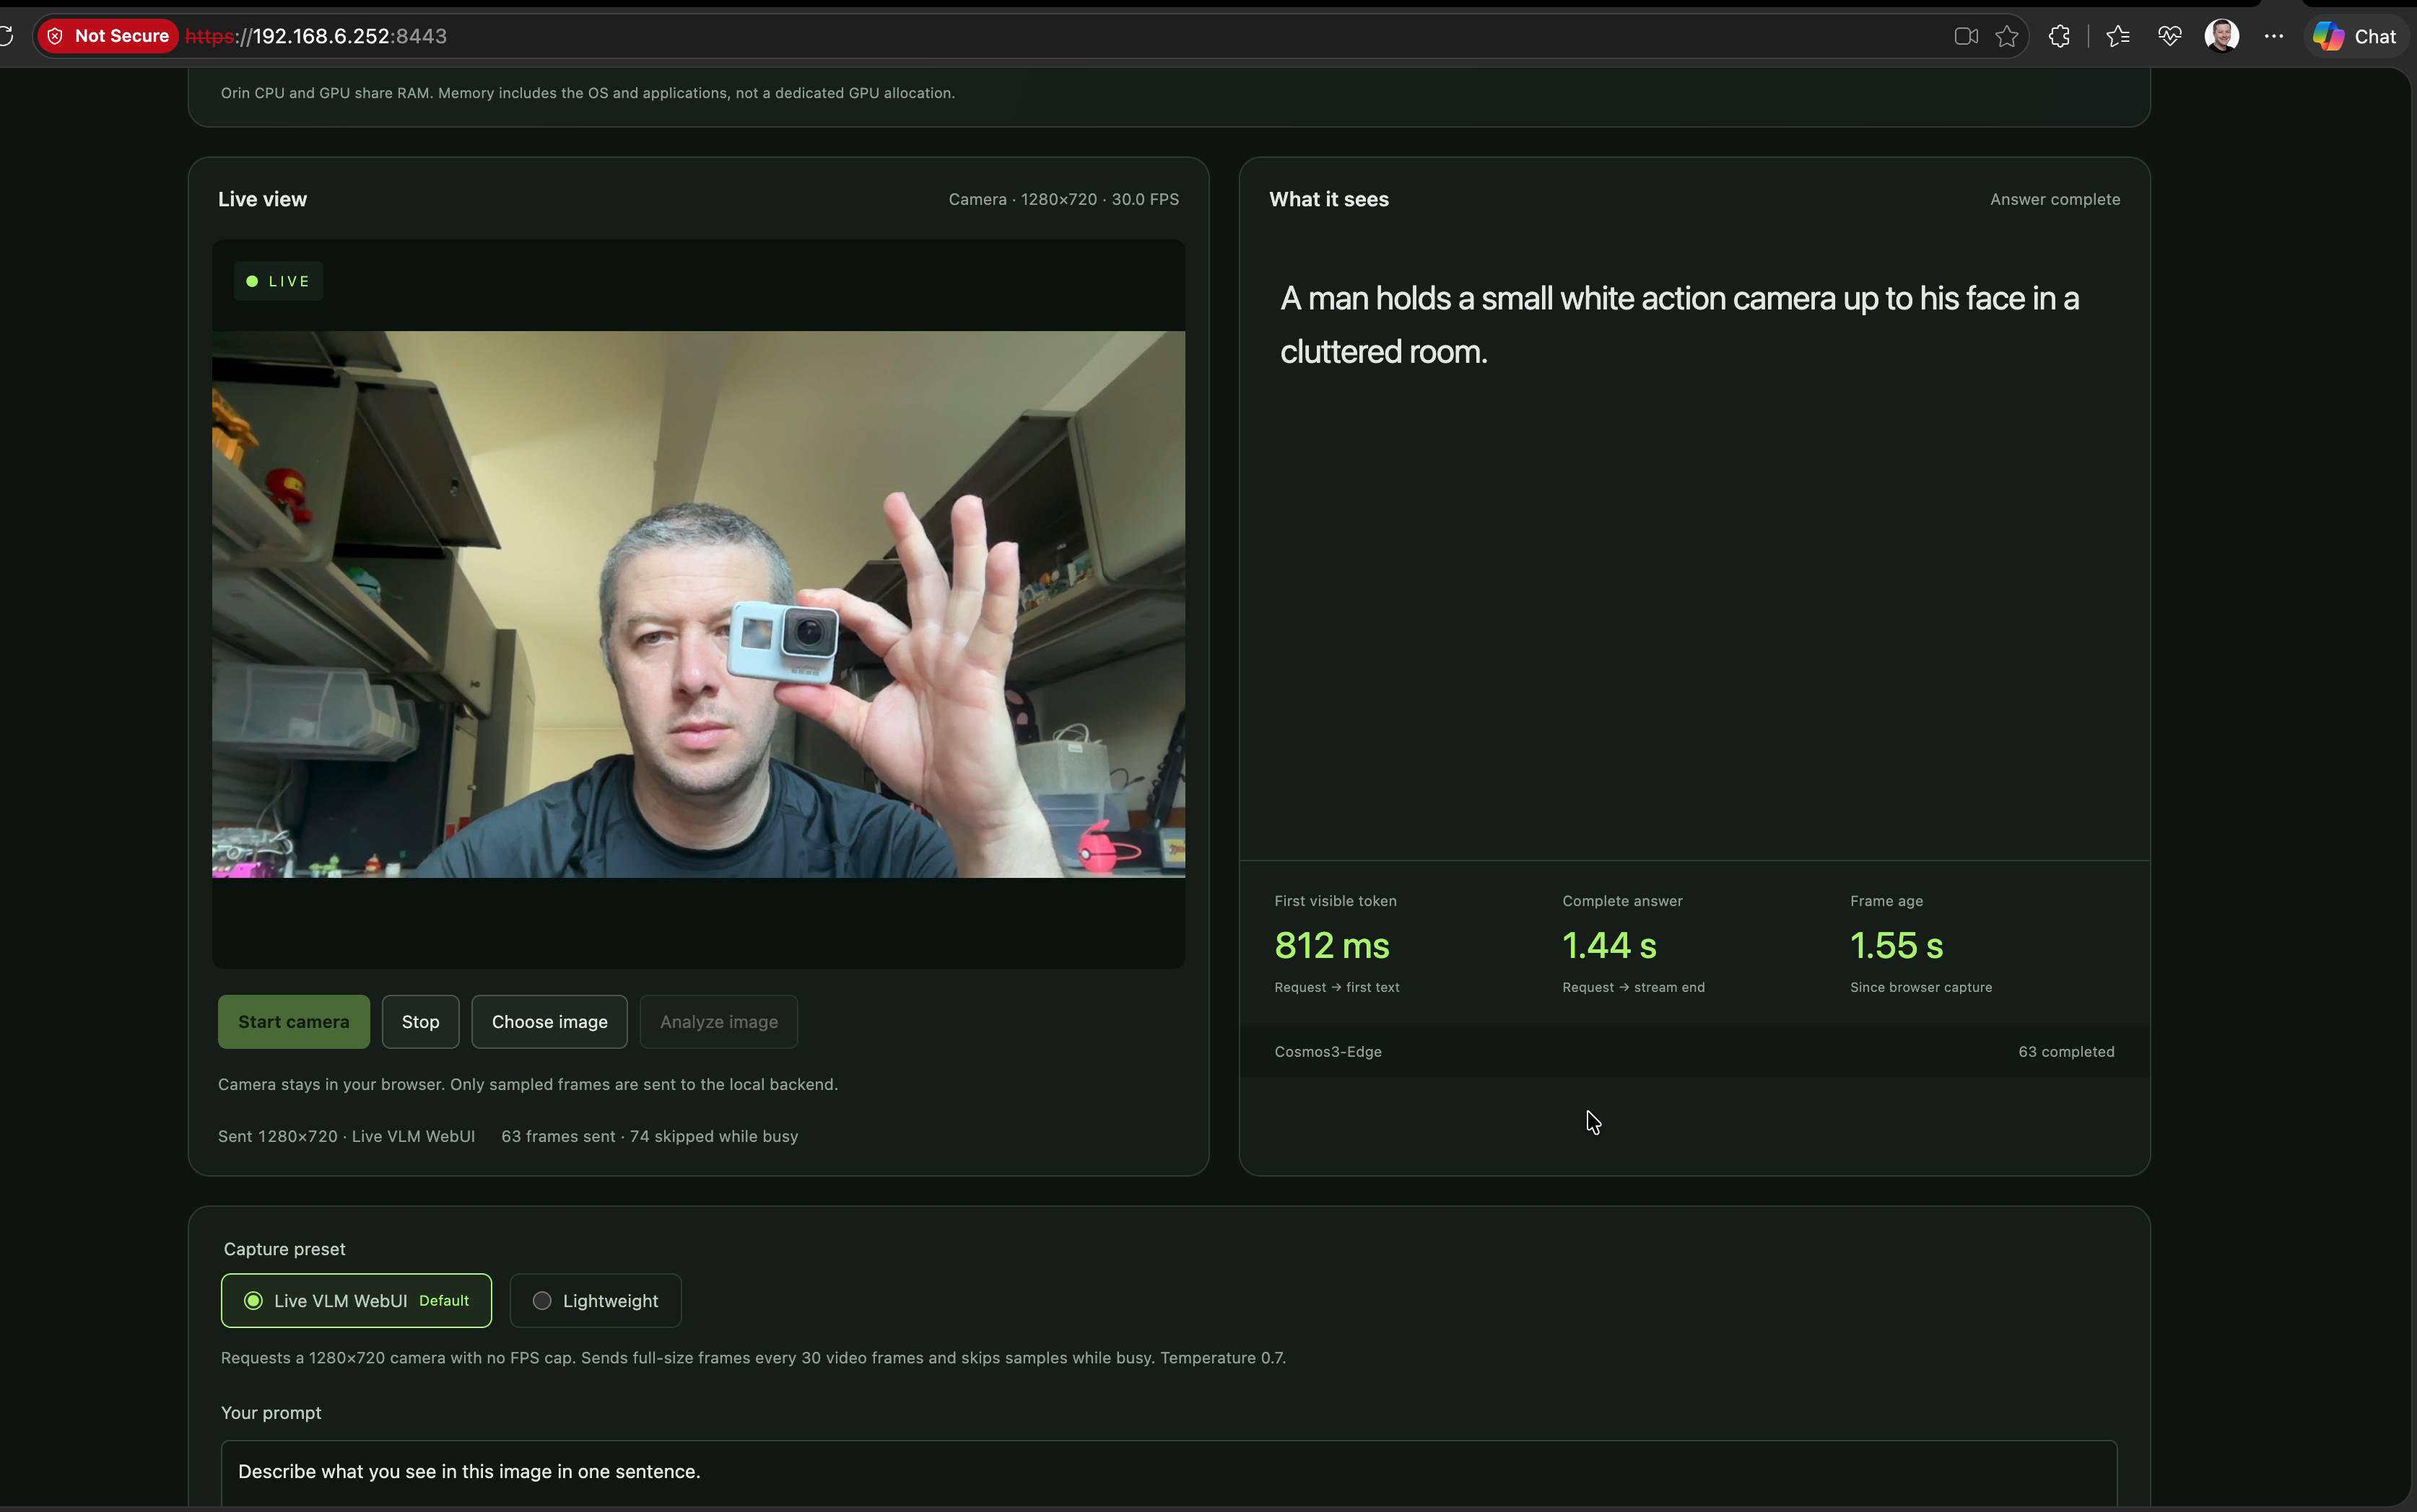
Recorded “before”: Live VLM default preset
Clip 00:00:05.808
1280×720 sent
30.0 FPS camera label
Live VLM default selected
Visible timing
First text: 812 ms
Complete: 1.44 s
Frame age: 1.55 s
Resource values and the token limit are outside the viewport.
Comparison follow-up, 2026-09-20
21
Notes:
User-designated unoptimized/before recording, after the default-preset change and after the earlier bounded optimization search. Source: Codex recording unoptimized Sep 20 Cosmos3-Edge.mov. SHA-256 6f4b66d3572edf2faffa617baa77b1d448635354f1874d4960e2c7c87238b438. Exact frame PTS 5.808333 s, zero-based frame 232. The full source screenshot is embedded without crop or pixel modification. Visible camera and sent frame dimensions are 1280×720 with reported 30.0 FPS. The preset and temperature 0.7 description are visible, as is the one-sentence prompt. UI reports Answer complete. First visible token 812 ms, complete answer 1.44 s, frame age 1.55 s. These are one rounded UI observation. CPU/GPU/shared-RAM numbers and the active token-limit control are outside the viewport. The recording therefore does not independently prove the current output ceiling. Corrected FP16 and memory limits were already deployed. This is the user’s new comparison baseline, not pristine upstream code.
Sources:
output/before-cosmos3-edge-2026-09-20/manifest.json
output/before-cosmos3-edge-2026-09-20/02-before-05.808s-action-camera.png
deployment/selected-config.json
research/capture-preset-comparison.md

Slide 22
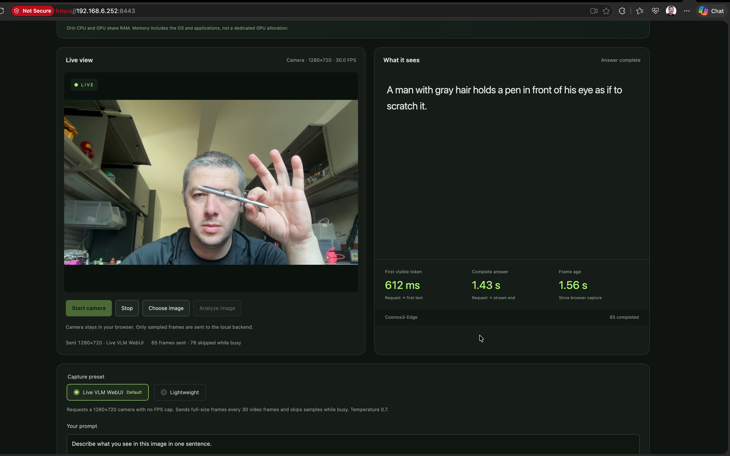
The “before” evidence includes model limits
Clip 00:00:09.842
First text: 612 ms
Complete: 1.43 s
Frame age: 1.56 s
Inferred action
The answer adds
“as if to scratch it”.
The image does not establish that action.
Individual observation. No accuracy rate inferred.
Comparison follow-up, 2026-09-20
22
Notes:
Source recording and hash as in manifest. Pen frame PTS 9.841667 s, frame index 370. Full screenshot is embedded unchanged. Exact visible model output: A man with gray hair holds a pen in front of his eye as if to scratch it. The phrase “as if to scratch it” is a model-inferred action not established by the screenshot. No intent is attributed to the person. The model did identify a pen. UI reports first token 612 ms, complete answer 1.43 s, frame age 1.56 s. The live preview can be later than the sampled model input. This curated observation is not an accuracy benchmark. The evidence pack contains six original-resolution frames, including the scene, action camera, pen, toy, battery and scissors. All have exact timestamps, SHA-256 hashes and verified re-extraction.
Sources:
output/before-cosmos3-edge-2026-09-20/manifest.json
output/before-cosmos3-edge-2026-09-20/03-before-09.842s-pen.png
output/before-cosmos3-edge-2026-09-20/README.md

Slide 23
The goal seek retained corrected FP16
Earlier fixed workload: 512×512, 64-token ceiling, temperature 0
Candidate | p50 answer | Peak shared RAM | Decision
FP16 reference | 1.830 s | 6.382 GiB | Retained: reference-equivalent, 18/19 strict
RTN INT4 all linears | 1.229 s | 4.195 GiB | Rejected: quality fell to 13/19
RTN INT4 MLP only | 1.027 s | 5.014 GiB | Rejected: new color error at 18/19
FP16 fixed clocks | 1.758 s | 6.353 GiB | Rejected: <5% gain and swap activity
Stop rule: 3 consecutive non-improvements. Four trials completed. No further trial ran.
Comparison follow-up, 2026-09-20
23
Notes:
This search preceded the Live VLM preset correction. Every measured candidate used the same frozen 512×512 geometric image, prompt, 64-token ceiling and temperature 0. Five warmups and 30 measured requests per candidate. Acceptance required at least 5% reduction in median complete-answer latency or peak system RAM, with no more than 5% regression in the other metric or p95 latency, quality equivalence, and no errors/OOM/swap. The ceiling was tightened from 12 to 5 total candidates. Four trials ran, then three consecutive non-improvements stopped the search. All-linears RTN strict quality was 13/19. MLP-only RTN scored 18/19 but introduced a new color error, failing the frozen reference-equivalence policy. Fixed clocks yielded only 3.94% latency gain and observed system swap-counter activity. The fifth compact-profile trial did not run. Shared RAM means system MemTotal minus MemAvailable and includes CPU/GPU/OS. It is distinct from model VRAM and process RSS. Table metrics are candidate-trial results; the next slide reports a separate final-service verification of the same selected engine.
Sources:
results/optimization-search-plan.json
results/optimization-selection.json
results/optimization-quality-policy.json
results/benchmark-fp16-qualified.jsonl
results/raw/benchmark-rtn-v1-rejected-01.jsonl
results/raw/benchmark-rtn-mlp-rejected-01.jsonl
results/raw/benchmark-fp16-clocks-01.jsonl

Slide 24
Results after goal seek and the comparison limit
No candidate earned an accepted improvement. Corrected FP16 remains selected.
Final service verification | Measured result
p50 first text / complete answer | 265.5 ms / 1.826 s
Peak shared system RAM | 6.435 GiB, includes CPU/GPU/OS
API soak | 366 successful requests across 600.7 s
Chronology: optimization search, then your default-setting correction, then the recording.
A paired optimization result under the Live VLM defaults remains unmeasured.
The earlier 64-token benchmark cannot quantify a gain over your later recording.
Comparison follow-up, 2026-09-20
24
Notes:
The selected configuration remained corrected FP16, input 1024, KV 2048, batch 1, encoder cache budget zero, stock dynamic 25 W. These are the separate final-service verification results, not an additional search candidate. Five warmups, 30 measured requests. p50 first text 265.54039800066676 ms; p50 complete 1825.8987585013529 ms; p95 complete 1829.9888356496922 ms. Peak system RAM unavailable 6909468672 bytes (6.434944 GiB); RSS 6342467584 bytes. The counters overlap and must not be added. Dedicated CUDA allocator peak was not collected. Final service had no observed errors/OOM/swap. Soak: 600.701 seconds, 366 successful requests. Strict geometric score remained 18/19; natural photo diagnostic was 5/9 generous or 4/9 strict, with 0/3 fully correct images. The chronology is material: final-service benchmark started 2026-09-20 07:18 UTC, soak ended about 07:29 UTC; prompt/token verification was 18:14 UTC, Live VLM preset verification 23:41 UTC; recording creation metadata is 2026-09-21 00:15:52 UTC (September 20 locally). No candidate search was repeated after default alignment. The user-designated before recording contains individual stochastic camera observations and no visible resource values or active token limit. A paired before/after optimization claim under the Live VLM defaults remains unmeasured. This revision documents existing results rather than inventing or launching a new benchmark.
Sources:
results/raw/benchmark-final-service-01.jsonl
results/raw/soak-final-service-01.summary.json
results/ui-telemetry-validation.json
results/browser-ui-presets.json
deployment/selected-config.json
output/before-cosmos3-edge-2026-09-20/manifest.json
results/natural-smoke-final-01-review.json

Slide 25
A new 10% latency goal
New phase after your Live VLM default correction
Control | Frozen comparison
Images | 3 recording-derived JPEGs, each 1280×720, JPEG 0.75
Generation | 512-token ceiling, temperature 0.7, top-p 0.9, top-k 50
Runtime | Corrected FP16, input 1024, KV 2048, dynamic stock 25 W
Measurement | 5 warmups + 30 measured requests per image, one active
Accept / stop | ≥10% median-latency gain across images. First confirmed failure stops.
Same answer text, token count and normal stop required. Encoder cache stays off.
Local API timing excludes browser capture and Wi-Fi. The earlier 5% search is complete.
New 10% latency goal, 2026-09-21 UTC
25
Notes:
Slides 1–24 preserve the first version and its later comparison discussion as of the preceding delivery. This appendix records a subsequent user-requested latency goal with a newly frozen Live VLM workload. The exact user instruction is: “Improve the Cosmos3-Edge inference to get a minimum of 10% improvement each time in terms of latency. Stop improving when you can no longer get 10% improvement from the last run.” The 10% requirement comes from the user. The agent chose the three-image workload, geometric mean of per-image medians, five warmups and thirty measurements per image, exact-output controls and resource gates. The agent interpreted the stop instruction as the first confirmed measured candidate that fails the acceptance gates, with one matched repeat only when the threshold or equivalence is ambiguous. These controls were frozen before measurement and are not verbatim user requirements. The completed original search accepted improvements at a 5% threshold under 512×512, 64-token, greedy settings. Those earlier numbers are not the denominator here. The new plan was frozen at 2026-09-21T00:50:30Z. Primary metric: geometric mean of per-fixture median complete-answer latency; equal image weighting, compared with last accepted candidate. Acceptance requires at least 10% reduction and no more than 5% per-fixture median or p95 regression, identical output text/completion counts/normal stop, no errors/OOM/swap, and at least 512 MiB available shared RAM. One matched repeat is allowed only for an ambiguous threshold or equivalence. The first confirmed failure stops the search and restores the last accepted candidate. The three input JPEGs are camera-preview crops of the user's recording, resized to 1280×720 and encoded by Chromium at JPEG 0.75. They are not original sensor images or the exact historical inference inputs. Their pixels and hashes stay fixed between runs. The benchmark uses serial streaming requests through the Orin-local proxy. It includes image decode and inference but excludes browser capture/encoding, the 30-frame cadence and Wi-Fi. Prompt: Describe what you see in this image in one sentence. Native resolved sampling remains temperature 0.7, top_p 0.9 and top_k 50, using the existing seed 42 / offset 0 behavior. The candidate hypothesis is Reduce redundant work in the native top-K sampler while preserving partition, comparator, arithmetic, output and RNG semantics; profile first. Other candidates are considered only after an accepted improvement.
Sources:
results/latency10/plan.json
benchmarks/live-vlm-1280/manifest.json
results/latency10/baseline-summary.json
results/latency10/baseline-config.json
research/capture-preset-comparison.md
results/optimization-search-plan.json
research/latency10-follow-up.md
/Users/asotelo/Documents/ChatGPT/jetson-orin-streaming-codes/results/latency10/comparison.json

Slide 26
Paired results under the Live VLM defaults
Identical frozen JPEGs, prompt and output ceiling
Image | Tokens B / C | Base answer p50 / p95 ms | Trial answer p50 / p95 ms | TTFT p50 B / C ms | p50 gain
Action camera | 14 / 14 | 1004.6 / 1016.3 | 997.3 / 1013.3 | 432.9 / 427.8 | 0.73%
Pen | 40 / 40 | 2151.1 / 2167.4 | 2144.4 / 2166.8 | 442.6 / 441.1 | 0.31%
Scissors | 17 / 17 | 1152.3 / 1162.3 | 1147.7 / 1162.3 | 450.7 / 446.4 | 0.40%
Across-image median metric: 1355.4 ms baseline, 1348.9 ms trial
0.48% reduction. The required 10% threshold is 1219.9 ms or less.
Metric: geometric mean of the three per-image medians. B / C = baseline / candidate.
New 10% latency goal, 2026-09-21 UTC
26
Notes:
The baseline group is live-vlm-fp16-baseline; the candidate group is live-vlm-fp16-retained-topk. Each image has 30 measured requests following five warmups. B/C means baseline/candidate. The table reports complete-answer median and p95, median first-visible-text timing, and actual completion tokens. A 512-token maximum is a ceiling, not the measured output length. For a mismatch, both token counts are shown rather than claiming a common output. Equal image weighting gives geometric means of 1355.4104504346024ms and 1348.9166893343772ms, a 0.47909923507989394% latency reduction. The 10% threshold for this baseline is 1219.8694053911422ms. All measured answers preserve text, token count and normal stop. The baseline initially summarized in results/latency10/baseline-summary.json had geometric mean 1355.4104504346024ms. The final comparator receipt controls these paired values, including any plan-authorized repeat. All per-fixture TTFT p95 values and exact answers remain in that receipt. The measurements do not compare against the earlier recording's rounded browser labels or the original 64-token benchmark. {"per_fixture":[{"fixture":"01-action-camera.jpg","ratios":{"p50_latency_ms":0.9927240572191822,"p95_latency_ms":0.9970684049795476},"output_equivalent":true},{"fixture":"02-pen.jpg","ratios":{"p50_latency_ms":0.9968746531882712,"p95_latency_ms":0.9997066104656184},"output_equivalent":true},{"fixture":"03-scissors.jpg","ratios":{"p50_latency_ms":0.996033153433705,"p95_latency_ms":0.9999782577576172},"output_equivalent":true}],"decision":"stop_and_restore_last_accepted"}
Sources:
/Users/asotelo/Documents/ChatGPT/jetson-orin-streaming-codes/results/latency10/comparison.json
results/latency10/plan.json
benchmarks/live-vlm-1280/manifest.json
results/latency10/raw/baseline-01-action-camera.jsonl
results/latency10/raw/baseline-02-pen.jsonl
results/latency10/raw/baseline-03-scissors.jsonl
results/latency10/raw/candidate-01-action-camera.jsonl
results/latency10/raw/candidate-02-pen.jsonl
results/latency10/raw/candidate-03-scissors.jsonl

Slide 27
Trial decision and shared-memory limits
Candidate failed the frozen acceptance gates
Task-authored retained-partial top-K prototype. Model precision and sampling stay fixed.
Sampled memory / output | Baseline | Candidate
Peak shared system RAM | 6.443 GiB | 6.420 GiB
Peak process RSS | 5.909 GiB | 5.897 GiB
Minimum available RAM | 0.926 GiB | 0.949 GiB
Output preservation | Repeatable reference | Exact text / tokens / stop
The stop rule retains the last accepted baseline.
RAM includes CPU, GPU and OS. RSS overlaps. No dedicated VRAM peak was measured.
Preserved answers still contain unsupported mirror and gesture claims.
New 10% latency goal, 2026-09-21 UTC
27
Notes:
Candidate failed the frozen acceptance gates. The stop rule retains the last accepted baseline. This is the benchmark decision, not independent evidence that a deployment or restoration command completed. Rejection reasons: ["geomean_complete_latency_gain_below_10_percent"]. Baseline failures: []. Candidate failures: []. Shared RAM is MemTotal minus MemAvailable and includes CPU, GPU, OS and applications. Process RSS overlaps with shared system RAM and must not be added to it. These are sampled extrema across warmups and measured requests; dedicated CUDA allocator or VRAM peaks were not collected. Minimum available shared RAM must remain at least 512 MiB. All measured answers preserve text, token count and normal stop. The baseline is repeatable with actual completion lengths 14 / 40 / 17 tokens for action camera/pen/scissors. Byte-identical output establishes preservation, not absolute correctness. The action-camera baseline adds an unsupported mirror claim. The pen answer adds unsupported body-side and gesture-meaning claims. The three examples do not establish representative model accuracy. The measured candidate is this task's retained-partial top-K prototype. Each CUDA thread retains its current local maximum, and only the winning index's owner rescans its partition after invalidation. The prototype preserves the eight partitions, 256 threads per block, comparison and reduction order, stage-2 arithmetic, RNG behavior, model precision and generation parameters. It caches a local intermediate within one sampler launch, not image embeddings, model responses or results across requests. The public upstream supplies the sampler and CUDA/TensorRT runtime. This task authors the prototype patch, bounded experiment and equivalence harness. The following slide separates the sampler diagnostic from the user's complete-answer goal. Serial harness concurrency is verified by the comparator. Absence of unrelated clients and queue backlog requires the separate device isolation evidence.
Sources:
/Users/asotelo/Documents/ChatGPT/jetson-orin-streaming-codes/results/latency10/comparison.json
results/latency10/baseline-summary.json
results/latency10/plan.json
scripts/summarize_latency10.py
scripts/profile_sampler.cu
scripts/check_sampler_equivalence.cu
patches/topk-retained-partial.patch
results/latency10/profiling/sampler-baseline.txt
results/latency10/profiling/sampler-candidate.txt
results/latency10/profiling/sampler-baseline-controlled.txt
results/latency10/profiling/sampler-candidate-controlled.txt
results/latency10/profiling/equivalence.jsonl
https://github.com/NVIDIA/TensorRT-Edge-LLM/blob/e8b29522938901f6df19ebeedd4b69bc8edbcd97/cpp/sampler/sampling.cu

Slide 28
Sampler gain and whole-answer latency
Task-authored top-K prototype, unchanged model precision and sampling
Measurement scope | Baseline | Candidate | Reduction
Synthetic full sampler mean, ms per call | 0.261280 | 0.203009 | 22.30%
Whole-answer metric ms across images | 1355.4 | 1348.9 | 0.48%
1,000 / 1,000 synthetic calls. 90 / 90 whole-answer requests. Baseline / candidate.
GPU equivalence passed: 338 cases, 1,020 sampled tokens.
The user’s 10% requirement applies to complete answers.
Sampler timing does not establish the latency of other model stages.
New 10% latency goal, 2026-09-21 UTC
28
Notes:
This task authored the retained-partial top-K prototype. Each thread keeps its local maximum across selections, and only the winning index's owner rescans after invalidation. The experiment preserves model weights and FP16 precision, image bytes, generation settings, the existing eight partitions and 256-thread reduction order, stage-2 arithmetic and RNG behavior. NVIDIA's public TensorRT-Edge-LLM provides the original sampler. Standalone baseline sampler diagnostic: CUDA-event mean 0.26128 ms per call across 1000 calls after 1000 warmups. Standalone candidate sampler diagnostic: CUDA-event mean 0.203009 ms per call across 1000 calls after 1000 warmups. These diagnostics use synthetic fixed FP32 logits. CUDA-event intervals include GPU work and host-submission gaps. They do not measure whole-model latency, and batch-mean quantiles are not individual-token latency quantiles. The separate greedy diagnostic does not replace the serving sampler. The displayed diagnostic pair replays both saved standalone profiler binaries under the same loaded, idle model service. These controlled runs supersede the initial timing pair for the displayed comparison. The initial baseline had the model resident while the initial candidate ran before service restart. The original receipts remain historical evidence and do not establish a controlled relative gain. The paired GPU harness reports passed across 338 FP16/FP32 cases, comparing 163328 stage-1 indices, 163328 stage-1 FP32 value bit patterns, 22996778 scratch-logit bit patterns and 1020 sampled token IDs. All recorded stage-1 comparisons and trailing guard checks passed. Fixtures include ties, uneven vocabularies, multiple batches, signed zero and nonfinite values. Nonfinite fixtures validate stage 1 only, not supported sampling behavior. This proves the recorded GPU fixture equivalence, not model accuracy or an end-to-end speedup. The synthetic full-sampler mean fell by 22.302127985303134%, calculated from the two measured CUDA-event means. The separate complete-answer metric changed from 1355.4104504346024 ms to 1348.9166893343772 ms, a 0.47909923507989394% reduction across 90 baseline requests and 90 candidate requests. The complete-answer metric is a geometric mean of per-image medians. The sampler metric is an arithmetic mean of synthetic sampler calls. They have different denominators and scopes and must not be added, subtracted or used to infer an exact model-stage breakdown. Whole-answer timing includes image decode, vision encoding, prefill, decoding and local streamed output. The required 10% gain applies to that whole-answer metric. Candidate failed the frozen acceptance gates. The first equivalence-harness link encountered duplicate CUDA device symbols when source inclusion and the runtime archive both supplied the sampler. A recovery wrapper restored the original runtime. The corrected test build removed the redundant sampler object from a separate archive copy and preserved the serving archive. This was an agent test-build correction, not a user intervention or a speed result. The native incremental rebuild took 42.21 seconds without observed OOM or swap activity, as recorded in the build receipt. No global-optimality or representative accuracy claim follows from this bounded experiment.
Sources:
/Users/asotelo/Documents/ChatGPT/jetson-orin-streaming-codes/results/latency10/comparison.json
results/latency10/profiling/sampler-baseline.txt
results/latency10/profiling/sampler-candidate.txt
results/latency10/profiling/sampler-baseline-controlled.txt
results/latency10/profiling/sampler-candidate-controlled.txt
results/latency10/profiling/equivalence.jsonl
results/latency10/native-build/status.json
research/latency10-follow-up.md
patches/topk-retained-partial.patch
scripts/profile_sampler.cu
scripts/check_sampler_equivalence.cu
https://github.com/NVIDIA/TensorRT-Edge-LLM/blob/e8b29522938901f6df19ebeedd4b69bc8edbcd97/cpp/sampler/sampling.cu

Slide 29
Statistics from the “after” recording
49.197 seconds of recorded browser observations
Visible reading | Recorded observation
Completed responses | 20 distinct states, counters 45–64
First visible token | Median 975 ms, range 715–1,900 ms
Complete answer | Median 1.98 s, range 1.50–2.95 s
CPU / GPU readings | CPU 0.5–3.5%, GPU 0.0–99.9%
Shared system RAM | 6.38–6.39 GiB of 7.37 GiB
At recording time: restored FP16, before the new MLP optimization goal.
Rounded browser readings. No causal latency or accuracy gain follows from this recording.
User-designated after recording, 2026-09-20
29
Notes:
“After” is the user's designation for this recording, not a causal optimization or accuracy result. The prior controlled trial improved complete-answer latency by about 0.48%, failed the user's 10% threshold and was rejected. At recording time, the service had returned to the original corrected FP16 runtime, before the new MLP goal. The restoration receipt records 2026-09-21T01:12:44.401493+00:00, with runtime SHA-256 7917679a203010646f4412ccbb2a00bf6a97265114c5f17b5fc98574b376fc12. Three post-restoration requests matched the baseline and the functional verification passed. Those deployment receipts establish the runtime at recording time; the browser recording does not independently establish binary identity. The file title “Codex opted for accuracy” is user-supplied wording and is not evidence of an accuracy gain. The runtime at recording time already included the task's earlier correctness fixes. Historical slides 2–28 remain unchanged; the new cover identifies the current MLP deployment. These new observations do not replace their controlled benchmark. Source recording: After - Codex opted for accuracy - ten percent goal.mov, SHA-256 7f0eb89718adba7317b37b93018243c9778503fd75c6e0cf15486c74a3eeb363. The source contains 2169 variable-rate frames at 3348×2096 over 49.196667 seconds. The statistics cover 20 distinct visible completed-response states, with session counters from 45 to 64. These are rounded UI values, not server logs, exact per-request event times or independently measured GPU durations. Telemetry sampling: 492 source frames at nominal 10 Hz; first source frame at or after each t = 0.0, 0.1, …, 49.1 s. Repeated UI updates are retained. The 12 completion-recovery frames are excluded from these range calculations., 492 source frames. Repeated screen readings can repeat the same one-second UI update, so the sample count is not a count of independent device measurements. CPU and GPU percentages include idle gaps and asynchronous polling. Shared RAM is the displayed system reading including CPU, GPU, OS and applications, not dedicated VRAM or a CUDA allocator peak. The live preview can differ from the earlier sampled image used by the model. The clip does not establish actual completion-token counts. Neither these timings nor resource ranges establish a causal before/after improvement. Exact statistics: {"latency":{"units":"milliseconds","measurement":"UI request → first visible text and request → stream end; displayed rounded values","percentile_method":"Linear interpolation at (n−1)×p (Hyndman–Fan type 7); each of the 20 completions has equal weight.","ttft_ms":{"min":715,"p50":975,"p95":1463,"max":1900,"mean":1070.2},"complete_answer_ms":{"min":1500,"p50":1980,"p95":2779,"max":2950,"mean":2060.5}},"telemetry":{"sampling_method":"492 source frames at nominal 10 Hz; first source frame at or after each t = 0.0, 0.1, …, 49.1 s. Repeated UI updates are retained. The 12 completion-recovery frames are excluded from these range calculations.","sampled_frames":492,"all_sampled_values_parsed":true,"sampling_start_pts_seconds":0,"sampling_end_pts_seconds":49.108333,"cpu_percent":{"min":0.5,"max":3.5},"gpu_percent":{"min":0,"max":99.9},"shared_ram_used_gib":{"min":6.38,"max":6.39},"shared_ram_total_gib":7.37,"shared_ram_percent":{"min":86.6,"max":86.7},"scope":"Visible system shared-RAM use; no model-only VRAM estimate."}}. Limitations: ["These are values visibly rounded by the browser UI in a user recording, not server-side timing measurements or a controlled benchmark.","Each completed response is counted once using the visible completed counter. The first completion can belong to a request that began before the clip.","CPU, GPU and shared RAM ranges come from 492 video samples at nominal 10 Hz. The UI telemetry refreshes more slowly, so repeated screen samples are not independent resource measurements and can miss peaks.","Shared RAM covers system memory used by the OS and applications, not a dedicated model VRAM allocation. It must not be added to CPU RAM as a separate pool.","Camera frame rate and skipped-frame counters are not inference throughput or failed requests.","Live preview frames can be newer than the inference input. No selected screenshot proves pixel-identical correspondence between the current preview and the displayed answer.","The selected view shows the Live VLM WebUI preset and 1280×720 camera/sent dimensions; max tokens, temperature, top-k and top-p controls are not visible in these frames.","Actual generated-token counts, exact historical request payloads, backend health, OOM events and end-to-end accuracy cannot be established from the recording.","The six curated examples are illustrations, not a random quality sample. Specific brand, color and handheld-model claims can be unsupported or vary between adjacent answers.","“After” and “opted for accuracy” are the user’s recording labels. This material does not establish a causal before/after latency gain or an accuracy gain.","This clip belongs after restoration of the original corrected FP16 runtime following the rejected sampler experiment and before the new MLP optimization goal. It does not depict the later MLP candidate."].
Sources:
output/after-cosmos3-edge-2026-09-20/manifest.json
output/after-cosmos3-edge-2026-09-20/statistics.json
results/latency10/restoration.json
results/latency10/restoration-verification.json
results/latency10/comparison.json
research/latency10-follow-up.md

Slide 30
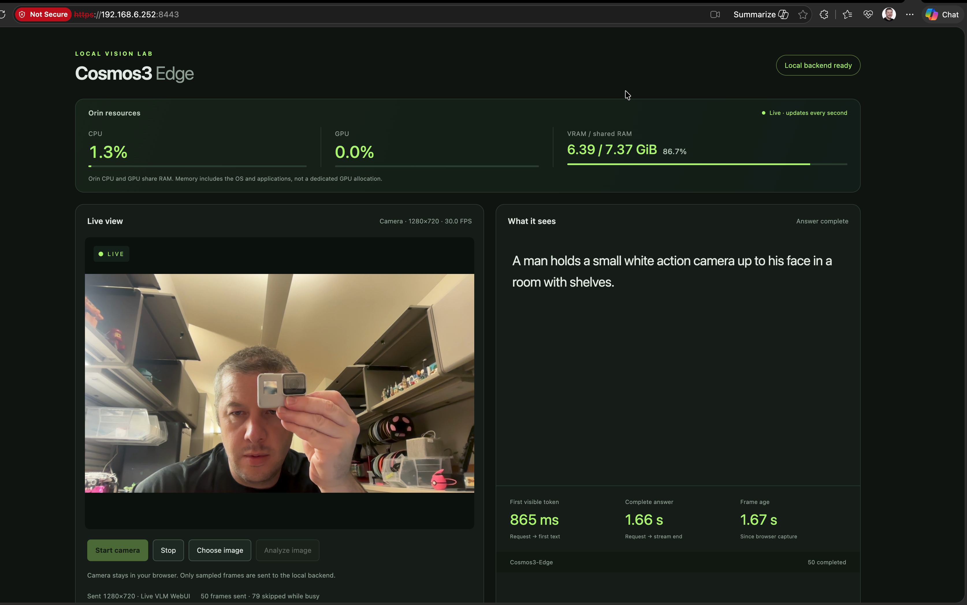
After recording: action camera
Clip 00:14.000
First text: 865 ms
Complete: 1.66 s
Frame age: 1.67 s
The response identifies a camera. This is one recorded example.
The preview may be newer than the image used for the answer.
User-designated after recording, 2026-09-20
30
Notes:
“After” is the user's designation for this recording, not a causal optimization or accuracy result. The prior controlled trial improved complete-answer latency by about 0.48%, failed the user's 10% threshold and was rejected. At recording time, the service had returned to the original corrected FP16 runtime, before the new MLP goal. The restoration receipt records 2026-09-21T01:12:44.401493+00:00, with runtime SHA-256 7917679a203010646f4412ccbb2a00bf6a97265114c5f17b5fc98574b376fc12. Three post-restoration requests matched the baseline and the functional verification passed. Those deployment receipts establish the runtime at recording time; the browser recording does not independently establish binary identity. The file title “Codex opted for accuracy” is user-supplied wording and is not evidence of an accuracy gain. The runtime at recording time already included the task's earlier correctness fixes. Historical slides 2–28 remain unchanged; the new cover identifies the current MLP deployment. These new observations do not replace their controlled benchmark. The full evidence PNG is embedded without cropping, pixel modification, overlays or distortion. Source PTS 14 seconds, zero-based frame 611, image SHA-256 6f41955b2477728cbefb08b5a97a080adf14000385cb7bbe3c9800ff2f446e72. Visible status: Answer complete. The UI reports first visible token 865 ms, complete answer 1.66 seconds, frame age 1.67 seconds and session completion counter 50. Exact model text: A man holds a small white action camera up to his face in a room with shelves. The response identifies a camera. This is one recorded example. The preview may be newer than the image used for the answer. The live preview may be newer than the inference input. The screenshot captures one rounded observation and does not supply a controlled latency or accuracy comparison. Any specific brand/model name or inferred intent remains model output unless independently established. Frame metadata: {"id":"after-02","title":"Action camera recognition","file":"02-after-14.000s-action-camera.png","filename":"02-after-14.000s-action-camera.png","sha256":"6f41955b2477728cbefb08b5a97a080adf14000385cb7bbe3c9800ff2f446e72","pixel_rgb_md5":"b6687e2daae4c5fe57f16ffff9cd939f","source_frame_index_zero_based":611,"source_pts":8400,"source_pts_seconds":14,"source_pts_seconds_exact":"14.000000","source_time_base":"1/600","timecode_rounded_ms":"00:14.000","width":3348,"height":2096,"status":"Answer complete","visible_first_token_ms":865,"visible_complete_answer_s":1.66,"visible_frame_age_s":1.67,"visible_completed":50,"visible_frames_sent":50,"visible_skipped_while_busy":79,"visible_model_output":"A man holds a small white action camera up to his face in a room with shelves.","visible_cpu_percent":1.3,"visible_gpu_percent":0,"visible_shared_ram_used_gib":6.39,"visible_shared_ram_total_gib":7.37,"visible_shared_ram_percent":86.7,"visual_observation":"The device has a prominent lens and front display, consistent with an action camera. The housing looks light gray or silver; white is an imprecise color description.","preview_object_matches_answer_family":true,"preview_input_identity_verified":false,"visual_assessment":"success_with_color_caveat"}.
Sources:
output/after-cosmos3-edge-2026-09-20/manifest.json
output/after-cosmos3-edge-2026-09-20/statistics.json
output/after-cosmos3-edge-2026-09-20/02-after-14.000s-action-camera.png
results/latency10/restoration.json
results/latency10/restoration-verification.json
results/latency10/comparison.json
research/latency10-follow-up.md

Slide 31
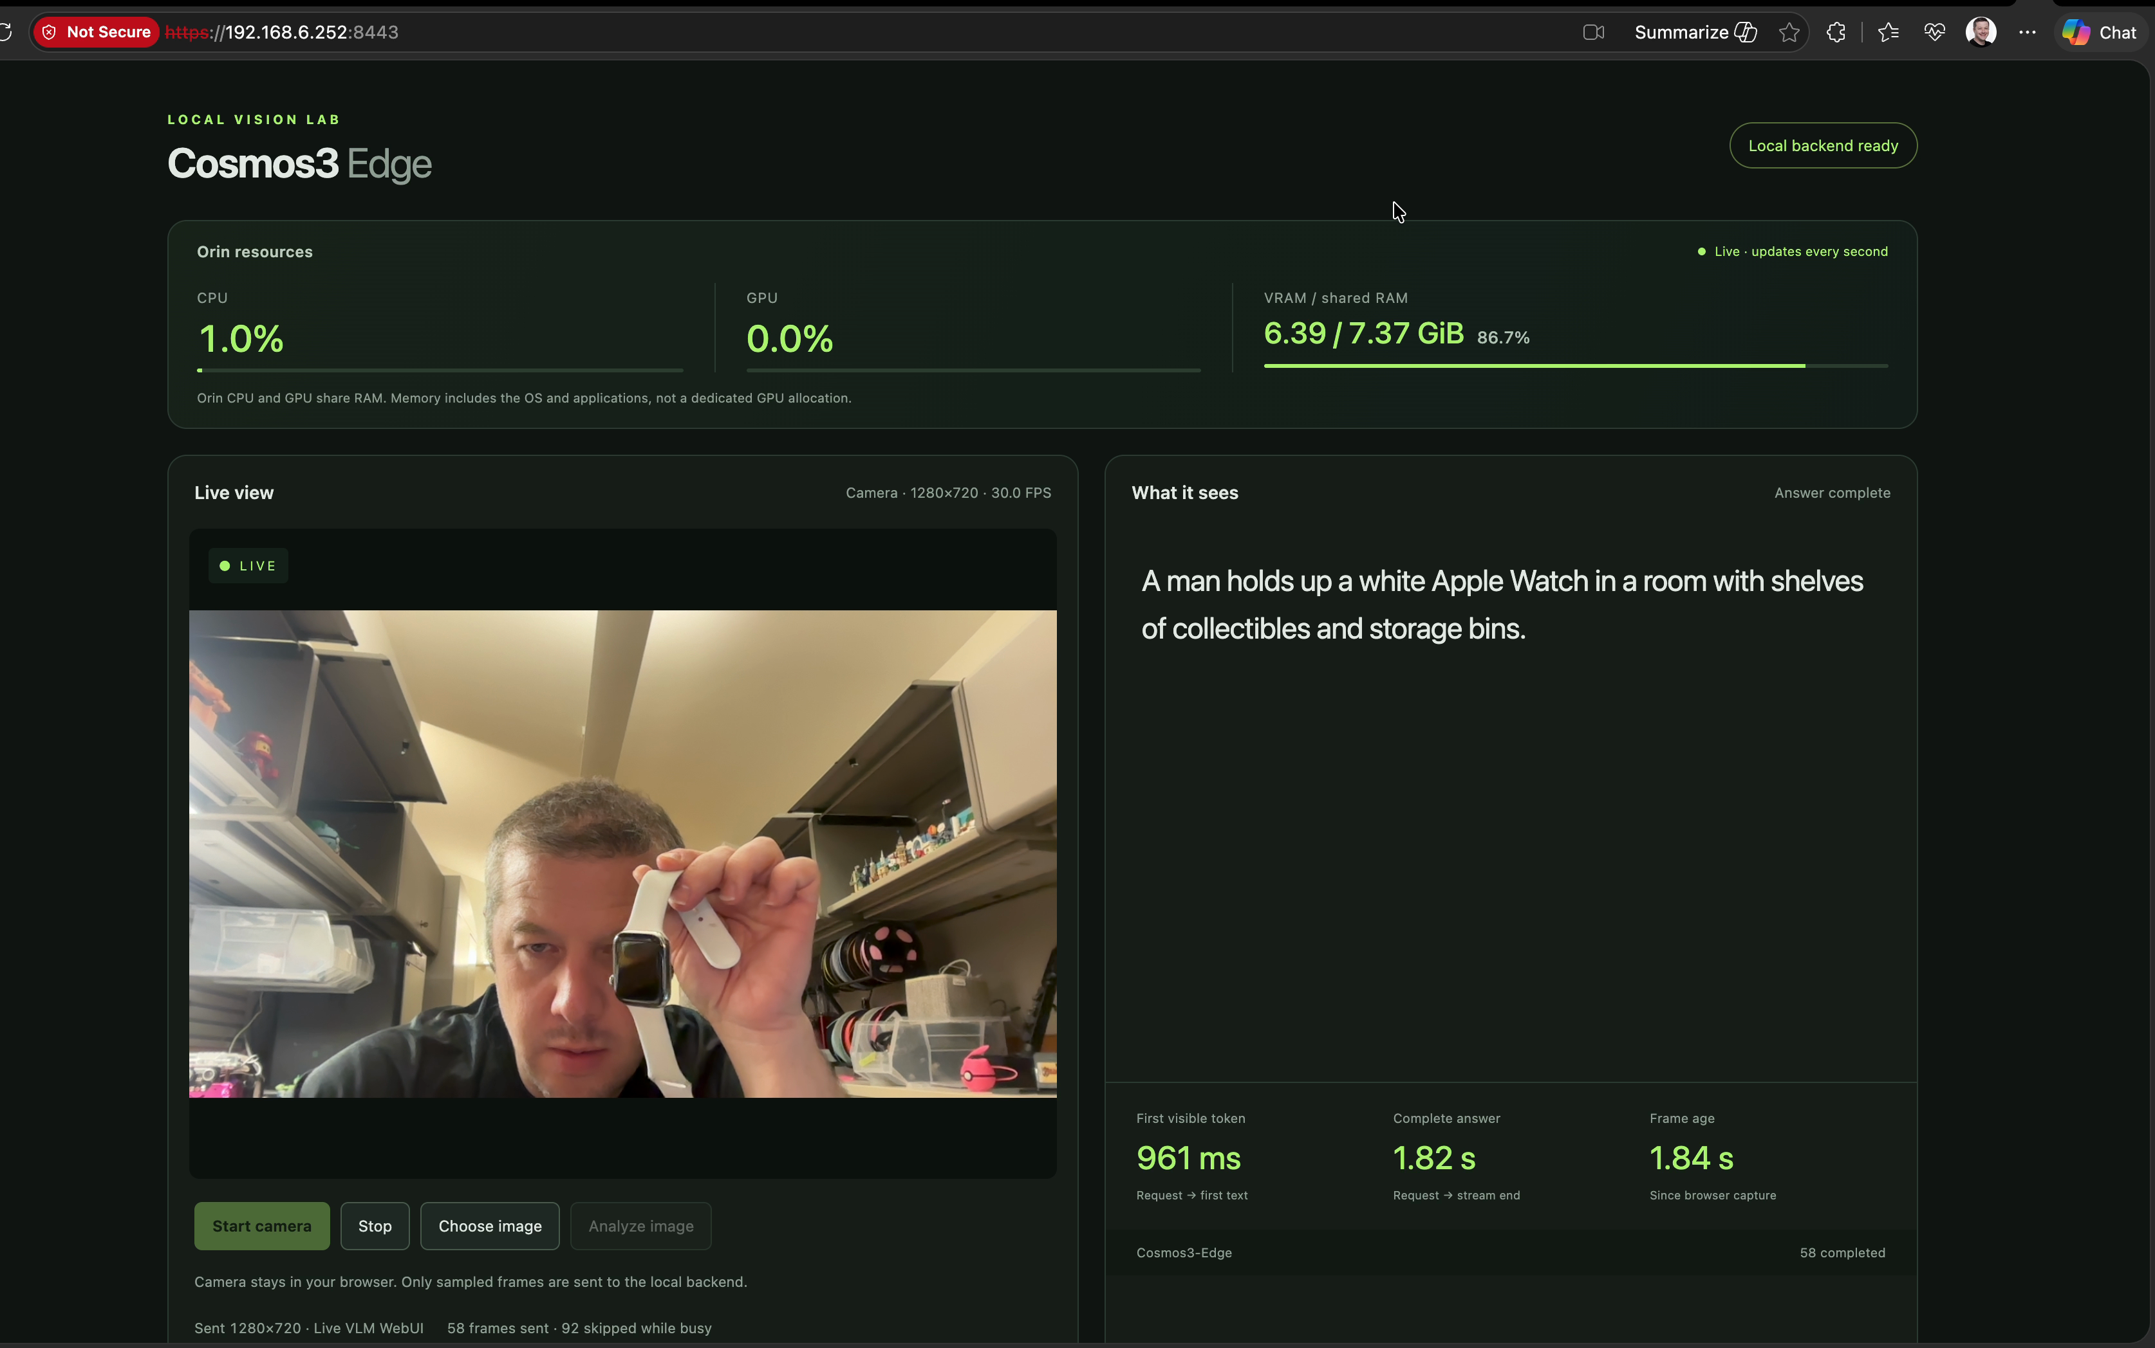
After recording: wristwatch
Clip 00:35.142
First text: 961 ms
Complete: 1.82 s
Frame age: 1.84 s
The response describes the watch shown near the camera.
A successful object description does not establish an accuracy rate.
User-designated after recording, 2026-09-20
31
Notes:
“After” is the user's designation for this recording, not a causal optimization or accuracy result. The prior controlled trial improved complete-answer latency by about 0.48%, failed the user's 10% threshold and was rejected. At recording time, the service had returned to the original corrected FP16 runtime, before the new MLP goal. The restoration receipt records 2026-09-21T01:12:44.401493+00:00, with runtime SHA-256 7917679a203010646f4412ccbb2a00bf6a97265114c5f17b5fc98574b376fc12. Three post-restoration requests matched the baseline and the functional verification passed. Those deployment receipts establish the runtime at recording time; the browser recording does not independently establish binary identity. The file title “Codex opted for accuracy” is user-supplied wording and is not evidence of an accuracy gain. The runtime at recording time already included the task's earlier correctness fixes. Historical slides 2–28 remain unchanged; the new cover identifies the current MLP deployment. These new observations do not replace their controlled benchmark. The full evidence PNG is embedded without cropping, pixel modification, overlays or distortion. Source PTS 35.141667 seconds, zero-based frame 1524, image SHA-256 c02435aef3153067fa8ee3927daf3321ad93c70de411391373ed9902147e5af2. Visible status: Answer complete. The UI reports first visible token 961 ms, complete answer 1.82 seconds, frame age 1.84 seconds and session completion counter 58. Exact model text: A man holds up a white Apple Watch in a room with shelves of collectibles and storage bins. The response describes the watch shown near the camera. A successful object description does not establish an accuracy rate. The live preview may be newer than the inference input. The screenshot captures one rounded observation and does not supply a controlled latency or accuracy comparison. Any specific brand/model name or inferred intent remains model output unless independently established. Frame metadata: {"id":"after-04","title":"Watch recognition","file":"04-after-35.142s-watch.png","filename":"04-after-35.142s-watch.png","sha256":"c02435aef3153067fa8ee3927daf3321ad93c70de411391373ed9902147e5af2","pixel_rgb_md5":"30105eb7405c1dd815bf7f94c146df53","source_frame_index_zero_based":1524,"source_pts":21085,"source_pts_seconds":35.141667,"source_pts_seconds_exact":"35.141667","source_time_base":"1/600","timecode_rounded_ms":"00:35.142","width":3348,"height":2096,"status":"Answer complete","visible_first_token_ms":961,"visible_complete_answer_s":1.82,"visible_frame_age_s":1.84,"visible_completed":58,"visible_frames_sent":58,"visible_skipped_while_busy":92,"visible_model_output":"A man holds up a white Apple Watch in a room with shelves of collectibles and storage bins.","visible_cpu_percent":1,"visible_gpu_percent":0,"visible_shared_ram_used_gib":6.39,"visible_shared_ram_total_gib":7.37,"visible_shared_ram_percent":86.7,"visual_observation":"A rectangular smartwatch with a white strap is visibly held up. Watch family and strap color are supported; exact brand is not independently verified from this recording.","preview_object_matches_answer_family":true,"preview_input_identity_verified":false,"visual_assessment":"success_with_brand_limit"}.
Sources:
output/after-cosmos3-edge-2026-09-20/manifest.json
output/after-cosmos3-edge-2026-09-20/statistics.json
output/after-cosmos3-edge-2026-09-20/04-after-35.142s-watch.png
results/latency10/restoration.json
results/latency10/restoration-verification.json
results/latency10/comparison.json
research/latency10-follow-up.md

Slide 32
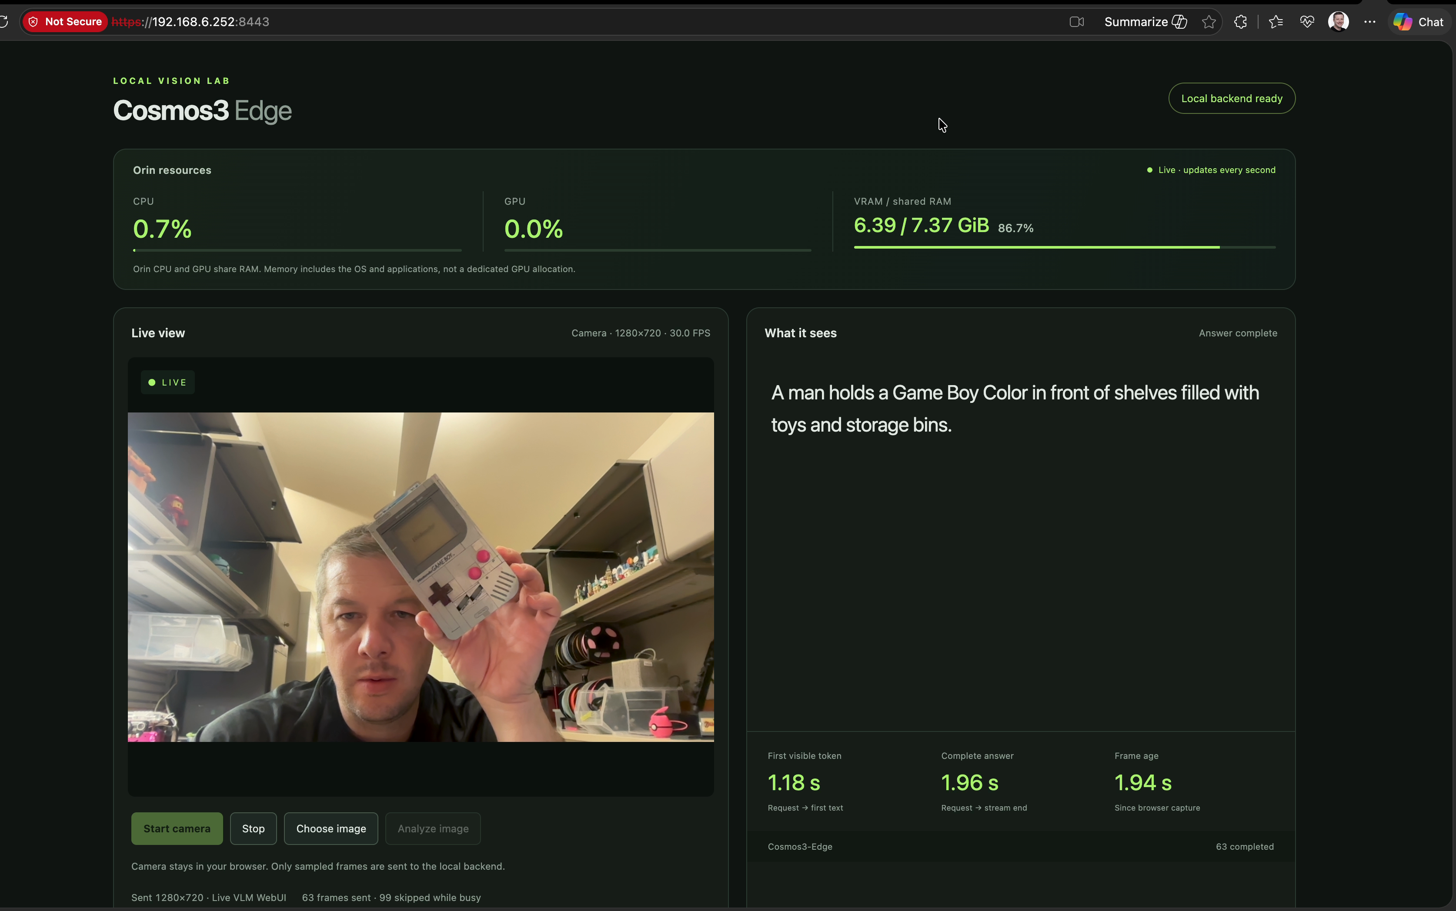
After recording: handheld identification
Clip 00:47.267
First text: 1,180 ms
Complete: 1.96 s
Frame age: 1.94 s
The model names a specific handheld. Nearby responses use different model names.
Treat the specific model name as model output, not a verified identification.
User-designated after recording, 2026-09-20
32
Notes:
“After” is the user's designation for this recording, not a causal optimization or accuracy result. The prior controlled trial improved complete-answer latency by about 0.48%, failed the user's 10% threshold and was rejected. At recording time, the service had returned to the original corrected FP16 runtime, before the new MLP goal. The restoration receipt records 2026-09-21T01:12:44.401493+00:00, with runtime SHA-256 7917679a203010646f4412ccbb2a00bf6a97265114c5f17b5fc98574b376fc12. Three post-restoration requests matched the baseline and the functional verification passed. Those deployment receipts establish the runtime at recording time; the browser recording does not independently establish binary identity. The file title “Codex opted for accuracy” is user-supplied wording and is not evidence of an accuracy gain. The runtime at recording time already included the task's earlier correctness fixes. Historical slides 2–28 remain unchanged; the new cover identifies the current MLP deployment. These new observations do not replace their controlled benchmark. The full evidence PNG is embedded without cropping, pixel modification, overlays or distortion. Source PTS 47.266667 seconds, zero-based frame 2076, image SHA-256 4a73cfdad94af4018ab3d896acd000cccf502e173c1b80f9728a7b7671022241. Visible status: Answer complete. The UI reports first visible token 1180 ms, complete answer 1.96 seconds, frame age 1.94 seconds and session completion counter 63. Exact model text: A man holds a Game Boy Color in front of shelves filled with toys and storage bins. The model names a specific handheld. Nearby responses use different model names. Treat the specific model name as model output, not a verified identification. The live preview may be newer than the inference input. The screenshot captures one rounded observation and does not supply a controlled latency or accuracy comparison. Any specific brand/model name or inferred intent remains model output unless independently established. Frame metadata: {"id":"after-06","title":"Handheld console specificity limitation","file":"06-after-47.267s-handheld.png","filename":"06-after-47.267s-handheld.png","sha256":"4a73cfdad94af4018ab3d896acd000cccf502e173c1b80f9728a7b7671022241","pixel_rgb_md5":"b518e2a438f89a1b6014057e52dc4711","source_frame_index_zero_based":2076,"source_pts":28360,"source_pts_seconds":47.266667,"source_pts_seconds_exact":"47.266667","source_time_base":"1/600","timecode_rounded_ms":"00:47.267","width":3348,"height":2096,"status":"Answer complete","visible_first_token_ms":1180,"visible_complete_answer_s":1.96,"visible_frame_age_s":1.94,"visible_completed":63,"visible_frames_sent":63,"visible_skipped_while_busy":99,"visible_model_output":"A man holds a Game Boy Color in front of shelves filled with toys and storage bins.","visible_cpu_percent":0.7,"visible_gpu_percent":0,"visible_shared_ram_used_gib":6.39,"visible_shared_ram_total_gib":7.37,"visible_shared_ram_percent":86.7,"visual_observation":"The visible gray object has a GAME BOY label and original-style housing, burgundy buttons, and diagonal speaker slots. The specific Color label appears inconsistent with those visible features. Exact hardware versus replica identity is not independently verified. The next completed answer at frame 2167 / 49.141667 s uses the broader label silver Game Boy.","preview_object_matches_answer_family":true,"preview_input_identity_verified":false,"visual_assessment":"apparent_subtype_error"}.
Sources:
output/after-cosmos3-edge-2026-09-20/manifest.json
output/after-cosmos3-edge-2026-09-20/statistics.json
output/after-cosmos3-edge-2026-09-20/06-after-47.267s-handheld.png
results/latency10/restoration.json
results/latency10/restoration-verification.json
results/latency10/comparison.json
research/latency10-follow-up.md

Slide 33
New MLP goal after the checkpoint
User steering changes the starting point and preserves the 10% stop rule
Decision | Recorded scope
Frozen checkpoint | Earlier FP16 work and 28-slide presentation preserved
User choice | Start from MLP-only RTN INT4 and improve latency and RAM
Agent measurement | Three images, 5 warmups + 30 measurements per image
Search stop | A confirmed gain below 10% ends the search
Deployment clarification | Retain useful RAM savings without further trials
Known quality limit | 18/19 diagnostic facts; yellow triangle described as orange
After measurement, the agent corrected its interpretation: 10% stops the search; useful RAM savings can remain deployed.
New MLP goal after the frozen checkpoint
33
Notes:
The user requested MLP-only RTN as the new starting point, lower latency and RAM, and to stop when a further step cannot improve p50 by 10%. The agent froze the choice of three 1280×720 images, five warmups and 30 measured requests per image, the equally weighted geometric mean of per-image median complete-answer latency, exact text/token/stop controls, a 5% per-image regression limit, 512 MiB available RAM floor, and a first-confirmed-failure stopping interpretation. The agent initially also treated 10% as deployment eligibility, then corrected that conflation after measurement: stop searching, retain a useful lower-memory configuration. The original frozen plan and failed comparison remain unchanged. No 10% latency success is claimed. These operational choices are agent decisions, not additional verbatim user requirements. The prompt is “Describe what you see in this image in one sentence.” with max tokens 512, temperature 0.7, omitted request top-p/top-k resolving to 0.9/50. Dynamic stock 25 W, input capacity 1024 and per-image capacity 512 remain. Serial local proxy requests include decoding and inference but exclude browser capture, JPEG encoding and Wi-Fi. Fixtures are screen-recording-derived camera crops, not recovered historical inference payloads. The user chose MLP-only RTN INT4 despite its known yellow-to-orange color error. The six synthetic diagnostic images still score 18/19 facts, with the same prior MLP outputs. This 64-token greedy check is separate from the 512-token Live VLM latency workload. Output preservation prevents an observed regression against this baseline; it does not establish general accuracy. Natural examples and recording answers can contain false claims. The previous FP16 phase stopped after a 0.48% candidate gain. The user subsequently asked to freeze the current version, then selected a new MLP-only starting point. The recording on slides 29–32 precedes this MLP phase. The original 5% search, later FP16 10% search and this MLP goal have separate baselines and selection rules. Historical commits identify the frozen work, but no external personal repository is used in this presentation source.
Sources:
results/mlp-goal/plan.json
results/mlp-goal/policy-clarification.json
results/mlp-goal/selection.json
results/mlp-goal/quality-baseline-review.json
GOAL.md
research/latency10-follow-up.md

Slide 34
Matched MLP latency results
1.19% lower complete-answer latency
Image | Baseline ms | Candidate ms | Change | Tokens
action camera | 996.9 | 1000.5 | 0.36% higher | 21 / 21
pen | 877.0 | 859.0 | 2.05% lower | 16 / 16
scissors | 878.1 | 861.9 | 1.85% lower | 16 / 16
Geometric mean | 915.7 | 904.8 | 1.19% lower | Same ceiling
Below the 10% continuation gate. Search stopped; the small latency difference may be noise.
Identical answers and tokens. Same 1280×720 inputs, 512-token ceiling and T0.7.
New MLP goal after the frozen checkpoint
34
Notes:
The user requested MLP-only RTN as the new starting point, lower latency and RAM, and to stop when a further step cannot improve p50 by 10%. The agent froze the choice of three 1280×720 images, five warmups and 30 measured requests per image, the equally weighted geometric mean of per-image median complete-answer latency, exact text/token/stop controls, a 5% per-image regression limit, 512 MiB available RAM floor, and a first-confirmed-failure stopping interpretation. The agent initially also treated 10% as deployment eligibility, then corrected that conflation after measurement: stop searching, retain a useful lower-memory configuration. The original frozen plan and failed comparison remain unchanged. No 10% latency success is claimed. These operational choices are agent decisions, not additional verbatim user requirements. The prompt is “Describe what you see in this image in one sentence.” with max tokens 512, temperature 0.7, omitted request top-p/top-k resolving to 0.9/50. Dynamic stock 25 W, input capacity 1024 and per-image capacity 512 remain. Serial local proxy requests include decoding and inference but exclude browser capture, JPEG encoding and Wi-Fi. Fixtures are screen-recording-derived camera crops, not recovered historical inference payloads. The user chose MLP-only RTN INT4 despite its known yellow-to-orange color error. The six synthetic diagnostic images still score 18/19 facts, with the same prior MLP outputs. This 64-token greedy check is separate from the 512-token Live VLM latency workload. Output preservation prevents an observed regression against this baseline; it does not establish general accuracy. Natural examples and recording answers can contain false claims. Final comparison: {"accepted":false,"decision":"stop_and_keep_last_accepted_mlp","selected_candidate_id":"live-vlm-mlp-baseline","candidate_to_baseline_ratio":0.9881426269250084,"latency_reduction_percent":1.1857373074991573,"peak_shared_ram_candidate_to_baseline_ratio":0.9688093294721424,"per_fixture":[{"fixture":"01-action-camera.jpg","output_equivalent":true,"backend_changes":{"max_kv_cache_capacity":{"before":2048,"after":1664},"max_image_tokens":{"before":1024,"after":512},"native_extension_sha256":{"before":"7917679a203010646f4412ccbb2a00bf6a97265114c5f17b5fc98574b376fc12","after":"f9ead1dc9a9fbeb392ccd0e485817dedb8c657833bb01a1facc362248741a7a0"},"native_extension_current_sha256":{"before":"7917679a203010646f4412ccbb2a00bf6a97265114c5f17b5fc98574b376fc12","after":"f9ead1dc9a9fbeb392ccd0e485817dedb8c657833bb01a1facc362248741a7a0"}},"ratios":{"p50_latency_ms":1.0036429390787285,"p95_latency_ms":0.997850627032594}},{"fixture":"02-pen.jpg","output_equivalent":true,"backend_changes":{"max_kv_cache_capacity":{"before":2048,"after":1664},"max_image_tokens":{"before":1024,"after":512},"native_extension_sha256":{"before":"7917679a203010646f4412ccbb2a00bf6a97265114c5f17b5fc98574b376fc12","after":"f9ead1dc9a9fbeb392ccd0e485817dedb8c657833bb01a1facc362248741a7a0"},"native_extension_current_sha256":{"before":"7917679a203010646f4412ccbb2a00bf6a97265114c5f17b5fc98574b376fc12","after":"f9ead1dc9a9fbeb392ccd0e485817dedb8c657833bb01a1facc362248741a7a0"}},"ratios":{"p50_latency_ms":0.9795012844720307,"p95_latency_ms":0.9900506490888166}},{"fixture":"03-scissors.jpg","output_equivalent":true,"backend_changes":{"max_kv_cache_capacity":{"before":2048,"after":1664},"max_image_tokens":{"before":1024,"after":512},"native_extension_sha256":{"before":"7917679a203010646f4412ccbb2a00bf6a97265114c5f17b5fc98574b376fc12","after":"f9ead1dc9a9fbeb392ccd0e485817dedb8c657833bb01a1facc362248741a7a0"},"native_extension_current_sha256":{"before":"7917679a203010646f4412ccbb2a00bf6a97265114c5f17b5fc98574b376fc12","after":"f9ead1dc9a9fbeb392ccd0e485817dedb8c657833bb01a1facc362248741a7a0"}},"ratios":{"p50_latency_ms":0.9814646456426098,"p95_latency_ms":0.9910339440653367}}],"rejection_reasons":["geomean_complete_latency_gain_below_10_percent"],"memory_changes":{"candidate_vs_incumbent":{"shared_ram_unavailable":{"before_peak_bytes":5495009280,"after_peak_bytes":5323616256,"decrease_bytes":171393024,"decrease_percent":3.11906705278576},"process_rss":{"before_peak_bytes":4990783488,"after_peak_bytes":4759748608,"decrease_bytes":231034880,"decrease_percent":4.629230672007866}},"selected_vs_incumbent":{"shared_ram_unavailable":{"before_peak_bytes":5495009280,"after_peak_bytes":5495009280,"decrease_bytes":0,"decrease_percent":0},"process_rss":{"before_peak_bytes":4990783488,"after_peak_bytes":4990783488,"decrease_bytes":0,"decrease_percent":0}},"candidate_vs_initial_mlp":{"shared_ram_unavailable":{"before_peak_bytes":5495009280,"after_peak_bytes":5323616256,"decrease_bytes":171393024,"decrease_percent":3.11906705278576},"process_rss":{"before_peak_bytes":4990783488,"after_peak_bytes":4759748608,"decrease_bytes":231034880,"decrease_percent":4.629230672007866}},"selected_vs_initial_mlp":{"shared_ram_unavailable":{"before_peak_bytes":5495009280,"after_peak_bytes":5495009280,"decrease_bytes":0,"decrease_percent":0},"process_rss":{"before_peak_bytes":4990783488,"after_peak_bytes":4990783488,"decrease_bytes":0,"decrease_percent":0}}},"memory_change_definition":"Decrease in sampled peak memory; positive means lower, negative means higher. Shared RAM and RSS overlap and are never added.","memory_history_scope":"Only the supplied incumbent, candidate and optional initial MLP runs; no claim about an unprovided search history."}. Baseline ID live-vlm-mlp-baseline; candidate ID live-vlm-mlp-n4-compact. Per-fixture baseline: [{"fixture":"01-action-camera.jpg","p50_latency_ms":996.9122269976651,"p95_latency_ms":1008.729976444738,"p50_ttft_ms":473.4077429966419,"p95_ttft_ms":484.4949111517053,"completion_tokens":21,"answer":"A man holds a GoPro camera up to his face as if he is taking a selfie."},{"fixture":"02-pen.jpg","p50_latency_ms":877.0079265013919,"p95_latency_ms":882.0037088029494,"p50_ttft_ms":484.43965350452345,"p95_ttft_ms":487.6425162045052,"completion_tokens":16,"answer":"A man holds a pen in front of his face while raising three fingers."},{"fixture":"03-scissors.jpg","p50_latency_ms":878.1416690035257,"p95_latency_ms":883.2488672516774,"p50_ttft_ms":484.86015149683226,"p95_ttft_ms":489.6475982503034,"completion_tokens":16,"answer":"A man is holding a pair of scissors in front of his face."}]. Per-fixture candidate: [{"fixture":"01-action-camera.jpg","p50_latency_ms":1000.5439175074571,"p95_latency_ms":1006.5618395019555,"p50_ttft_ms":481.4108494974789,"p95_ttft_ms":486.82069834976573,"completion_tokens":21,"answer":"A man holds a GoPro camera up to his face as if he is taking a selfie."},{"fixture":"02-pen.jpg","p50_latency_ms":859.0303905002656,"p95_latency_ms":873.2283443991037,"p50_ttft_ms":468.259355504415,"p95_ttft_ms":482.63645064871525,"completion_tokens":16,"answer":"A man holds a pen in front of his face while raising three fingers."},{"fixture":"03-scissors.jpg","p50_latency_ms":861.8650019925553,"p95_latency_ms":875.3296085036709,"p50_ttft_ms":471.0603349885787,"p95_ttft_ms":483.1134517546161,"completion_tokens":16,"answer":"A man is holding a pair of scissors in front of his face."}]. Values cover 90 measured responses plus 15 excluded warmups per configuration. Memory extrema include both.
Sources:
results/mlp-goal/comparison-01.json
results/mlp-goal/plan.json
results/mlp-goal/policy-clarification.json
results/mlp-goal/baseline-summary.json

Slide 35
Shared RAM and capacity settings
Measured value or capacity | Baseline | Selected candidate
Peak shared RAM unavailable | 5.118 GiB | 4.958 GiB
Peak process RSS | 4.648 GiB | 4.433 GiB
Minimum shared RAM available | 2.252 GiB | 2.411 GiB
KV capacity, tokens | 2048 | 1664
Aggregate image capacity, tokens | 1024 | 512
Per-image capacity, tokens | 512 | 512
163.45 MiB (3.12%) lower sampled shared-RAM peak. RSS overlaps this pool.
New MLP goal after the frozen checkpoint
35
Notes:
The user requested MLP-only RTN as the new starting point, lower latency and RAM, and to stop when a further step cannot improve p50 by 10%. The agent froze the choice of three 1280×720 images, five warmups and 30 measured requests per image, the equally weighted geometric mean of per-image median complete-answer latency, exact text/token/stop controls, a 5% per-image regression limit, 512 MiB available RAM floor, and a first-confirmed-failure stopping interpretation. The agent initially also treated 10% as deployment eligibility, then corrected that conflation after measurement: stop searching, retain a useful lower-memory configuration. The original frozen plan and failed comparison remain unchanged. No 10% latency success is claimed. These operational choices are agent decisions, not additional verbatim user requirements. The prompt is “Describe what you see in this image in one sentence.” with max tokens 512, temperature 0.7, omitted request top-p/top-k resolving to 0.9/50. Dynamic stock 25 W, input capacity 1024 and per-image capacity 512 remain. Serial local proxy requests include decoding and inference but exclude browser capture, JPEG encoding and Wi-Fi. Fixtures are screen-recording-derived camera crops, not recovered historical inference payloads. Baseline memory: peak system unavailable 5495009280 bytes, peak process RSS 4990783488 bytes, minimum available 2417766400 bytes. Candidate memory: peak system unavailable 5323616256 bytes, peak process RSS 4759748608 bytes, minimum available 2589159424 bytes. Memory extrema include warmup and measured requests. System unavailable RAM uses MemTotal minus MemAvailable and includes OS/apps. RSS overlaps that same physical pool and must not be added to it. Actual capacities: {"baseline":{"input":1024,"kv":2048,"images":1024,"perImage":512},"candidate":{"input":1024,"kv":1664,"images":512,"perImage":512}}. The model remains MLP-only RTN INT4 with FP16 attention, LM head, vision, projector, embeddings, activations and KV. This is one combined candidate: N4 native GEMV plus aggregate image capacity 1024 to 512 and KV capacity 2048 to 1664. The full-answer experiment does not isolate the kernel contribution from the buffer contribution to latency or RAM. Fewer reserved capacity tokens do not count as an improvement if actual image/text/output work changes. The original comparator's selected_vs fields reflect its then-frozen rejection rule. The later deployment selection retains this candidate, so candidate_vs_incumbent gives the final retained memory saving. Original memory deltas and safeguard decisions: {"candidate_vs_incumbent":{"shared_ram_unavailable":{"before_peak_bytes":5495009280,"after_peak_bytes":5323616256,"decrease_bytes":171393024,"decrease_percent":3.11906705278576},"process_rss":{"before_peak_bytes":4990783488,"after_peak_bytes":4759748608,"decrease_bytes":231034880,"decrease_percent":4.629230672007866}},"selected_vs_incumbent":{"shared_ram_unavailable":{"before_peak_bytes":5495009280,"after_peak_bytes":5495009280,"decrease_bytes":0,"decrease_percent":0},"process_rss":{"before_peak_bytes":4990783488,"after_peak_bytes":4990783488,"decrease_bytes":0,"decrease_percent":0}},"candidate_vs_initial_mlp":{"shared_ram_unavailable":{"before_peak_bytes":5495009280,"after_peak_bytes":5323616256,"decrease_bytes":171393024,"decrease_percent":3.11906705278576},"process_rss":{"before_peak_bytes":4990783488,"after_peak_bytes":4759748608,"decrease_bytes":231034880,"decrease_percent":4.629230672007866}},"selected_vs_initial_mlp":{"shared_ram_unavailable":{"before_peak_bytes":5495009280,"after_peak_bytes":5495009280,"decrease_bytes":0,"decrease_percent":0},"process_rss":{"before_peak_bytes":4990783488,"after_peak_bytes":4990783488,"decrease_bytes":0,"decrease_percent":0}}}.
Sources:
results/mlp-goal/comparison-01.json
results/mlp-goal/plan.json
results/mlp-goal/policy-clarification.json
results/mlp-goal/selection.json

Slide 36
Task-authored MLP kernel experiment
36 GPU cases passed with 202,752 identical FP16 values
Synthetic measurement | 2 outputs/block | 4 outputs/block | Change
Up projection, ms/call | 0.15148 | 0.14887 | 1.73% lower
Down projection, ms/call | 0.12601 | 0.11548 | 8.35% lower
Registers per thread | 40 | 58 | More registers
Maximum active blocks/SM | 6 | 4 | Lower occupancy
Synthetic graph batches reuse weights. Dynamic clocks affect these measurements.
Full-answer trial combines kernel and buffer changes. Individual gains are unmeasured.
New MLP goal after the frozen checkpoint
36
Notes:
The task-authored candidate dispatches only batch-one Cosmos MLP shapes (N,K)=(9216,2048) and (2048,9216) to the existing public GEMV template with four outputs per block instead of two. It retains the upstream half2 multiply-accumulate and reduction order. NVIDIA public integration and the MIT HAN Lab kernel retain their respective attribution and licenses. Source-only review found full output coverage for these exact shapes; the GPU harness adds bitwise tests. Results: {"kind":"equivalence_summary","cases":36,"compared_fp16_values_bitwise":202752,"pass":true}. Tests use nine bounded finite/signed-zero/subnormal fixture patterns, two seeds and two shapes, with independent poisoned output buffers and guards. They do not prove correctness over every possible input. Build chronology matters: the compact engine build completed 2026-09-21T04:00:30.777989+00:00, using plugin SHA-256 f0076f9548eb53dee2e5e53e5ca91ea10f91d83010b63ae709e191fc0464aa75. The N4 native compile ran later, from 2026-09-21T04:01:24.462146+00:00 through 2026-09-21T04:01:54.139216+00:00. The subsequent inference verification loaded plugin SHA-256 302d4e8c8f579471cfcdebcb0910f20caf4228dbcc9000b60757db4780176dbe and runtime SHA-256 f9ead1dc9a9fbeb392ccd0e485817dedb8c657833bb01a1facc362248741a7a0. The older engine-build plugin hash records the build sequence and must not be mislabeled as the plugin used for measured inference. The end-to-end candidate combines this kernel change with reduced reserved capacities. Individual full-model kernel/buffer latency or memory gains were not established by separate trials. Per-case compared_fp16_bits labels a count of values; the equivalence summary correctly records FP16 values. Synthetic CUDA graph timing uses 100 warmups, 200 calls per trial and 12 trials per variant with alternating AB/BA order. Each table entry is the median across batch means, not a single-call p50. Dynamic clocks visibly change within timing traces. Reused synthetic weights and graph batches do not measure model latency or support an exact decomposition of whole-answer time. Full receipts: [{"kind":"environment","source_sha256_required":"3a55142d894fef9ae50ff8f609d385a7b2fbee9be09d73b69a3ea97fee7e595c","source_sha_checked_by_harness":false,"device":"Orin","sm":87,"multiprocessors":8,"cuda_runtime_version":13020,"cuda_driver_version":13020,"cuda_compiler_major":13,"cuda_compiler_minor":2,"batch":1,"group_size":128,"threads_per_block":256,"baseline_n_per_block":2,"candidate_n_per_block":4,"weights":"synthetic native V1 q+8 packed INT4","accumulation":"unchanged upstream half2 MAC and warp/interwarp reductions","limitation":"repeated synthetic weights; full-model latency and RAM unmeasured"},{"kind":"kernel_attributes","n_per_block":2,"registers_per_thread":40,"local_bytes_per_thread":0,"shared_bytes_per_block":512,"maximum_active_blocks_per_sm":6},{"kind":"kernel_attributes","n_per_block":4,"registers_per_thread":58,"local_bytes_per_thread":0,"shared_bytes_per_block":1024,"maximum_active_blocks_per_sm":4},{"kind":"equivalence","n":9216,"k":2048,"pattern":"signed_random","seed":12605957,"compared_fp16_bits":9216,"nonzero_outputs":9216,"output_fnv1a64":"bd65bdcddacf1d34","guards_pass":true,"bitwise_pass":true},{"kind":"equivalence","n":9216,"k":2048,"pattern":"signed_random","seed":2654435769,"compared_fp16_bits":9216,"nonzero_outputs":9216,"output_fnv1a64":"bf6a388474d901be","guards_pass":true,"bitwise_pass":true},{"kind":"equivalence","n":9216,"k":2048,"pattern":"positive_relu2","seed":12605957,"compared_fp16_bits":9216,"nonzero_outputs":9216,"output_fnv1a64":"702b27e2359de049","guards_pass":true,"bitwise_pass":true},{"kind":"equivalence","n":9216,"k":2048,"pattern":"positive_relu2","seed":2654435769,"compared_fp16_bits":9216,"nonzero_outputs":9216,"output_fnv1a64":"ad2fe4b8e17c287d","guards_pass":true,"bitwise_pass":true},{"kind":"equivalence","n":9216,"k":2048,"pattern":"sparse_boundaries","seed":12605957,"compared_fp16_bits":9216,"nonzero_outputs":9216,"output_fnv1a64":"52c9c5c1a90a834c","guards_pass":true,"bitwise_pass":true},{"kind":"equivalence","n":9216,"k":2048,"pattern":"sparse_boundaries","seed":2654435769,"compared_fp16_bits":9216,"nonzero_outputs":9216,"output_fnv1a64":"69c463b70cf8ca16","guards_pass":true,"bitwise_pass":true},{"kind":"equivalence","n":9216,"k":2048,"pattern":"alternating_cancellation","seed":12605957,"compared_fp16_bits":9216,"nonzero_outputs":0,"output_fnv1a64":"68685c488793c325","guards_pass":true,"bitwise_pass":true},{"kind":"equivalence","n":9216,"k":2048,"pattern":"alternating_cancellation","seed":2654435769,"compared_fp16_bits":9216,"nonzero_outputs":0,"output_fnv1a64":"68685c488793c325","guards_pass":true,"bitwise_pass":true},{"kind":"equivalence","n":9216,"k":2048,"pattern":"signed_zero","seed":12605957,"compared_fp16_bits":9216,"nonzero_outputs":0,"output_fnv1a64":"68685c488793c325","guards_pass":true,"bitwise_pass":true},{"kind":"equivalence","n":9216,"k":2048,"pattern":"signed_zero","seed":2654435769,"compared_fp16_bits":9216,"nonzero_outputs":0,"output_fnv1a64":"68685c488793c325","guards_pass":true,"bitwise_pass":true},{"kind":"equivalence","n":9216,"k":2048,"pattern":"zero_weights","seed":12605957,"compared_fp16_bits":9216,"nonzero_outputs":0,"output_fnv1a64":"68685c488793c325","guards_pass":true,"bitwise_pass":true},{"kind":"equivalence","n":9216,"k":2048,"pattern":"zero_weights","seed":2654435769,"compared_fp16_bits":9216,"nonzero_outputs":0,"output_fnv1a64":"68685c488793c325","guards_pass":true,"bitwise_pass":true},{"kind":"equivalence","n":9216,"k":2048,"pattern":"unit_weights","seed":12605957,"compared_fp16_bits":9216,"nonzero_outputs":9216,"output_fnv1a64":"35999ddc18b07e6e","guards_pass":true,"bitwise_pass":true},{"kind":"equivalence","n":9216,"k":2048,"pattern":"unit_weights","seed":2654435769,"compared_fp16_bits":9216,"nonzero_outputs":9216,"output_fnv1a64":"ca5b4b2edd774c18","guards_pass":true,"bitwise_pass":true},{"kind":"equivalence","n":9216,"k":2048,"pattern":"wide_finite","seed":12605957,"compared_fp16_bits":9216,"nonzero_outputs":9216,"output_fnv1a64":"d0892430da42e07c","guards_pass":true,"bitwise_pass":true},{"kind":"equivalence","n":9216,"k":2048,"pattern":"wide_finite","seed":2654435769,"compared_fp16_bits":9216,"nonzero_outputs":9216,"output_fnv1a64":"a7fc8927480d4c28","guards_pass":true,"bitwise_pass":true},{"kind":"equivalence","n":9216,"k":2048,"pattern":"subnormal_inputs","seed":12605957,"compared_fp16_bits":9216,"nonzero_outputs":9216,"output_fnv1a64":"e8c5f1cba730c955","guards_pass":true,"bitwise_pass":true},{"kind":"equivalence","n":9216,"k":2048,"pattern":"subnormal_inputs","seed":2654435769,"compared_fp16_bits":9216,"nonzero_outputs":9215,"output_fnv1a64":"bd09eea32eeefdba","guards_pass":true,"bitwise_pass":true},{"kind":"equivalence","n":2048,"k":9216,"pattern":"signed_random","seed":12605957,"compared_fp16_bits":2048,"nonzero_outputs":2048,"output_fnv1a64":"812e61b91d71e4f8","guards_pass":true,"bitwise_pass":true},{"kind":"equivalence","n":2048,"k":9216,"pattern":"signed_random","seed":2654435769,"compared_fp16_bits":2048,"nonzero_outputs":2048,"output_fnv1a64":"e163170190bbba4b","guards_pass":true,"bitwise_pass":true},{"kind":"equivalence","n":2048,"k":9216,"pattern":"positive_relu2","seed":12605957,"compared_fp16_bits":2048,"nonzero_outputs":2048,"output_fnv1a64":"62bc35d6305d805a","guards_pass":true,"bitwise_pass":true},{"kind":"equivalence","n":2048,"k":9216,"pattern":"positive_relu2","seed":2654435769,"compared_fp16_bits":2048,"nonzero_outputs":2048,"output_fnv1a64":"bdd780e017e2da65","guards_pass":true,"bitwise_pass":true},{"kind":"equivalence","n":2048,"k":9216,"pattern":"sparse_boundaries","seed":12605957,"compared_fp16_bits":2048,"nonzero_outputs":2048,"output_fnv1a64":"1f0725377d55d7dd","guards_pass":true,"bitwise_pass":true},{"kind":"equivalence","n":2048,"k":9216,"pattern":"sparse_boundaries","seed":2654435769,"compared_fp16_bits":2048,"nonzero_outputs":2048,"output_fnv1a64":"67a173058fc09cee","guards_pass":true,"bitwise_pass":true},{"kind":"equivalence","n":2048,"k":9216,"pattern":"alternating_cancellation","seed":12605957,"compared_fp16_bits":2048,"nonzero_outputs":0,"output_fnv1a64":"b93a0c83ce3b6325","guards_pass":true,"bitwise_pass":true},{"kind":"equivalence","n":2048,"k":9216,"pattern":"alternating_cancellation","seed":2654435769,"compared_fp16_bits":2048,"nonzero_outputs":0,"output_fnv1a64":"b93a0c83ce3b6325","guards_pass":true,"bitwise_pass":true},{"kind":"equivalence","n":2048,"k":9216,"pattern":"signed_zero","seed":12605957,"compared_fp16_bits":2048,"nonzero_outputs":0,"output_fnv1a64":"b93a0c83ce3b6325","guards_pass":true,"bitwise_pass":true},{"kind":"equivalence","n":2048,"k":9216,"pattern":"signed_zero","seed":2654435769,"compared_fp16_bits":2048,"nonzero_outputs":0,"output_fnv1a64":"b93a0c83ce3b6325","guards_pass":true,"bitwise_pass":true},{"kind":"equivalence","n":2048,"k":9216,"pattern":"zero_weights","seed":12605957,"compared_fp16_bits":2048,"nonzero_outputs":0,"output_fnv1a64":"b93a0c83ce3b6325","guards_pass":true,"bitwise_pass":true},{"kind":"equivalence","n":2048,"k":9216,"pattern":"zero_weights","seed":2654435769,"compared_fp16_bits":2048,"nonzero_outputs":0,"output_fnv1a64":"b93a0c83ce3b6325","guards_pass":true,"bitwise_pass":true},{"kind":"equivalence","n":2048,"k":9216,"pattern":"unit_weights","seed":12605957,"compared_fp16_bits":2048,"nonzero_outputs":2048,"output_fnv1a64":"9a7bd64d923e86de","guards_pass":true,"bitwise_pass":true},{"kind":"equivalence","n":2048,"k":9216,"pattern":"unit_weights","seed":2654435769,"compared_fp16_bits":2048,"nonzero_outputs":2048,"output_fnv1a64":"c9ab4e855bb7b82d","guards_pass":true,"bitwise_pass":true},{"kind":"equivalence","n":2048,"k":9216,"pattern":"wide_finite","seed":12605957,"compared_fp16_bits":2048,"nonzero_outputs":2048,"output_fnv1a64":"528169fcb8c8673a","guards_pass":true,"bitwise_pass":true},{"kind":"equivalence","n":2048,"k":9216,"pattern":"wide_finite","seed":2654435769,"compared_fp16_bits":2048,"nonzero_outputs":2048,"output_fnv1a64":"cc1c0a2723dffe8d","guards_pass":true,"bitwise_pass":true},{"kind":"equivalence","n":2048,"k":9216,"pattern":"subnormal_inputs","seed":12605957,"compared_fp16_bits":2048,"nonzero_outputs":2048,"output_fnv1a64":"f60647e962f449e3","guards_pass":true,"bitwise_pass":true},{"kind":"equivalence","n":2048,"k":9216,"pattern":"subnormal_inputs","seed":2654435769,"compared_fp16_bits":2048,"nonzero_outputs":2048,"output_fnv1a64":"b54b1492c631948c","guards_pass":true,"bitwise_pass":true},{"kind":"equivalence_summary","cases":36,"compared_fp16_values_bitwise":202752,"pass":true},{"kind":"timing_fixture","n":9216,"k":2048,"seed":12605957,"input_fnv1a64":"0605f7c94cde0138","packed_weight_fnv1a64":"cbbcaa977af03d6d","scales_fnv1a64":"a93a57a5a480716c"},{"kind":"timing","n":9216,"k":2048,"mode":"graph_batch","warmup_per_variant":100,"calls_per_trial":200,"trials_per_variant":12,"order":"alternating_AB_BA","baseline_ms_per_call_trials":[0.151509434,0.151556954,0.151495367,0.151523843,0.151509121,0.151471362,0.151537433,0.12654081,0.116665117,0.116667993,0.116603352,0.116376474],"candidate_ms_per_call_trials":[0.148896962,0.148924157,0.148884475,0.148862407,0.148915038,0.14887616,0.148885116,0.148830712,0.113070078,0.11306864,0.112806082,0.11276944],"baseline_median_batch_mean_ms":0.151483364,"candidate_median_batch_mean_ms":0.148869283,"median_batch_mean_reduction_percent":1.725655432},{"kind":"timing_fixture","n":2048,"k":9216,"seed":12605957,"input_fnv1a64":"80b3ebaccd0f369f","packed_weight_fnv1a64":"fd31a69409b910ad","scales_fnv1a64":"8bbd938671caa50a"},{"kind":"timing","n":2048,"k":9216,"mode":"graph_batch","warmup_per_variant":100,"calls_per_trial":200,"trials_per_variant":12,"order":"alternating_AB_BA","baseline_ms_per_call_trials":[0.126058877,0.126564637,0.126384318,0.125400484,0.125788316,0.126272008,0.126027361,0.126162082,0.125957116,0.125953123,0.125987515,0.12599808],"candidate_ms_per_call_trials":[0.11522048,0.115892798,0.116042078,0.115390241,0.115422398,0.115476482,0.115493439,0.115575522,0.115566246,0.115455039,0.115457602,0.1155072],"baseline_median_batch_mean_ms":0.12601272,"candidate_median_batch_mean_ms":0.11548496,"median_batch_mean_reduction_percent":8.354521493},{"kind":"synthetic_56_gemv_projection","baseline_ms":7.769890368,"candidate_ms":7.401918828,"saved_ms":0.367971539,"is_model_latency_measurement":false}].
Sources:
results/mlp-goal/profiling/gemv-graph.jsonl
results/mlp-goal/native-build/status.json
results/mlp-goal/compact-build/status.json
results/rtn-build-20260921T040030Z-41c97631.json
results/mlp-goal/verification.json
patches/int4-gemv-cosmos-mlp-n4.patch
scripts/profile_mlp_gemv.cu
https://github.com/NVIDIA/TensorRT-Edge-LLM/blob/e8b29522938901f6df19ebeedd4b69bc8edbcd97/cpp/kernels/int4GroupwiseGemmKernels/int4WoQGemvCuda.cu
https://github.com/mit-han-lab/llm-awq/blob/main/awq/kernels/csrc/quantization_new/gemv/gemv_cuda.cu

Slide 37
Selected MLP deployment and limits
Search stopped; the leaner MLP candidate is deployed
Final state | Evidence
Latency observation | 1.19% lower; 10% continuation threshold missed
Selected shared-RAM peak | 4.958 GiB; 163.45 MiB lower
API streaming soak | 600.5 s, 569 responses, 0 errors
Services and browser | Backend/UI active; image and synthetic-camera checks passed
Direct browser access | https://192.168.6.252:8443
Known color error remains. The soak tests API stability; camera QA uses synthetic moving frames.
New MLP goal after the frozen checkpoint
37
Notes:
The user chose MLP-only RTN INT4 despite its known yellow-to-orange color error. The six synthetic diagnostic images still score 18/19 facts, with the same prior MLP outputs. This 64-token greedy check is separate from the 512-token Live VLM latency workload. Output preservation prevents an observed regression against this baseline; it does not establish general accuracy. Natural examples and recording answers can contain false claims. The user requested MLP-only RTN as the new starting point, lower latency and RAM, and to stop when a further step cannot improve p50 by 10%. The agent froze the choice of three 1280×720 images, five warmups and 30 measured requests per image, the equally weighted geometric mean of per-image median complete-answer latency, exact text/token/stop controls, a 5% per-image regression limit, 512 MiB available RAM floor, and a first-confirmed-failure stopping interpretation. The agent initially also treated 10% as deployment eligibility, then corrected that conflation after measurement: stop searching, retain a useful lower-memory configuration. The original frozen plan and failed comparison remain unchanged. No 10% latency success is claimed. These operational choices are agent decisions, not additional verbatim user requirements. The prompt is “Describe what you see in this image in one sentence.” with max tokens 512, temperature 0.7, omitted request top-p/top-k resolving to 0.9/50. Dynamic stock 25 W, input capacity 1024 and per-image capacity 512 remain. Serial local proxy requests include decoding and inference but exclude browser capture, JPEG encoding and Wi-Fi. Fixtures are screen-recording-derived camera crops, not recovered historical inference payloads. Policy clarification after measurement: {"created_utc":"2026-09-21T04:06:38.438870+00:00","user_instruction":"Start from RTN INT4 MLP only, improve latency and RAM footprint, stop when p50 cannot improve by10percent and load the optimized model.","original_agent_interpretation":"The frozen plan treated10percent as both a continuation threshold and a deployment eligibility threshold.","corrected_interpretation":"10percent controls whether to continue searching. Stop now, and deploy the usable measured candidate with lower RAM and no material latency or output regression.","reason":"Discarding the lower-memory MLP candidate would undo progress toward the requested footprint objective. User did not require discarding every useful improvement below10percent. This clarification does not turn1.19percent into a10percent win or authorize more marginal trials.","timing":"Clarified after first candidate measurement; originalplan andcomparison preserved without edits.","continuation_threshold_met":false,"original_comparison_accepted":false,"deployment_selected":"live-vlm-mlp-n4-compact","observed_latency_reduction_percent":1.1857373074991573,"latency_caveat":"The small observed latency difference may include measurement noise. This is a memory-saving deployment selection, not a10percent latency success.","shared_ram_decrease_bytes":171393024,"observed_regression_limits":"Every per-imagep50/p95 within frozen5percent gate; allp95values lower.","evidence":["results/mlp-goal/plan.json","results/mlp-goal/comparison-01.json","results/mlp-goal/quality-candidate-review.json"],"frozen_plan_sha256":"46378d5a97bf522b62aee8f58b35799ff5e15051ea7e4a1f51ca57f616ad7e81","comparison_sha256":"98413e511ffca12ce657dcef6c4058c2d723719ad2ddb55327b7fee111281c34"}. Selection: {"selected_candidate_id":"live-vlm-mlp-n4-compact","decision":"stop_search_and_deploy_lower_memory_mlp","reason":"10percent continuation threshold notmet. Select lower-memory equivalent MLPcandidate without further optimization trials.","selected_at_utc":"2026-09-21T04:06:38.438870+00:00","stop_rule_triggered":true}. Verification: {"verified_at_utc":"2026-09-21T04:07:23.213222+00:00","health_before":{"status":"ready","active_requests":0,"queued_requests":0},"fixtures":[{"image":"benchmarks/live-vlm-1280/01-action-camera.jpg","identical_to_baseline":true,"result":{"ttft_ms":508.19072999001946,"total_latency_ms":1109.0886250021867,"completion_tokens":21,"completion_tokens_per_second":18.934465223605187,"throughput_definition":"completion_tokens / total_request_seconds","usage":{"prompt_tokens":511,"completion_tokens":21,"total_tokens":532},"output_text":"A man holds a GoPro camera up to his face as if he is taking a selfie.","http_status":200,"finish_reason":"stop","stream_done":true,"error":null}},{"image":"benchmarks/live-vlm-1280/02-pen.jpg","identical_to_baseline":true,"result":{"ttft_ms":474.7798290045466,"total_latency_ms":864.0464010095457,"completion_tokens":16,"completion_tokens_per_second":18.51752403725739,"throughput_definition":"completion_tokens / total_request_seconds","usage":{"prompt_tokens":511,"completion_tokens":16,"total_tokens":527},"output_text":"A man holds a pen in front of his face while raising three fingers.","http_status":200,"finish_reason":"stop","stream_done":true,"error":null}},{"image":"benchmarks/live-vlm-1280/03-scissors.jpg","identical_to_baseline":true,"result":{"ttft_ms":478.8451820058981,"total_latency_ms":870.1910250092624,"completion_tokens":16,"completion_tokens_per_second":18.386767434000706,"throughput_definition":"completion_tokens / total_request_seconds","usage":{"prompt_tokens":511,"completion_tokens":16,"total_tokens":527},"output_text":"A man is holding a pair of scissors in front of his face.","http_status":200,"finish_reason":"stop","stream_done":true,"error":null}}],"selected_candidate_id":"live-vlm-mlp-n4-compact","web_url":"https://192.168.6.252:8443","metrics":{"sampled_at":"2026-09-21T04:07:25.290724+00:00","status":"ok","cpu":{"utilization_percent":5.2},"gpu":{"utilization_percent":84.4},"memory":{"used_bytes":5309173760,"total_bytes":7912775680,"utilization_percent":67.1,"shared":true,"measurement":"MemTotal - MemAvailable"},"age_ms":798,"sample_interval_ms":1000},"health_after":{"status":"ready","active_requests":0,"queued_requests":0},"services":{"cosmos-edge-backend":"MainPID=101996\nNRestarts=0\nActiveState=active\nSubState=running\n","cosmos-edge-ui":"MainPID=84351\nNRestarts=0\nActiveState=active\nSubState=running\n"},"runtime_cmdline":"/home/jetson/cosmos-edge/external/TensorRT-Edge-LLM/.venv/bin/python /home/jetson/cosmos-edge/scripts/rtn_backend.py serve --model /home/jetson/cosmos-edge/models/cosmos3-edge-rtn-mlp-int4 --cache-dir /home/jetson/cosmos-edge/data/engine-cache-mlp-compact --max-input-len 1024 --max-kv-capacity 1664 --host 127.0.0.1 --port 8000 --max-image-tokens 512 --max-image-tokens-per-image 512 ","native_sha256":"f9ead1dc9a9fbeb392ccd0e485817dedb8c657833bb01a1facc362248741a7a0","plugin_sha256":"302d4e8c8f579471cfcdebcb0910f20caf4228dbcc9000b60757db4780176dbe","runtime_maps":["ffff096e0000-ffff0a77f000 r-xp 00000000 103:01 2247552 /home/jetson/cosmos-edge/external/TensorRT-Edge-LLM/build/libNvInfer_edgellm_plugin.so.1.0","ffff0a77f000-ffff0a78b000 ---p 0109f000 103:01 2247552 /home/jetson/cosmos-edge/external/TensorRT-Edge-LLM/build/libNvInfer_edgellm_plugin.so.1.0","ffff0a78b000-ffff0a790000 r--p 010ab000 103:01 2247552 /home/jetson/cosmos-edge/external/TensorRT-Edge-LLM/build/libNvInfer_edgellm_plugin.so.1.0","ffff0a790000-ffff0a79a000 rw-p 010b0000 103:01 2247552 /home/jetson/cosmos-edge/external/TensorRT-Edge-LLM/build/libNvInfer_edgellm_plugin.so.1.0","ffff14380000-ffff15967000 r-xp 00000000 103:01 2247376 /home/jetson/cosmos-edge/external/TensorRT-Edge-LLM/build/pybind/_edgellm_runtime.cpython-312-aarch64-linux-gnu.so","ffff15967000-ffff1597b000 ---p 015e7000 103:01 2247376 /home/jetson/cosmos-edge/external/TensorRT-Edge-LLM/build/pybind/_edgellm_runtime.cpython-312-aarch64-linux-gnu.so","ffff1597b000-ffff15980000 r--p 015eb000 103:01 2247376 /home/jetson/cosmos-edge/external/TensorRT-Edge-LLM/build/pybind/_edgellm_runtime.cpython-312-aarch64-linux-gnu.so","ffff15980000-ffff1598c000 rw-p 015f0000 103:01 2247376 /home/jetson/cosmos-edge/external/TensorRT-Edge-LLM/build/pybind/_edgellm_runtime.cpython-312-aarch64-linux-gnu.so"],"status":"passed","scope":"Three selected-runtime functional requests, not a new performance benchmark."}. Browser checks: {"observed_at_utc":"2026-09-21T04:07:47.612Z","entry_url":"http://192.168.6.252:8090","checks":{"http_redirect_to_orin_https":true,"secure_camera_context":true,"live_vlm_defaults":true,"camera_stream_stop":true,"camera_restart":true,"incremental_stream":true,"defaults_reach_backend":true,"fresh_camera_frames":true,"serial_requests":true,"live_cpu_gpu_shared_ram":true,"no_browser_errors":true},"scope":"Real browser against Orin HTTPS and real model inference. Camera uses Chromium synthetic moving frames; local certificate is accepted by test context.","web_url":"https://192.168.6.252:8443/","upload_answer":"A man is holding a pair of scissors in front of his face.","upload_timings":"First visible token\n699 ms\nRequest → first text\nComplete answer\n1.17 s\nRequest → stream end\nFrame age\n1.11 s\nSince browser capture","metrics":{"sampled_at":"2026-09-21T04:08:00.348931+00:00","status":"ok","cpu":{"utilization_percent":1},"gpu":{"utilization_percent":0},"memory":{"used_bytes":5300232192,"total_bytes":7912775680,"utilization_percent":67,"shared":true,"measurement":"MemTotal - MemAvailable"},"age_ms":720,"sample_interval_ms":1000},"status":"passed","posts":[{"max_tokens":512,"temperature":0.7,"prompt":"Describe what you see in this image in one sentence.","frame_sha256":"9a99df86c3fd38c8e81bd42c5e50d1284cfd7ce7daaaa31f313fcba2ec9bbe79"},{"max_tokens":512,"temperature":0.7,"prompt":"Describe what you see in this image in one sentence.","frame_sha256":"c4a1987ce471f7b571a1d21cdb6d8edc6c1e8bf8289777e0546cf31812fd2cee"},{"max_tokens":512,"temperature":0.7,"prompt":"Describe what you see in this image in one sentence.","frame_sha256":"e3b9b42be73c99ea8de9553c4b7440aea0994643d17b2059a58f56f922b014c0"},{"max_tokens":512,"temperature":0.7,"prompt":"Describe what you see in this image in one sentence.","frame_sha256":"5def6ff5b7a03f11329e7d1be97640a76e182715deac41dac214d5b3b2c42bd0"},{"max_tokens":512,"temperature":0.7,"prompt":"Describe what you see in this image in one sentence.","frame_sha256":"76cc9124618b406f9a6c1904fd501d31275c081b922bf781a8e90ea7e2af6211"},{"max_tokens":512,"temperature":0.7,"prompt":"Describe what you see in this image in one sentence.","frame_sha256":"c4a1987ce471f7b571a1d21cdb6d8edc6c1e8bf8289777e0546cf31812fd2cee"}],"browser_errors":[],"maximum_requests_in_flight":1}. The browser uses Chromium synthetic moving frames, not a physical camera, with self-signed certificate acceptance limited to its test context. It confirms fresh image requests, Live VLM defaults, streaming, stop/restart and visible CPU/GPU/shared-RAM metrics. New selected-runtime API streaming soak: {"kind":"soak_summary","status":"passed","scope":"API streaming soak; not browser/camera validation or semantic quality grading","elapsed_seconds":600.5037185059919,"requested_seconds":600,"policy":{"minimum_duration_seconds":600,"minimum_available_bytes":536870912,"maximum_active_requests":1,"maximum_queued_requests":1,"rss_growth_baseline_window_seconds":[60,120],"rss_growth_final_window_seconds":60,"rss_growth_absolute_tolerance_bytes":67108864,"rss_growth_relative_tolerance":0.05,"growth_rule":"Fail if final-window median RSS minus baseline median exceeds max(64 MiB, 5% baseline RSS).","system_ram_growth_rule":"Report the same windows separately; system unavailable RAM is not added to RSS.","length_finish_reason_is_failure":true,"quality_rule":"No semantic grading or exact answer matching; the frozen quality screen is separate."},"request_count":569,"request_failure_count":0,"case_counts":{"01-left-right":95,"02-counts":95,"03-above-below":95,"04-inside-outside":95,"05-relative-size":95,"06-quadrants":94},"length_finish_count":0,"minimum_available_bytes":2593685504,"counter_deltas":{"swap_in_pages":0,"swap_out_pages":0,"system_oom_kills":0},"growth":{"process_rss_bytes":{"baseline_median":4751347712,"final_median":4750225408,"growth_bytes":-1122304,"baseline_samples":120,"final_samples":120,"tolerance_bytes":237567385.60000002},"system_ram_unavailable_bytes":{"baseline_median":5307822080,"final_median":5306198016,"growth_bytes":-1624064,"baseline_samples":120,"final_samples":120,"tolerance_bytes":null}},"memory":{"sampler_errors":[],"local_system_ram_unavailable_peak_bytes":5319090176,"local_process_rss_peak_bytes":4752343040,"tegrastats_ram_used_peak_bytes":5146411008,"local_swap_occupied_peak_bytes":0,"swap_activity_detected":false,"oom_detected":false,"cuda_allocator_allocated_bytes":null,"cuda_allocator_reserved_bytes":null,"cuda_allocator_note":"Requires backend instrumentation; cannot be inferred from RAM or RSS.","memory_note":"Local host observations. Jetson GPU/CPU share RAM. RAM, RSS and allocator counters overlap; do not add them or label system RAM as dedicated VRAM. Peaks are sampled, not exact."},"resource_sample_count":1199,"oom_note":"The sampled oom_kill counter is system-wide. CUDA/backend failures also reject the run as request errors; this is not CUDA allocator instrumentation.","health_sample_count":589,"peak_active_requests":1,"peak_queued_requests":0,"failure_reasons":[],"candidate_id":"live-vlm-mlp-n4-compact","completed_utc":"2026-09-21T04:18:34.602111+00:00","raw_jsonl":"results/mlp-goal/soak-final.jsonl","manifest_sha256":"39b1257e9f56b08965aa294ab99239c4881ce683c58ed550b702540e8c816085","pid_after":{"pid":101996,"start_ticks":8468816,"command":"/home/jetson/cosmos-edge/external/TensorRT-Edge-LLM/.venv/bin/python /home/jetson/cosmos-edge/scripts/rtn_backend.py serve --model /home/jetson/cosmos-edge/models/cosmos3-edge-rtn-mlp-int4 --cache-dir /home/jetson/cosmos-edge/data/engine-cache-mlp-compact --max-input-len 1024 --max-kv-capacity 1664 --host 127.0.0.1 --port 8000 --max-image-tokens 512 --max-image-tokens-per-image 512","executable":"/usr/bin/python3.12"},"provenance_after":{"backend_config_path":"/home/jetson/cosmos-edge/deployment/selected-config.json","backend_config_sha256":"aacd98c583d1be9d2335d1042f98e05f30c8c6efd477d825771db21b48875f11","backend_config":{"candidate":"live-vlm-mlp-n4-compact","model":"nvidia/Cosmos3-Edge","model_revision":"344d602b128d1bbdacb43b08d0a3626f46343e29","backend_revision":"e8b29522938901f6df19ebeedd4b69bc8edbcd97","precision":"RTN INT4 MLP weights; FP16 attention, LM head, vision, projector, embeddings, activations and KV","max_input_len":1024,"max_kv_cache_capacity":1664,"max_batch_size":1,"encoder_embedding_cache_budget_bytes":0,"text_context_reuse":false,"power_mode":"stock25W ID1","patch_sha256":{"tensorrt-edge-llm-v0.10.1-encoder-cache-budget.patch":"af1a3fc45204d23b44cd2f3c424cda461fe257a2f2f426583fa53725435899fb","cosmos3-half-pixel-position.patch":"b0ee740480efd902131dcf9691bac9f7d1be25c188ca3f79a692eb51c751ea7f","cosmos3-patch-embedding-chw.patch":"d56614bd8d413d7069a90850e7641ff9a7d4624df6aa8d47fec48de1cdea0d64","int4-gemv-cosmos-mlp-n4.patch":"4bbb7c10010cfaf4e2cede83ea104cb19456678ecdde67acf74653dadada0fc9"},"native_extension_sha256":"f9ead1dc9a9fbeb392ccd0e485817dedb8c657833bb01a1facc362248741a7a0","engine_build_receipt":"results/rtn-build-20260921T040030Z-41c97631.json","cache":"/home/jetson/cosmos-edge/data/engine-cache-mlp-compact","image_quality":"18/19 synthetic facts, exact baseline outputs on six diagnostic images and90measured LiveVLM requests; yellow-to-orange limitation remains.","quantization_scope":"mlp-only","quantized_linear_count":56,"weight_sha256":"93ac92d48d893aa45009fb327846bdd1052d03b22150ab8b64698d00a23d1854","int4_gemm_plugin_version":1,"created_utc":"2026-09-21T04:01:54.283417+00:00","clock_policy":"restored stock dynamic 25W","sampling":{"temperature":0.7,"top_p":0.9,"top_k":50,"request_top_p":"omitted","request_top_k":"omitted","native_philox_seed":42,"native_philox_offset":0},"native_extension_current_sha256":"f9ead1dc9a9fbeb392ccd0e485817dedb8c657833bb01a1facc362248741a7a0","max_image_tokens":512,"max_image_tokens_per_image":512,"plugin_sha256":"302d4e8c8f579471cfcdebcb0910f20caf4228dbcc9000b60757db4780176dbe","gemv_source_sha256":"3d47772a5d4d46ec207e6d6d3fb43acd27bcd6c872880423c74982e65e7c5708","candidate_change":"Batch-one MLP GEMV output tiling2to4 for9216x2048/2048x9216 only, aggregate visual capacity1024to512, KV2048to1664. Same per-image512/input1024/output512 limits and weights.","selected":true,"selection_evidence":"results/mlp-goal/selection.json","deployment_memory_mode":"Swap disabled; existing2GiBswapfile preserved","memory_mode_evidence":"results/deployment-memory-mode/receipt.json","served_via":"cosmos-edge-backend.service"},"backend_revision":"e8b29522938901f6df19ebeedd4b69bc8edbcd97","backend_tracked_diff_sha256":"cb6f6780b31341bf92ef1dbff1d5587a112ed679e03cb06ab311045480b045e2","soak_script_sha256":"28c61c6ec66936dfe4e24303e50fd275e71906346cdd585f908bd0bb52a0d5b2","benchmark_script_sha256":"c60461adb37ed0ead473d655aa7c266de01d98fd5ce8bbb825096d6b9cfdf18b"}}. This separate soak does not inherit the earlier FP16 stability result, validate a physical camera or grade semantic quality. Its six frozen diagnostic fixtures use their manifest settings, separate from the 512-token Live VLM latency workload. The search is bounded by the frozen user/agent stopping contract and is not a proof of global optimality. The earlier NVMe cold-start timeouts remain unresolved unless a new explicit repair receipt states otherwise. Access uses a task-local self-signed HTTPS certificate; the first visit requires browser acceptance. No trust store modification is implied. Camera functionality depends on a secure context and browser permissions.
Sources:
results/mlp-goal/selection.json
results/mlp-goal/policy-clarification.json
results/mlp-goal/verification.json
results/mlp-goal/browser-verification.json
results/mlp-goal/soak-final.summary.json
results/mlp-goal/comparison-01.json
results/mlp-goal/quality-baseline-review.json
results/mlp-goal/plan.json

