Slide 1
Two hackathons,
one local vision demo
Cosmos3-Edge on an 8 GB Jetson Orin Nano
What worked, what the user changed, and what the numbers actually measure
21 September 2026 · 8-slide talk with evidence appendix
Notes:
Opening: Can we make useful camera understanding run locally on an 8 GB Orin Nano? These are two different engineering campaigns, not a normalized race. The first campaign is represented by its supplied report and a frozen public-source review. The current campaign was built independently from public NVIDIA components and user steering. The final device serves a working streaming application. No simultaneous DeepStream/Home Assistant cohosting test is claimed.
Sources: research/two-hackathon-steering.md; research/oneshot-writeup-review.md; research/two-hackathon-branch-comparison.md; https://github.com/nv-asotelo/porch-dad/blob/935ea4887e19038e93be2bcbe19a5ecbe4777ec5/cosmos3-edge-orin/results/runtime-controls/deployment.json

Slide 2
Two routes to useful edge vision
A local camera app within a small shared-memory budget
Design choice | First campaign | Current independent task
INT4 scope | 169 text-layer linears | 56 MLP linears
Power policy | MAXN_SUPER, fixed clocks | Stock 25 W, dynamic clocks
Application | Live VLM WebUI + JSON shim | Original UI + streamed text
Engineering focus | Resident runtime, broad quantization | Bring-up, streaming, audited timing
Different precision, power and serving choices require different performance claims.
Two hackathons · Cosmos3-Edge on Orin Nano
02
Notes:
Both campaigns target local camera understanding in shared 8 GB memory. The first report prioritizes resident serving, broad text INT4 and upstream Live VLM WebUI. The current task begins with official USB-C JetPack installation and develops its own streaming application and native server measurement. The user initially prohibited personal/internal code reuse; the one-shot branch was reviewed only later with explicit permission. First-campaign architecture is source-audited, not newly executed. More headroom could help other applications, but concurrent service capacity was not measured.
Sources:
research/two-hackathon-branch-comparison.md
research/oneshot-writeup-review.md
https://github.com/nv-asotelo/porch-dad/tree/1375886c6941caa6f43688e5945c036a584399fe
https://github.com/nv-asotelo/porch-dad/blob/935ea4887e19038e93be2bcbe19a5ecbe4777ec5/cosmos3-edge-orin/THIRD_PARTY_NOTICES.md

Slide 3
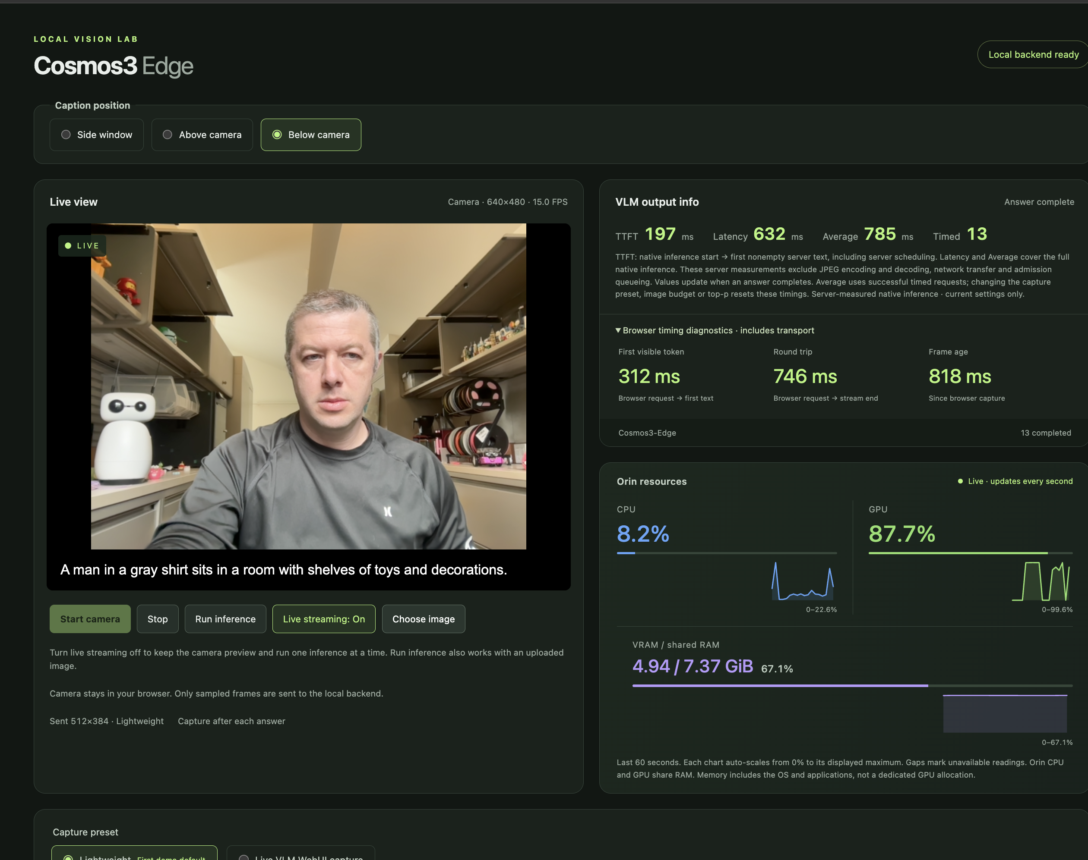
One frame, two timing boundaries
197 ms
Server first text
312 ms
Browser first text
One displayed observation.
The gap is not a Wi-Fi test.
Two hackathons · Cosmos3-Edge on Orin Nano
03
Notes:
Use this screenshot to explain the timer, not to rank engines. The final user screenshot displays server TTFT 197 ms and browser first text 312 ms. The 115 ms gap contains excluded preparation and delivery/scheduling and is not a Wi-Fi-only measurement. Server TTFT starts after JPEG decode/preparation/admission and includes native work plus detokenization and Python consumer scheduling until first nonempty text. It is not a CUDA event. Native whole-answer latency is 632 ms; average 785 ms over 13 timed requests. The input differs from the synthetic controlled TTFT test. Shared RAM is 4.94/7.37 GiB including OS/apps, not dedicated VRAM. The screenshot is supplied by the user and embedded unaltered.
Sources:
output/two-hackathons-evidence/manifest.json
https://github.com/nv-asotelo/porch-dad/blob/935ea4887e19038e93be2bcbe19a5ecbe4777ec5/cosmos3-edge-orin/scripts/cosmos_runtime.py
https://github.com/nv-asotelo/porch-dad/blob/935ea4887e19038e93be2bcbe19a5ecbe4777ec5/cosmos3-edge-orin/results/ui-runtime-controls-browser.json
research/two-hackathon-steering.md

Slide 4
Human steering changed the defaults
Human request | What changed
“Compare fairly” to Live VLM | Prompt, output ceiling and capture preset aligned
Separate image and answer limits | Input budget 320 / 512 / Custom; output cap separate
Remove JPEG and network time | Native server timers; browser diagnostics retained
Restore the first demo | Original lightweight controls; temporary FP16 engine
Measure before switching back | Matched TTFT test, then final MLP INT4 deployment
Final: MLP INT4 with the first demo’s lightweight controls. Exact settings are in the appendix.
Two hackathons · Cosmos3-Edge on Orin Nano
04
Notes:
The first demo used agent-chosen lightweight camera settings, 64 output tokens and greedy decoding. The user asked to match Live VLM WebUI: upstream sample prompt, output cap 512, 1280×720 capture and 30-frame cadence, then to make that preset default. The user also directed HTTPS/Orin hosting, resource graphs, prompt choices, manual inference, live toggle and caption placement. Later, the user explicitly requested image cap 320, static clocks, 256 MiB encoder cache and top-p .95. Those were intermediate settings, superseded after the user reported slower behavior and asked for original lightweight defaults and then the original engine. FP16 was temporarily restored; after a further user request, matched measurement preceded switching back to INT4 MLP. These interventions are part of the result, not evidence of a fully autonomous single attempt.
Sources:
research/two-hackathon-steering.md
https://github.com/nv-asotelo/porch-dad/blob/935ea4887e19038e93be2bcbe19a5ecbe4777ec5/cosmos3-edge-orin/deployment/selected-config.json

Slide 5
Matched time to first text
Same image and prompt. Same controls. Native server boundary.
Engine | Median | p95 | Measured
Original FP16 | 249.5 ms | 250.6 ms | 30
MLP INT4 | 239.3 ms | 240.7 ms | 30
10.2 ms lower median for MLP on this fixture
Five warmups each · 256 visual tokens · cache off · 25 W / dynamic clocks
Sequential runs. One additional logged request started during the MLP run.
Two hackathons · Cosmos3-Edge on Orin Nano
05
Notes:
The controlled comparison follows the user request to measure the original engine while it was loaded, then measure MLP. Five warmups and 30 measured serial requests per engine used the same 512×512 synthetic JPEG and shape/color left/right prompt. Image cap 512 produced 256 actual visual tokens. Output cap 64, temperature 0, top-p 1, cache 0, text reuse disabled, stock 25 W and dynamic clocks match. Original FP16 median server TTFT is 249.50099 ms, p95 250.5663975; MLP is 239.318147 ms, p95 240.71571125. The observed median difference is 10.182843 ms, 4.0813%, on this fixture only. Runs are sequential, not randomized. One additional logged request started during MLP, none during FP16; shared scheduling and clocks can still vary. It is not a statistically generalized model claim or a cross-hackathon comparison.
Sources:
https://github.com/nv-asotelo/porch-dad/blob/935ea4887e19038e93be2bcbe19a5ecbe4777ec5/cosmos3-edge-orin/results/runtime-controls/ttft-comparison.json
https://github.com/nv-asotelo/porch-dad/blob/935ea4887e19038e93be2bcbe19a5ecbe4777ec5/cosmos3-edge-orin/results/runtime-controls/ttft-fp16/receipt.json
https://github.com/nv-asotelo/porch-dad/blob/935ea4887e19038e93be2bcbe19a5ecbe4777ec5/cosmos3-edge-orin/results/runtime-controls/ttft-mlp/receipt.json

Slide 6
Historical gains use different workloads
First campaign, as reported in the supplied write-up
Reported change | Result | What it measures
Decode rate | 22.5 → 76 tokens/s | Generated-token throughput
Process memory | 6.02 → 3.70 GB | Process RSS, not dedicated VRAM
Later repeated-image run | 253 ms median | Complete HTTP answer; 14 median tokens
253 ms to finish an answer and 239 ms to start text are different measurements.
Precision scope, power, input detail and cache behavior also differ. No cross-campaign speed ratio.
Two hackathons · Cosmos3-Edge on Orin Nano
06
Notes:
The first campaign results here are reported by the user-supplied Sept 13–14 HTML, not rebenchmarked in this task. Resident serving plus CUDA graphs and power changes reduced reported cold per-request wall time from 13.91 to 2.07 seconds; that bundled change is not a pure model speedup. Broader text INT4 is reported at 76 output tokens/s versus 22.5 and process RSS 3.70 versus 6.02 GB. Its later 253 ms median is complete HTTP response at median 14 output tokens in a repeated-JPEG harness, where encoder cache reuse was not excluded. Current 239.3 ms is server first text and cannot be divided into 253 to create a speed ratio. Its separate live fit, 200 + 13.49×output tokens, describes 2818 reported rows without committed raw rows; not the same cohort. Dense text quality worsened at image budget 320. The 22.5× headline against a cold-start baseline is intentionally not used as a model-performance claim.
Sources:
research/oneshot-writeup-review.md
research/two-hackathon-branch-comparison.md
output/two-hackathons-evidence/manifest.json
https://github.com/nv-asotelo/porch-dad/tree/1375886c6941caa6f43688e5945c036a584399fe

Slide 7
Stopping rules bounded the search
Trial in this task | Measured change | Decision
Earlier FP16 sampler | 0.48% lower answer latency | Rejected; restored runtime
Compact MLP profile | 1.19% lower answer latency 163.45 MiB less peak shared RAM | Stopped search; kept smaller profile
MLP failed the original 10% acceptance rule.
The agent clarified the rule after measurement: stop pursuing gains below 10%, while retaining the memory benefit.
Known color error remains. Neither global optimality nor general accuracy was established.
Two hackathons · Cosmos3-Edge on Orin Nano
07
Notes:
The original search protected FP16 reference behavior. Broad RTN alternatives failed the diagnostic quality gate. A later FP16 sampler trial improved full-answer latency by 0.48%, below the 10% stopping threshold, so it was rejected and the runtime restored. The user subsequently chose MLP-only INT4 as a new baseline, accepting a known color limitation. Its compact-profile trial reduced aggregate whole-answer median by 1.19% and sampled peak shared RAM by 163.45 MiB. Crucially it FAILED the ORIGINAL frozen acceptance rule. AFTER measurement, the agent reinterpreted the 10% threshold as governing continued search rather than retaining a useful smaller candidate. The search stopped and that smaller candidate remained deployed. The unchanged failed comparison and policy-clarification.json preserve this post-measurement correction. This is not a predeclared acceptance pass. Diagnostic 18/19 facts is a small fixed test, not general accuracy. A later mixed-budget token sweep was interrupted by user steering; no completed fixed/marginal fit is claimed.
Sources:
https://github.com/nv-asotelo/porch-dad/blob/935ea4887e19038e93be2bcbe19a5ecbe4777ec5/cosmos3-edge-orin/research/latency10-follow-up.md
https://github.com/nv-asotelo/porch-dad/blob/935ea4887e19038e93be2bcbe19a5ecbe4777ec5/cosmos3-edge-orin/research/mlp-goal.md
https://github.com/nv-asotelo/porch-dad/blob/935ea4887e19038e93be2bcbe19a5ecbe4777ec5/cosmos3-edge-orin/results/mlp-goal/policy-clarification.json
https://github.com/nv-asotelo/porch-dad/blob/935ea4887e19038e93be2bcbe19a5ecbe4777ec5/cosmos3-edge-orin/results/runtime-controls/token-sweep/interrupted-summary.json

Slide 8
Working demo, explicit tradeoffs
Public NVIDIA stack
Cosmos3-Edge, JetPack and TensorRT-Edge-LLM provide the model and execution foundation.
Task-authored integration
Streaming camera UI, native timing, runtime controls, bounded tuning and evidence.
Live demo on the Orin
https://192.168.6.252:8443/
Two hackathons · Cosmos3-Edge on Orin Nano
08
Notes:
The practical result is a working Orin-hosted camera app with streamed captions, manual/live controls, resource histories, explicit advanced controls, request logs and server timing. NVIDIA provides the pretrained Cosmos3-Edge model, JetPack and TensorRT-Edge-LLM. Live VLM WebUI supplies the workflow reference and prompt text. Task-authored work is integration, original streaming UI, bounded runtime controls, logging, quantization adaptation and scoped GEMV launch tuning; it does not claim invention of the underlying model, quantization method or kernel. To rank the two branches fairly, the next experiment would need a shared quality set and identical power/input/cache/timing contract. This deck does not authorize further optimization or start that experiment. Demo is local HTTPS; existing local certificate may need trust. Public source and exact evidence accompany the presentation.
Sources:
https://github.com/nv-asotelo/porch-dad/blob/935ea4887e19038e93be2bcbe19a5ecbe4777ec5/cosmos3-edge-orin/THIRD_PARTY_NOTICES.md
https://github.com/nv-asotelo/porch-dad/blob/935ea4887e19038e93be2bcbe19a5ecbe4777ec5/cosmos3-edge-orin/research/contribution-ledger.md
https://github.com/nv-asotelo/porch-dad/blob/935ea4887e19038e93be2bcbe19a5ecbe4777ec5/cosmos3-edge-orin/results/runtime-controls/deployment.json
https://github.com/NVIDIA/TensorRT-Edge-LLM
https://github.com/NVIDIA-AI-IOT/live-vlm-webui

Slide 9
Architecture and runtime differences
Axis | First campaign source | Current final deployment
INT4 layers | 169 attention + MLP + head | 56 MLP only
Quantizer / plugin | RTN + MSE clipping / V2 | Symmetric RTN / V1 + N4
Power / clocks | MAXN_SUPER / static | Stock 25 W / dynamic
Image token cap | 320 | 512
Encoder cache | 256 MiB native default¹ | 0
Input / KV capacity | 1536 / 2048 | 1024 / 1664
UI response | Whole-answer JSON | Incremental SSE text
¹ Historical executed cache state is not independently proven. Both retain FP16 components.
Technical appendix · Cosmos3-Edge on Orin Nano
09
Notes:
This table is a source/config comparison, not a reexecution of the first branch. Frozen first branch 1375886 uses 169 eligible linears including attention/MLP/head, stock V2 INT4, group 128 and RTN with per-group MSE clipping. Current uses 56 MLP linears, symmetric RTN group 128 and V1 with a scoped N4 GEMV launch change. Both retain FP16 components. First source native default encoder cache is 256 MiB, but the historical executed cache state is not independently proven. First config input/KV 1536/2048; current 1024/1664. Source audit notes recipe gaps, not demonstrated failures. See linked technical report for full reproducibility detail.
Sources:
research/two-hackathon-branch-comparison.md
results/two-hackathon-branch-comparison.json
https://github.com/nv-asotelo/porch-dad/tree/1375886c6941caa6f43688e5945c036a584399fe
https://github.com/nv-asotelo/porch-dad/blob/935ea4887e19038e93be2bcbe19a5ecbe4777ec5/cosmos3-edge-orin/deployment/selected-config.json

Slide 10
Recorded human and agent interventions
Stage | Intervention and consequence
Hardware bring-up | User recovery-jumper / connection steps; official USB-C flash
Initial assumptions | Agent chose lightweight capture, 64 output tokens, greedy decoding
Fair comparison and UI | Live VLM preset; HTTPS, prompts, graphs, caption controls
Freeze and bounded search | User froze a checkpoint and required 10% continuation gating
Policy correction | Agent kept smaller MLP profile after original acceptance failed
Runtime / timer steering | 320 input cap + cache/clocks trial; then JPEG/network excluded
Rollback and measurement | Stop active sweep; restore lightweight, test FP16, then return to MLP
No measured labor-hours or intervention count is available for the first campaign.
Technical appendix · Cosmos3-Edge on Orin Nano
10
Notes:
This is an abbreviated timeline, not a claim that each row was one user message or a count of all interventions. User reported the recovery jumper state and later confirmed its absence, assisted USB/connectivity/SSH, and offered an isolated auxiliary GPU that did no task work. Records do not establish who removed the jumper or when. The task used official USB recovery flashing with a task-owned Mac bridge. User repeatedly corrected assumptions, requested freezes and set quality/performance priorities. The first campaign separately reports resident-runtime repair, top-k correction, cache/contention checks and INT4 validation, but supplies no original dialogue or labor accounting. The post-measurement MLP policy change was agent clarification, not a newly invented user instruction.
Sources:
research/two-hackathon-steering.md
https://github.com/nv-asotelo/porch-dad/blob/935ea4887e19038e93be2bcbe19a5ecbe4777ec5/cosmos3-edge-orin/research/first-version-journey.md
https://github.com/nv-asotelo/porch-dad/blob/935ea4887e19038e93be2bcbe19a5ecbe4777ec5/cosmos3-edge-orin/results/mlp-goal/policy-clarification.json

Slide 11
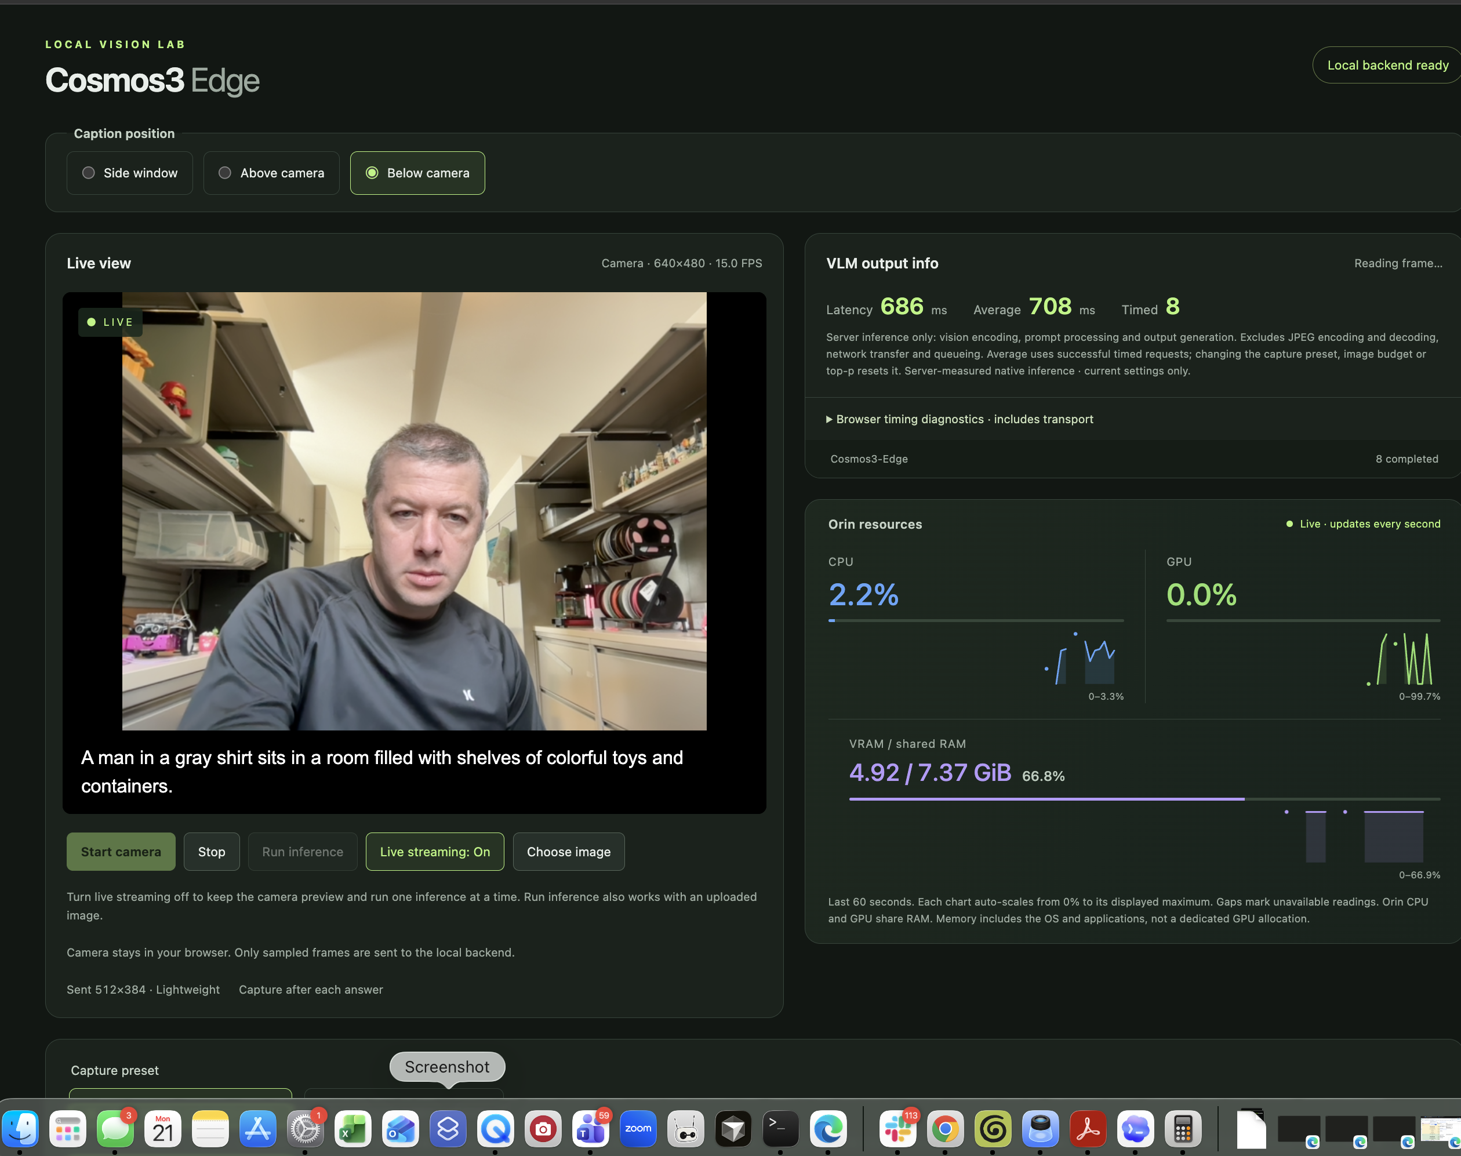
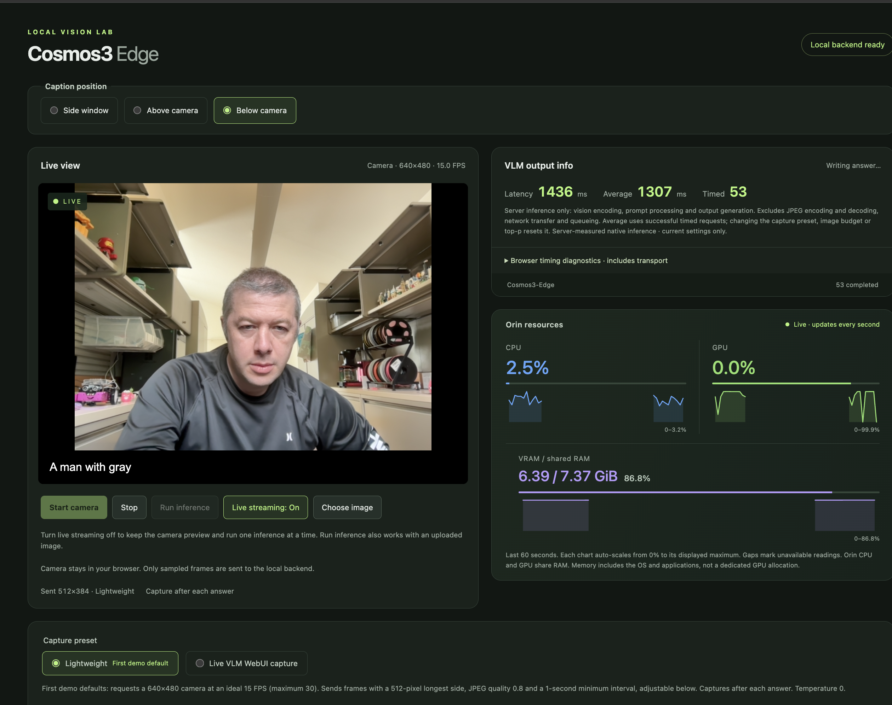
User screenshots are observations
MLP: user’s “Astra Settings” label
Original FP16: user’s “BF16” label
686 ms latency · 708 ms average · n = 8
4.92 / 7.37 GiB shared RAM
1,436 ms latency · 1,307 ms average · n = 53
6.39 / 7.37 GiB shared RAM
All show Lightweight capture. Advanced settings are outside the crop. These are not matched tests.
Technical appendix · Cosmos3-Edge on Orin Nano
11
Notes:
These two other screenshots are embedded unaltered. The first file was labeled INT4 MLP engine Astra Settings and shows native latency 686, average 708, count 8, shared RAM 4.92/7.37 GiB. The second user filename says BF16 original first version, while engine artifacts establish FP16; it shows previous completed native latency 1436, average 1307, count 53, shared RAM 6.39/7.37 GiB with a caption in flight. All three supplied screenshots show Lightweight, 640×480 at 15 FPS and sent 512×384. Advanced settings are outside the visible screenshot so filenames cannot establish image cap/cache/clocks. Changing inputs, token lengths, counts and snapshot times prevent a controlled speed or memory ratio. Shared RAM includes the OS/apps and overlaps process RSS.
Sources:
output/two-hackathons-evidence/manifest.json
research/two-hackathon-steering.md
https://github.com/nv-asotelo/porch-dad/blob/935ea4887e19038e93be2bcbe19a5ecbe4777ec5/cosmos3-edge-orin/results/runtime-controls/deployment.json

Slide 12
Keep each timing boundary explicit
Median on the fixed fixture | FP16 | MLP INT4
Server first text | 249.5 ms | 239.3 ms
Loopback HTTP first text | 267.7 ms | 261.7 ms
Native complete answer | 1,804.6 ms | 1,009.0 ms
Actual output tokens | 37 | 31
Different output lengths prevent a whole-answer engine-speed ratio.
The interrupted token-length sweep produced no finished fixed-ms / marginal-ms-per-token fit.
Historical first-demo HTTP median: 265.54 ms. It uses the broader HTTP boundary.
Technical appendix · Cosmos3-Edge on Orin Nano
12
Notes:
Primary server TTFT begins immediately before native inference after JPEG decode, preparation and admission and ends at first nonempty text observed by the Python consumer. It includes detokenization and consumer scheduling. Native whole-answer timing wraps native execution. Browser JPEG encoding, server JPEG decoding, queue/lock wait and network are excluded from these primary timers. Loopback HTTP starts earlier and includes service preparation and local delivery; browser timing is broader still. Historical first-demo FP16 HTTP p50 265.54 ms is close to the current FP16 267.67 but must not be compared as the same boundary to native 239.32. Whole-answer medians have 37 versus 31 output tokens, so a 44% model speedup claim would be invalid. One extra logged MLP request and an 849.36 ms HTTP maximum are disclosed; causal attribution is not proven. The interrupted length sweep preserved 110 measured client responses plus 12 warmups and 111 measured native rows because one in-flight completion arrived after stop. No fixed-ms or marginal-ms/token fit is published.
Sources:
https://github.com/nv-asotelo/porch-dad/blob/935ea4887e19038e93be2bcbe19a5ecbe4777ec5/cosmos3-edge-orin/results/runtime-controls/ttft-comparison.json
https://github.com/nv-asotelo/porch-dad/blob/935ea4887e19038e93be2bcbe19a5ecbe4777ec5/cosmos3-edge-orin/results/runtime-controls/ttft-mlp/other-requests.jsonl
https://github.com/nv-asotelo/porch-dad/blob/935ea4887e19038e93be2bcbe19a5ecbe4777ec5/cosmos3-edge-orin/results/runtime-controls/token-sweep/interrupted-summary.json

Slide 13
Final defaults and the intermediate trial
Control | Intermediate request | Final first-demo settings
Input image-token cap | 320; 512 and Custom options | 512; 320 and Custom remain
Maximum output tokens | 512, Live VLM reference | 64
Temperature / top-p | 0.7 / 0.95 | 0 / 1 (greedy)
Encoder cache / clocks | 256 MiB / static enabled | 0 / dynamic, stock 25 W
Capture / transmitted side | Live VLM capture preset | 640×480 at 15 FPS / 512 px
JPEG / minimum interval | Capture-preset dependent | 0.8 / 1 second
Input tokens control visual detail. Output tokens cap answer length. They are independent.
Technical appendix · Cosmos3-Edge on Orin Nano
13
Notes:
The final deployment restores the very first lightweight camera and original concise-scene prompt: Describe the visible scene in one concise sentence. Focus on objects and actions. Camera ideal 640×480, ideal 15/max30 FPS, transmitted longest side512, JPEG .8, minimum one second interval, temperature0, top-p1, output cap64, image cap512, encoder cache0, static clocks false at stock25W. The earlier user-requested Live VLM preset remains selectable; switching capture presets preserves edited prompt/output fields, so explicitly select Scene Description and output512 to match the upstream reference. Advanced image options320/512/Custom remain. Intermediate 320/.95/static1/256MiB acceptance had17 successful and4 invalid tests, with 1280×720 actual visual tokens299/480/364 for caps320/512/384. Both tested budgets recognized three objects but invented intent, so no accuracy parity. Final controls are verified against deployment and browser receipts. Changing input budget/top-p resets timing samples; cache/clocks are load-time settings shown read-only.
Sources:
https://github.com/nv-asotelo/porch-dad/blob/935ea4887e19038e93be2bcbe19a5ecbe4777ec5/cosmos3-edge-orin/deployment/selected-config.json
https://github.com/nv-asotelo/porch-dad/blob/935ea4887e19038e93be2bcbe19a5ecbe4777ec5/cosmos3-edge-orin/results/runtime-controls/deployment.json
https://github.com/nv-asotelo/porch-dad/blob/935ea4887e19038e93be2bcbe19a5ecbe4777ec5/cosmos3-edge-orin/results/ui-runtime-controls-browser.json
https://github.com/nv-asotelo/porch-dad/blob/935ea4887e19038e93be2bcbe19a5ecbe4777ec5/cosmos3-edge-orin/results/runtime-controls/validation-routes-fixed.json

Slide 14
Attribution and reproducible evidence
NVIDIA
Model, JetPack and TensorRT-Edge-LLM. Existing encoder, runtime and kernels.
Live VLM WebUI and public contributors
Workflow and prompts. Apache-2.0; public contributors include tokk-nv and chitoku.
Campaign-specific work
Resident serving and broader INT4 in the first campaign. Independent bring-up, streaming UI, runtime controls and measurement in this task.
Pinned source: first 1375886 · current 935ea488 (cosmos3-edge-orin/)
Reports, request logs, image hashes and full source links are in the speaker notes and repository.
Technical appendix · Cosmos3-Edge on Orin Nano
14
Notes:
NVIDIA provides pretrained Cosmos3-Edge under the model card OpenMDW-1.1 terms, TensorRT-Edge-LLM under Apache-2.0, and JetPack/CUDA/TensorRT under their respective terms. Live VLM WebUI is Apache-2.0; public contributors include tokk-nv and chitoku. Its workflow and prompt text inform this task, not reused UI code. Underlying INT4 GEMV retains NVIDIA and MIT HAN Lab notices; task changes include scoped N4 launch tiling, not invention of that kernel or RTN quantization. The first campaign supplied a resident shim, quantizer/runbook and report. Frozen commit metadata records Alex Sotelo and Claude Opus 5 coauthor attribution, not a measured division of labor. Current source public commit935ea488... includes the nested cosmos3-edge-orin subtree. First source is frozen1375886... and was inspected only with user authorization, not executed or reused. Technical write-ups record exact timing receipts, hashes, source paths and reproduction gaps. No internal communications, repositories or assets were used.
Sources:
https://huggingface.co/nvidia/Cosmos3-Edge
https://github.com/NVIDIA/TensorRT-Edge-LLM
https://github.com/NVIDIA-AI-IOT/live-vlm-webui
https://github.com/nv-asotelo/porch-dad/blob/935ea4887e19038e93be2bcbe19a5ecbe4777ec5/cosmos3-edge-orin/THIRD_PARTY_NOTICES.md
https://github.com/nv-asotelo/porch-dad/blob/935ea4887e19038e93be2bcbe19a5ecbe4777ec5/cosmos3-edge-orin/research/contribution-ledger.md
research/oneshot-writeup-review.md
research/two-hackathon-branch-comparison.md
https://github.com/nv-asotelo/porch-dad/tree/1375886c6941caa6f43688e5945c036a584399fe

