Slide 1
Cosmos3-Edge on
Jetson Orin Nano
Public implementation and measured findings
Selected configuration: fp16-corrected-i1024-kv2048
2026-09-20
Notes:
Original presentation design. A final label requires explicit selected-candidate and completed-soak evidence.
Measured values supplied by output/final-findings-data.json.
Sources:
results/optimization-selection.json
results/raw/soak-final-service-01.summary.json

Slide 2
Installed hardware and software
Component | Observed configuration
Device | Jetson Orin Nano P3767-0005 8 GB shared RAM
Storage and mode | WD_BLACK SN7100 1 TB Stock 25 W, ID1
Operating system | JetPack 7.2.1, L4T 39.2.1 Kernel 6.8.12-1021-tegra
Compute libraries | CUDA nvcc13.2.86, TensorRT 10.16.2.10
Installation evidence | Verified USB-C QSPI + NVMe flash Verified NVMe boot and CUDA calculation
Official NVIDIA flash tools ran through an original SSH/NFS transport bridge.
Measured findings, 2026-09-20
2
Notes:
Installed platform facts come from the actual device receipts. Advertised RAM and Linux MemTotal are distinct.
Measured values supplied by output/final-findings-data.json.
Sources:
results/normal-boot.json
results/jetpack-flash-status.json
results/installed-compute-packages.json
https://developer.nvidia.com/embedded/jetpack/downloads

Slide 3
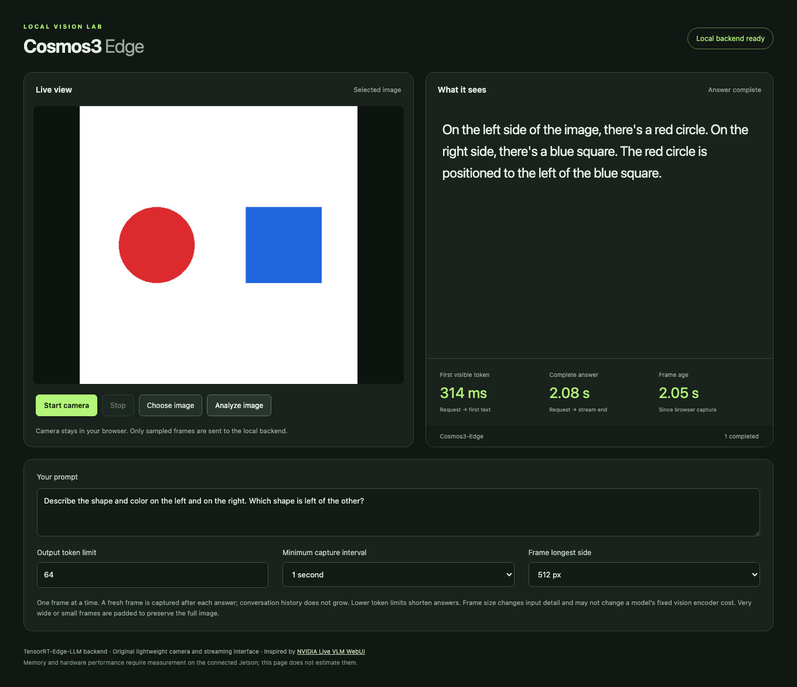
Streaming browser interface
Browser checks
Streaming: Pass
Stop and restart: Pass
Synthetic camera: Pass
Web access
http://localhost:8090
Actual Orin service through the Mac SSH tunnel
Measured findings, 2026-09-20
3
Notes:
Original UI and actual inference screenshot. Crop removes lower settings only. Screenshot timing is one request, not the benchmark distribution. The screenshot does not establish general image accuracy.
Measured values supplied by output/final-findings-data.json.
Sources:
results/browser-live-ui-final.json
results/browser-live-ui-final.json
results/browser-camera-ui-final.json
https://github.com/NVIDIA-AI-IOT/live-vlm-webui

Slide 4
Request and inference path
Stage | Responsibility | Source
Browser | Capture JPEG, prompt and sampling settings | Original UI
Orin HTTP proxy | Forward one request and stream SSE events | Original proxy
Resident backend | Decode image, run vision and language engines | TensorRT Edge-LLM
Checkpoint | Learned image and language behavior | NVIDIA Cosmos3-Edge
Browser response | Incremental text, timing and cancellation | Original UI
The webpage runs on the Orin. Access through a tunnel remains a transport detail.
Measured findings, 2026-09-20
4
Notes:
Original browser/proxy components wrap the public TensorRT Edge-LLM reasoner. One active request prevents accumulating frames. The application displays only real upstream token deltas.
Measured values supplied by output/final-findings-data.json.
Sources:
scripts/serve_ui.py
web/app.js
https://github.com/NVIDIA/TensorRT-Edge-LLM/blob/e8b29522938901f6df19ebeedd4b69bc8edbcd97/experimental/server/cli.py
https://github.com/NVIDIA/TensorRT-Edge-LLM/blob/e8b29522938901f6df19ebeedd4b69bc8edbcd97/experimental/server/runtime/engine.py

Slide 5
Compatibility and correctness repairs
Observed defect | Task contribution using public conventions
Generated runtime sidecars | Restore existing RoPE aliases and image/video delimiters
HWC weights with CHW pixels | Apply the public exporter’s patch-weight column permutation
Position interpolation | Select the Cosmos half-pixel convention in the existing kernel
Independent image cache | Expose its existing byte budget and set it to zero for measurement
NVIDIA supplies the model, runtime and underlying conventions. This task repairs their integration.
Measured findings, 2026-09-20
5
Notes:
These original diagnoses and small integrations reuse the public model/exporter conventions. No model training or new interpolation algorithm is claimed. Patch projection requires a fresh visual engine. Position and cache API changes require rebuilding the native binding.
Measured values supplied by output/final-findings-data.json.
Sources:
patches/cosmos3-patch-embedding-chw.md
patches/cosmos3-half-pixel-position.md
patches/encoder-cache-budget.json
scripts/repair_cosmos_runtime_config.py
scripts/repair_cosmos_chat_template.py
https://github.com/NVIDIA/TensorRT-Edge-LLM/blob/e8b29522938901f6df19ebeedd4b69bc8edbcd97/tensorrt_edgellm/models/cosmos3_reasoner/modeling_cosmos3_reasoner_visual.py
https://github.com/huggingface/transformers/blob/c587bc884db2c2e31fc2b8102314656b17aa07b1/src/transformers/models/cosmos3_edge/modeling_cosmos3_edge.py

Slide 6

Quality checks and their limits
18 / 19 synthetic facts
Strict screen: Fail
Reference equivalence: Accepted
Both paths describe the flat circles as spheres.
Natural photos
Official answer identical: Yes
All previously correct facts must remain correct. No additional false claim is permitted.
5/9 with partial credit.
0/3 fully correct photos.
Official reference also 5/9.
2/3 answers match exactly.
Cause remains unassigned.
Measured findings, 2026-09-20
6
Notes:
Strict six-image fixture grading and optimization equivalence are separate. The official unmodified model reproduced the entire case05 sphere answer on the exact image and prompt. A pre-INT4 policy preserves every previously correct fact and permits only that precise known error. It does not turn the strict 18/19 result into a 19/19 pass.
The distinct natural-photo smoke check is outside candidate selection. Fully correct photos means every required observation is correct, not merely a completed HTTP response. The natural-image official reference runs the unchanged public model through Transformers on Mac MPS FP16. It scores 5/9 with the same grading interpretation, with 2/3 answers exactly matching the Orin. In the recorded comparison, market gives only "Carrots." and dog incorrectly says "wooden deck" in both paths. The cap/mitt wording differs but both miss the required cap-on-mitt relation. The displayed 5/9 gives generous partial credit for carrot identity even though "Carrots." omits the required lower-right relation. Strict full-fact grading is 4/9. No photo satisfies every required fact under either interpretation. These observations do not establish a model-only cause for every failure. Mac execution time is diagnostic and is not an Orin performance measurement.
Captured official reference answer: Both objects are purple. The left object, which is a sphere, is larger than the right object, which is a smaller sphere.
Measured values supplied by output/final-findings-data.json.
Sources:
results/quality-final-service-01-review.json
results/optimization-quality-policy.json
results/reference-official-05-comparison.json
results/natural-smoke-final-01-review.json
results/reference-natural-smoke.json
benchmarks/natural-smoke/manifest.json
benchmarks/natural-smoke/README.md
results/reference-official-05.json
https://huggingface.co/nvidia/Cosmos3-Edge/blob/344d602b128d1bbdacb43b08d0a3626f46343e29/README.md

Slide 7
Measurement workload and stopping rule
Fixed workload
Baseline runtime profile
512 × 512 JPEG
Output ceiling: 64 tokens
Temperature 0, top_p 1
5 warmups, 30 measured requests
Input 1024, KV 2048, batch 1
Encoder cache: 0 bytes
Text context reuse: Off
At most 5 candidates. Stop after 3 consecutive non-improvements.
Require at least 5% lower p50 latency or peak memory, with no greater than 5% regression in the counterpart or p95 latency. Reject errors, OOM and swapping.
Measured findings, 2026-09-20
7
Notes:
Warmups remain separate from measured requests. TTFT starts at request dispatch and ends on the first nonempty text delta. Completion token counts must come from real backend usage. Equivalent-quality qualification is an overlay referencing unchanged raw measurements.
Measured values supplied by output/final-findings-data.json.
Sources:
research/benchmark-method.md
GOAL.md
results/benchmark-fp16-qualified.jsonl
results/raw/benchmark-fp16-reference-01.jsonl
results/optimization-quality-policy.json
results/optimization-search-plan.json

Slide 8
Measured FP16 baseline
Latency | p50 | p95
First visible text | 266.3 ms | 271.7 ms
Complete answer | 1830.4 ms | 1834.9 ms
20.21 tokens/s
End-to-end throughput
37 completion tokens
Shared RAM unavailable peak: 6.38 GiB
Process RSS peak: 5.90 GiB
Errors: 0 OOM: No Swap activity: No
Measured findings, 2026-09-20
8
Notes:
The qualification overlay references the original 35-request run, rather than recording a second measurement. Original raw SHA256: 3ecce48f18c461161a99368c221dc87abc43a8cb1e1a7c1b199f46f8d7d65417. Shared unavailable memory equals MemTotal minus MemAvailable. RSS is the process resident set. These overlapping counters must never be added.
Measured values supplied by output/final-findings-data.json.
Sources:
results/benchmark-fp16-qualified.jsonl
results/raw/benchmark-fp16-reference-01.jsonl
results/optimization-quality-policy.json

Slide 9
Original CPU INT4 conversion
2.22 GiB
First trial: all language linears
Uncalibrated RTN quantizes language linear weights and the LM head. Vision, projector and embedding tensors stay FP16.
Checkpoint file on disk
169 language linear modules
Group size 128
Native INT4 V1 kernels
GPTQ-compatible storage
The storage layout lets the pinned builder load RTN values. It makes no claim of GPTQ or AWQ optimization.
Checkpoint size is distinct from measured resident RAM, allocation and latency.
Measured findings, 2026-09-20
9
Notes:
Group-128 symmetric round-to-nearest with stored FP16 scales and signed values -7 through 7. RTN_GPTQ dispatch describes RTN values in GPTQ-compatible packing. No GPTQ optimization, AWQ optimization, calibration dataset, GPU conversion or community checkpoint was used. Source shards stayed read-only. The exact public parser and V1/V2 repackers passed CPU tests.
Measured values supplied by output/final-findings-data.json.
Sources:
results/rtn-cpu-validation.json
scripts/quantize_cosmos3_rtn.py
scripts/rtn_backend.py
tests/test_rtn_quantization.py
https://github.com/NVIDIA/TensorRT-Edge-LLM/blob/e8b29522938901f6df19ebeedd4b69bc8edbcd97/experimental/builder/weight_packing/int4.py
https://github.com/NVIDIA/TensorRT-Edge-LLM/blob/e8b29522938901f6df19ebeedd4b69bc8edbcd97/experimental/builder/core/quantization.py

Slide 10
Baseline, first INT4 trial and selection
Metric | FP16 baseline | First RTN: rejected | Final selected
TTFT p50 / p95 | 266.3 ms / 271.7 ms | 266.7 ms / 269.6 ms | 265.5 ms / 267.4 ms
Answer p50 / p95 | 1830.4 ms / 1834.9 ms | 1228.8 ms / 1234.2 ms | 1825.9 ms / 1830.0 ms
Shared RAM peak¹ | 6.38 GiB | 4.20 GiB | 6.43 GiB
Strict quality facts | 18/19 | 13/19 | 18/19
Reference equivalence | Pass | Fail | Pass
Selected: fp16-corrected-i1024-kv2048
¹ System RAM unavailable. Quality rejection takes precedence over latency or memory gains.
Measured findings, 2026-09-20
10
Notes:
First INT4 execution status: rejected. 13/19 facts; new errors and token-limit truncation.. Selection: fp16-corrected-i1024-kv2048. Identical workload fingerprints and memory counters are required for comparisons. The selected column is a separate final verification after swap was disabled; search-trial measurements remain unchanged. Rejected RTN measurements describe a tradeoff and cannot qualify it for selection. Strict quality and reference-equivalent quality remain separate.
Measured values supplied by output/final-findings-data.json.
Sources:
results/benchmark-fp16-qualified.jsonl
results/raw/benchmark-rtn-v1-rejected-01.jsonl
results/raw/benchmark-final-service-01.jsonl
results/optimization-quality-policy.json

Slide 11
Bounded search and memory constraints
Candidate | Result | Facts | p50 answer | RAM peak¹
FP16 reference | Selected | 18/19 | 1830.4 ms | 6.38 GiB
RTN INT4 all linears | Rejected | 13/19 | 1228.8 ms | 4.20 GiB
RTN INT4 MLP only | Rejected | 18/19 | 1026.6 ms | 5.01 GiB
FP16 fixed clocks | Rejected | 18/19 | 1758.3 ms | 6.35 GiB
Linux exposes 7.37 GiB shared physical RAM. Selected process RSS peak: 5.91 GiB.
¹ MemTotal − MemAvailable overlaps process RSS. Never add them.
CUDA allocator telemetry: not collected. Disk sizes measure storage.
Measured findings, 2026-09-20
11
Notes:
Orin Nano uses unified physical RAM for CPU and GPU. MemTotal minus MemAvailable includes CPU, GPU and system pressure. Process RSS and CUDA allocator telemetry answer different questions and overlap. Disk checkpoint/engine size is separate from memory. Missing allocator telemetry is explicitly unavailable.
Measured values supplied by output/final-findings-data.json.
Sources:
GOAL.md
research/fp16-build-memory.md
results/benchmark-fp16-qualified.jsonl
results/raw/benchmark-rtn-v1-rejected-01.jsonl
results/raw/benchmark-final-service-01.jsonl
results/optimization-search-plan.json
results/benchmark-fp16-qualified.jsonl
results/raw/benchmark-rtn-v1-rejected-01.jsonl
results/raw/benchmark-rtn-mlp-rejected-01.jsonl
results/raw/benchmark-fp16-clocks-01.jsonl

Slide 12
Selected configuration and sustained run
fp16-corrected-i1024-kv2048
FP16 preserves reference quality. Both INT4 variants add errors; fixed clocks miss the 5% gain and swap gate.
FP16 · dynamic stock 25 W · swap disabled
FP16 retained. Final service verification is separate from the four search trials.
Sustained-run check | Observed result
Duration and successful requests | 601 seconds / 366 requests
Minimum MemAvailable | 0.94 GiB
Errors / OOM / swap | 0 / No / No
Candidates considered: 4. Stop reason: Stopped after three consecutive non-improvements.
Measured findings, 2026-09-20
12
Notes:
This is a bounded observed selection, not a claim of a global optimum. Final export requires a 10-minute soak, no errors/OOM/swapping, at least 512 MiB minimum MemAvailable, and explicit candidate selection. Compare latency/memory improvement only under the same declared memory counter and workload.
Measured values supplied by output/final-findings-data.json.
Sources:
results/optimization-selection.json
results/raw/benchmark-final-service-01.jsonl
results/raw/soak-final-service-01.summary.json
GOAL.md
results/optimization-search-plan.json

Slide 13
Upstream contributions and licenses
Project / team | Contribution | Terms
NVIDIA Cosmos3-Edge | Pretrained model and tokenizer | OpenMDW-1.1
TensorRT Edge-LLM | Runtime, builders and kernels | Apache-2.0
live-vlm-webui contributors | Public interaction reference | Apache-2.0
PyTorch / Transformers | Official-model reference execution | Component licenses
Original task integration | UI, transport, repairs, measurements, RTN | Apache-2.0
Public repository contributors
UI: tokk-nv, chitoku
Runtime: nvluxiaoz, ever-wong, jhalabi-nv, nvxingkaiz, JCalafato, poweiw
Measured findings, 2026-09-20
13
Notes:
Repository contributors are public contribution credits, not assigned individual ownership of each feature. NVIDIA owns the model/runtime contributions. Original task code is Apache-2.0. Model OpenMDW-1.1, JetPack/CUDA/TensorRT terms and bundled dependency licenses remain separate. Paramiko LGPL-2.1 supports the optional SSH bridge. NumPy uses BSD-3-Clause and Pillow MIT-CMU. Official PyTorch and Transformers supply reference execution. PyTorch wheels retain all bundled license notices, beyond its main BSD-style license. See the contribution ledger for exact public evidence.
Measured values supplied by output/final-findings-data.json.
Sources:
research/contribution-ledger.md
THIRD_PARTY_NOTICES.md
https://huggingface.co/nvidia/Cosmos3-Edge/blob/344d602b128d1bbdacb43b08d0a3626f46343e29/README.md
https://github.com/NVIDIA/TensorRT-Edge-LLM/blob/e8b29522938901f6df19ebeedd4b69bc8edbcd97/LICENSE
https://github.com/NVIDIA-AI-IOT/live-vlm-webui
https://github.com/huggingface/transformers/blob/c587bc884db2c2e31fc2b8102314656b17aa07b1/LICENSE
https://github.com/pytorch/pytorch/blob/cf30153c4c131c8164ee7798e5022d810682e2cb/LICENSE
https://github.com/NVIDIA/TensorRT-Edge-LLM/commit/e8b29522938901f6df19ebeedd4b69bc8edbcd97

Slide 14
Limits and reproduction
Quality: 18/19 synthetic facts; natural photos 5/9 with partial credit, 0/3 fully correct.
Streaming checks passed. Natural-video and temporal understanding remain untested.
Small inputs are padded around a documented position-interpolation limit.
RAM and RSS overlap. CUDA allocator peak was not collected.
NVMe timeouts recur at cold load. Service recovers; storage issue remains unresolved.
Build selected engines
Native runtime + engine build:
docs/backend-build.md
Section 4, selected FP16
Serve on the Orin
sudo systemctl start cosmos-edge-backend cosmos-edge-ui
Repeat the measured workload
scripts/benchmark.py
Invocation and fixed settings:
research/benchmark-method.md
Measured findings, 2026-09-20
14
Notes:
Commands are supplied from the selected validated deployment. Exact source/model revisions, conversion receipts, patch hashes, engine receipts and raw benchmark files preserve provenance. The source corpus contains public code and original task assets only. No personal-namespace project or internal repository was used.
Measured values supplied by output/final-findings-data.json.
Sources:
docs/backend-build.md
sources.lock.json
docs/quality-workload.md
patches/cosmos3-half-pixel-position.md

