Slide 1
Cosmos3-Edge on
Jetson Orin Nano
Public implementation and measured findings
Selected configuration: fp16-corrected-i1024-kv2048
2026-09-20
Notes:
Original presentation design. A final label requires explicit selected-candidate and completed-soak evidence.
Measured values supplied by output/final-findings-data.json.
Sources:
results/optimization-selection.json
results/raw/soak-final-service-01.summary.json

Slide 2
Installed hardware and software
Component | Observed configuration
Device | Jetson Orin Nano P3767-0005 8 GB shared RAM
Storage and mode | WD_BLACK SN7100 1 TB Stock 25 W, ID1
Operating system | JetPack 7.2.1, L4T 39.2.1 Kernel 6.8.12-1021-tegra
Compute libraries | CUDA nvcc13.2.86, TensorRT 10.16.2.10
Installation evidence | Verified USB-C QSPI + NVMe flash Verified NVMe boot and CUDA calculation
Official NVIDIA flash tools ran through an original SSH/NFS transport bridge.
Measured findings, 2026-09-20
2
Notes:
Installed platform facts come from the actual device receipts. Advertised RAM and Linux MemTotal are distinct.
Measured values supplied by output/final-findings-data.json.
Sources:
results/normal-boot.json
results/jetpack-flash-status.json
results/installed-compute-packages.json
https://developer.nvidia.com/embedded/jetpack/downloads

Slide 3
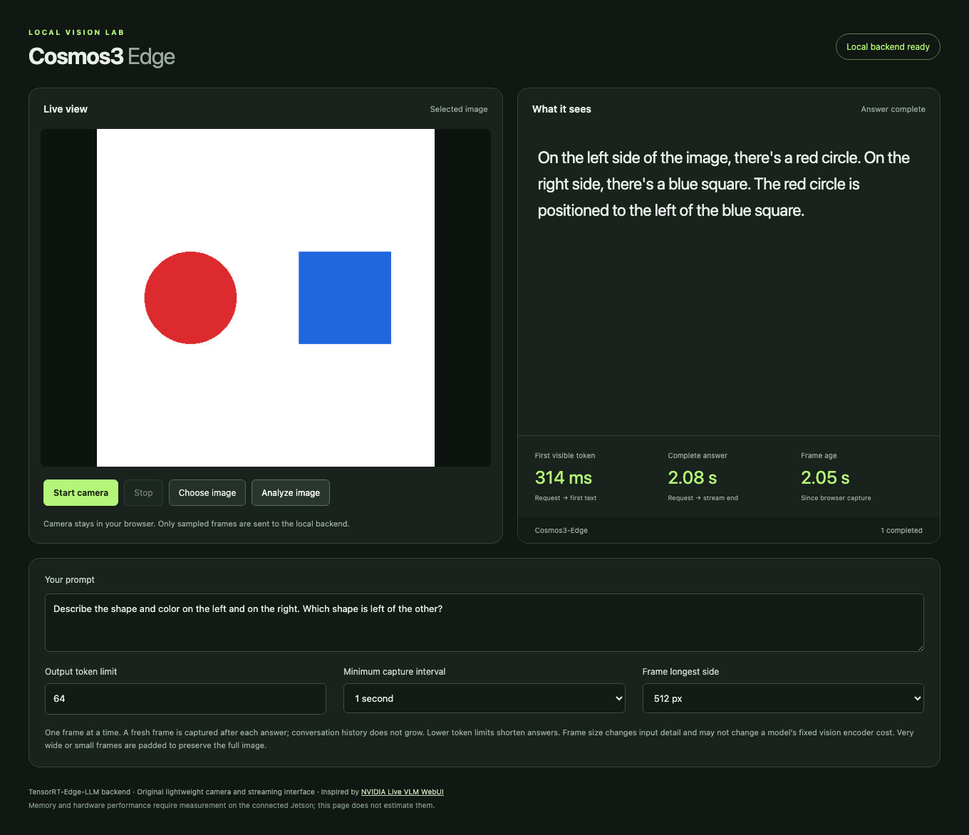
Streaming browser interface
Browser checks
Streaming: Pass
Stop and restart: Pass
Synthetic camera: Pass
Web access
http://localhost:8090
Actual Orin service through the Mac SSH tunnel
Measured findings, 2026-09-20
3
Notes:
Original UI and actual inference screenshot. Crop removes lower settings only. Screenshot timing is one request, not the benchmark distribution. The screenshot does not establish general image accuracy.
Measured values supplied by output/final-findings-data.json.
Sources:
results/browser-live-ui-final.json
results/browser-live-ui-final.json
results/browser-camera-ui-final.json
https://github.com/NVIDIA-AI-IOT/live-vlm-webui

Slide 4
Request and inference path
Stage | Responsibility | Source
Browser | Capture JPEG, prompt and sampling settings | Original UI
Orin HTTP proxy | Forward one request and stream SSE events | Original proxy
Resident backend | Decode image, run vision and language engines | TensorRT Edge-LLM
Checkpoint | Learned image and language behavior | NVIDIA Cosmos3-Edge
Browser response | Incremental text, timing and cancellation | Original UI
The webpage runs on the Orin. Access through a tunnel remains a transport detail.
Measured findings, 2026-09-20
4
Notes:
Original browser/proxy components wrap the public TensorRT Edge-LLM reasoner. One active request prevents accumulating frames. The application displays only real upstream token deltas.
Measured values supplied by output/final-findings-data.json.
Sources:
scripts/serve_ui.py
web/app.js
https://github.com/NVIDIA/TensorRT-Edge-LLM/blob/e8b29522938901f6df19ebeedd4b69bc8edbcd97/experimental/server/cli.py
https://github.com/NVIDIA/TensorRT-Edge-LLM/blob/e8b29522938901f6df19ebeedd4b69bc8edbcd97/experimental/server/runtime/engine.py

Slide 5
Compatibility and correctness repairs
Observed defect | Task contribution using public conventions
Generated runtime sidecars | Restore existing RoPE aliases and image/video delimiters
HWC weights with CHW pixels | Apply the public exporter’s patch-weight column permutation
Position interpolation | Select the Cosmos half-pixel convention in the existing kernel
Independent image cache | Expose its existing byte budget and set it to zero for measurement
NVIDIA supplies the model, runtime and underlying conventions. This task repairs their integration.
Measured findings, 2026-09-20
5
Notes:
These original diagnoses and small integrations reuse the public model/exporter conventions. No model training or new interpolation algorithm is claimed. Patch projection requires a fresh visual engine. Position and cache API changes require rebuilding the native binding.
Measured values supplied by output/final-findings-data.json.
Sources:
patches/cosmos3-patch-embedding-chw.md
patches/cosmos3-half-pixel-position.md
patches/encoder-cache-budget.json
scripts/repair_cosmos_runtime_config.py
scripts/repair_cosmos_chat_template.py
https://github.com/NVIDIA/TensorRT-Edge-LLM/blob/e8b29522938901f6df19ebeedd4b69bc8edbcd97/tensorrt_edgellm/models/cosmos3_reasoner/modeling_cosmos3_reasoner_visual.py
https://github.com/huggingface/transformers/blob/c587bc884db2c2e31fc2b8102314656b17aa07b1/src/transformers/models/cosmos3_edge/modeling_cosmos3_edge.py

Slide 6

Quality checks and their limits
18 / 19 synthetic facts
Strict screen: Fail
Reference equivalence: Accepted
Both paths describe the flat circles as spheres.
Natural photos
Official answer identical: Yes
All previously correct facts must remain correct. No additional false claim is permitted.
5/9 with partial credit.
0/3 fully correct photos.
Official reference also 5/9.
2/3 answers match exactly.
Cause remains unassigned.
Measured findings, 2026-09-20
6
Notes:
Strict six-image fixture grading and optimization equivalence are separate. The official unmodified model reproduced the entire case05 sphere answer on the exact image and prompt. A pre-INT4 policy preserves every previously correct fact and permits only that precise known error. It does not turn the strict 18/19 result into a 19/19 pass.
The distinct natural-photo smoke check is outside candidate selection. Fully correct photos means every required observation is correct, not merely a completed HTTP response. The natural-image official reference runs the unchanged public model through Transformers on Mac MPS FP16. It scores 5/9 with the same grading interpretation, with 2/3 answers exactly matching the Orin. In the recorded comparison, market gives only "Carrots." and dog incorrectly says "wooden deck" in both paths. The cap/mitt wording differs but both miss the required cap-on-mitt relation. The displayed 5/9 gives generous partial credit for carrot identity even though "Carrots." omits the required lower-right relation. Strict full-fact grading is 4/9. No photo satisfies every required fact under either interpretation. These observations do not establish a model-only cause for every failure. Mac execution time is diagnostic and is not an Orin performance measurement.
Captured official reference answer: Both objects are purple. The left object, which is a sphere, is larger than the right object, which is a smaller sphere.
Measured values supplied by output/final-findings-data.json.
Sources:
results/quality-final-service-01-review.json
results/optimization-quality-policy.json
results/reference-official-05-comparison.json
results/natural-smoke-final-01-review.json
results/reference-natural-smoke.json
benchmarks/natural-smoke/manifest.json
benchmarks/natural-smoke/README.md
results/reference-official-05.json
https://huggingface.co/nvidia/Cosmos3-Edge/blob/344d602b128d1bbdacb43b08d0a3626f46343e29/README.md

Slide 7
Measurement workload and stopping rule
Fixed workload
Baseline runtime profile
512 × 512 JPEG
Output ceiling: 64 tokens
Temperature 0, top_p 1
5 warmups, 30 measured requests
Input 1024, KV 2048, batch 1
Encoder cache: 0 bytes
Text context reuse: Off
At most 5 candidates. Stop after 3 consecutive non-improvements.
Require at least 5% lower p50 latency or peak memory, with no greater than 5% regression in the counterpart or p95 latency. Reject errors, OOM and swapping.
Measured findings, 2026-09-20
7
Notes:
Warmups remain separate from measured requests. TTFT starts at request dispatch and ends on the first nonempty text delta. Completion token counts must come from real backend usage. Equivalent-quality qualification is an overlay referencing unchanged raw measurements.
Measured values supplied by output/final-findings-data.json.
Sources:
research/benchmark-method.md
GOAL.md
results/benchmark-fp16-qualified.jsonl
results/raw/benchmark-fp16-reference-01.jsonl
results/optimization-quality-policy.json
results/optimization-search-plan.json

Slide 8
Measured FP16 baseline
Latency | p50 | p95
First visible text | 266.3 ms | 271.7 ms
Complete answer | 1830.4 ms | 1834.9 ms
20.21 tokens/s
End-to-end throughput
37 completion tokens
Shared RAM unavailable peak: 6.38 GiB
Process RSS peak: 5.90 GiB
Errors: 0 OOM: No Swap activity: No
Measured findings, 2026-09-20
8
Notes:
The qualification overlay references the original 35-request run, rather than recording a second measurement. Original raw SHA256: 3ecce48f18c461161a99368c221dc87abc43a8cb1e1a7c1b199f46f8d7d65417. Shared unavailable memory equals MemTotal minus MemAvailable. RSS is the process resident set. These overlapping counters must never be added.
Measured values supplied by output/final-findings-data.json.
Sources:
results/benchmark-fp16-qualified.jsonl
results/raw/benchmark-fp16-reference-01.jsonl
results/optimization-quality-policy.json

Slide 9
Original CPU INT4 conversion
2.22 GiB
First trial: all language linears
Uncalibrated RTN quantizes language linear weights and the LM head. Vision, projector and embedding tensors stay FP16.
Checkpoint file on disk
169 language linear modules
Group size 128
Native INT4 V1 kernels
GPTQ-compatible storage
The storage layout lets the pinned builder load RTN values. It makes no claim of GPTQ or AWQ optimization.
Checkpoint size is distinct from measured resident RAM, allocation and latency.
Measured findings, 2026-09-20
9
Notes:
Group-128 symmetric round-to-nearest with stored FP16 scales and signed values -7 through 7. RTN_GPTQ dispatch describes RTN values in GPTQ-compatible packing. No GPTQ optimization, AWQ optimization, calibration dataset, GPU conversion or community checkpoint was used. Source shards stayed read-only. The exact public parser and V1/V2 repackers passed CPU tests.
Measured values supplied by output/final-findings-data.json.
Sources:
results/rtn-cpu-validation.json
scripts/quantize_cosmos3_rtn.py
scripts/rtn_backend.py
tests/test_rtn_quantization.py
https://github.com/NVIDIA/TensorRT-Edge-LLM/blob/e8b29522938901f6df19ebeedd4b69bc8edbcd97/experimental/builder/weight_packing/int4.py
https://github.com/NVIDIA/TensorRT-Edge-LLM/blob/e8b29522938901f6df19ebeedd4b69bc8edbcd97/experimental/builder/core/quantization.py

Slide 10
Baseline, first INT4 trial and selection
Metric | FP16 baseline | First RTN: rejected | Final selected
TTFT p50 / p95 | 266.3 ms / 271.7 ms | 266.7 ms / 269.6 ms | 265.5 ms / 267.4 ms
Answer p50 / p95 | 1830.4 ms / 1834.9 ms | 1228.8 ms / 1234.2 ms | 1825.9 ms / 1830.0 ms
Shared RAM peak¹ | 6.38 GiB | 4.20 GiB | 6.43 GiB
Strict quality facts | 18/19 | 13/19 | 18/19
Reference equivalence | Pass | Fail | Pass
Selected: fp16-corrected-i1024-kv2048
¹ System RAM unavailable. Quality rejection takes precedence over latency or memory gains.
Measured findings, 2026-09-20
10
Notes:
First INT4 execution status: rejected. 13/19 facts; new errors and token-limit truncation.. Selection: fp16-corrected-i1024-kv2048. Identical workload fingerprints and memory counters are required for comparisons. The selected column is a separate final verification after swap was disabled; search-trial measurements remain unchanged. Rejected RTN measurements describe a tradeoff and cannot qualify it for selection. Strict quality and reference-equivalent quality remain separate.
Measured values supplied by output/final-findings-data.json.
Sources:
results/benchmark-fp16-qualified.jsonl
results/raw/benchmark-rtn-v1-rejected-01.jsonl
results/raw/benchmark-final-service-01.jsonl
results/optimization-quality-policy.json

Slide 11
Bounded search and memory constraints
Candidate | Result | Facts | p50 answer | RAM peak¹
FP16 reference | Selected | 18/19 | 1830.4 ms | 6.38 GiB
RTN INT4 all linears | Rejected | 13/19 | 1228.8 ms | 4.20 GiB
RTN INT4 MLP only | Rejected | 18/19 | 1026.6 ms | 5.01 GiB
FP16 fixed clocks | Rejected | 18/19 | 1758.3 ms | 6.35 GiB
Linux exposes 7.37 GiB shared physical RAM. Selected process RSS peak: 5.91 GiB.
¹ MemTotal − MemAvailable overlaps process RSS. Never add them.
CUDA allocator telemetry: not collected. Disk sizes measure storage.
Measured findings, 2026-09-20
11
Notes:
Orin Nano uses unified physical RAM for CPU and GPU. MemTotal minus MemAvailable includes CPU, GPU and system pressure. Process RSS and CUDA allocator telemetry answer different questions and overlap. Disk checkpoint/engine size is separate from memory. Missing allocator telemetry is explicitly unavailable.
Measured values supplied by output/final-findings-data.json.
Sources:
GOAL.md
research/fp16-build-memory.md
results/benchmark-fp16-qualified.jsonl
results/raw/benchmark-rtn-v1-rejected-01.jsonl
results/raw/benchmark-final-service-01.jsonl
results/optimization-search-plan.json
results/benchmark-fp16-qualified.jsonl
results/raw/benchmark-rtn-v1-rejected-01.jsonl
results/raw/benchmark-rtn-mlp-rejected-01.jsonl
results/raw/benchmark-fp16-clocks-01.jsonl

Slide 12
Selected configuration and sustained run
fp16-corrected-i1024-kv2048
FP16 preserves reference quality. Both INT4 variants add errors; fixed clocks miss the 5% gain and swap gate.
FP16 · dynamic stock 25 W · swap disabled
FP16 retained. Final service verification is separate from the four search trials.
Sustained-run check | Observed result
Duration and successful requests | 601 seconds / 366 requests
Minimum MemAvailable | 0.94 GiB
Errors / OOM / swap | 0 / No / No
Candidates considered: 4. Stop reason: Stopped after three consecutive non-improvements.
Measured findings, 2026-09-20
12
Notes:
This is a bounded observed selection, not a claim of a global optimum. Final export requires a 10-minute soak, no errors/OOM/swapping, at least 512 MiB minimum MemAvailable, and explicit candidate selection. Compare latency/memory improvement only under the same declared memory counter and workload.
Measured values supplied by output/final-findings-data.json.
Sources:
results/optimization-selection.json
results/raw/benchmark-final-service-01.jsonl
results/raw/soak-final-service-01.summary.json
GOAL.md
results/optimization-search-plan.json

Slide 13
Upstream contributions and licenses
Project / team | Contribution | Terms
NVIDIA Cosmos3-Edge | Pretrained model and tokenizer | OpenMDW-1.1
TensorRT Edge-LLM | Runtime, builders and kernels | Apache-2.0
live-vlm-webui contributors | Public interaction reference | Apache-2.0
PyTorch / Transformers | Official-model reference execution | Component licenses
Original task integration | UI, transport, repairs, measurements, RTN | Apache-2.0
Public repository contributors
UI: tokk-nv, chitoku
Runtime: nvluxiaoz, ever-wong, jhalabi-nv, nvxingkaiz, JCalafato, poweiw
Measured findings, 2026-09-20
13
Notes:
Repository contributors are public contribution credits, not assigned individual ownership of each feature. NVIDIA owns the model/runtime contributions. Original task code is Apache-2.0. Model OpenMDW-1.1, JetPack/CUDA/TensorRT terms and bundled dependency licenses remain separate. Paramiko LGPL-2.1 supports the optional SSH bridge. NumPy uses BSD-3-Clause and Pillow MIT-CMU. Official PyTorch and Transformers supply reference execution. PyTorch wheels retain all bundled license notices, beyond its main BSD-style license. See the contribution ledger for exact public evidence.
Measured values supplied by output/final-findings-data.json.
Sources:
research/contribution-ledger.md
THIRD_PARTY_NOTICES.md
https://huggingface.co/nvidia/Cosmos3-Edge/blob/344d602b128d1bbdacb43b08d0a3626f46343e29/README.md
https://github.com/NVIDIA/TensorRT-Edge-LLM/blob/e8b29522938901f6df19ebeedd4b69bc8edbcd97/LICENSE
https://github.com/NVIDIA-AI-IOT/live-vlm-webui
https://github.com/huggingface/transformers/blob/c587bc884db2c2e31fc2b8102314656b17aa07b1/LICENSE
https://github.com/pytorch/pytorch/blob/cf30153c4c131c8164ee7798e5022d810682e2cb/LICENSE
https://github.com/NVIDIA/TensorRT-Edge-LLM/commit/e8b29522938901f6df19ebeedd4b69bc8edbcd97

Slide 14
Limits and reproduction
Quality: 18/19 synthetic facts; natural photos 5/9 with partial credit, 0/3 fully correct.
Streaming checks passed. Natural-video and temporal understanding remain untested.
Small inputs are padded around a documented position-interpolation limit.
RAM and RSS overlap. CUDA allocator peak was not collected.
NVMe timeouts recur at cold load. Service recovers; storage issue remains unresolved.
Build selected engines
Native runtime + engine build:
docs/backend-build.md
Section 4, selected FP16
Serve on the Orin
sudo systemctl start cosmos-edge-backend cosmos-edge-ui
Repeat the measured workload
scripts/benchmark.py
Invocation and fixed settings:
research/benchmark-method.md
Measured findings, 2026-09-20
14
Notes:
Commands are supplied from the selected validated deployment. Exact source/model revisions, conversion receipts, patch hashes, engine receipts and raw benchmark files preserve provenance. The source corpus contains public code and original task assets only. No personal-namespace project or internal repository was used.
Measured values supplied by output/final-findings-data.json.
Sources:
docs/backend-build.md
sources.lock.json
docs/quality-workload.md
patches/cosmos3-half-pixel-position.md

Slide 15
Original goal and agent stopping policy
User-defined goal
Agent-chosen policy | Recorded limit
Search ceiling | 12 initially, then 5
Each measured trial | 5 warmups + 30 requests
Required gain | At least 5%, with quality checks
Early stop | 3 consecutive non-improvements
Actual outcome | 4 trials, corrected FP16 retained
Install JetPack through USB-C.
Run Cosmos3-Edge with TRT-Edge-LLM.
Serve streaming vision on the Orin.
Measure memory and latency.
Present findings and public-source credits.
“so you don’t keep iterating on marginal gains”
User request for a finite search
Measured findings, 2026-09-20
15
Notes:
The user requested installing JetPack over USB-C, Cosmos3-Edge through TensorRT-Edge-LLM, a streaming UI served on the Orin, low memory and latency after signs of life, and a findings presentation. The user explicitly required public code and prohibited personal-namespace/internal repositories and communications. Exact user quote: “Give yourself a proper goal setting so you don’t keep iterating on marginal gains for either.” Numeric thresholds were agent choices. The initial ceiling was 12 candidates, later tightened to 5. Each measured trial used 5 warmups and 30 measured requests. Three consecutive non-improvements stop the search. A candidate needs at least 5% improvement in p50 answer latency or sampled peak memory, no greater than 5% regression in the counterpart or p95 latency, preserved reference-equivalent quality, and no errors, OOM or workload swap. Four trials were evaluated. The compact fifth trial was not run.
Safe transcript excerpts and attribution audit: research/first-version-journey.md.
Sources:
GOAL.md
results/deployment-status.json
results/optimization-search-plan.json
results/optimization-selection.json

Slide 16
User steering and progress oversight
Progress oversight
“Did you install jetpack via the usb-c?”
“what have you done thus far?”
Connectivity reports from the user
“can you work on wifi or do you want ethernet”
“giving the GPU ethernet back and you on wifi”
Optional GPU access
“Isolate your work from anything else on that computer.”
Agent authentication failed. No remote workspace or auxiliary GPU use.
Measured findings, 2026-09-20
16
Notes:
Exact user oversight prompts: “Did you install jetpack via the usb-c?” and “what have you done thus far?” These are status requests, not physical interventions. Exact connectivity reports: “Do you need the GPU? I took the ethernet offline so you can go faster, can you work on wifi or do you want ethernet”; “nvm we’ll take all night if you need to, giving the GPU ethernet back and you on wifi”. These statements are user reports, not independently verified interface changes or measured network speed improvements. Optional GPU authorization required all remote work to remain in one newly created task directory. The safe exact excerpt “Isolate your work from anything else on that computer.” omits host and credentials. The user also said “ok was able to ssh in from the terminal inside this codex side chat”. A user login did not establish agent authentication: the recorded agent clients were rejected, no task directory or files were created, and the auxiliary GPU was never used. Local Mac MPS reference execution and actual Orin GPU inference are distinct from that unused auxiliary machine.
Safe transcript excerpts and attribution audit: research/first-version-journey.md.
Sources:
GOAL.md
results/aux-gpu-status.json
results/normal-boot.json

Slide 17
Human readiness and verified agent actions
Stage | Human report or request | Verified agent action
Recovery entry | FC REC–GND reported “done”: readiness confirmation | Detect APX, read EEPROM, upload RAM recovery
USB access | Accessory approval requested if a prompt appeared Approval unconfirmed | Use native USB SSH and an NFS bridge Complete official QSPI/NVMe flash
Normal boot | “the jumper isn’t in” Reported state, no action timestamp | Verify NVMe boot and task-key SSH Run CUDA and expand storage
Agent preparation continued while hardware readiness was unresolved.
Measured findings, 2026-09-20
17
Notes:
The user reported “Poll the USB and see if you see it now, it’s jumpered FC REC and GND”. The later “done” followed a requested fresh recovery power cycle and is recorded here as a readiness confirmation, not independent proof of a detailed unplug/replug sequence or its timing. The status receipt records a user-confirmed physical reset, and the subsequent EEPROM/bulk-upload receipt passed. The user later said “the jumper isn’t in”. This establishes user-reported state, not who removed it or when. At RAM boot the agent asked for accessory approval if a prompt appeared. Approval itself was not confirmed; the agent instead verified native Mac USB SSH and used an SSH/NFS bridge around the VM networking issue. The official flash finished without reboot. The agent continued source/model and package preparation while normal-boot readiness remained unresolved. Package installation in a native ARM chroot was not GPU execution. After the user’s jumper-state confirmation, normal NVMe boot, task-key SSH, CUDA execution and storage expansion passed. Receipt timestamps are recording times. This history does not establish a physical reboot after the later systemd service installation.
Safe transcript excerpts and attribution audit: research/first-version-journey.md.
Sources:
results/host-inventory.json
results/deployment-status.json
results/jetson-board.json
results/ram-recovery-boot.json
results/usb-transfer-path.json
results/jetpack-flash-status.json
results/chroot-compute-provisioning.json
results/blocked-audit.json
results/normal-boot.json
results/cuda-preflight.json
results/final-service-audit.json

Slide 18
First-version boundary and later follow-ups
First version: Orin inference, four trials and the soak. Benchmark ceiling stays 64 tokens.
After the first version | Verified follow-up status
CPU / GPU / memory UI | Added and verified. RAM is shared system memory.
Upstream prompt + token limit | Matched the sample prompt and 512-token UI default.
Direct Orin webpage | https://192.168.6.252:8443 HTTP now redirects to HTTPS for camera access.
Capture comparison toggle | Live VLM now defaults to full source / every 30 frames. Lightweight retains the earlier capture settings.
Camera access requires accepting the local certificate and granting permission.
Comparison follow-up, 2026-09-20
18
Notes:
Slides 1–17 retain the earlier findings and intervention record. This slide updates the later UI state. User steering first matched prompt and the 512-token default, then explicitly requested a capture comparison toggle with Live VLM WebUI as the default. The default requests ideal 1280×720 with no FPS constraint, counts 30 browser-presented frames, preserves source dimensions, skips samples while busy, and uses temperature 0.7. Lightweight preserves previous capture settings. Prompt/token edits survive switching. This matches documented settings with remaining browser/WebRTC, JPEG and streaming differences. HTTP now redirects the LAN page to HTTPS. The original deterministic 64-token benchmark is unchanged. No new candidate search ran after the preset correction.
Sources:
research/first-version-journey.md
research/capture-preset-comparison.md
results/ui-presets-validation.json
results/browser-ui-presets.json
results/ui-camera-redirect-validation.json
results/browser-ui-camera-redirect.json

Slide 19
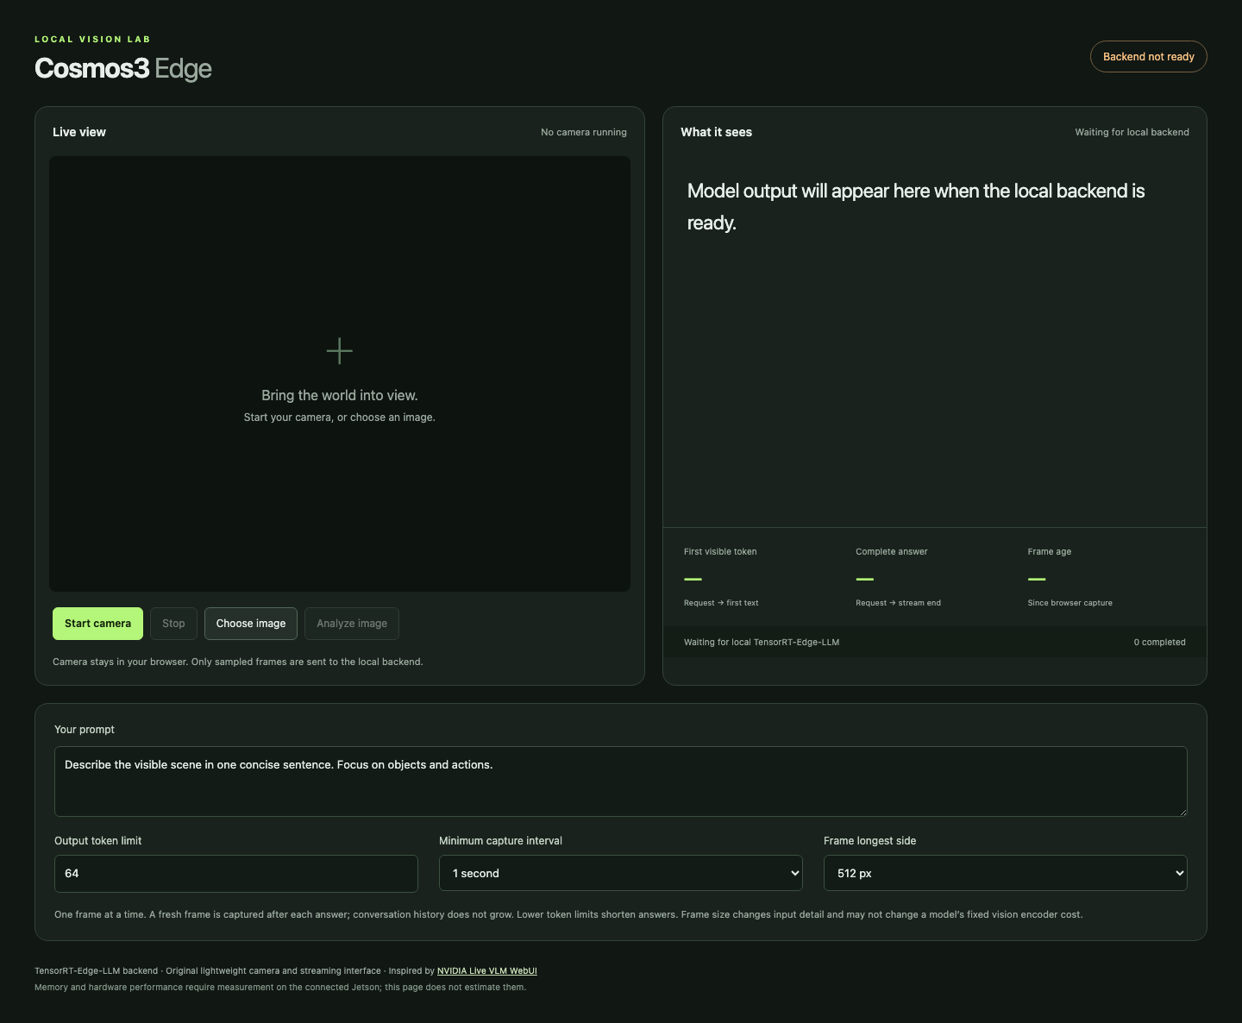
My initial assumptions and their limits
My starting choices
640×480 camera, ideal 15 FPS
512 px longest side, 1 s interval
64 output tokens, temperature 0
Working hypothesis
Capped frames and resident inference would reduce backlog and setup overhead.
Comparison gap
I had not matched Live VLM’s default workload before running the search.
Initial preview before backend readiness. The claimed overhead benefit was a hypothesis.
Comparison follow-up, 2026-09-20
19
Notes:
I treated Live VLM WebUI as a workflow reference and selected a compact deterministic initial workload. The preserved initial UI screenshot shows a 64-token ceiling, 1-second minimum interval, 512-pixel longest side, and prompt: “Describe the visible scene in one concise sentence. Focus on objects and actions.” Camera request 640×480, ideal 15 FPS/max 30 FPS, JPEG 0.8 and temperature 0/top_p 1 are preserved in the later Lightweight profile and comparison contract. The original interim presentation explicitly labels reduced backlog/setup overhead from capped frames and resident inference as a hypothesis. The screenshot was captured before backend readiness and establishes settings only. The candidate benchmark later used its separate frozen geometric prompt with 512×512 images and 64 output tokens. Smaller frames, fewer output tokens, and greedy decoding did not establish an equivalent workload to Live VLM defaults.
Sources:
.qa/ui-desktop.png
.presentation-build/create.mjs
research/benchmark-method.md
research/capture-preset-comparison.md
web/app.js

Slide 20
Your steering changed the comparison settings
“Make the Live VLM WebUI default”
Setting | My initial defaults | Defaults after your steering
Camera request | 640×480, ideal 15 FPS | 1280×720, no FPS constraint
Sent image | 512 px longest side | Preserve full source dimensions
Capture cadence | 1 s minimum, after answer | Every 30 frames, skip while busy
JPEG quality | Browser 0.8 | Browser 0.75, nominal match
Output ceiling | 64 tokens | 512 tokens
Generation | Temperature 0, greedy | Temperature 0.7
Prompt now: “Describe what you see in this image in one sentence.”
The toggle retains Lightweight. Encoding, transport and timing boundaries still differ.
Comparison follow-up, 2026-09-20
20
Notes:
Exact user sequence: “Set the max tokens and the sample prompt to the same default parameters as Web VLM UI.” Then: “Are the capture interval and the frame longest side the same defaults as Web VLM UI?” Then: “can we have a toggle so we have an apples to apples comparison to web vlm ui? Make the Live VLM WebUI default”. Prompt/token matching happened first. The explicit toggle request later aligned capture and generation defaults. Initial UI prompt was “Describe the visible scene in one concise sentence. Focus on objects and actions.” New prompt is shown on this slide. Full source frames remain subject to documented input bounds. Source dimensions are the actual negotiated camera dimensions, not guaranteed to equal the ideal request. The browser JPEG 0.75 value is nominal: upstream uses Pillow defaults, so bytes differ. Initial top_p=1 used greedy temperature 0; Live VLM omits top_p/top_k so the backend resolves 0.9/50. Upstream uses received WebRTC frames while this app uses browser-presented frames. The UI streams tokens while upstream requests non-streaming answers. These limits prevent an identical end-to-end transport equivalence claim.
Sources:
research/first-version-journey.md
research/capture-preset-comparison.md
results/ui-telemetry-validation.json
results/ui-presets-validation.json
https://github.com/NVIDIA-AI-IOT/live-vlm-webui/blob/2fd5ba0b334c334d24bf0f9439d8742b243d22be/src/live_vlm_webui/static/index.html
https://github.com/NVIDIA-AI-IOT/live-vlm-webui/blob/2fd5ba0b334c334d24bf0f9439d8742b243d22be/src/live_vlm_webui/video_processor.py
https://github.com/NVIDIA-AI-IOT/live-vlm-webui/blob/2fd5ba0b334c334d24bf0f9439d8742b243d22be/src/live_vlm_webui/vlm_service.py

Slide 21
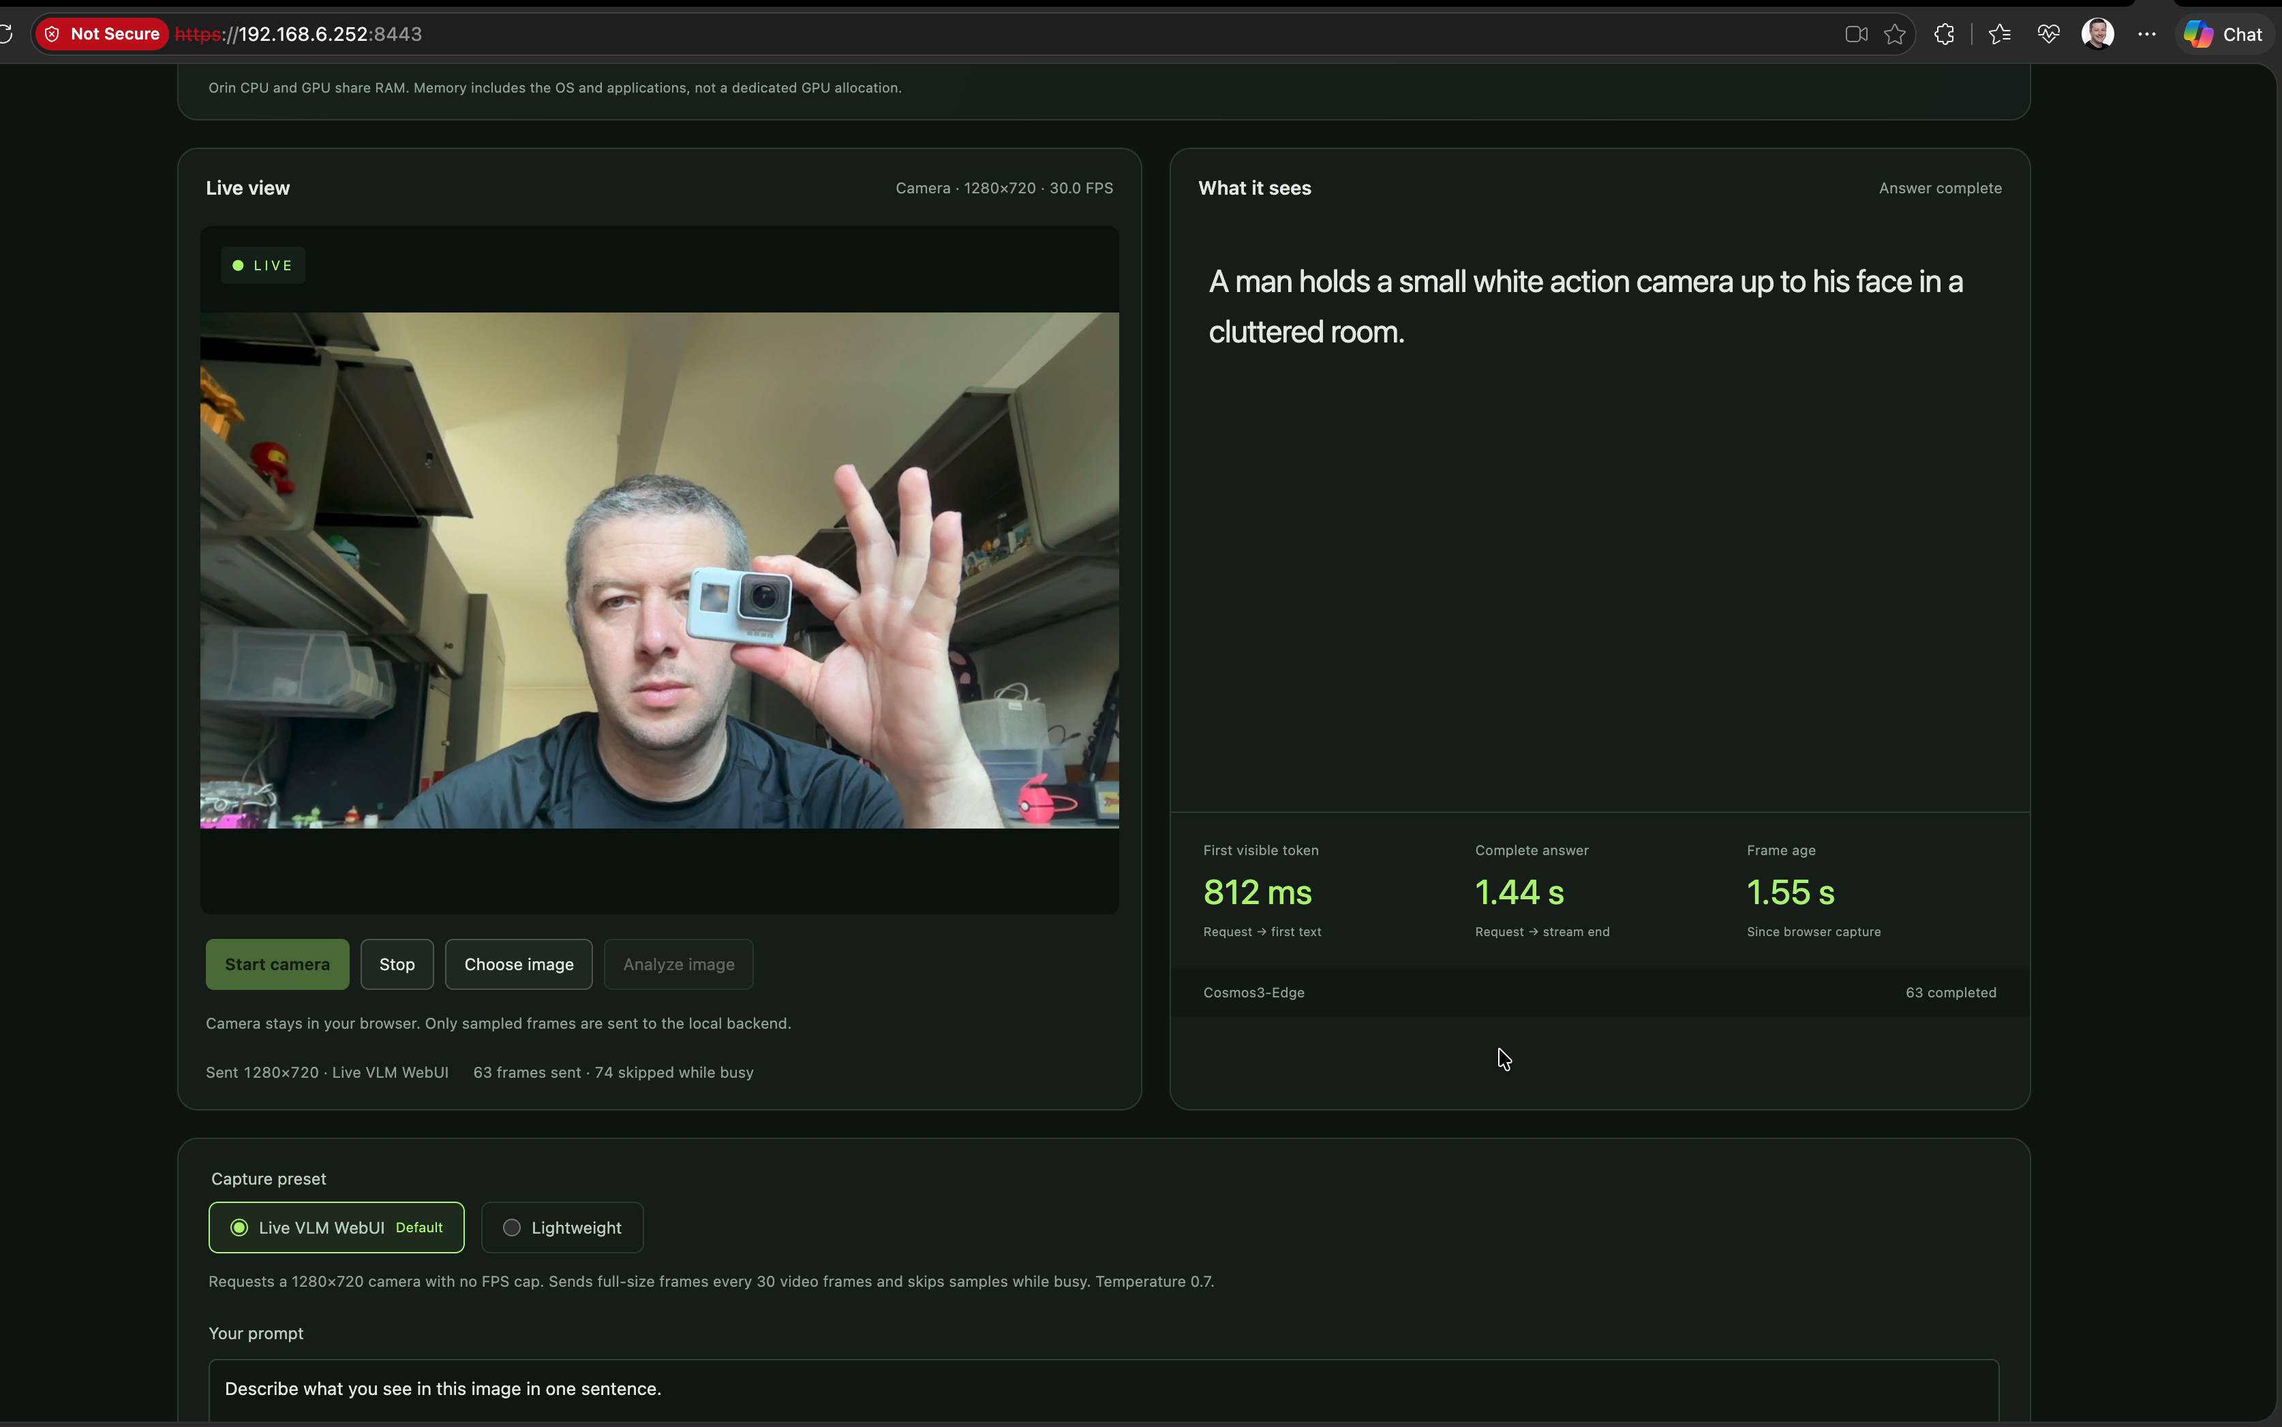
Recorded “before”: Live VLM default preset
Clip 00:00:05.808
1280×720 sent
30.0 FPS camera label
Live VLM default selected
Visible timing
First text: 812 ms
Complete: 1.44 s
Frame age: 1.55 s
Resource values and the token limit are outside the viewport.
Comparison follow-up, 2026-09-20
21
Notes:
User-designated unoptimized/before recording, after the default-preset change and after the earlier bounded optimization search. Source: Codex recording unoptimized Sep 20 Cosmos3-Edge.mov. SHA-256 6f4b66d3572edf2faffa617baa77b1d448635354f1874d4960e2c7c87238b438. Exact frame PTS 5.808333 s, zero-based frame 232. The full source screenshot is embedded without crop or pixel modification. Visible camera and sent frame dimensions are 1280×720 with reported 30.0 FPS. The preset and temperature 0.7 description are visible, as is the one-sentence prompt. UI reports Answer complete. First visible token 812 ms, complete answer 1.44 s, frame age 1.55 s. These are one rounded UI observation. CPU/GPU/shared-RAM numbers and the active token-limit control are outside the viewport. The recording therefore does not independently prove the current output ceiling. Corrected FP16 and memory limits were already deployed. This is the user’s new comparison baseline, not pristine upstream code.
Sources:
output/before-cosmos3-edge-2026-09-20/manifest.json
output/before-cosmos3-edge-2026-09-20/02-before-05.808s-action-camera.png
deployment/selected-config.json
research/capture-preset-comparison.md

Slide 22
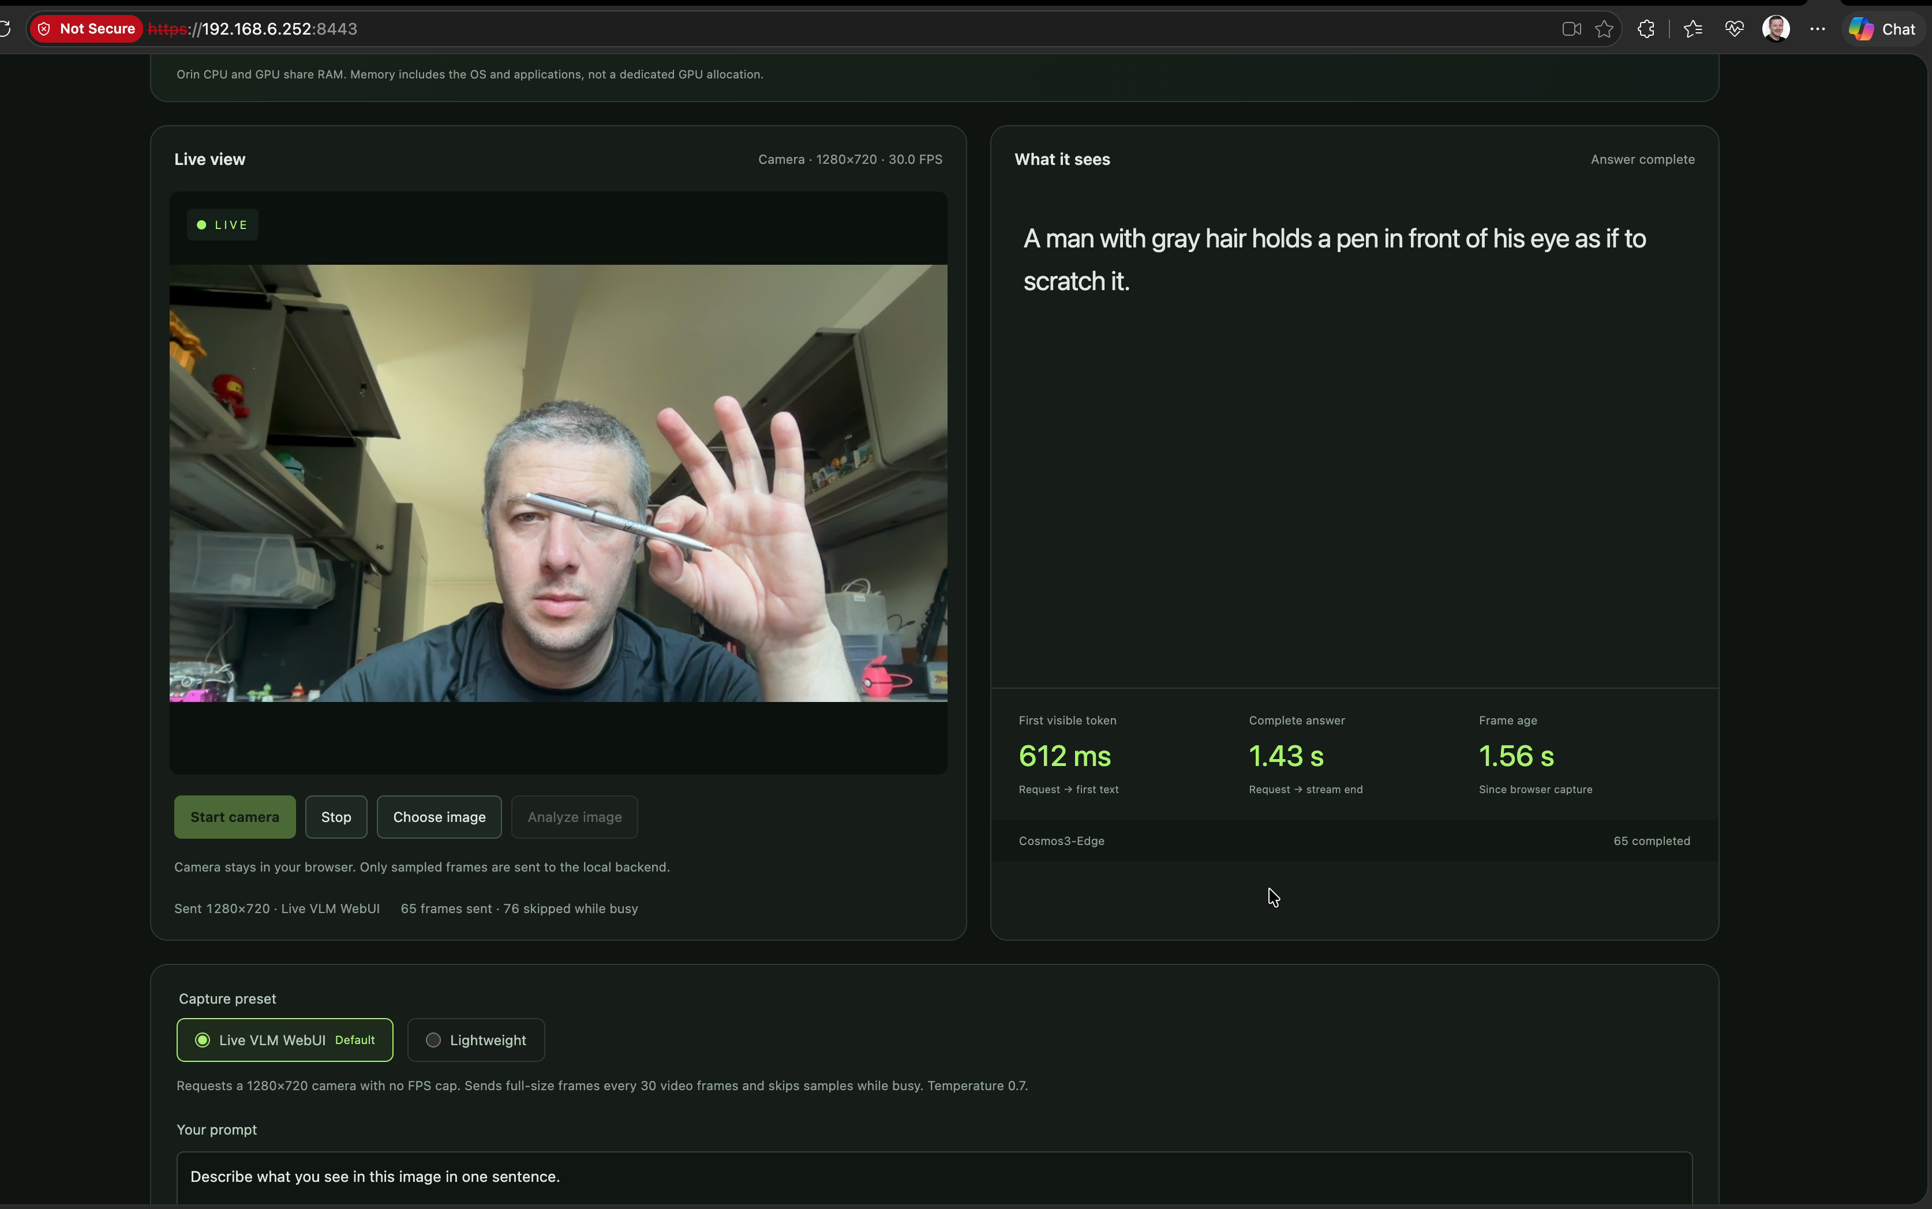
The “before” evidence includes model limits
Clip 00:00:09.842
First text: 612 ms
Complete: 1.43 s
Frame age: 1.56 s
Inferred action
The answer adds
“as if to scratch it”.
The image does not establish that action.
Individual observation. No accuracy rate inferred.
Comparison follow-up, 2026-09-20
22
Notes:
Source recording and hash as in manifest. Pen frame PTS 9.841667 s, frame index 370. Full screenshot is embedded unchanged. Exact visible model output: A man with gray hair holds a pen in front of his eye as if to scratch it. The phrase “as if to scratch it” is a model-inferred action not established by the screenshot. No intent is attributed to the person. The model did identify a pen. UI reports first token 612 ms, complete answer 1.43 s, frame age 1.56 s. The live preview can be later than the sampled model input. This curated observation is not an accuracy benchmark. The evidence pack contains six original-resolution frames, including the scene, action camera, pen, toy, battery and scissors. All have exact timestamps, SHA-256 hashes and verified re-extraction.
Sources:
output/before-cosmos3-edge-2026-09-20/manifest.json
output/before-cosmos3-edge-2026-09-20/03-before-09.842s-pen.png
output/before-cosmos3-edge-2026-09-20/README.md

Slide 23
The goal seek retained corrected FP16
Earlier fixed workload: 512×512, 64-token ceiling, temperature 0
Candidate | p50 answer | Peak shared RAM | Decision
FP16 reference | 1.830 s | 6.382 GiB | Retained: reference-equivalent, 18/19 strict
RTN INT4 all linears | 1.229 s | 4.195 GiB | Rejected: quality fell to 13/19
RTN INT4 MLP only | 1.027 s | 5.014 GiB | Rejected: new color error at 18/19
FP16 fixed clocks | 1.758 s | 6.353 GiB | Rejected: <5% gain and swap activity
Stop rule: 3 consecutive non-improvements. Four trials completed. No further trial ran.
Comparison follow-up, 2026-09-20
23
Notes:
This search preceded the Live VLM preset correction. Every measured candidate used the same frozen 512×512 geometric image, prompt, 64-token ceiling and temperature 0. Five warmups and 30 measured requests per candidate. Acceptance required at least 5% reduction in median complete-answer latency or peak system RAM, with no more than 5% regression in the other metric or p95 latency, quality equivalence, and no errors/OOM/swap. The ceiling was tightened from 12 to 5 total candidates. Four trials ran, then three consecutive non-improvements stopped the search. All-linears RTN strict quality was 13/19. MLP-only RTN scored 18/19 but introduced a new color error, failing the frozen reference-equivalence policy. Fixed clocks yielded only 3.94% latency gain and observed system swap-counter activity. The fifth compact-profile trial did not run. Shared RAM means system MemTotal minus MemAvailable and includes CPU/GPU/OS. It is distinct from model VRAM and process RSS. Table metrics are candidate-trial results; the next slide reports a separate final-service verification of the same selected engine.
Sources:
results/optimization-search-plan.json
results/optimization-selection.json
results/optimization-quality-policy.json
results/benchmark-fp16-qualified.jsonl
results/raw/benchmark-rtn-v1-rejected-01.jsonl
results/raw/benchmark-rtn-mlp-rejected-01.jsonl
results/raw/benchmark-fp16-clocks-01.jsonl

Slide 24
Results after goal seek and the comparison limit
No candidate earned an accepted improvement. Corrected FP16 remains selected.
Final service verification | Measured result
p50 first text / complete answer | 265.5 ms / 1.826 s
Peak shared system RAM | 6.435 GiB, includes CPU/GPU/OS
API soak | 366 successful requests across 600.7 s
Chronology: optimization search, then your default-setting correction, then the recording.
A paired optimization result under the Live VLM defaults remains unmeasured.
The earlier 64-token benchmark cannot quantify a gain over your later recording.
Comparison follow-up, 2026-09-20
24
Notes:
The selected configuration remained corrected FP16, input 1024, KV 2048, batch 1, encoder cache budget zero, stock dynamic 25 W. These are the separate final-service verification results, not an additional search candidate. Five warmups, 30 measured requests. p50 first text 265.54039800066676 ms; p50 complete 1825.8987585013529 ms; p95 complete 1829.9888356496922 ms. Peak system RAM unavailable 6909468672 bytes (6.434944 GiB); RSS 6342467584 bytes. The counters overlap and must not be added. Dedicated CUDA allocator peak was not collected. Final service had no observed errors/OOM/swap. Soak: 600.701 seconds, 366 successful requests. Strict geometric score remained 18/19; natural photo diagnostic was 5/9 generous or 4/9 strict, with 0/3 fully correct images. The chronology is material: final-service benchmark started 2026-09-20 07:18 UTC, soak ended about 07:29 UTC; prompt/token verification was 18:14 UTC, Live VLM preset verification 23:41 UTC; recording creation metadata is 2026-09-21 00:15:52 UTC (September 20 locally). No candidate search was repeated after default alignment. The user-designated before recording contains individual stochastic camera observations and no visible resource values or active token limit. A paired before/after optimization claim under the Live VLM defaults remains unmeasured. This revision documents existing results rather than inventing or launching a new benchmark.
Sources:
results/raw/benchmark-final-service-01.jsonl
results/raw/soak-final-service-01.summary.json
results/ui-telemetry-validation.json
results/browser-ui-presets.json
deployment/selected-config.json
output/before-cosmos3-edge-2026-09-20/manifest.json
results/natural-smoke-final-01-review.json

