Slide 1
Microservice with OAuth2
Viquar Khan

Slide 2
SAML vs OpenID vs OAuth
SAML (Security Assertion Markup Language) is a standard that encompasses profiles, bindings and constructs to achieve
Single Sign On (SSO),
Federation and
Identity Management.
OpenID is an open standard sponsored by Facebook, Microsoft, Google, PayPal, Ping Identity, Symantec, and Yahoo. OpenID allows user to be authenticated using a third-party services called identity providers. Users can choose to use their preferred OpenID providers to log in to websites that accept the OpenID authentication scheme.
- OpenID and SAML2 are both based on the same concept of federated identity
OAuth (Open Authorization) is a standard for authorization of resources. It does not deal with authentication.

Slide 3
SAML vs OpenID comparison
SAML2 supports single sign-out OpenID does not supports single sign-out
SAML service providers are using with the SAML2 Identity Providers, OpenID has a discovery protocol which dynamically discovers the corresponding OpenID Provider, once an OpenID is given. SAML has a discovery protocol based on Identity Provider Discovery Service Protocol (OpenID relying parties are not coupled with OpenID Providers).
SAML the user is tightly coupled with SAML2 IdP ,SAML2 identifier is only valid for the SAML2 IdP. OpenID, you own your identifier and you can map it to any OpenID Provider you wish.
SAML 2 is based on XML OpenID is not based on Json
SAML can be either Service Provider (SP) initiated or Identity Provider (IdP) initiated. OpenID always SP initiated.
SAML web profile for web Browser only OpenID Both web browser and mobile

Slide 4
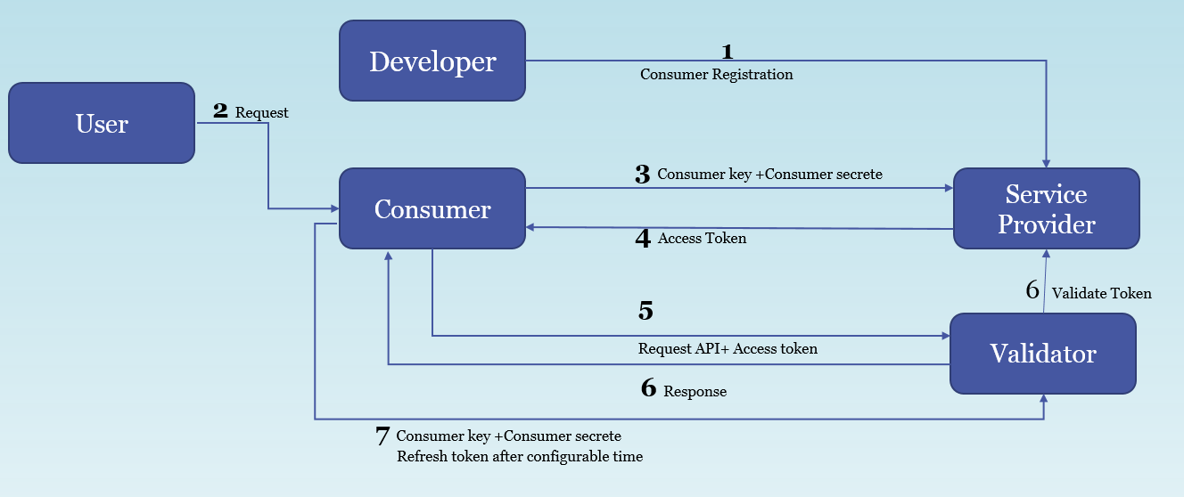
OAuth 2.0:
The OAuth 2.0 authorization framework enables a third-party application to obtain limited access to an HTTP service, either on behalf of a resource owner by orchestrating an approval interaction between the resource owner and the HTTP service, or by allowing the third-party application to obtain access on its own behalf. This specification replaces and obsoletes the OAuth 1.0 protocol described in RFC 5849.
Example :
Uber: https://developer.uber.com/docs/riders/guides/authentication/introduction
Facebook: https://developers.facebook.com/docs/facebook-login

Slide 5
OAuth2 continue..
Oauth2 Roles
Resource owner: An entity capable of granting access to a protected resource. when the resource owner is a person, it is referred to as an end-user.
Resource server: The server hosting the protected resources, capable of accepting and responding to protected resource requests using access tokens.
Client: An application making protected resource requests on behalf of the resource owner and with its authorization. It could be a mobile app asking your permission to access your Facebook feeds, a REST client trying to access REST API, a web site [Stack overflow e.g.] providing an alternative login option using Facebook account.
Authorization server: The server issuing access tokens to the client after successfully authenticating the resource owner and obtaining authorization.
OAuth different types of tokens.
WS-Security tokens, especially SAML tokens
JWT tokens
Legacy tokens
Custom tokens

Slide 6
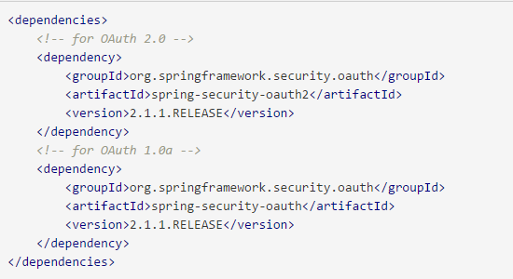
Spring Boot with OAuth2 for consumer
Spring Security OAuth provides support for using Spring Security with OAuth (1a) and OAuth2 using standard Spring Security programming models and configuration idioms.
Features
Support for OAuth providers and OAuth consumers
Oauth 1(a) (including two-legged OAuth, a.k.a. "Signed Fetch")
OAuth 2.0.
POC:
https://spring.io/guides/tutorials/spring-boot-oauth2/
https://github.com/dsyer/sparklr-boot

Slide 7
Pivotal Cloud Foundry-UAA for Service provider
What is User Account and Authentication (UAA) Server
The User Account and Authorization server
UAA is as an OAuth2 provider
Core component of Cloud Foundry, battle tested in production
Apache 2 License, download the WAR and run it for free
OAuth2 compliant, almost OpenID Connect compliant
Supports /user info
Multitenant
Spring Security OAuth2 is based on UAA
Spring Cloud Security is a great fit with UAA
Because UAA produces JWT containing both scopes and identity
https://docs.pivotal.io/pivotalcf/1-10/concepts/architecture/uaa.html

Slide 8
References:
https://stackoverflow.com/questions/tagged/oauth
https://en.wikipedia.org/wiki/OAuth
https://oauth.net/2/
http://saml.xml.org/
http://openid.net/
https://spring.io/guides/tutorials/spring-boot-oauth2/
https://github.com/dsyer/sparklr-boot
https://content.pivotal.io/blog/how-to-integrate-an-application-with-cloud-foundry-using-oauth2

