Slide 1
Microservices at eBay

Slide 2

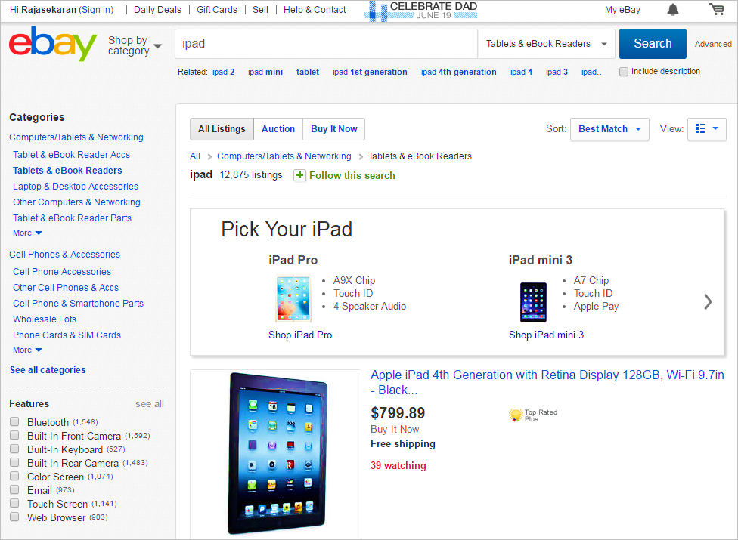
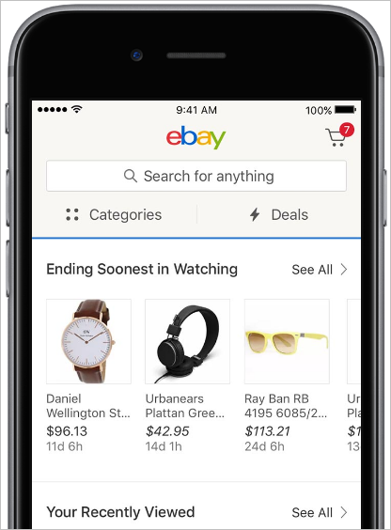





















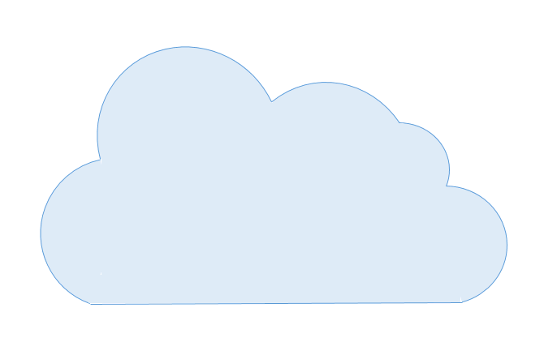










eBay Architecture
Applications
eBay Hosted Applications
eBay Mobile Applications
3rd Party Applications
Commerce Services
Login
Identity
Catalog
Search
List
Pricing
Offer
ADs
Messages
Cart
Coupons
Payment
Shipping
CS
Platform Services
Application Profiles
{rest api}
App Stack
Data Access
Dev Tools
Presentation
Messaging
Services
Batch
Infrastructure
Cloud
Data Center
Compute
Network
Storage
Tools
Monitoring

Slide 3
Technology objectives
Increase team autonomy and agility
Agile process
Microservices
Better structured, more testable code
Code quality initiatives
Technical debt reduction
Unit testing
Bring content to the customer
Increased POP / datacenter presence
Localized data in Europe, etc.
More flexible Cloud deployments
Microservices
Mockability, pluggability of code
Cloud native architecture

Slide 4
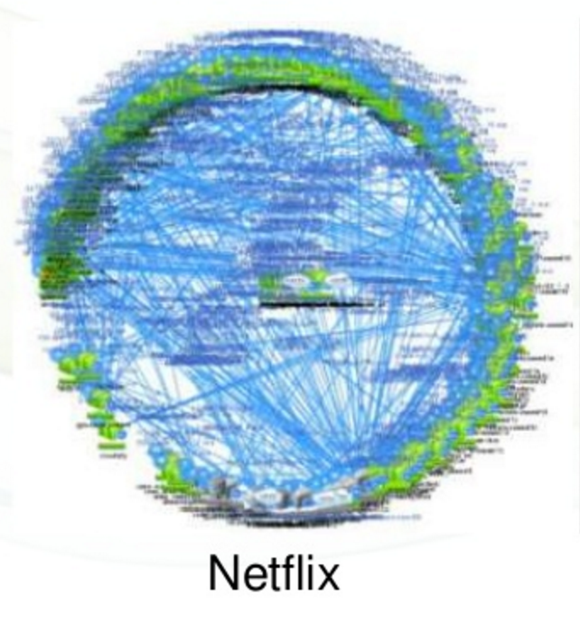
Application Strategy
Domain Driven Design
Refactor and isolate more “pure” domain functions
Refactor database tables
Clean, simple, reusable business services
Increased use of data services
Reduce code tangle and technical debt
Increase testability
We are already pursuing SOA with many hundreds of services.
Microservices are the next step in SOA.
…
Catalog
List
Offer
Cart
Shipping

Slide 5
Frameworks Strategy
Modularity
As minimal as desired
Everything has a published/managed API
Local component or remote service as decided by the provider
Componentization
Alignment with industry-leading options
Spring.io
Node.js
Prepare the stack for cloud-native architecture

Slide 6
Cloud Native Architecture: Key Considerations
To run in the cloud, an application has to detach from arbitrary deployment assumptions.
Externalized Dependencies: “Dependencies are declared up front, and isolated, so they can be substituted per environment”
Service Registry and Discovery: Services are “attached resources” - service registration and discovery glues the application to the environment
Externalized Configuration: Configuration is decoupled from the code so that it is injected and can be customized per environment.
See: https://12factor.net/

Slide 7
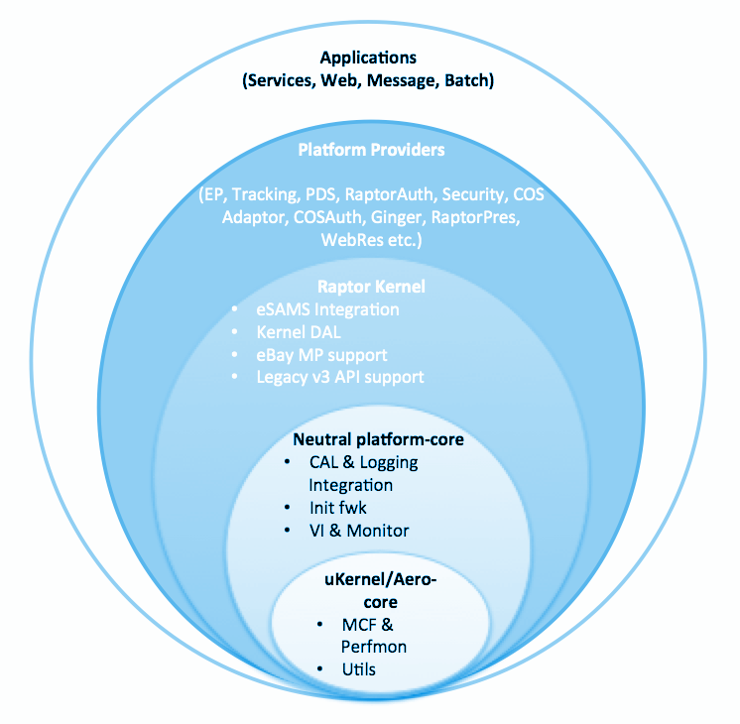
Componentization +
Application Code
Expermt API
Tracking API
….
Expermt Impl
Tracking Impl
….
Key Mgt API
OAuth API
Key Mgt Impl
OAuth Impl
DAL API
Metadata API
Log API
DAL Impl
Metadata Impl
Log Impl
CAL API
Console API
Metrics
CAL Impl
Console Impl
Metrics Impl
Raptor.io
Spring Boot
Embedded Container (Tomcat)
External Container (Tomcat)
Java 7, Java 8

Slide 8
Long Term: Micro-services + Containerization
Platform Code
Application Code
Expmt API
Tracking API
….
Expmt Impl
TrackingImpl
EP API
Tracking API
Key Mgt API
OAuth API
Low-latency RPC
….
eSAMS API
OAuth API
Key Mgt Impl
OAuth Impl
DAL API
Metadata API
Log API
DAL Impl
Framework-as-a-Service (FaaS)
DAL API
Metadata API
Log API
Metadata Impl
Log Impl
CAL API
Console API
Metrics API
CAL API
Console API
Metrics API
CAL Impl
Console Impl
Metrics Impl
Java Runtime
Platform run-time(s)
{Java, Scala, Node.js, Go, …}
App Runtime(s)
Node.js Runtime
Stack<?> Runtime

Slide 9
Long-term: eBay Applications
QA
Production
Service-A | Service-B
… | …
Config | Key Mgt
… | …
DB-A | DB-B
… | …
Service-A | Service-B
… | …
Config | Key Mgt
… | …
DB-A | DB-B
… | …
App
FaaS
App
FaaS
App
FaaS
App
FaaS
Configs-QA
Configs-QA
Configs-Prod
Configs-Prod
App
FaaS
App
FaaS
FaaS
App
FaaS
App
Configs-QA
Configs-QA
Configs-Prod
Configs-Prod

Slide 10



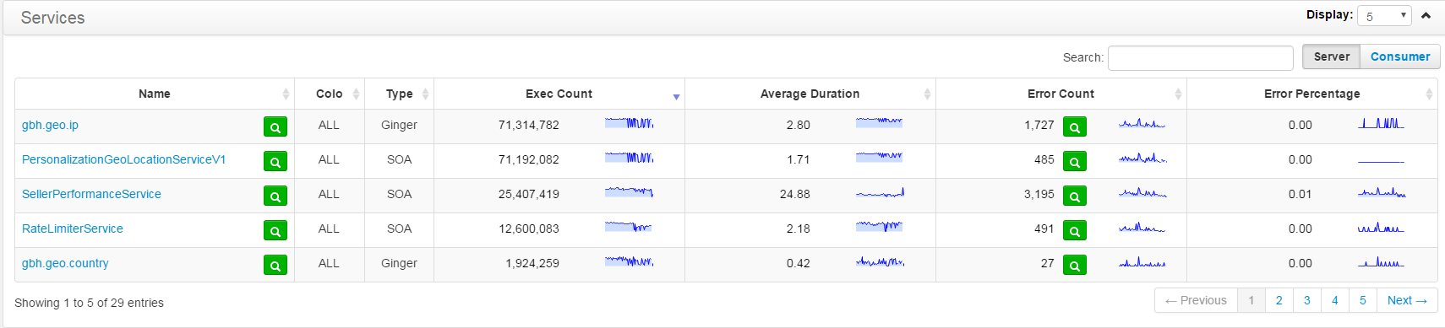

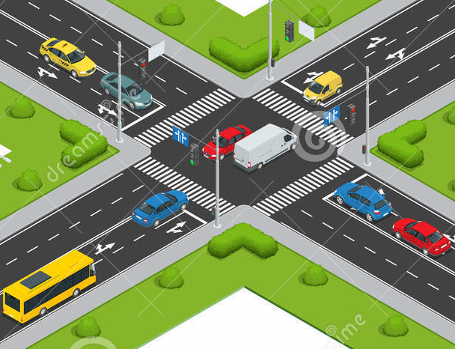
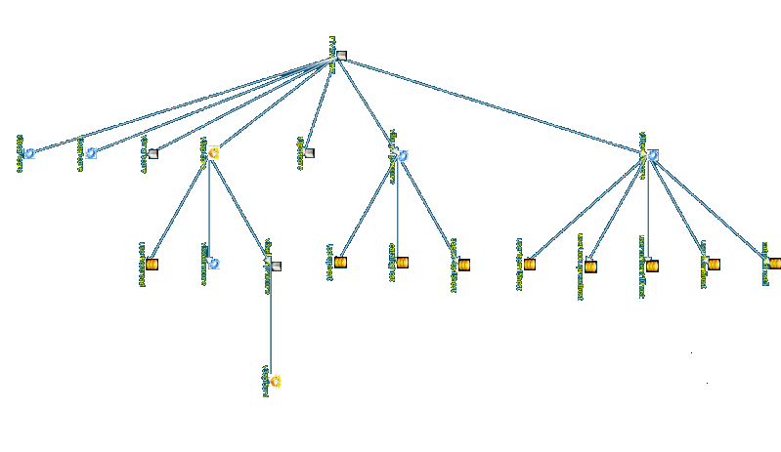

Challenges for Microservices
Contracts
Registration
Routing
Dependency tracking
Resiliency
Monitoring
Fault diagnosis
Security

Slide 11
Service Contracts
{
"kind" : "eBayDescriptor#restDescription",
"descriptorVersion" : "v1",
"id" : "shopping:v0.0",
"name" : "shopping",
"version" : "0.0.1-SNAPSHOT",
"title" : "Shopping API",
"description" : "Lets you shop on eBay",
"documentationLink" : "https://github.scm.corp.ebay.com/commerceos/cos-reference-implementation",
"protocol" : "rest",
"parameters" : { },
"serviceRef" : "SampleService/1.0.0",
"methods" : { },
"resources" : {
"cart" : {
"methods" : {
"get" : {
"path" : "/cart/{cartId}",
"httpMethod" : "GET",
"parameters" : {
"cartId" : {
"type" : "string",
"location" : "path"
}
},
What is in a contract?
Schema: datatypes
Resources / methods
Errors
Authorization (e.g. Oauth scopes)
Endpoint declarations
Documentation
Versioning info
Ownership
eBay using an internal standard based on Google Discovery Doc
JSON Schema for data types
Must carefully control schema evolution
See also: Swagger / OpenAPI
Benefits:
People know how to use the API
Generate client stubs (e.g. Java data objects)
Help implement security and other policy
Bootstrap the registration of providers in the runtime environment
Assess compatibility and impact of change

Slide 12
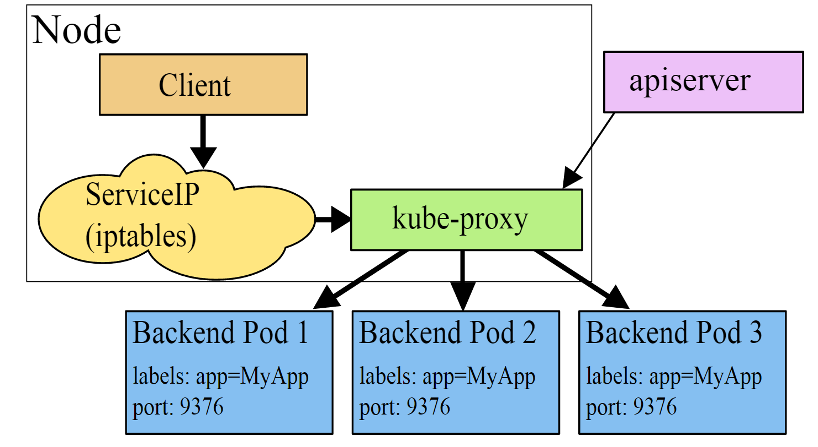
Service Registration and Discovery
Based on service provider contract, extract endpoint info into builds
Provider endpoints are registered into the runtime environment
Consumers locate and bind to these endpoints.
Architecture options: https://www.nginx.com/blog/service-discovery-in-a-microservices-architecture/
Registration examples:
Hashicorp Consul
Netflix Eureka
Binding methods:
Client side e.g. Netflix Ribbon
Server side e.g. via load balancer / routing
Kubernetes / DNS registration
Kubernetes has built-in services, located via SkyDNS.
Gets you to a cluster (physical LB today).
Internally, kube machinery controlled by proxy, locates the pod.
eBay may extend for both Kube and non Kube usage.

Slide 13

Routing and Load balancing
Internal service calls (pool to pool)
Prior to Kubernetes, clients have JMX like beans and config files for each environment they bind to; specify DNS FQDN
Under Kubernetes, there is a global eBay DNS, which the Kubernetes native DNS (SkyDNS) integrates into
Colo failover via GTM of the load balancer
Publicly exposed services
Publish the eBay Service Descriptor Doc (GDD like)
Authentication via OAuth
Rate limiting – currently in the service itself
Routing based on layer 7 (URL, HTTP headers, etc.) – using WSO2 ESB and Apache Camel

Slide 14
Dependency tracking: WIRI vs. WISB
What It Should Be (WISB): Declarative dependency allows you to work predictably.
Design analysis of an app’s dependencies, e.g. for resiliency, capacity, interface evolution
Instantiate and test clusters of services
Service discovery in a given environment
Smooth out authorization policy (A will need to talk to B and we allow this, so…)
What It Really Is (WIRI): Allows reconciliation of intended and real dependencies.
Identify “referenced but not used”
Identify undeclared real dependencies
Sources of WIRI info: Call logging, network infrastructure views (connections built, etc.)
Can be various conflicts among these due to mistakes, bad data e.g. “forgot to log”
How it works:
Consumers need to declare their level 1 service dependencies e.g. in a file or with annotations.
Shared code can also declare service dependencies.
The build process extracts all dependencies into a concise “manifest”
This is used by tools for analysis, by PaaS/Discovery for binding into the given environment, etc.

Slide 15
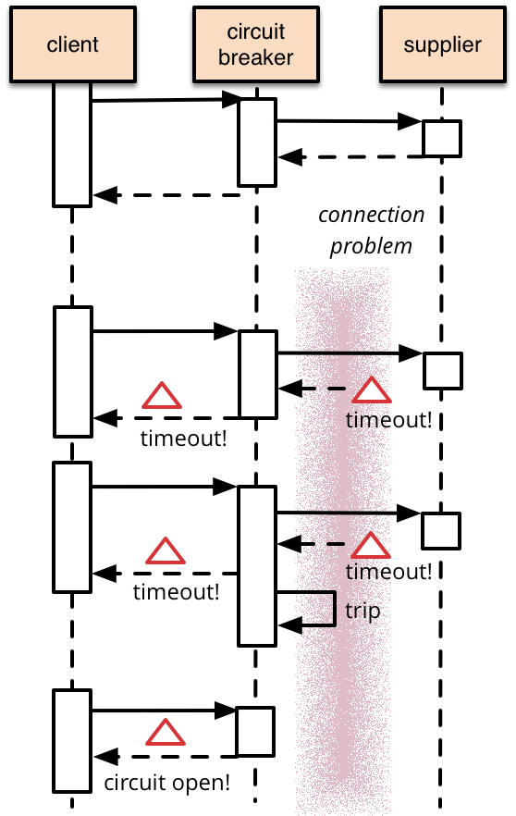
Resiliency
In chained service calls, issues tend to cascade without protections
Bulkheading (isolation) of different flows (e.g. outbound clients/commands) in a host
Timeouts, retries, markdown, markup, fallback
Circuit breaker pattern (e.g. Hystrix) provides error thresholding with markdown / markup / fallback
In large-scale service architecture, uniform policy and enforcement is critical
Config audit
SLA management
Beware of embedded / reused clients – app teams may not be aware of them
Actively test failures
Chaos Monkey, etc.
eBay has built a client side framework

Slide 16
Monitoring
Collect TPS / errors / latency for all services (all endpoints of any kind, actually)
Per consumer reporting highly desirable for internal (pool to pool) calls
Per operation reporting almost essential
Also of interest: Hosting pool (if multiple services live there), hosting machine (if not ephemeral)
Need to aggregate in a form of OLAP (eBay moving to Druid); time series DB storage
Combinatorial explosion: Services * consumers * operations * time intervals * number of datapoints
Very large scale collection and visualization problem
See also: Prometheus; Netflix Turbine

Slide 17
Fault diagnosis
Use both logs and metrics to diagnose. How many errors and what are they? Where does the slowdown localize?
Individual failures – need to identify single bad box
This is why per-host reporting is helpful
Pool slowdown – what is the underlying source of latency?
Downstream slowdown or problem in the pool’s code or both?
Need a full dependency graph showing all latencies/trends across all service calls, narrowed by a time window
SLA management is helpful. What is the “expected” maximum latency? The “typical” (e.g. median, 90%) latency?
Generally root cause is in some event (seen in log) just prior to the issue; but can be very hard to locate and attribute
Huge debugging time sink
Pool meltdown – congestion or other factor made pool unstable
Need to trace origin of the event and locate root causes; similar to slowdown investigation usually
Connection management issues – resets, etc.
Expect to invest more and more in this area as your service count grows

Slide 18
Security challenges
Confidentiality: TLS 1.2. Trend will be toward full internal TLS encryption
Key management and distribution needed to bootstrap “trust”
Get primordial keypair onto a system via provisioning or deployment; must limit visibility of it
Negotiation of shared key
Key management is a critical part of the chain; expiry, rotation, etc.
Zoning, micro-segmentation
Manual firewall setup not scalable
Trend toward software defined controls based on iptables, etc.
Hardening systems critical
Portscan
Patching O/S, app runtime, 3rd party software
Application software scanning and certification (Fortify, OWASP, etc.)
Container security, certification, security verification

Slide 19

Summary: Road ahead
10x services
Making our apps lean and cloud native
Refactoring – need large scale tooling for dependency untangling
Agile and TDD – grow out a better unit test suite
CI/CD and dynamic environments
Hybrid cloud
Data services
Caching, geo-distributed databases (e.g. Amazon Aurora)
Increasing intelligence

Slide 20
Appendix – References from the talk
Netflix 2016 SF talks referenced:
https://qconsf.com/sf2016/presentation/what-comes-after-microservices - (Matt Raney - Uber)
https://qconsf.com/sf2016/presentation/mastering-chaos-netflix-guide-microservices
https://qconsf.com/sf2016/presentation/autonomous-operations-microservices-machine-learning-ai
Discovery related references
https://www.nginx.com/blog/service-discovery-in-a-microservices-architecture/
http://blog.christianposta.com/microservices/netflix-oss-or-kubernetes-how-about-both/
https://github.com/grpc/grpc/blob/master/doc/load-balancing.md
Refactoring
Refactoring book: Refactoring: Improving the Design of Existing Code
Dependency visualization: https://www.quora.com/What-are-the-best-tools-for-visualizing-source-code-dependencies
Pfff and its analysis techniques: http://codebetter.com/patricksmacchia/2009/08/24/identify-code-structure-patterns-at-a-glance/
Code analysis tooling: http://semanticdesigns.com/

