Slide 1
NEMOTRON VOICE AGENT
Nemotron Voice Agent
Frontend / Backend agent — architecture, request flow, and cluster deployment
chart 0.1.103
app 2.0.32
one 8×H100 node · 5 replicas
Astra + NVCF deployment
Nemotron Voice Agent · generated 2026-08-26

Slide 2
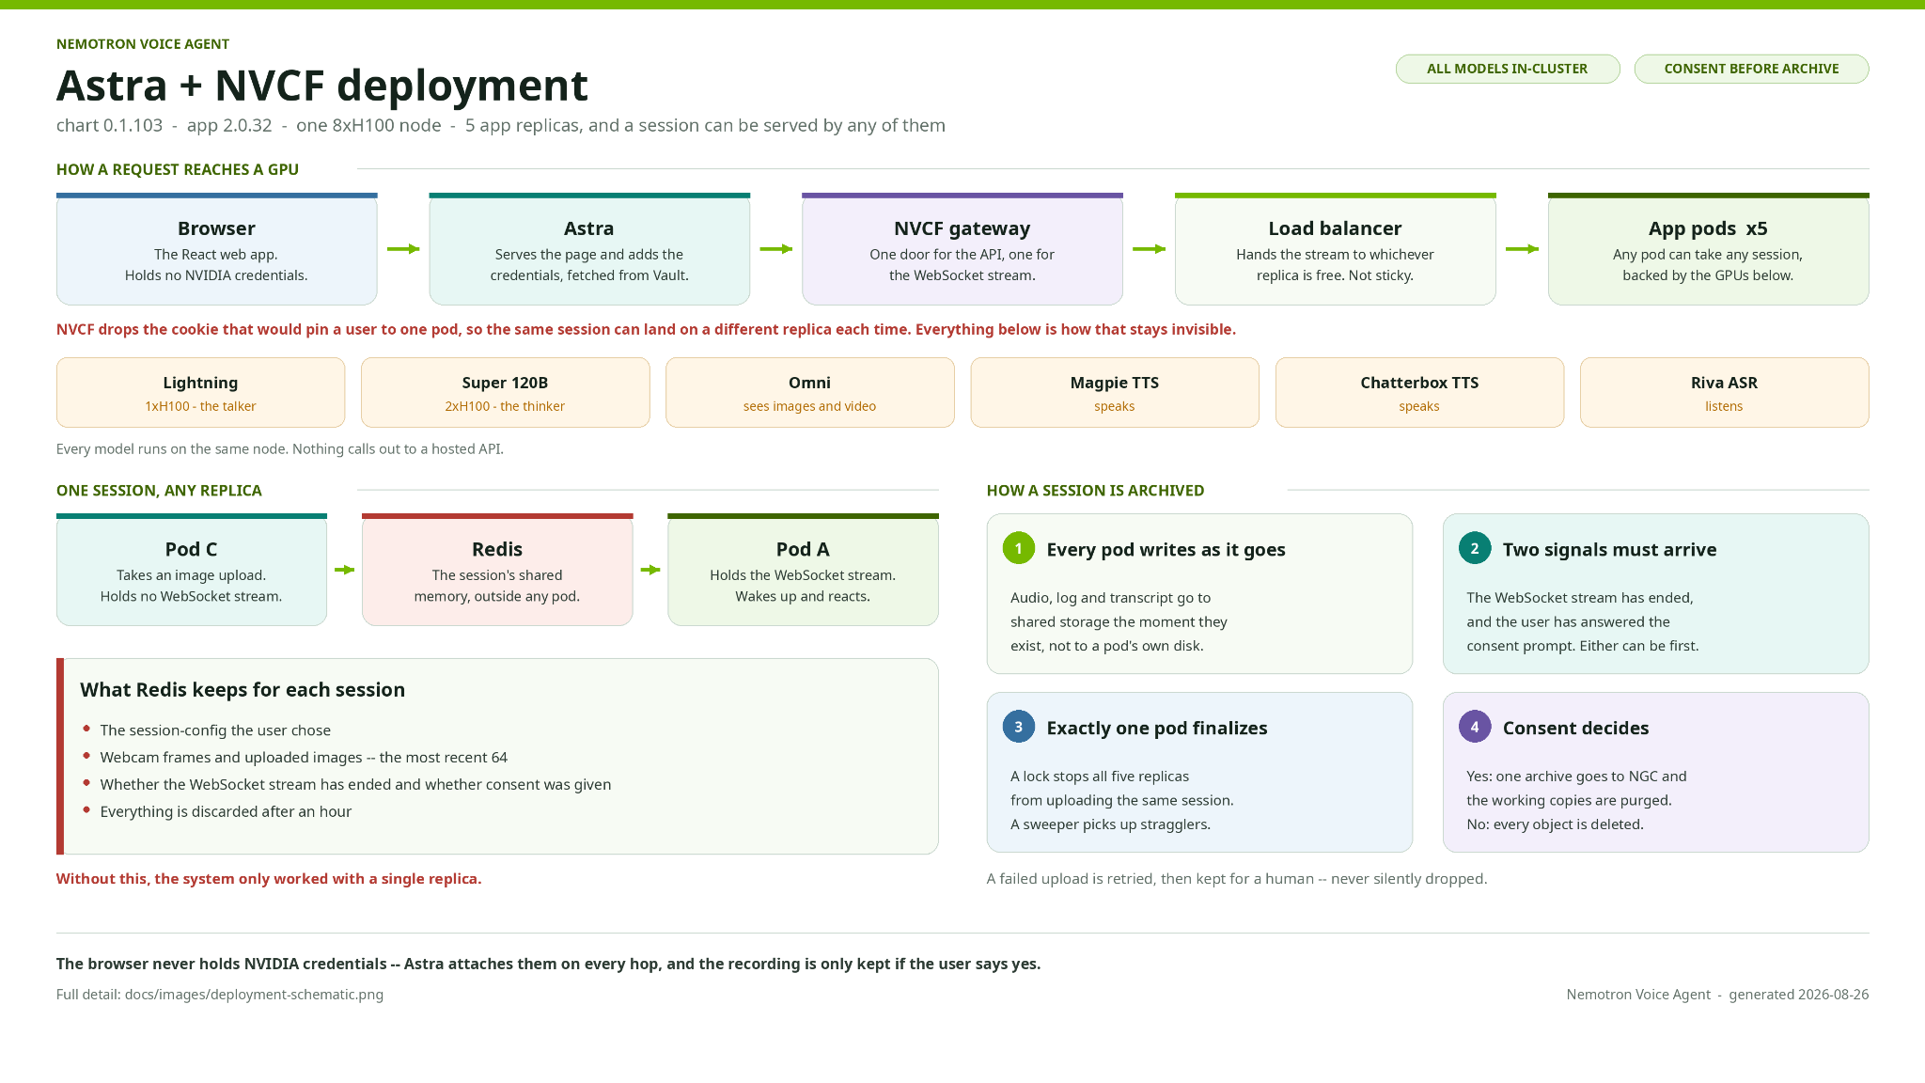

Slide 3
NEMOTRON VOICE AGENT
Deployment request flow
one 8×H100 node · 5 app replicas
any pod can serve any session
Many concurrent sessions, five interchangeable replicas, one shared state
1 · REQUESTS FAN OUT ACROSS REPLICAS
CONCURRENT SESSIONS
INGRESS
APP POD REPLICAS
SHARED, OUTSIDE ANY POD
Load balancer
hands the stream to whichever replica is free · not sticky
app-pod-1
Redis
the session lives here — config, last 64 frames, stream + consent flags
Session A · turn 1
browser · WebSocket
app-pod-2
Session B · turn 4
browser · WebSocket
GPU node · 8×H100
Lightning · Super 120B · Omni · Magpie TTS · Chatterbox TTS · Riva ASR
app-pod-3
holds the finalize lock
Session C · turn 2
browser · WebSocket
app-pod-4
Object storage → NGC
written once, after consent · stragglers swept up
app-pod-5
2 · WHY A SESSION SURVIVES ANY REPLICA
No sticky sessions
NVCF drops the cookie that pinned a user to one pod, so consecutive turns land anywhere.
State is external
Nothing a session needs is on a pod's local disk — Redis is the single source of truth.
Exactly one finalize
A lock across the five replicas means one pod archives the session; a sweeper retries the rest.
No hosted API calls
Every model runs on the same node, so a replica never leaves the cluster to answer.
blue · inbound session green · replica holding the finalize lock
Nemotron Voice Agent · generated 2026-08-26

Slide 4
NEMOTRON VOICE AGENT
Frontend / Backend Agent — architecture
Where each module lives and how one turn moves down the stack
1 · Configuration
examples_registry.yaml
one entry
prompts.yaml
talker · thinker
services.yaml
model catalog
2 · Voice pipeline
pipeline.py
ASR
speech → text
Talker LLM
reasoning off
TTS
text → speech
3 · Talker tools
tool_handlers.py
call_backend
delegates the turn
cancel_backend
aborts in flight
4 · Planner
planner.py
Thinker LLM
reasoning on
JSON plan
unexecuted
5 · Domain
airline
airline/thinker.py
dispatch
airline/state.py
session state
airline/tools.py
tool schema · hardwired to TTS
flight_search.py
tool
booking_tool.py
tool
pnr_status.py
tool
airline/backend.py
HTTP client
airline/database
FastAPI · Postgres
red · direct coupling
Nemotron Voice Agent · generated 2026-08-26

Slide 5
NEMOTRON VOICE AGENT
Frontend / Backend Agent — made generic
The airline domain becomes one configuration among many — the pipeline never changes
1 · Configuration
examples_registry.yaml
domain_profile · tools
prompts.yaml
talker · thinker
services.yaml
model catalog
2 · Voice pipeline
unchanged
ASR
Talker LLM
TTS
3 · Talker tools
unchanged
call_backend
cancel_backend
4 · Planner
unchanged
Thinker LLM
JSON plan
5 · Domain seam
src/domain.py · DomainSpec
6 · Domains
airline · ToolSpec registry
tools as data
generic · ToolSpec registry
tools as data
future domain
added by configuration
7 · One definition
per tool
src/tools.py
ToolSpec
Thinker prompt
Input validation
Execution
Speech
blue · new module dashed · added by configuration
Nemotron Voice Agent · generated 2026-08-26

Slide 6
NEMOTRON VOICE AGENT
Schematic request flow
Trusted configuration
Talker · Lightning · 512 tok · temp 0.2
Thinker · Super 120B · budget 1024 · temp 0.0
One delegated turn — request across the top, grounded response returns below
1 · FRONTEND REQUEST
User
voice
Streaming ASR
speech → transcript
Lightning Talker
reasoning OFF
call_backend()
Talker tool boundary
Domain backend
lifecycle + orchestration
plan(query, enabled_tools)
2 · PLAN AND EXECUTE
Super Thinker
reasoning ON · plan only
JSON plan
unexecuted
Validate entire plan
enabled tools only · arguments checked · maximum 3 calls
Available tools
WeatherAPI · Finnhub · Perplexity · BMI
0.3 s filler timer
concurrent branch
Filler speech
only while waiting
Filler only plays if the plan takes longer than 0.3 s — the grounded payload cancels it.
raw service data
3 · GROUNDED RETURN
Deterministic formatter
validated args + service data · no second LLM call
Grounded payload
response_text
Lightning final response
default re-entry
Speech preparation
+ TTS
User hears audio
blue · model call grounded service data only — no second generation
Nemotron Voice Agent · generated 2026-08-26

Slide 7
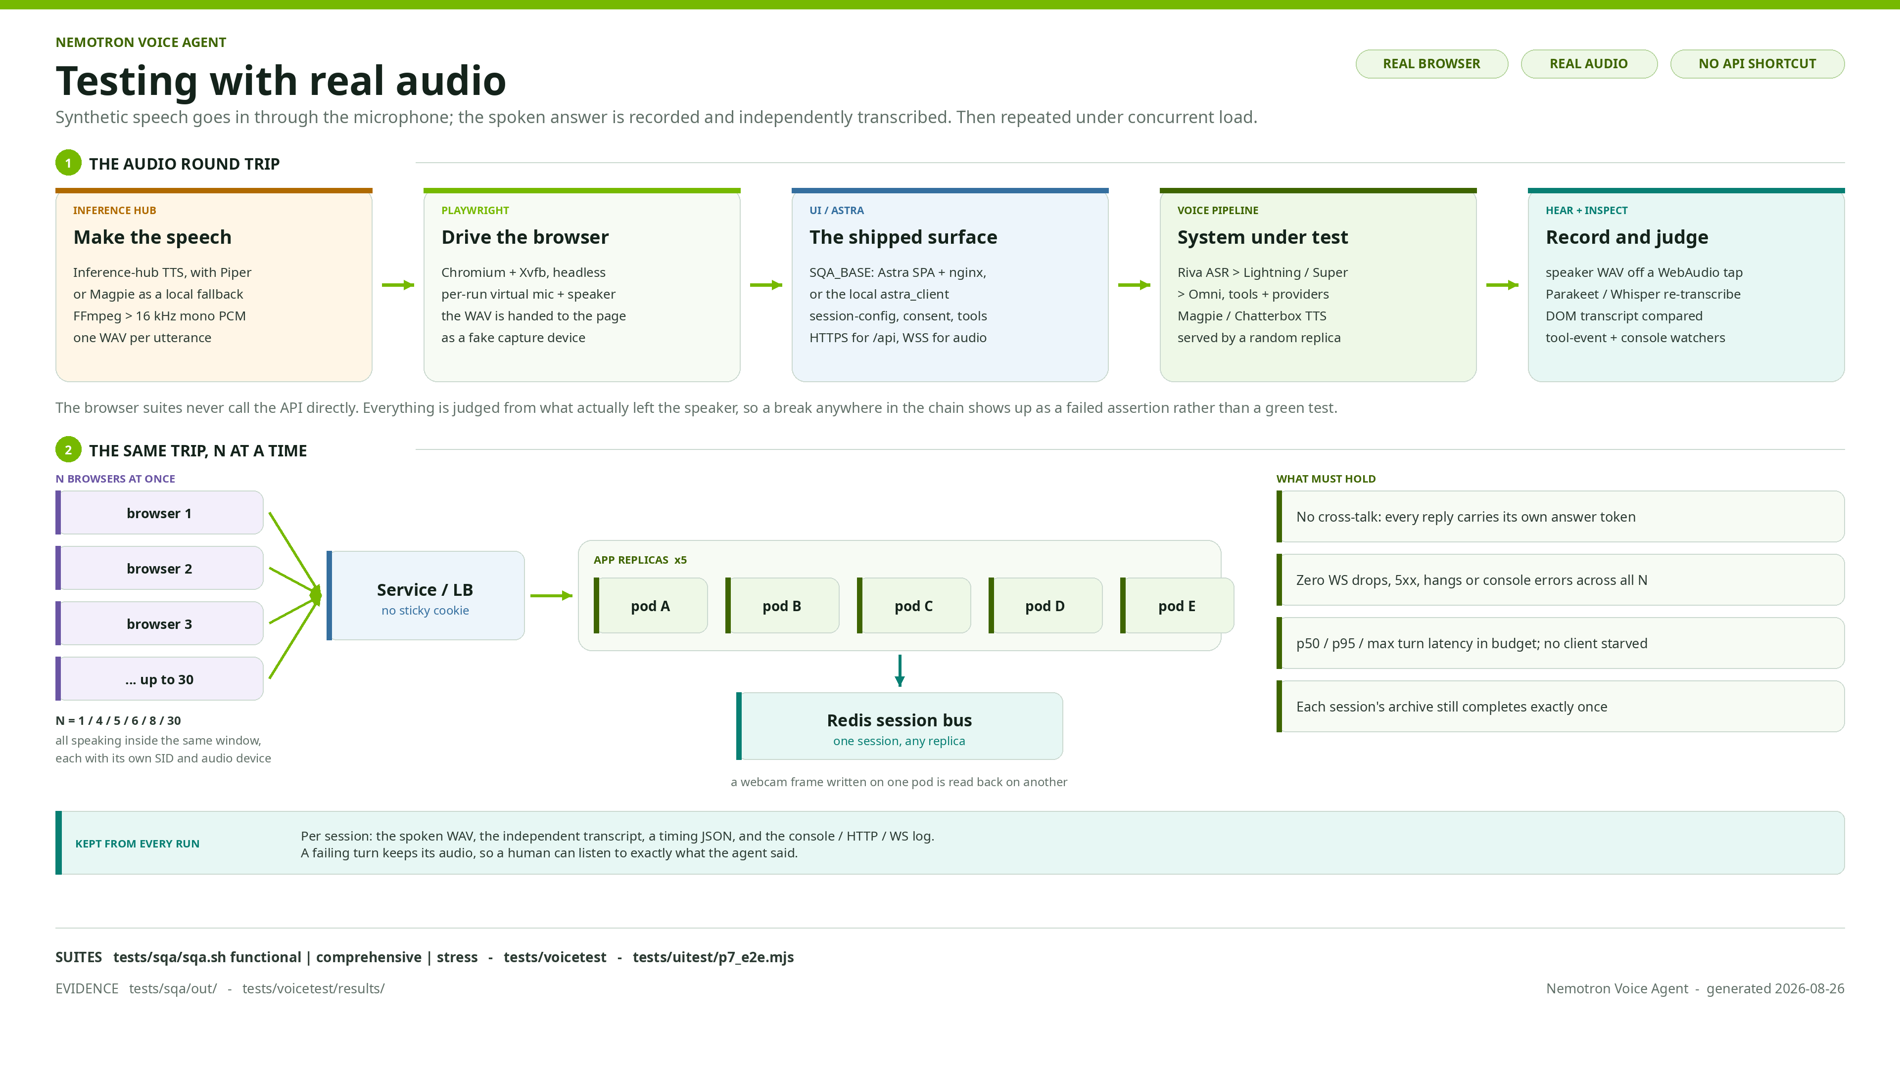

Slide 8
