Slide 1

Text Similarity: A Comprehensive Overview
Text similarity is a fundamental concept in natural language processing (NLP) and has wide-ranging applications in various fields. It involves determining the degree to which two pieces of text are similar or different, taking into account not only the words themselves but also their meanings, relationships, and overall context. Understanding text similarity is crucial for tasks like search engine optimization, document summarization, plagiarism detection, and machine translation.
N V Tharun Kumar
192210423

Slide 2
Importance of Text Similarity
1
Search Engine Optimization
2
Document Summarization
Text similarity algorithms help search engines identify relevant web pages based on user queries. By comparing the query text to the content of web pages, search engines can rank results based on their similarity, ensuring users find the most relevant information.
Text similarity is vital for generating concise and informative summaries of long documents. By identifying the most important sentences or paragraphs with the highest similarity to the overall document's theme, algorithms can create summaries that capture the essence of the original text.
3
Plagiarism Detection
4
Machine Translation
Text similarity algorithms are used to detect plagiarism by comparing submitted work to existing resources. By identifying instances of high text similarity, these algorithms help ensure academic integrity and prevent unauthorized copying of content.
Text similarity plays a key role in machine translation. By comparing the source text with translated versions in different languages, algorithms can identify the most accurate and natural-sounding translations, enhancing the quality of machine-generated translations.

Slide 3

Techniques for Measuring Text Similarity
Lexical Similarity
1
Focuses on comparing the words themselves, often using techniques like word matching, term frequency-inverse document frequency (TF-IDF), or Jaccard similarity.
2
Syntactic Similarity
Examines the grammatical structure of sentences, analyzing the order of words and the relationships between them using techniques like parse trees or dependency parsing.
Semantic Similarity
3
Goes beyond word and sentence structure to understand the underlying meaning of the text, using techniques like word embeddings, knowledge graphs, or ontologies.

Slide 4
Bag-of-Words Approach
Concept
Example
Limitations
The bag-of-words approach represents text as a collection of words, ignoring the order and grammatical structure. Each word is treated as an individual element, and the model simply counts the frequency of each word in the text.
Consider the sentences "The cat sat on the mat" and "The mat was on the cat." Although the word order is different, the bag-of-words approach treats them as identical because they contain the same words with the same frequencies.
While simple to implement, the bag-of-words approach can be limited in its ability to capture semantic meaning. It disregards grammatical structure and word order, which are essential for understanding the nuances of language.

Slide 5
Cosine Similarity
Mathematical Concept
Implementation
Applications
It is often used in conjunction with the bag-of-words approach, where each document is represented as a vector with each dimension corresponding to a unique word in the corpus.
Cosine similarity is widely used in search engine ranking, document retrieval, and recommendation systems, where it helps identify documents most similar to a given query or user profile.
Cosine similarity measures the angle between two vectors representing the text documents. A smaller angle indicates a higher similarity, as the vectors are pointing in similar directions.

Slide 6
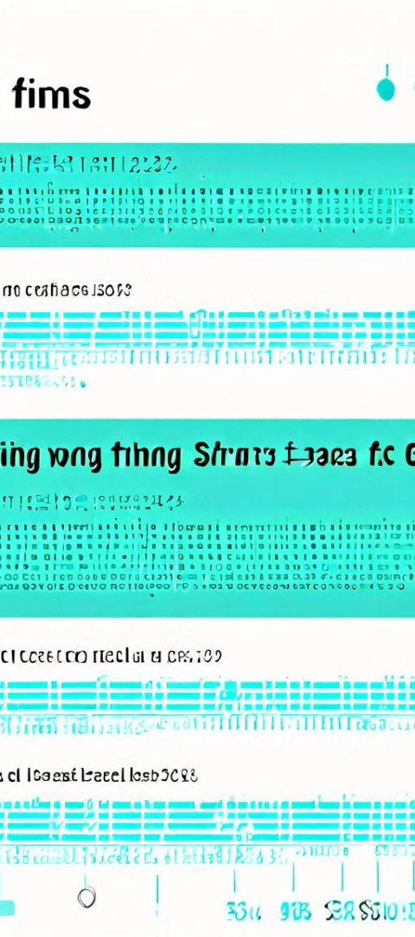



Edit Distance
Levenshtein Distance
This distance metric calculates the minimum number of edits (insertions, deletions, and substitutions) needed to transform one string into another. A lower edit distance indicates higher similarity.
Damerau-Levenshtein Distance
An extension of the Levenshtein distance that also considers transpositions (swapping adjacent characters) as a valid edit operation, improving accuracy in cases where typos or slight variations are common.
Applications
Edit distance is used in spell checkers, search engines, and natural language processing tasks like text correction, phonetic matching, and sequence alignment.

Slide 7
Semantic Similarity
Technique
Description
Word Embeddings
Represent words as vectors in a multidimensional space, where words with similar meanings are located closer together.
Knowledge Graphs
Structured databases that capture knowledge about entities and their relationships, enabling semantic similarity calculations based on shared connections and attributes.
Ontologies
Formal representations of knowledge domains, defining concepts, relationships, and hierarchies, enabling semantic similarity calculations based on shared concepts and taxonomic classifications.

Slide 8



Conclusion and Key Takeaways
Understanding Text Similarity is Essential
Multiple Techniques Exist
Future Advancements are Promising
Various techniques, ranging from lexical to semantic, can be used to measure text similarity, each with its strengths and limitations.
Text similarity is a fundamental concept in NLP with wide-ranging applications in various fields, from search engines to machine translation.
Ongoing research in NLP is continually improving text similarity algorithms, leading to more accurate and sophisticated methods for understanding and processing textual information.

