Slide 1


Introduction to Fraudulent Claims Detection
The insurance industry faces a significant challenge in detecting fraudulent claims, which can have a major financial impact. This presentation will explore data warehousing strategies, predictive analytics, and advanced techniques to combat insurance fraud and protect honest policyholders.
N.V.THARUN KUMAR
192210423

Slide 2

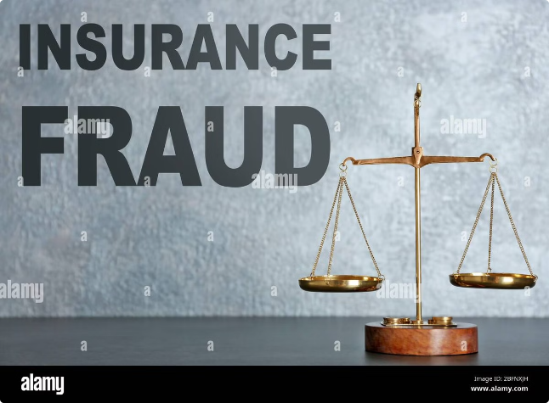
Challenges in the Insurance Industry
1
Complex Claim Patterns
2
Massive Data Volumes
Fraudsters employ sophisticated tactics to disguise their activities, making it difficult to identify suspicious claims.
Insurance companies must analyze vast amounts of structured and unstructured data to detect anomalies.
3
Evolving Fraud Tactics
Fraudsters continually adapt their methods, requiring insurers to stay vigilant and update their detection methods.

Slide 3
Data Warehousing for Fraud Prevention
Centralized Data Repository
Advanced Analytics
Improved Decision-Making
A robust data warehouse consolidates claims data, policy information, and other relevant data sources to enable comprehensive analysis.
The data warehouse supports the application of predictive models, anomaly detection, and other sophisticated analytical techniques.
Accurate, real-time insights from the data warehouse empower insurers to make informed decisions and take proactive measures against fraud.

Slide 4

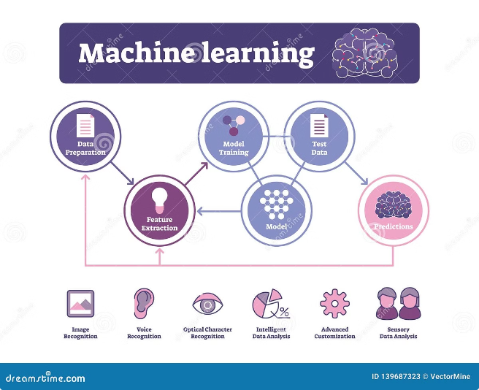
Predictive Analytics and Machine Learning
1
Fraud Patterns Analysis
Leveraging machine learning to identify complex patterns and anomalies in claims data that could indicate fraudulent activity.
2
Predictive Modeling
Developing advanced predictive models to assess the likelihood of a claim being fraudulent, enabling proactive intervention.
3
Continuous Improvement
Iteratively refining the analytics models as new data and fraud tactics emerge, ensuring the detection system remains effective.

Slide 5


Anomaly Detection Techniques
Network Analysis
Outlier Detection
Examining connections and relationships between policyholders, providers, and claims to identify suspicious patterns.
Identifying claims that deviate significantly from the norm, which could indicate fraudulent activity.
Text Mining
Behavioral Analytics
Analyzing unstructured data, such as claims descriptions, to detect keywords or phrases associated with fraud.
Monitoring policyholder and provider behavior to identify suspicious activities or deviations from normal patterns.

Slide 6


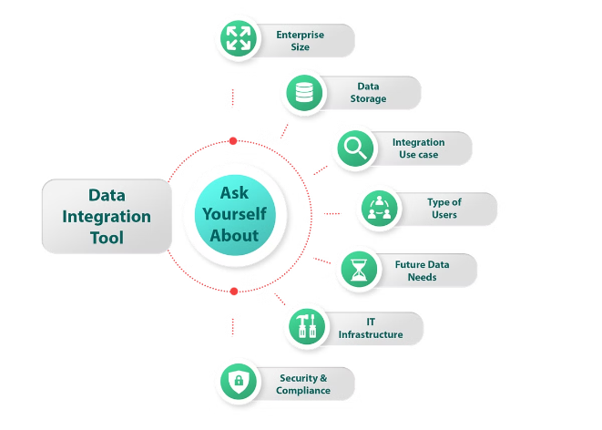


Data Integration and Governance
Data Quality
Ensuring the accuracy, completeness, and timeliness of data is crucial for effective fraud detection.
Data Security
Implementing robust data governance and security measures to protect sensitive information and prevent unauthorized access.
Data Privacy
Adhering to data privacy regulations and safeguarding customer information while leveraging it for fraud detection.

Slide 7





Automated Claims Processing
Real-Time Analysis
Applying fraud detection algorithms to claims as they are submitted, enabling immediate identification of suspicious activity.
Automated Flagging
Automatically flagging high-risk claims for further investigation, streamlining the claims review process.
Continuous Monitoring
Continuously monitoring claims data to identify emerging fraud patterns and update detection models accordingly.

Slide 8

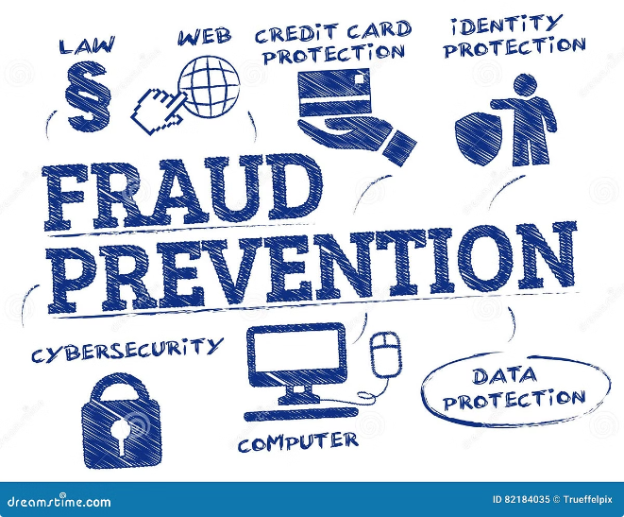
Conclusion and Recommendations
Comprehensive Data Strategy
Develop a robust data warehousing solution to consolidate and analyze claims data from multiple sources.
Advanced Analytics
Leverage predictive analytics, machine learning, and anomaly detection techniques to uncover complex fraud patterns.
Automation and Optimization
Implement automated claims processing and continuous monitoring to enhance the efficiency and effectiveness of fraud detection.
Collaboration and Governance
Ensure strong data governance, security, and privacy measures to support the fraud detection initiatives.

