Slide 1
LAB
Smart Fitness App with AI Camera Coach
Graduation Project • 2026
IT • CLOUD COMPUTING • 12.CCP
Nasser Centre for Science and Technology · NCST
Nominated for "The Inventor" · Bahrain International Channel

Slide 2
01 · THE TEAM
Student Names & Roles
1
Mohammed Jasim
Team Leader · Technical Writer · AI Model Designer
2
Nasser Kuwaitan
UI Designer
3
Ali Ramzi
Full Website Tester
4
Mohammd Waleed
Cloud Architect
5
Ali Salman
Cloud Architect
LAB — AI Fitness Tracker
Page 2

Slide 3
02 · ACADEMIC INFO
Department & Supervisors
DEPARTMENT
SUPERVISING TEACHERS
Information Technology
Mr. Khalid Maroof
SPECIALIZATION
Project Supervisor
Cloud Computing
Mr. Abdullrahman Khaled
Project Supervisor
CLASS
12.CCP
Dr. Raghu Dumpati
Project Supervisor
LAB — AI Fitness Tracker
Page 3

Slide 4
03 · ABOUT THE PROJECT
Brief Description
LAB is a website that uses your phone or laptop camera to act like a personal fitness coach. It watches your body while you move, counts your reps, and tells you if your form is good or bad. You do not need a smart watch or any other device — just a camera.
Workout Tracker
Neon Run Game
Boxing Mode
Do push-ups, squats, and plank. The app counts your reps and grades you.
A running game you play with your body. Jog to run and jump to skip enemies.
A shadow-boxing trainer. Throw punches, dodge, and block using your body.
LAB — AI Fitness Tracker
Page 4

Slide 5
04 · WHY WE BUILT IT
Purpose & Target Beneficiaries
PURPOSE
▸ Give everyone a free fitness coach that anyone can use at home.
▸ Replace costly smart watches and gym trainers with just a camera.
▸ Use AI to check your form and count your reps live, while you train.
▸ Make exercise fun by turning it into games like Neon Run and Boxing.
WHO WILL USE IT
Home Users
Students
Beginners
Gamers
People with no gym
Short workout breaks
Need help with form
Want to move and play
LAB — AI Fitness Tracker
Page 5

Slide 6
05 · STATUS
Current Development Stage
✓ FINISHED — APP IS LIVE AND WORKING ONLINE
WHAT IS DONE
▸ Full website built with a modern dark fitness design
▸ A server that handles all user requests in a safe and fast way
▸ An online database that saves all user data
▸ Three ways to log in: Google, Microsoft, or email and password
▸ Live AI camera that tracks push-ups, squats, and plank
▸ Neon Run game with 5 levels and 3 enemy types
▸ Boxing Mode with rounds, voice cues, and a score system
▸ Admin page to manage users, see actions, and search
▸ App is online: server on Render, website on AWS Amplify
LAB — AI Fitness Tracker
Page 6

Slide 7
06 · WHAT WE LEARNED
Challenges Faced During Development
Login problem on iPhone Safari
The website and the server are on two different web addresses. iPhone Safari blocked the login. We fixed it by using a safer login method that works on all phones.
Making the AI camera accurate
It took many tries to make the AI count reps and check form correctly for different body types and camera angles.
Slow first load on the server
Our free server goes to sleep when nobody uses it. The first visit after sleep is slow. We had to find ways to wake it up faster.
Linking the website, server, and database
We had to connect three different services and make sure they all share the same settings and updates. This took a lot of testing.
Running the game and AI at the same time
Playing the running game while the AI watches your body uses a lot of power. We had to make the code faster so it does not lag.
LAB — AI Fitness Tracker
Page 7

Slide 8
07 · WHAT'S NEXT
Future Development Plans
1
More Exercises
2
Mobile App
Add lunges, burpees, mountain climbers, and yoga poses to the AI camera.
Build a real app for iPhone and Android that also works without internet.
3
Friends & Scores
4
Smart AI Coach
Add friend challenges, weekly score boards, and share your results.
An AI coach that builds your plan, changes the level, and talks to you.
5
Paid Plans
6
Smart Watches
Add a premium plan with deeper stats, custom programs, and meal plans.
Connect with Apple Watch and Google Fit for heart rate and calories.
LAB — AI Fitness Tracker
Page 8

Slide 9
08 · TRY IT NOW
Prototype & Live Demonstration
PROTOTYPE AVAILABLE — LIVE & PUBLICLY ACCESSIBLE
Live Web App (Frontend)
main.dfi1vofcktrh3.amplifyapp.com
Hosted on AWS Amplify
Backend API
grd-project-server.onrender.com
Hosted on Render
Source Code
github.com/nv23158-mohammed-jasim/GRD-PROJECT
Full source on GitHub
LAB — AI Fitness Tracker
Page 9

Slide 10
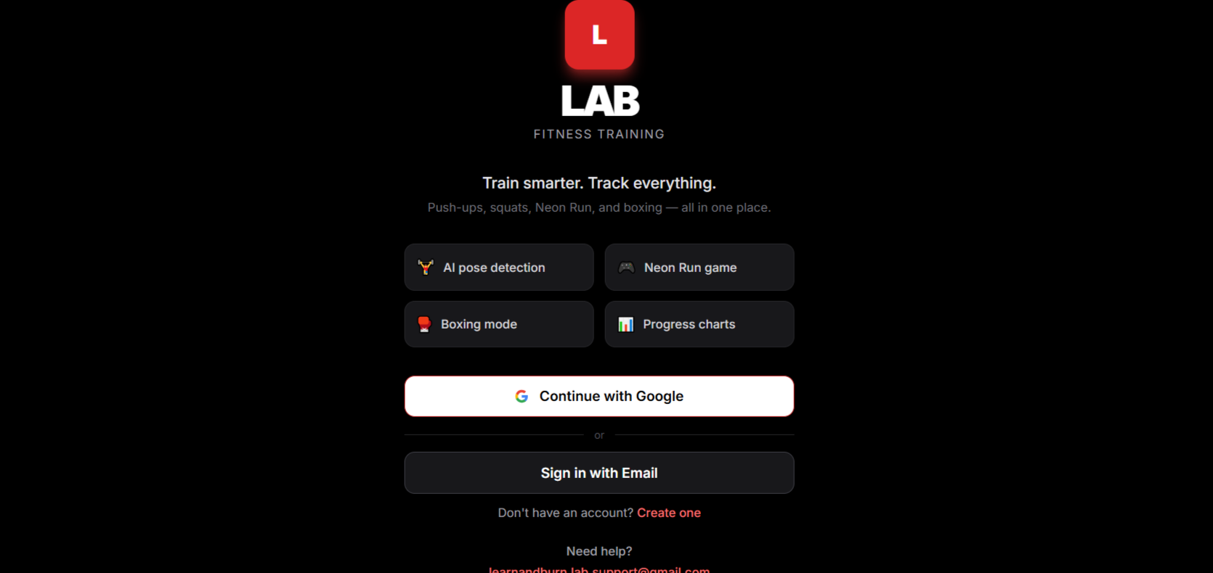
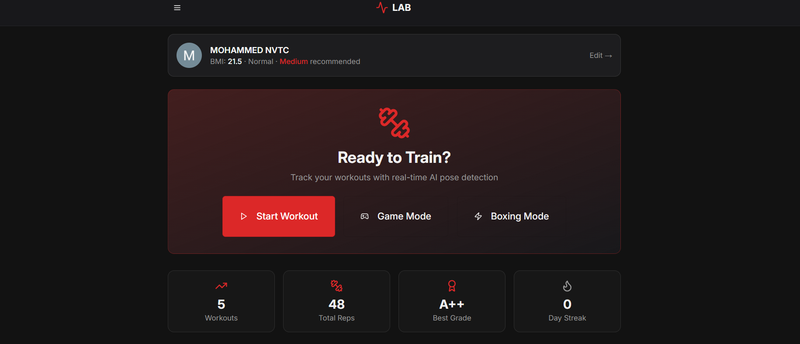
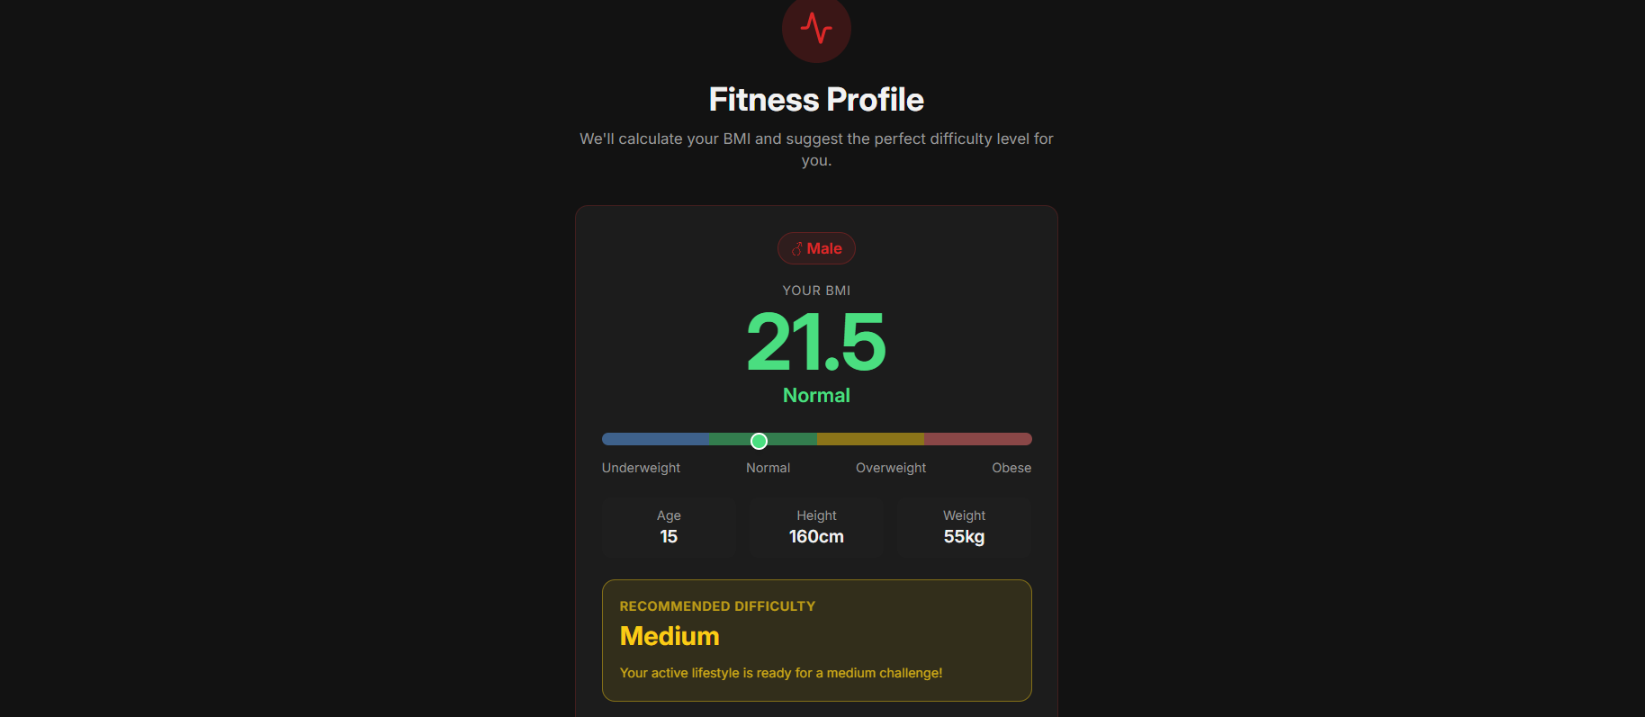
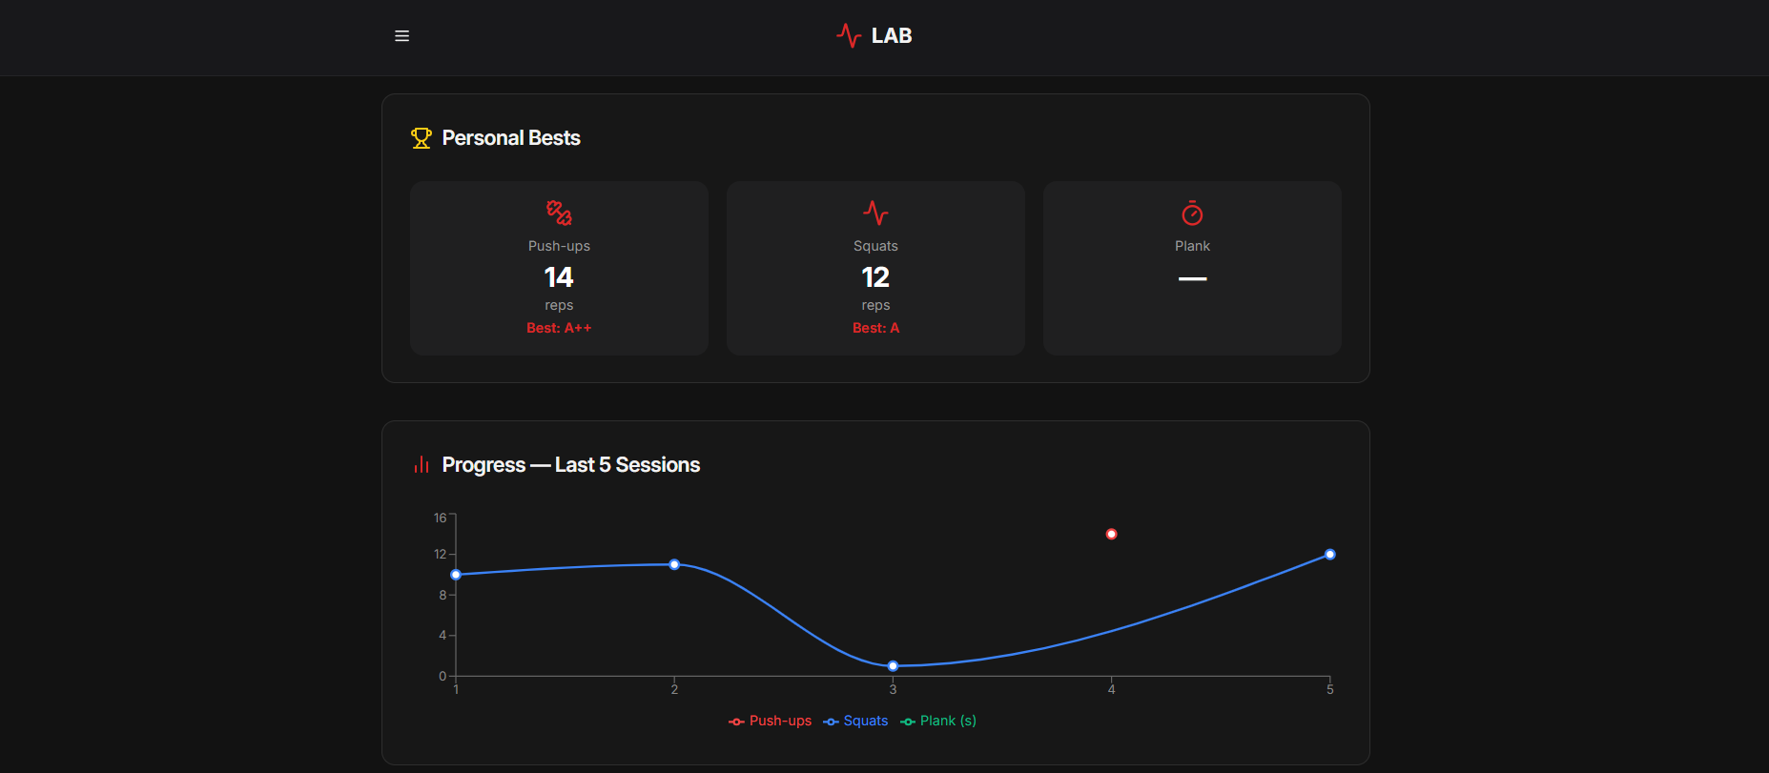
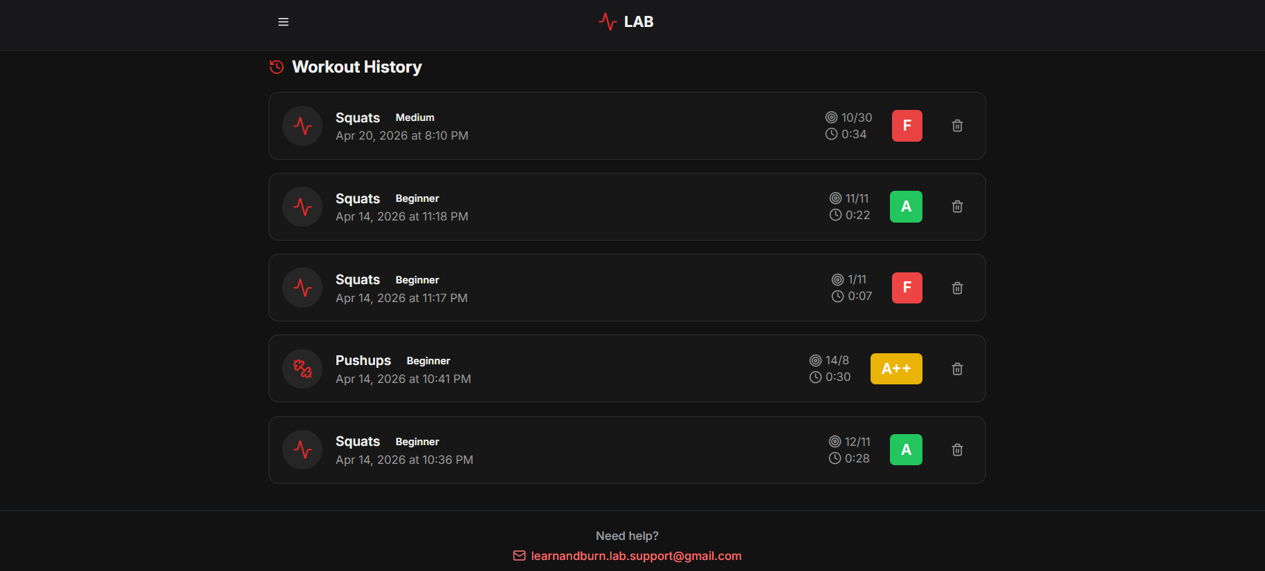
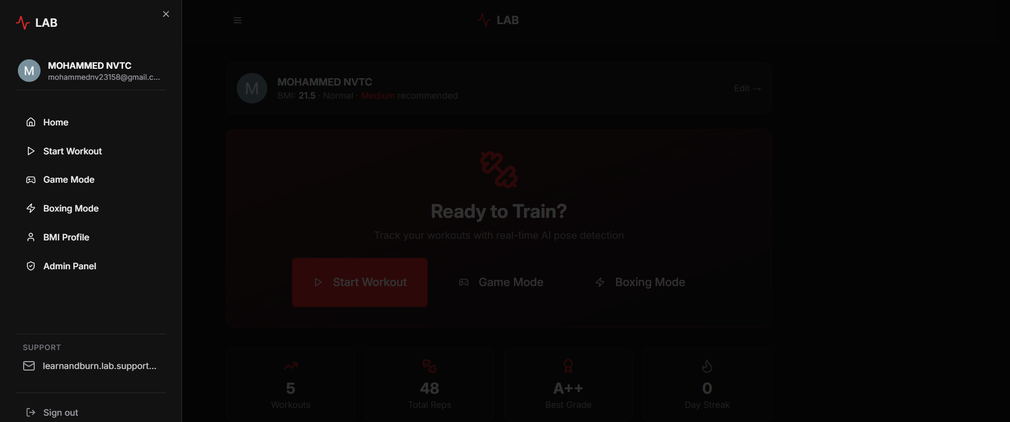
09 · GALLERY
Project Photos
Login Screen
Home Dashboard
BMI Fitness Profile
Personal Bests & Progress
Workout History
Navigation Menu
LAB — AI Fitness Tracker
Page 10

Slide 11
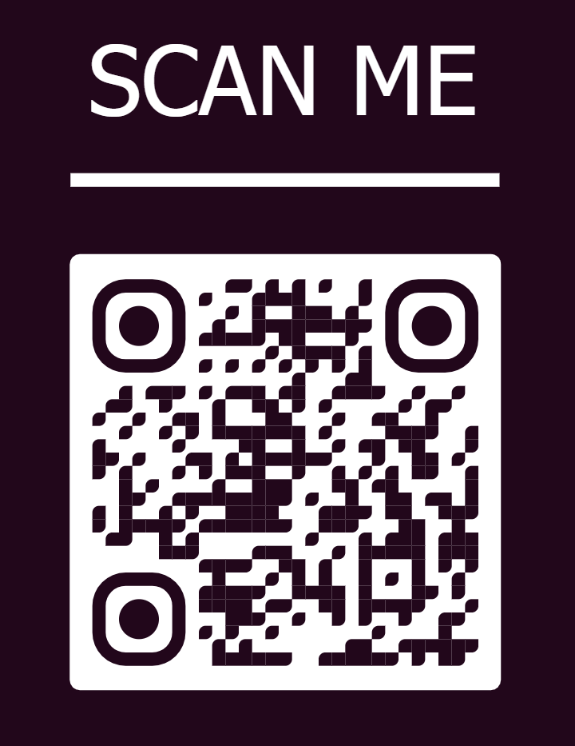
THANK YOU
Questions & Discussion
LAB — AI-Powered Fitness Tracking
Class 12.CCP • Cloud Computing • 2026
Scan to try the live app

