Slide 1

LEARN AND BURN
LAB
AI-Powered & Cloud Based Fitness Training App
Graduation Project
TEAM MEMBERS
Mohammed Jasim
Ali Salman
NV23158
NV23155
Ali Ramzi
Nasser Kuwaitan
NV23126
NV23091
Mohammed Waleed
NV2170

Slide 2
Introduction
LAB
Mohammed Jasim
What is LAB?
How It Works
LAB is a smart fitness web application.
It uses the camera to track body movement in real time.
No extra equipment is needed.
It works directly in the web browser.
1
AI detects your body using the camera
2
System counts your reps automatically
3
Feedback is shown after the workout
4
Results are saved after each session

Slide 3
Project Idea & Objectives
LAB
Mohammed Jasim
The Idea
Build a smart fitness system using Artificial Intelligence — so everyone can train better, anywhere.
WHY LAB?
🤖
🔢
💬
✓ No gym membership needed
AI Tracking
Auto Count
Instant Feedback
Track exercises using AI and camera
Count reps automatically
Give real-time feedback
✓ Works on any device with a camera
✓ AI gives better form correction
🎮
☁️
✓ Track progress over time
✓ Simple to use — no setup
Gamification
Cloud Storage
Make fitness fun with games
Save user data safely

Slide 4
AI Workout System
LAB
Mohammed Jasim
The AI detects your body position and gives feedback in real time.
Push-Ups
Squats
Plank
› Side-view detection
› Knee angle detection
› Full body position check
› Tracks elbow, head & back
› Shows squat depth
› Detects hips & spine
› Checks plank first
› Real-time corrections
› Timer-based tracking
› Counts reps + gives grade
› Tracks range of motion
› Posture score
System uses pose estimation AI — no wearable device needed

Slide 5
UI & User Experience
LAB
Nasser Kuwaitan
Design Principles
User Flow
Simple & Clean
1
Enter BMI Info
Easy to understand for any user
BMI Calculator
2
Get Fitness Level
Users enter height & weight at start
Level System
3
Choose Workout
System gives users a fitness level
Color Feedback
4
Train with AI
Colors guide users during workout
Responsive
5
View Results
Works on all devices and screens

Slide 6
Features & Interaction
LAB
Nasser Kuwaitan
Everything users need — in one place.
📷
Live Camera AI
📊
Rep Counter
🏆
Grade System
AI tracks body in real time using the camera. No extra device needed.
System counts reps automatically and shows the count on screen.
Each workout gives you a grade based on form and reps.
📈
Progress Tracker
🎯
Goal Setting
⚡
Fast Start
Users can see their history and progress over time.
Set targets and the system tracks if you reach them.
No complex setup. Open the app and start training in seconds.

Slide 7
Cloud System
LAB
Mohammed Waleed & Ali Salman
LAB runs on a modern cloud system — fast, safe, and always available.
☁️
⚙️
🗄️
🔧
AWS Amplify
Render
Neon PostgreSQL
GitHub
Frontend Hosting
Backend Server
Database
Version Control
How the Cloud Works Together
→ User opens the app → AWS Amplify serves the website
→ App sends data → Render backend processes the request
→ Backend reads/writes data → Neon PostgreSQL stores it safely
→ Code updates go through GitHub → automatically deployed

Slide 8
System Flow & Authentication
LAB
Mohammed Waleed & Ali Salman
Users log in with Google. The system checks identity and keeps everything safe.
1
2
3
4
5
User Clicks Login
Google Checks
Token Created
Token Saved
Requests Sent
User clicks 'Login with Google'
Google verifies identity
Backend creates a secure token
Token is saved in the app
Token is used for all requests
Security Features
Why This Matters
✓ Google OAuth 2.0 login
› Only real users can access the system
✓ JWT token authentication
› User data is private and protected
✓ HTTPS on all connections
› Sessions expire automatically
✓ No passwords stored
› Simple — one click to sign in

Slide 9
Testing & Validation
LAB
Ali Ramzi
The system was tested on many devices. All features were checked and fixed.
💻 Laptop
📱 Phone
📱 iPad
🖥️ Desktop
What Was Tested
Test Results
✓ AI System — Pose detection accuracy on all devices
AI Accuracy
92%
✓ User Interface — All buttons and screens work correctly
UI Passed
100%
✓ Cloud Services — Data saves and loads properly
Cloud Uptime
99%
✓ Authentication — Google login works on all browsers
Login Success
100%
✓ Performance — App runs fast without delays

Slide 10
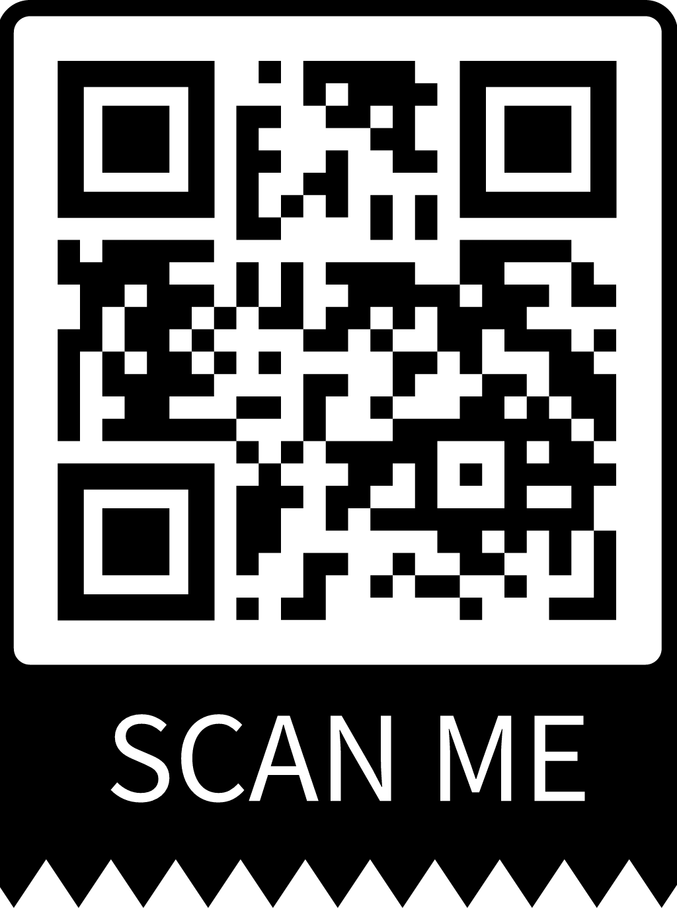
CONCLUSION
LAB — A Smarter Way to Train
LAB uses AI to track workouts in real time
No gym or equipment needed — just a camera
Cloud system keeps data safe and always available
Simple design works for all users and devices
The system is tested and ready to use
Thank You
We are ready for your questions.

