Slide 1
Basics of Next.js with React

Slide 2

Identify the features and benefits of Next.js for building efficient web applications with React
Create Next.js welcome and login applications
Outline server-side rendering (SSR) and demonstrate routing in Next.js
Create a Rest API using Next.js

Slide 3
Introduction to Next.js

Slide 4

What Is Next.js?
It is a React framework for building full-stack web applications.
It abstracts and automatically configures tooling needed for React, like bundling, compiling, and more.
It helps in building interactive, dynamic, and fast React applications.
It is known for providing the best developer experience when building production-ready applications with all the required features.
Notes:
Next.js is a React framework for building full-stack web applications using the React library. You use React Components to build user interfaces, and Next.js for additional features and optimizations.
Next.js also abstracts and automatically configures tooling needed for React, like bundling, compiling, and more. This allows you to focus on building your application instead of spending time with configuration.
Next.js can help you build interactive, dynamic, and fast React applications.
Next.js is known for the best developer experience when building production-ready applications with all the features you need.

Slide 5
Key Features of Next.js
Data fetching
Built-in Cascading Style Sheets (CSS)
Server-side rendering (SSR)
Dynamic routing
TypeScript support
Image optimization
Layouts
Automatic code splitting
Fast refresh
Notes:
Some key features of Next.js:
Data Fetching
Built-in CSS
Server-Side Rendering (SSR)
Dynamic Routing
TypeScript
Image Optimization
Layouts
Fast Refresh
Automatic code splitting

Slide 6
Key Features of Next.js
Data fetching
It provides developers with various methods to fetch and render data in their applications.
It aligns with different rendering strategies like server-side rendering (SSR), static site generation (SSG), and client-side rendering (CSR).
Built-in Cascading Style Sheets (CSS)
Next.js supports importing CSS files directly into JavaScript or React components.
Notes:
Data Fetching
Data fetching in Next.js is a fundamental aspect, providing developers with various methods (Examples: Static Generation with getStaticProps, Server-side Rendering with getServerSideProps) to fetch and render data in their applications. These methods align with different rendering strategies like Server-Side Rendering (SSR), Static Site Generation (SSG), and Client-Side Rendering.
[SSR in Next.js: Renders pages on the server for each request, providing improved SEO and faster initial page load, suitable for dynamic content.
SSG in Next.js: Generates static HTML files at build time, leading to high performance and faster loading, ideal for pages with static content.
Client-Side Rendering in Next.js: Loads and renders content in the browser using JavaScript, enhancing interactivity and user experience, but may impact initial load time and SEO.]
2. Built-in CSS
Next.js supports to import CSS files directly in your JavaScript/React components.

Slide 7
Key Features of Next.js
Server-side rendering (SSR)
Next.js allows pages to be rendered on the server side, thereby improving performance and SEO.
Dynamic routing
It is a file-system-based routing mechanism where pages get automatically routed based on their file names in the pages directory.
TypeScript support
It is a built-in support that makes it easier to build robust applications with type-checking.
Notes:
3. Server-Side Rendering (SSR)
Next.js allows pages to be rendered on the server side. This means the server pre-renders each page into HTML, which is then sent to the client. This process can improve performance and SEO.
4. Dynamic Routing
Next.js offers a file-system-based routing mechanism where pages are automatically routed based on their file names in the pages directory. This eliminates the need for explicit route declarations, simplifying the creation of new routes. Additionally, dynamic routing is supported, allowing for the creation of complex routing patterns with variables in the URL.
Dynamic routes are pages that enable you to add customized parameters to a URL.
Any URL is mapped to the file system and stored in the page folder without the need for extra configuration.
5. TypeScript
Next.js has built-in TypeScript support, making it easier to build robust applications with type-checking.

Slide 8
Key Features of Next.js
Image optimization
G
This helps to resize, optimize, and serve images in modern formats like WebP.
Layouts
It allows developers to create reusable layout components that can wrap around pages or groups of pages.
This is particularly useful for maintaining consistent design elements like headers, footers, and sidebars across different pages.
Notes:
6 Image Optimization
Next.js includes automatic image optimization with the next/image component, which can resize, optimize, and serve images in modern formats like WebP. [WebP is a modern image format that provides superior lossless and lossy compression for images on the web.]
This tries not to transport huge pictures to gadgets with a smaller viewport.
Automatic Image Optimization works with any picture source
7. Layouts
The Layouts feature in Next.js allows developers to create reusable layout components that can wrap around pages or groups of pages. This is particularly useful for maintaining consistent design elements like headers, footers, and sidebars across different pages. By defining a layout component once, you can apply it across multiple pages, ensuring a consistent look and feel while reducing redundancy in code. This feature streamlines the development process and makes it easier to manage and update the UI across an entire Next.js application.

Slide 9
Key Features of Next.js
Fast refresh
It provides instant feedback on edits made to React components.
It preserves the state of the components while updating the code, which enhances the development experience.
Automatic code splitting
This feature enhances application performance by splitting the JavaScript code into smaller chunks.
This process happens at the page level; each page in the pages directory gets its own JavaScript bundle.
This approach optimizes the initial load of the application, as users download only the code they need for the page they are visiting, rather than the entire application's code.
Notes:
8. Fast Refresh
This feature provides instant feedback on edits made to React components. It preserves the state of the components while updating the code, which enhances the development experience.
9 Automatic code splitting
Next.js automatically implements code splitting, a feature that enhances application performance by splitting the JavaScript code into smaller chunks. This process happens at the page level: each page in the pages directory gets its own JavaScript bundle. This means that only the code necessary for rendering a particular page is loaded when a user visits that page, leading to faster page load times. This approach optimizes the initial load of the application, as users download only the code they need for the page they're visiting, rather than the entire application's code. This results in improved performance, especially for larger applications.

Slide 10
Benefits of Next.js
Improved performance
Flexibility with rendering techniques
Better SEO
Scalability
Enhanced user experience
Rich ecosystem
Simplified routing
Community and support
Full stack capabilities
Developer experience
Ease of deployment
Zero configuration startup
Notes:
Some benefits of Using Next.js with React:
Improved Performance: Next.js's server-side rendering and static site generation contribute to faster page load times, which is crucial for user experience and SEO.
Better SEO: Server-side rendered pages and statically generated sites are more easily indexed by search engines, leading to potentially higher search rankings.
Enhanced User Experience: Features like automatic code splitting and optimized image handling ensure that users experience faster, more responsive web applications.
Simplified Routing: The file-system-based routing in Next.js simplifies the creation of routes, making the development process more intuitive.
Full-stack Capabilities: With API routes, Next.js allows developers to write server-side logic directly within the application, facilitating the development of full-stack applications.
Ease of Deployment: Next.js applications can be easily deployed on various hosting platforms, often with minimal configuration.
Flexibility with Rendering Techniques: Next.js supports different rendering techniques (SSR, SSG, client-side rendering) within the same application, giving developers flexibility based on each page’s needs.
Scalability: The framework is designed to build applications that can scale, making it suitable for both small and large-scale applications.
Rich Ecosystem: Being part of the React ecosystem, Next.js benefits from a wide range of compatible libraries and tools.
Community and Support: A large, active community means better support, more resources, and a continuous stream of updates and improvements.
Developer Experience: Features like hot module replacement and fast refresh contribute to a more efficient and enjoyable development experience.
Zero Configuration Startup: Next.js works out of the box with sensible defaults, yet it is highly customizable for complex use cases.
These benefits make Next.js a compelling choice for developers looking to leverage React for more efficient, scalable, and performance-oriented web applications.

Slide 11
Creating Next.js Welcome Application
Problem Statement:​
Duration: 15 min
You have been assigned a task to create the Next.js application to display a simple welcome message.

Slide 12
Assisted Practice: Guidelines
Steps to be followed:
1. Set up the next.js project
2. Create the Project
3. Run the application

Slide 13
Server-Side Rendering (SSR) in Next.js

Slide 14
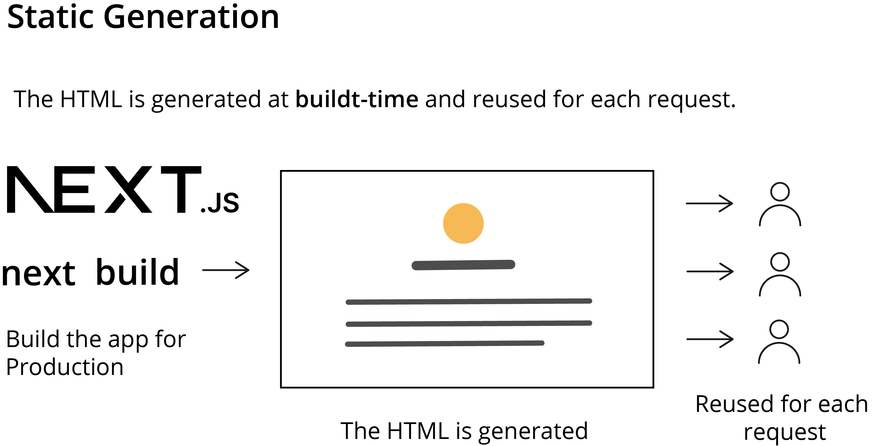
SSR in Next.js
It refers to the process of rendering React components on the server to generate HTML for a page request, which is then sent to the client's browser.
Static generation
The HTML is generated at built-time and reused for each request.
Next, build
Build the app for production
The HTML is generated.
Reused for each request
Notes:
Server-Side Rendering in Next.js
Server-side rendering (SSR) in Next.js refers to the process of rendering React components on the server to generate HTML for a page request, which is then sent to the client's browser. This approach differs from traditional React applications, where rendering typically occurs in the browser (client-side). SSR in Next.js offers several advantages, particularly in terms of performance and SEO.

Slide 15
Create a React Next.js Login Application
Problem Statement:​
Duration: 15 min
You have been assigned a task to create the Next.js application by creating server-side components to do login with file and testing with the React component.

Slide 16
Assisted Practice: Guidelines
Steps to be followed:
1. Create and set up the Next.js project
2. Create a file that contains a set of login details
3. Create a server folder that holds a server-side component
4. Create a client folder
5. Run the application

Slide 17
Routing in Next.js

Slide 18
Routing in Next.js
It refers to the process of managing navigation between different pages in a web application based on URL paths.
Types of routes:
Index routes
The index.js files in the pages directory get automatically routed to the root directory.
Nested routes
It involves organizing files into subdirectories within the pages directory and enables the creation of nested URL structures.
Dynamic routes
It uses square brackets ([ ]) to indicate dynamic segments in
the URL.
Notes:
Routing in Next.js, refers to the process of managing navigation between different pages in a web application based on URL paths.
Types of Routes in Next.js:
Index Routes: The index.js files in the pages directory get automatically routed to the root directory.
Nested Routes: It involves organizing files into subdirectories within the pages directory and enables the creation of nested URL structures.
Dynamic Routes: It uses square brackets ([ ]) to indicate dynamic segments in the URL.

Slide 19
Creating Next.js Routing Application
Problem Statement:​
Duration: 15 min
You have been assigned a task to create the Next.js server-side routing application based upon the path provided by browser.

Slide 20
Assisted Practice: Guidelines
Steps to be followed:
1. Create and set up a Next.js project
2. Create components for routing
3. Run the application

Slide 21
Creating a Rest API Using Next.js
Problem Statement:​
Duration: 15 min
You have been assigned a task to create a Next.js server-side component for a REST API that interacts with a file module for efficient data storage and retrieval, accessible across various technologies.

Slide 22
Assisted Practice: Guidelines
Steps to be followed:
1. Create and set up a Next.js project
2. Create a JSON file for an employee
3. Create a routing component
4. Run the application

Slide 23
Next.js is a React framework for building full-stack web applications as well as interactive, dynamic, and fast React applications.
SSR in Next.js refers to rendering React components on the server to generate HTML for a page request, which is then sent to the client's browser.
Routing in Next.js refers to the process of managing navigation between different pages in a web application based on URL paths.

Slide 25
Which among the following is a built-in support that makes it easier to build robust applications with type-checking?
1
Server-side rendering
Fast refresh
TypeScript
Data fetching

Slide 26
Which among the following is a built-in support that makes it easier to build robust applications with type-checking?
1
Server-side rendering
Fast refresh
TypeScript
Data fetching
C
TypeScript is a built-in support that makes it easier to build robust applications with type-checking.

