Slide 1
Hydrotools
A Microsoft Excel Extension for Surveying
Written & Presented by:
Nick Viner

Slide 2


About Hydrotools
Hydrotools is a Visual Basic (VB) based application which runs in conjunction with Microsoft Excel to allow the user to quickly and efficiently perform operations commonly found in the field of marine surveying.

Slide 3
In This Presentation….
Will look at:
Unit conversions & Vector calculations
Tide data formatting for CARIS
Offset calculations for CARIS
Logging capabilities
Magnetometer data analyst

Slide 4
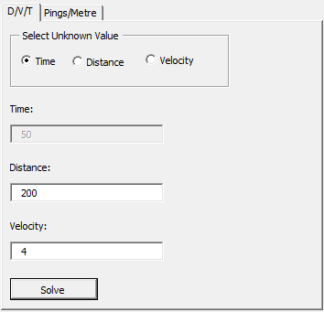
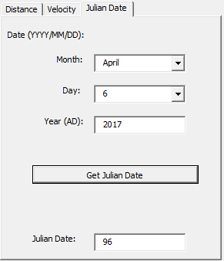
Calculators & Unit Conversion
Hydrotools comes equipped with an array of basic calculators which allow for the quick conversion of units including:
Distance
Velocity
Dates (Gregorian to Julian)

Slide 5
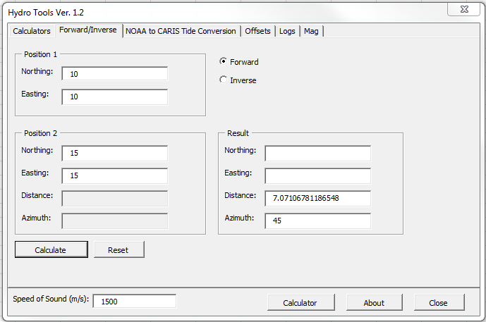
Vector Calculations
Hydrotools is also capable of basic forward/inverse calculations.

Slide 6
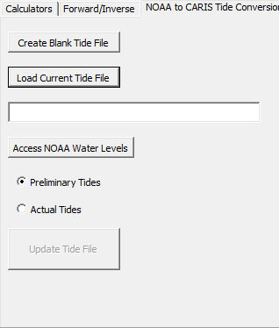
Tide Data Formatting
Internet access provided, Hydrotools is able to quickly format water level data from any NOAA Tide Station for later input into CARIS for processing.
Click here to start HydroTools

Slide 7
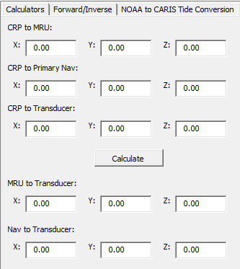
Offset Calculations
Entering offets into CARIS can be a confusing process at best. Luckily Hydrotools has an offset calculator which will solve the necessary offsets and output them with the correct +/- values.

Slide 8
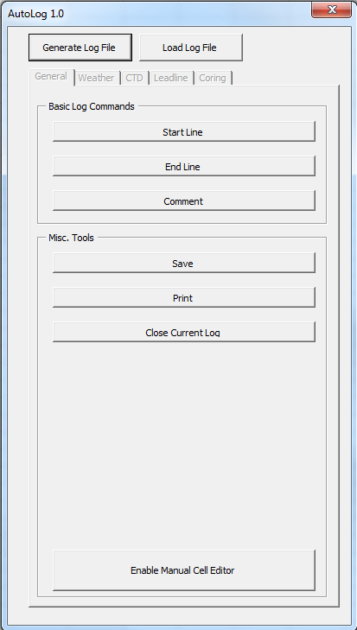
Hydrotools’ AutoLog
AutoLog provides the user an efficient way of filling out digital logs though the use of log templates in Excel.
Logs in Excel
Allows both manual and automatic entry
When used properly, can completely eliminate user error.
Click here to start HydroTools

Slide 9
Magnetometer Data Analyst
Analyzing Data from the G-880 Magnetometer

Slide 10
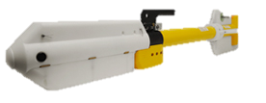
Overview
The Hydrotools Magnetometer Analyzer was written in an attempt to better understand Magnetometric data output strings.
Specific to the Geometrics G-880 Cesium Magnetometer.

Slide 11
About the G-880
The G-880 magnetometer utilizes the interactions between infrared light and Cesium atoms to determine changes in surrounding magnetic field.
Striking the Cesium atoms with infrared lights causes shifts in their energy levels which is the driving mechanic for all Cesium magentometers.
For more information, refer to the G-880 user manual.

Slide 12
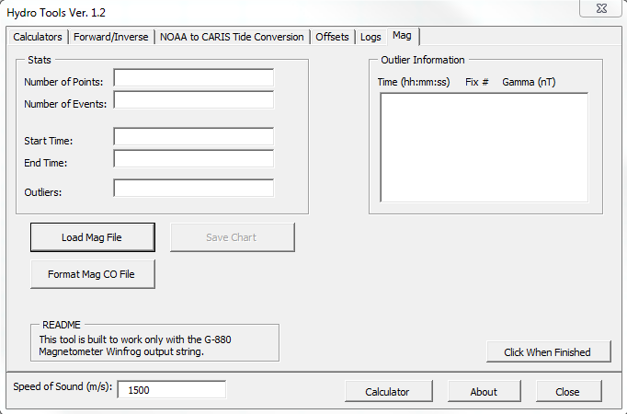
Hydrotools Mag Analyzer
The Mag Data Analyzer serves two primary functions:
Load Mag data files and output pertinent data as well as a graph of the data.
Parse Mag Cable-out files by line number and format them in a manner which can be used by Geos processing.

Slide 13
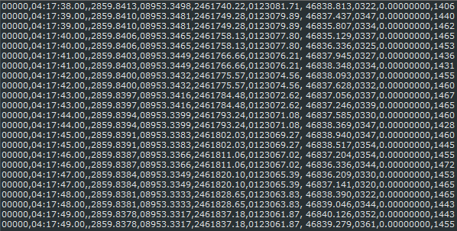
Processing G880 Output
The unedited mag string comes in the format:
Fix num, Time (HH:MM:SS.ss),,Lat (DDMM.mmmm), Lon (DDMM.mmmm), X, Y, Gamma (nT), , Signal Strength.
Data is comma delimited.

Slide 14
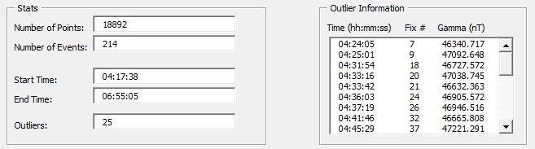
Processing G880 Output
Hydrotools extracts the following data:
Number of points
Number of events/fixes
Start time
End time
Potential outliers (indicatory of mag hit)

Slide 15
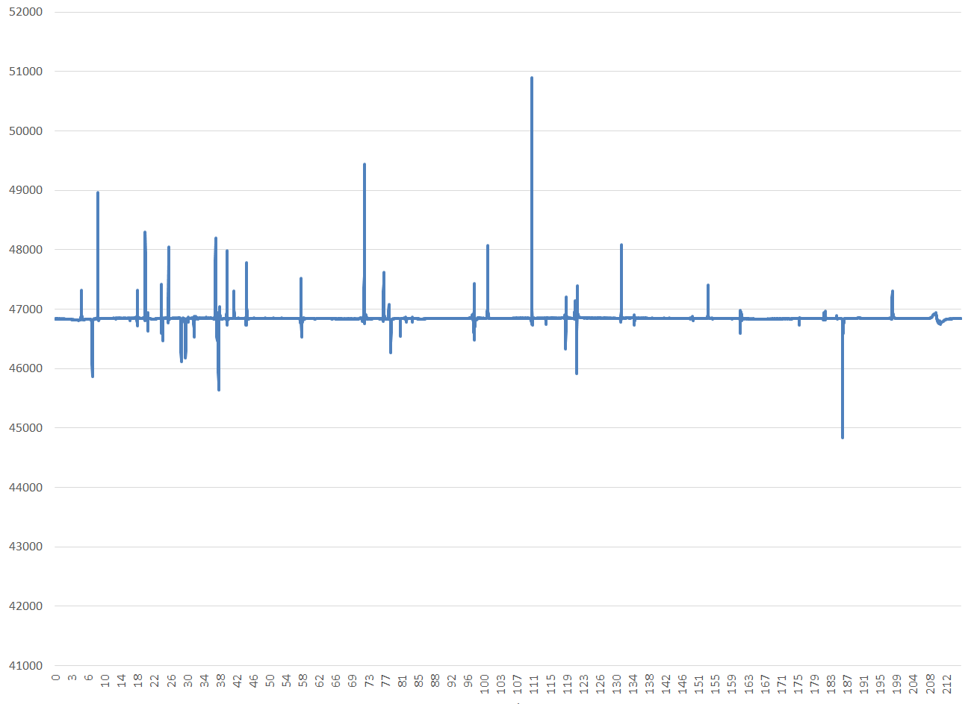
Processing G880 Output
A graph is generated which displays the gamma values throughout the line.

Slide 16
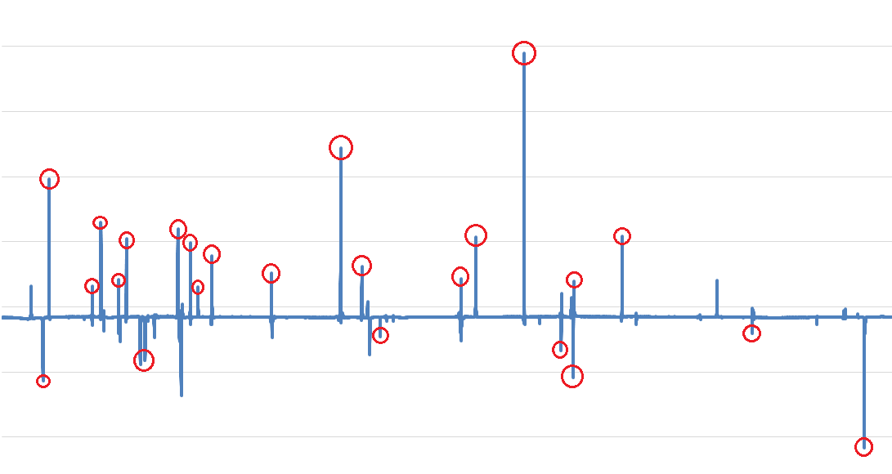
Processing G880 Output
Algorithm pointed out the following outliers. Still a work in progress.

Slide 17
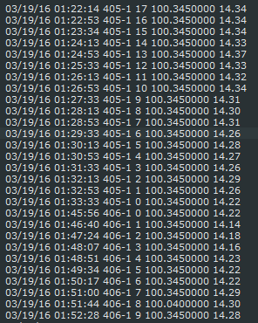
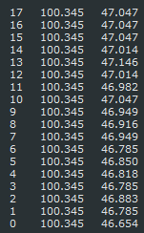
Formatting Mag CO.
Hydrotools is able to take a Mag CO file from Hydromap, parse it into individual files by day, and convert it to a fix, cable out (ft), and depth (m).

Slide 18
Final Thoughts
Goal was to improve on my Excel knowledge.
The goal was met through development of my skills with VB, primarily in dealing with an analyzing external data files.
Also touched on another goal in dealing with magnetometers.

Slide 19
Questions?

