Slide 1
Annual Goals Presentation
General performance and data workflow analysis for 2016
Written & Presented by:
Nick Viner

Slide 2
Overview
Goals were set in the following categories:
  Career Advancement
  Health & Safety
  Learn & Diversify
  Data Movement
Note: Hyperlinks will not work without Hydrotools memory stick.

Slide 3
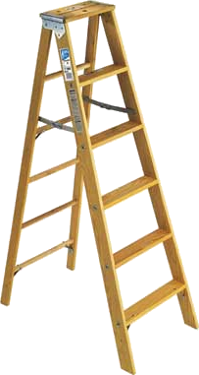
Career Advancement
Overall improvement as a surveyor, and diversification of skillset.

Slide 4

Health & Safety
No reported incidents or near misses from myself or coworkers.

Slide 5

Learn & Diversify
The following progress was made:
  Development of data processing tools.
  Magnetometer research.
  Improvement of Hydromap processing skills (both regular and AUV data).
  C-Ghost/Wolf mobilizations.
  Rebuilding Sea Scout server rack.

Slide 6
Data Movement
Development of Excel macros and Batch files which can quickly process and format specific data types into a manner useable for processing.
  Ie. Parsing mag data into individual lines (see below for sample code).

Slide 7

Data Movement
Updated the NOAA XML schema to satisfy the 2016/2017 Descriptive Report requirements.
The XML document validated and a workflow manual was written.

Slide 8
The Big Picture
In order to improve understanding of collected data, as well as surveying in general, I’ve begun work on a small application I call “Hydrotools”.
Not only does this allow me to improve on any aspect of surveying, I am able to improve on myself as a coder, and use the code I’ve written to examine how I’ve progressed over time (changes in code complexity, change logs, depth of code in relation to topics in surveying).

Slide 9
Hydrotools
A Microsoft Excel Extension for Surveying
Written & Presented by:
Nick Viner

Slide 10


About Hydrotools
Hydrotools is a Visual Basic (VB) based application which runs in conjunction with Microsoft Excel to allow the user to quickly and efficiently perform operations commonly found in the field of marine surveying.
It was written in order to improve my own skills with Microsoft Excel and to better my understanding of surveying as a whole.

Slide 11
In This Presentation….
Will look at:
  Unit conversions & Coordinate calculations
  Tide data formatting for CARIS
  Offset calculations for CARIS
  Logging capabilities
  Magnetometer data analyst
  CTD data cleaning

Slide 12
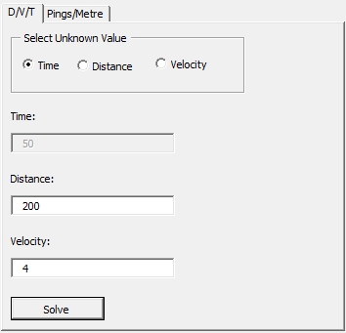
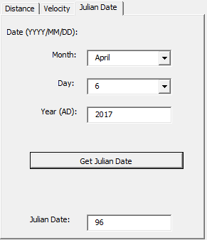
Calculators & Unit Conversion
Hydrotools comes equipped with an array of basic calculators which allow for the quick conversion of units including:
  Distance
  Velocity
  Dates (Gregorian to Julian)

Slide 13
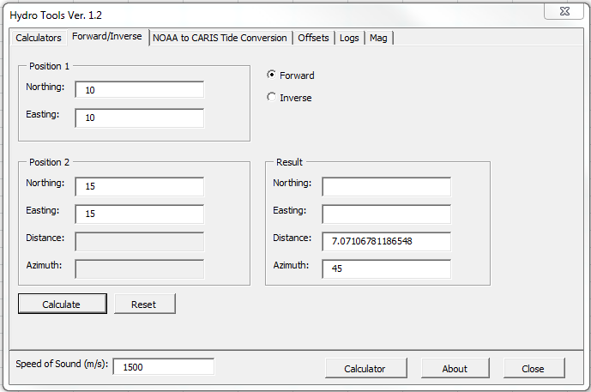
Coordinate Calculations
Hydrotools is also capable of basic coordinate calculations.

Slide 14
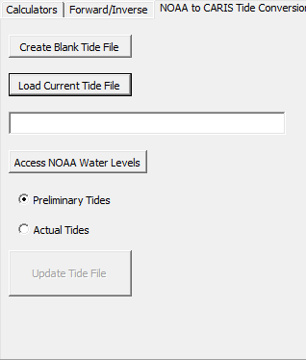
Tide Data Formatting
Internet access provided, Hydrotools is able to quickly format water level data from any NOAA Tide Station for later input into CARIS for processing.
Click here to start HydroTools

Slide 15
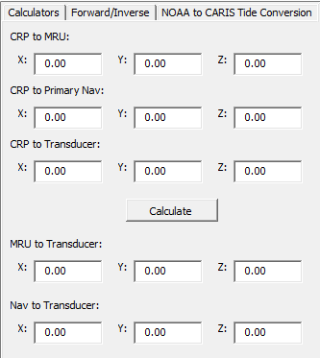
Offset Calculations
Entering offsets into CARIS can be a confusing process at best. Luckily Hydrotools has an offset calculator which will solve the necessary offsets and output them with the correct +/- values.

Slide 16
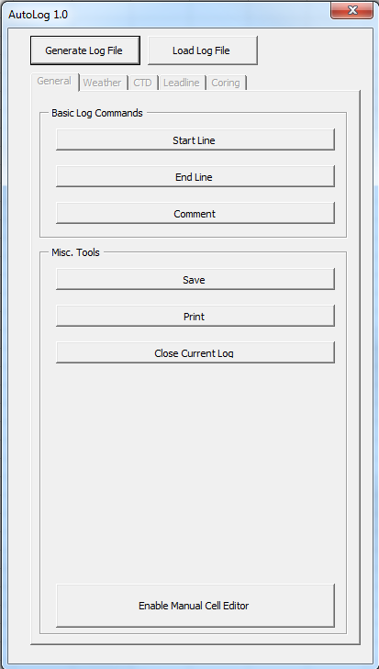
Hydrotools’ AutoLog
AutoLog provides the user an efficient way of filling out digital logs though the use of log templates in Excel.
  Logs in Excel
  Allows both manual and automatic entry
  When used properly, can completely eliminate user error.
Click here to start HydroTools

Slide 17
Magnetometer Data Analyst
Analyzing Data from the G-882 Magnetometer

Slide 18
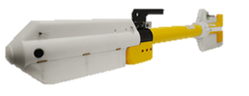
Overview
The Hydrotools Magnetometer Analyzer was written in an attempt to better understand Magnetometric data output strings.
  Specific to the Geometrics G-882 Cesium Magnetometer.

Slide 19
About the G-882
The G-882 magnetometer utilizes the interactions between infrared light and Cesium atoms to determine changes in surrounding magnetic field.
  Striking the Cesium atoms with infrared lights causes shifts in their energy levels which is the driving mechanic for all Cesium magentometers.
  For more information, refer to the G-882 user manual.

Slide 20
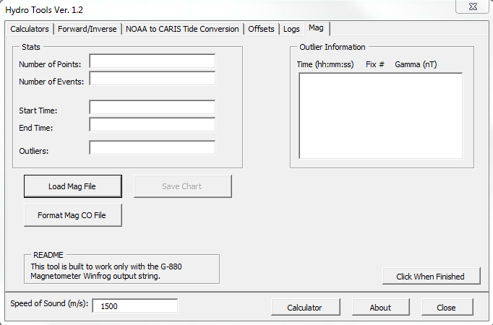
Hydrotools Mag Analyzer
The Mag Data Analyzer serves two primary functions:
  Load Mag data files and output pertinent data both numerically and visually.
  Parse Mag Cable-out files by line number and format them in a manner which can be used by Geos for processing.

Slide 21
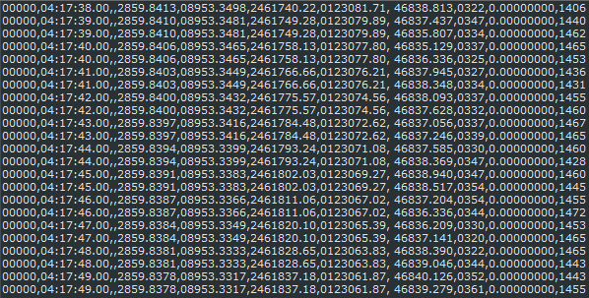
Processing G880 Output
The unedited mag string comes in the format:
  Fix num, Time (HH:MM:SS.ss),,Lat (DDMM.mmmm), Lon (DDMM.mmmm), X, Y, Gamma (nT), , Signal Strength.
Data is comma delimited.

Slide 22
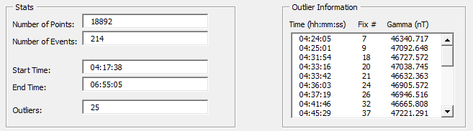
Processing G880 Output
Hydrotools extracts the following data:
  Number of points
  Number of events/fixes
  Start time
  End time
  Potential outliers (indicatory of mag hit)

Slide 23
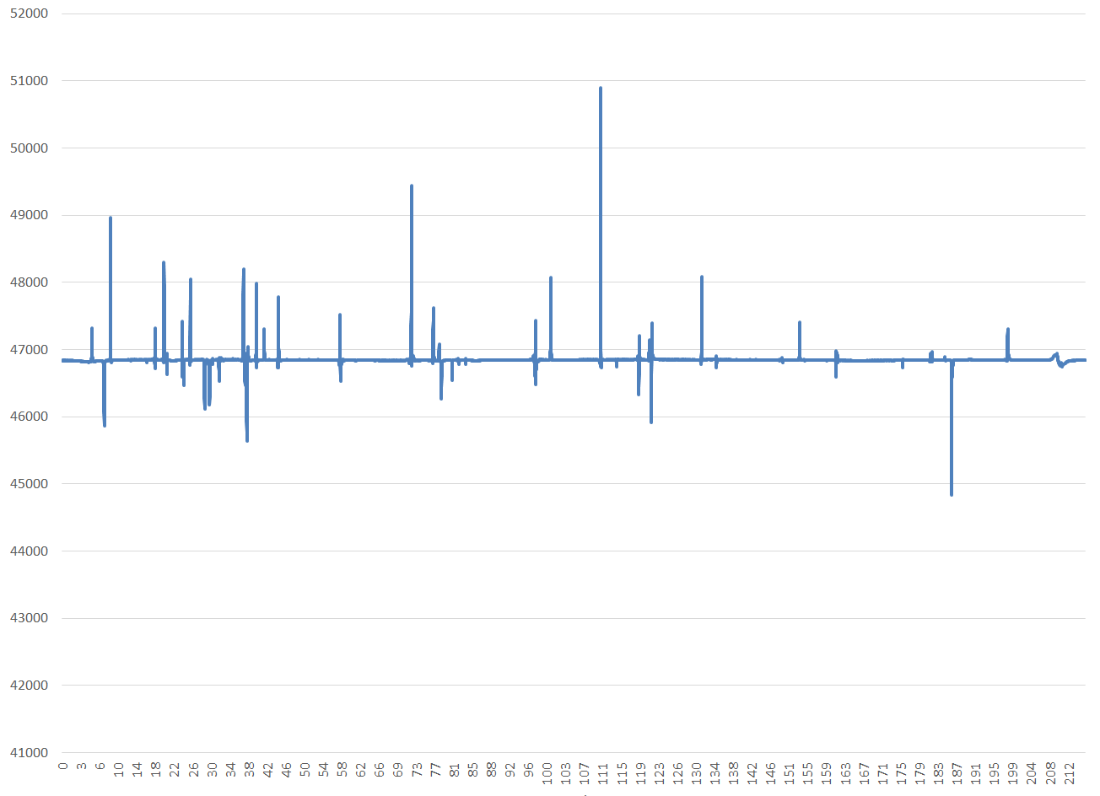
Processing G880 Output
A graph is generated which displays the gamma values throughout the line.

Slide 24
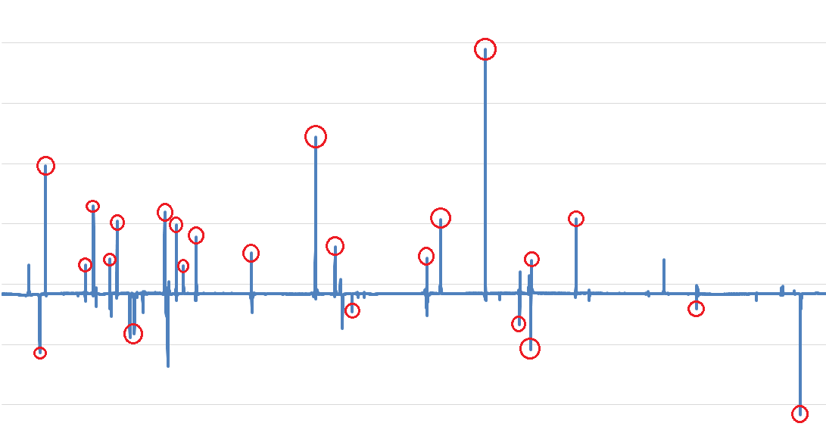
Processing G880 Output
Algorithm pointed out the following outliers. Still a work in progress.

Slide 26
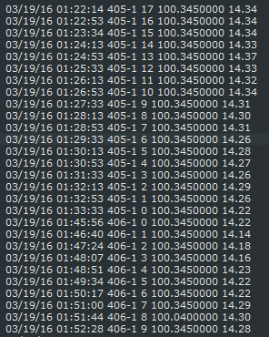
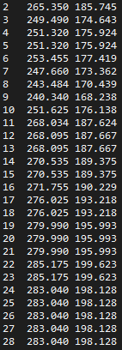
Formatting Mag CO.
Hydrotools is able to take a Mag CO file from Hydromap, parse it into individual files by line, and convert it to a fix, cable out (ft), layback (ft).

Slide 27
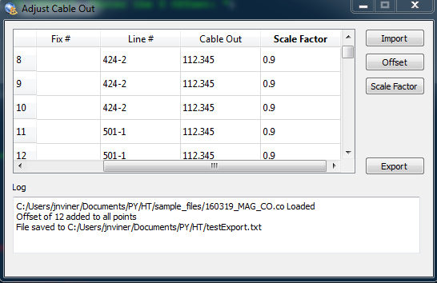
Formatting Mag CO.
Also a standalone Mag CO processing application written using PyQT.
The Excel version is still currently far more thorough.

Slide 28
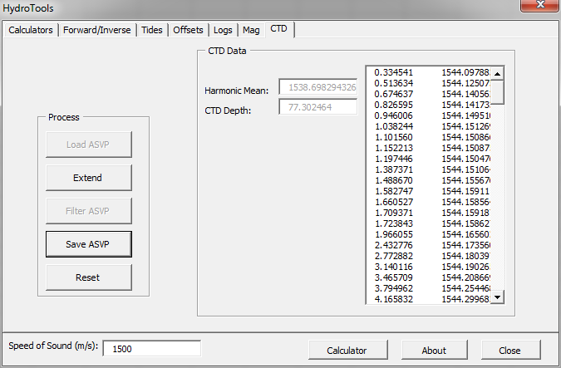
CTD Data
Able to load in ASVP files to extract the harmonic mean and depth values used in the logs. Can also filter the data so SIS will accept it.

Slide 29



Final Thoughts
Goal was to improve on my Excel knowledge.
The goal was met through development of my skills with VB, primarily in dealing with an analyzing external data files.
Also touched on another goal in dealing with magnetometers.
Eventually going to rewrite the code in either VB.net, Python, or C++ which will make the following possible:
  Run independently of Excel.
  Compatibility with I/O devices for the realtime collection and processing of data.
  Allow for the creation and editing of XML files.

Slide 30
Questions?

