Slide 1

A Success Story: Research Internships in Science and Engineering (RISE)
Contact: rise@daad.de

Slide 2
DAAD: Some Facts and Figures
The world’s largest agency for international academic cooperation and exchange
Budget 2007: € 277 million / US$ 400 million
(85% federal government)
55,000 individuals supported in 2006; about 1,500 from the US and Canada
Regional Office for Canada and the US in New York City

Slide 3

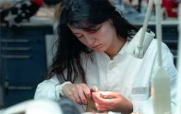
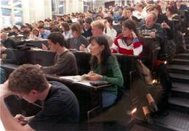
DAAD offers:
Information, counseling
Various types of scholarships for
  Undergraduates, Graduates, PhD candidates and Postdocs
  Internships, Summer courses, Study and Research
  All fields of study

Slide 4
Basic Elements of RISE
American undergraduates work with German doctoral students in their labs for the summer (6-12 weeks)
Real world research experience with thorough experience of today's Germany
No language requirement
Web-based matching process

Slide 5
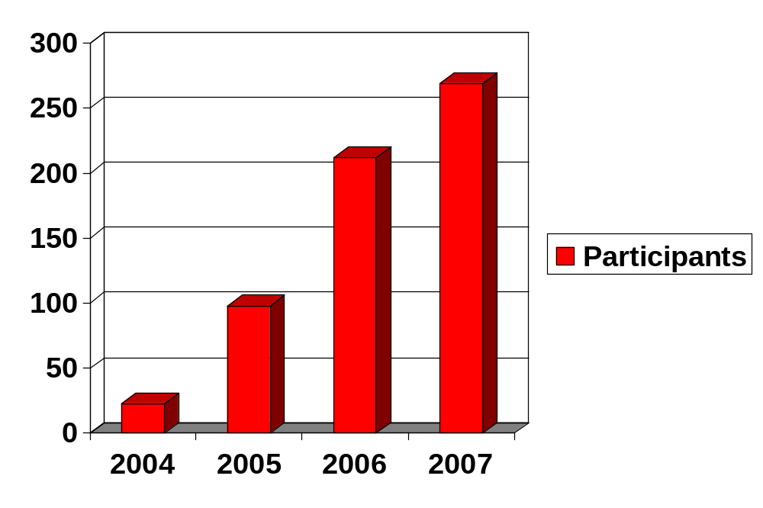
And That‘s What Happened

Slide 6
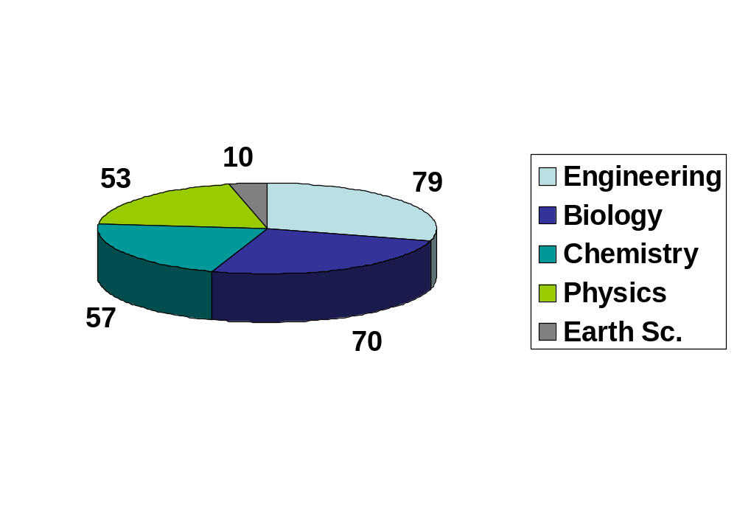
2007: RISE Interns By Disciplines

Slide 7
2007: Home Universities
25% Canadians / 75% Americans
Total of 119 universities
Top 8 institutions:
McGill University (QC): 13
U of Alberta (AB): 7
Duke U (NC): 6
Cornell (NY): 5
MIT (MA): 5
U Pittsburgh (PA): 5
Queen‘s U (ON): 5
York U (ON): 5

Slide 8
Host institutions in Germany
86 institutions in 52 cities
17 scholars in Max Planck Institutes, 38 in other extra-university research centers
Many in DFG-supported research training groups

Slide 9
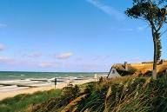
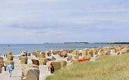
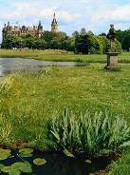
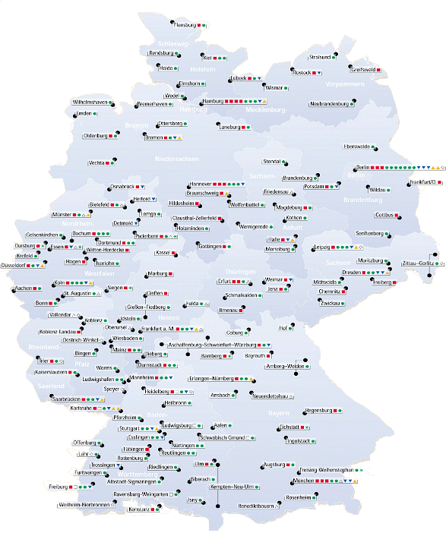
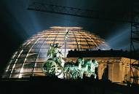

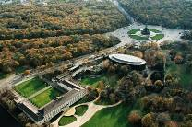
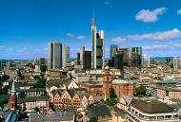
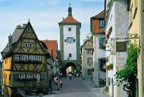
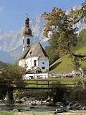
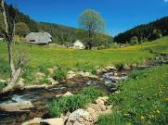
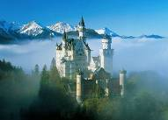
In 2007 RISE scholars were placed at 86 institutions in 56 cities all across Germany

Slide 10
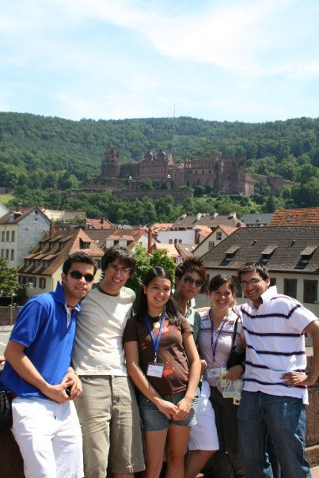
Scholarship holder meeting in Heidelberg
Meet the other scholarship holders
Learn about funding opportunities
Visit an important industrial site
Get to know one of the most beautiful German cities

Slide 11
Results: IIE Survey in 2006
Overall satisfaction: 97% (interns) / 86% (hosts)
92% consider working or studying in Germany again
60% had never been to Germany before, 57% had never learned German
30% enroll in German language class after return
“Ability to engage in practical, hands-on research” and “Desire to work/travel abroad” equally important motivations (60% each)

Slide 12
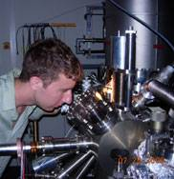
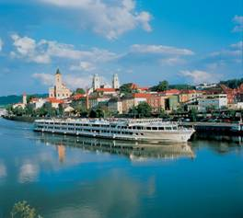
What Students Say
It was really encouraging to be a part of a large-scale research project, because I really felt like something important and worthwhile.
Megan Klevze, TU Freiberg, Environmental Engineering
You’re probably asking yourself: Should I apply to the RISE program? Yes, you
should definitely apply to the RISE program. I enjoyed my experience in and out of the lab.
Stephen Brunner, U Hamburg, Physics

Slide 13
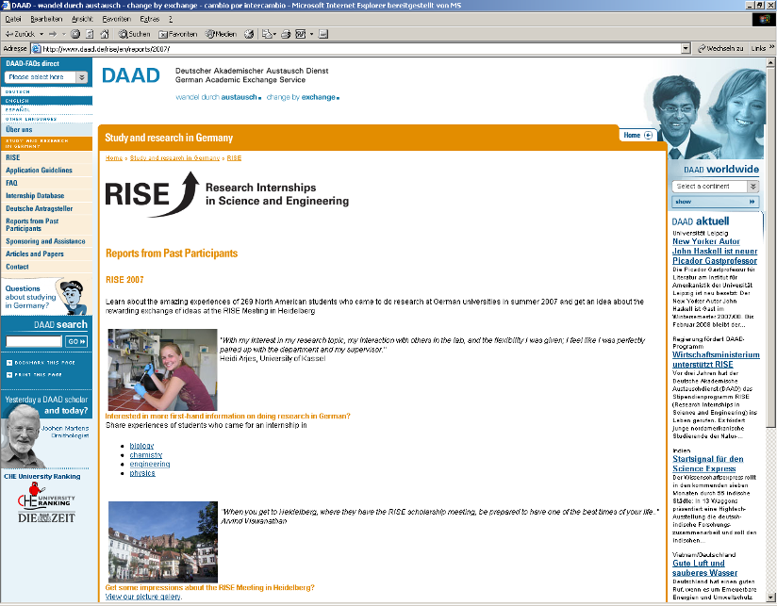
More than 150 reports from past participants on our website: www.daad.de/rise
More than 150 reports
from past participants
on our website

Slide 14
Moving Forward
Adding a language component, starting in 2008
Two-week intensive language course for beginners in main destination regions
... and extend the RISE experience to industry and commerce

Slide 15
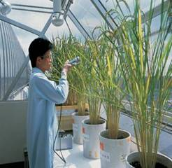
RISE professional
For undergraduate DAAD alumni, or any
recent graduates or graduate students
6-12 week summer placements in industry
internships with leading German companies
German requirements depend on the
nature of the internship
Scholarships and housing assistance are provided
2007: 54 internships
2008: probably 100
www.daad.de/rise-pro

Slide 16
The Next Step For Your Students
Go to www.daad.de/RISE
Contact rise@daad.de
Online applications accepted from December 6 until January 31

