Slide 1
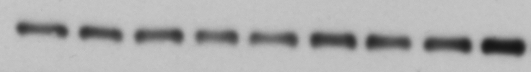

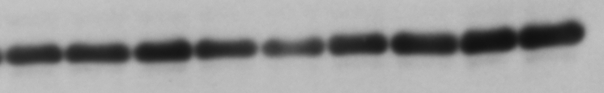

total Akt
Ⓟ473-Akt
GAPDH
GAPDH
D | — | — | — | + | + | + | + | + | +
T | — | — | — | — | — | — | + | + | +
D | — | — | — | + | + | + | + | + | +
T | — | — | — | — | — | — | + | + | +

