Slide 1
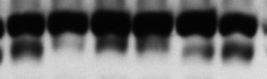

slow >
LC3
fast >
GAPDH
D | — | — | + | + | + | +
T | — | — | — | — | + | +

