Slide 1

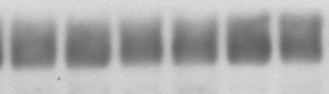
eIF3f
GAPDH
D | — | — | + | + | + | +
T | — | — | — | — | + | +

