Slide 1
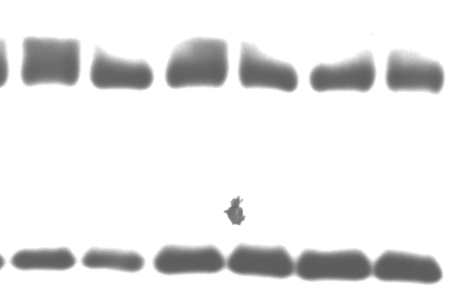
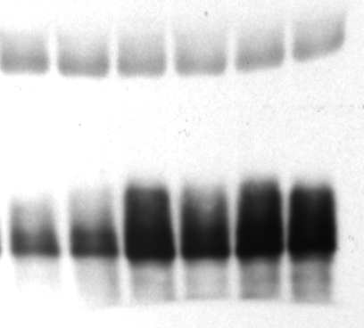
GAPDH
GAPDH
Ⓟ-4EBP
total 4EBP
D | — | — | + | + | + | +
T | — | — | — | — | + | +
D | — | — | + | + | + | +
T | — | — | — | — | + | +

