Slide 1
Java Packaging. Containers (1)
Canonical Java Packaging
  JAR Files. Fat JARs
  JPMS + jlink
  GraalVM native-image
Linux Packaging (DEB, RPM)
Virtualization
Containers: Concepts, Tools, Implementation
Container Orchestration
Some Container Solutions

Slide 2
Deadline-Driven Development™
Apr 23: Second Release
  All previously found defects fixed
  At least 2 User Stories implemented
  Proper error handling
  Unit Tests for all classes except framework-related
    Line/Statement Coverage ≥ 70%

Slide 3
Canonical Java Packaging: JAR
Just fancy ZIP archives containing compiled Java classes, resources and metainformation (META-INF/)
@see https://docs.oracle.com/javase/7/docs/technotes/guides/jar/jar.html
Compiled classes and class resources are put into directories corresponding to Java packages.
E.g. class ru.hse.java.HelloWorld => ru/hse/java/HelloWorld.class
  No directories are created for anonymous, inner and static inner classes, because they are synthesized by the compiler
  E.g. class ru.hse.java.HelloWorld.MyCoolClass => ru/hse/HelloWorld$MyCoolClass.class
Most important metainformation is the Manifest, META-INF/MANIFEST.MF:
Manifest-Version: 1.0
Main-Class: ru.hse.MyCoolProjectMain
<more key-value pairs...>
META-INF/ directory also MAY contain:
  Digital signature files (*.RSA, *.DSA, SIG-*)
  Service Provider definitions (META-INF/services/<FQCN of Service Class Impl>). @see future seminar on DI
java -jar my-cool-project-1.0.jar

Slide 4
Fat (Uber) JAR
https://stackoverflow.com/a/36539885/3438672
Bring all of your dependencies (transitively) in a single large JAR file
Three methods:
  Unpack all dependency JARs (maven-assembly-plugin → jar-with-dependencies)
  Unpack all dependency JARs, but also rename their packages and merge resources (maven-shade-plugin)
    To avoid conflicts with your library users’ dependencies
  Copy JARs into your JAR and use a special class loader to transparently access their classes (onejar, spring-boot-plugin:repackage)
Classpath is Linear → JAR Hell
  maven-enforcer-plugin helps, use it!

Slide 5
JPMS + jlink
https://www.baeldung.com/java-9-modularity
Java Platform Module System
  Modules depend on each other (requires [transitive] ...)
  Modules have Strong Encapsulation™
    Explicitly define which packages are visible to the outside world (exports ... [to ...])
    Explicitly define which packages they allow reflection access to (opens ... [to ...])
  Dependency Cycles and Split Packages disallowed
  Inter-module dependencies are assumed to be mostly static (determined at app start time)
Requires you to cleanly separate your system into modules, which is NO SMALL TASK
But as a bonus, you can package only modules really used by your application:
  jlink --module-path $JAVA_HOME/jmods:mlib \
  --add-modules com.greetings \
  --output greetingsapp
...the image will include only used JDK modules (jmods:…)

Slide 6
GraalVM native-image
Ahead-of-Time compiles your Java code into a native application for the target platform
  Some limitations, mostly around Reflection usage and static class initialization (static finals and static {} blocks spawning threads and the like)
  Popular frameworks are supported out-of-box, less popular can encounter problems
Emerging frameworks using native-image as the default: Quarkus, Micronaut
Good fit for Microservices, Serverless, CLIs, Agents, …
  Fast start (low start latency) far more important than peak throughput
  GC and runtime is naive compared to OpenJDK’s Hotspot

Slide 7
Linux Packaging (RPM, DEB)
General tools for managing components of a Linux distribution
  Manage packages, which provide files installed into your filesystem
  Packages are versioned and depend on each other (possibly with a version/version range specified)
  Package Managers provide dependency resolution, download and installation
Cannot have multiple versions of the same package
  Multiple packages, however, can provide the same binary,
  e.g. /bin/java via update-alternatives

Slide 8
Virtualization
Run 1+ Guests (OS w/virtualized hardware) on a single Host, managed by a Hypervisor
  Reasonably fast now: hardware (e.g., Intel VT-x) and software-assisted (Paravirtualization)
Advantages
  Tight Isolation (CPU and memory access, virtualized network, virtualized storage, …)
  Better Resource Utilization: A single host server can manage multiple guest VMs
  Better Scalability: both Vertical (allocate more host resources to guest) and Horizontal (spawn more guests)
  Better Disaster Recovery
    VM crashed? Just spawn a new one instead
    VMs have transparent access to replicated network storage
Drawbacks
  You bring Everything but the kitchen sink: Full OS image + all packages + your app (orders of magnitude smaller)
  Expensive VM setup and teardown (tens of seconds..minutes, depending on your workload and resources available)
  Some performance degradation (top → Steal time)

Slide 9
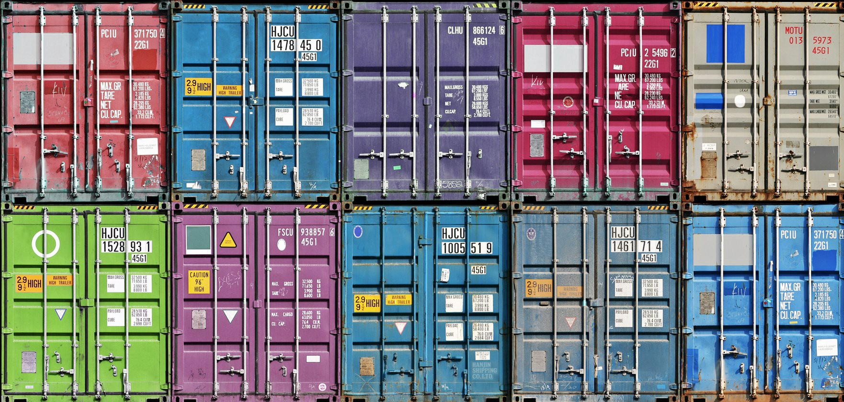
Containers! Containers! Containers!

Slide 10
Containers: Concept
Hypervisors virtualize hardware and then run a full-fledged real OS on it
But modern OSs already have powerful primitives for process, filesystem, network isolation and resource management!
Container includes all relevant (software and data, NOT OS!) dependencies for your application/service
  …unlike VMs, you cannot e.g. run on a fixed specific kernel version.
  But this is rarely required for most common apps and services anyway

Slide 11
Containers: Packaging & Delivery
Linux Containers were intended for standard packaging and delivery of software
  To [re]create development environment
  To run multiple different versions concurrently
It is in contrast to e.g. FreeBSD Jails, which were designed a security feature first and foremost
Docker Images, OCI
  Optimized for efficient downloads and caching:
    Layered filesystem
    Hash-based layer identity
  Images are tagged (typically with version). latest tag (convention)
Container Registries (similar to Maven artifact repositories)
  DockerHub
  Private installations
  Cloud offerings from all major cloud providers, incl. Yandex.Cloud

Slide 12
Containers: Isolation → Namespaces
Unit of isolation in Containers is the Process
Namespaces limit visibility of sensitive system entities: processes, network interfaces, users, mount points, …
Process isolation: main process in container runs as PID 1, but its PID in the host is different
Network isolation: container has limited access to host network interfaces, can have special bridge network interfaces etc.
User isolation: process inside container runs as root (or as some user that you specify)
Mount point isolation: containers cannot access host storage unless explicitly specified

Slide 13
Containers: Isolation → FS
pivot_root (chroot on steroids) to have / independent of host root filesystem
Union Filesystem, overlayfs
upperdir
Mutable scratch space
lowerdir₁
…
Immutable, these come from the image
lowerdir_{N}

Slide 14
Containers: Limits and Security
cgroups (Control Groups): Hierarchical Resource Accounting and Limits
  Limit CPU core usage
  Memory usage (RSS, resident set size)
  I/O (read and write iops)
  Network bandwidth
  Process is typically killed or throttled when resource overuse is detected
Container Security: Principle of least privilege
  Drop capabilities (CAP_...)
  seccomp-bpf: Selective filtering of syscalls

Slide 15
Container Orchestration
Containers are much more lightweight that VMs
  You can have tens and even hundreds of them running on a modest VM!
Container Orchestration (E.g. Kubernetes, Docker Swarm, Nomad, Amazon ECS, …): Managing lots of containers, and Clusters of similar containers
  Resource Allocator
  Workload Scheduler
    Jobs: batch, throughput-oriented workloads
    Services (stateless and stateful): interactive, latency-oriented workloads
  Resilience: restarts/retries, container migration
  Autoscaling
  Persistent storage management
Container Management Philosophy: Cattle NOT Pets!

Slide 16
Some Container Solutions
Basic Container Management: Docker (safer, simpler production alternative is rkt)
  build image, push (publish to registry), pull (download from registry)
  run image/run command inside image
  view stdout/stderr of container process/route process logs to syslog and whatever
Basic Orchestration: Docker Compose
Advanced Orchestration: Hashicorp Nomad, Kubernetes
Container-Optimized Linux distributions (Alpine, distroless):
Minimal dependencies required to run containers →
→ Smaller attack surface and better performance
Container Operating Systems: CoreOS, AWS Bottlerocket (experimental)

