Slide 1
Object Oriented Design, Part 2
Design Pattern Definition. Pattern Classification
Common GoF Patterns
  Strategy
  Decorator
  Iterator. External and Internal Iteration
  Observer. Events and Event Objects
  Proxy. Remote Stubs. Decorator vs Proxy
  Facade
  Creational Patterns: Singleton, Abstract Factory, Builder
Some Pattern Pitfalls

Slide 2
Deadline-Driven Development™
Mar 26: Object-Oriented Design Artifacts
  High-Level Design, e.g. using CRC Cards
    Class candidates w/public methods
    Class Relationships and Interactions (of the form: X uses Y to accomplish z)
  Detailed Design
    System Structure, e.g. using UML Class Diagram
      Classes, Public Methods. Fields iif these are important for your design
      Class Relationships (Association, Aggregation, Composition) with Cardinality (1-1, 1-*, *-*)
    System Behavior, e.g. using UML Sequence and/or State Machine/Activity Diagrams
      Class Interactions
      State Transitions
  Ad-hoc Diagrams and Text (incl. code snippets) are allowed. But CRC Cards+UML are preferred
Apr 02: First Release
  Local Maven or Gradle build. Must compile and run!
  Should demonstrate a basic User Story
  Unit Tests would be good (but not a requirement!)

Slide 3
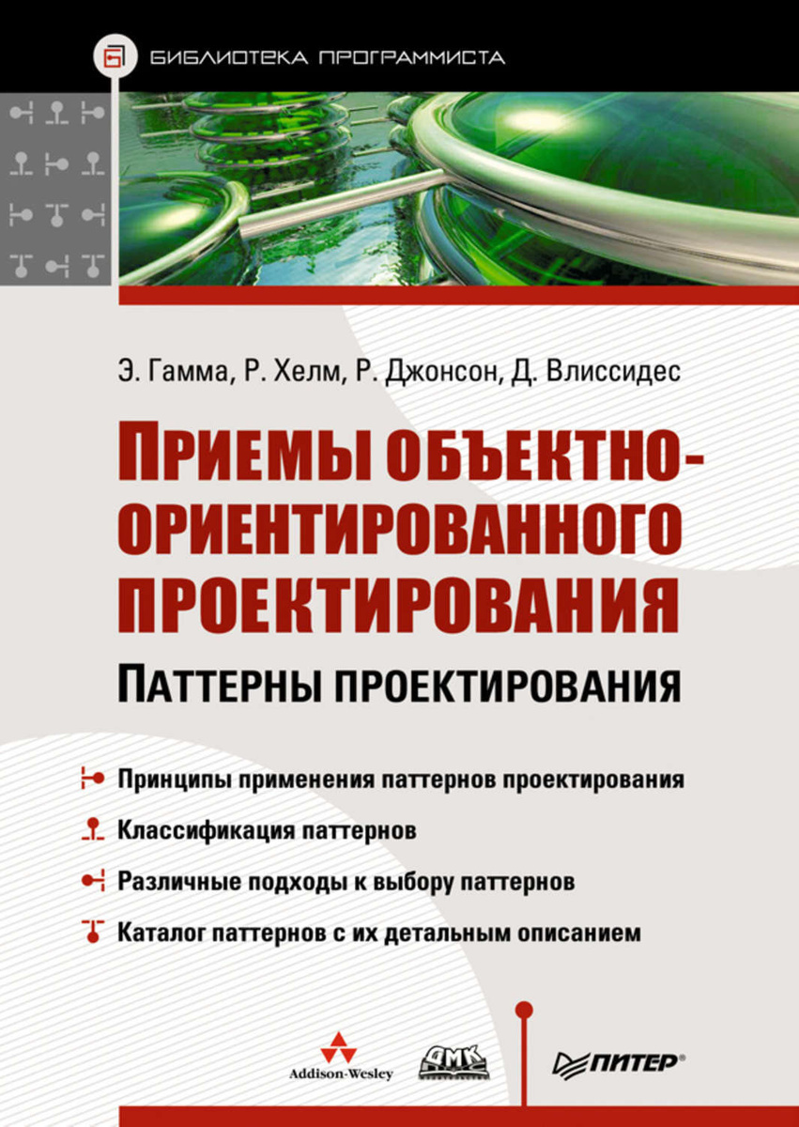
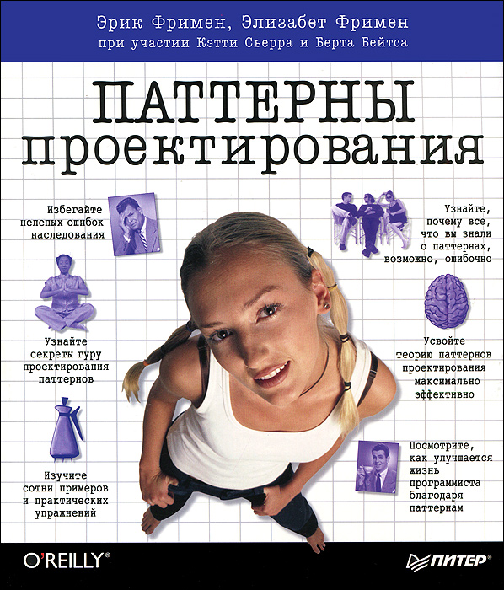
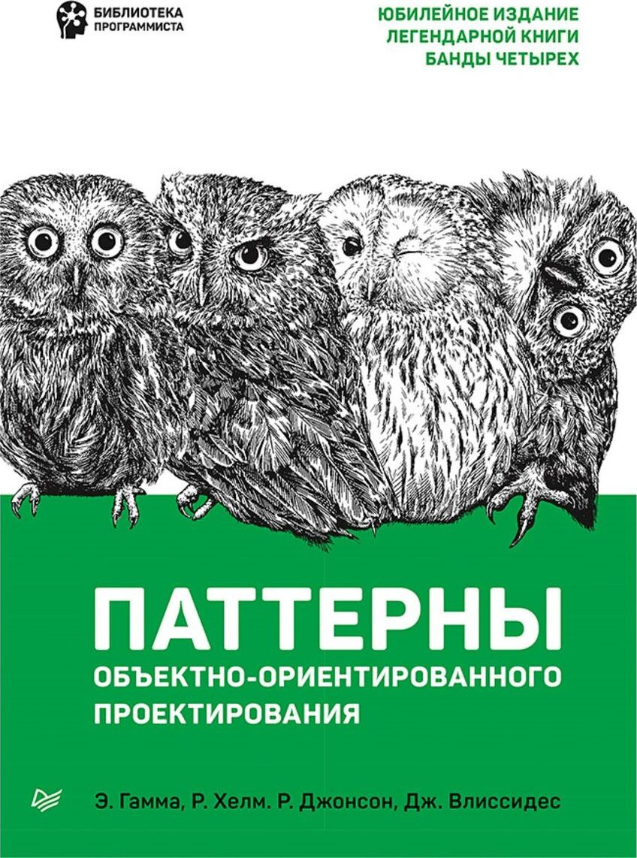
Best Intro into Patterns
The Classic GoF Book
Same book, different cover

Slide 4
Design Pattern is…
https://en.wikipedia.org/wiki/Software_design_pattern
General, Reusable solution to a commonly occurring problem
  within a given Context
  in Software Design
    e.g., Christopher Alexander described patterns in architecture
Description or Template that can be used in many different situations
  Shows relationships and interactions between classes or objects in general
  Facilitates Common Language between developers
Formalized best practice
Patterns are Programming Paradigm-Dependent!
  Some OO Patterns are Functional Programming in disguise
  E.g. http://www.norvig.com/design-patterns/design-patterns.pdf

Slide 5
Pattern Classification
Creational
Structural
Behavioral
Abstract Factory
Factory Method
Builder
Singleton
Prototype
…
Decorator
Proxy
Facade
Adapter
Flyweight
…
Strategy
Iterator
Observer
State
Template Method
Visitor
…

Slide 6
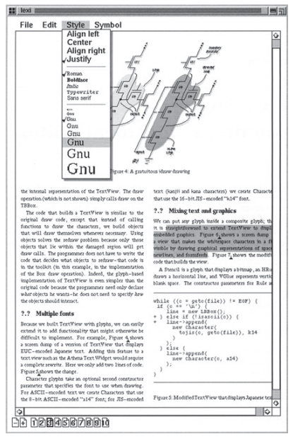
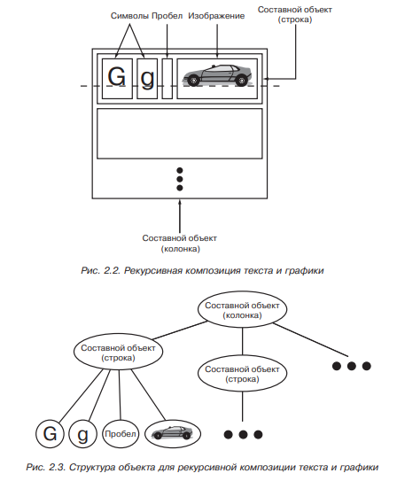
GoF Book: Cake is a Lie!
The Classic
Design Patterns book is mostly dense text
  Pattern Rationale
  Source code in C++
  And some diagrams
    In OMT, not UML

Slide 7
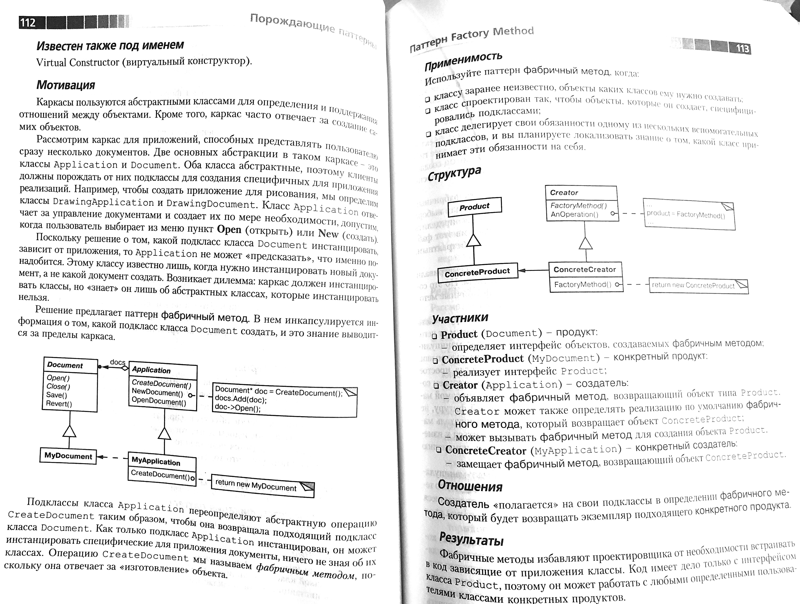
Pattern Description in GoF Book
Pattern Name, Classification, AKA
Intent: Goals + Reason to Use
Motivation: Example Problem + Context
Applicability: All Suitable Contexts
Structure: Classes & Interactions
Participants: Classes + Roles
Collaboration: Class Interactions
Consequences:
  Results, Side Effects
  Tradeoffs
Related Patterns

Slide 8
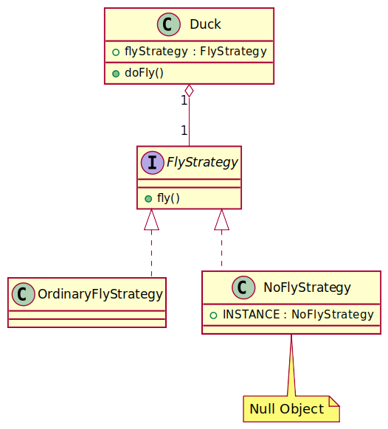
Strategy
Duck.fly(). RubberDuck extends Duck. Oops!
Solution:
  FlyStrategy.fly()
  Duck <<use>> FlyStrategy.fly()
  RubberDuck → (Duck, NoFlyStrategy)
  Ordinary Duck → (Duck, OrdinaryFlyStrategy)
Strategy offers Pluggable Behavior
  e.g. Retry Strategy
Stategy User is impl-independent
  Just requires that impl has the specified interface (=public methods, pre-and postconditions, invariants)

Slide 9
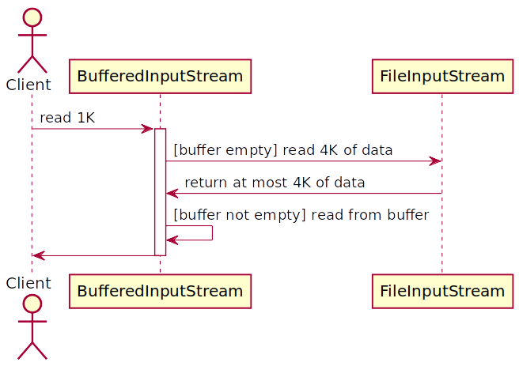
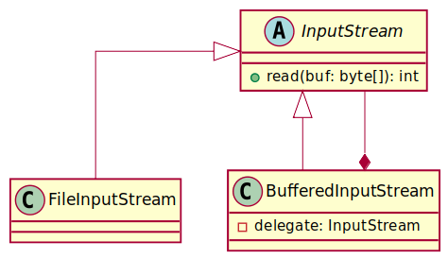
Decorator

Slide 10
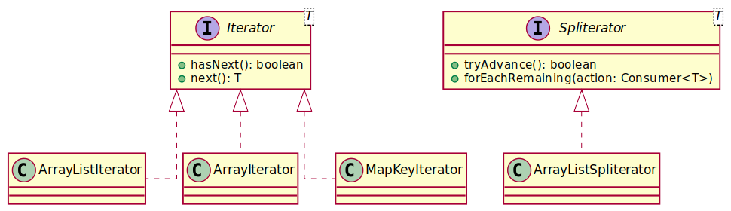
Iterator

Slide 11
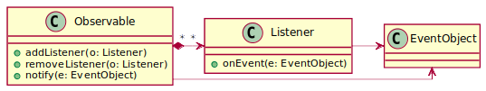
Observer

Slide 12
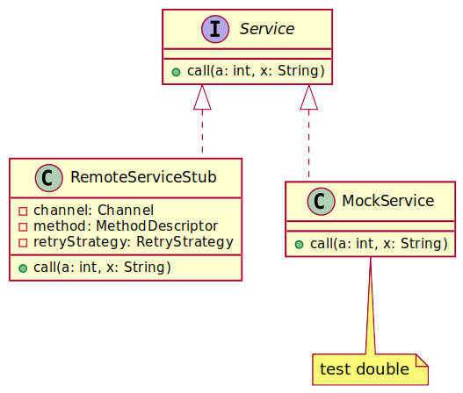
Proxy
Proxy vs Decorator:
Decorators can have similar implementations as Proxies but serve a different purpose
  E.g. protection proxy, logging proxy
Decorator adds one or more responsibilities to an object
Proxy controls access to an object
Unlike a Decorator:
  RPC Proxy (e.g. RemoteServiceStub) will not contain a direct reference to the real subject
  Virtual Proxy (e.g. reading data from file on demand) will not contain a direct reference to the real data until called

Slide 13
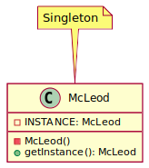
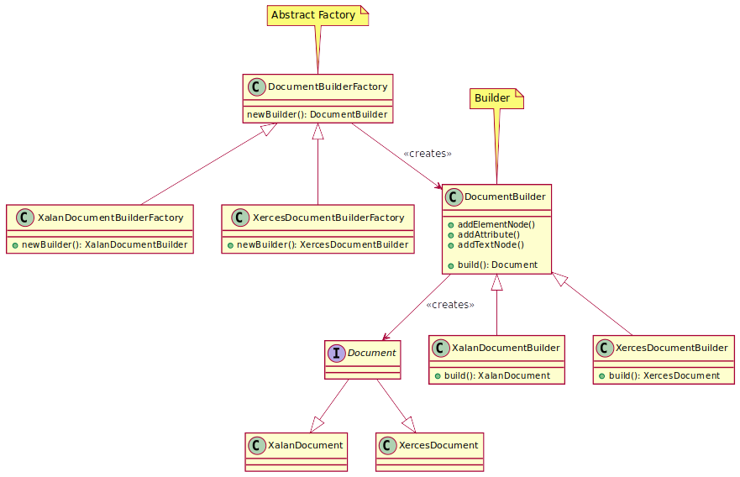
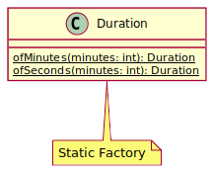
Common Creational Patterns

Slide 14
Some Pattern Pitfalls
I hate switch and Map, let's use polymorphism
  https://csis.pace.edu/~bergin/patterns/ppoop.html
We Need Flexibility Everywhere!
  ...and then it turns out the interface always has 1 impl
  System Architecture is what cannot be changed without completely destroying the System

Slide 15
Recommended Reading (List)
Head First Patterns by Eric & Elizabeth Freeman
  https://www.ozon.ru/product/head-first-patterny-proektirovaniya-obnovlennoe-yubileynoe-izdanie-frimen-erik-robson-elizabet-211433204
Design Patterns: Elements of Reusable Object‑Oriented Software by E. Gamma, R. Helm, R. Johnson, D. Vlissides
  https://www.ozon.ru/product/priemy-obektno-orientirovannogo-proektirovaniya-patterny-proektirovaniya-135466040/

