Slide 1
Inversion of Control (IoC) &
Dependency Injection (DI) – 1
Inversion of Control, The Secret Sauce of Frameworks
  UI Example: Hardcoded Message Loop vs Event-Based Framework
  The Hollywood Principle
  Common IoC Patterns: Observer/Slots & Signals, Template Method (Hook)
Service Locator Pattern
How is Dependency Injection Different?
Manual DI. DI Styles: Constructor > Field > Setter
DI Standard (JSR 330): javax.inject.{@Inject,@Qualifier,@Named, Provider<T>}

Slide 2
UI: Hardcoded Message Loop
Important Question
Dialog dlg = <...>;
Message msg;
while ((msg = dlg.pollMsg()) != null) {
switch (msg.type()) {
case CLICK:
UI.toast("You're doomed!");
break;
default:
dlg.defaultAction(msg);
}
}
// dialog closes here
Do you wish to delete Important.doc
permanently or lose it forever?
Yes
No
Cancel

Slide 3
UI: Event-Based Framework
Callbacks customize framework actions
Important Question
Dialog dlg = <...>; dlg.addClickHandler(
__ → UI.toast("Wheee!"));
// UI framework-managed msg
// loop starts here
int res = dlg.showModal();
// dialog closes here
Do you wish to delete Important.doc
permanently or lose it forever?
Yes
No
Cancel
Framework defines Control Flow

Slide 4
UI: Event-Based Framework (2)
public class Dialog extends <...> {
public void addClickHandler(ClickHandler h) {
dispatcher.add(h);
}
// <...>
public void showModal() {
Message msg;
while ((msg = dlg.pollMsg()) != null) {
dispatcher.handlersOf(msg.type())
.ifPresent(EventHandler::on)
.orElse(this::defaultAction);
}
}
}
Callback Interface: Event Handler
@FunctionalInterface
public interface ClickHandler
extends EventHandler {
void onClick(ClickEvent e);
default void on(Message m) {
this.onClick(<...>);
}
}
UI Framework calls user code
@ specific lifecycle points
of Dialog's Message Loop

Slide 5
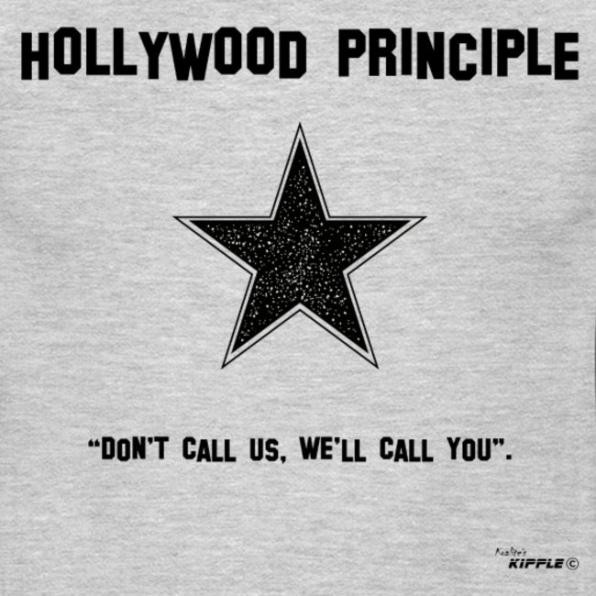
© Koalite's Kipple

Slide 6
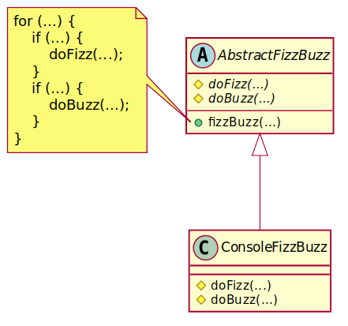
IoC Pattern: Template Method
doFizz(), doBuzz() are hooks called by fizzBuzz()
@ specific lifecycle points

Slide 7
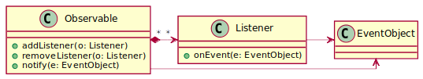
IoC Patterns: Observer
See Also: Signals & Slots (inspired by Qt)
public class MyUIApp extends UIApplication<MyUIApp> {
private final Signal1<EventObject> signal = new Signal1<>(...);
public static void main(String... args) {
MyUIApp app = new MyUIApp(args);
app.signal.connect(eo → { // <...> });
app.run();
}
}
// Somewhere in framework UIApplication code, we emit the event:
this.signals(EventObject.class).emit(new EventObject(...));

Slide 8
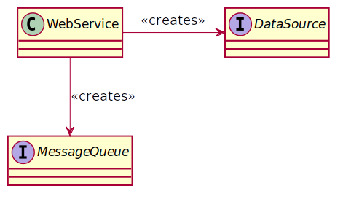
Hardcoded Service Dependencies
@Path("/accounts")
public class WebService extends <...> {
private final DataSource dataSource;
private final MessageQueue messageQueue;
public WebService() {
this.dataSource = new PgSqlDataSource("pgsql.infra", "...");
this.messageQueue = new RabbitMessageQueue("rabbit.infra", 3232);
}
@POST
@Consumes("application/json")
public void createAccount(Account account) {
var savedAccount = dataSource.persist(account);
messageQueue.enqueue(new AccountCreatedEvent(savedAccount.id());
}
}

Slide 9
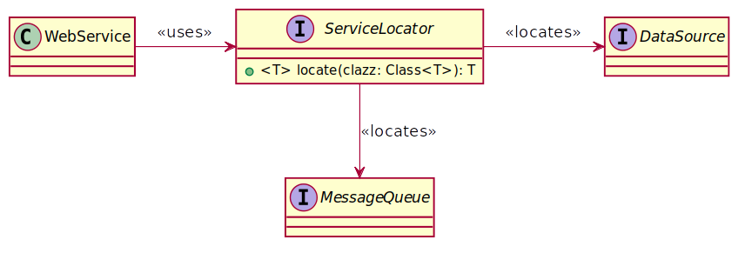
Service Locator/Service Registry
public class WebService extends <...> {
// <...>
public WebService(ServiceLocator locator) {
this.dataSource = locator.locate(DataSource.class);
this.messageQueue = locator.locate(MessageQueue.class);
}
// <...>
}

Slide 10
Service Locator is Fragile
public class PgSqlDataSource implements DataSource {
private final ServiceLocator locator;
public PgSqlDataSource(ServiceLocator locator) {
this.locator = locator;
}
public <T extends Entity<T>> persist(T entity) {
PreparedStatement st = <...>;
try (Connection conn = getConnection()) {
return persisted(conn.executePrepared(st));
} finally {
// Hi, NPE!
locator.locate(Tracer.class).traceDbQuery(st);
// Is silently losing traces any better?
locator
.locateOrDefault(Tracer.class, __ → {})
.traceDbQuery(st);
}
// <...>
}
public class MR implements ServiceLocator {
private final Map<Class, Object> m;
public void <T> put(Class<T> c, T o) {
if (null != m.putIfAbsent(c, o))
throw <...>
}
public <T> locate(Class<T> clazz) {
return clazz.cast(m.get(clazz));
}
}
public class FMR implements ServiceLocator {
private final Map<Class, Object> m;
private final Map<Class, Supplier> sm;
public void <T> put(Class<T> c,
Function<ServiceLocator, T> s) {
if (null != sm.putIfAbsent(c, sm))
throw <...>
}
public <T> locate(Class<T> clazz) {
return m.computeIfAbsent(clazz,
c → sm.get(clazz).apply(this));
}
}

Slide 11
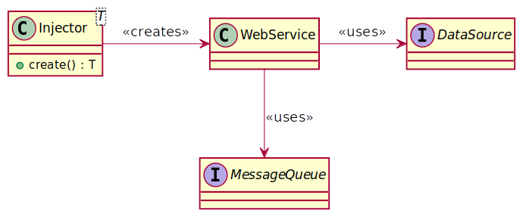
Dependency Injection
public class WebService extends <...> {
public static void main(String... args) {
Injector.root(WebService.class)
.configure(<...>)
.create().run(args);
}
@Inject
public WebService(DataSource ds,
MessageQueue mq) {
this.dataSource = ds;
this.messageQueue = mq;
}
// <...>
}

Slide 12
Manual DI
public class WebService extends <...> {
public static void main(String... args) {
new WebService(
dataSource(), messageQueue().get()
).run(args);
}
public WebService(DataSource ds,
MessageQueue mq) {
this.dataSource = ds;
this.messageQueue = mq;
}
// <...>
private static DataSource dataSource() {
return new PgSqlDataSource(
connectionPool(),
<...>
);
}
private static Supplier<MessageQueue>
messageQueue() {
return Suppliers.memoize(() →
new RabbitMessageQueue(<...>));
}
// <...>

Slide 13
Standard DI: JSR 330 (javax.inject)
@Inject: Declare dependency interfaces
  constructors > fields > setters
@Qualifier: Inject different implementations of the same interface
  @Named: Choose impl by (unique) name
Provider<T>: Lazy and optional injection
  Essentially the same as Supplier<T>

Slide 14
Recommended Reading
Martin Fowler, IoC Concepts:https://martinfowler.com/bliki/InversionOfControl.html
Martin Fowler, DI (w/lots of code!):https://martinfowler.com/articles/injection.html
DI vs Service Locator: https://sergeyteplyakov.blogspot.com/2013/03/di-service-locator.html

