Slide 1
Design Patterns
Design Pattern Definition. Pattern Classification
Common GoF Patterns
  Strategy
  Decorator
  Iterator. External and Internal Iteration
  Сomposite (Tree)
  Observer. Events and Event Objects
  Proxy. Remote Stubs. Decorator vs Proxy
  Facade
  Creational Patterns: Singleton, Abstract Factory, Builder
Some Pattern Pitfalls

Slide 2
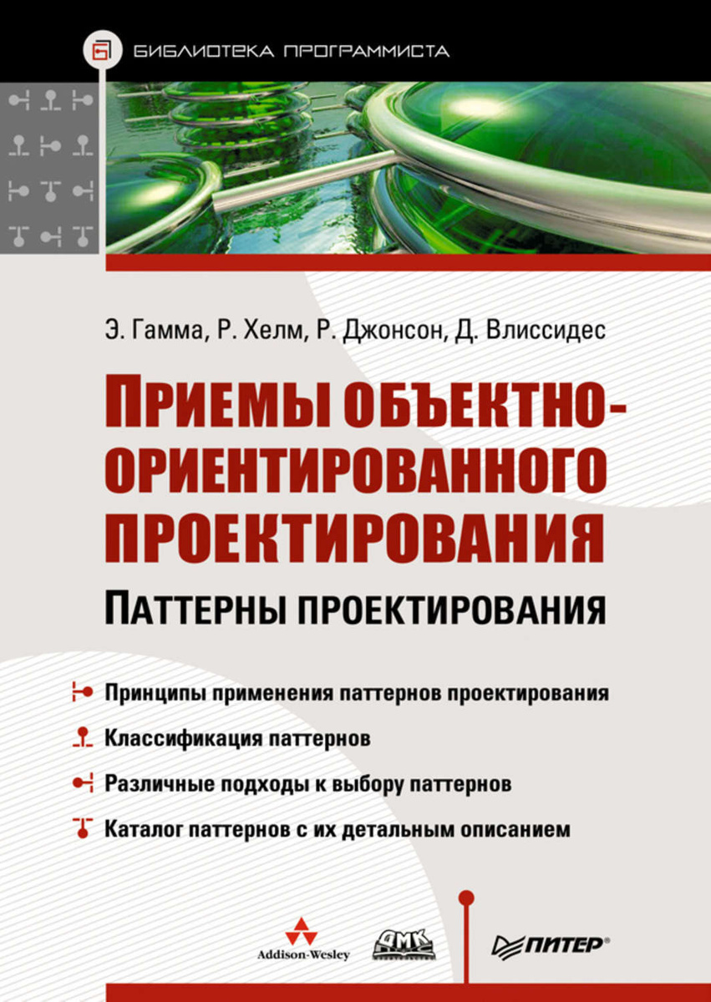
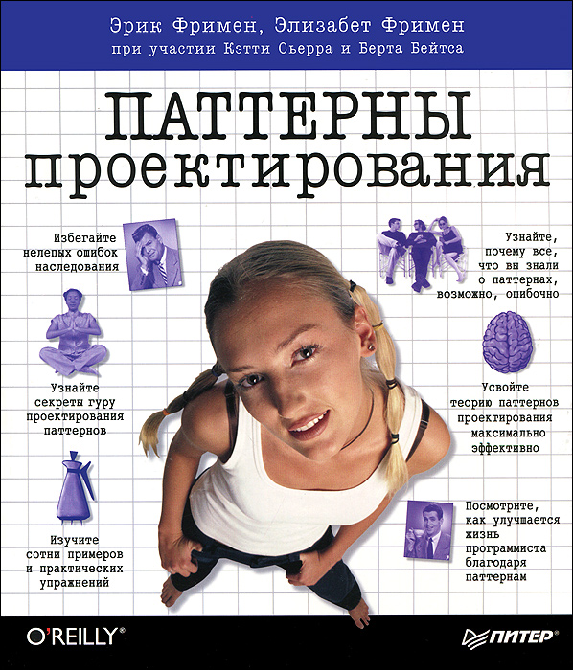
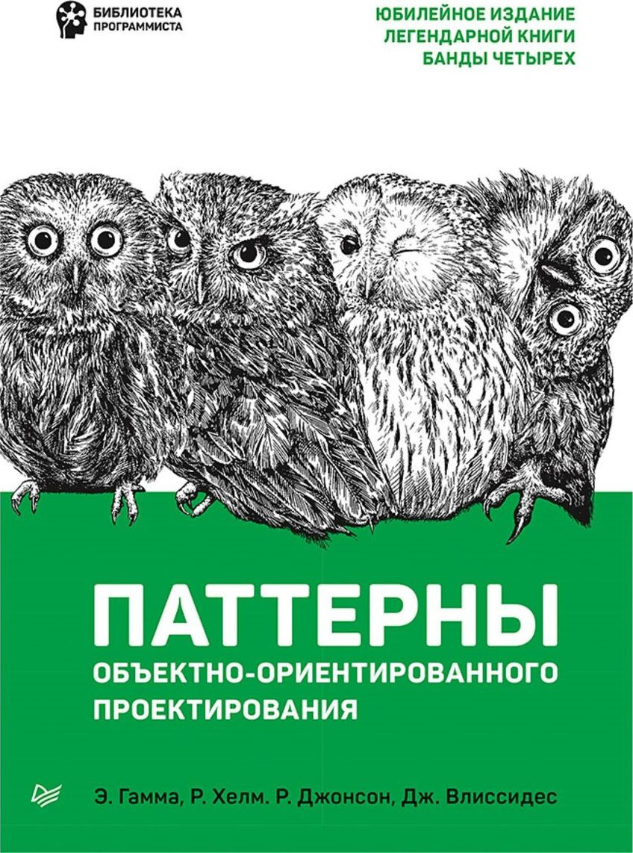
Best Intro into Patterns
The Classic GoF Book
Same book, different cover

Slide 3
Design Pattern is…
https://en.wikipedia.org/wiki/Software_design_pattern
General, Reusable solution to a commonly occurring problem
  within a given Context
  in Software Design
    e.g., Christopher Alexander described patterns in architecture
Description or Template that can be used in many different situations
  Shows relationships and interactions between classes or objects in general
  Facilitates Common Language between developers
Formalized best practice
Patterns are Programming Paradigm-Dependent!
  Some OO Patterns are Functional Programming in disguise
  E.g. http://www.norvig.com/design-patterns/design-patterns.pdf

Slide 4
Pattern Classification
Creational
Structural
Behavioral
Abstract Factory
Factory Method
Builder
Singleton
Prototype
…
Decorator
Proxy
Facade
Adapter
Flyweight
…
Strategy
Iterator
Observer
State
Template Method
Visitor
…

Slide 5
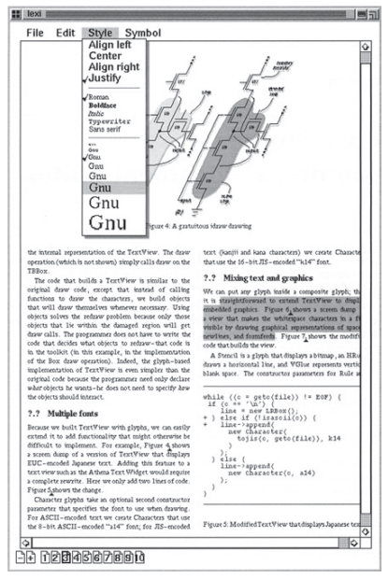
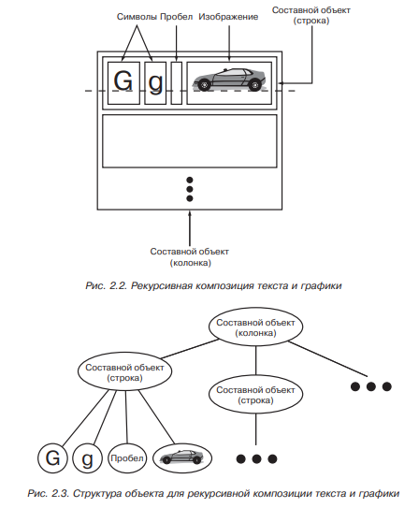
GoF Book: Cake is a Lie!
The Classic
Design Patterns book is mostly dense text
  Pattern Rationale
  Source code in C++
  And some diagrams
    In OMT, not UML

Slide 6
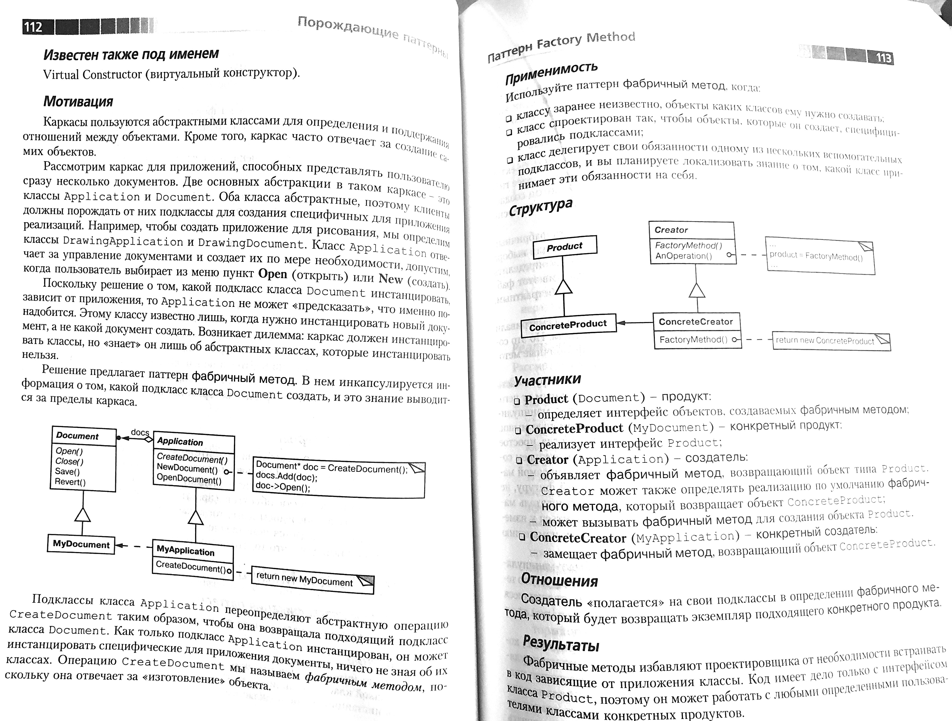
Pattern Description in GoF Book
Pattern Name, Classification, AKA
Intent: Goals + Reason to Use
Motivation: Example Problem + Context
Applicability: All Suitable Contexts
Structure: Classes & Interactions
Participants: Classes + Roles
Collaboration: Class Interactions
Consequences:
  Results, Side Effects
  Tradeoffs
Related Patterns

Slide 7
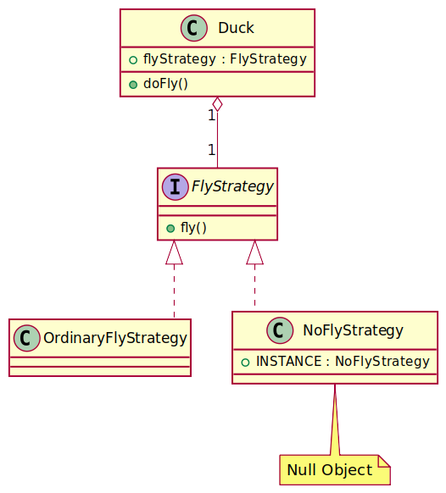
Strategy
Duck.fly(). RubberDuck extends Duck. Oops!
Solution:
  FlyStrategy.fly()
  Duck <<use>> FlyStrategy.fly()
  RubberDuck = (Duck, NoFlyStrategy)
  Ordinary Duck = (Duck, OrdinaryFlyStrategy)
Strategy offers Pluggable Behavior
  e.g. Retry Strategy
Stategy User is implementation-independent
  Just requires that impl has the specified interface (=public methods, pre-and postconditions, invariants)

Slide 8
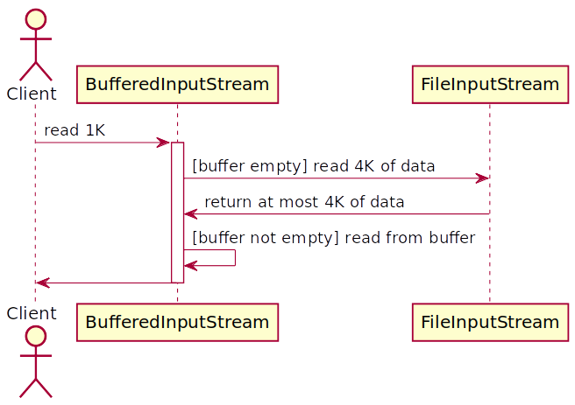
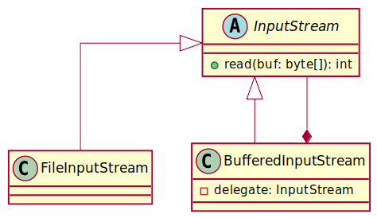
Decorator

Slide 9
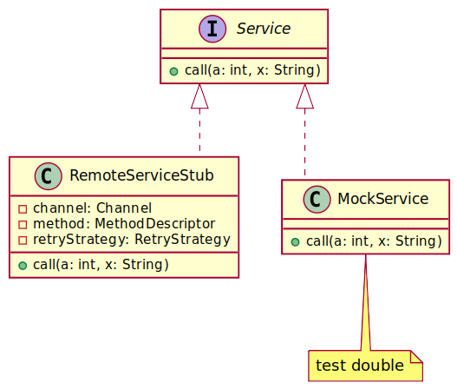
Proxy
Proxy vs Decorator:
Decorators can have similar implementations as Proxies but serve a different purpose
  E.g. protection proxy, logging proxy
Decorator adds one or more responsibilities to an object
Proxy controls access to an object
Unlike a Decorator:
  RPC Proxy (e.g. RemoteServiceStub) will not contain a direct reference to the real subject
  Virtual Proxy (e.g. reading data from file on demand) will not contain a direct reference to the real data until called

Slide 10
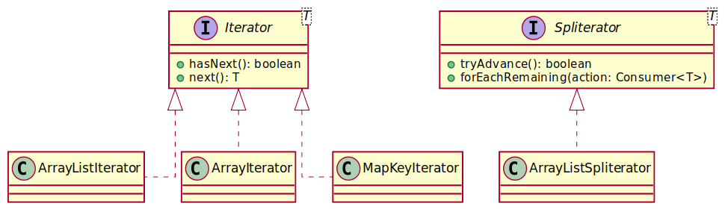
Iterator

Slide 11
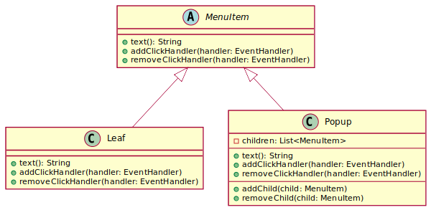
Composite (Tree)
Open Cmd+O
Open Recent >
Recent File 1
Recent File 2
…
Recent File N

Slide 12
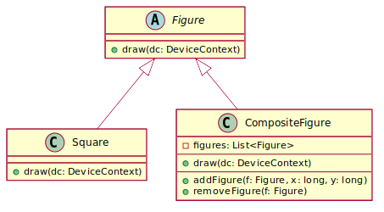
Composite (Tree)

Slide 13
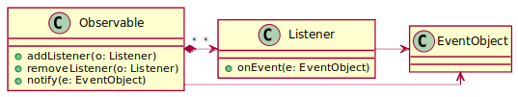
Observer

Slide 14
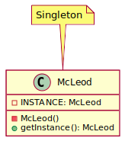
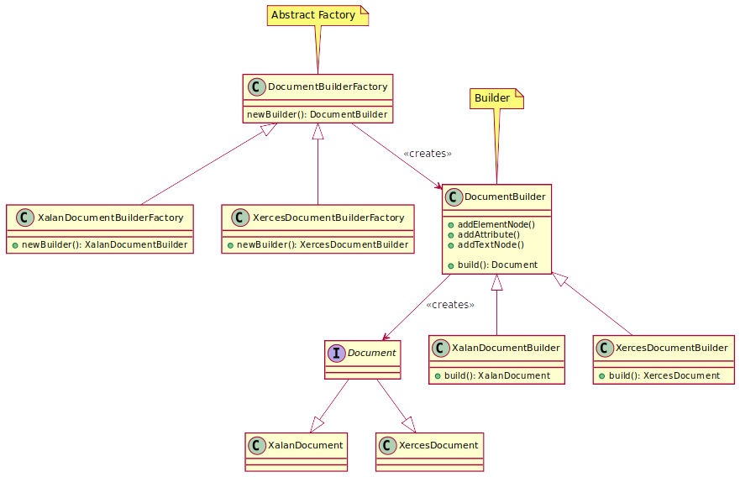
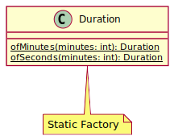
Common Creational Patterns

Slide 15
Some Pattern Pitfalls
I hate switch and Map, let's use polymorphism
  https://csis.pace.edu/~bergin/patterns/ppoop.html
We Need Flexibility Everywhere!
  ...and then it turns out the interface always has 1 impl
  System Architecture is what cannot be changed without completely destroying the System

Slide 16
Recommended Reading (List)
Head First Patterns by Eric & Elizabeth Freeman
  https://www.ozon.ru/product/head-first-patterny-proektirovaniya-obnovlennoe-yubileynoe-izdanie-frimen-erik-robson-elizabet-211433204
Design Patterns: Elements of Reusable Object‑Oriented Software by E. Gamma, R. Helm, R. Johnson, D. Vlissides
  https://www.ozon.ru/product/priemy-obektno-orientirovannogo-proektirovaniya-patterny-proektirovaniya-135466040/

